Slide 1
Test
Iteration 2

Slide 2
Unit test
Unit testing is the process of isolating a section of code and then testing that the internals of that section work as you expect.

Slide 3
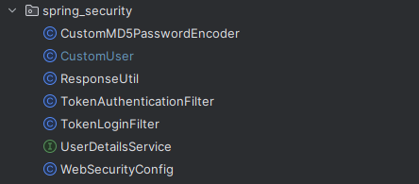
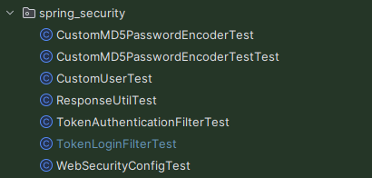
Mock code structure

Slide 4
Test flow
Declare a class to be tested
Call the function to be tested in the class
Use assertions to detect results

Slide 5
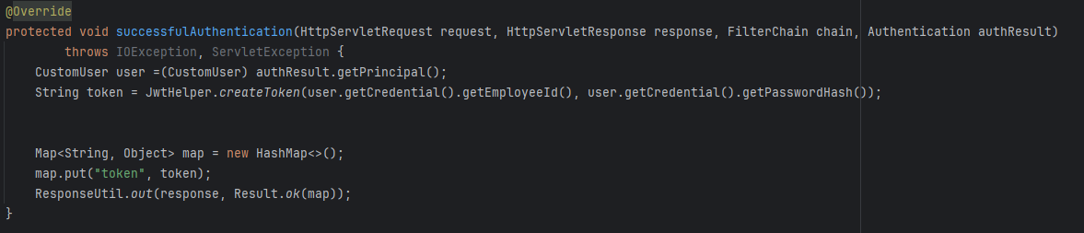
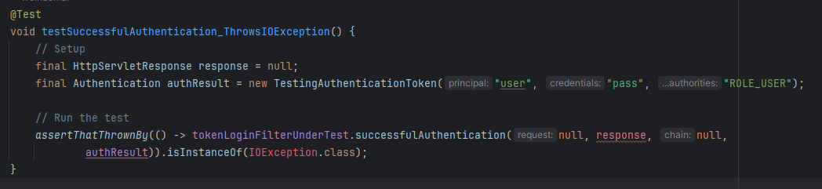
Mock code example

Slide 6
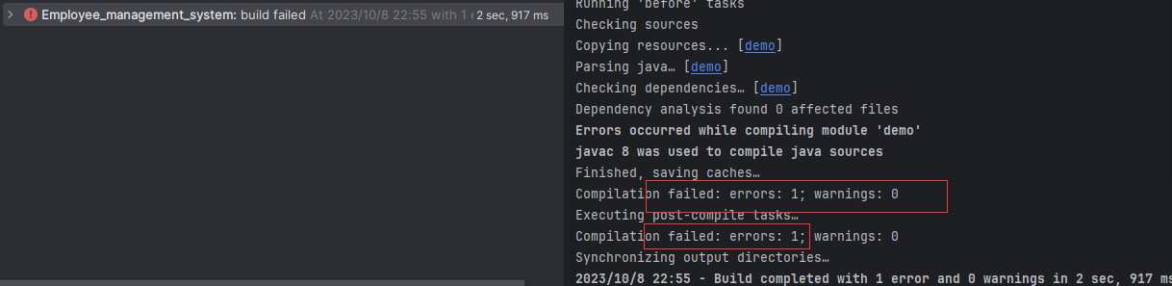
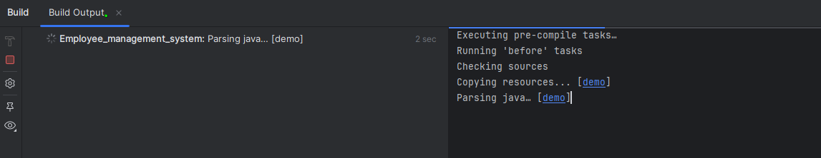
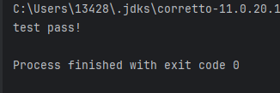
Find bugs
Test result

