Slide 1
Security Testing
Weihao Mai
Iteration 3

Slide 2
Testing Process Overview
Unit Tests
JUnit4
Automated Tests
JUnit4

Slide 3
The State of Testing, pre-Iteration 2
Incomplete documentation
Multiple errors across the testing layer
a.Test dependencies not installed
b. Missing Java packages
c. JWT server
Tests tested code that did not exist

Slide 4
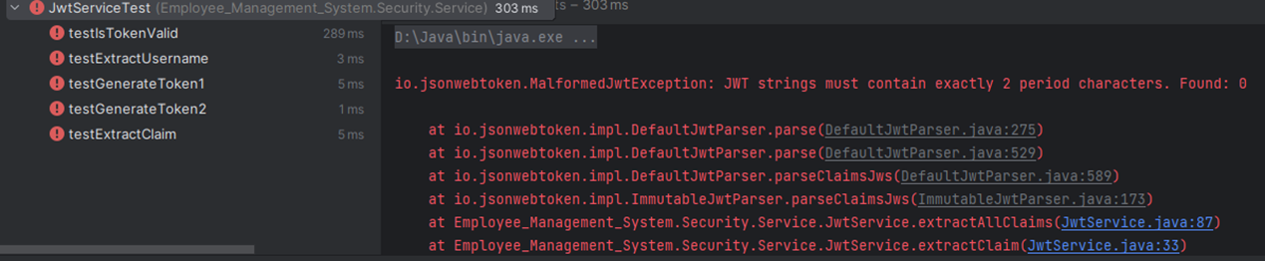
The State of Testing, pre-Iteration 2

Slide 5
The State of Testing, Now
Test documentation included in repo
Split tests into isolated file trees
Unit tests can be run without integration tests
Bad tests have been deleted

Slide 6
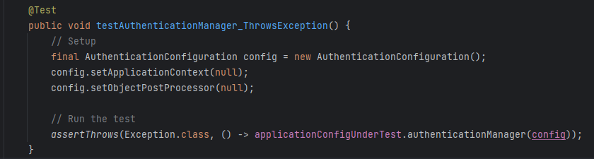
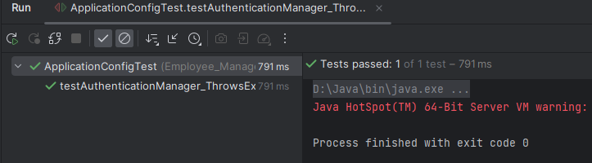
Code Example

Slide 7
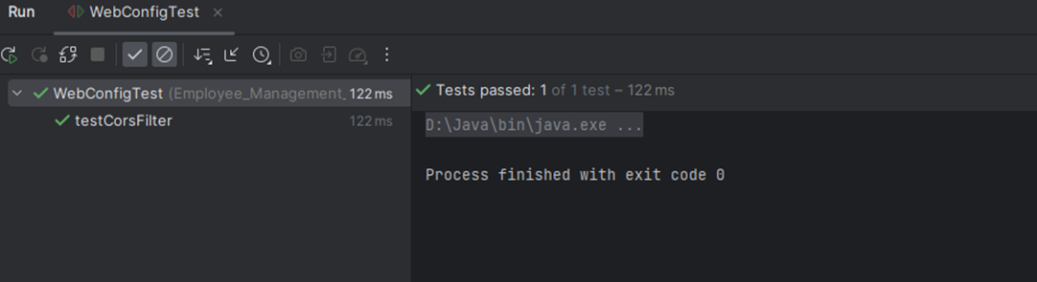
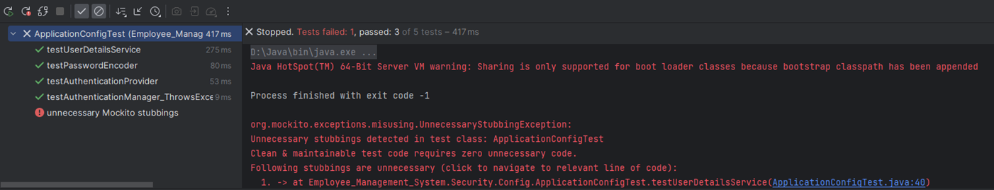
The State of Testing, Now

Slide 8
Testing Metrics
# Tests : 21
Unit:21(failures = 0, warning = 4)
Testing Pass Pate : 100%

Slide 9
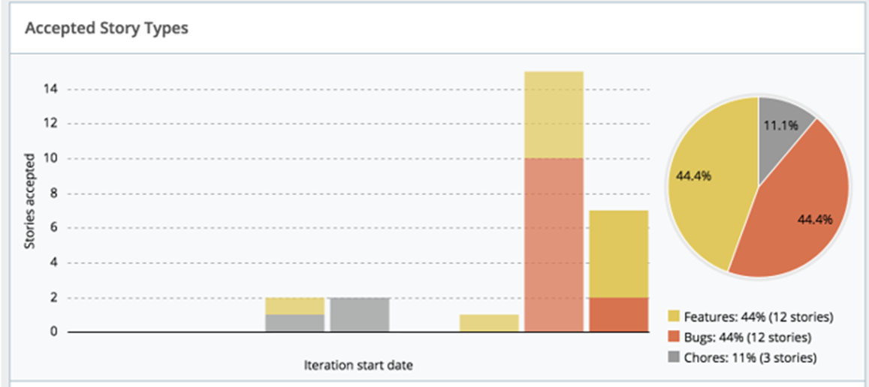
Testing, Defect Tracking

Slide 10
Summary
Finish Security Test
Allow security modules to be integrated throughout the project
Lay the foundation for integration testing

