Slide 1
HRMasery
Team_3 Project

Slide 2
Outline
Overview/purpose
Project plan
Role Assignments
Iteration Evolution
Software Architecture
Requirement analysis
Design
Implementation
Testing
User Interface
Project management
Security
Demo

Slide 3
Project Overview/Purpose
We will create an Employee Management System using Java and Spring Boot in 6 weeks to demonstrate CRUD (create, read, update, delete) operations.
It will help staff and administration workers to create, read, update, and delete roles thru an user interface.
We have a basic underlying potential users, functionalities, and technology stack, but more may be added as we progress.

Slide 4
Project Plan
**Baseline view:**
Our application will have a baseline login page
User would be able to perform one or more CRUD operations based on their roles
**Potential Users:**
1. Staff Workers: To view roles and request updates.
2. Administration Workers: To create, update, and delete roles.
**Technology Stack**
Java as the default language
Springboot will the framework
User interfaces would be created via React

Slide 5
Role Assignments
Team Leader: Jianle Xie
QA Leader: Yuxuan Wang
Design and Implementation Leader: Abigya Devkota
Requirement Leader: Haolun Li
Configuration Leader: JingJing Tang
Security Leader: Weihao Mai, Zhiwei Lin

Slide 6
Iteration Evolution
Iteration 0:
Solidify project plan and documentations(SPPP)
Coded backend skeleton model
Iteration 1:
Completed Software Design Documentation
Integrate/update database into backend model
Created individual junit tests for backend/frontend/database/security
Code frontend skeleton model
Test application’s preliminary CRUD functionalities
Iteration 2:
Code review and refactor smells
Integration testing of frontend/backend/database/security
Regression testing after integration
Iteration 3:
Migrant to docker setup
Implementation of role-base login
Regression testing

Slide 7
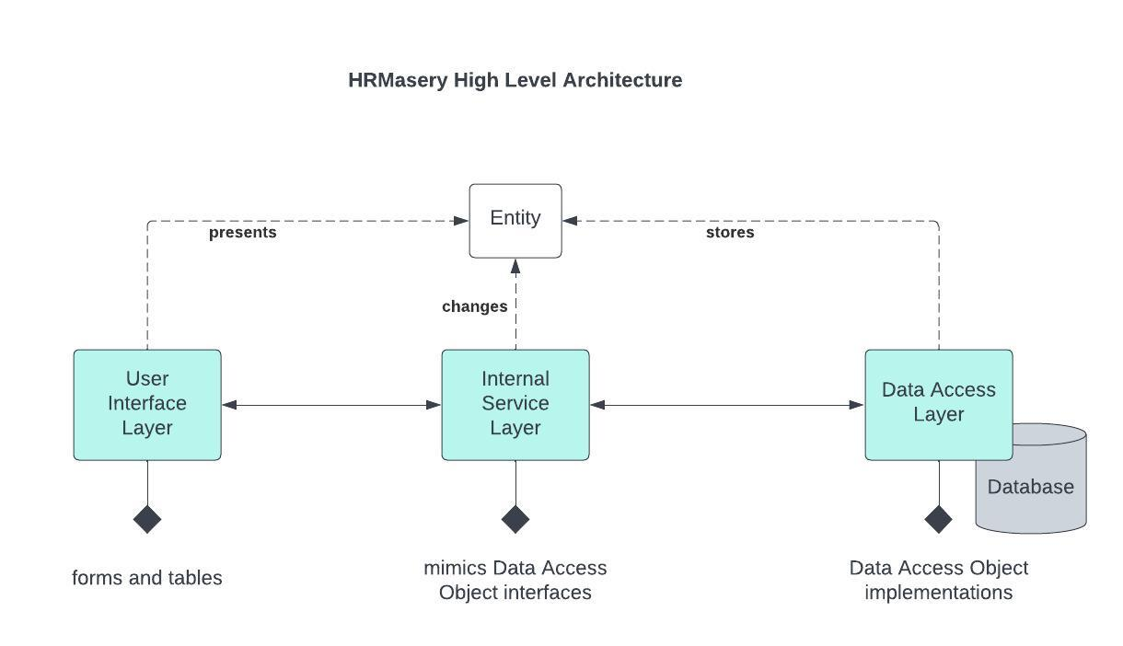
Software Architecture

Slide 8
Software Architecture
Utilizes a MVC model:
User(view) - User interface capable of accepting and sending requests to create, read, update and delete a record based on roles.
Controller (handled requests) - Internal Service has multiple controllers to handle User requests, interact with the database and authenticate a user based on their role.
Model (handled database) - stores the most accurate representation of the user record and credentials
i.e source of truth for user data

Slide 9
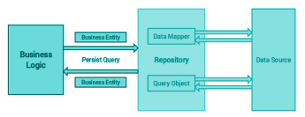
Design:
Created Design Patterns(Yuxuan Wang )

Slide 10
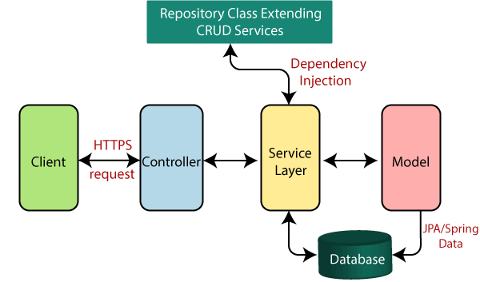
Implementation:
Backend structure(Yuxuan Wang, Jingjing Tang)
Repository: provide an abstract layer for relational database and help to standardize
Common database operations(CRUD)
Controller: handle the incoming HTTP requests from clients and sent response from database
Service: encapsulate the business logic and designed for easy test jobs
Model: define the structure and attributes of the data of our application

Slide 11
Implementation:
Backend structure for User and Credential (Yuxuan Wang, Jingjing Tang)
Use Java and Spring Boot to demonstrate CRUD (create, read, update, delete) operations.
User would be able to perform one or more CRUD operations
Add an stuff (register using ‘Name’, ‘Email’,’Phone number’, ‘Job title’, ‘Annual Salary’)
View Employee
Edit Employee
Delete Employee
Technology stack: Java - Springboot
Spring Data JPA framework

Slide 12
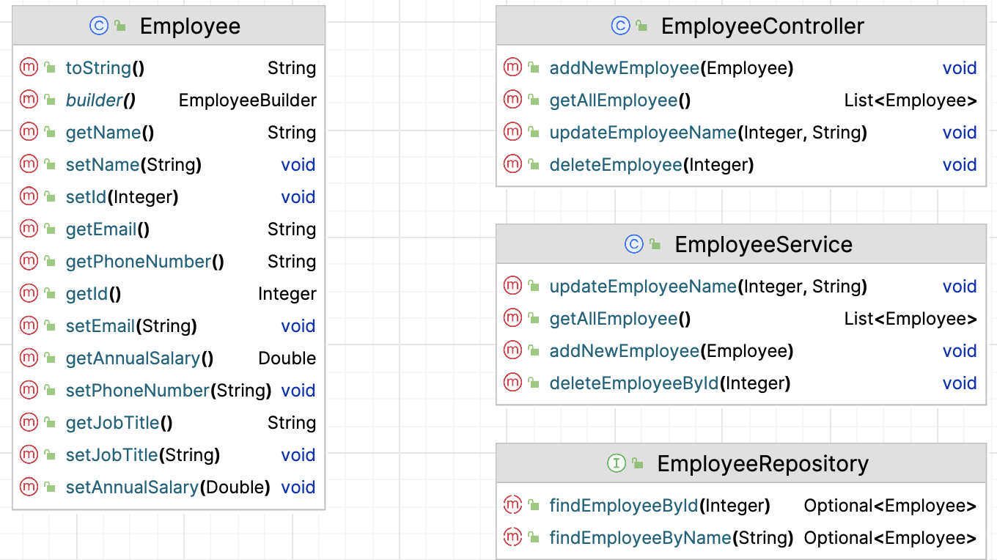
Design:
Design Class Diagram(Jingjing Tang)

Slide 13
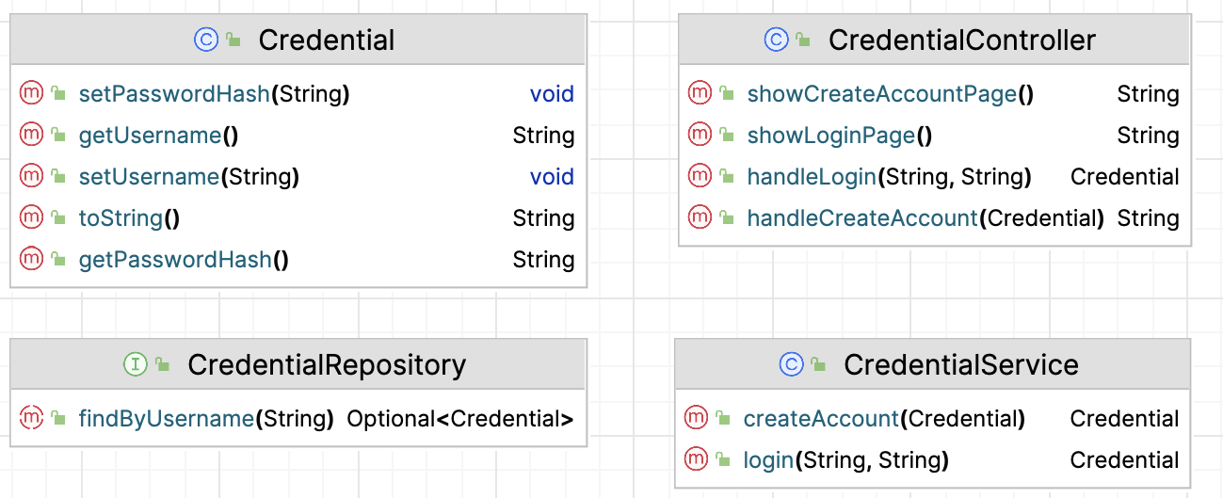
Design:
Design Class Diagram(Jingjing Tang)

Slide 14
Testing:
System testing for backend (Yuxuan Wang, Jingjing Tang)
Functional tests reside in src/test/java/Employee_Managem ent_system
Utilize Spring JPA Test and in-memory H2 database
Separate tests for Employee, Employee Service, Credential and Credential Service

Slide 15
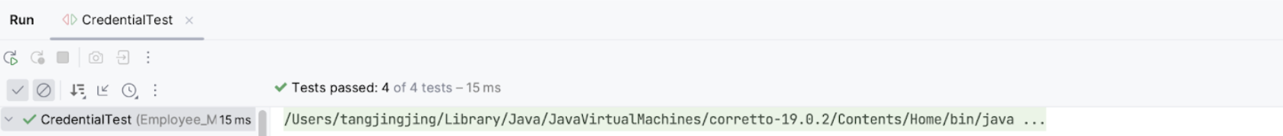
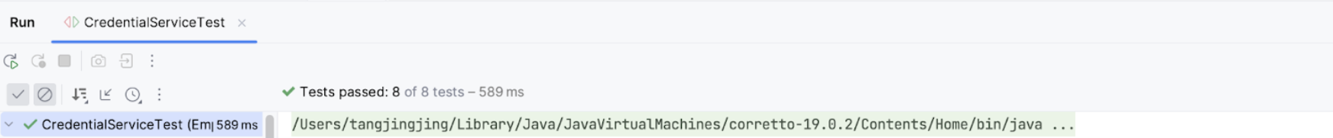
Testing:
System testing for backend (Yuxuan Wang, Jingjing Tang)

Slide 16
Testing Metrics for backend (Yuxuan Wang, Jingjing Tang)
Total lines of test files | 374
Total number of test cases | 31
Test cases pass rate | 100%

Slide 17
Design:
Design Classes(Haolun Li)
LeaveRequest
LeaveRequestController
LeaveRequestRepository
LeaveRequestService
ApprovalRejectionDto

Slide 18
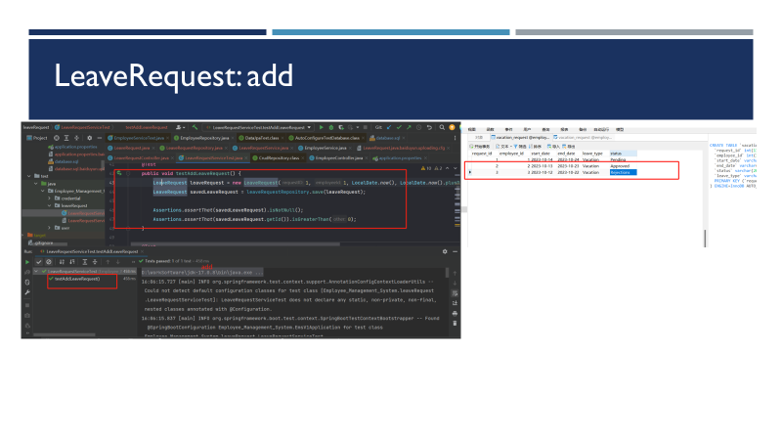
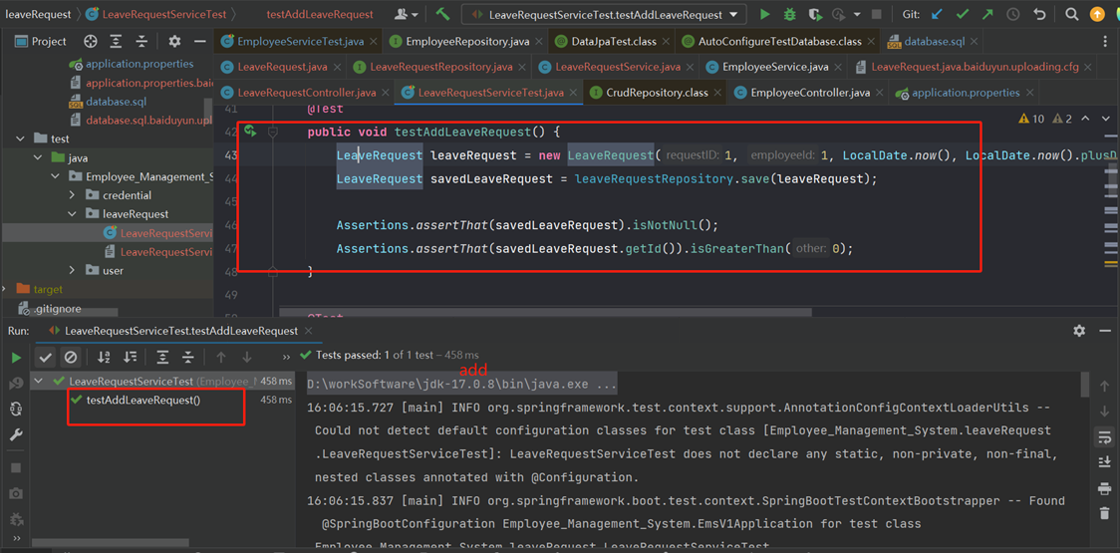
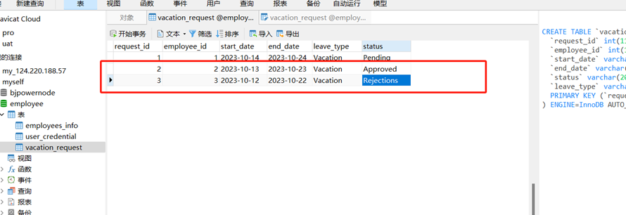
Implementation:
Backend structure for User and Credential (Yuxuan Wang, Jingjing Tang)
Use Java and Spring Boot to demonstrate CRUD (create, read, update, delete) operations.
User would be able to perform one or more CRUD operations
Add an stuff (register using ‘Name’, ‘Email’,’Phone number’, ‘Job title’, ‘Annual Salary’)
View Employee
Edit Employee
Delete Employee
Technology stack: Java - Springboot
Spring Data JPA framework

Slide 19
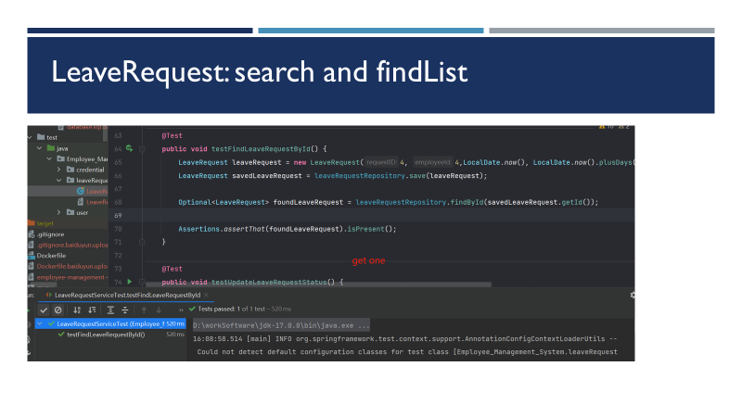

Slide 20
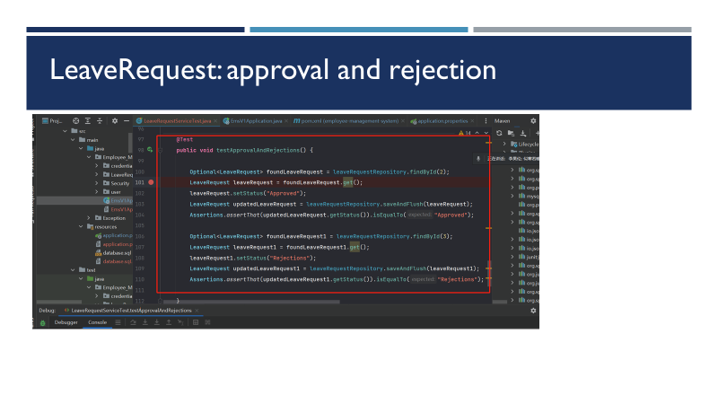
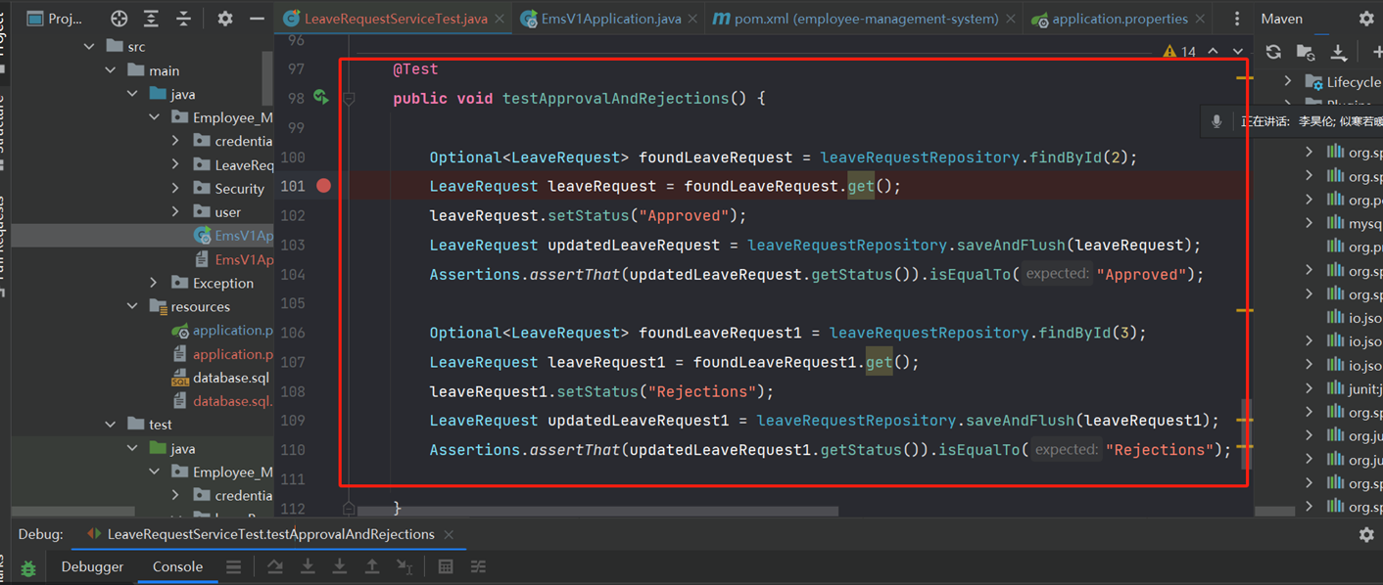

Slide 21
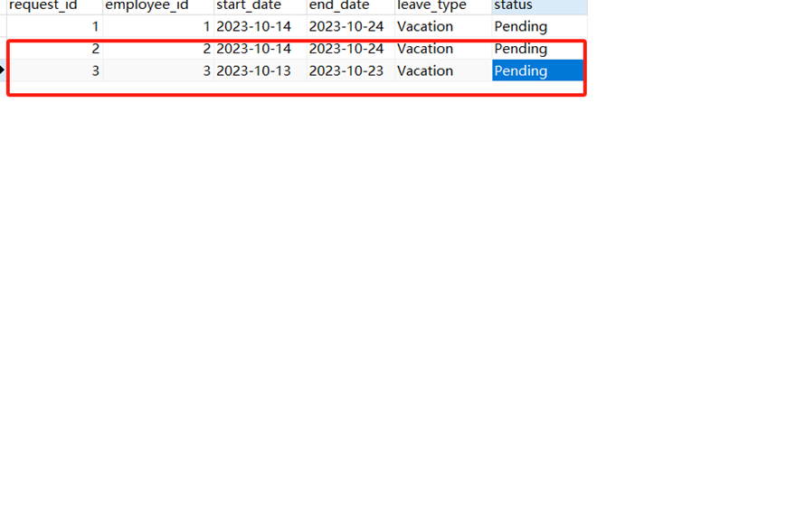


Slide 22
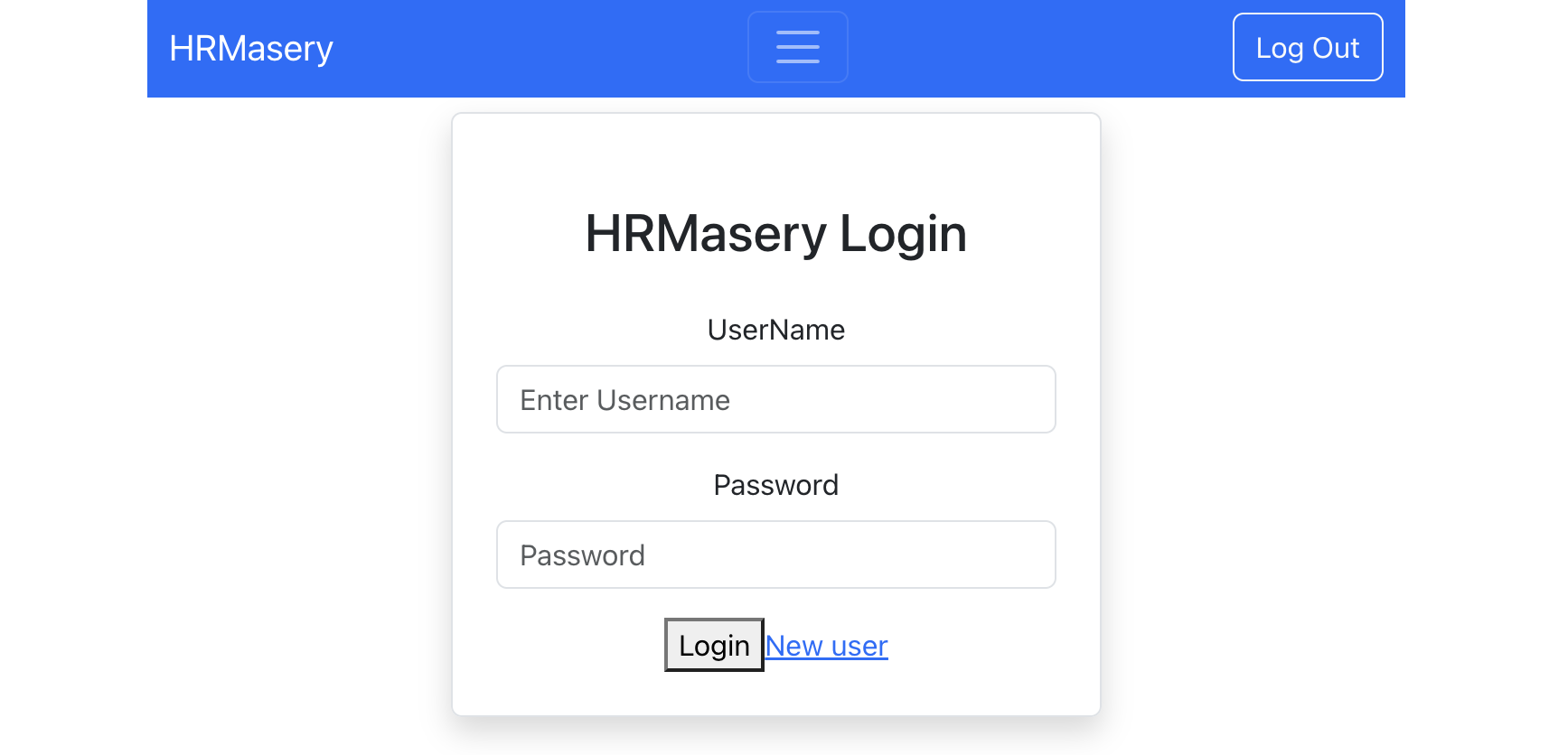
User Interface
Login page:
Navbar:
Logo and Logout button
Username input
Password input
Login button
Role base Login
New user

Slide 23
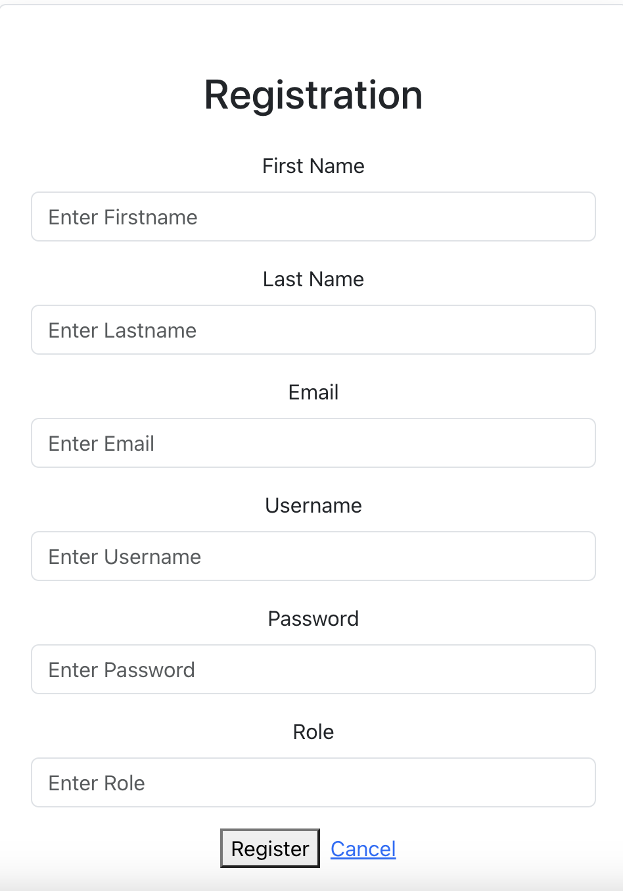
Registration Page
By Clicking ‘New User’, routes to the Registration page
User can register themselves by enter the information:
First name, Last name, Email, Username, Password, and Role
Newly created users can use their own credentials to login (username and password)
Register button submits the information into the Credential database
Cancel button to reroute back to the Login page

Slide 24
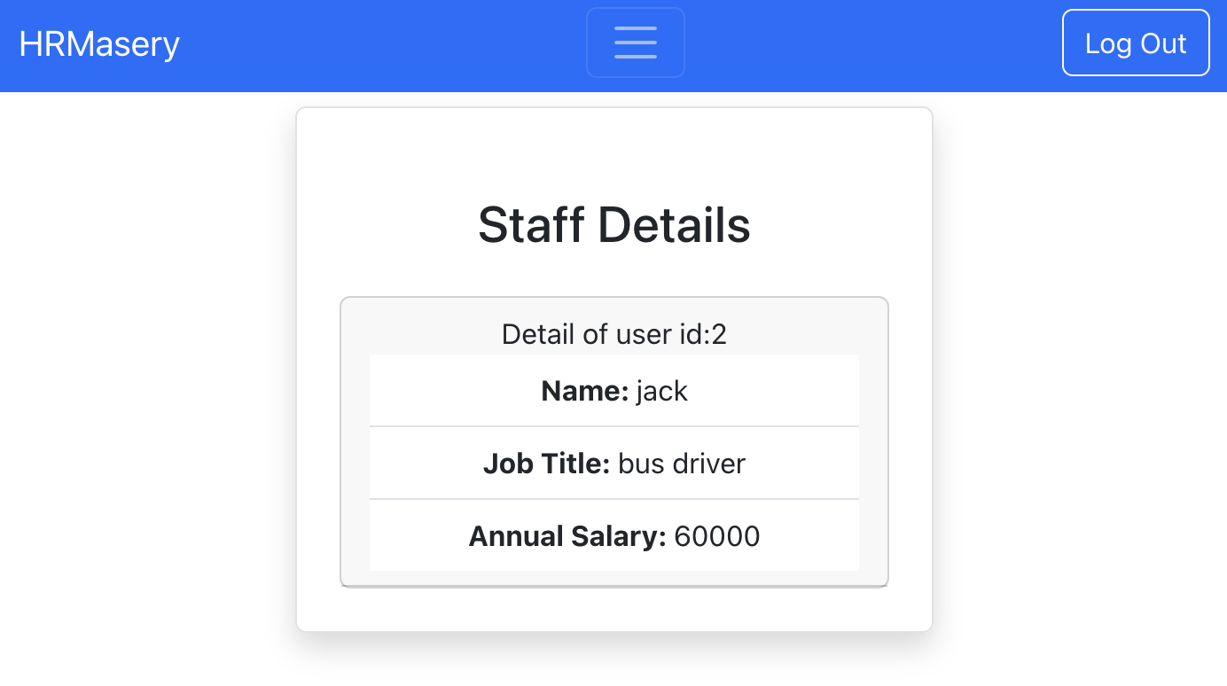
Staff Homepage
After successfully logging in, if the user is a STAFF role, then it will be routed to Staff Homepage
Displays the staff user’s information
Admin role will also see Staff’s details via ‘View Employee’ button

Slide 25
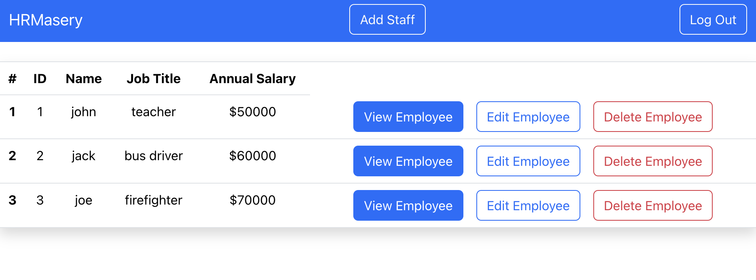
Admin Homepage
After successfully logging in, if the user is an ADMIN role, will route to Admin Homepage
Display all employee into table format with some of the attributes
ID, Name, JobTitle, Annual Salary
Each employee has 3 buttons next to them:
View Employee
Edit Employee
Delete Employee
‘Delete Employee’ deletes the selected employee from the current Employee database
‘Add Staff’ button is available on the NavBar to add additional employees
‘Log Out’ button is available to logout and and clear authentication.

Slide 26
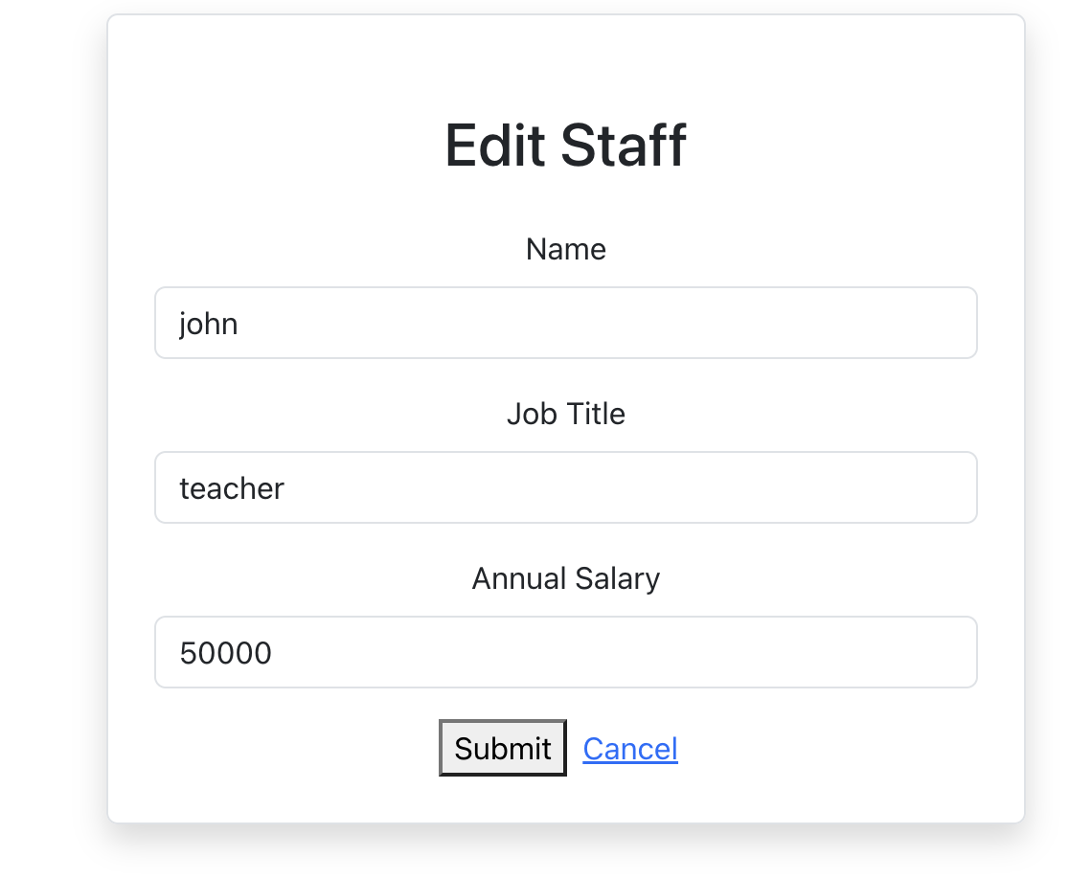
Edit Employee
Shows the the current information of the select staff
Staff information can be replaced with customized input
Submit button will update the Employee database
Cancel button will reroute the user back to homepage

Slide 27
Overall Quality Metrics
Metrics Name | Value
Project total lines of Code | 2938
Total Number of Methods | 99
Total Number of person hours used | 300 hours (todate)
Total Lines of test codes | 321
Total Number of classes | 24
Total Lines of Java | 1260
Total Lines of JS | 798
Total Number of User Stories | 7

Slide 28
Risk Management
Evolution of Risks:
Iteration 0:
Mainly concern with Technology Competency, Design and implementation, and Integration and deployment
Due to unfamiliar tech stack and/or unclear project direction/vision
Iteration 1:
Technology Competency lessens as gains in tech stack experience, but communication risk becomes greater due to division of Team into sub-teams
Communication risk spills over to inconsistent communication as well
Iteration 2:
Technology Competency increases again as each individual parts are needed to be integrated

Slide 29
JWT(JSON Web Token)
By Jianle Xie, Zhiwei Lin, Weihao Mai

Slide 30
When should you use JSON Web Tokens?
Authorization:
Once the user is logged in, each subsequent request will include the JWT, allowing the user to access routes, services, and resources that are permitted with that token.
Information Exchange:
JSON Web Tokens are a good way of securely transmitting information between parties.

Slide 31
What is the JSON Web Token structure?
Header：The header typically consists of two parts: the type of the token, which is JWT, and the signing algorithm being used, such as HMAC SHA256 or RSA.
Payload:The second part of the token is the payload, which contains the claims. Claims are statements about an entity (typically, the user) and additional data.
Signature:To create the signature part you have to take the encoded header, the encoded payload, a secret, the algorithm specified in the header, and sign that.
Therefore, a JWT typically looks like the following.
xxxxx.yyyyy.zzzzz

Slide 32
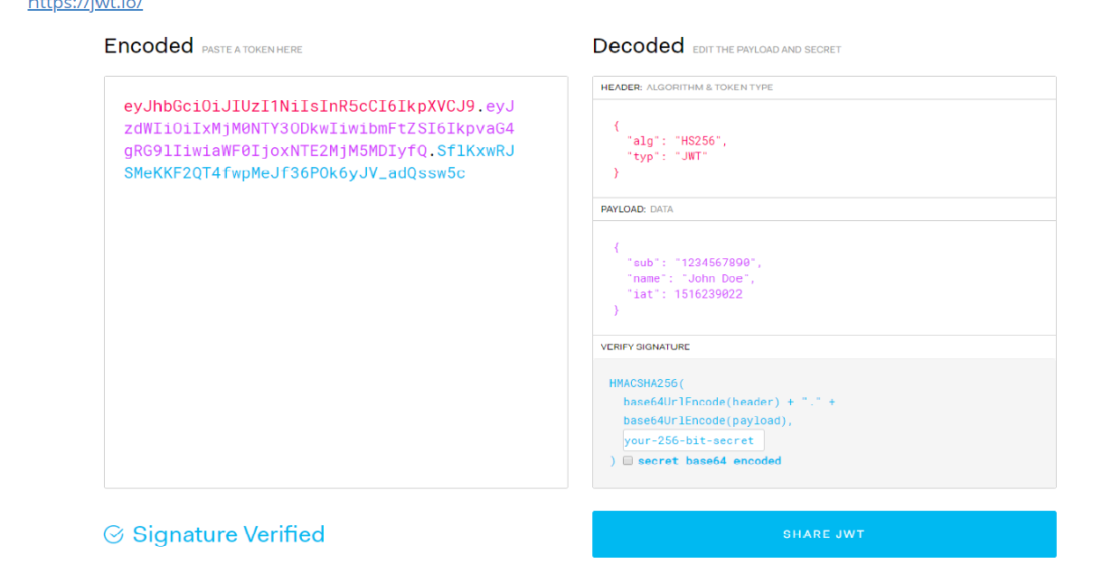

Slide 33
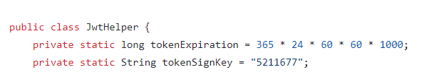
Applied in our project (JwtService)

Slide 34
Spring-Security
By Jianle Xie, Zhiwei Lin, Weihao Mai

Slide 35
How to use it ?
<dependency>
<groupId>org.springframework.boot</groupId>
<artifactId>spring-boot-starter-security</artifactId>
</dependency>

Slide 36
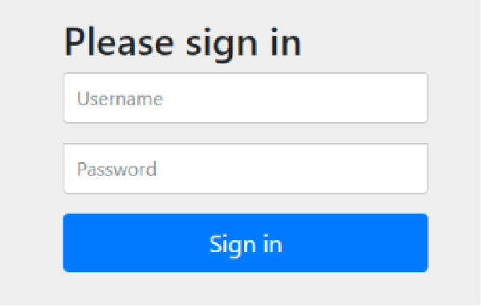
After you add it
Spring Security provides many features by default to protect the entire program.Like
1. Require authenticated users to interact with the application
2. Create the default login form
3. Generate a random password with user name 'user' and print it on the console

Slide 37
Three core components in Spring-Security
1. Authentication：The authentication information is stored, representing the current logged-in user
Information included：
(1). Principal: User information, such as the user name without authentication. After authentication, the user object is stored.
(2). Credentials: User credentials, usually a password.
(3). Authorities: Control authority.
​ 2. SeucirtyContext：Context object, used to get Authentication.
​ 3. SecurityContextHolder: Context management object, used to get “SecurityContext” anywhere in the program.

Slide 38
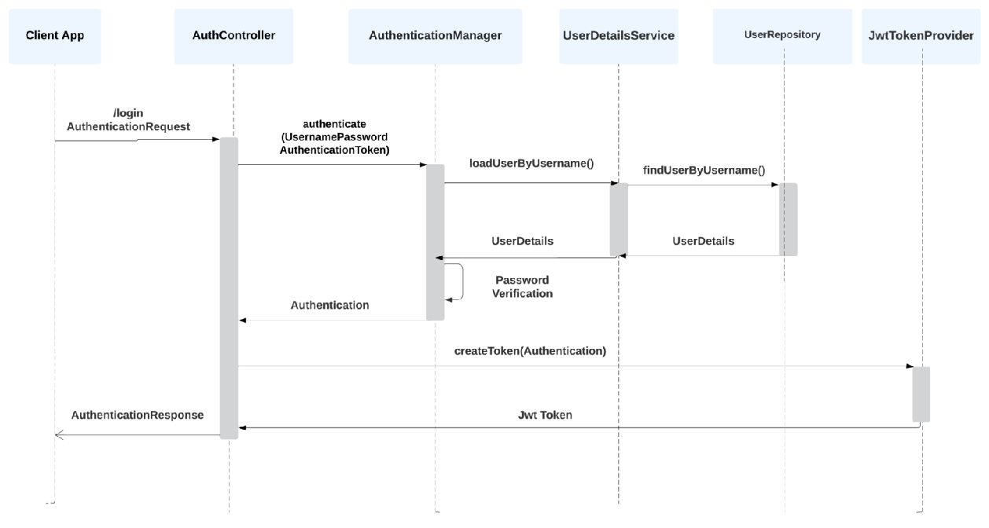
WorkFlow

Slide 39
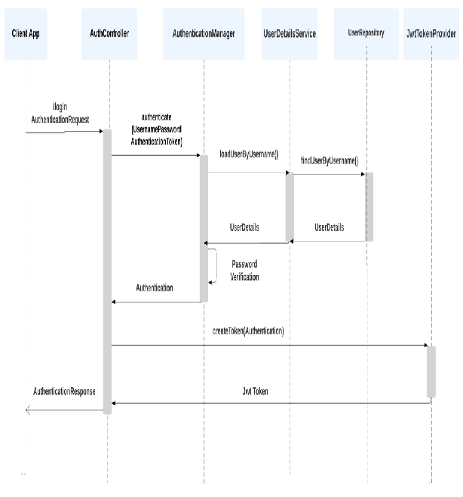
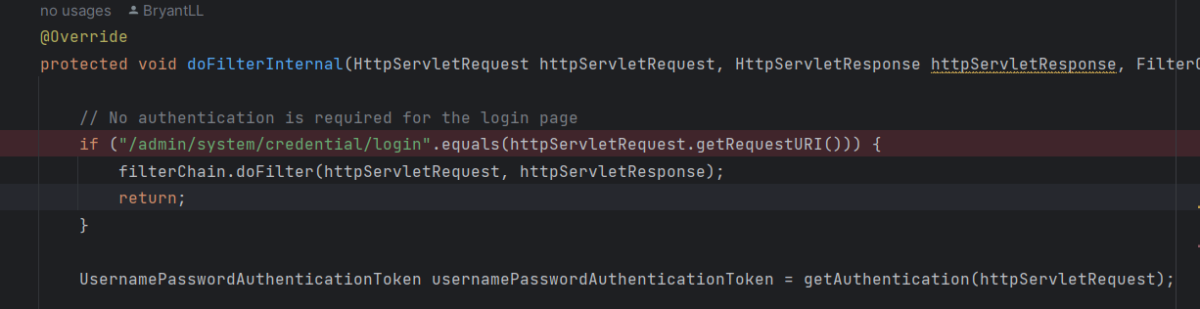
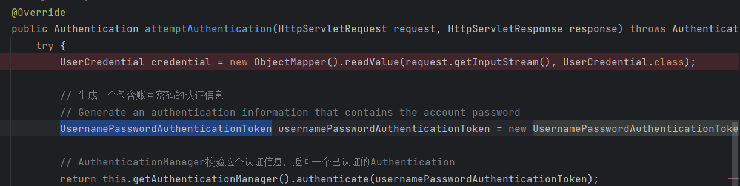
Running sequence(1)
Step1: AuthController->doFilterInternal
Step2:Use UsernamePasswordAuthenticationToken to geneate authentication infomation and Call AuthenticationManage’s authenticate() to check information

Slide 40
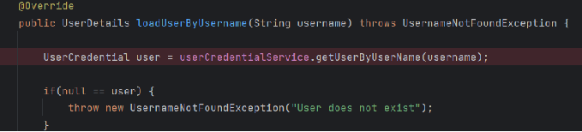
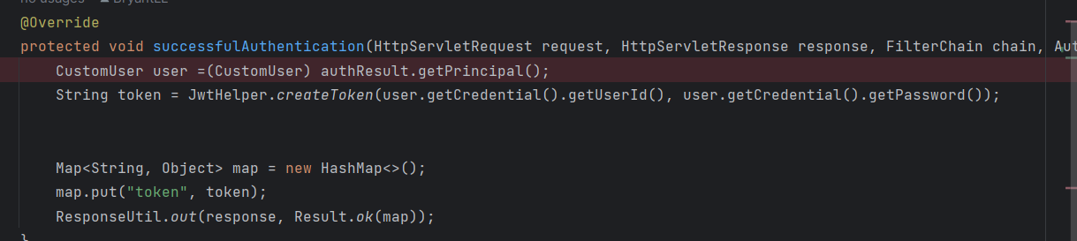
Running sequence(2)
Step3: Method authenticate() ->
Step4: Successful verification: Using JwtService to create token

Slide 41
Demo

