Slide 1
HRMasery
An Employee Management System

Slide 2
Outline
Role Assignments
Overview/purpose
Project plan
High Level requirements
Desirable and Optional Features
Management
Configuration
Quality Assurance Plan
Future plans

Slide 3
Role Assignments
Team Leader: Jianle Xie
QA Leader: Yuxuan Wang
Design and Implementation Leader: Abigya Devkota
Requirement Leader: Haolun Li
Configuration Leader: JingJing Tang
Security Leader: Weihao Mai (TBD)

Slide 4
Project Overview/Purpose
We will create an Employee Management System using Java and Spring Boot in 6 weeks to demonstrate CRUD (create, read, update, delete) operations.
It will help staff and administration workers to create, read, update, and delete roles thru an user interface.
We have a basic underlying potential users, functionalities, and technology stack, but more may be added as we progress.

Slide 5
Project Plan
**Baseline view:**
Our application will have a baseline login page
User would be able to perform one or more CRUD operations based on their roles
**Potential Users:**
1. Staff Workers: To view roles and request updates.
2. Administration Workers: To create, update, and delete roles.
**Technology Stack**
Java as the default language
Springboot will the framework
User interfaces would be created via React

Slide 6
High level requirements
Essential features:
Create: As an employee or administrator, I wanted to create my employee information so that it can be stored in the database.
Estimation person hours: 24 hrs
Read: As an employee or administrator, I wanted to view all current employees so that we know how many employees are there.
Estimation person hours: 24 hrs
Update: As an employee or administrator, I wanted to update my information so that everything is accurate.
Estimation person hours: 24 hrs
Delete: As an administrator, I wanted to be able to delete records when employees leave the company.
Estimation person hours: 24 hrs
***hours are based on all team member’s available schedule

Slide 7
Desirable and Optional Features
Desirable Features:
For enhanced security, we would like to implement a login page in the application to authenticate each user, distinguishing between workers and administrators.
Optional Features:
Explore Spring Security for encryption

Slide 8
Management
Objective:
We want to build an employee management system with basic functionalities (create, read, update, delete) with a user interface and no known bugs.
Risk Management:
Top 3 major risk categories involves:
Technology Competence,
Design and implementation, and
Integration and deployment

Slide 9
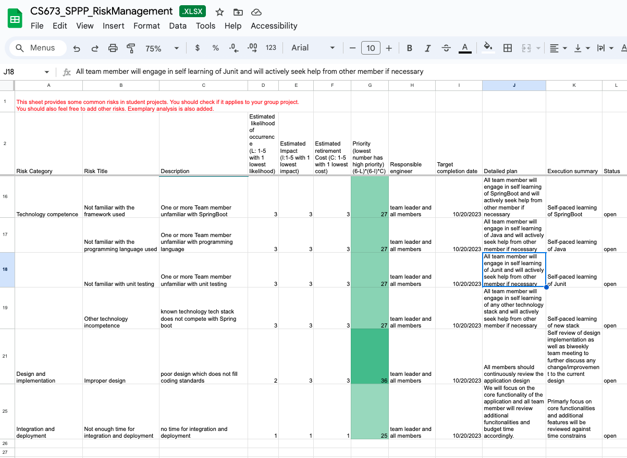

Slide 10
Configuration
Tools: Java SDK 17 or later, Maven, Intellij IDEA, Junit, Apache, React, Github, Github issues
Code commit and Branching Strategy:
New branch is created for any change to be added
Changes are only merged to main after pull request review
Make sure no conflicts exist in branch before being merged to main
Deployment plan:
If time permits, application will be deployed

Slide 11
Quality Assurance
Use various metrics line test coverage per class, method to maintain code quality
Use java best practices (e.g. camelCase method, class attributes are private, etc.)
Code is reviewed through pull request by team members before being merged to main
Unit and integration testing
Use github issues to raise defects, prioritize defects based on needed functionality and time

Slide 12
Future plans
Cover non functional requirements like user submitting forms for data updates
Build a more robust user interface
Deploy application
Confirm security leader

