Slide 1

Team 5: GearOnTheGo
(Iteration 0)
By: Ahnaf Tajwar, Jian Song, Lazaro Perez, Saahil Vashishta, Samantha Mathis, Shajee ur Rehman

Slide 2
Contents
Leadership Roles
Project Application
Tech Stack
Related Work
Proposed Requirements
Management Plan
Risk Management
Timeline
Configuration Management Plan
Tools
Quality Assurance Plan

Slide 3
Leadership Roles
Roles | Names
Team Leader | Samantha Mathis
Requirements Leader | Saahil Vashishta
QA Leader | Lazaro Perez
Design and Implementation Leader | Jian Song
Security Leader | Ahnaf Tajwar
Configuration Leader | Shajee ur Rehman
Notes:
All

Slide 4




Project Description and Tech Stack
Our project is a recreational equipment rental service web application. Our vision is to align people who are in need of these recreational equipments, examples include(canoes, kayaks, mountain bikes, boats, jet skis etc), with people who have the equipment readily available for others to use for a specified time. The functionality of the site is to allow users to choose items that are posted by individuals in their vicinity who need these items.
Tech Stack
Notes:
Laz

Slide 5





Related Work
Found The following websites that were related to our web application idea:
KitLender
Turo
REI
ZipCar
Uber
None of the ideas are exactly same as ours. There are some similarities and many differences.
Notes:
Saahil

Slide 6
Proposed requirements
Created the first draft for Functional Requirements including:
Essential Functional Requirements
Desirable Functional Requirements
Optional Functional Requirements
Created the first draft for Non-functional Requirements
Added Security based non functional requirements
Created a tabular format for requirements and worked on ATOMIC requirements
Requirement ID | Requirement Description | Estimated Time (hours)
Example: 0001 | Example: User shall login using: Username AND Password | Example: 3
Notes:
Saahil

Slide 7
Management Plan
Objectives and Priorities
Login Feature
Database
Users
Items for rent
Search for Items
View your rentals
View your items
Checkout
Timeframe
Payment
Confirmation
Automatic returns after the end return date
Notes:
Samantha

Slide 8
Risk Management
The highest priority risks that we decided were Not enough time for testing and not familiar with the programming language. We decided these were high priority because we think they are more likely to happen then some of the other risks. A few of us are still new to flask so it'll take some time to learn and get the hang of the framework. Testing is a key component of everything, without adequate testing we won’t know if later on we will encounter a bug or if all of our features work the same when they are put together. Some of the lowest priority risks were Improper planning, Duplicate work, Loss of a member, and improper management skills. This was decided because even though these are big risks that could potentially put us behind schedule we all agree it will be easy to avoid these risks. To avoid these risks we plan on open communication, weekly meetings, Tracking and assigning work.. All of the risks are detailed out in the risk management spreadsheet, listing the priority, the impact, detailed plan and execution summary.
Notes:
Samantha

Slide 9
Timeline
Iteration 1
Iteration 2
Iteration 3
User Registration
User Login
Hosting Equipment
Comprehensible and easy to navigate UI
Make Reservations
Search Features
Profiles
ChatGPT
About Us
FAQ
Notes:
Ahnaf

Slide 10
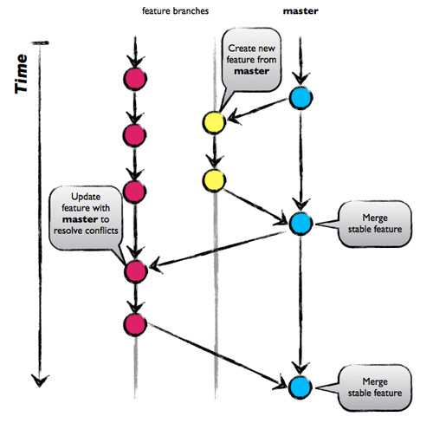
Configuration Management Plan
Tools
Git and Github desktop as the version control tools
IDE: VS Code
Jira to track progress.
Lucid Chart for UML diagrams.
Postman for API testing.
Other tools (CI/CD, container, etc.): To be determined
Git Branching Strategy - GitHub Flow branching strategy
Notes:
Jay

Slide 11
Configuration Tools (Continued)
Further Testing Tools may include:
Pytest (testing framework for Python)
Selenium (used for testing web applications and possible automation)
Below are the following options that integrate Python in order to authenticate payments:
Payment Gateways (Python SDK’s/Libraries that allow integration of their services with your web application)
Two-Factor Authentication.
The usage of such tools will be determined.
Notes:
Shajee

Slide 12
Tools to prevent scam
It is essential for the continued success of any web application or business model to focus on the prevention of scams.
Reputable payment gateways such as Stripe can be used to ensure Payment Authentication.
Staff and Customer Support Teams must also be trained and given ample tools to be up to speed with processing refunds for customers.
Notes:
Shajee

Slide 13
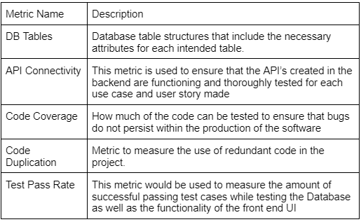
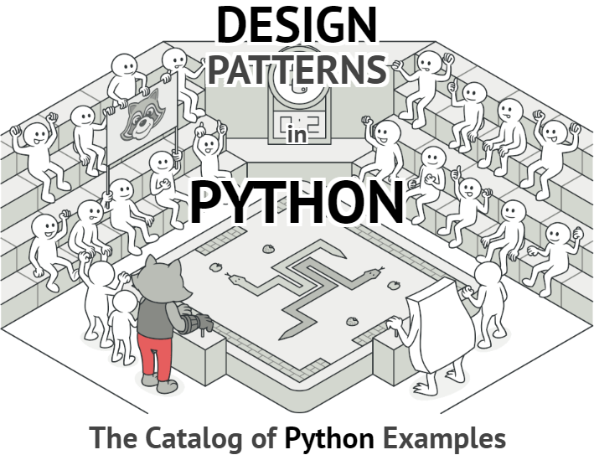


Quality Assurance Plan
Notes:
Lazaro Perez -
Table 1 - Explain the sort of metrics that would be used during the project.
Coding Standards - Explain how we will implement a coding format, variables and functions with proper names related to their intention, design patterns to keep the from code redundancies, and proper documentation.
Code Review Process - This will be a done by the whole team as we collaborate on the code base to ensure that the deliverables are being met throughout each iteration.
Testing - Explain Postman as 1 of the tools to use to test the API for creating the user profiles as well as the creation of the items on each profile.
Defect Management - Utilizing Github Issues tracker for tracking and documenting issues with the code base.

Slide 14
Thank you for your time!

