Slide 1

Team 5: GearOnTheGo
Iteration(2)
By: Ahnaf Tajwar, Jian Song, Lazaro Perez, Saahil Vashishta, Samantha Mathis, Shajee ur Rehman

Slide 2
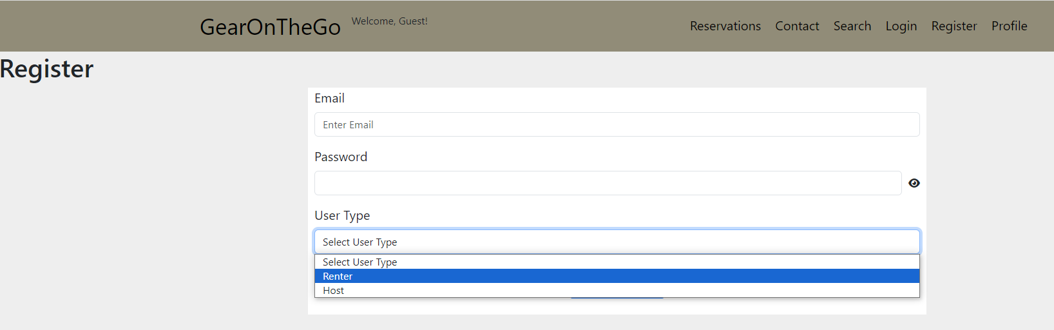
Login/Registration
Implemented a user type when registering as a new user
Added user_type to user table in database
Users can only access certain pages based on their user_type
(May remove user_type in future for ease of use)
Error message displayed if invalid credentials entered

Slide 3
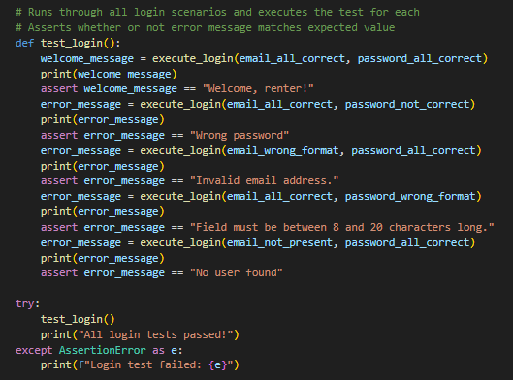
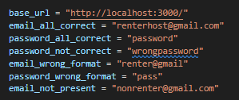

Login Testing
Tested login combinations
Several credential combinations executed
Automated testing using Selenium
Pass all tests

Slide 4
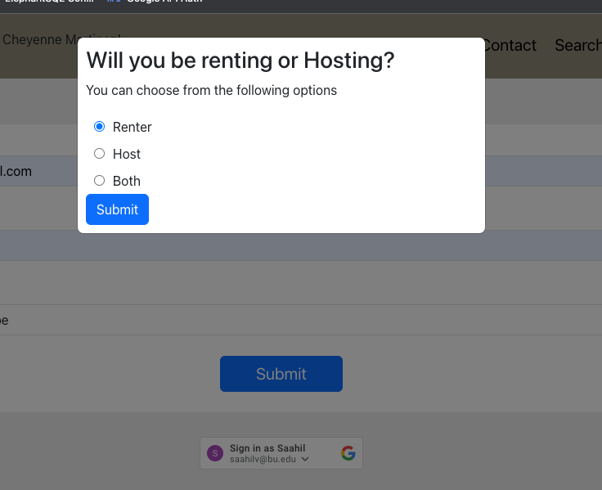
Addition of UserType to Sign-up with Google
Implemented a user type when registering as a new user
Added a pop-up to choose from existing radio buttons
Notes:
Saahil

Slide 5

Login/Registration Testing - Google
Automated Testing with Selenium was added and executed
Functional Testing with pytest was added and executed
Unit Testing with pytest was added and executed
Notes:
Saahil

Slide 6
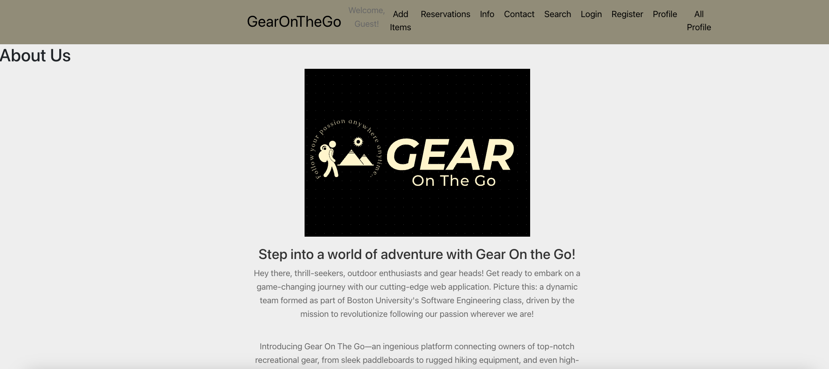
Info Page for the Website
An About Us page was added to give product information
As part of the next iteration, team member information, fun facts and images will also be added
Notes:
Saahil

Slide 7
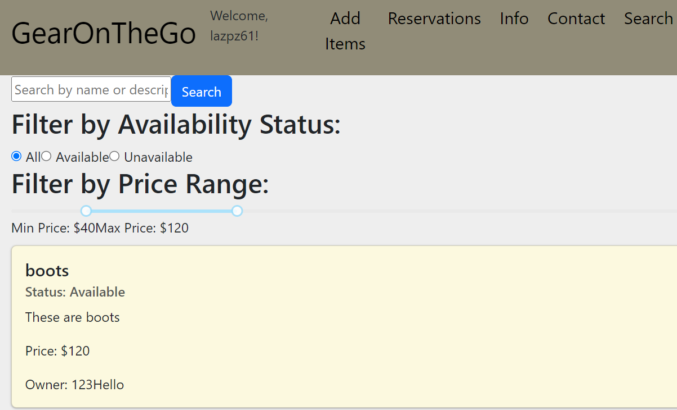
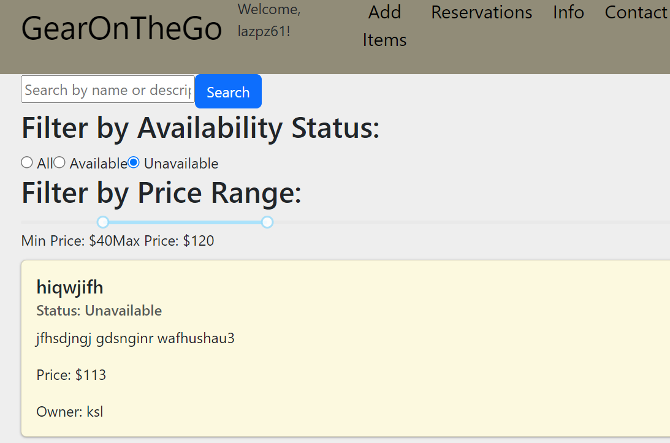
Search Features - Price Filter
In addition to our search functionality we have included the ability to filter through the equipment items that lies within a price range that will be populated on the search page.
This will also be used within the availability and unavailability search filtering to narrow the search based on the prices adjusted on the slider.
The library being used for this functionality is rc-slider. The way that the code is handling the slider is placing the min and max values as part of the search query to the API, and in REACT we are handling any null pointers, with conditional handling to present the correct items on the screen.

Slide 8
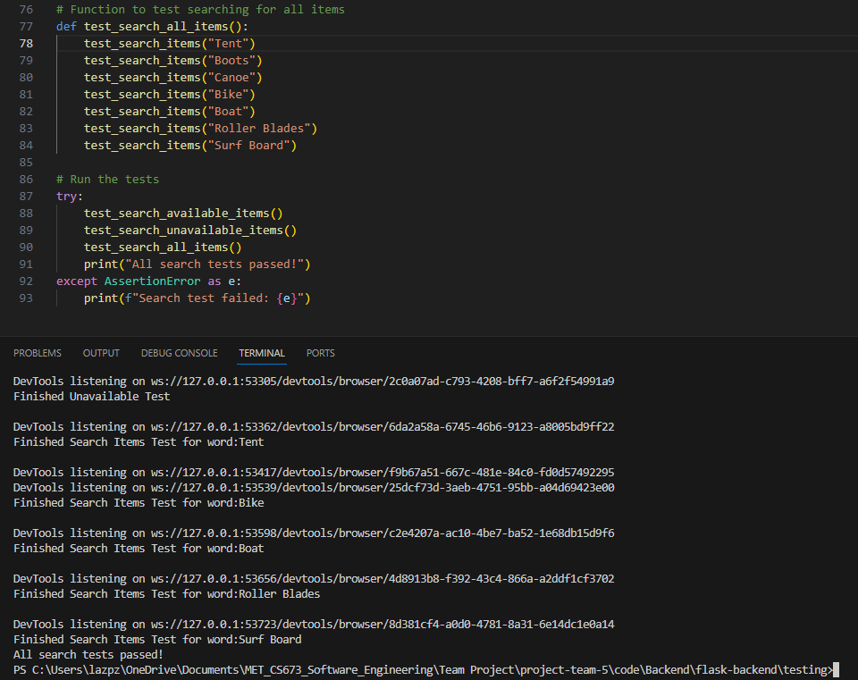
Testing the Search Features
In this iteration we used Selenium for the automation testing.
For Search, the automation we’ve made strides to include testing for using the Availability and Unavailability radio buttons, as well as providing several search terms to discern that items were populated during the automation testing.

Slide 9
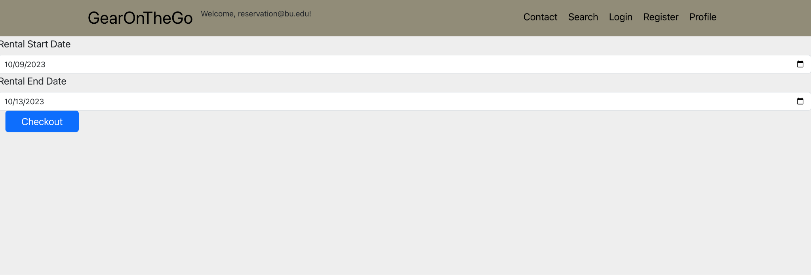
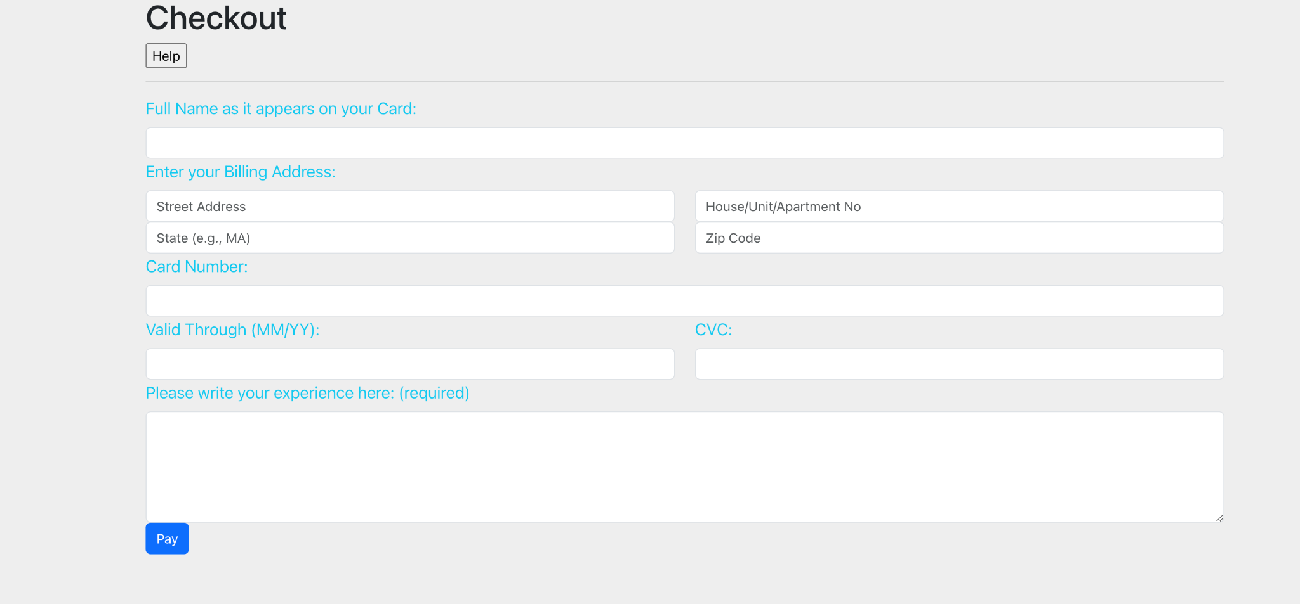
Reservation Process
Reserve after searching for an item
Directed to Checkout page after entering valid dates
Continue from the Checkout page

Slide 10
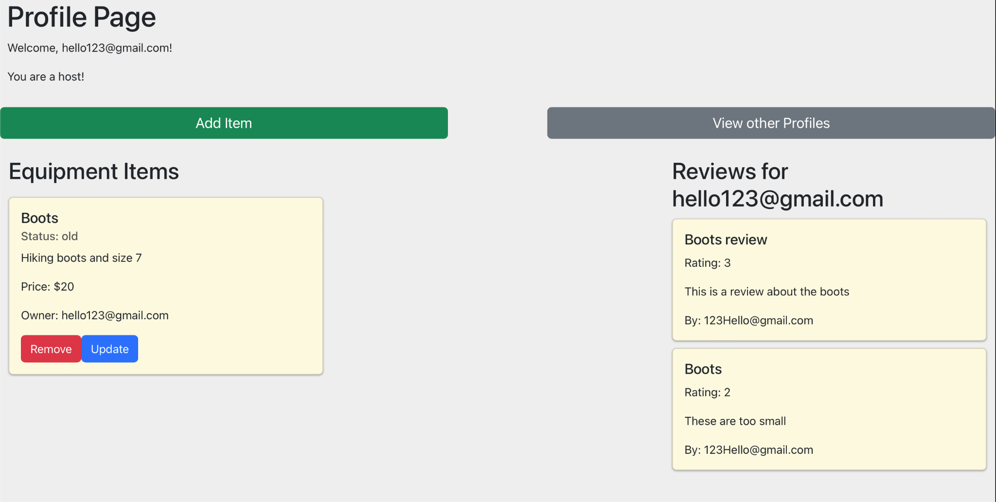
Profile Page for Host
View Items you are currently hosting
Add new items to host
Update or Remove existing items
View other profiles
View Reviews that other users have left on your profile

Slide 11
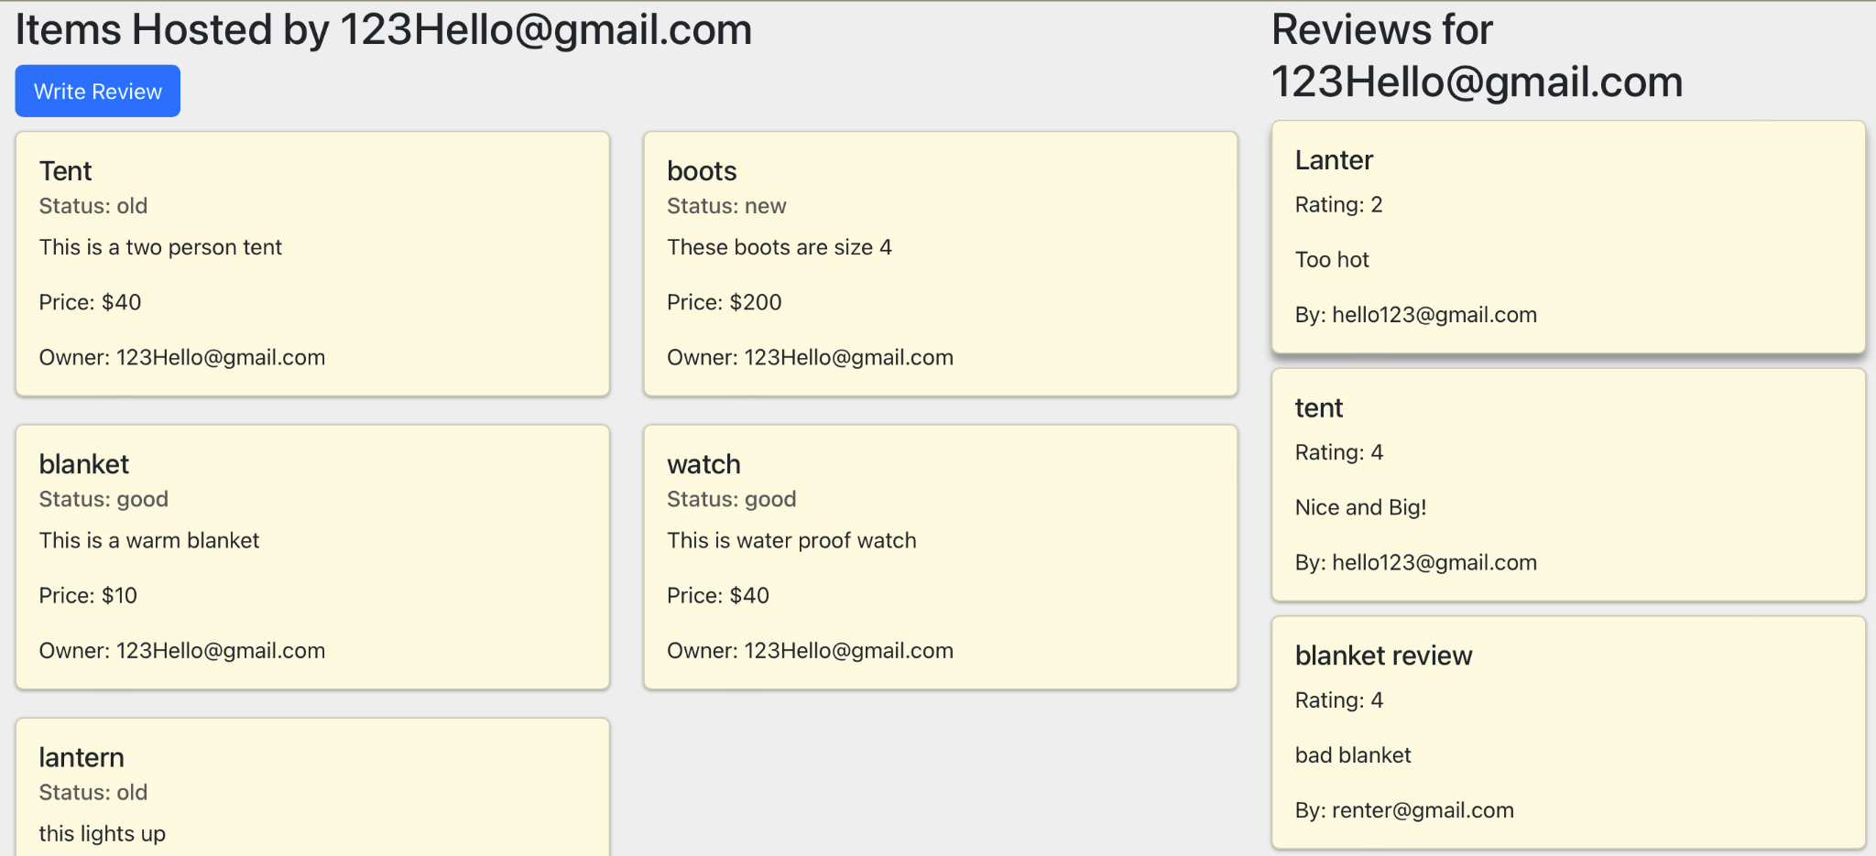
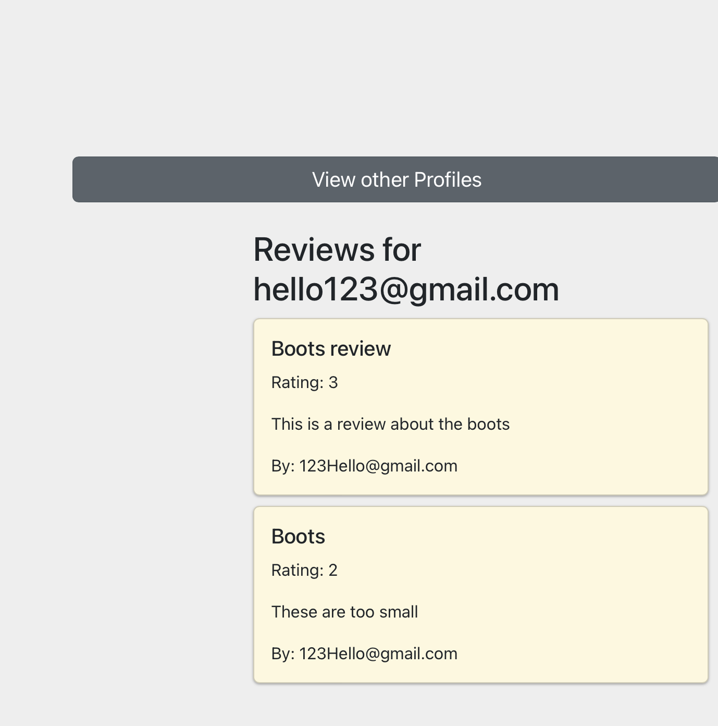
Review features
View Reviews on their account
View other profiles
Each other profile will have a button for the current user to add a new review which will then show up on the other users profile page

Slide 12
Checkout Process
The Checkout Process now redirects the user to a ‘Payment Successful’ page.
This is reliant on the user inputting the appropriate information AND a valid Card Number.

Slide 13
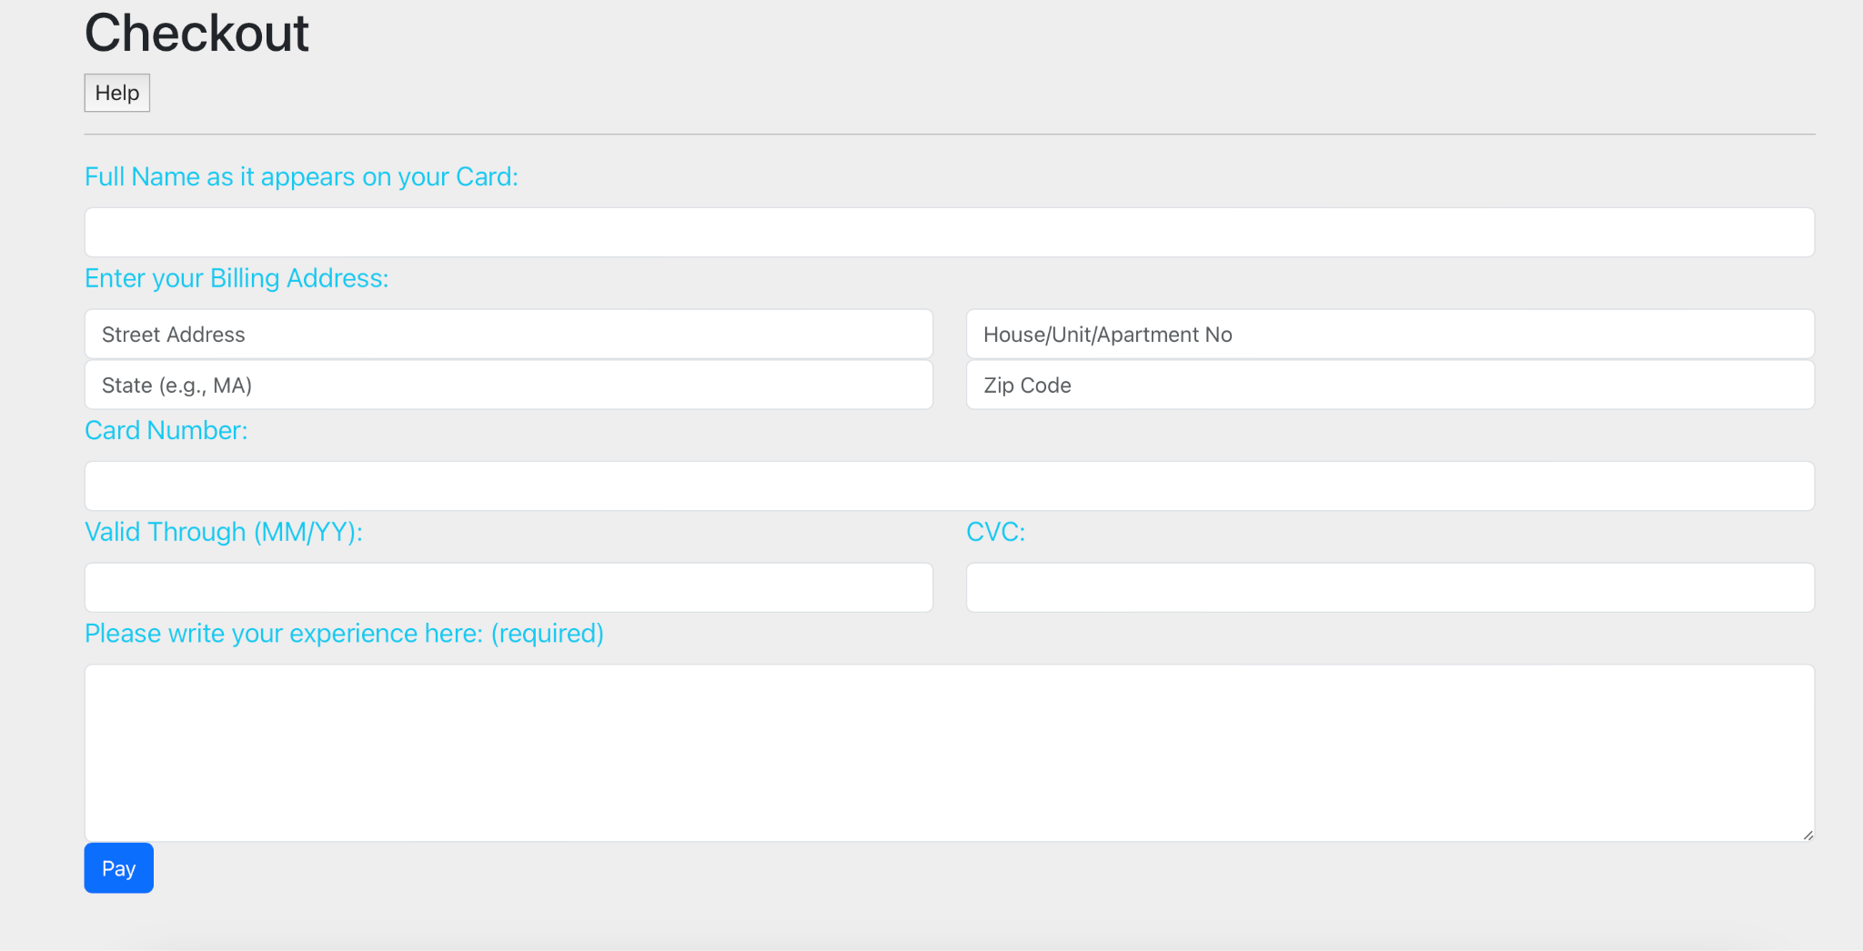
Checkout Page

Slide 14
Checkout Process Testing
In order to ensure that the user inputs the appropriate information; several checks and their subsequent prompts have been set up.
These include a help button, alerts, an algorithm to validate the card number, required form fields and a pay button that submits the information.
Incorrect inputs were used in order to test these prompts and for the form to submit the correct information

Slide 15
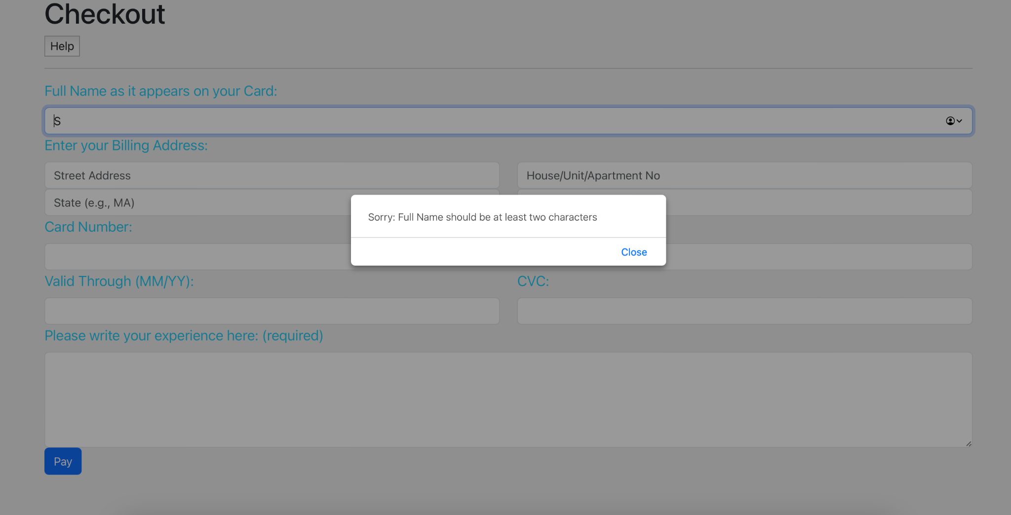
Checkout Process Testing Screenshots

Slide 16
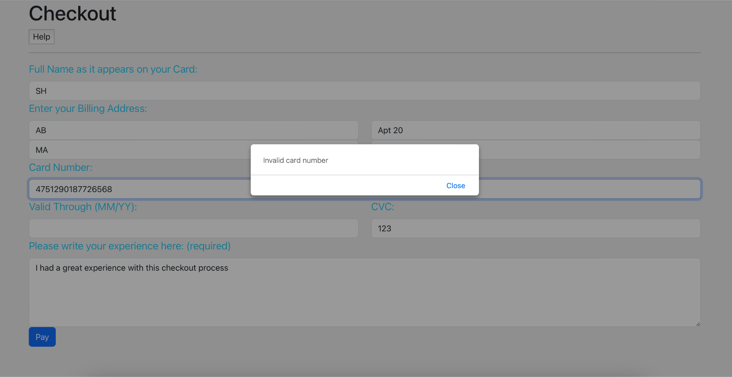
Checkout Process Testing Screenshots (continued)

Slide 17
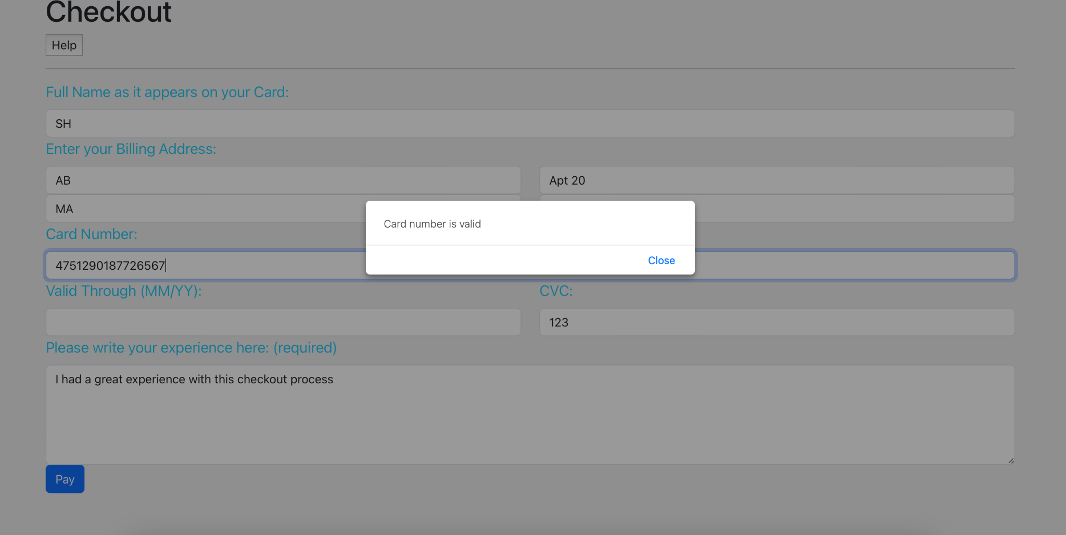
Checkout Process Testing Screenshots (continued)

Slide 18
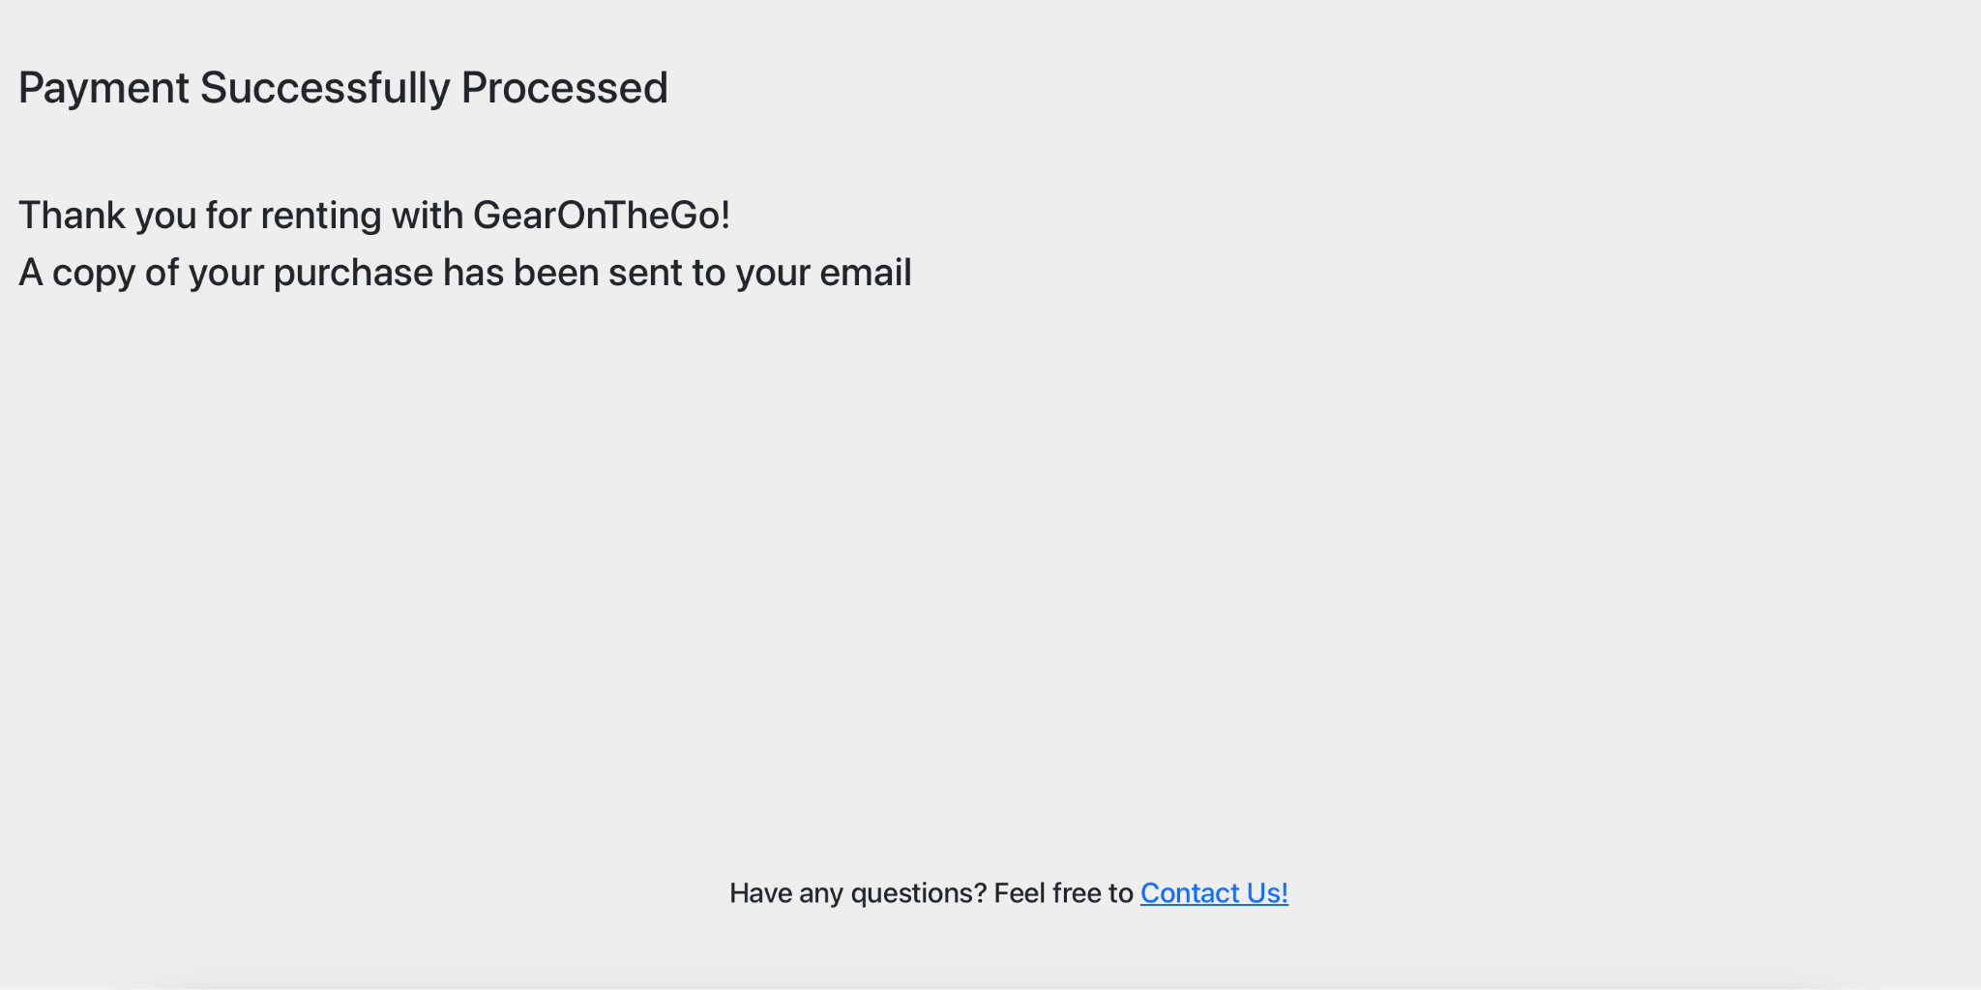
Successful Payment Page

