Slide 1

Team 5: GearOnTheGo
Iteration(1)
By: Ahnaf Tajwar, Jian Song, Lazaro Perez, Saahil Vashishta, Samantha Mathis, Shajee ur Rehman

Slide 2

SDD
Team populated the following sections:
Software Architecture
Included folder structure
Backend uses Flask, Frontend uses React, PostgreSQL Database is hosted on ElephantSQL
Class Diagram
7 entities defined currently
UI Design
Initial mockups provided and discussed
Database Design
Tables: equipment, user, paymentinfo, reservation
Security Design
Email and password validation
Design Patterns
Abstract Factory, Observer, Composite

Slide 3
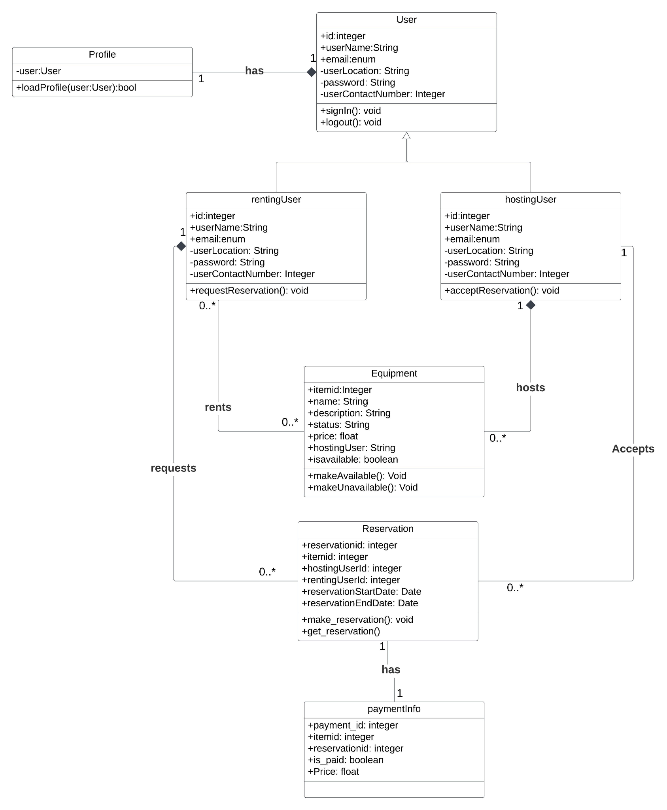

Class Diagram
Class Diagram was made using UML on Lucidchart.
7 entities were identified so far:
User
Renting User
Hosting User
Profile
Equipment
Reservation
Payment Information

Slide 4
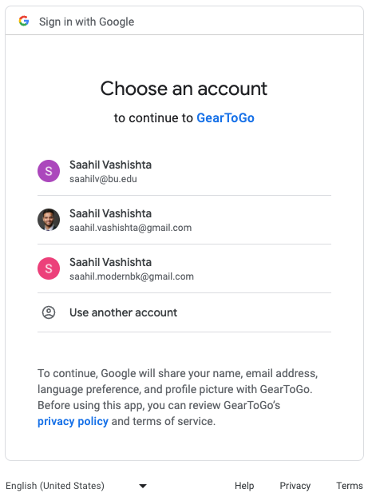

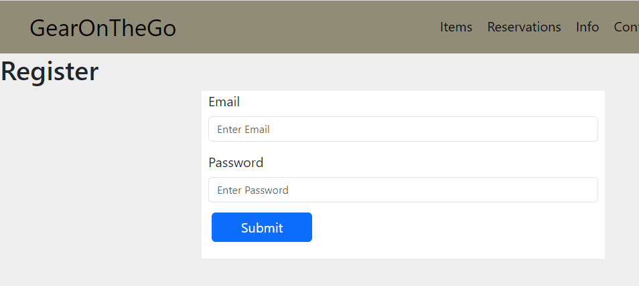
Login/Registration
The team implemented user registration using a combination of a validated email and password.
A Google sign-up option was also added to the functionality.
Passwords were hashed using Bcrypt for added security.
Hashed password saved to database
Users can only access certain pages if logged in

Slide 5
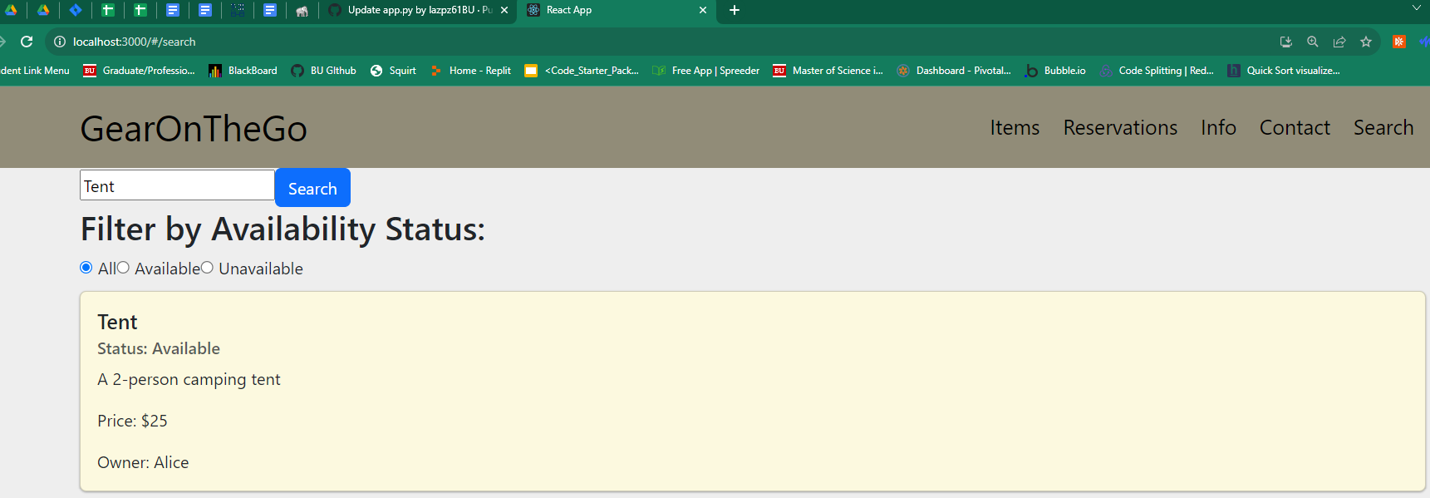
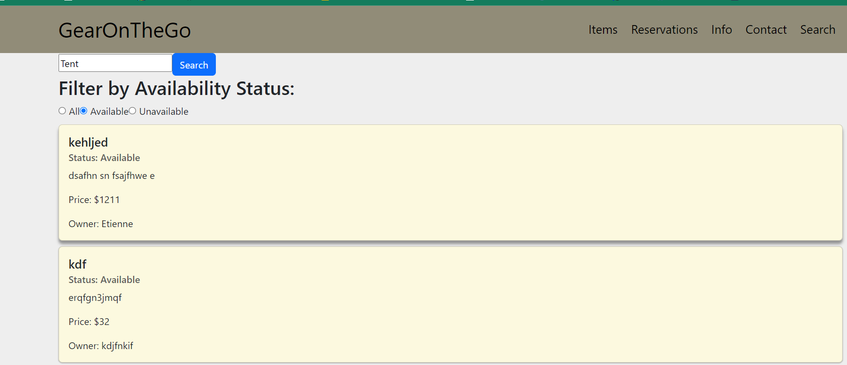
Search Features
We’ve implemented a feature for searching all items, as well as searching for all items that are available and unavailable.
The purpose for having a search is so that it is convenient for a renter user to choose from a selection of items that are are being hosted.
The unavailability search functionality is a piece that will be made for host users in order for them to know which items would be best for them to place as an option to place on their account for rental.

Slide 6
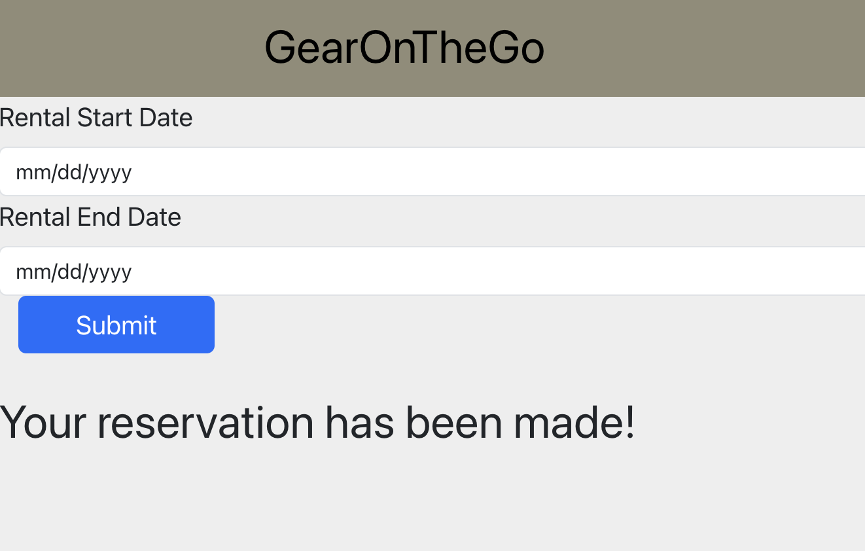
Make Reservations
The team implemented reservation system including making and checking reservations
When making reservations, related information will be directed from Equipment and User, so the user does not need to input those information again
The inputs required are only rental start date and rental end date
Users can access their existing reservations on their dashboard (more to come on Iteration 2)

Slide 7

Checkout Process
The Checkout page allows the renting user to make a payment to the hosting user after they have made their reservation.
The renting user must fill out the required fields such as Name on Card, Billing Address, Card Number and a brief message documenting their experience.
The price for the item will be drawn from the reservation database.
The Checkout page validates the Card Number before allowing the information to be submitted.

Slide 8


Secure Payment Processing
Payment will then be submitted to the payment info database.
Card Information will be hashed and not visible in the database.
The Stripe secure payment processing system will be incorporated into it at a later iteration.
The RU and HU will both be notified regarding a successful payment.

Slide 9
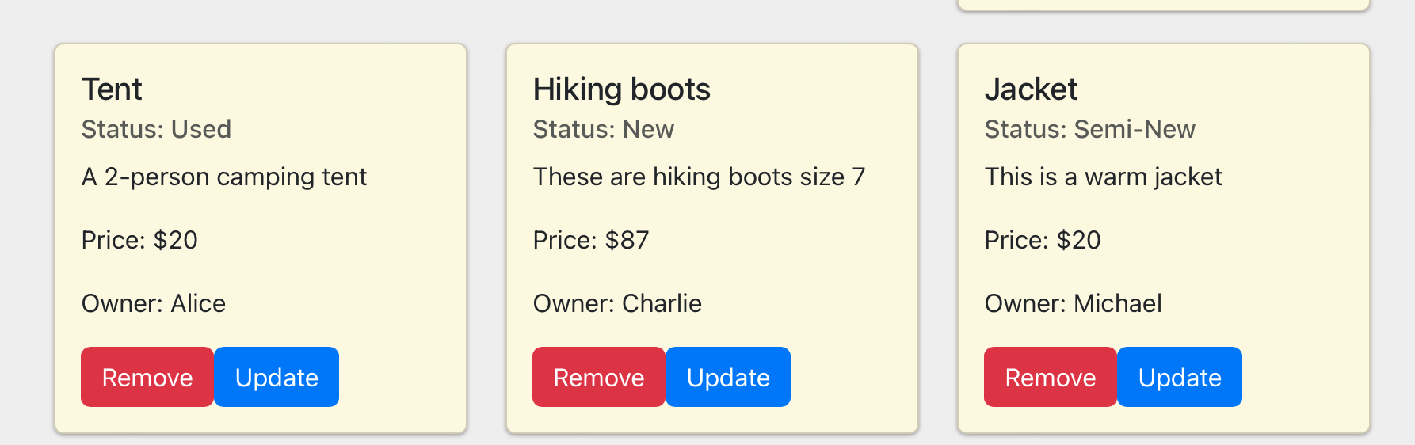
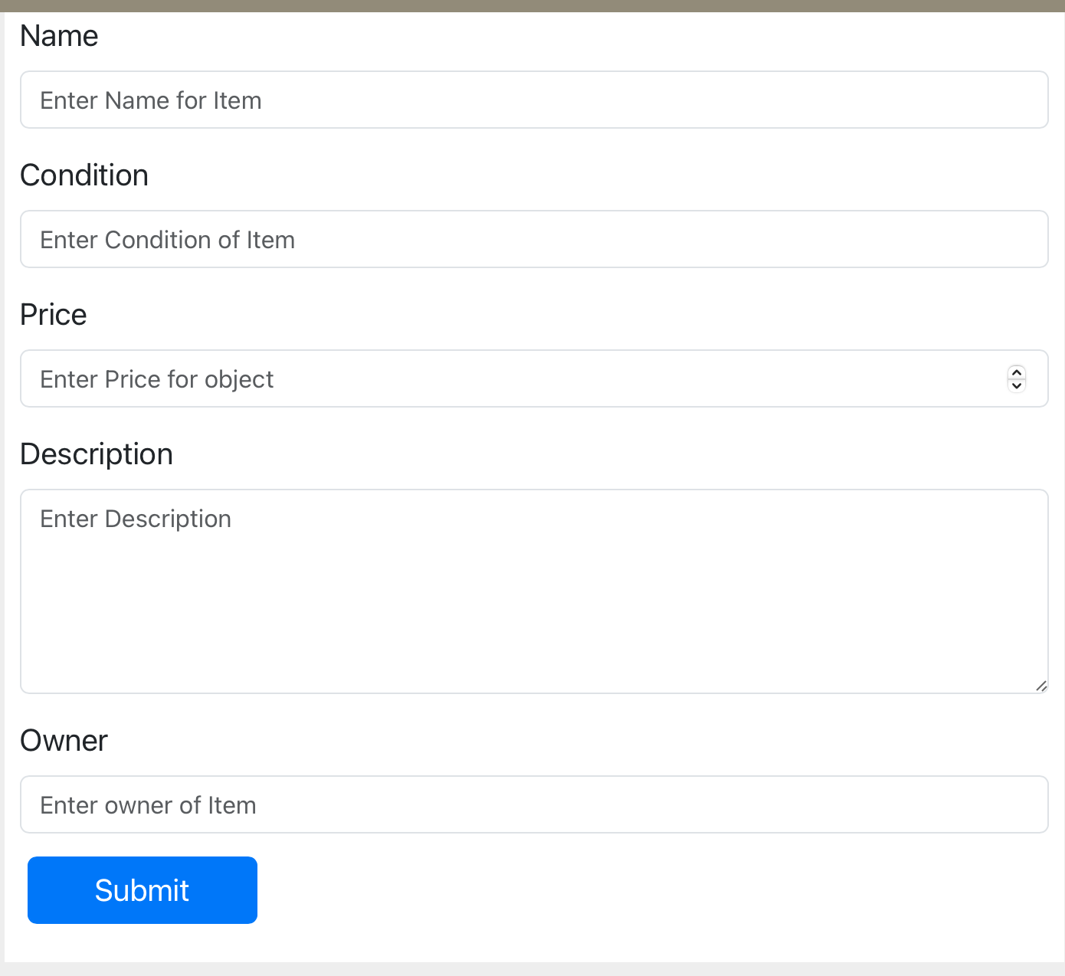
Add/update/Remove equipment
Features to view the items from the equipment database
Ability to add items by filling out a form
Each item comes with a Remove and update button
Features to come:
Adding Permissions -> Only allowing the user that is logged in to affect their items instead of any item

Slide 10


STD
The team added manual tests for current functionality.
For future iterations, there will be more focus on integration tests and automated tests using selenium.
The team is using the following format for manual tests:
Test ID | Test Description | Dependencies | Input Data | Test Steps | Expected result | Actual Result | Pass/Fail
0001 | Save user email and password to database | Database in ElephantSQL connected | Email, Password | Go to Register page, Enter email, Enter password, Click Register | Entered user email and password is saved to database | User email and password saved to database | Pass

