Slide 1
Iteration 3 Rental Car Management (RCM)
Team Rocket (Team 6)
Alisa Belousova, Cangqing (Kris) Wang, Chenghao (Steven) Ye, Devon Dudley, and Nickolas Cruz

Slide 2
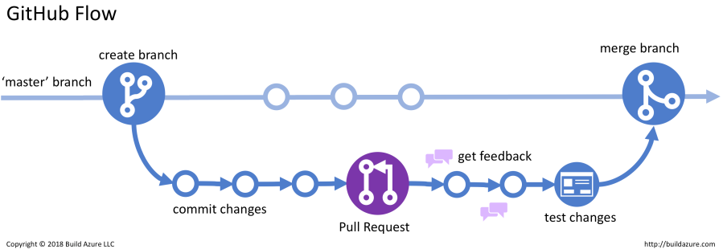
Development workflow: Github flow
Notes:
Github was set up to deploy to Vercel. Every pull request enforces successful deployment and good coding practices

Slide 3
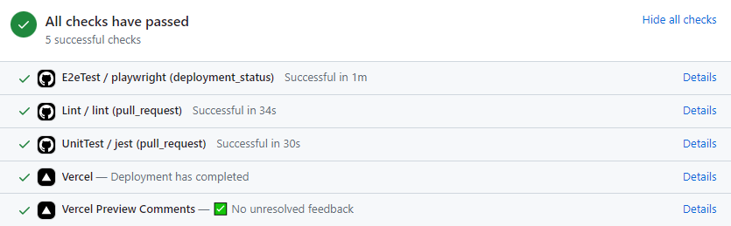
Code quality
Notes:
Github was set up to deploy to Vercel. Every pull request enforces successful deployment and good coding practices

Slide 4
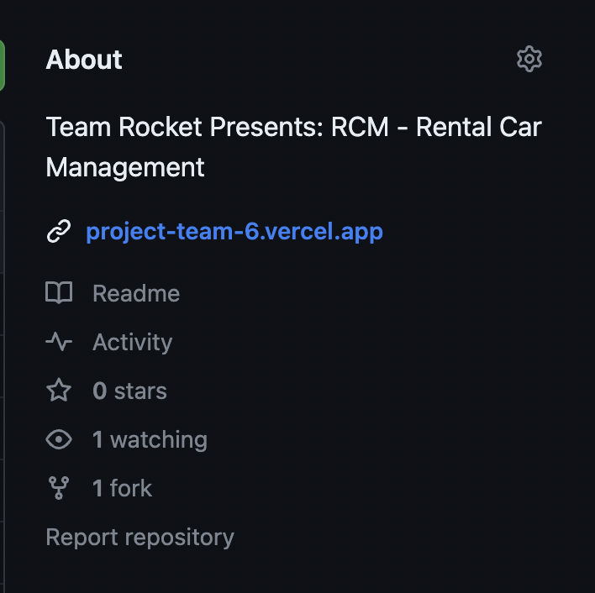
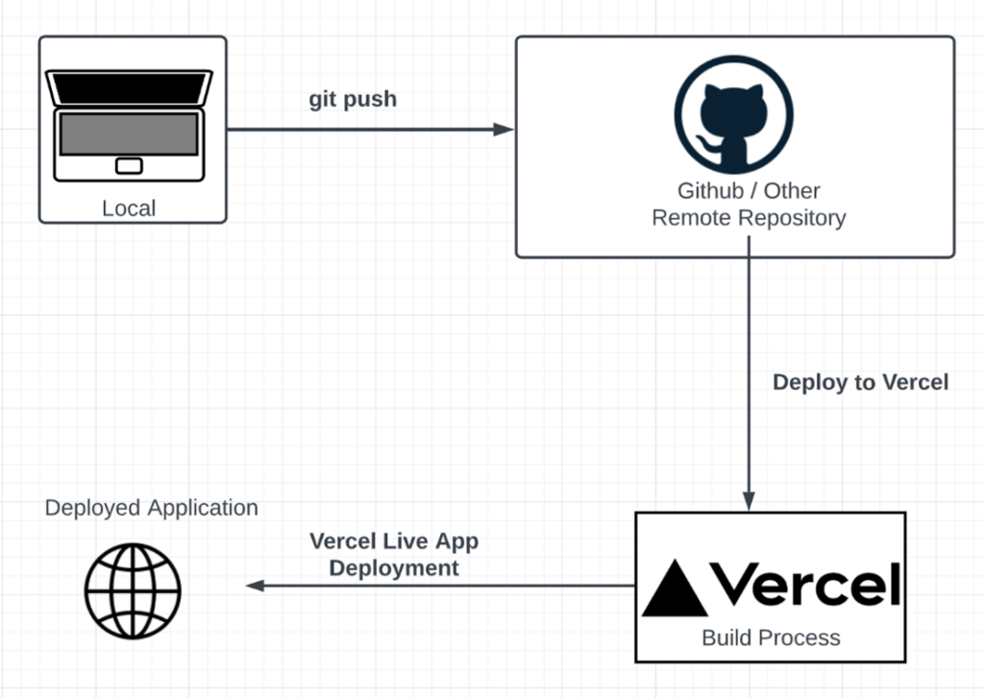
Deployment
Notes:
Github was set up to deploy to Vercel. Every pull request enforces successful deployment and good coding practices

