Slide 1
RCM Rental Car Management
Team Rocket (Team 6)
Alisa Belousova, Cangqing (Kris) Wang, Chenghao (Steven) Ye, Devon Dudley, and Nickolas Cruz

Slide 2
Project Overview: A business management system for rental companies.
RCM is made to be a business management tool to help rental companies simplify the upkeep of their inventory.
It is supposed to keep track of car details (such as make, model, number of seats, and car type)
In addition, it assists in management of maintenance of cars.
Ultimately, it should be used as an easy to navigate application to help the companies control their assets.

Slide 3
Related Work
There are many business management tools, such as Proofhub, bit.ai, and timely.
This led us to want to focus on a specific business and category, landing us on rental car management.

Slide 4
High Level Requirements
In this app we want to include these essential following functions:
An editor to edit vehicle information as needed
A database that will store all of the information of the vehicles
A search to find a vehicle’s data, or a vehicle based on make/model/type of vehicle/ID#
A tool to store maintenance (both past and future) that can also be edited.
We would also like to incorporate:
A calendar for the maintenance schedules that will can send reminders when needed
Security
A login, password and encryption to protect user data

Slide 5
Management Plan
We will develop the initial web pages
Ensure that each page can complete its main function
Then link the pages together so they can be easily traversed through
Create the database
Ensure the pages can access the database as necessary
Create a login and password security measure (including encryption)
Edit the site as needed to ensure simple and easy navigation

Slide 6
Risk Management
People leaving
2 people have already left the team/class
We will divide work as needed if this continues to occur.
Too large of a scope
We initially wanted to work on a different project and realized the scope would be too large given the time of the class and difficulty of the project
Should this be a problem with this project we will reevaluate what is necessary and cut down on unneeded features
Disagreements within the team
While disagreements will occur, we will attempt to work together as a group to discuss and vote if necessary to resolve our differences.

Slide 7
Timeline
We hope for the timeline to progress smoothly in the following manner:
Iteration 1: 20 hours each
Setting up the sites and working on connecting them to each other and the database will take time.
Iteration 2: 20 hours each
Here we wish to incorporate the security measures and if possible the calendar system as those will be complicated
Final Iteration: 10 hours each
Preferably we would like this to be primarily composed of additional, non-necessary functions that enhance the project, but are not needed.
Also work on any minor fixes or follow up on feedback

Slide 8
Tools
We will try and use a variety of tools to make our project flow smoothly
Git/Github
TailwindCSS
MERN
JIRA
Deployment app

Slide 9
Quality assurance plan
Metrics:
It is hard to come up with metrics as we have not begun working on the actual project to much of a capacity at this time. We will reevaluate as needed.
Coding standards
We will practice traditional practices, such as using indentation within nested functions, camelCase for functions names, and naming conventions to make easy to understand functions.
Code Review
We will help each other review code. This is not only limited to the team leader, as everyone might have a useful analysis that differs from one another.
Testing
We will both manually test, and can use outside tools, such as codePen or JSfiddle
Defect management
We can use tools within IDE’s, github, and use manual defect management as necessary.

Slide 10
A brief look
The following slides have a brief look into what the project might look like.
At this time much is subject to change, but we developed these wire frames on figma.com and hope to use them as a basis for the site.
Each slide has notes attached giving a brief description of what the page’s functions would be.

Slide 11
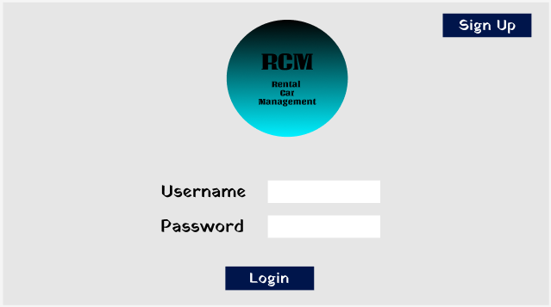

Slide 12
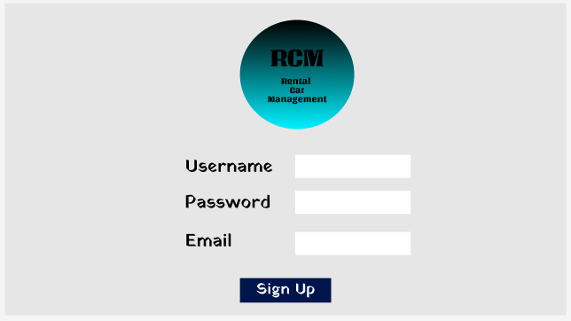

Slide 13
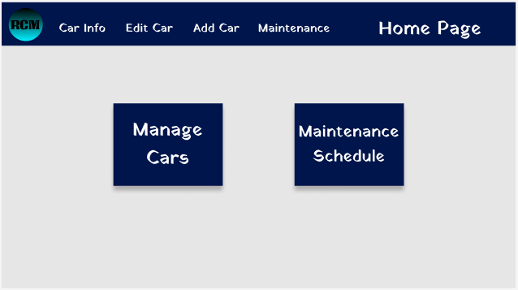

Slide 14
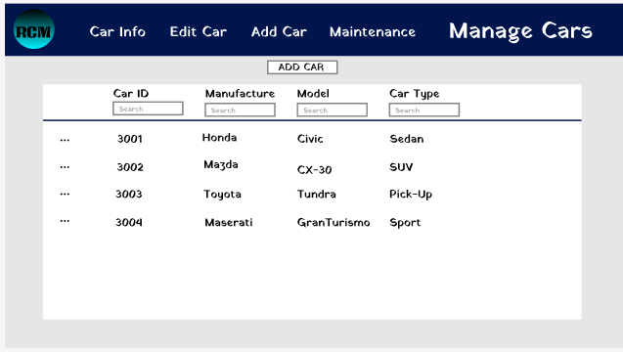

Slide 15
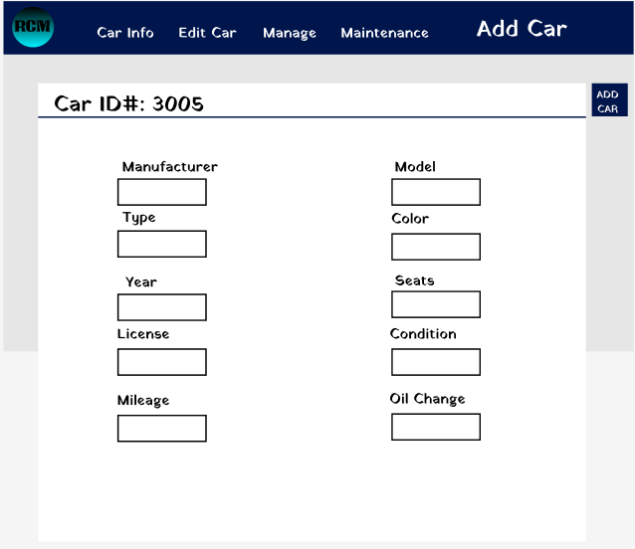

Slide 16
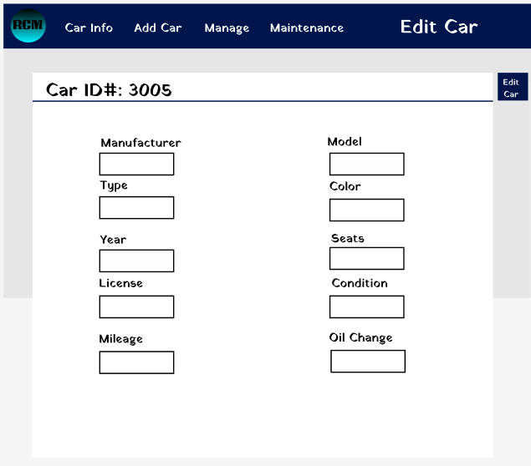

Slide 17
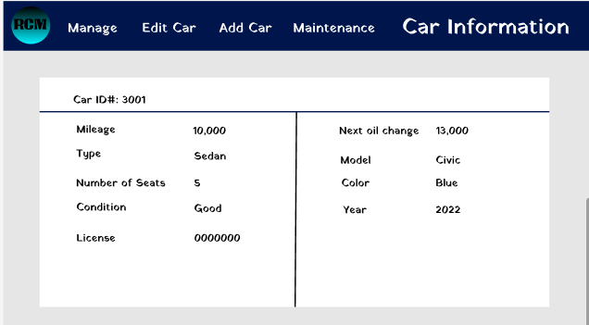

Slide 18
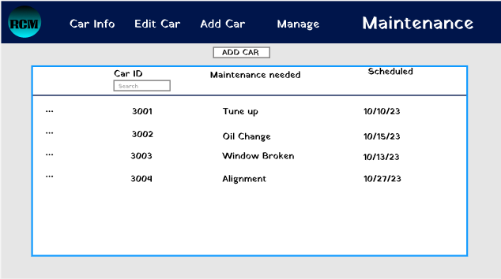

Slide 19
