Slide 1
Iteration 2 Rental Car Management (RCM)
Team Rocket (Team 6)
Alisa Belousova, Cangqing (Kris) Wang, Chenghao (Steven) Ye, Devon Dudley, and Nickolas Cruz

Slide 2
Development Goals:
Database integration
Develop user registration system
Implement form validation
Develop user login system
Implement session management
Conduct security testing
Conduct manual testing for registration and login
Develop Endpoints for API calls

Slide 3
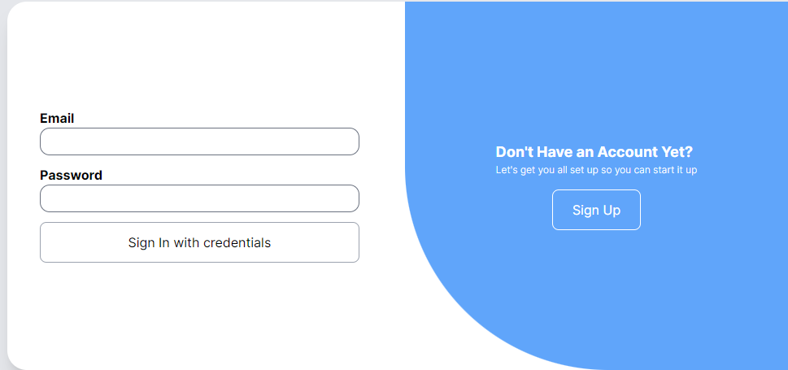
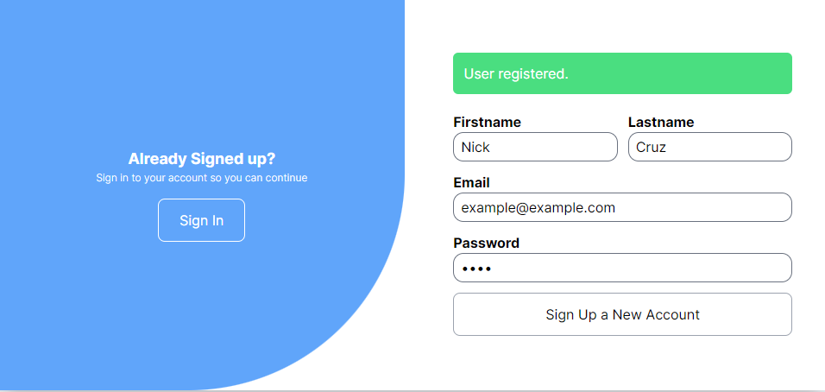
Development Achievements
Develop user login system
Input values are compared against database records
Develop user registration system
Input values are successfully inserted into the database
Password is hashed prior to storage in database

Slide 4
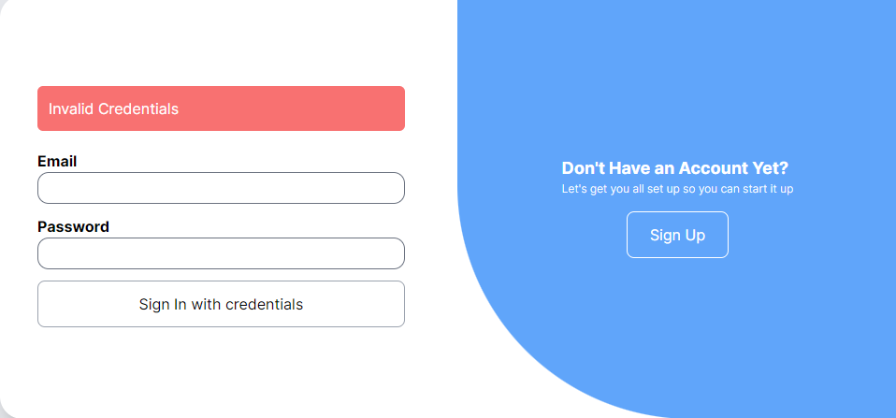
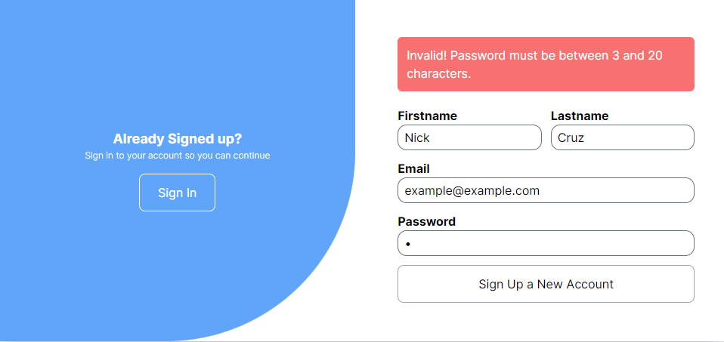
Development Achievements
Implement form validation
All fields are required for both sign in and sign up page
Passwords must be between 3 and 20 characters
Cannot register an email twice
Implement session management
Using JWT to keep track of session (in progress)
Unable to access rest of site without logging in
Notes:
We configured the handler to use JWT to manage sessions, but we do not yet have user sessions implemented across different pages

Slide 5
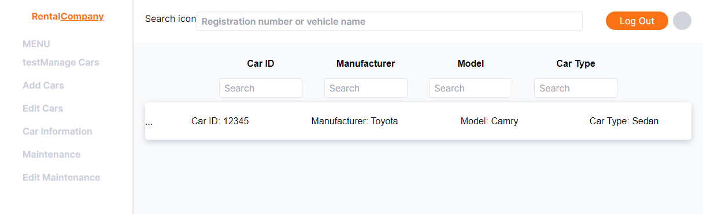
Development Achievements
Initial UI skeleton
Navigation (Layout, Formatting)
Car management page

Slide 6
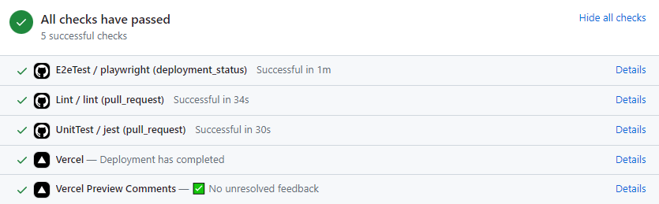
Development Achievements
CI/CD Configuration
Github integration with Vercel
Linting and Testing requirements
Notes:
Github was set up to deploy to Vercel. Every pull request enforces successful deployment and good coding practices

Slide 7
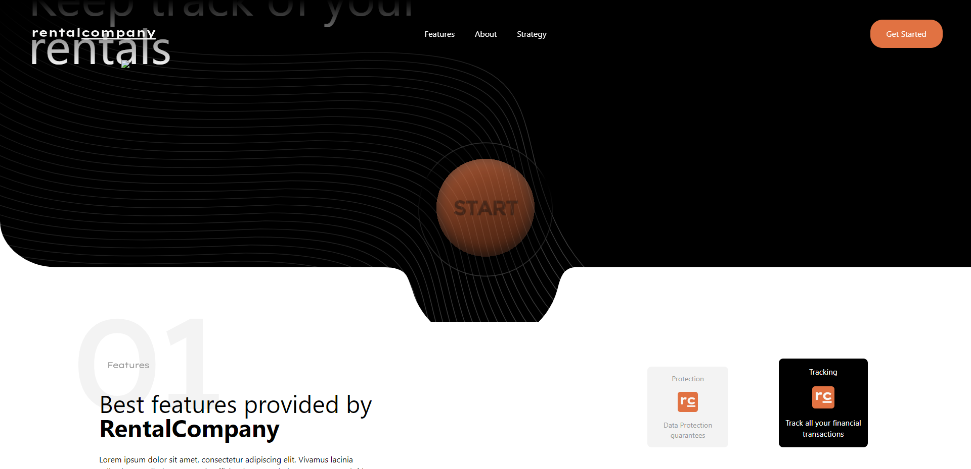
Development Achievements
Created home page
Backend endpoints
Add/Edit/Maintenance
Successfully connected and can:
Add/Create
Get car information
Edit car information

Slide 8
Future Work
Complete user session management
Develop the UI
Work on additional security features
Work on visual design of the site
Ensure connectivity and ease of use

