Slide 1
Iteration 1 Rental Car Management (RCM)
Team Rocket (Team 6)
Alisa Belousova, Cangqing (Kris) Wang, Chenghao (Steven) Ye, Devon Dudley, and Nickolas Cruz

Slide 2
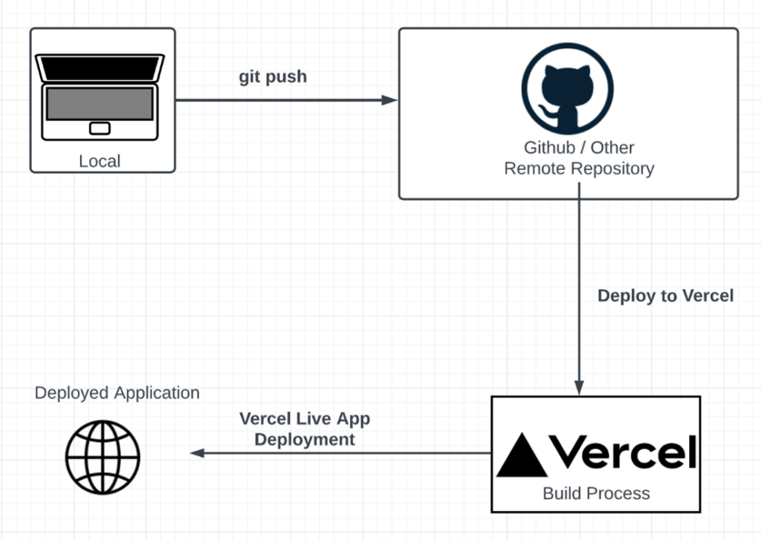
Architectural Design
NextJS
ReactJS Frontend
NodeJS Backend
MongoDB
Database storage
Vercel
Web hosting platform
Notes:
MERN – Mongo Database, Express, React, Node
NextJS is a consolidated NodeJS and ReactJS framework that has its own built-in server, which means we no longer need Express in our project
We are using Vercel as our web hosting platform, which as you can see from the architecture diagram on the right, is integrated with Github and allows for easy deployment to production

Slide 3
Development Goals:
Database integration
Develop user registration system
Implement form validation
Develop user login system
Implement session management
Conduct security testing
Conduct manual testing for registration and login

Slide 4
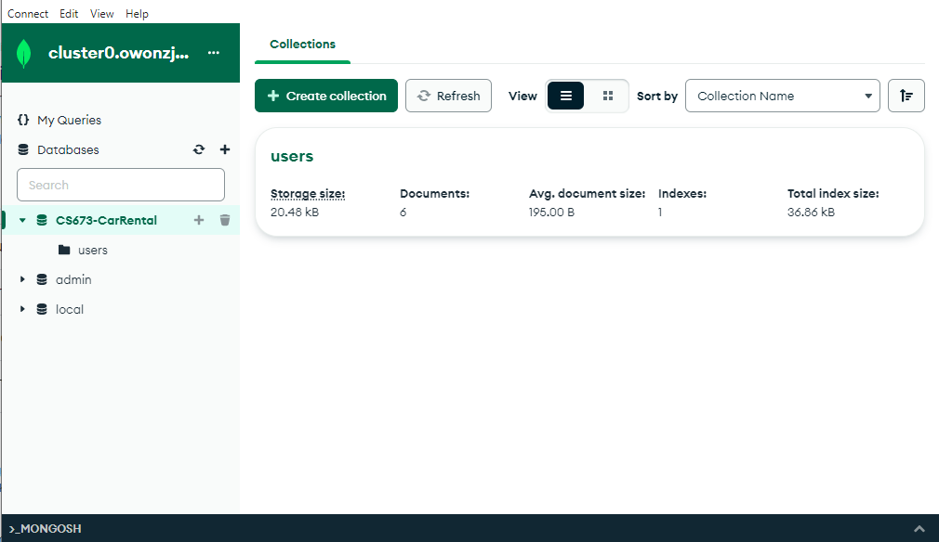
Development Achievements
Database integration
Database CS673-CarRental created
Collection Users created to store user information
firstname (string)
lastname (string)
email (string)
password (string)
date (date)
Notes:
Collection > Documents

Slide 5
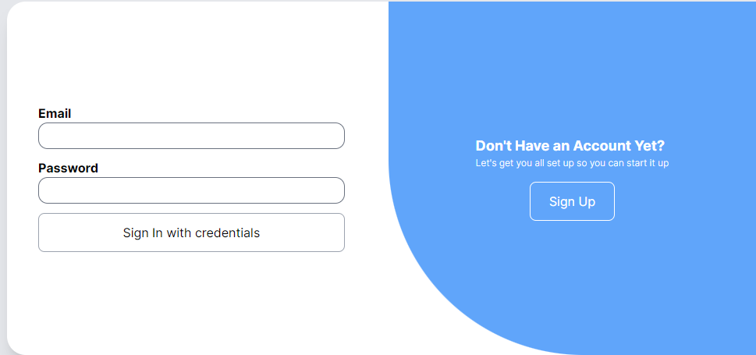
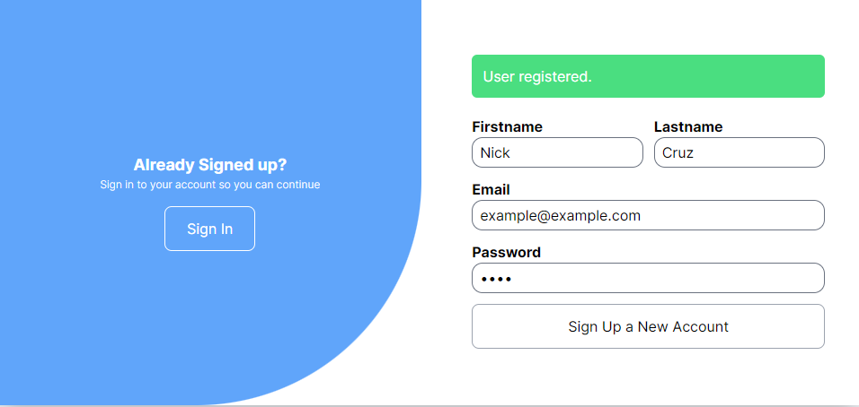
Development Achievements
Develop user login system
Input values are compared against database records
Develop user registration system
Input values are successfully inserted into the database
Password is hashed prior to storage in database

Slide 6
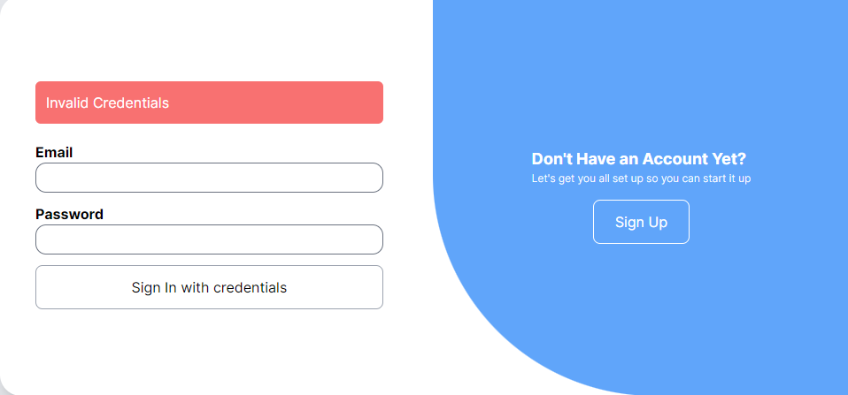
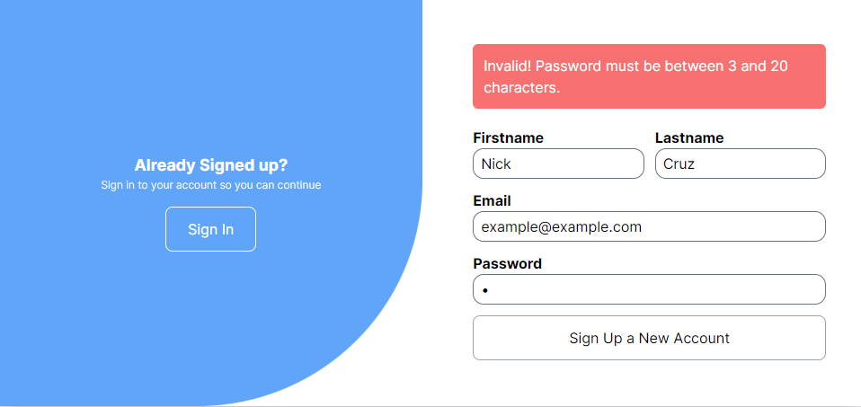
Development Achievements
Implement form validation
All fields are required for both sign in and sign up page
Passwords must be between 3 and 20 characters
Cannot register an email twice
Implement session management
Using JWT to keep track of session (in progress)
Notes:
We configured the handler to use JWT to manage sessions, but we do not yet have user sessions implemented across different pages

Slide 7
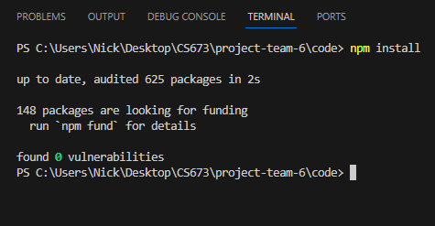
Development Achievements
Conduct manual testing for registration and login
Successful user creation and login validation
Conduct security testing
0 Vulnerabilities Found

Slide 8
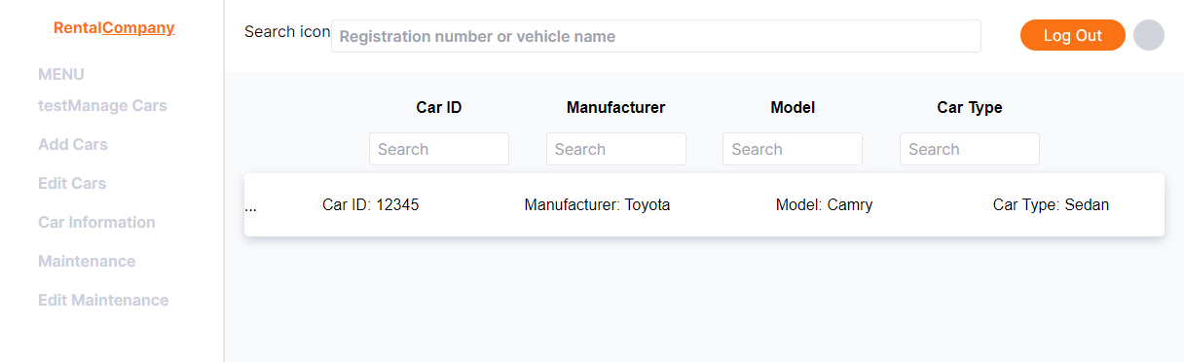
Additional Development Achievements
Initial UI skeleton
Navigation (Layout, Formatting)
Car management page

Slide 9
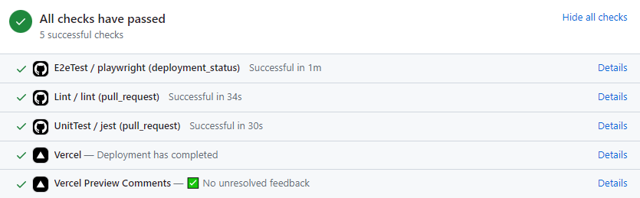
Additional Development Achievements
CI/CD Configuration
Github integration with Vercel
Linting and Testing requirements
Notes:
Github was set up to deploy to Vercel. Every pull request enforces successful deployment and good coding practices

Slide 10
Future Work
Complete user session management
Complete the Car Management Page
Develop Add Car page
Develop Edit Car page
Develop Maintenance page
Develop Edit Maintenance page

