Slide 1
TeamFirst
Initial Presentation Iteration 0 - Notification Management
Refer: https://github.com/BUMETCS673/project-teamfirst for our latest files and minutes
Notes:
Our vision as driven by Jordany was that we would combine with the other groups for the purpose of providing various microservices that would all later be coupled together to provide a larger offering. As a team we took on the Notification Management system.

Slide 2
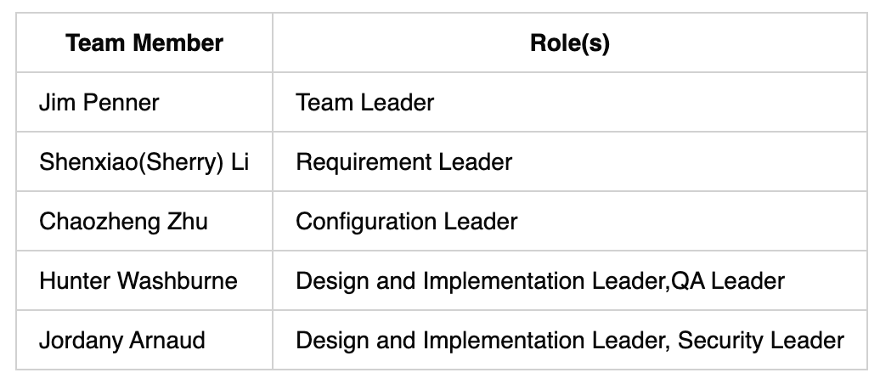
Team Members & Responsibilities

Slide 3
Project Overview
Our contribution to the Online Learning Platform involves creating a “Notification Service.” This service is important for our project-based learning platform. It helps to share information easily within the university, making communication smoother and increasing student engagement.
Purpose and Motivation
In a learning environment where activities and interactions are always changing, it's important to have updates and alerts in real-time. Our goal is to meet this need by creating a strong notification system. This system will give users timely information about important events, changes, or updates related to their roles in the learning platform.
Our purpose is to make communication and information sharing easier among everyone in the university community. We plan to do this by using microservices architecture and RESTful APIs. Our service will be flexible and scalable, allowing notifications to be sent through various channels like SMS and email. Our aim is to make sure users have a better experience, stay engaged, and collaborate more effectively by keeping them informed about what's happening in the learning platform.

Slide 4
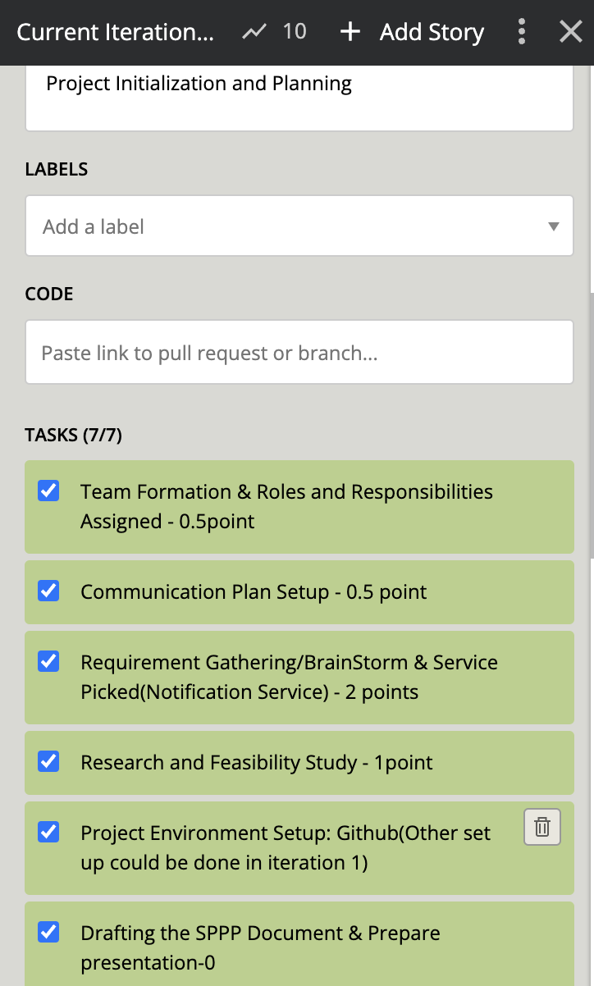
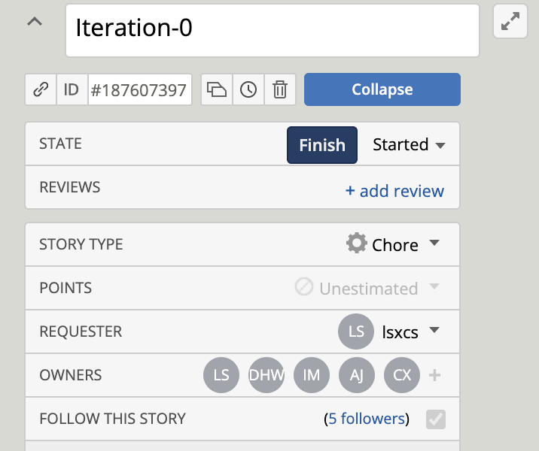
Project progress tracking tool - pivotal tracker
Notes:
We use pivotal tracker https://www.pivotaltracker.com/n/projects/2703926
as our the project progress tracking tool. Within each iteration, we prioritize tasks and divide into subtasks with status and owners.Every interation we will have planning, execution, review, and retrospective steps.

Slide 5
Iteration Overview & Mgr plan –Sherry
We will prioritize the core functionalities first, followed by desirable and optional features if time permits.
Iteration Breakdown Overview:
Iteration 1:
Set up Development Environment(Spring Boot, RabbitMQ, MongoDB)
Register a Service
Create Notification Rule
Create Template
Iteration 2:
Configure Notification Preferred Channels
Send Notification & View Notification
Track Notification Delivery Status(Optional Feature)
Iteration 3:
Buffer time for testing and bug fixes
Aggregation & Deployment
Security Features spread across iterations. Optional features can be implemented if there is remaining time or during buffer periods in the iterations.
Notes:
In addition to the Notification service, we will also implement an API gateway using Spring Cloud Gateway. This gateway will serve as a centralized entry point for the notification service and all our other services.

Slide 6
Configuration Plan–Chaozheng
We will use Git and Github for Version control
Intellij will be IDE tool
‘CI/CD will use github action
Docker will be our container
SAST, DAST TBD
Code Commit Guideline and Git Branching Strategy
Each person should have a sub branch ( normally is their own name)
Each developer link their local code with our cloud one use code:
git remote add upstream https://github.com/BUMETCS673/project-teamfrist
Every time begin coding, make sure pull code from upstream to main branch
Main branch should onlys used to pull, push is based on your name branch
git pull upstream main
Then align name branch code same as main branch
Git merge main
When completed new feature coding:,
Git add.
Git commit -m’ your change message’
Git push origin <name-branch_defined_by_yourself>
Go to github repo page, find and click the pull request button
Click and send pull request

Slide 7
Testing and Quality Assurance
Coding Standard
Our team will be using the Google Java code style, with Java standard naming conventions.
Code Review Process
Owner of each feature writes code, then weekly we meet and owners explain their code and everyone comments on Zoom (recorded).
Testing
Everyone will write unit tests using JUnit5 for their own code, while the QA lead (Hunter) will focus more on functional and end-to-end (integration) testing.
Unit tests will be run daily.
Functional testing will be run as components are brought into a somewhat feature complete state.
Integration testing (probably using Postman) will be performed as the other teams (UI, etc.) start to deliver their beta products.
Defect Management
Bugs will be tracked on Pivotal Tracker, along with all of the rest of the project.

