Slide 1
ResumeAI- ATS-Like Resume Reviewer
CS673 Software Engineering | Team 4

Slide 2
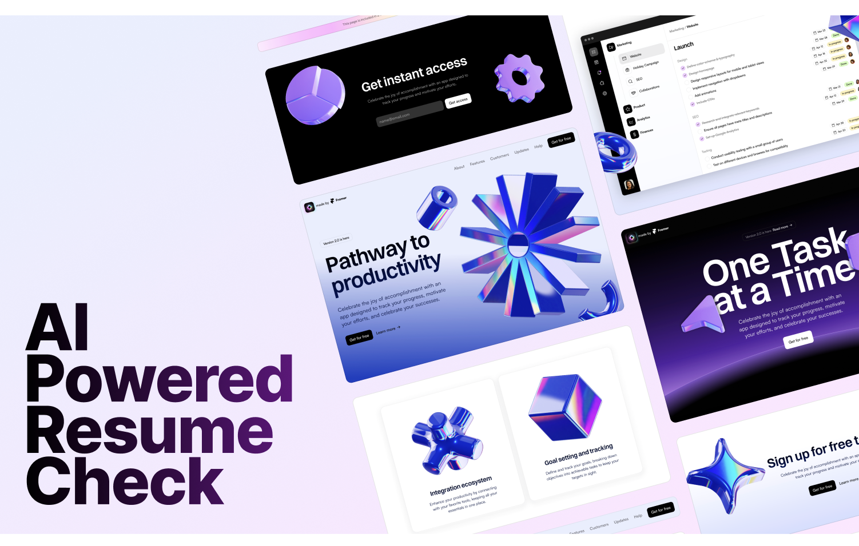

Slide 3
Overview
ResumeAI is an ATS-like resume reviewer providing advanced analytics for both recruiters and applicants.
Recruiters get ranked resumes based on Job Descriptions (JDs) and insights for decision-making.
Applicants can upload resumes and receive feedback for improvement.
Both have personal dashboards with analytics to improve the recruitment process.

Slide 4
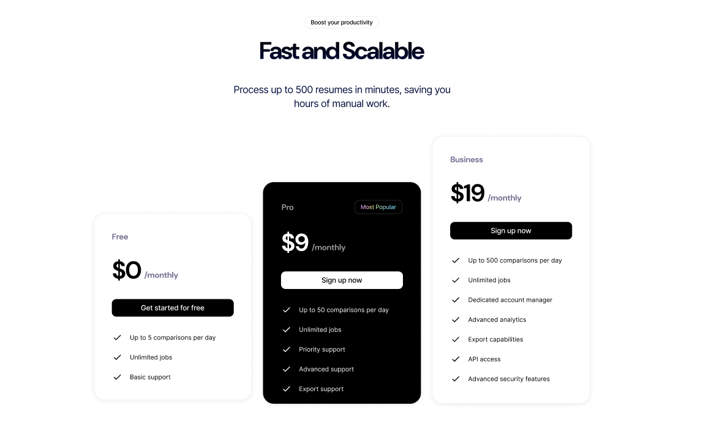

Slide 5
Motivation
Job applicants often face unclear insights about their competencies and recruitment criteria.
Recruiters spend only 6-8 seconds per resume, leading to a lack of thorough evaluation.
ResumeAI aims to enhance transparency for applicants and offer recruiters tools to better shortlist candidates.
A more streamlined lifecycle ensures better matches between job descriptions and candidates.

Slide 6
Purpose
12.4 million Americans are estimated to be searching for jobs in the upcoming year.
Recruiters spend minimal time reviewing resumes, and applicants take an average of 5 months to find jobs.
ResumeAI aims to reduce this inefficiency by providing better insights for both recruiters and applicants, increasing job matches and ensuring a fair recruitment process.

Slide 7
Potential Users
All job seekers, ranging from entry-level to experienced professionals.
Recruiters looking for a tool to efficiently evaluate and rank resumes based on job descriptions.

Slide 8
Basic Functionality
Upload resumes and job descriptions (JDs) for detailed analysis.
Rank resumes based on how well they match a JD.
Provide applicants with analytics to help them improve their resumes.
Personal dashboards for both recruiters and applicants to manage information.

Slide 9
Functional Requirements (1)
Signup: As a recruiter or an applicant, I want to create an account so I can access the dashboard.
Login: As a user, I want to log in and view the custom dashboard for my profile.
Manage account and subscription: View and manage profiles, subscription plans, and more.

Slide 10
Functional Requirements (2)
Analytics and metrics: View analytics such as the number of resume uploads, remaining uploads, and more.
Resume upload: Upload resumes for further analysis.
JD upload and score: Upload job descriptions and match them with resumes for scoring.

Slide 11
Functional Requirements (3)
Resume analysis (Applicant): View a detailed analysis of resumes against JDs to improve them.
Resume analysis and ranking (Recruiter): Recruiters can rank resumes based on JD scores to find the best matches.

Slide 12
Desirable Features
Keyword search: Recruiters can search for resumes based on specific keywords or tags.
Best resumes: Filter and get the best resumes from the system for a specific job description.

Slide 13
Optional Features
Job listing management for recruiters, allowing them to upload and manage job listings.
Applicants can view job listings and apply for them.
AI-powered resume editing to help applicants tweak resumes for better JD matches.

Slide 14
Nonfunctional Requirements
User and platform security: Protect data from unauthorized access and threats like DDoS attacks.
Reliability, maintainability, availability, and performance to ensure minimal downtime and high operational efficiency.

Slide 15
Tech Stack
React, Fastify(NodeJS), TypeScript
Docker, PostgreSQL
GitHub Actions, AWS ECS, AWS Cloudwatch

Slide 16
Configuration Management Plan
Tools: Git and GitHub for version control.
Code Commit Guideline: Follow strict branching strategies, pull request reviews, and code formatting standards.

Slide 17
CI/CD Plan
Use Docker containers via AWS ECS.
Continuous deployment through GitHub Actions for smooth deployment and management of updates.

Slide 18
Quality Assurance Plan
Use metrics such as lines of code (LOC), cyclomatic complexity, defect density, test pass rates, and story completion rates to monitor quality.
Mandatory code reviews for all pull requests, with at least two team members approving before merging.

Slide 19
Testing
Unit testing is required for all code, measured by code coverage.
Integration testing using GitFlow to ensure all features work well together.
React-specific tests to ensure UI matches Figma designs.

Slide 20
Defect Management
Critical defects, like login failures, are treated as release blockers.
Feature design mismatches and small bugs are handled in subsequent iterations.

Slide 21
Risk Management
Identified risks include cybersecurity threats, data breaches, platform downtime, and user error.
A risk management plan will be continuously updated in a Google Sheet.
The team will regularly monitor and mitigate identified risks.

Slide 22
Timeline
Iteration 0: Setup, planning, and initial tasks such as defining functional requirements and tech stack.
Iteration 1-3: Gradual implementation of core and optional features, testing, and integration.
Continuous updates to the timeline as new iterations progress.

