Slide 1
Team 6
FitFusion - Work out Recording website
2024.10.17
CS673 FA2024
ITERATION 1

Slide 2
Team 6
Team Members
Haoran Zheng | Team Leader
Yunrui Huang | Configuration Leader
Chengqin Li | QA Leader
Jiankun Dong | Design and implementation Leader
Yuhan Pan | Requirement Leader
Hangqi Wu | Security Leader

Slide 3
CONTENT
01 ITERATION 1 OVERVIEW
02 FRONTEND ARCHITECTURE
03 BACKEND ARCHITECTURE
04 NEXT STEPS

Slide 4
Iteration 1 Overview
Refine requirements
Set up configuration environment for frontend(Vue), backend(Node.js), database(MySQL),Git, Docker
Implement basic functions (User Login, Exercise Guides, Record Training)
Complete some basic functional tests
Refine jira's user story and goals for next time

Slide 5
Implemented User Stories
User create account and login
Exercise recording
Video illustration
Notes:
Hey everyone! I’m excited to share the core features and technical plans for our fitness platform.
1. User Registration and Login
Users can sign up quickly using OAuth for Google or Facebook logins, ensuring a smooth and secure process.
2. Personalized Fitness Plan (ChatGPT API)
We’ll use the ChatGPT API to generate personalized workout plans in real time, making it feel like users have their own virtual coach.
3. Exercise Tracking
Users can log workouts and track progress, updated instantly with real-time database management.
4. Push Notifications
Reminders and progress tips will be sent using Cloud Messaging system to keep users engaged.

Slide 6
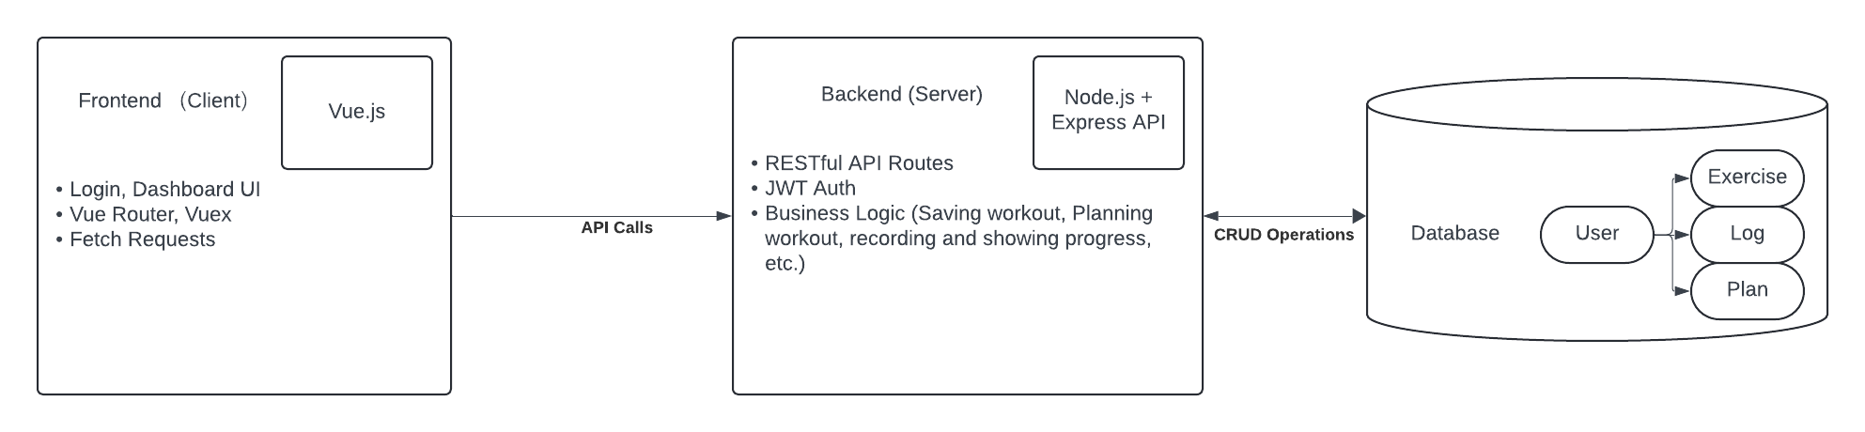
Overall Architecture

Slide 7
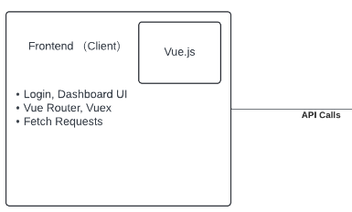
Frontend Architecture

Slide 8
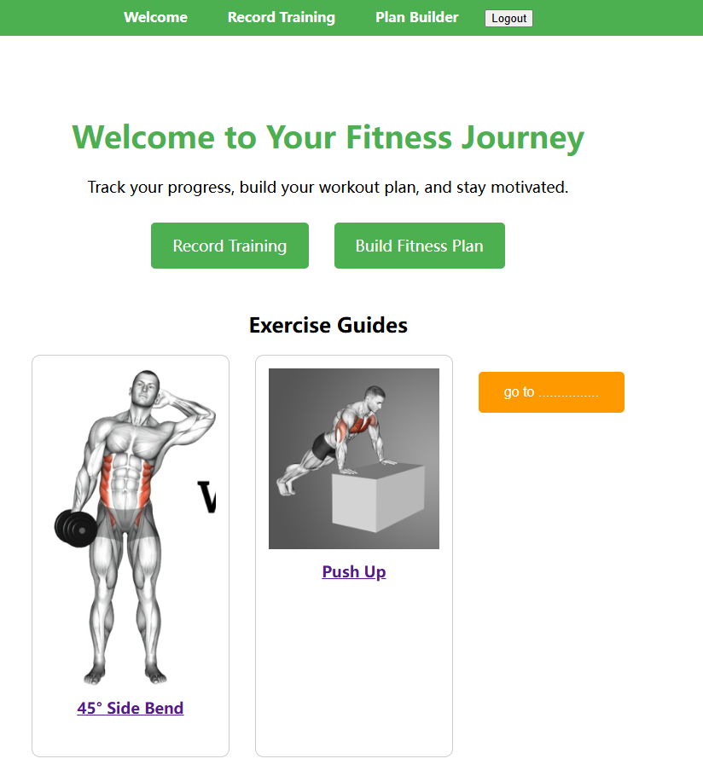
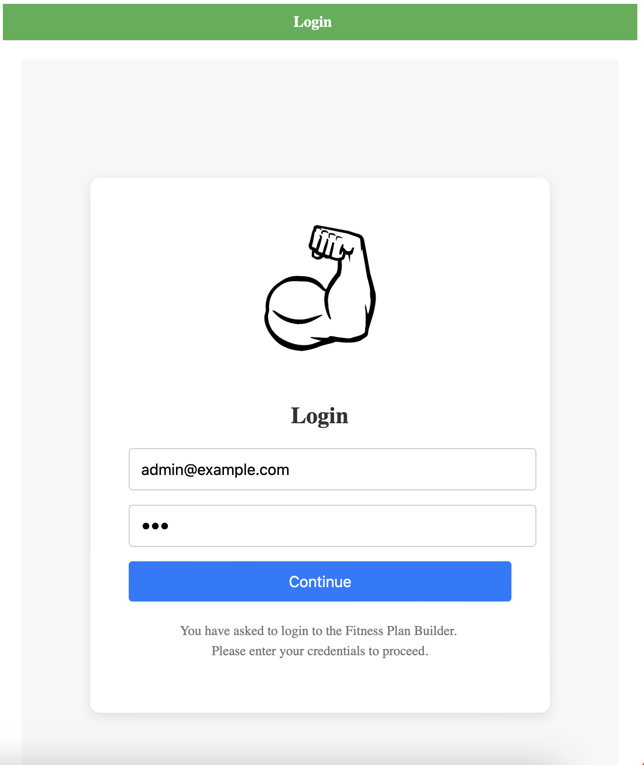
Frontend Architecture
The user login function has been completed and tested with the existing test.
Entering the "Welcome" interface, you will see the display of some fitness movements, as well as the options of "Record Training" and "Build Fitness Plan".

Slide 9
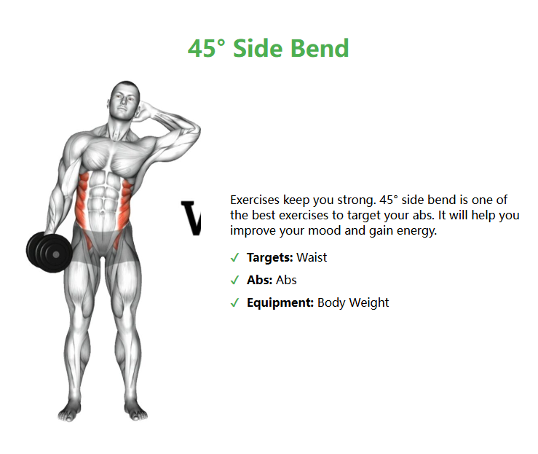
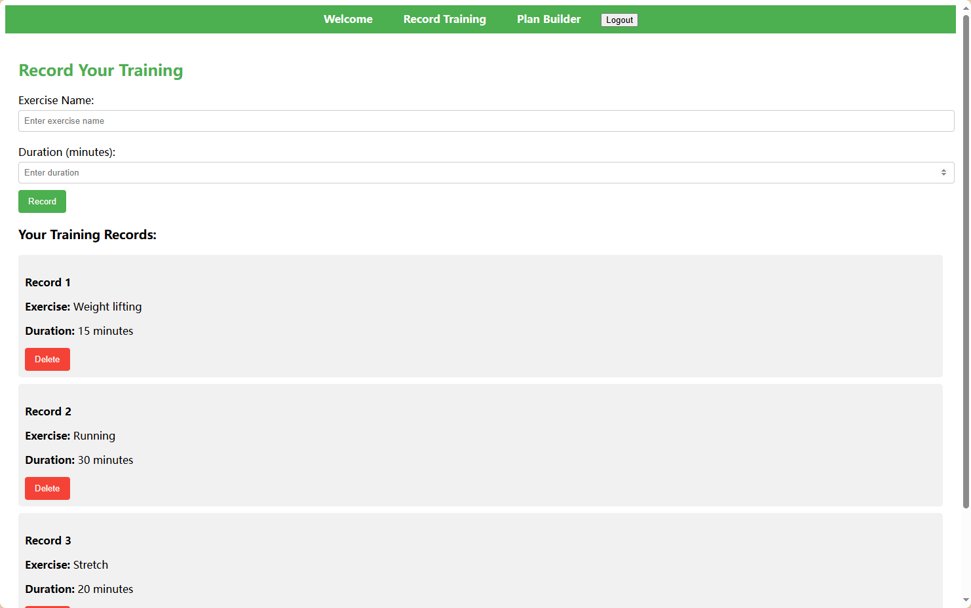
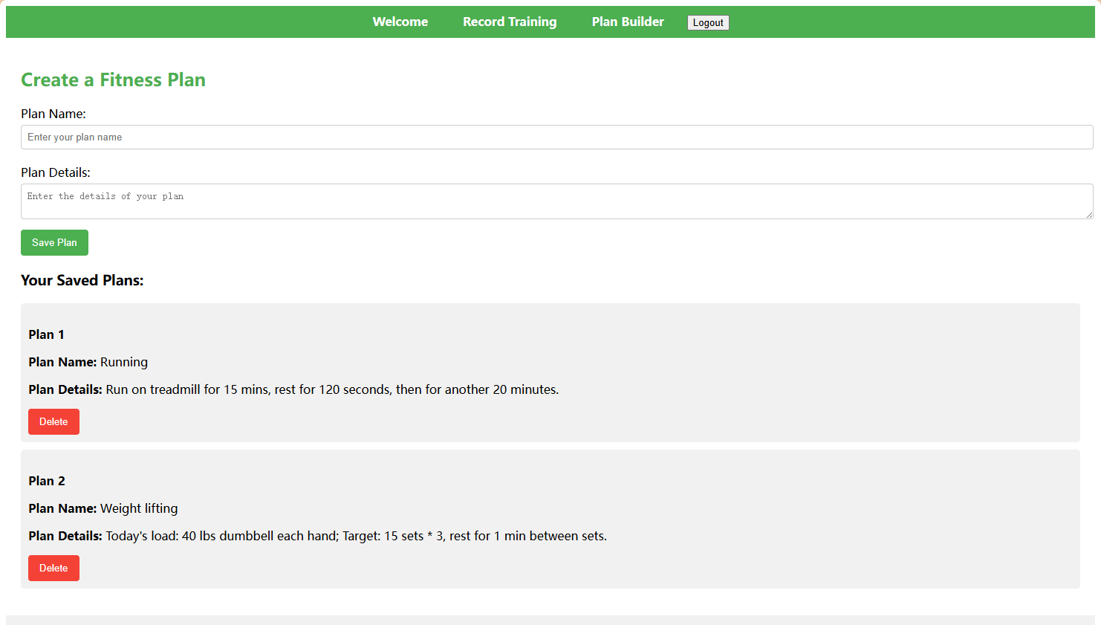
Frontend Architecture
There will be detailed explanations and examples of exercises (dynamic diagrams) for fitness movements.
The "Record Your Training" page can record your exercise and exercise time today.
The "Fitness Plan" page can record what specific movements you want to do and a detailed description of this action.

Slide 10
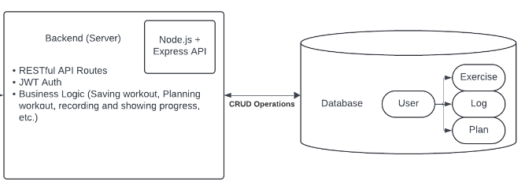
BACKEND ARCHITECTURE
What we use for backend: NodeJs + Express API

Slide 11
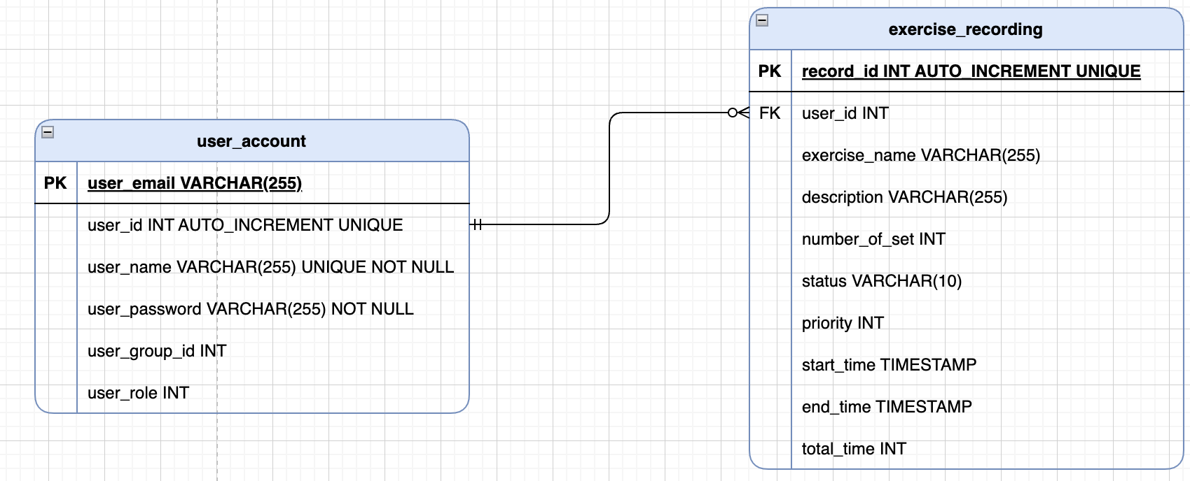
Database and tables

Slide 12
How we verify the account
createToken(userid): token
checkToken(token):userid
createToken: take userid -> generate token
checkToken: verify the token -> return associated userid and boolean value
Notes:
Desirable Features
1. Video Support (YouTube Link Integration)
We’ll embed YouTube workout videos’ Link directly into the web app, providing users with easy access to expert content.
2. Social Interaction
This interaction helps keep users motivated and accountable by connecting them with others on similar fitness journeys,
Users can comment, like, and share progress via a real-time social feed for community engagement.
Optional Features
1. Integration with Wearable Devices
API integration with Fitbit or Apple Watch will allow users to sync their health data.
this feature is optional as not all users will have or need wearable devices.
However, for those who do, API integration allows them to sync their health data for more precise tracking.
2. Workout Suggestions
Actually we’ll leverage chatgpt api, so it’s optional for using machine learning to recommend new workouts based on user performance.
3. Fitness Challenges and Competitions
Users can join challenges and compare progress with friends using a gamification system. this feature is optional
Not every user is motivated by competition. It’s perfect for users who enjoy a competitive element
Conclusion
By leveraging tools like ChatGPT and YouTube, we’re creating an interactive and personalized fitness experience that keeps users engaged and motivated.

Slide 13
Testing
Test for login:
we use our account.
input our email account and password
then click continue button
login successfully
- Test for recording training:
- enter exercise name and duration
- then click record
- the recording message will be showed beside
- Test for fitness plan
- input plan name and plan details
- then save the plan
- the saving message will be showed beside

Slide 14
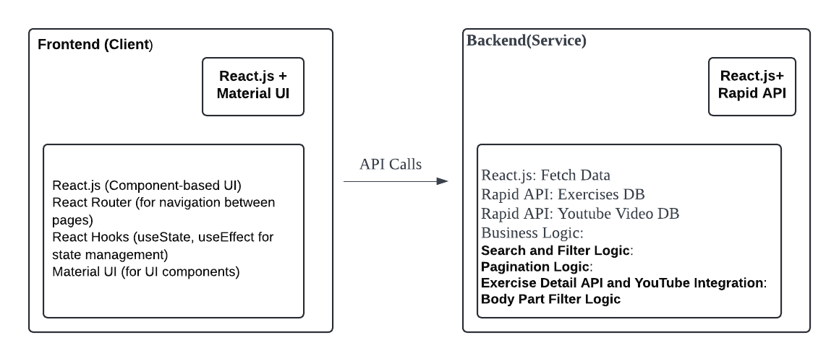
Video and Illustration Support
Notes:
In our frontend, we leverage React.js for a component-based user interface,and React Router to manage navigation between pages, allowing easy access to different functionalities within the app.
For state management and lifecycle methods, we rely on React Hooks, such as useState and useEffect
Our UI design and components are built using Material UI, which provides a polished, user-friendly interface.
Our backend is built using React.js and integrated with Rapid API services to fetch data from external sources. We connect to two main APIs: the Exercises Database and the YouTube Video Database, providing exercise details and related videos.
Search and Filter Logic: This allows users to efficiently search for exercises based on body parts or equipment and filter the results accordingly.
Exercise Detail and YouTube Integration: When a user selects an exercise, we pull detailed information and related videos directly from the API for a richer experience. But Currently this functionality is not implemented yet, so it will be set in the next iteration.

Slide 15
User Stories
Search Exercises: User inputs search terms or selects a body part to filter exercises.☑️
View Exercise Details: User clicks on an exercise to view more detailed information about the exercise, including related YouTube videos.
Navigate Exercises: User uses pagination to browse through multiple exercises, ensuring that they can find the desired exercise easily.

Slide 16
Testing
Given I am on the search exercises page,When I enter a search term and click the search button,Then I should see a list of exercises in the “Showing Results” section with dynamic images of each exercise. I should also be able to retrieve the data by selecting the Body Part Exercises Card.☑️
Given I am on the exercise detail in the exercise card ,When I click on an exercise,Then I should see an embedded video that demonstrates the exercise.
Notes:
In the current implementation, the first feature, where users can enter a search term and see a dynamic list of exercises with images in the “Showing Results” section, is working. Additionally, users can retrieve data by selecting the body part exercise card. However, we are still refining and optimizing it for a smoother experience.It supposes to have more than 1000 illustrations with different body part in the next iteration.
For the second feature, which involves embedding a demonstration video on the exercise detail page when a user clicks on an exercise, this functionality is planned for our next update. It will be integrated soon to provide users with more detailed workout guidance.

Slide 17
Plan for next Iterations
Push notifications: Each time users build their own plan, we should put notifications at right time that users built with the description.
Build calendar: Let users to build their own calendar, for example, users want to do what exercises at what time.
Authorization integration, apply JWT for encryption
Update to follow MVC design principle

Slide 18
Team 6
FitFusion - Work out website
CS673 FA2024

