Slide 1
Team 6 - Iteration 3
FitFusion - Work out Recording website
2024.12.5
Presenter: Haoran Zheng, Jiankun Dong, Yuhan Pan, Hangqi Wu, Chengqin Li,Yunrui Huang
CS673 FA2024
ITERATION 3

Slide 2
Team 6
Team Members
Haoran Zheng | Team Leader
Yunrui Huang | Configuration Leader
Chengqin Li | QA Leader
Jiankun Dong | Design and implementation Leader
Yuhan Pan | Requirement Leader
Hangqi Wu | Security Leader

Slide 3
CONTENT
01 Requirement Analysis
02 Overall Design
03 Implementation
04 Deployment
05 Testing
06 Security

Slide 4
Requirement Analysis
FitFusion: Fitness Tracking Web App
Pain Points Solved:
Inconsistent progress tracking
Lack of personalized guidance
Missed workouts due to poor reminders

Slide 5
Requirement Analysis
Achieved functional requirements:
User registration and login.
Create fitness plan.
Fitness records and progress tracking.
Push notification reminders.
Video and Illustration Support.

Slide 6

User registration and login.
As a user, I want to have a secure and easy-to-use login function so that I can access my fitness tracking data and progress.
Given I am a registered user, when I enter my username and password on the login page and click login, then I should be authenticated and taken to my personalized dashboard showing my fitness data.

Slide 7
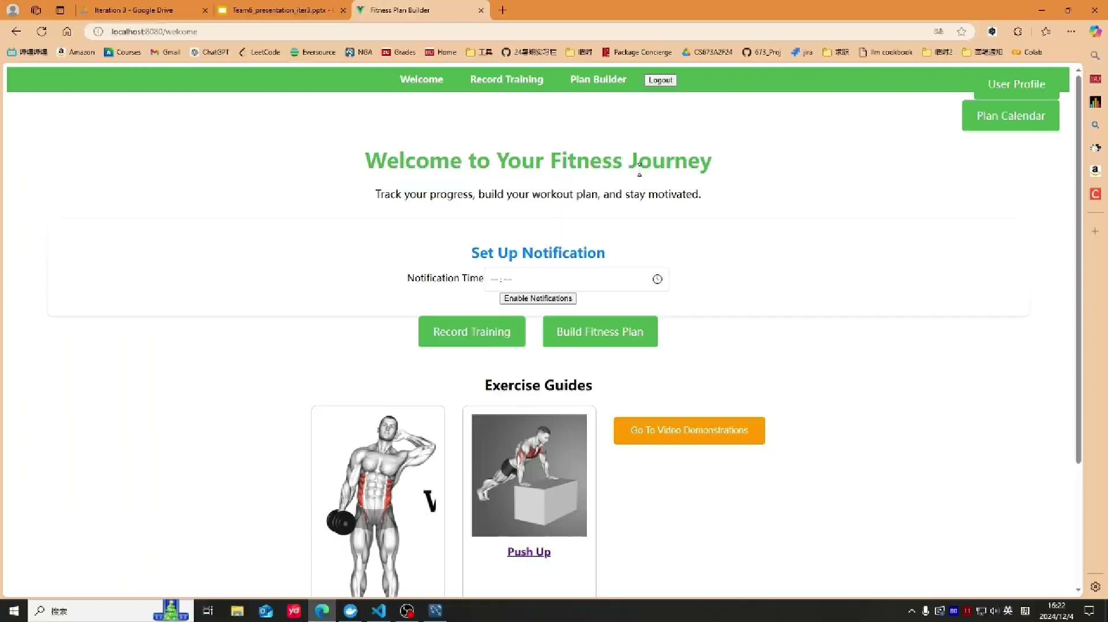
Push notification reminders
As a user, I want to receive a push notification reminding me of my scheduled gym exercises the day before they are due,
so that I can stay consistent and prepare for my workout in advance.
Given the user has set a specific reminder time (e.g., 8 PM the day before),
When it is 8 PM on the day before the scheduled workout,
Then the app should send the notification at the specified time.

Slide 8
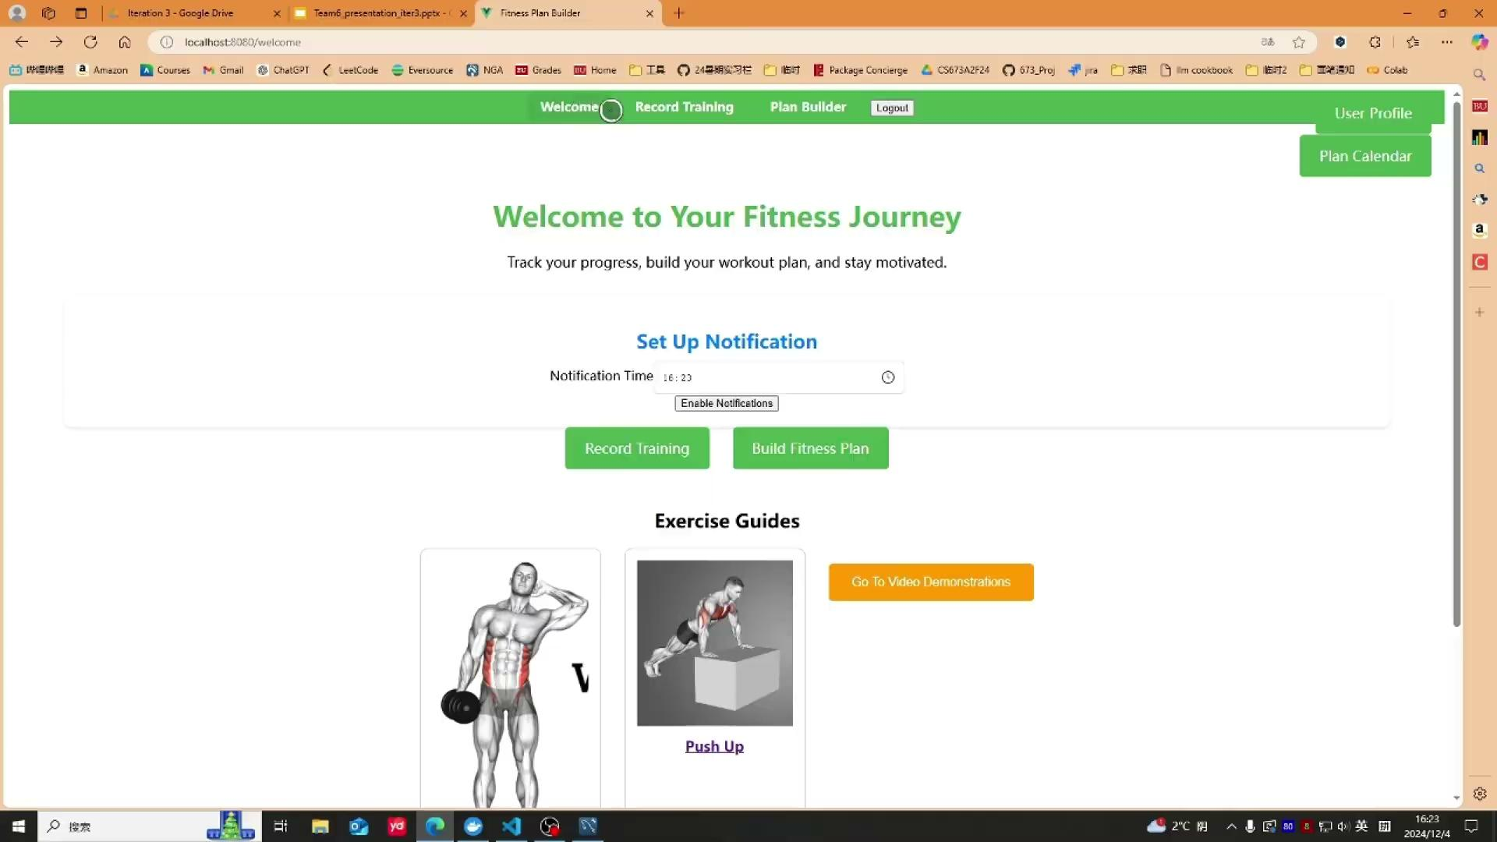
Fitness records and progress tracking.
As a user, I want to log my exercise duration and intensity so that I can monitor my fitness progress and make adjustments to my workout schedule.
Given I have successfully logged a workout, when I return to my dashboard, then I should see a list of my logged exercises along with the duration and intensity for each.

Slide 9
Create fitness plan.
Given I’m at the Create fitness plan page, when I select a certain date to record my exercise items on that day, then it will be correctly stored and displayed for me to reference.
In this page, you can select exercise ID, title,description, time, priority, intensity to create your own fitness plan, it will be displayed in the record data page, and will remind you the exercise content on that day

Slide 10
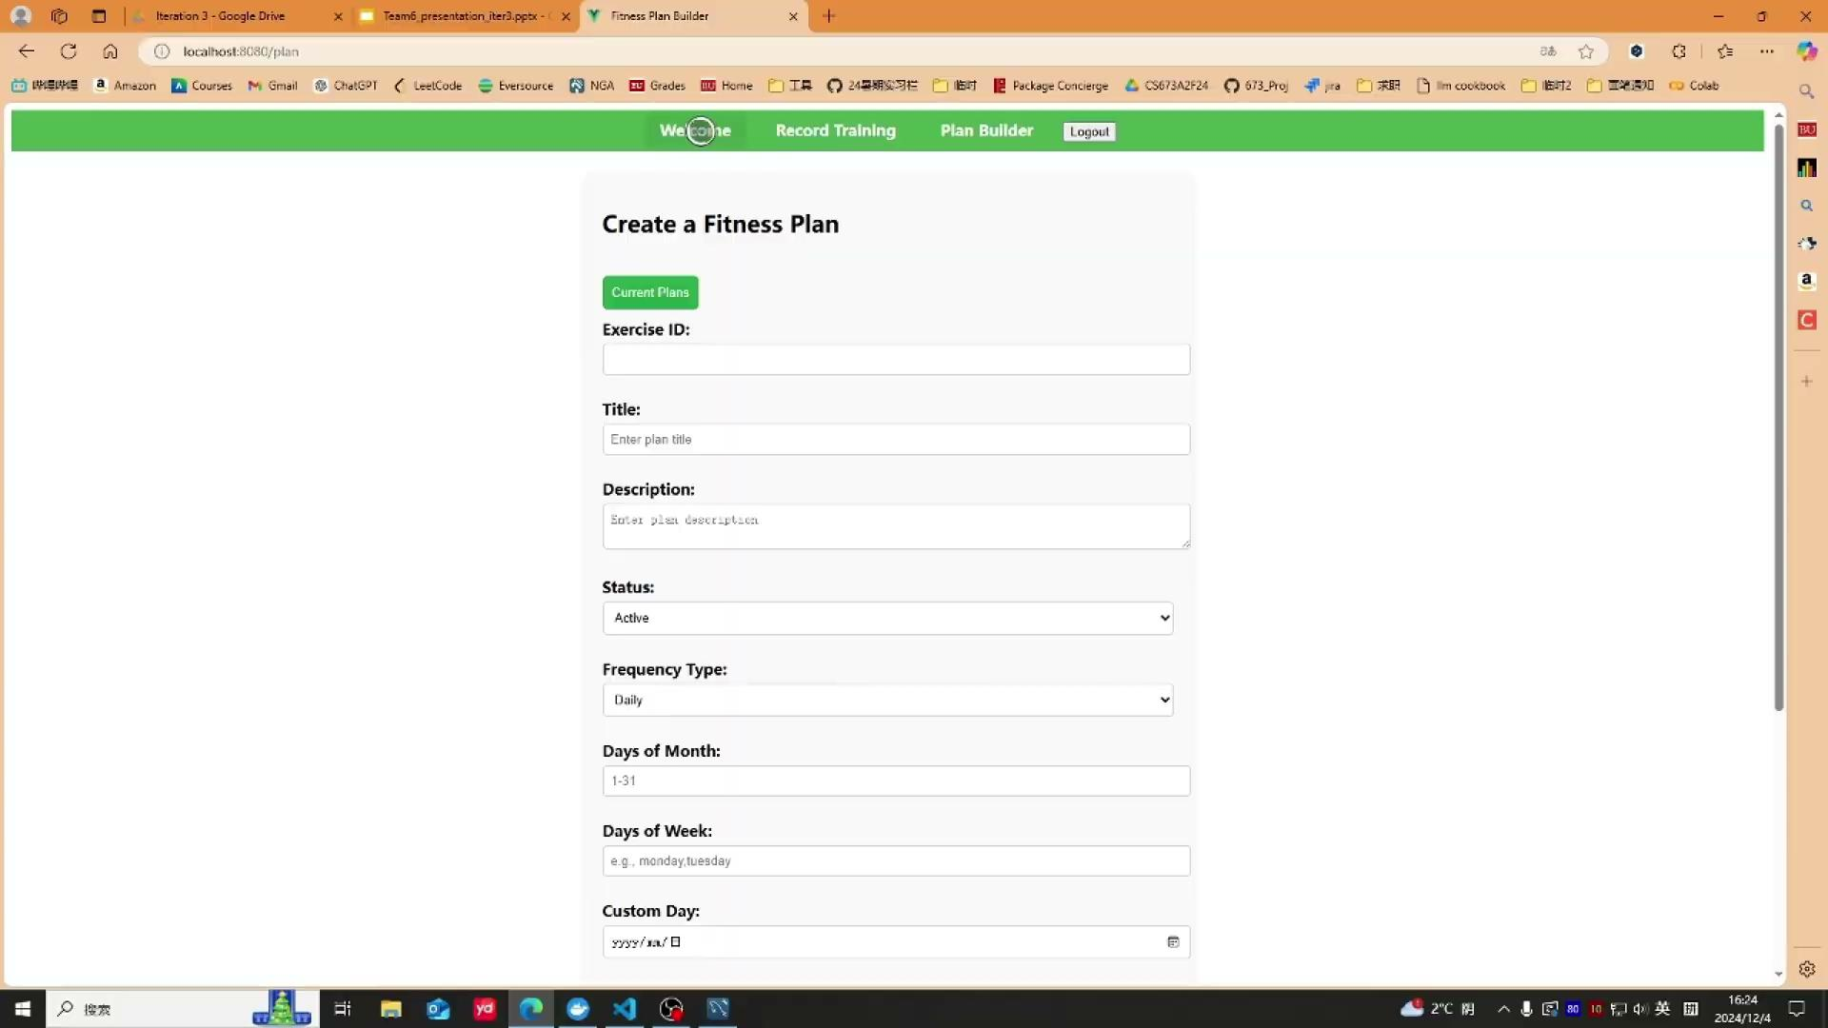
Calendar and Profile Card
As a user, I want a calendar feature in the fitness app where I can view my daily workout schedule. This feature should display my planned exercises for each day, helping me stay on track with my fitness goals.
Given I’m at the Record training page, when I select a certain date to record my exercise items on that day, then it will be correctly stored and displayed for me to reference.

Slide 11
Video And Illustration Support
Given I am on the search exercises page,When I enter a search term and click the search button,Then I should see a list of exercises in the “Showing Results” section with dynamic images of each exercise.
Given I am on the exercise detail page,When I click on an exercise,
Then I should see an embedded video that demonstrates the exercise.

Slide 12
Overall Design
Front-end architecture:
Use Vue.js to build a user-friendly interface.
Functions include user login, training record, fitness plan building, video demonstration​.

Slide 13
Overall Design
Backend architecture:
Use Node.js and Express to build REST API.
Integrate JWT for user authentication and authorization.
The database uses MySQL to store user data, training plans and records​.

Slide 14
Overall Design
System interaction:
The front and back ends communicate through REST API.
the back end interacts with the database through MySQL​.

Slide 15
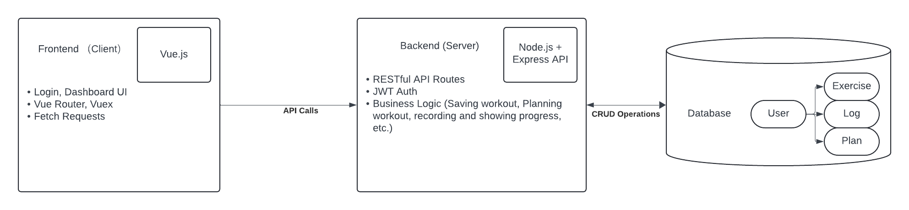
Overall Design

Slide 16
Implementation
Overview
Core modules:
User module: Support registration, login and personal profile management.
Activity recording module: Users can record the duration, intensity and other details of each exercise for further reference.
Plan management module: Allow users to formulate and track training plans, review them on calendar, and set notifications.

Slide 17
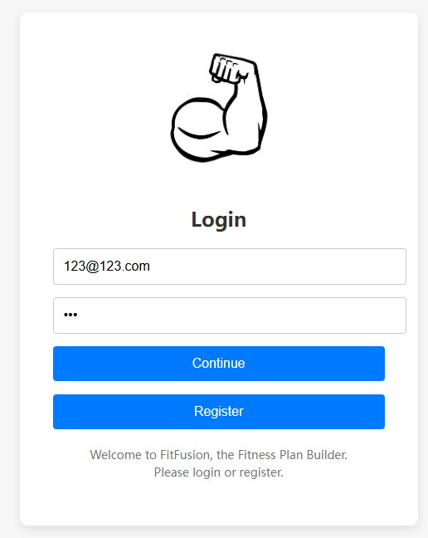
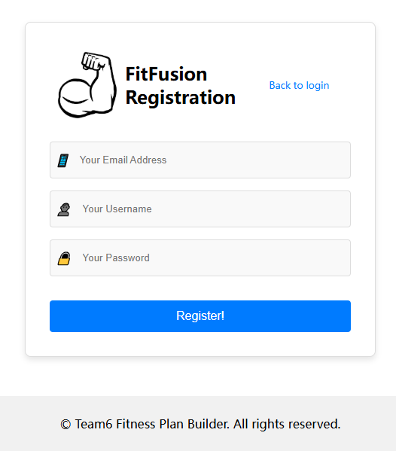
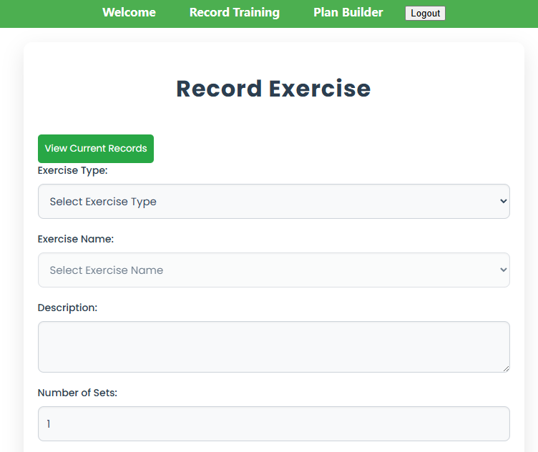
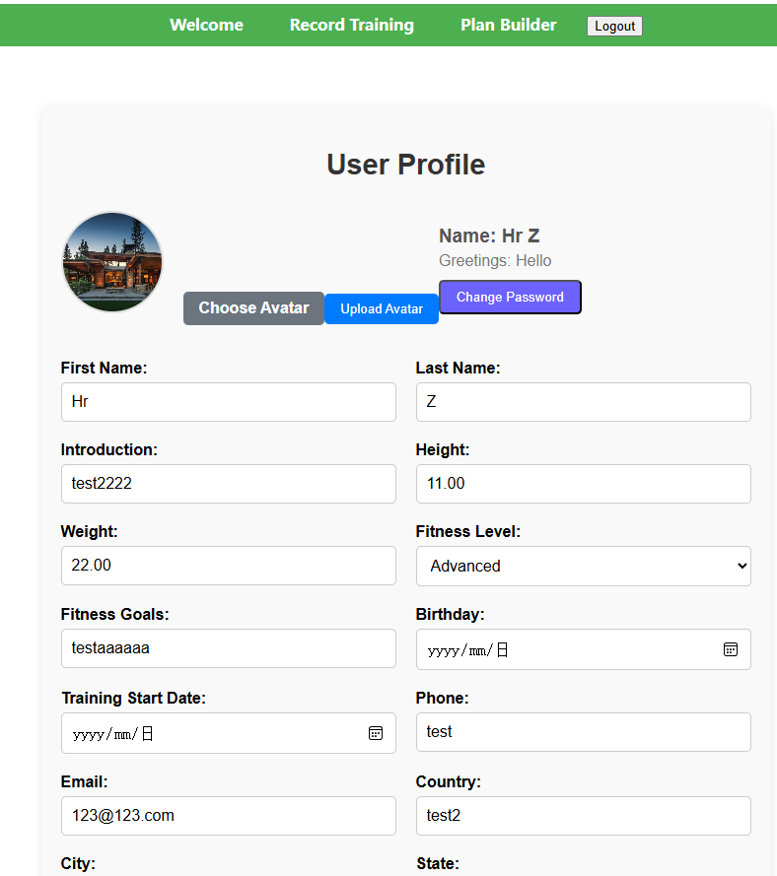
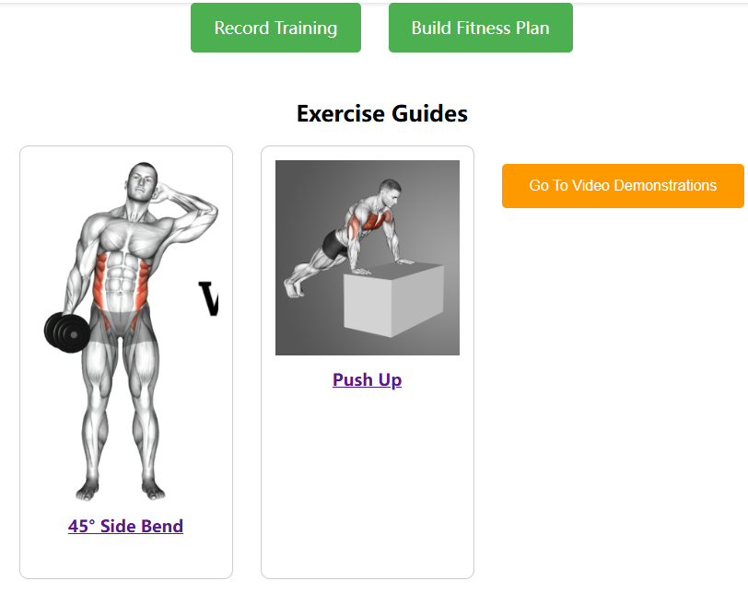
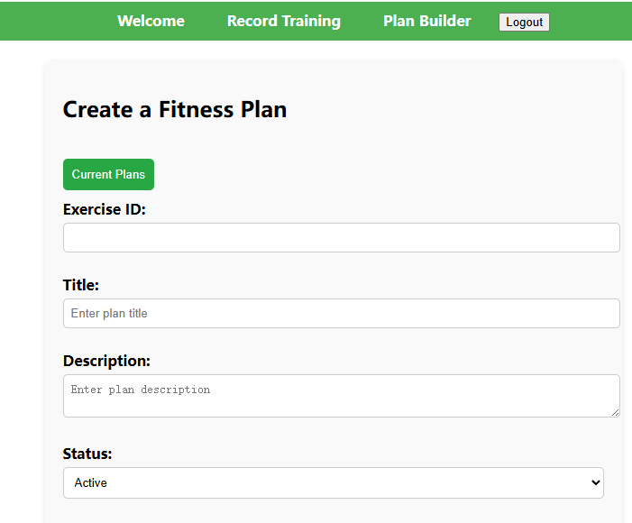
Implementation
Frontend: Summary of main pages finished in Iteration 0-2
1. User registration and login(with token);
2. Welcome page with fitness card and jump-to demos;
3. User profile and profile card;
4. Record + Plan building page.

Slide 18
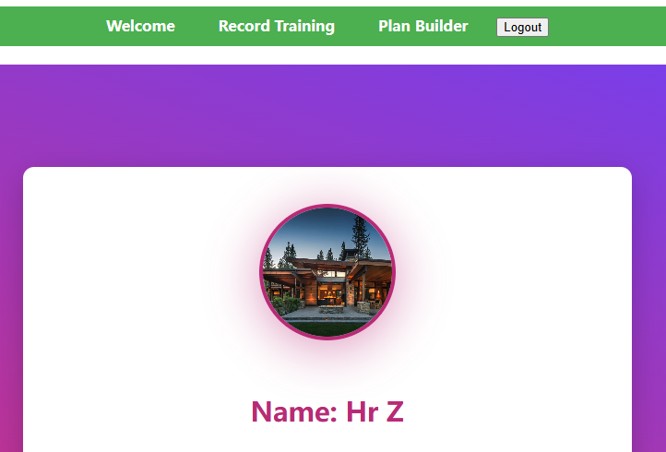
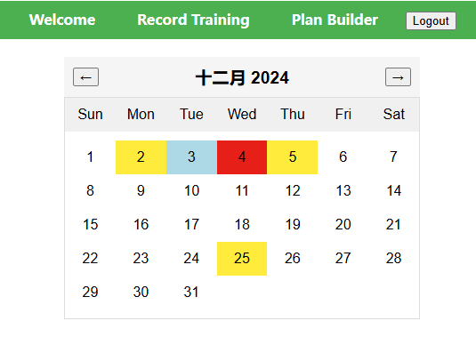
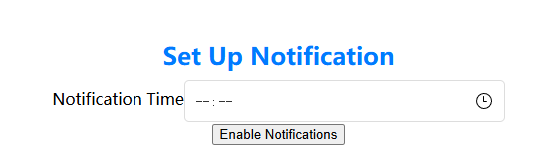
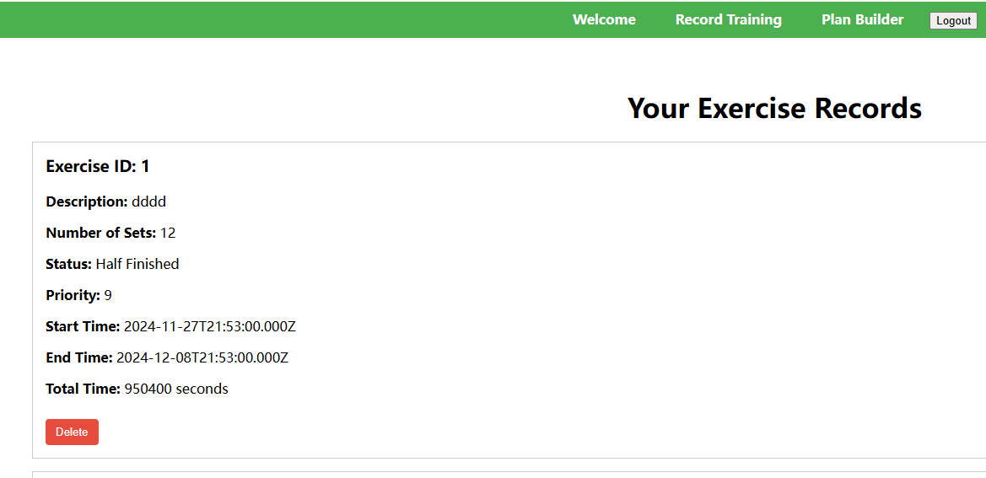
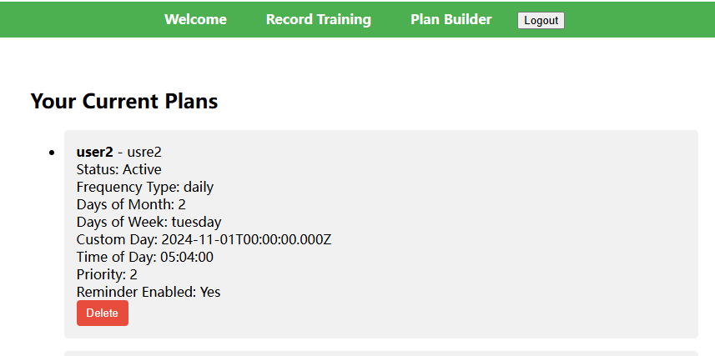
Implementation
Frontend: Finished in Iteration 3
1. On-page push notification function;
2. Avatar choosing, uploading, saving and showing in user profile;
3. GET current records and plans from database, and delete function;
4. Calendar component to clearly show which days have records/plans.

Slide 19
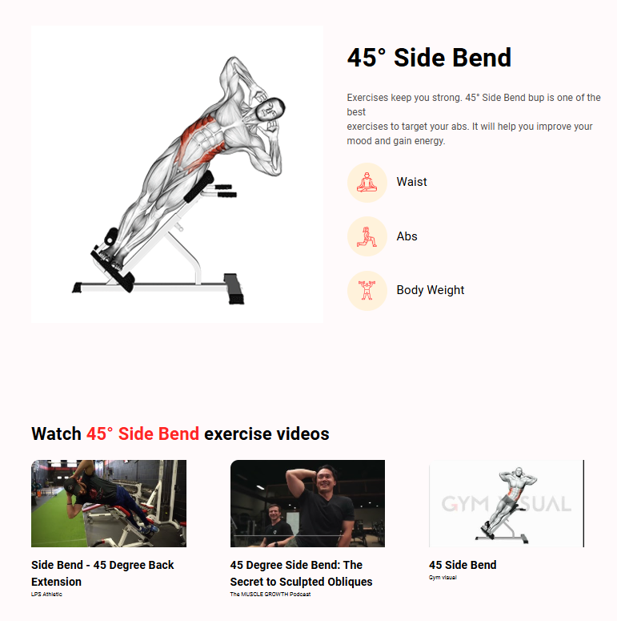
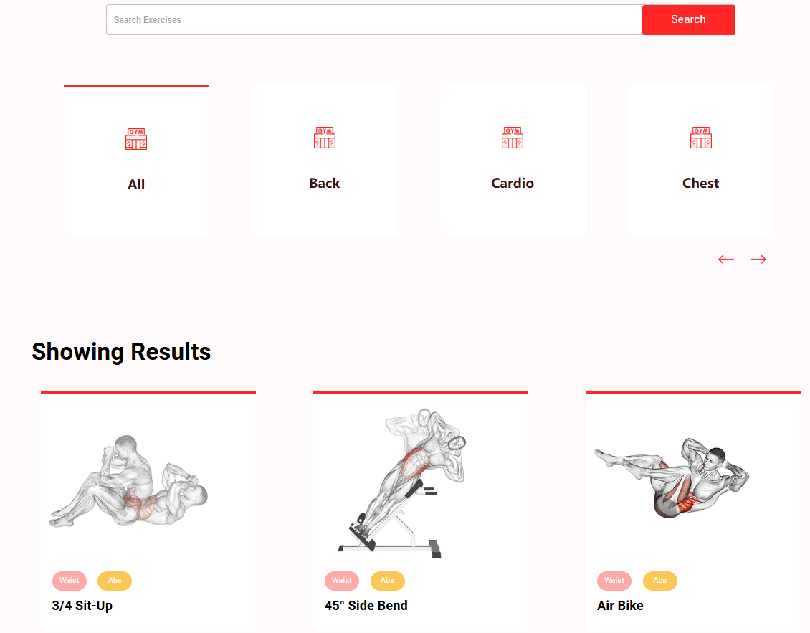
Implementation
Frontend: Fitness item demonstration page
Finished previously: Various kinds of fitness programs with text description, training body parts and basic sketch diagram, also keyword searching for certain fitness target;
Finished in Iteration 3: Adding jumpable YouTube video demonstrations for better interacting and instructing users.

Slide 20
Implementation
Backend
Database Connectivity
Data CRUD
Authentication
MVC
Refactor

Slide 21
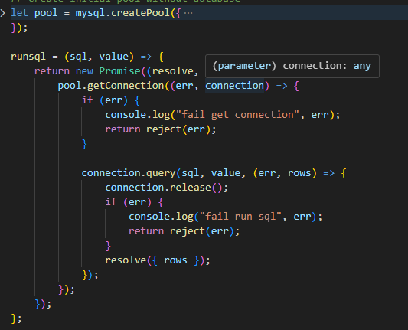
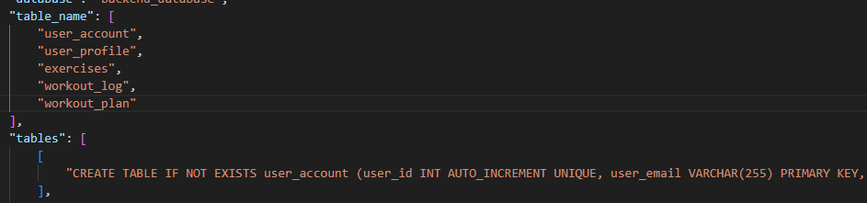
Implementation
Backend: Database Connectivity
Configure Split
Automate Table Setup
Database Check at every init
Sql Require Split

Slide 22
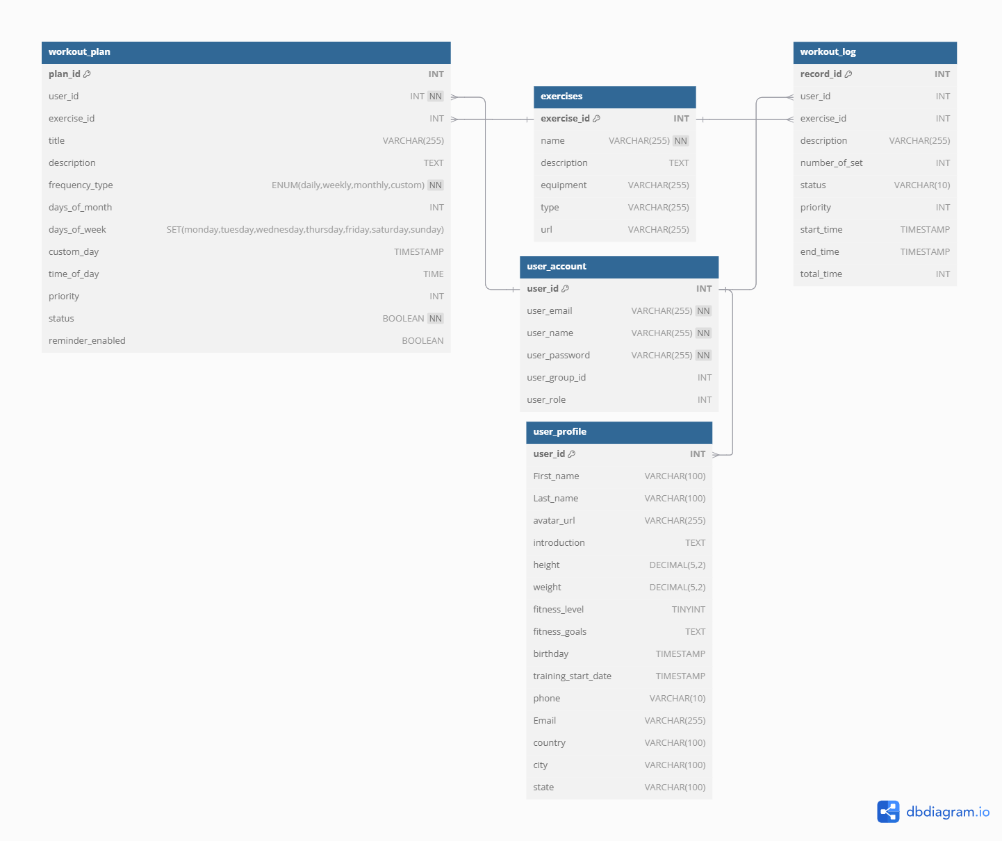
Implementation
Backend: Data CRUD
User Account (iteration 1)
User Profile (iteration 2)
Exercise (iteration 3)
User Workout Log (iteration 2 & 3)
User Planning (iteration 3)

Slide 23
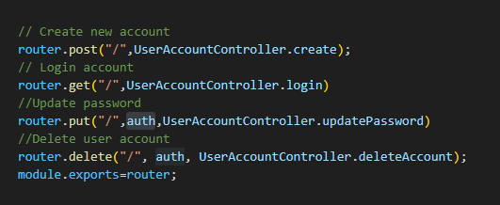
Implementation
Backend: Authentication
Unified Authentication Middleware
JSON Web Token
More Security

Slide 24
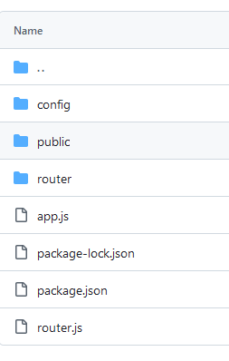
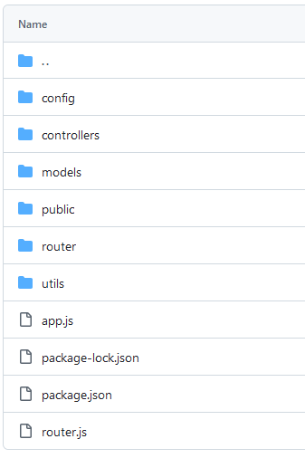
Implementation
Backend: Model-View-Controller
Rebuild

Slide 25
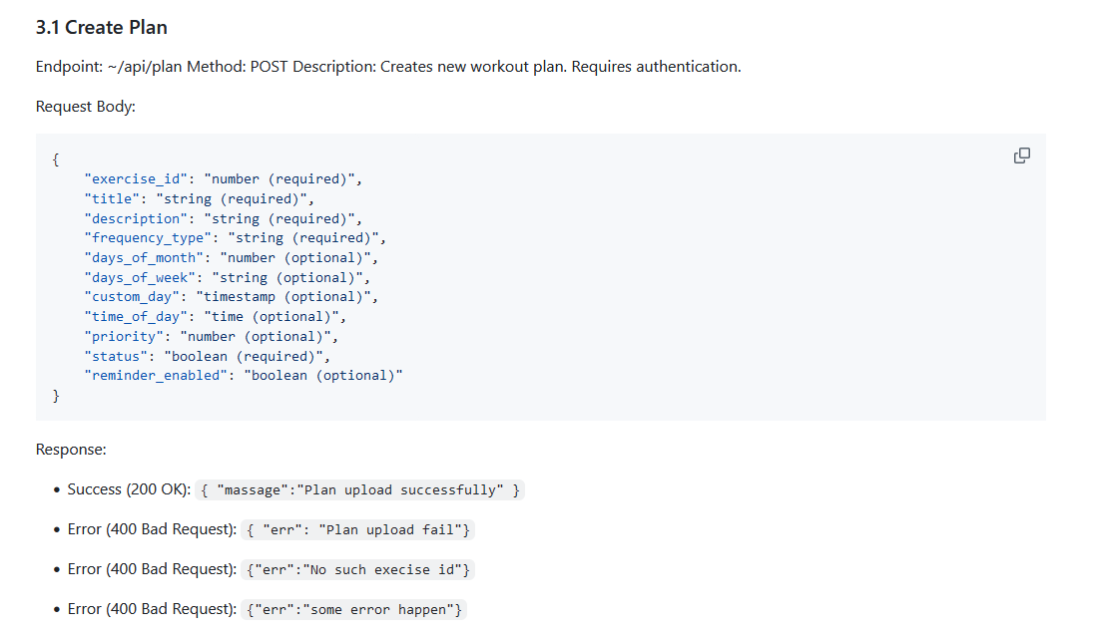
Implementation
Backend: Refactor
Data Hidden
API Documentation
Unified Return Format

Slide 26
Deployment
Development tools:
Version control: Git and GitHub.
Containerization: Docker.
Test tool: Cypress for end-to-end testing.

Slide 27
Dockerfile: Multi-Stage Build
Stage 1: Build Vue.js Application
- Base Image: `node:lts-alpine`
- Build Production Assets
Stage 2: Test Stage with Cypress
- Base Image: `cypress/included:13.15.1`
- Run End-to-End Tests
Stage 3: Production with NGINX
- Base Image: `nginx:stable-alpine`
- Serve Frontend on Port 80

Slide 28
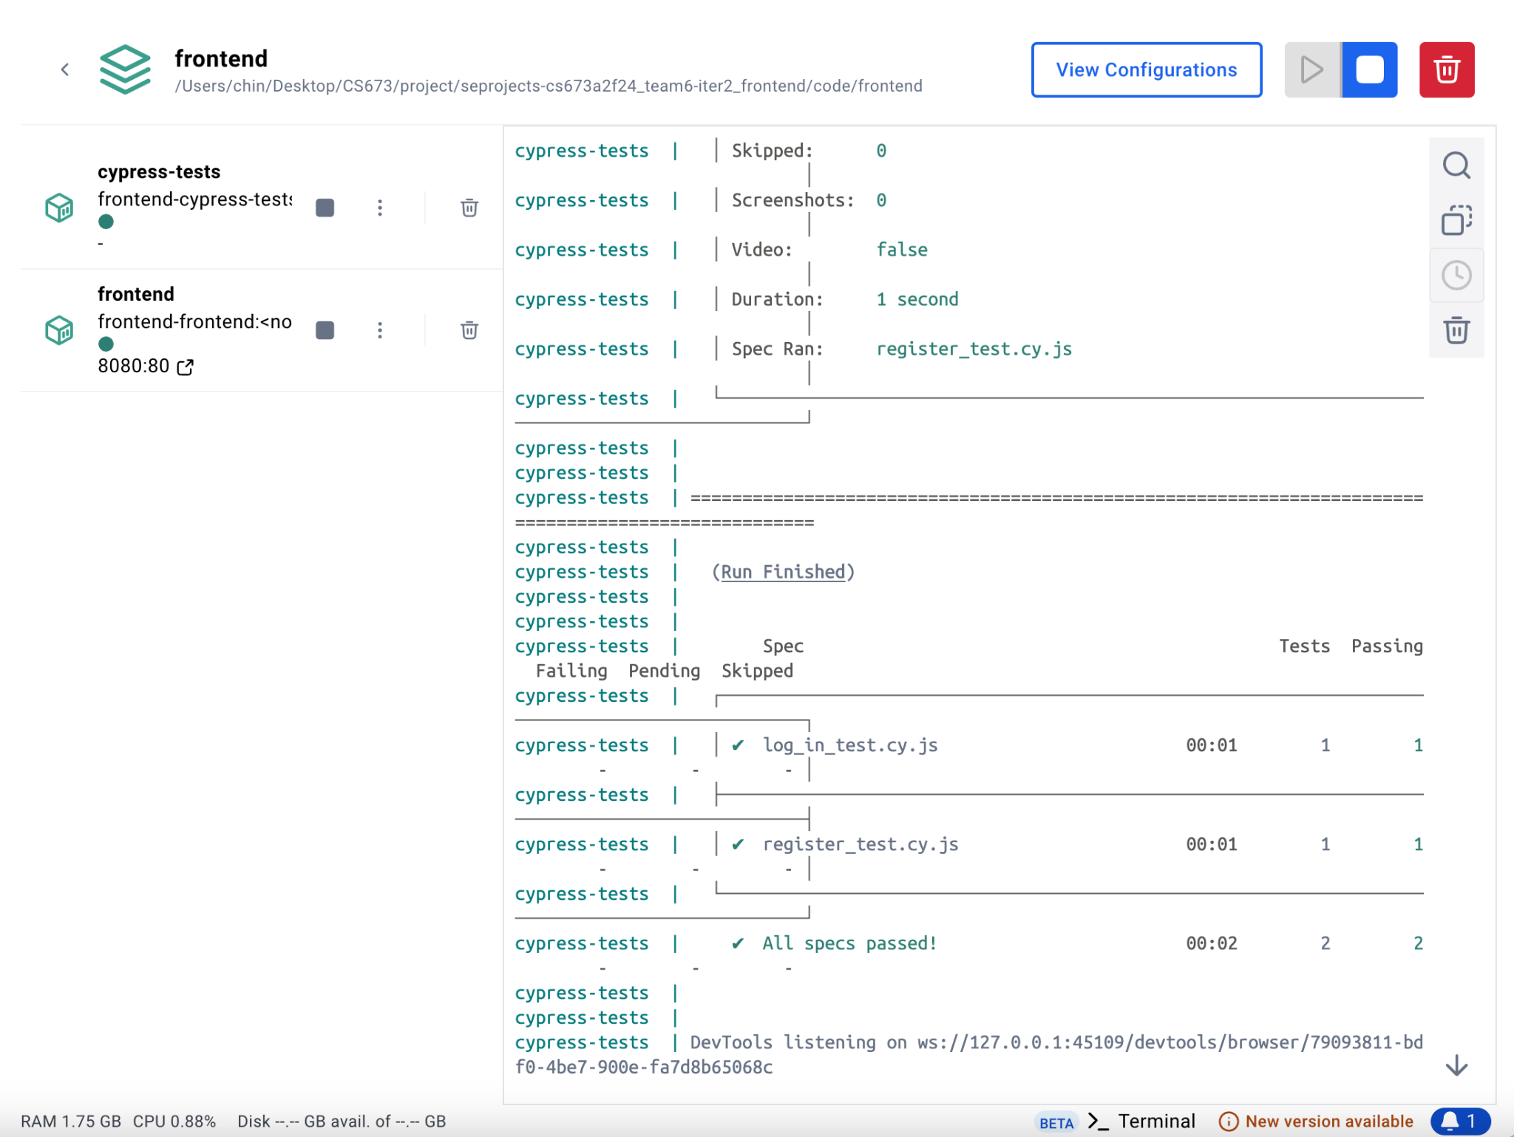
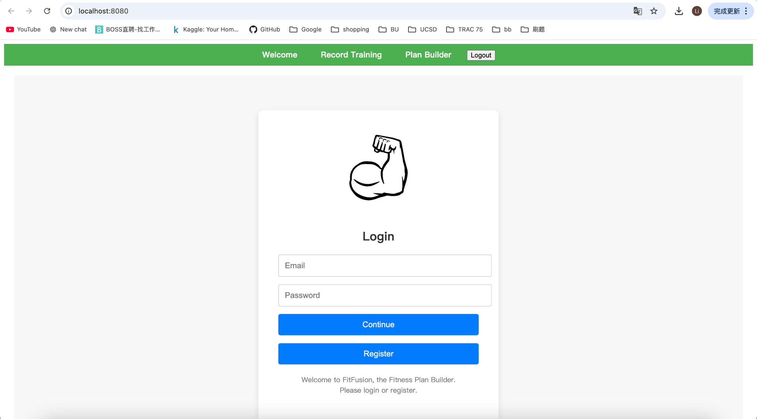
Deployment Steps
Build and Start Containers:
`docker-compose up --build`
Run Cypress Tests:
`docker-compose run cypress-tests`
Access Frontend:
Visit `http://localhost:8080`

Slide 29
More Testing…
Back-end testing
Postman for manual testing
Cypress for e2e/unit testing
Changes in iteration 3:
Updated test cases based on design change of the database in iteration 3.
Included security tests.

Slide 30
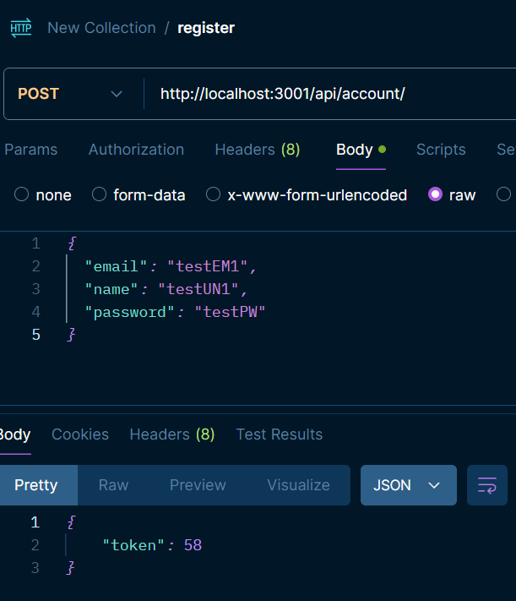
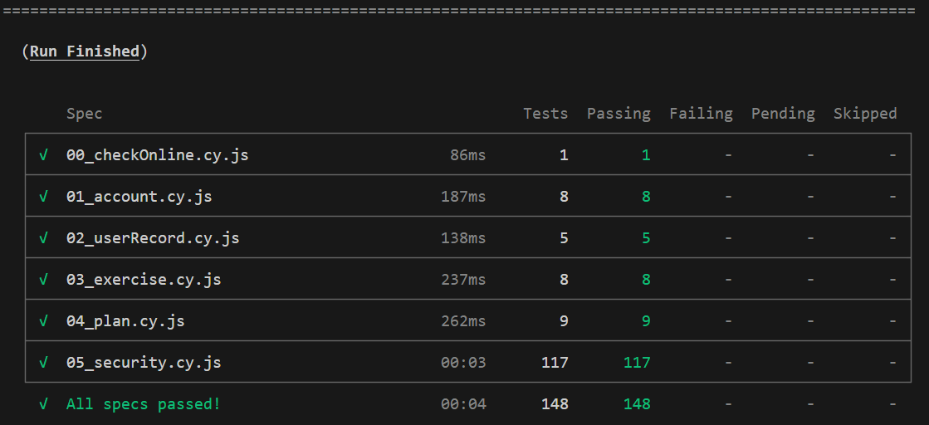
Testing: Backend

Slide 31
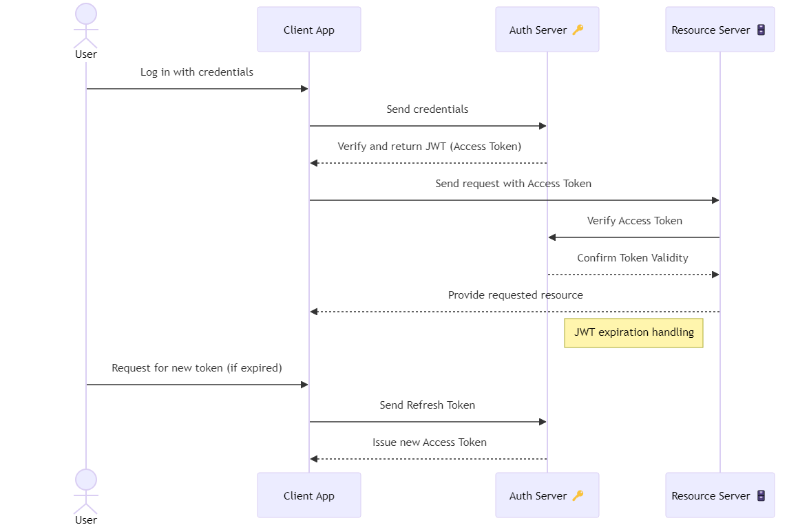
Security
JWT

Slide 32
More Security
bcrypt: password hashing
Password hashing is handled by backend, and hashed value is stored in DB
Injection attack protection
Prevent injection attack by using parameterized query
Role-based access
Prevent normal users to delete or create system information such as common exercises

Slide 33
Demo

Slide 34
Team 6
FitFusion - Work out website
CS673 FA2024

