Slide 1
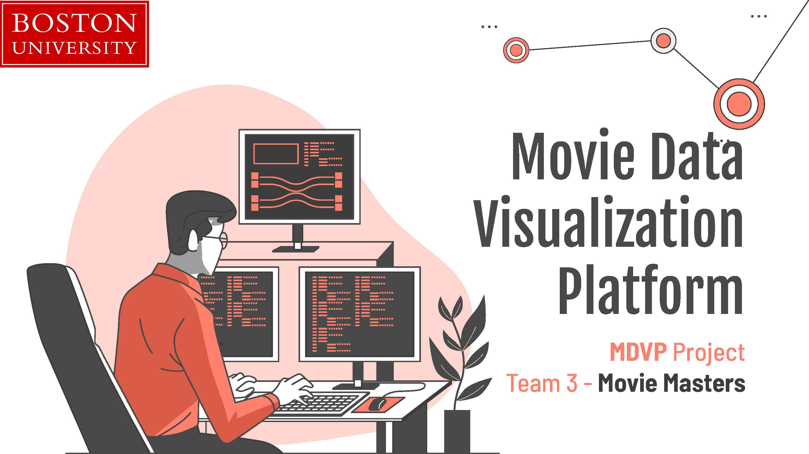

Slide 2
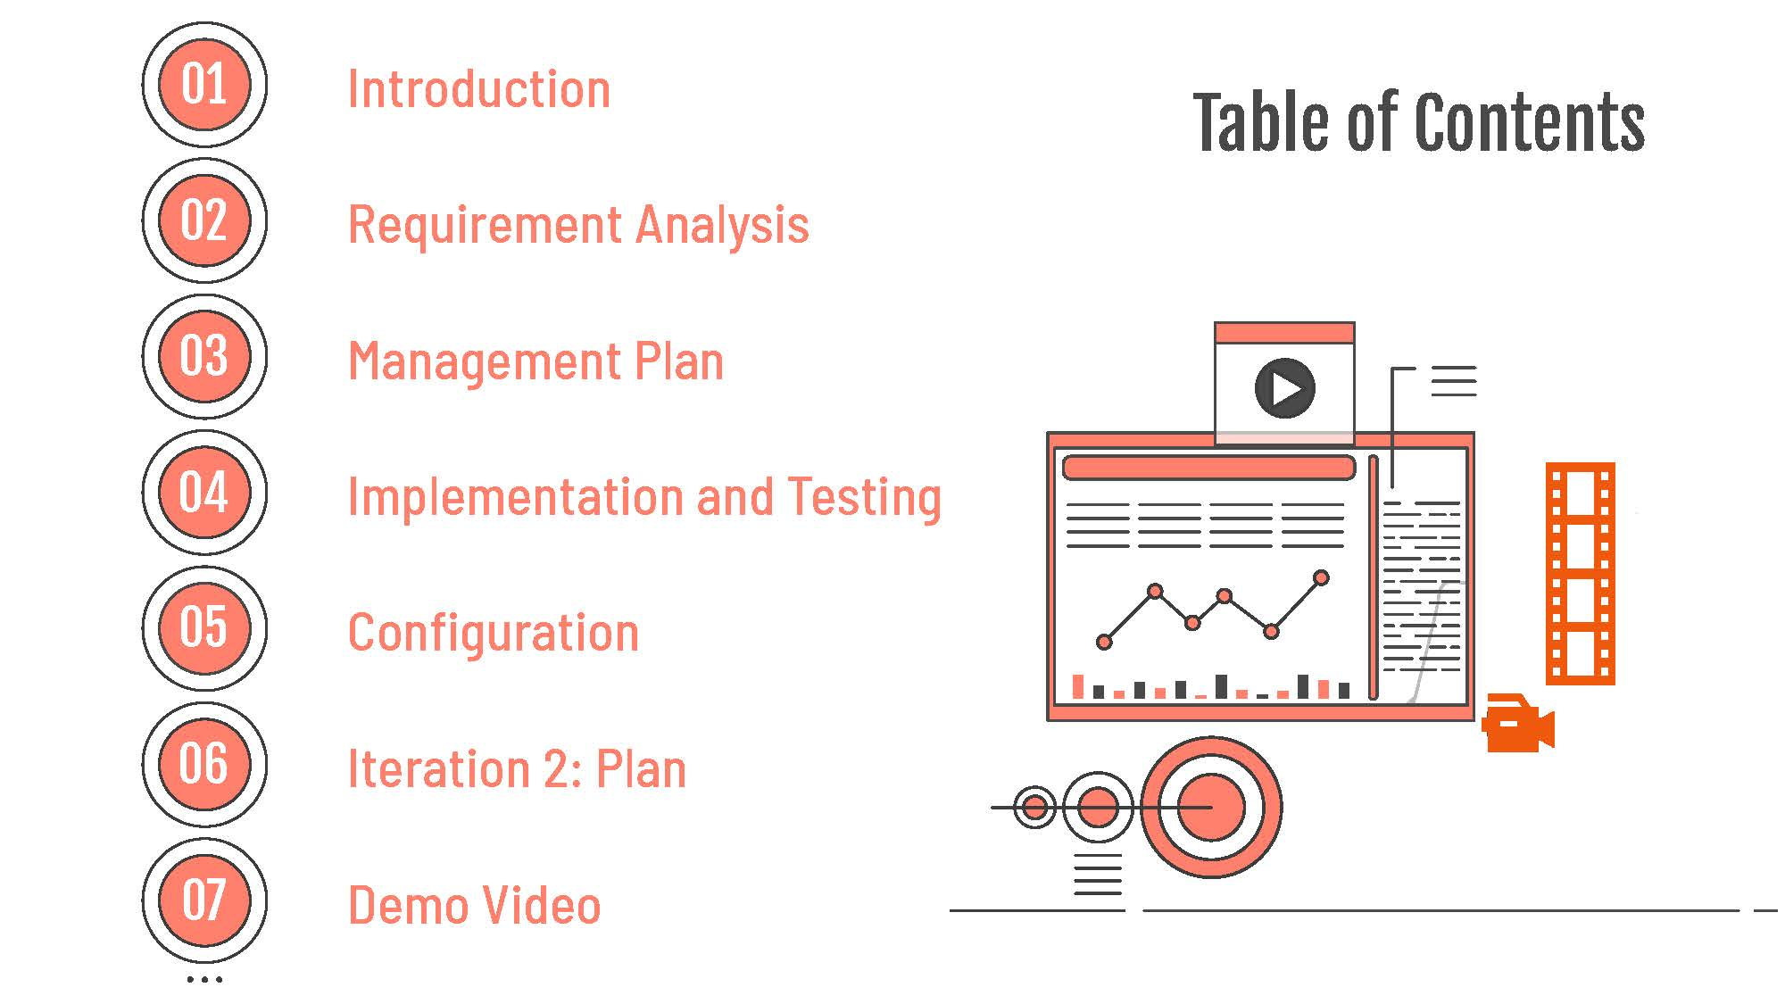

Slide 3





Project Overview
Goal: Develop a web-based platform to analyze and visualize IMDB movie data.
Motivation: Address the need to process and present large datasets in a way that reveals insights and trends in the film industry.
Target Users:
Movie Enthusiasts: Discover movie trends.
Data Analysts: Perform deep analysis of movie data.
Film Critics: Use data to support their reviews.
Researchers: Analyze trends in movie releases, ratings, and genres.

Slide 4




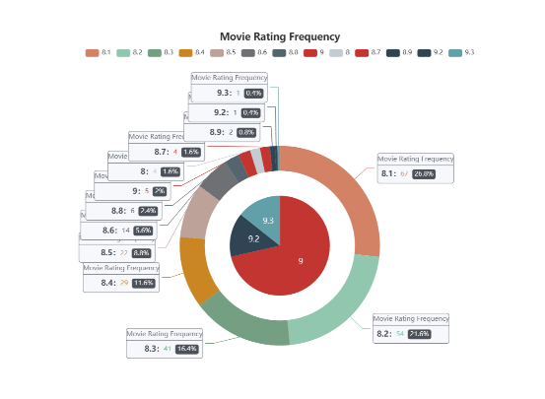
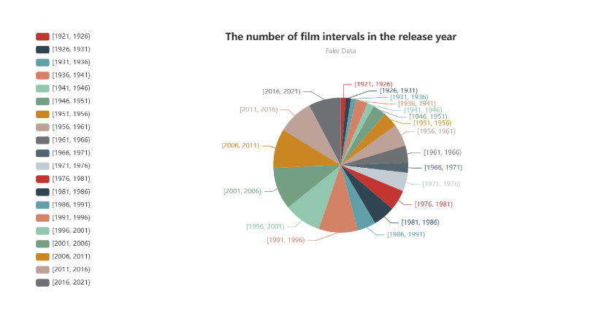
Platform Functionalities
Core Features:
Movie Release Trend Visualization: By year, genre, and production country.
Sentiment Analysis: Analyze audience reviews for overall sentiment.
Word Cloud Generation: Generate word clouds for frequently mentioned terms in reviews.

Slide 5

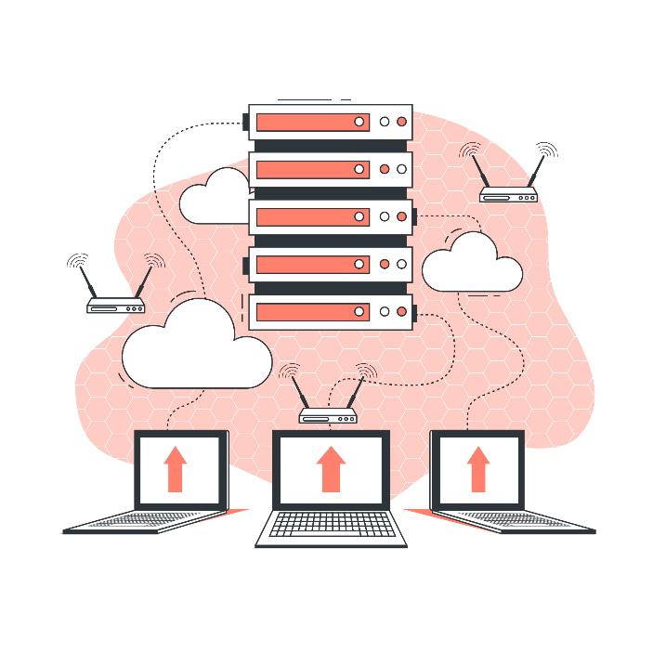




Technology Stack
Backend: Python with Django for server-side processing.
Database:
MySQL to store movie data.
Frontend: HTML, CSS, JavaScript, and ECharts for interactive data visualizations.
Tools:Git and GitHub for version control, Pandas for data processing, Docker for containerization.

Slide 6
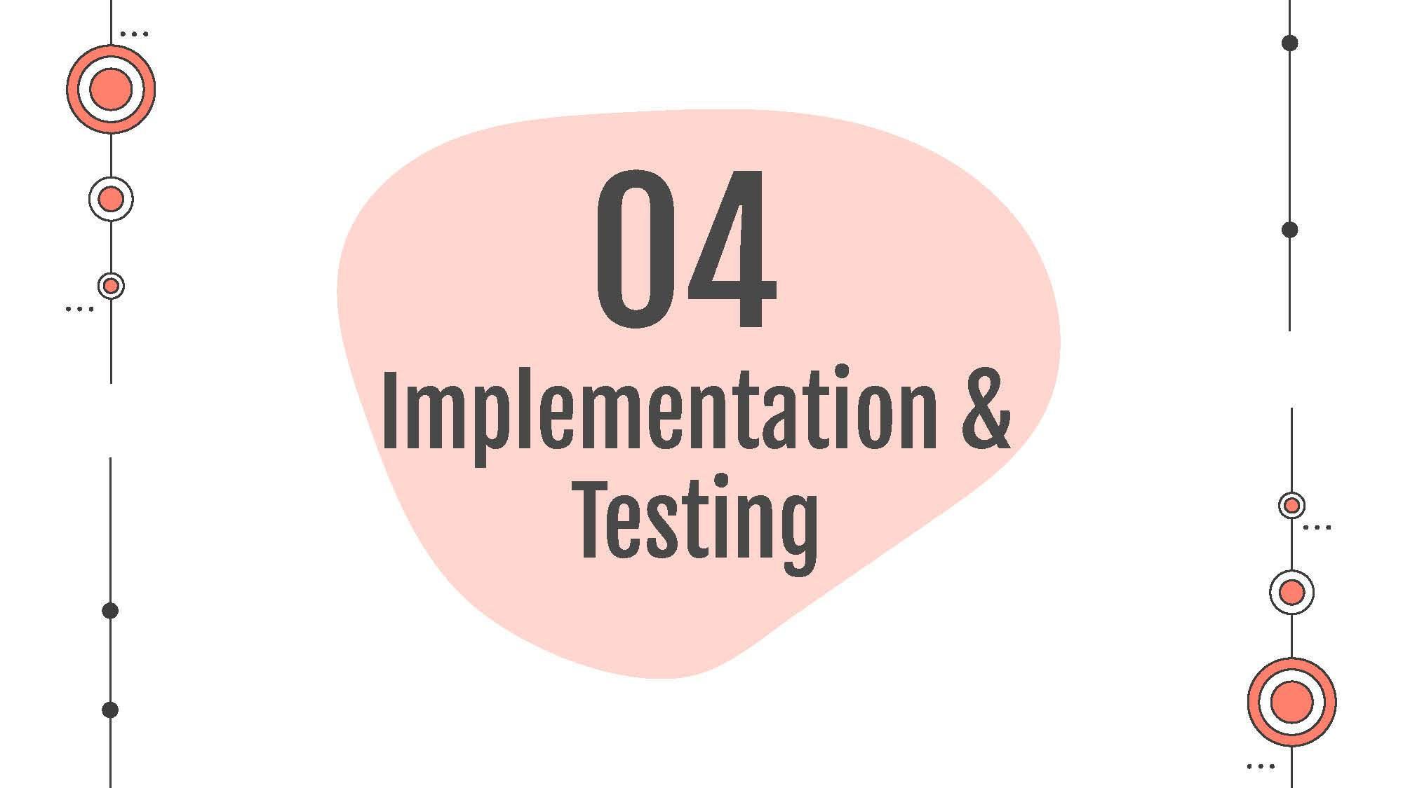

Slide 7
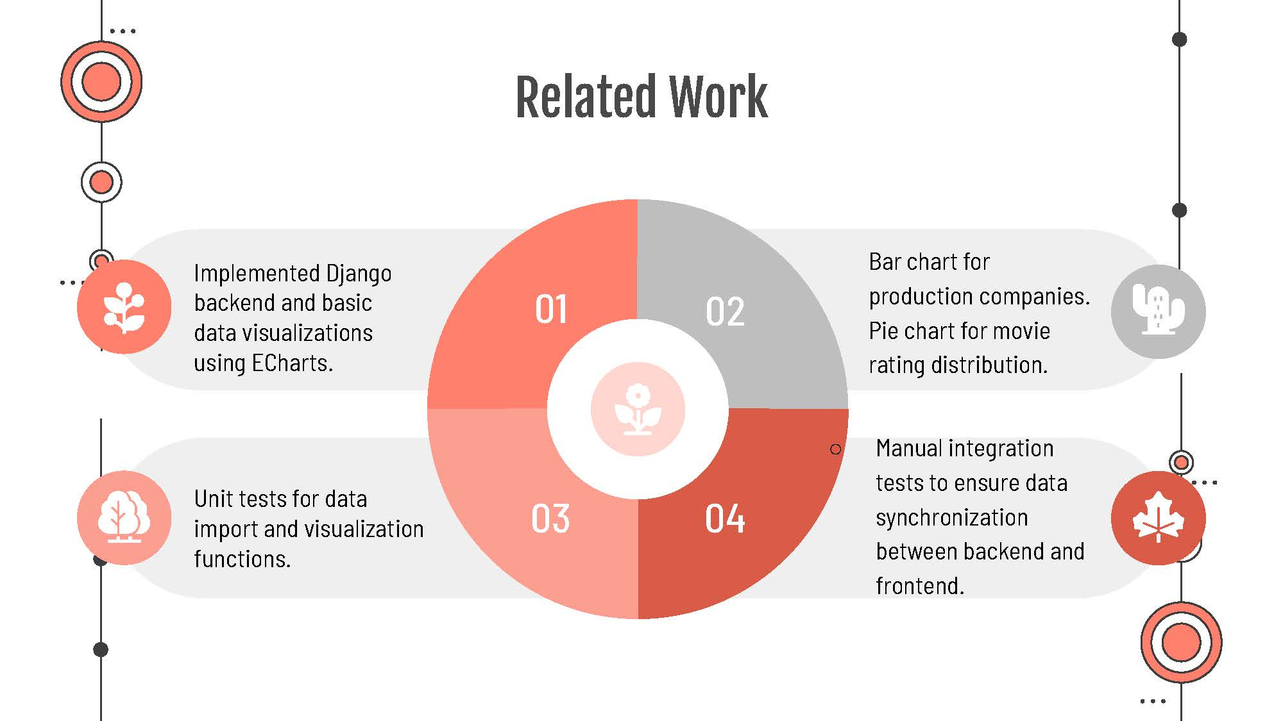

Slide 8
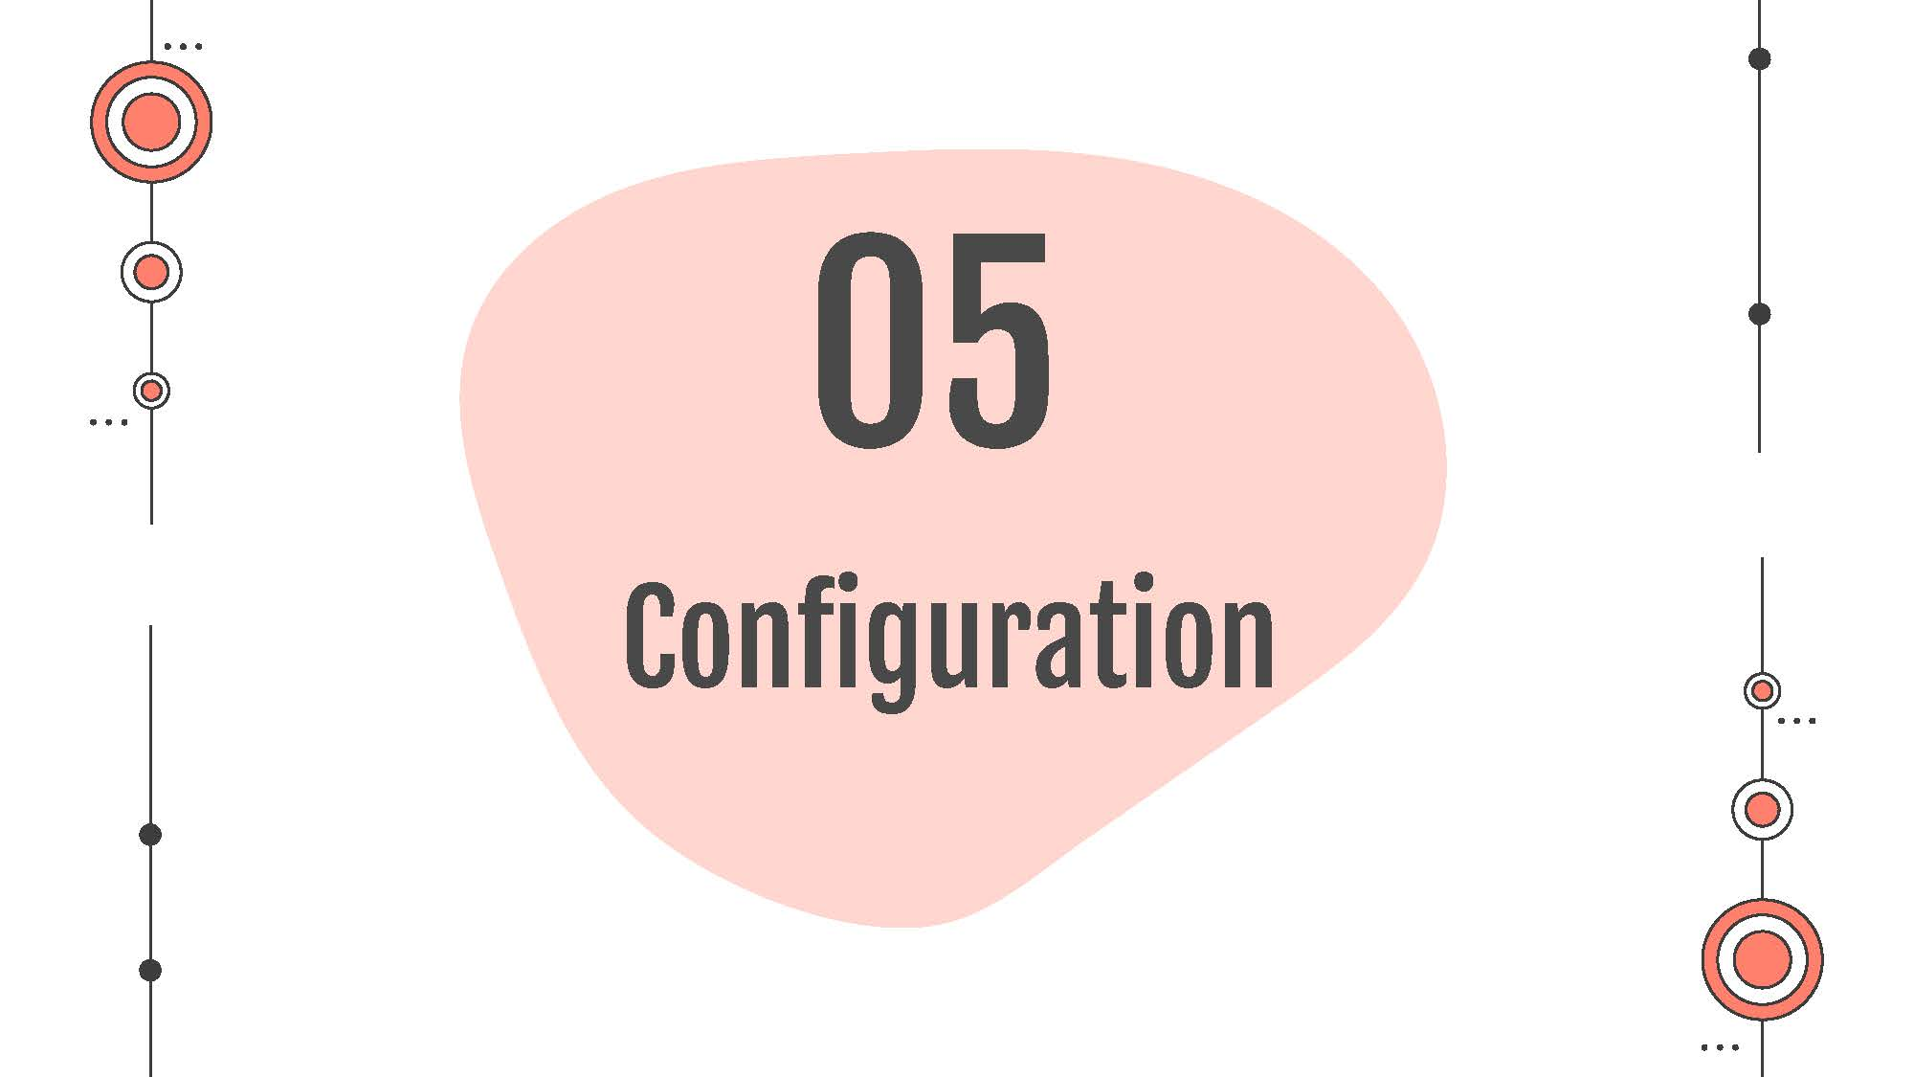

Slide 9
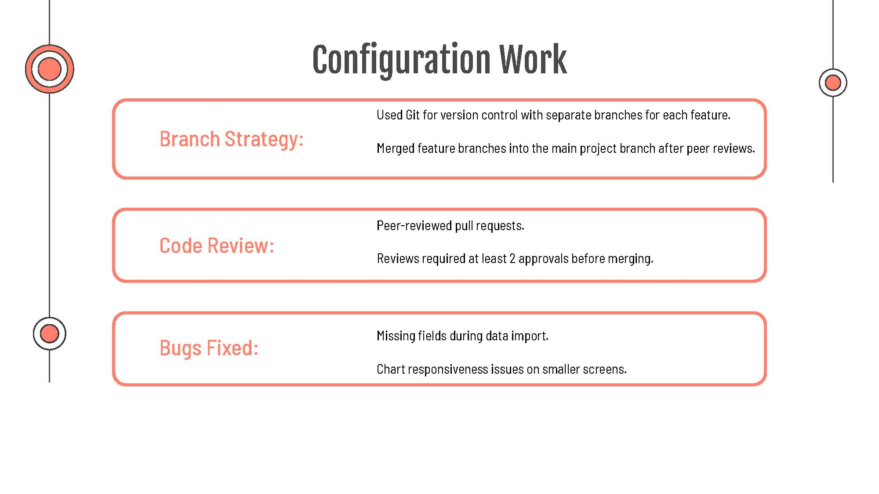

Slide 10
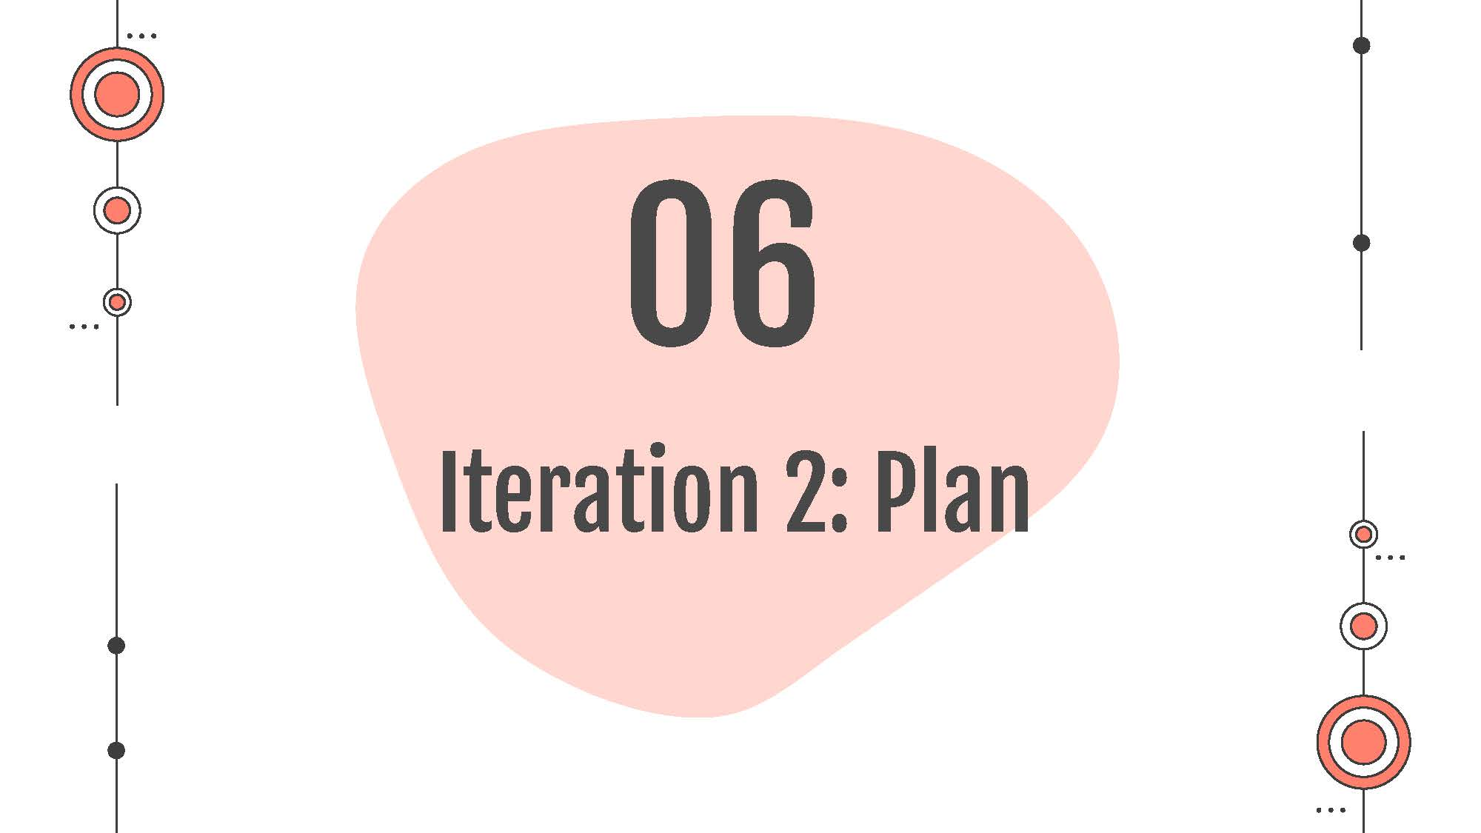

Slide 11
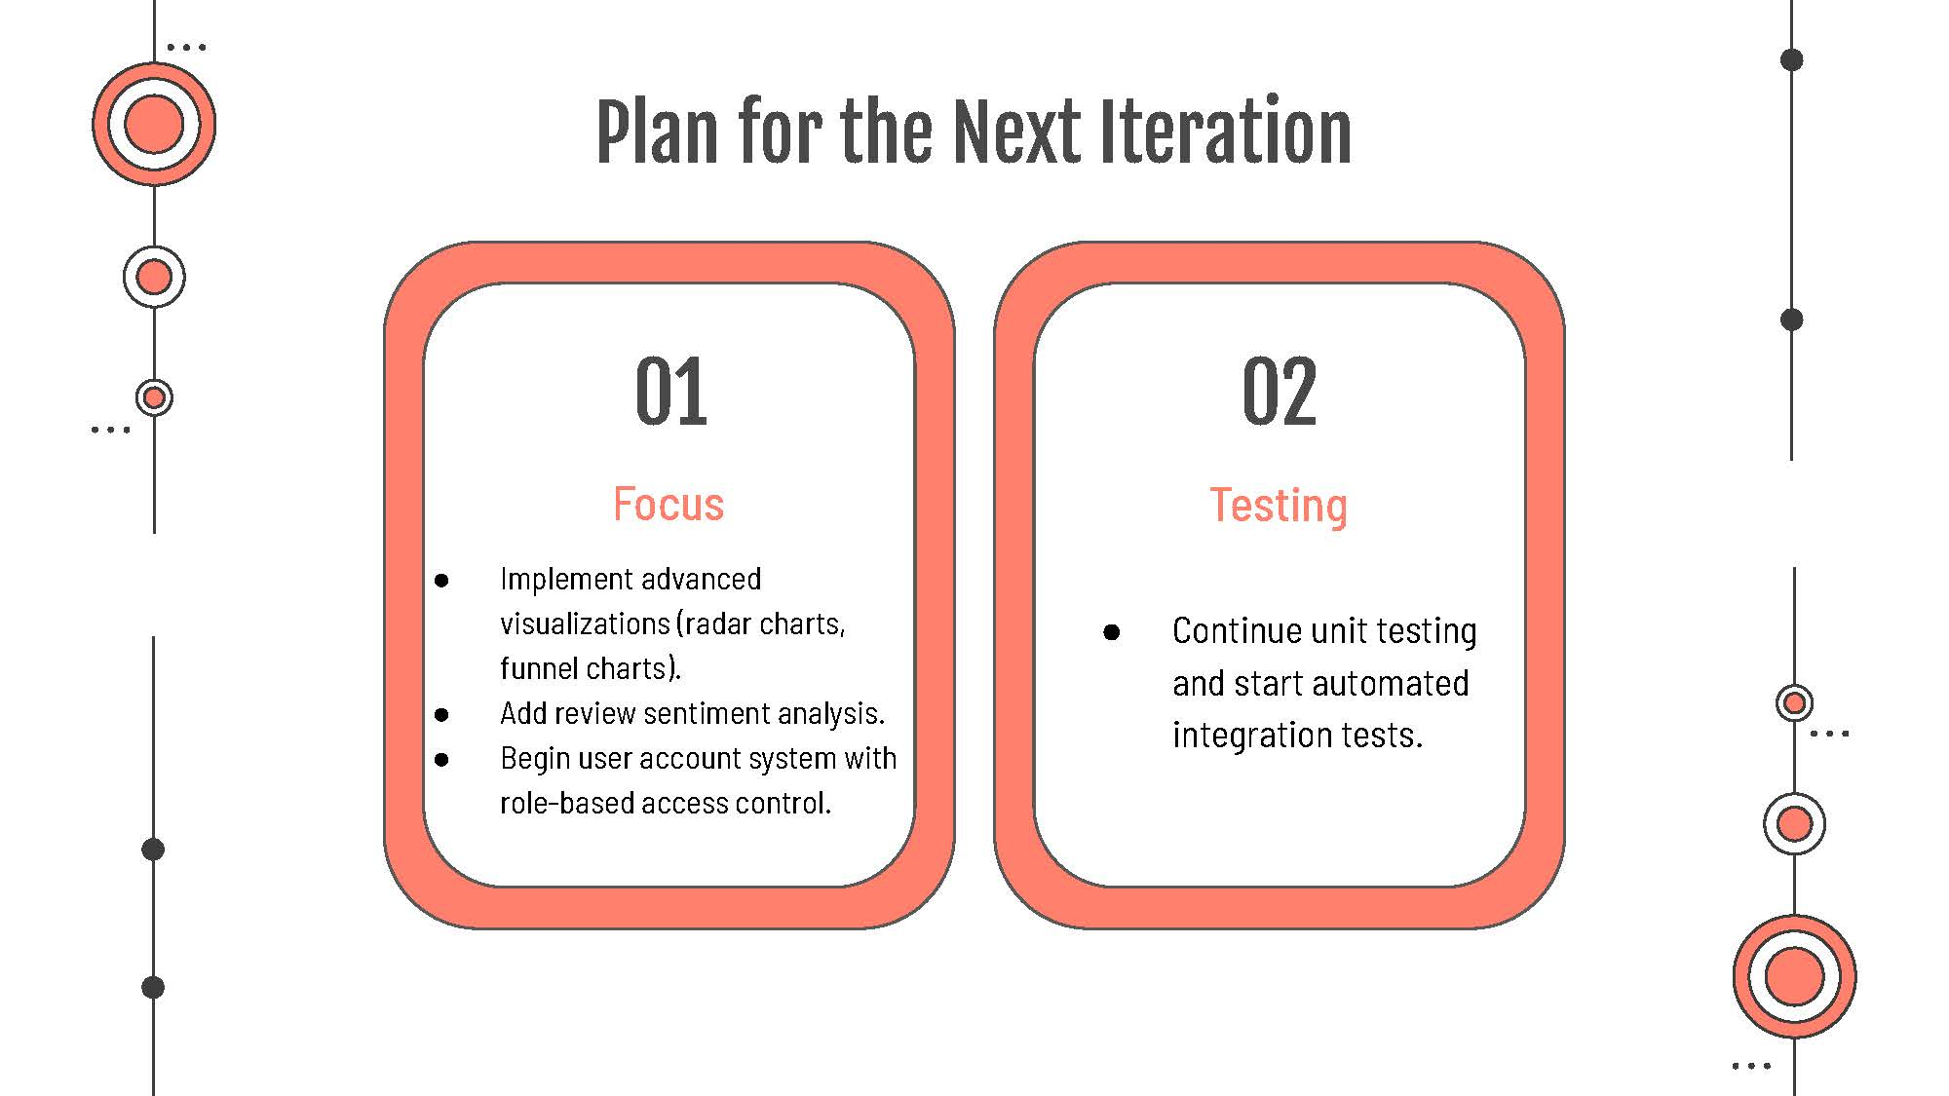

Slide 12
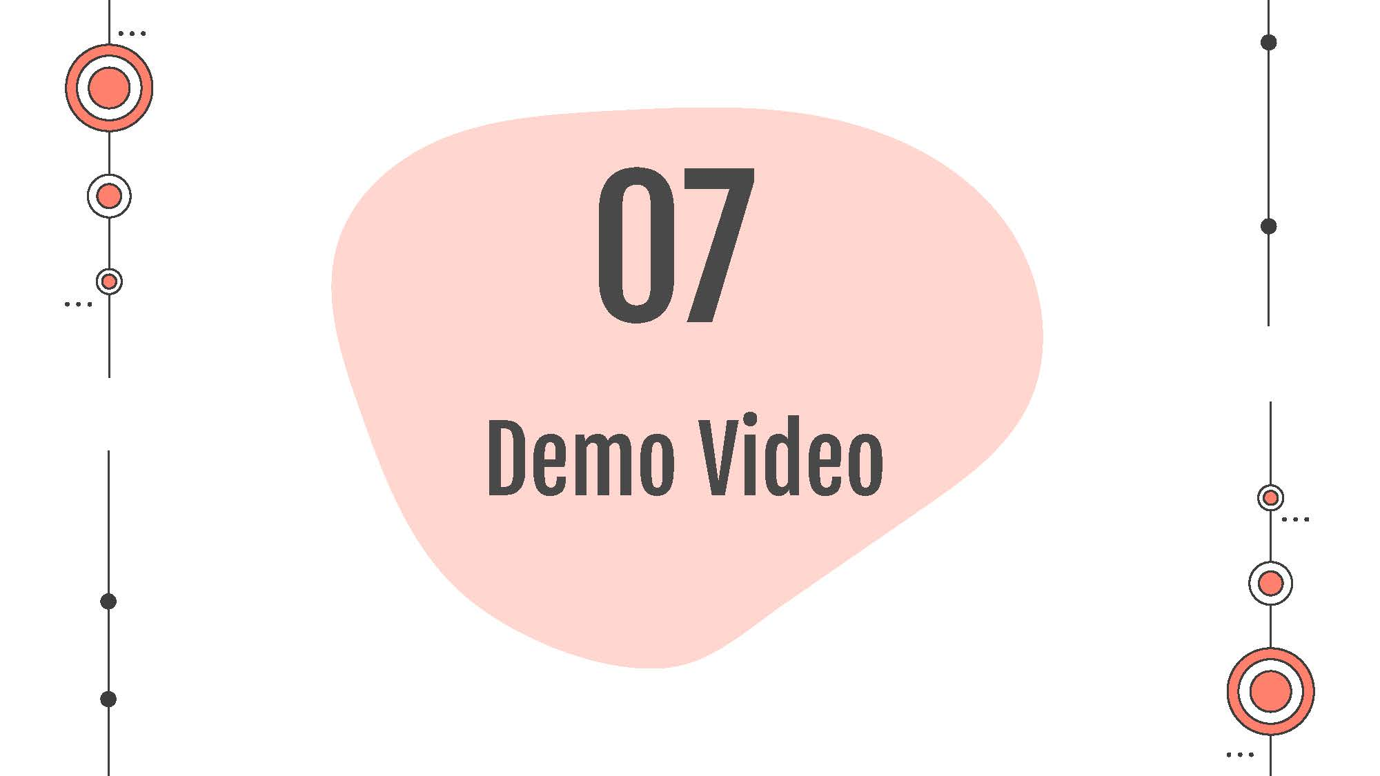

Slide 13
