Slide 1

Movie Data Visualization Platform
MDVP Project
Team 3 - Movie Masters

Slide 2
Table of Contents
01
05
02
06
03
07
04
08
Introduction
Testing
User Account Features & Security
Design
Implementation
Project Management
Requirement Analysis
Website Live Demo

Slide 3
01
Introduction
Planning Phase

Slide 4
Our Project
MDVP
We aim to build a web-based platform for analyzing and visualizing IMDb movie data, motivated by the need to efficiently process large datasets and make it easy to identify trends and insights into the film industry.

Slide 5
Our Team Members
Hengyi Song
Design & Implementation
Leader
Xuansheng Xia
Team Leader
Mingyuan Xu
Configuration
Leader
Ziliang Ren
QA
Leader
Xiaojuan Li
Requirement
Leader

Slide 6
02
Design

Slide 7
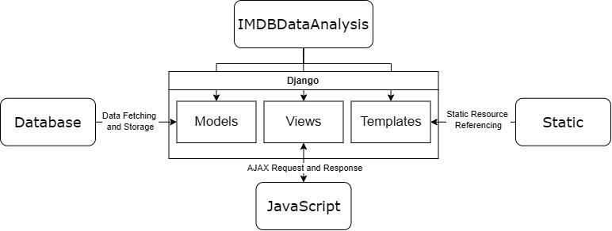
System Architecture
Key Components:
Backend: Django (Models, Views)
Frontend: Templates (HTML/CSS), JavaScript
Database: MySQL
Containerization: Docker
Interaction Flow: Backend processes → Templates render data → Visualized with ECharts.

Slide 8
Database Design
Movies Table
Reviews Table
Users Table
Attributes:
title, year, rating, language, genre, runtime, etc.
Relationships:
Many-to-Many with Genres,
One-to-Many with Companies.
Attributes:
review content, associated movie.
Relationship:
One-to-Many with Movies.
Attributes:
username, email, password hash, etc.
Relationships:
Independent for now but can support future user-specific features.

Slide 9
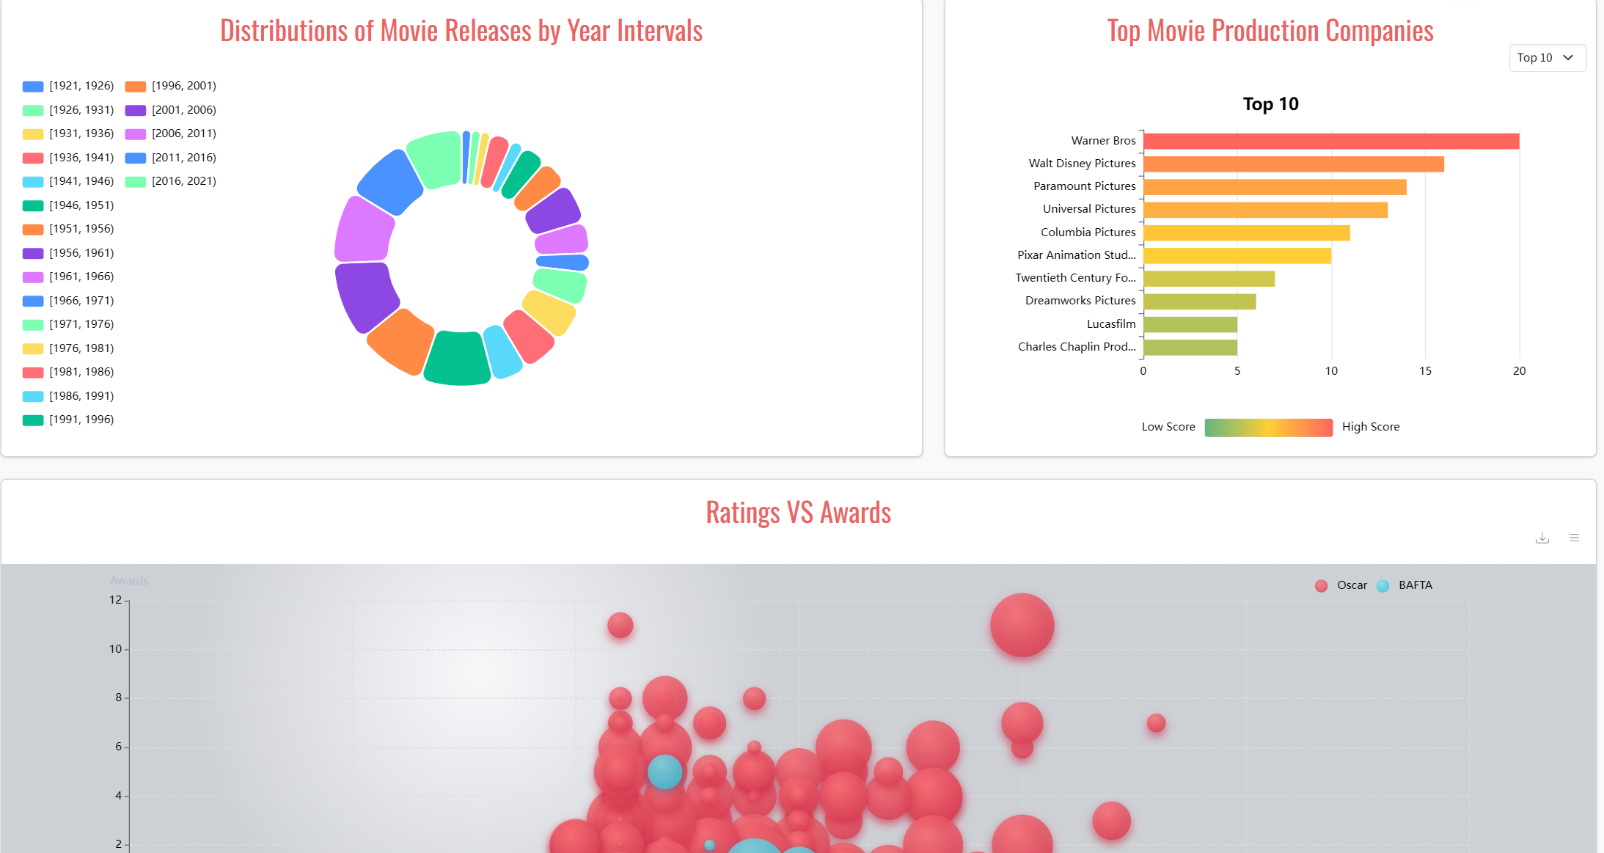
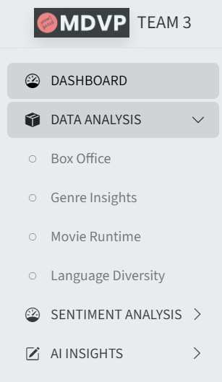
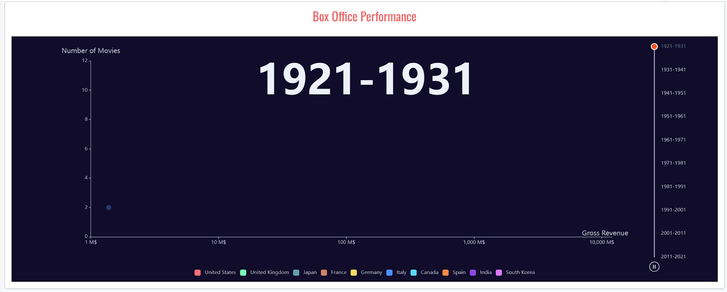
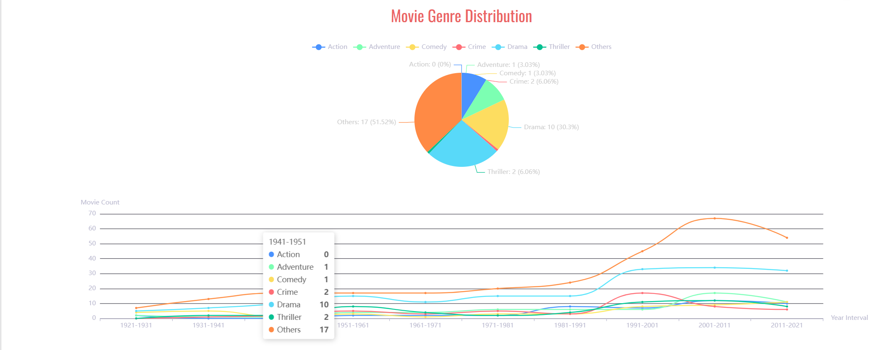
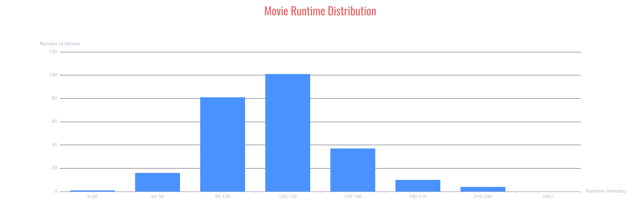
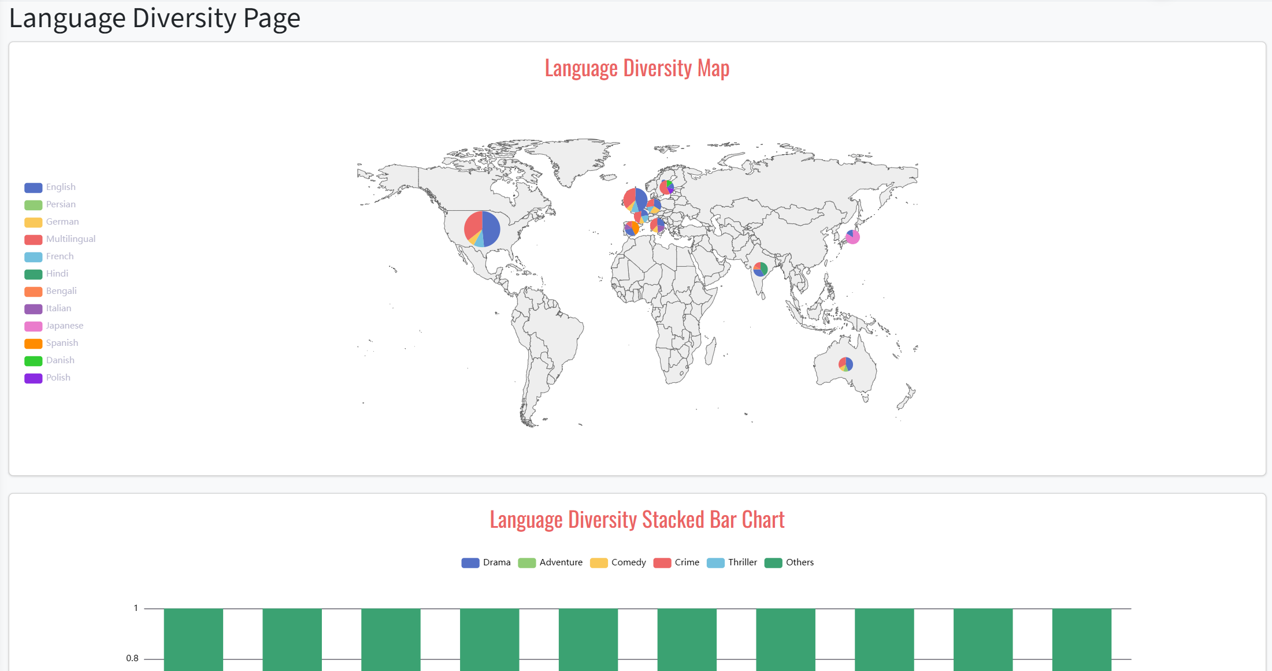
UI Design Overview
Navigation Panel:
Positioned on the left, offering access to the following sections:
Dashboard: Provides an overview of key insights and statistics.
Data Analysis: Comprises four sub-sections:
  Box Office: Visualizes box office trends across countries and time periods.
  Genre Insights: Displays the performance and distribution of different genres.
  Movie Runtime: Highlights trends in movie durations over time.
  Language Diversity: Analyzes the representation of languages in movies.
Sentiment Analysis: Analyzes user reviews, including sentiment scores and word clouds.
AI Insights: Advanced analysis integrating AI-driven metrics and predictions.

Slide 10
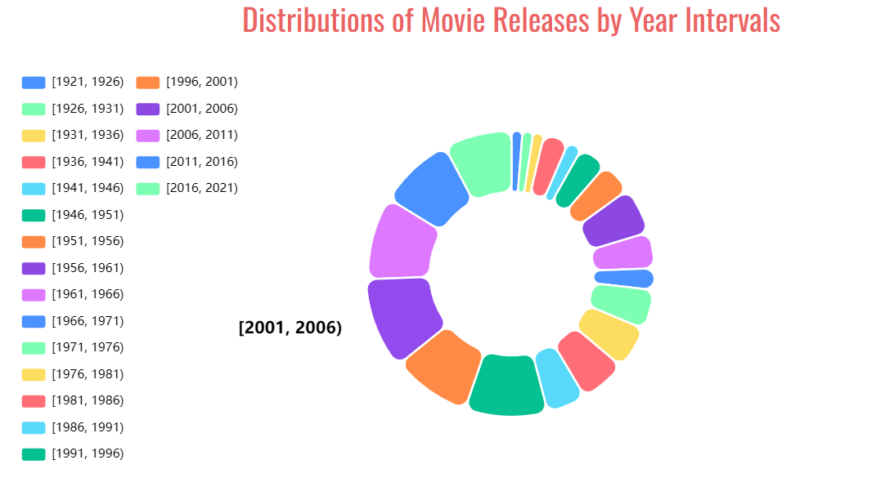
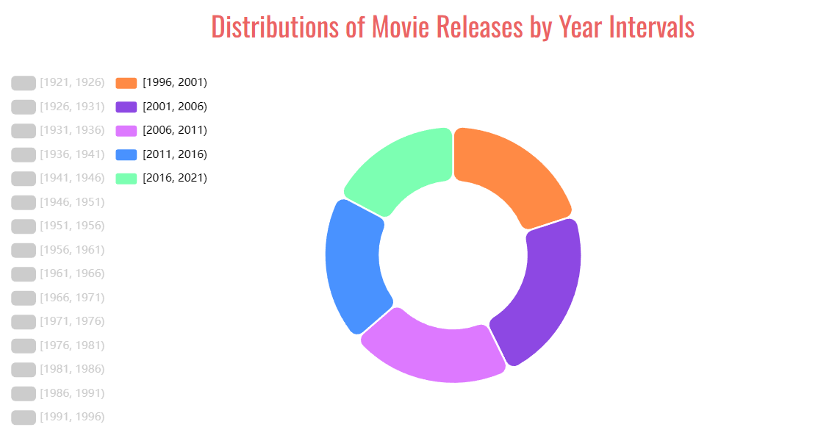
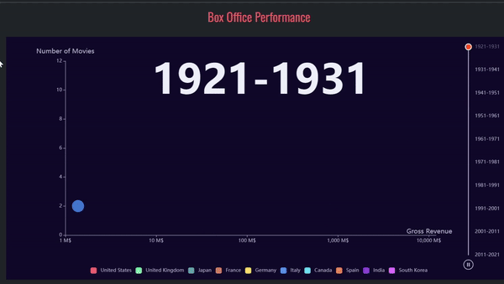
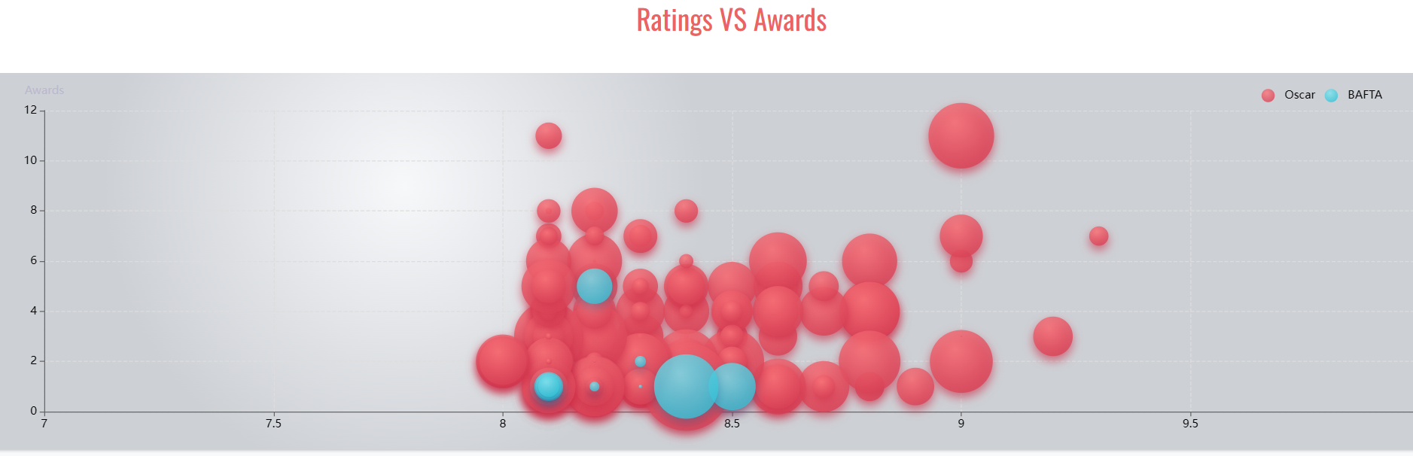
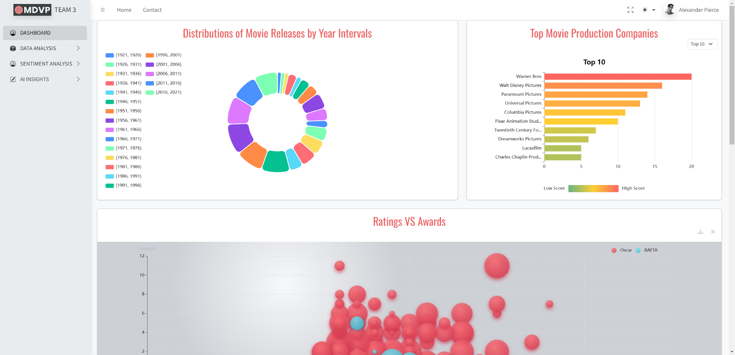
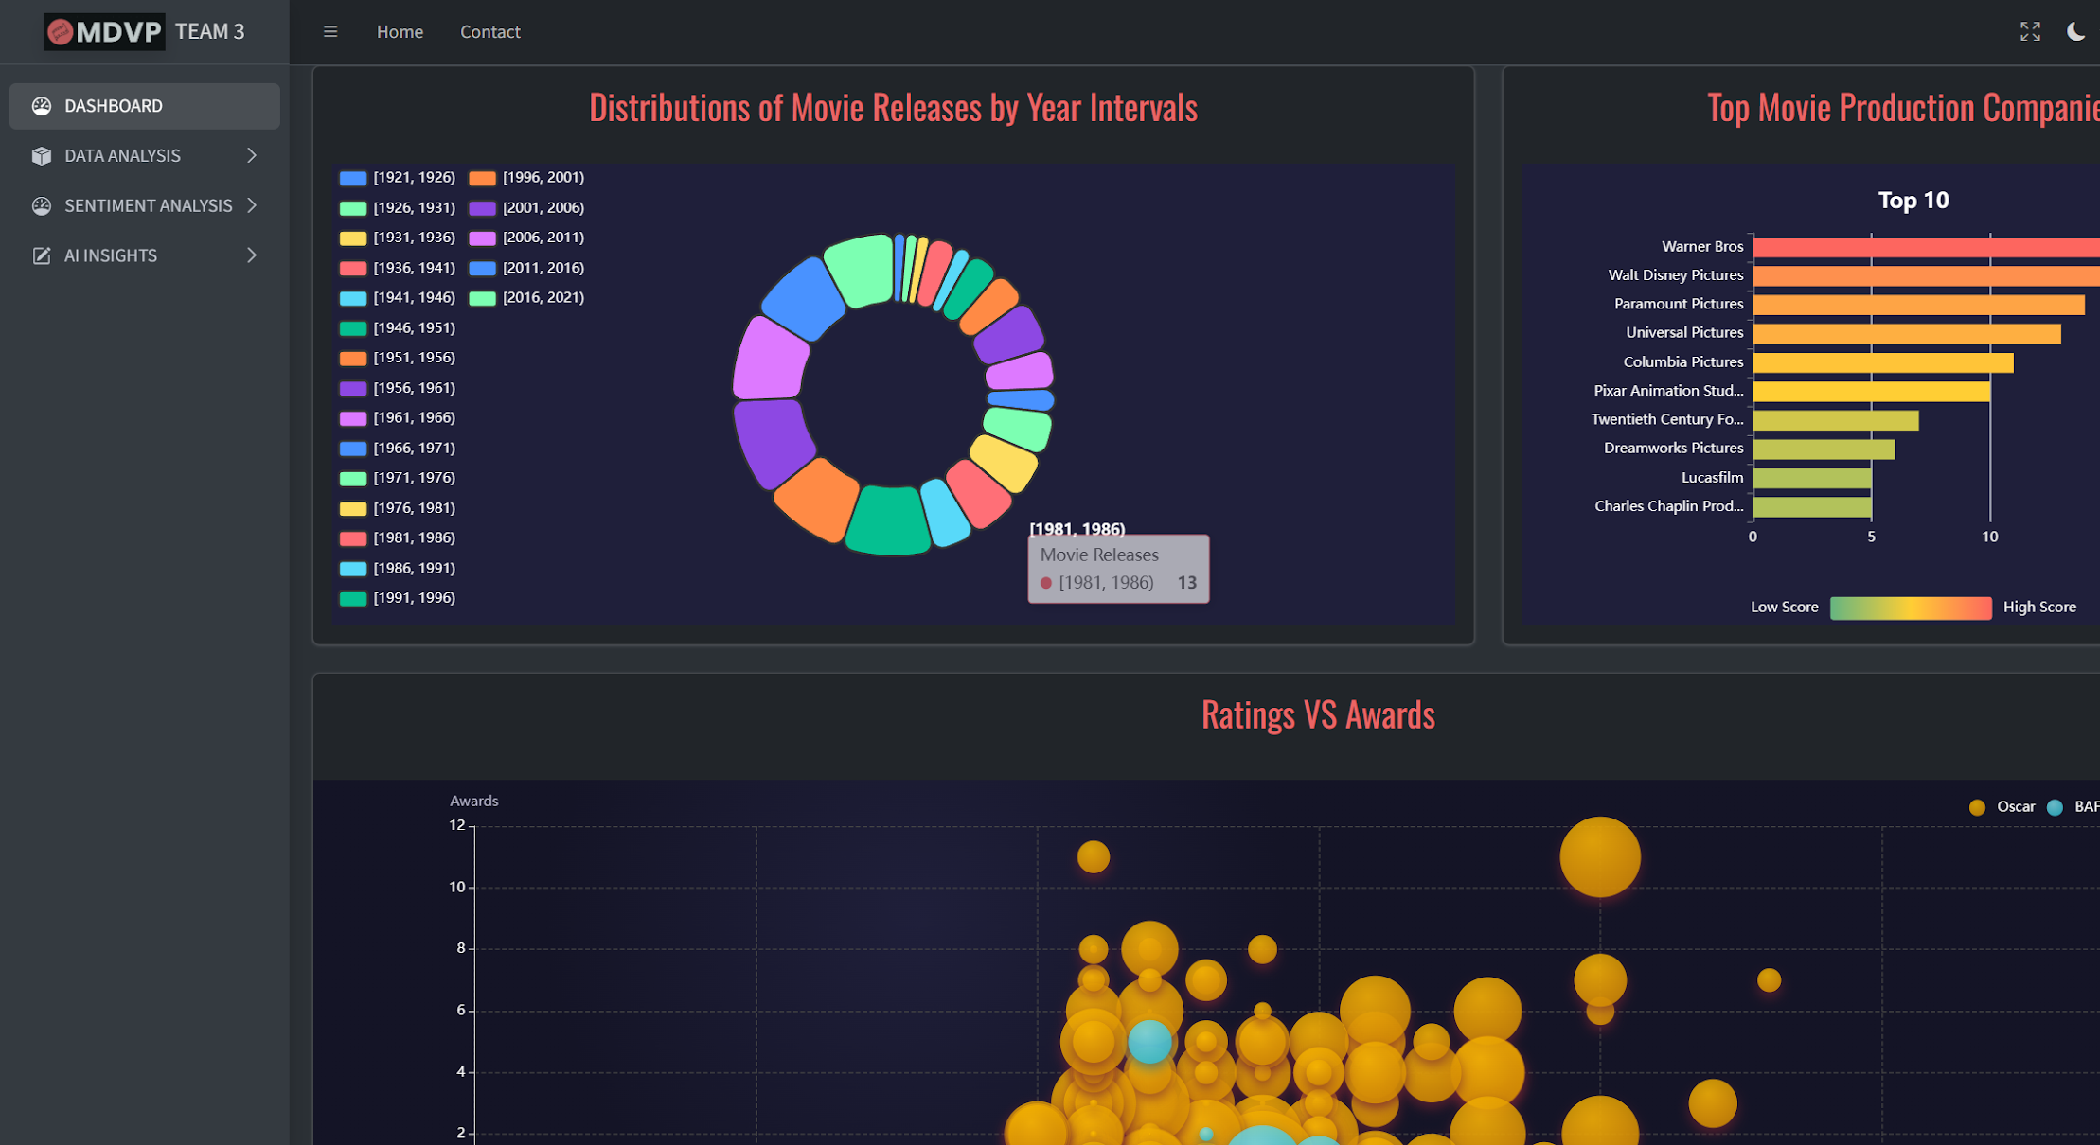
Enhanced Visual Elements
Interactive Charts:
Includes pie charts, bar charts, and radar charts, offering dynamic data interaction.
Bubble Charts:
Displays relationships between box office performance and movie attributes.
Dark and Light Modes:
The interface offers dark and light themes, providing flexibility for user preferences and enhancing accessibility across different lighting conditions.

Slide 11
03
Implementation

Slide 12
Implementation
Data Processing:
Pandas Workflow:
Data loading → Cleaning → Grouping → Exporting JSON for visualization.
Examples:
  Runtime Conversion: Standardized to minutes.
  Language Analysis: Top 20 languages by frequency.
  Yearly Trends: Movies grouped by 5-year intervals.
Visualization Implementation
ECharts Integration:
  Bar Charts: Genre-based ratings.
  Funnel Charts: Country-wise production.
  Word Cloud: Sentiment analysis keywords.
  Dynamic Updates: AJAX calls for seamless data retrieval.

Slide 13
Implementation
Security Measures:
Database Security:
  Environment variables for credentials.
  SQL injection prevention (Django ORM).
Session Management:
  CSRF protection.
  Session timeout for inactive users.
Challenges & Future Work
Key Challenges:
  Docker integration for seamless deployment.
  Optimizing AJAX-based data updates.
Future Enhancements:
  Real-time data refresh.
  User account management.

Slide 14
04
Requirement Analysis

Slide 15
High-Level Requirements
Essential Requirements
Non-Functional Requirements
Interactive Dashboard Visualization: Explore movie attributes (ratings, genres, distributions, rewards, etc.)
Box Office & Genre Insights: Visualize box office performance and genre distribution
Movie Duration & Language Analysis: Analyze movie runtimes and language diversity
Sentiment Analysis: generate a word cloud from movie reviews and perform sentiment analysis
Performance: Charts and tables render within 2 seconds; pagination loads within 1 second.
Scalability: Supports up to 1,000 concurrent users with room for future features.
Security: User authentication uses encrypted storage and transmission.
Database Security: Protect against unauthorized access and SQL injection
Usability: Intuitive navigation with responsive charts, tooltips, and legends.
Maintainability: Modular code design with documentation and regular reviews.
Database Security: Protect against unauthorized access and SQL injection

Slide 16
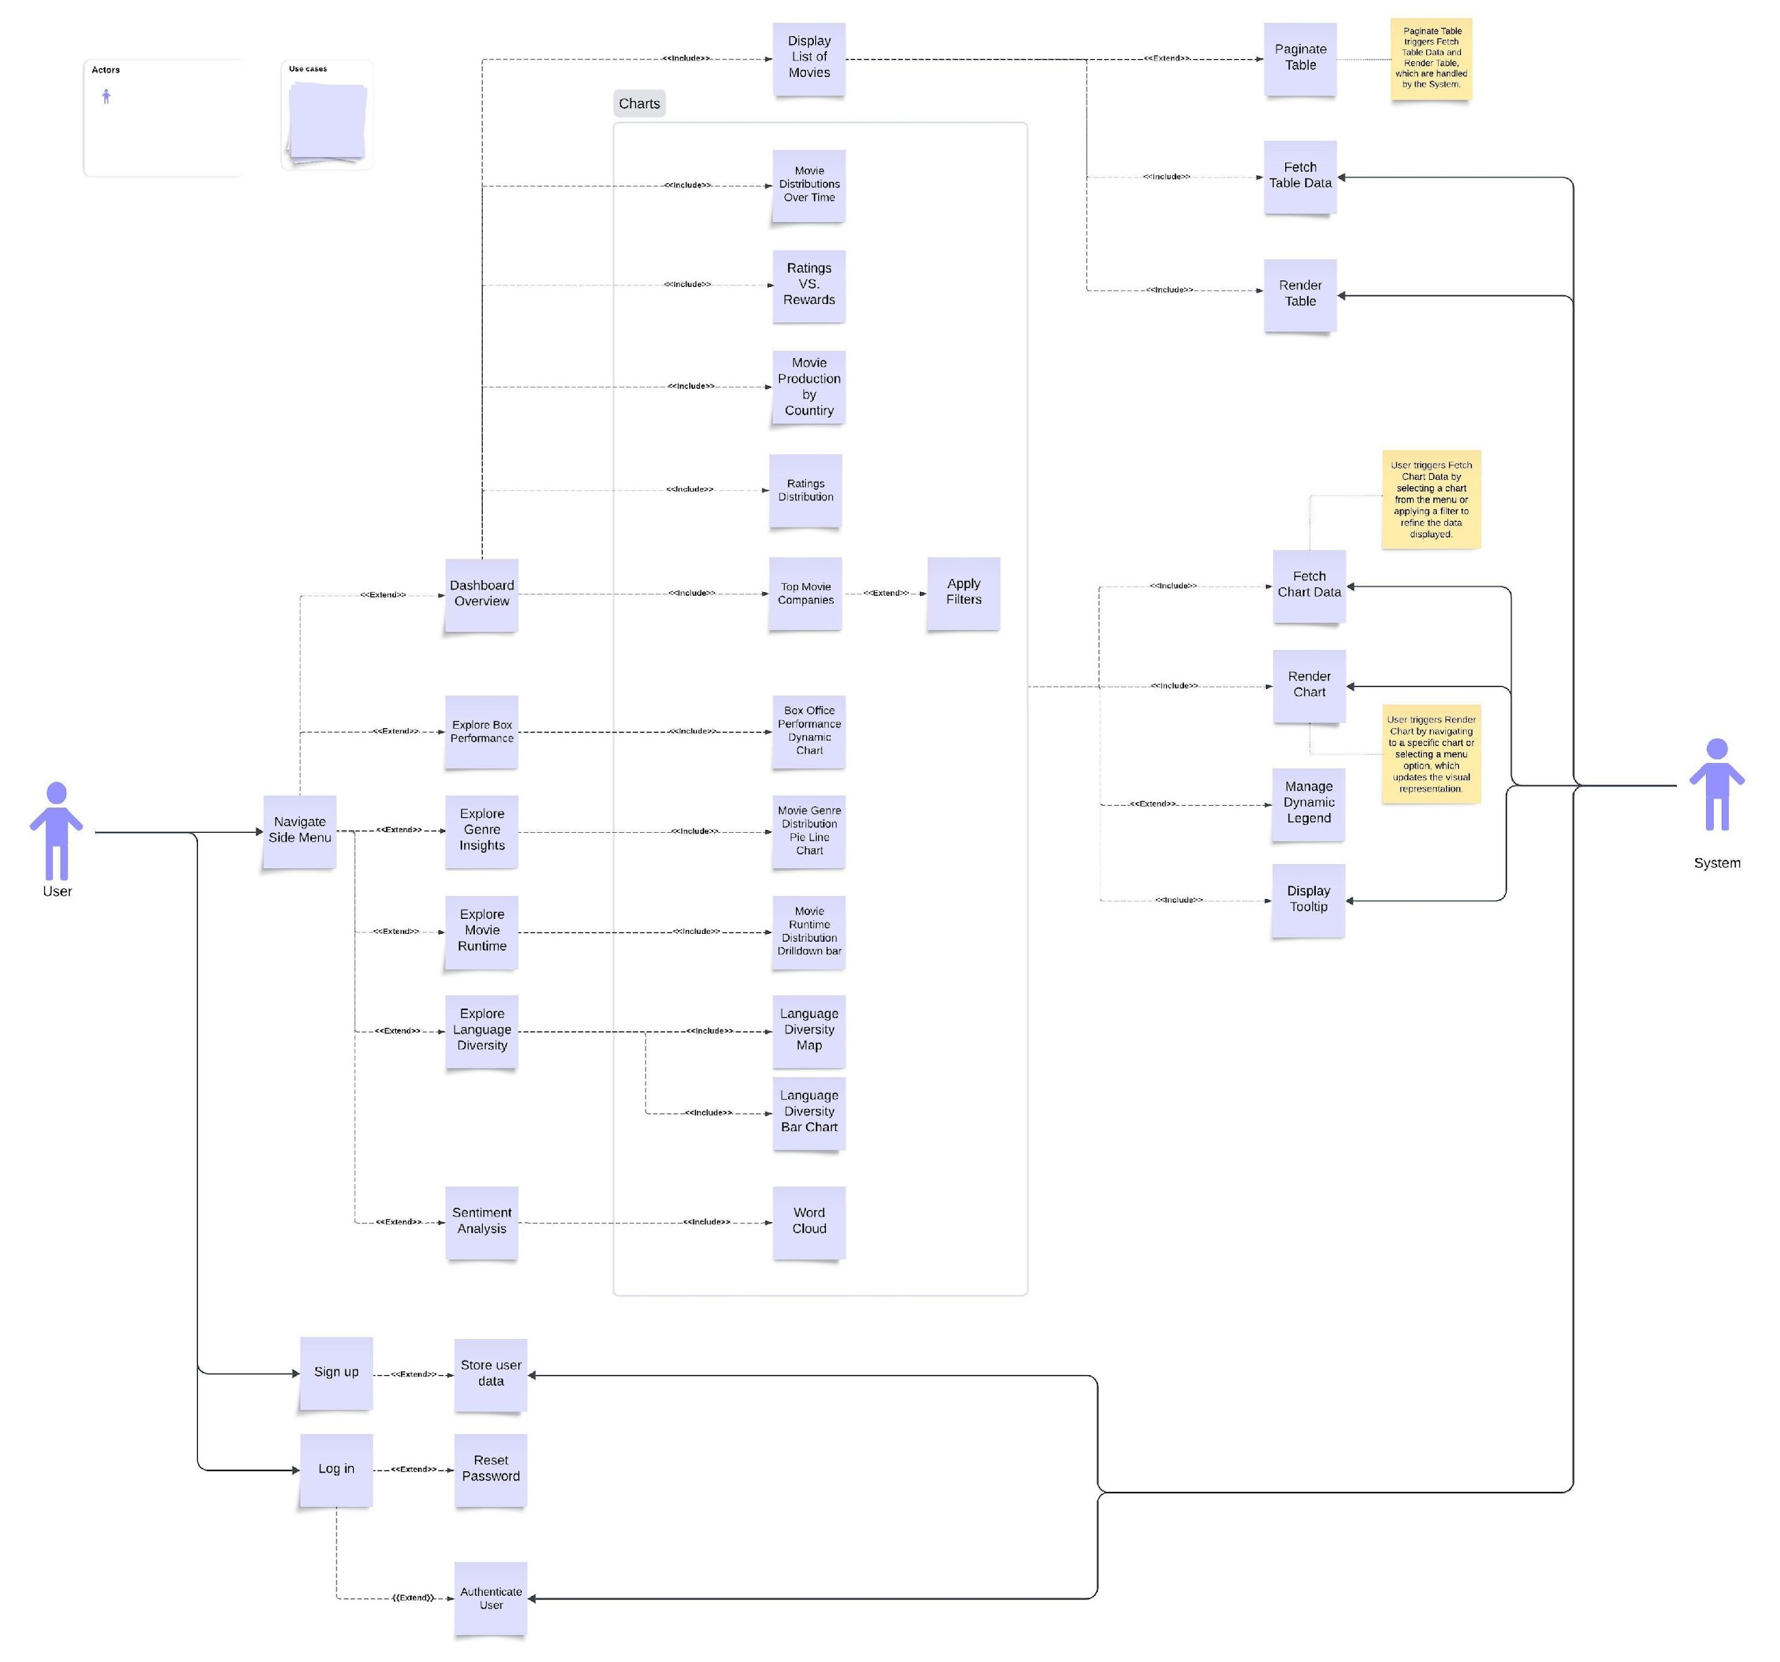
Use Case
Diagram

Slide 17
User Story Example
User Story #27: Box Office Performance Dynamic Bubble Chart
Title: Implement a Dynamic Bubble Chart for Box Office Performance
Description:
As a user, I want to view a dynamic bubble chart that visualizes the relationship between the gross revenue and number of movies produced across different countries and time intervals so that I can identify trends in box office performance.

Slide 18
User Story #27: Box Office Performance Dynamic Bubble Chart

Slide 19
Acceptance Test Example
Acceptance Test 1
Acceptance Test 2
Given the "Box Office Performance" menu is available,
When I click on this menu,
Then I should see a dynamic bubble chart, where:
  The x-axis represents gross revenue.
  The y-axis represents the number of movies produced.
  The size of the bubbles represents the total movie count for each country.
  The bubbles are color-coded by country.
Given the bubble chart is displayed,
When I hover over a bubble,
Then a tooltip should display the following details for the selected country:
Country name
Gross revenue
Number of movies produced
Total movie count
The time interval

Slide 20
Acceptance Test Example
Acceptance Test 3
Acceptance Test 4
Given the bubble chart is displayed,
When I interact with the timeline,
Then the chart should dynamically update to reflect the box office performance for the selected time interval.
Given the bubble chart is displayed,
When I view the legend at the bottom of the chart,
Then I should see the countries listed with colors corresponding to their bubbles on the chart.

Slide 21
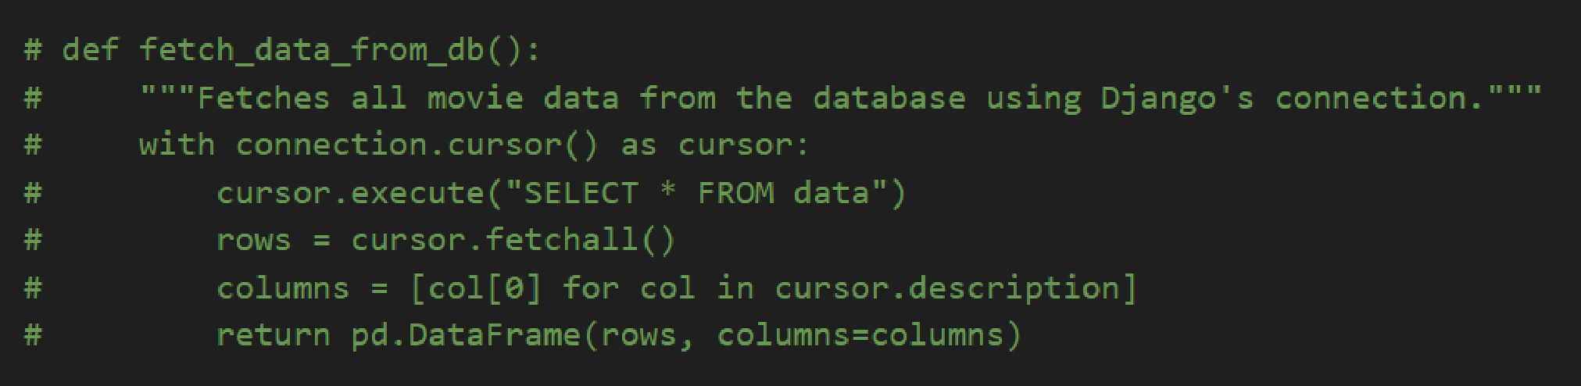
Refactoring Example
Fetching Data from Database
Before Refactoring
Data was fetched directly from the database using Django's connection.cursor() and raw SQL queries. This approach was functional but lacked the benefits of Django's ORM.

Slide 22
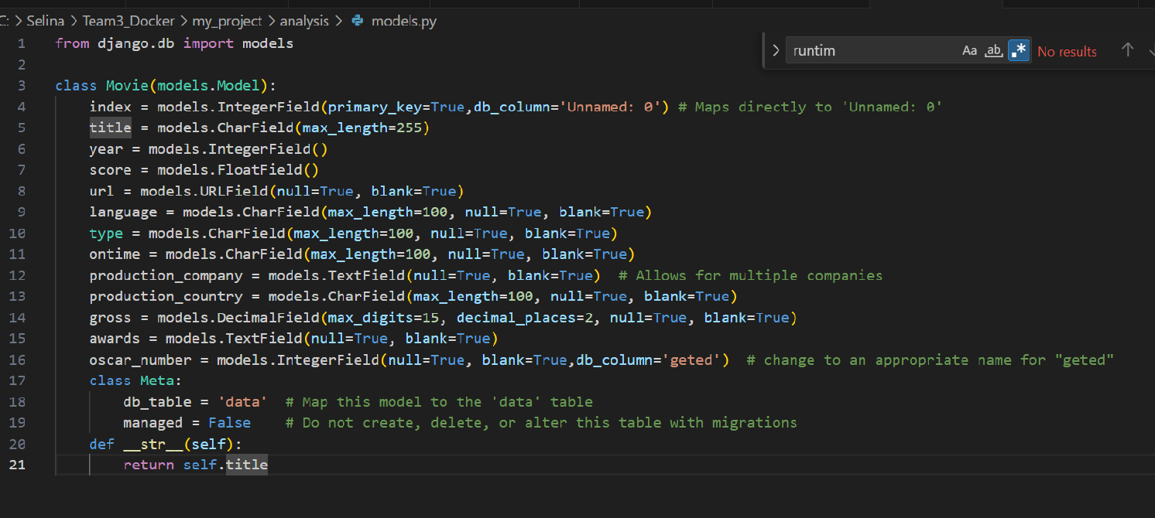
After Refactoring
The implementation now leverages Django's ORM and the Movie model for database interaction. This improves readability, maintainability, and security.

Slide 23
Key Benefits of Refactoring
Readability: ORM queries like Movie.objects.all().values() are more expressive and easier to understand than raw SQL.
Maintainability: Model definitions act as a single source of truth. Any schema changes are handled in the model, not scattered across raw SQL queries
Extensibility : Filtering, ordering, and complex queries can now be handled with ORM methods, simplifying future feature additions.
Security: The ORM automatically escapes inputs, reducing the risk of SQL injection.
Reusability: The Movie model can be reused throughout the project, allowing consistent access to database data

Slide 24
Requirement Management
Tracking Requirement
Jira for managing user stories, tasks, and epics, with Kanban boards for tracking progress.
Progress Reports for weekly updates on completed tasks, ongoing work, and blockers
Handling Requirement Changes
Changes were logged in Jira, assigned priorities, and approved after impact analysis.
Updates were discussed in team meetings and reflected in user stories, and acceptance criteria.

Slide 25
User Story Counts Table
 | Planned | Completed | Total
Counts | 3 | 13 | 16
Points | 10 | 89 | 99

Slide 26
05
Testing

Slide 27
Testing overview
Key Points:
Testing ensures the reliability and functionality of the system by identifying issues early.
Focused on:
  Verifying core functions, such as data visualization and sentiment analysis.
  Ensuring accurate data processing.
  Testing robustness under different conditions.

Slide 28
Testing types
Unit Testing
Integration Testing
Testing individual functions or components (e.g. generate_word_cloud)
Ensuring smooth interaction between modules (e.g. FunnelDataAPI_Test )
System Testing
Acceptance Testing
Verifying the end-to-end functionality of the system
Confirming that the project meets user requirements

Slide 29
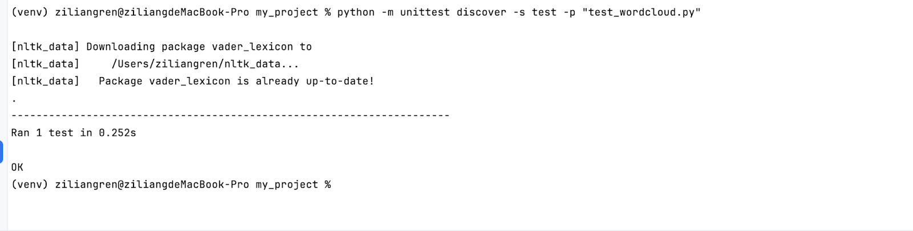
Test Case Examples
01
word cloud generation
Verified that high-frequency words are accurately identified and visualized
Tested rendering consistency with different datasets, including large and small reviews

Slide 30
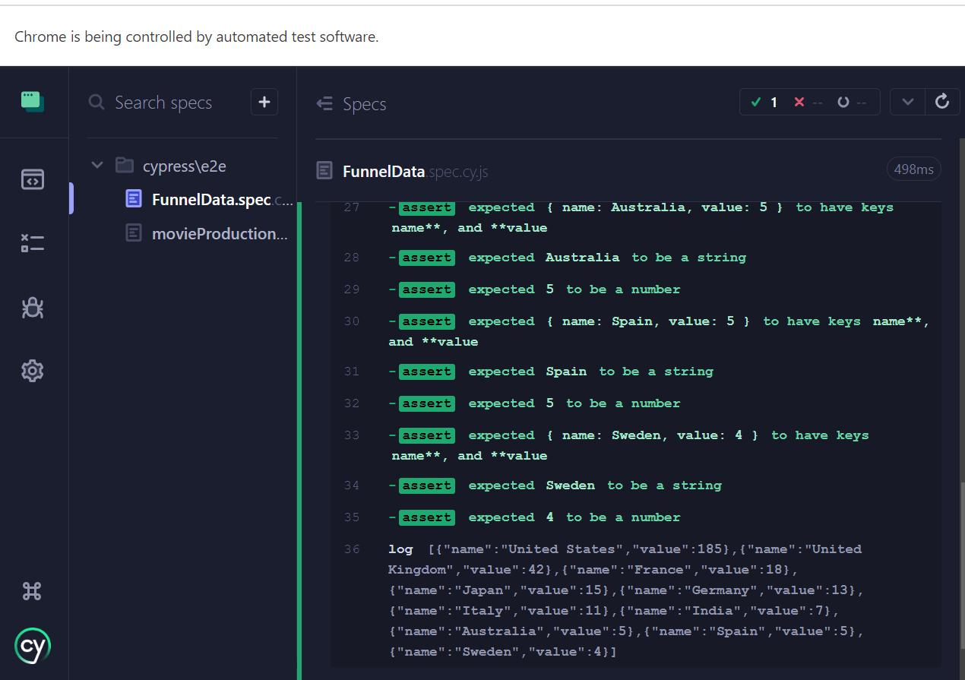
02
funnel data API test
Verified that the API returns the top 10 countries by movie production count with accurate data.Ensured the JSON response contains the correct structure (name as a string, value as a number).Tested API response consistency under different setups using Cypress

Slide 31
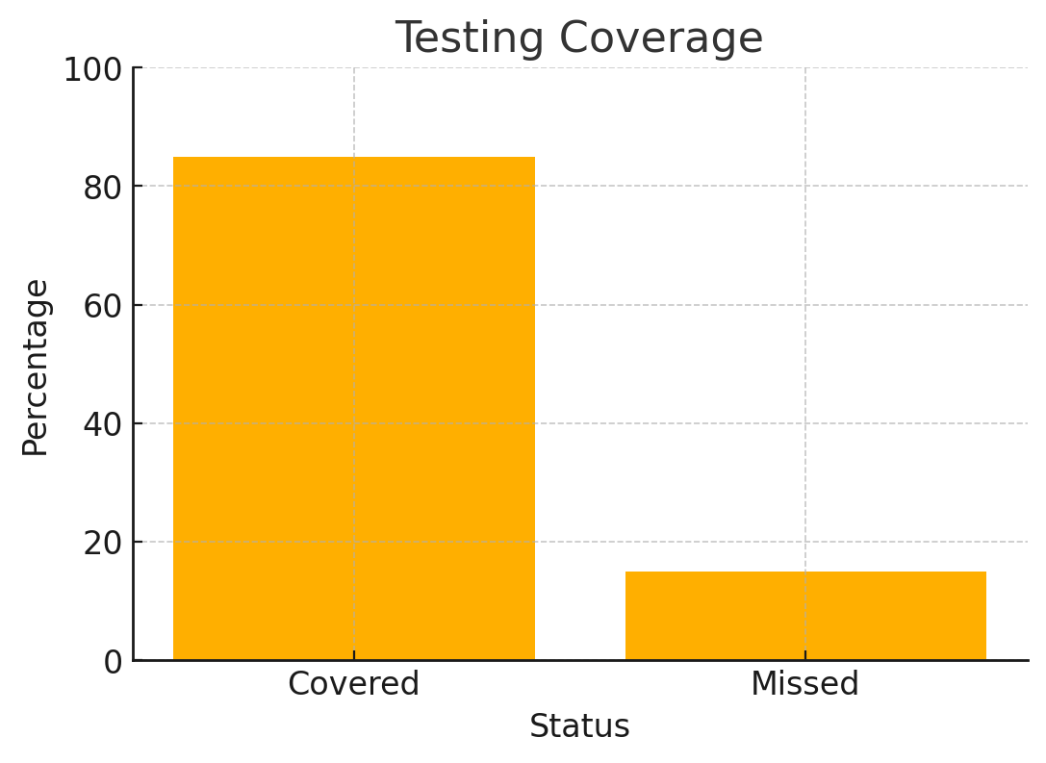
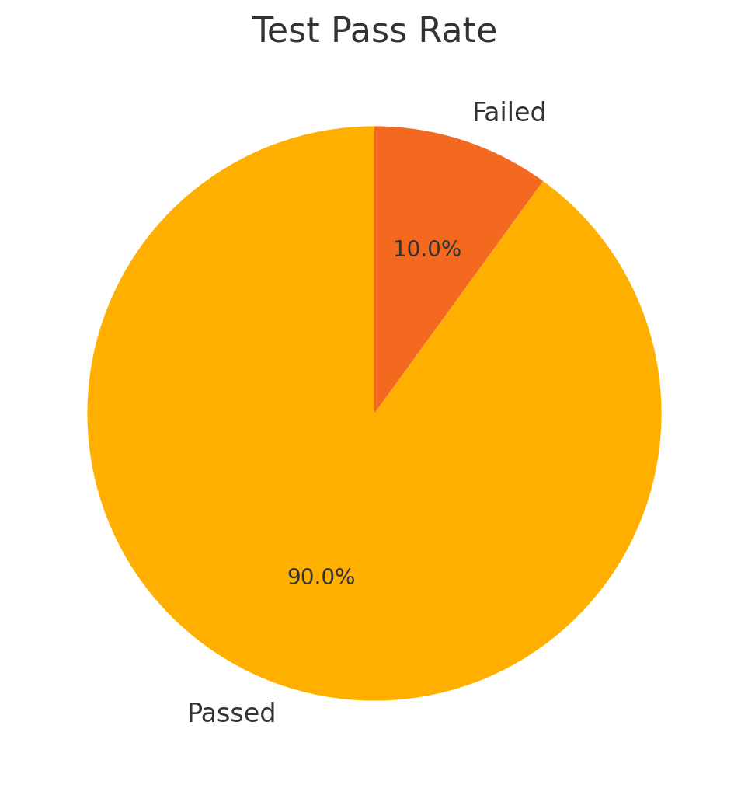
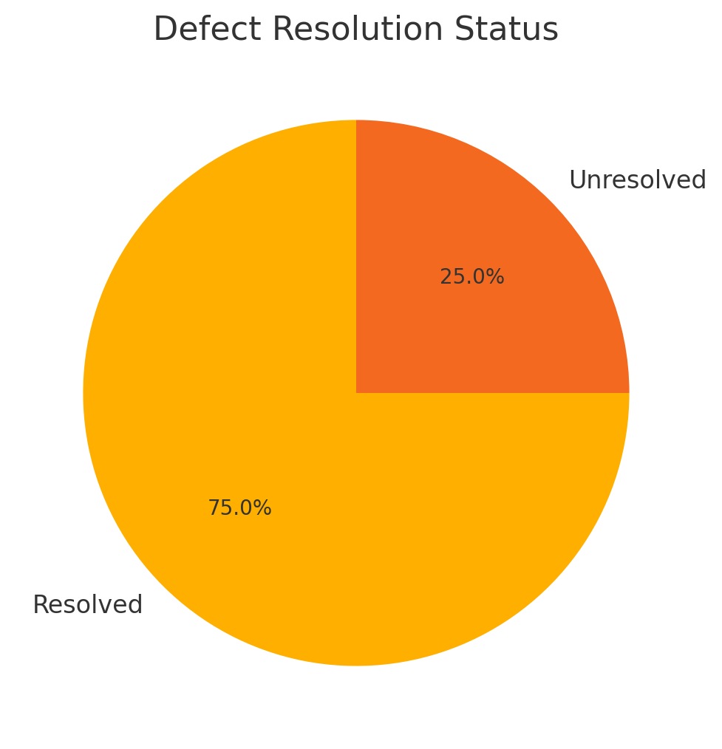
Testing Metrics
Test Coverage
Pass Rate
Defects

Slide 32
06
User Account Features and Security

Slide 33

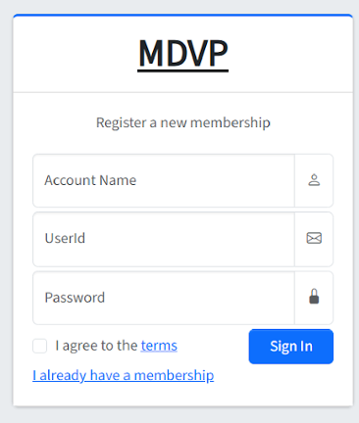
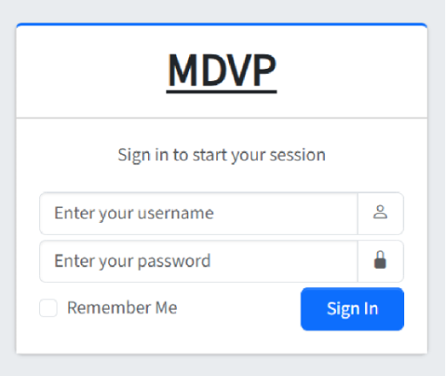
Feature Updates
New user login and registration pages implemented
New design for better user experience
Added 'Remember Me' option on the login page
Introduced terms and conditions acceptance during registration

Slide 34
• Encrypted passwords for secure storage.
• Email validation added for registration.
• CSRF protection enabled for login and registration forms.
• Password complexity requirements implemented.
Security
Enhancements

Slide 35
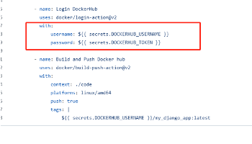
Docker Workflow Security
Utilized GitHub Actions to automate Docker image builds.
Integrated secret management for DockerHub credentials.
Secrets ensure secure authentication without exposing credentials.
Pushes secure and verified images to DockerHub.

Slide 36
07
Project management

Slide 37
Version Control
Implemented Git/GitHub for code integrity and team collaboration.
Deployment Automation
Utilized Docker and GitHub Actions for consistent environments and automated deployments.

Slide 38
Risk Management
Technical Training
Docker Setup
Conducted training to enhance skills in Django and Python.
Overcame configuration issues by optimizing settings and documenting solutions.

Slide 39
Quality Management
Lines of Code (LOC)
Cyclomatic Complexity
01
02
Tracked to measure development progress.
Managed to ensure code maintainability.
Defect Rate
Test Coverage
03
04
Aimed for a rate below 1.5 defects per KLOC
Targeted 80% for backend and 70% for frontend

Slide 40
Project Achievements
Development and Integration
Enhanced Data Processing:
We have successfully developed and integrated the platform's core features, including dynamic movie trend visualizations, sentiment analysis of user reviews, and interactive word clouds derived from review text.
The backend's dataAnalysis application has significantly enhanced our platform's ability to process and analyze extensive datasets from IMDb. This application is pivotal for delivering complex analytical operations and deep insights into movie industry trends
User-Friendly Interface:
Robust System Architecture:
We have crafted a user-friendly interface that simplifies navigation and interaction with the platform's data visualizations and analysis tools.
Our platform is built on a robust, Docker-based architecture, which ensures scalability and security. The use of Docker containers for the database, frontend, and backend components promotes seamless integration and maintains consistent deployment environments

Slide 41
Challenges and Solutions
01
02
Cross-Env Configs
Dynamic Configuration
Used a centralized tool to manage configs across environments, cutting complexity and errors.
Enabled real-time config updates without redeployment, increasing adaptability.

Slide 42
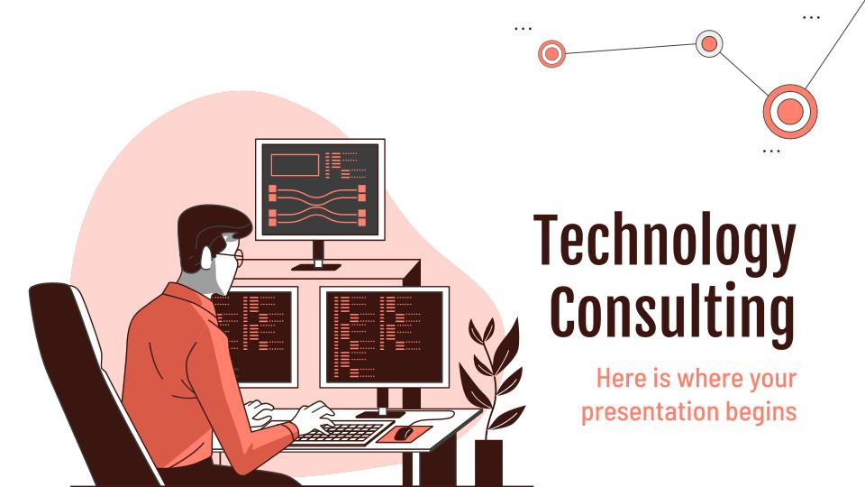
Lessons Learned
Adaptability: Gained insight into the necessity of being flexible with configuration strategies to accommodate rapid technological changes and maintain efficiency in deployment processes.
Proactive Configuration Checks: Learned the value of preemptively identifying and resolving potential configuration issues to prevent disruptions in the deployment pipeline and ensure system stability.

Slide 43
08
Live Demo

Slide 44
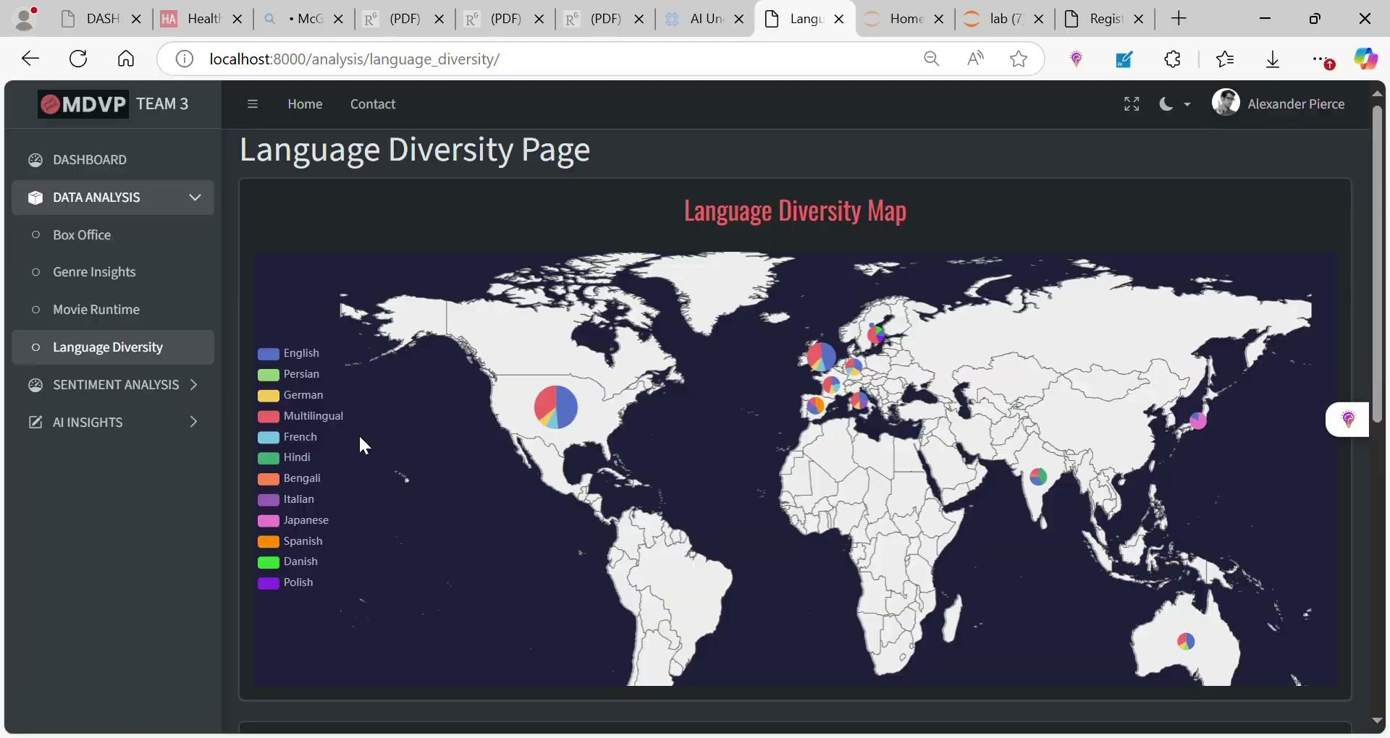
Language Diversity MAp

Slide 45
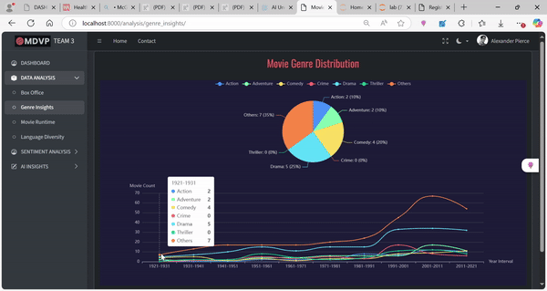
Movie Genre Distribution

Slide 46
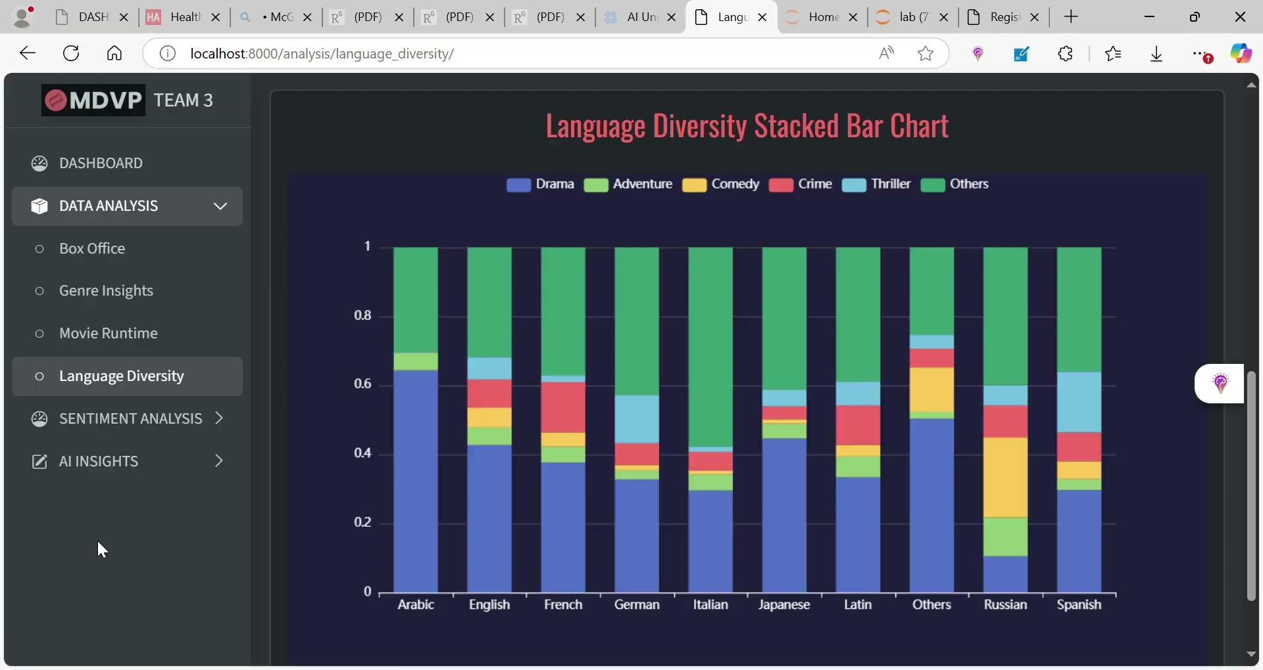
Language Diversity Bar Chart

Slide 47
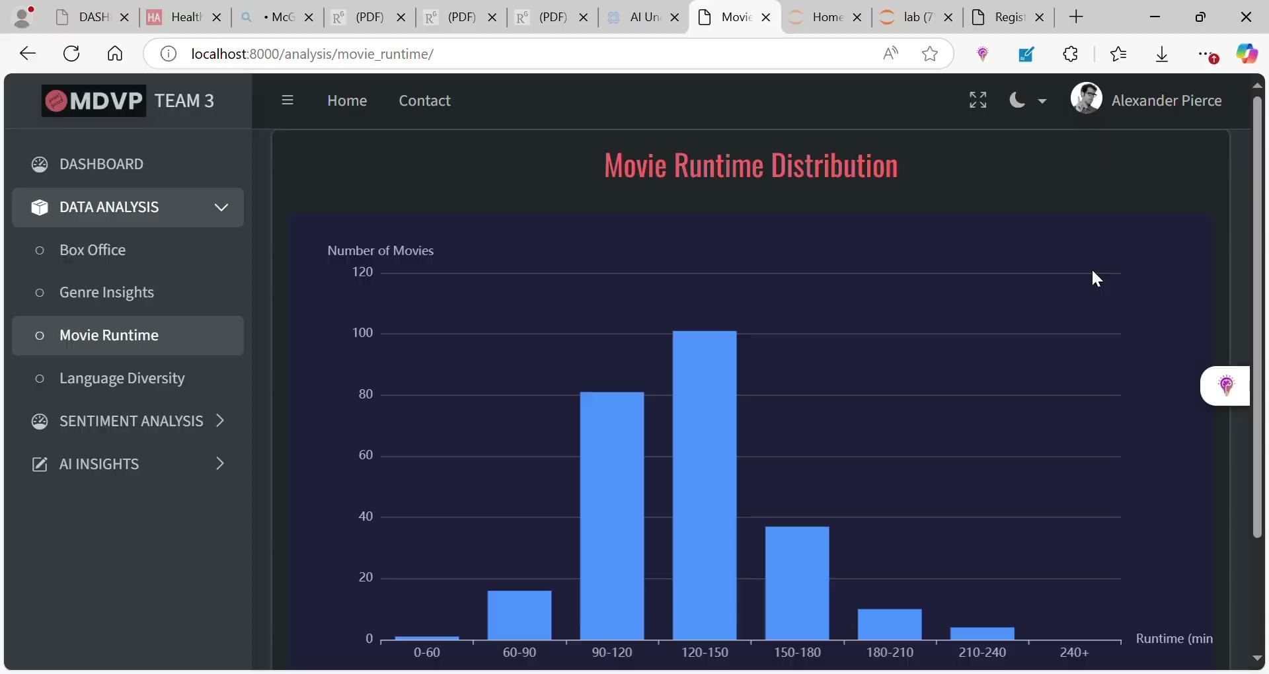
Movie Runtime Distribution

Slide 48
Thanks!
Do you have any questions?
Please keep this slide for attribution

