Slide 1

Movie Data Visualization Platform
MDVP Project
Team 3 - Movie Masters

Slide 2
Table of Contents
01
03
04
05
User Management
02
Dashboard & Demo
Sentiment/Word Cloud
Automated Testing

Slide 3
01
Registration and Login Features

Slide 4

Function Overview
Provide secure, user-friendly signup and login functionality in the movie data visualization app.
Custom signup form with specific username and password requirements.
Login feature with error handling and redirection.
Inline error messages for user feedback.

Slide 5
Username Requirements:
Length between 5-13 characters
Letters and numbers only
Password Requirements:
At least 8 characters
Must include uppercase, lowercase, digit, and special character
Warning Messages:
Error messages are displayed in red to alert users immediately
Signup Form Requirements

Slide 6
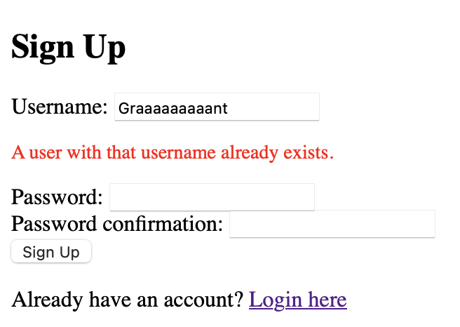
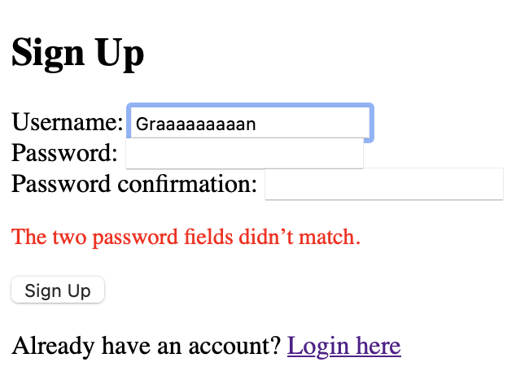
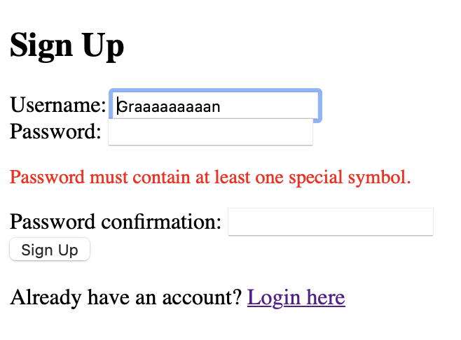
Signup Page Implementation
Error messages (in red) guide users when validation rules are not met.
Screenshots demonstrate feedback such as:
  A user with that username already exists
  Password must contain at least one uppercase letter
  Password must contain at least one special symbol

Slide 7
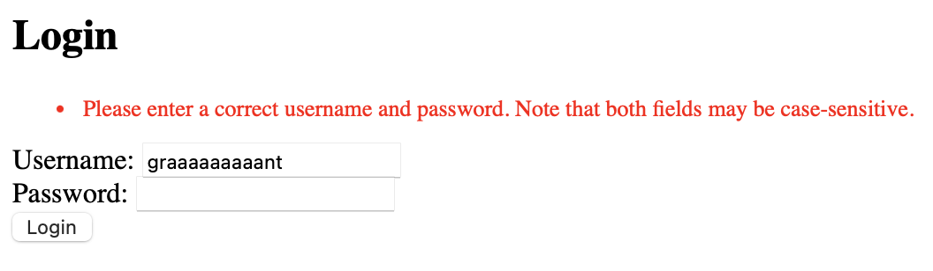
Login Page Implementation
The login functionality handles invalid credentials with warning message
This ensures users are alerted when entering incorrect information
Screenshot shows an example message

Slide 8
Security
Django’s secure password hashing and session handling
CSRF protection on all forms
1
2
3
Password validation enhances security against weak credentials

Slide 9
Future Improvements for Signup and Login
User Experience Enhancements:
Tooltips or guidelines displayed next to fields.
Password strength meter for visual feedback.
Advanced Security Measures:
Two-factor authentication for added security.
Email verification to confirm account ownership.

Slide 10
02
Dashboard

Slide 11
Frontend
Dashboard.html---Data Fetching & Display
Handles data retrieval
from the backend
Displays the data in an
interactive format for the user.
Allows easy adjustments
for styles like colors,
themes, and layouts.

Slide 12
Frontend
Charts-setup.js-manage chart styles
Centralizes all chart
styles and options.
Ensures consistent
visual themes across
all charts.
Allows easy adjustments
for styles like colors,
themes, and layouts.

Slide 13
Backend
Views.py
Processes and prepares
data for visualization
Sends data to
dashboard.html for display
Ensures data integrity and
efficient data flow from
backend to frontend

Slide 16
Bubble Size：Movie_Gross
Bubble Color：Awards_Type
X axis: Movies Rates
Y axis: Number of Awards
ToolTip: Title , Rating, Awards, and Gross

Slide 17
Light Mode-Bubble Chart

Slide 20
Funnel
Chart

Slide 21
Dynamic Demo-MDVP

Slide 22
03
Sentiment/wordcloud and testing

Slide 23
Function Overview
Word cloud
Retrieves text from the database.
Generates a word cloud image.
Returns a PNG response.

Slide 24
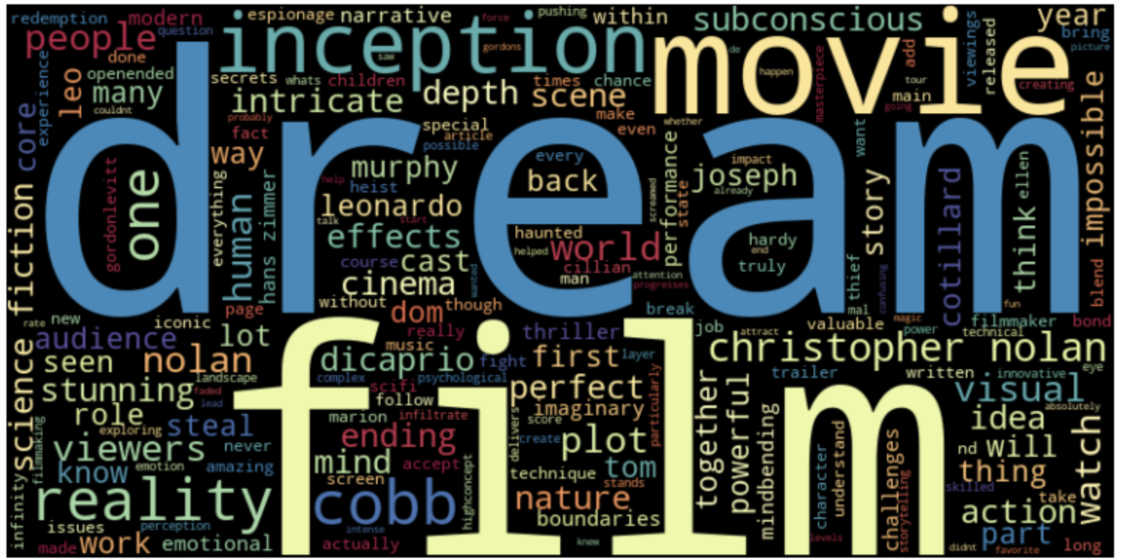
Purpose of WordCloud
Definition
Purpose in Project
Benefits
A WordCloud is a visual representation of the frequency of words in a text, where more frequently appearing words are shown in larger font sizes.
Provides a quick and intuitive overview of important words, enhancing data insights.
Helps users visually analyze key terms or themes within their text data.

Slide 25
Test Case Information
Name: WordCloud Generation
01
02
Priority: High
  Importance: Core feature for user experience.
03
New or Old: New
04

Slide 26
Preconditions and Dependencies
Content:
Django environment configured.
UserText model available.
Libraries: nltk and wordcloud.

Slide 27
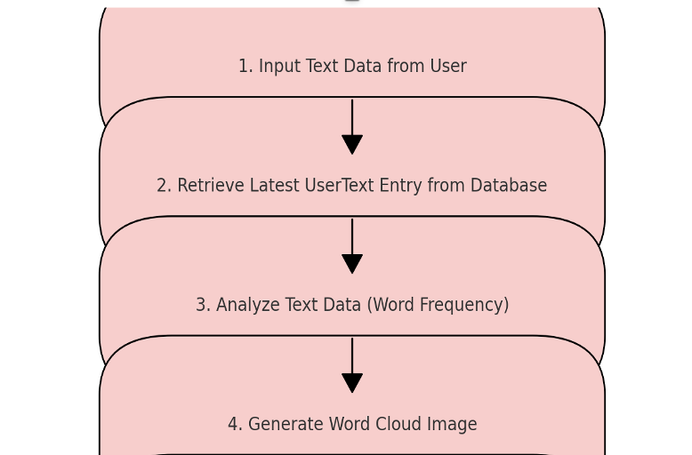
Input Data & Expected Output
input: UserText object with text "This is a test text for word cloud".Expected Output:Response type: HttpResponse.
Content type: image/png.
Content: Valid image data.

Slide 28
Test Steps
Mock UserText.objects.latest to return test data.
Call function and capture response.
1
2
3
4
Simulate GET request to generate_wordcloud
Verify response format and content

Slide 29
Test Results
If Pass: Function works as expected.
If Fail: Investigate and create issue.

Slide 30
Conclusion

Slide 31
04
Automated Testing

Slide 32
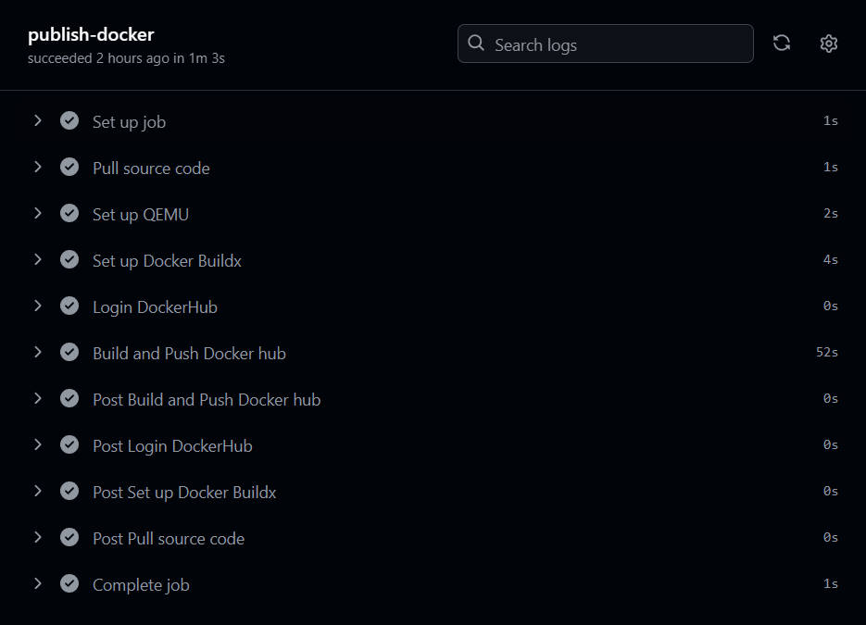
Automated Testing Framework Overview
              Objective: The primary goal of this automated testing framework is to ensure code quality and deployment consistency by automatically building and publishing the code each time changes are pushed to the development branch.
Implementation: This framework is implemented using GitHub Actions and operates on every push and pull request to the development branch.

Slide 33
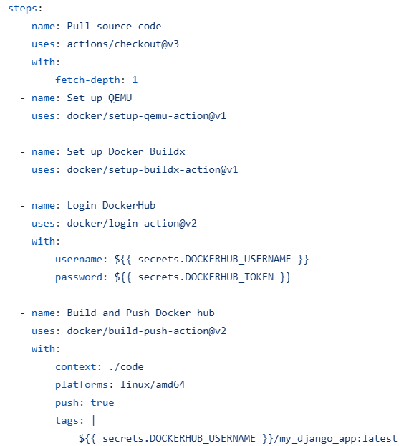
Framework Components
              YML File Location: The file Build-Dockerhub.yml is located in the .github/workflows folder in our code repository.
Test Frameworks: This setup does not utilize traditional test frameworks like Pytest or the Django testing suite. Instead, it focuses on automated building and deployment to ensure continuous integration.
Security Consideration: We took security into account by setting secrets.DOCKERHUB_USERNAME and secrets.DOCKERHUB_TOKEN in our code, an improvement suggested by our security leader.

Slide 34
Framework Components
              Workflow Steps:
Pull Source Code: Fetch the latest code from the repository.
Set Up QEMU: Configure QEMU for multi-platform support.
Set Up Docker Buildx: Enable Docker Buildx for cross-platform builds.
Login to Docker Hub: Securely log into Docker Hub.
Build and Push Docker Image: Build the Docker image and push it to Docker Hub under the latest tag.

Slide 35
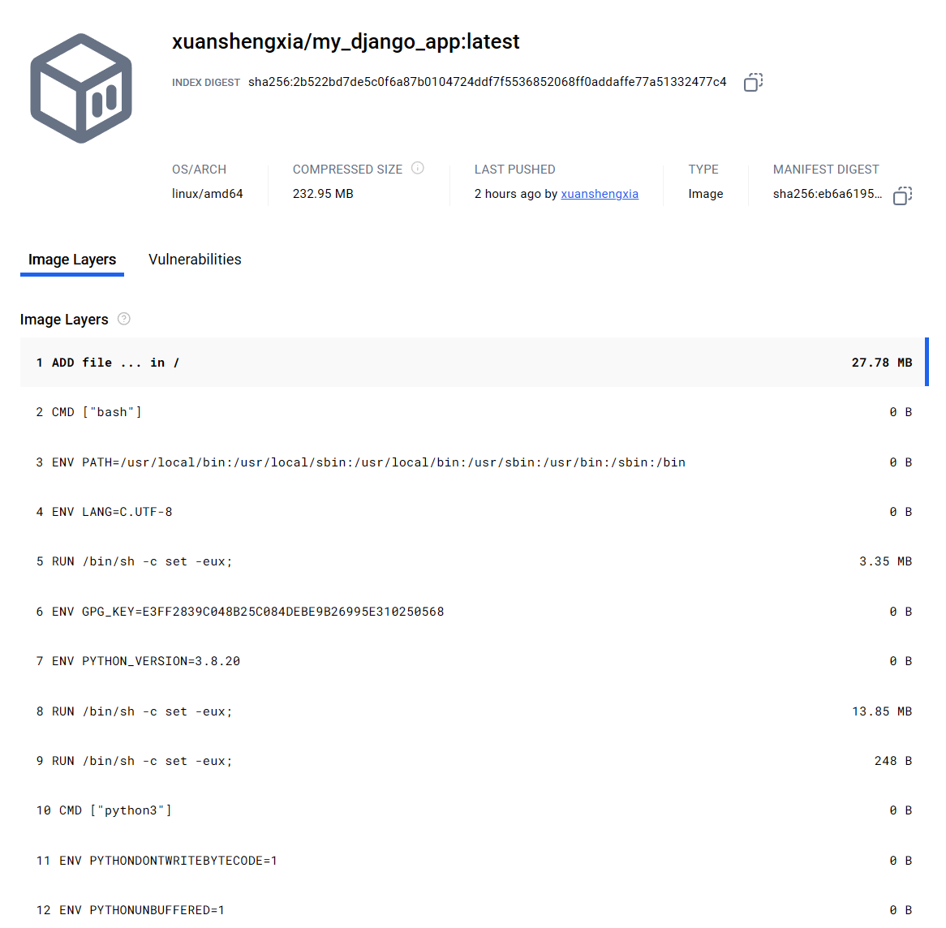
Docker Hub Results
After each GitHub Actions run, the built Docker image is pushed to Docker Hub.
The screenshot shows the Docker Hub page with the image layers, latest tag, and last pushed timestamp, confirming that our automated deployment updates the latest version consistently.
Running the Image: To pull and run the latest Docker image, use docker pull and docker run.

Slide 36
Thanks!
Do you have any questions?
Please keep this slide for attribution

