Slide 1

Team 3
Team Lead: Chris
Design and Implementation Lead: Abbie
Configuration Lead: Eddie
QA Lead: Amanda
Security Lead: Alex
Requirements Lead: Kenny

Slide 2
Project: Health and Wellness Tracker
Problem: It can be easy to lose track of our own diet, exercise, and wellness routines when life gets busy.
Solution: This project seeks to provide a straightforward and user-friendly system that helps users stay accountable, motivated and on track.

Slide 3
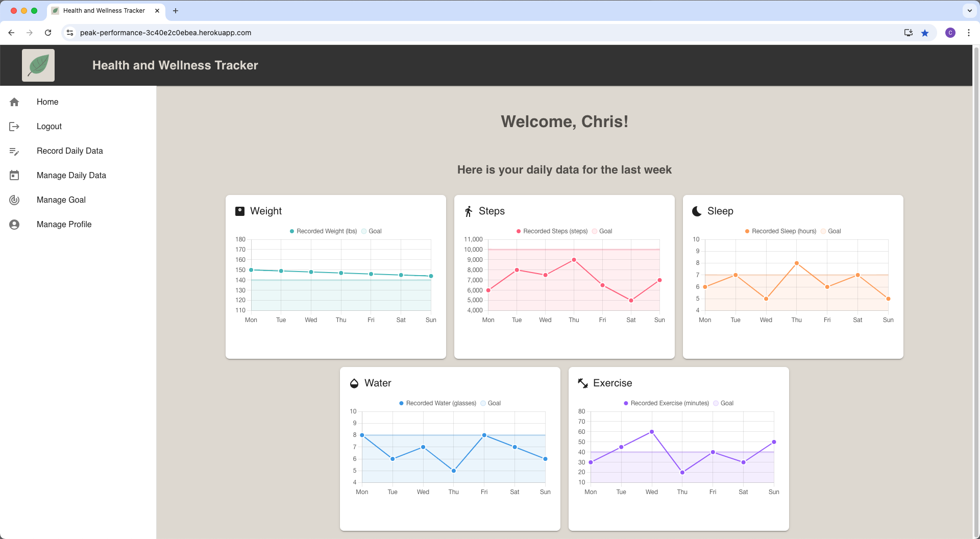

Slide 4
Requirement Analysis

Slide 5
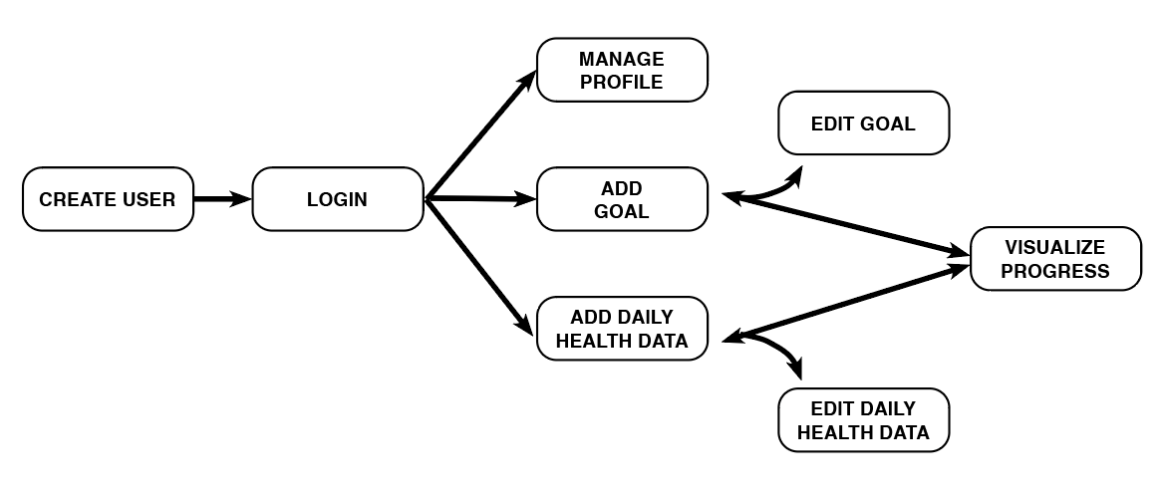
Requirements Overview: Use Case

Slide 6
Requirements Overview: Stories & Metrics
HRS / PTS
Implemented
Essential
Desirable
Optional
Login
Create Profile
Edit Profile
Add Goals
Edit Goals
Submit daily health summary
12/3
8/2
8/2
8/2
8/2
8/2
Edit Submitted Health Data
View Submitted Health Data
Time Series Dataviz
Homepage UI Improvements
Increased Password Security
Search and Add Friends
8/2
8/2
12/3
2/1
4/1
8/3
Notifications Receiver Panel
Streak Tracker Notifications
Edit Profile Visibility
Detailed Goal Statistics
Task Reminders
Create Custom Workouts
8/2
8/2
6/2
8/2
8/2
12/3
Dashboard Elements Adjustable by Timeframe
Nutrition Form
Fitness Form
Competitive Leaderboard
Suggest Daily Calories & Workouts
Specialized Preferences on User Profile
8/2
8/2
8/2
24/3
12/3
12/3
Specialized Goal Categories
Add Friends to Goals
Smart Nutrition Data Entry
Goals Calendar
12/3
8/2
8/2
24/3

Slide 7
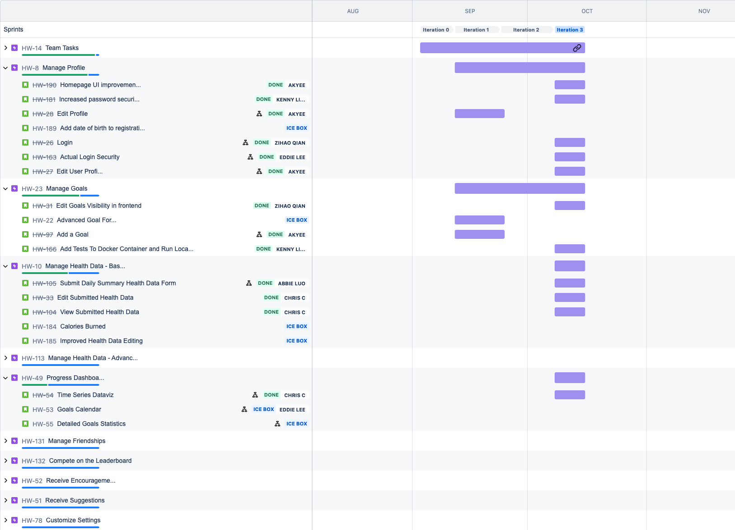
Requirements Tracking: Jira & Regular Bi-Weekly Meetings
Simplified some requirements (reducing to 5 data points), we cut some requirements (“friendships” feature) and we were able to exceed in other areas (UI).

Slide 8
Design

Slide 9
Architecture
MERN Tech Stack
MongoDB: NoSQL database for storing application data.
Express.js: Backend web application framework for Node.js.
React.js: Frontend library for building interactive UIs.
Node.js: JavaScript runtime for server-side programming.
Design Patterns
MVC: Structure is separated into components, enabling efficient teamwork, better organization, and scalability.
Model: MongoDB schemas (e.g., DailyEntry, User, Goal) represent the data and provide methods for querying.
View: Represents the UI layer, built with React.js.
Controller: Manages the flow of data and logic, using Express.js and Node.js.
The MVC architecture helps keep concerns separated, making the app modular and maintainable.

Slide 10
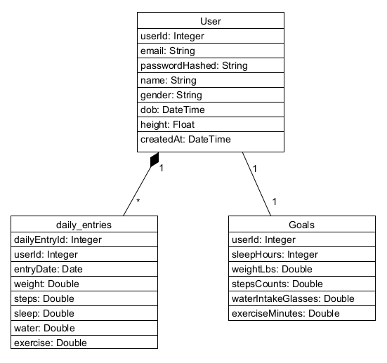
Class Diagram

Slide 11
Backend Architecture
Server
Server/Server.js - Entry Point of backend and responsible for:
Sets up the Express server
Connects MongoDB database
Defines the routes to handle API requests
Models
Represents the data structure in the application and directly interacts with the MongoDB database.
Controllers
Acts as the intermediary between the Model and the View (client)
Handles incoming HTTP requests from the client
Contains business logic
Routes
Defines the API endpoints and maps HTTP methods (GET, POST, etc.) to controller actions.

Slide 12
Frontend Architecture
Client/App.js
Entry Point of frontend Manages the application's main structure and sets up client side routing
Serves as the root component that wraps all other components in the React app
Defines the routes to handle API requests
src/Components
Reusable UI elements
src/Services/apiClient.js
Dynamic Server URL
Switches between development (localhost:5000) and production (Heroku URL) based on the environment.
Uses Axios for making HTTP requests from the frontend to the backend
src/Utils
Reusable functions

Slide 13
Configuration and Implementation

Slide 14
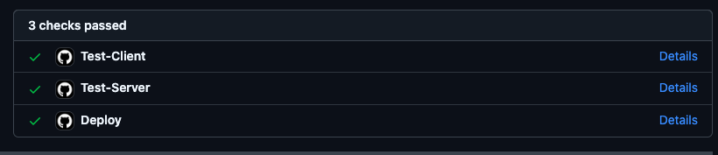
GitHub Strategy
Branching Strategy
feature -> dev -> release -> main
Feature branches named after Jira ticket
Release branches named after iteration
Pushes to dev will trigger a deployment to Heroku via GitHub Actions
Branch Protection
Pull requests to dev and main require a review from another team member
Pull requests to main require all Jest tests to pass along with a successful deployment to Heroku

Slide 15

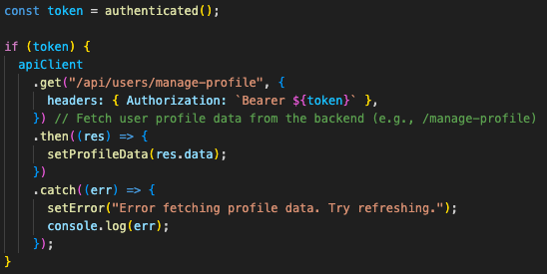
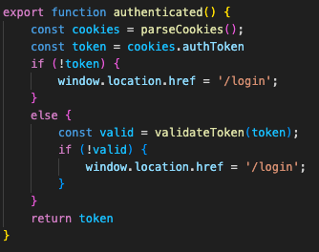
Implementation Example
Route
Component
Backend Function

Slide 16
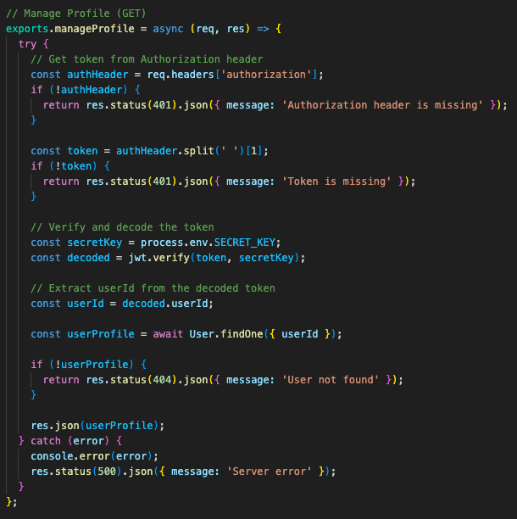
Implementation Example (cont.)
Controller

Slide 17
Testing

Slide 18
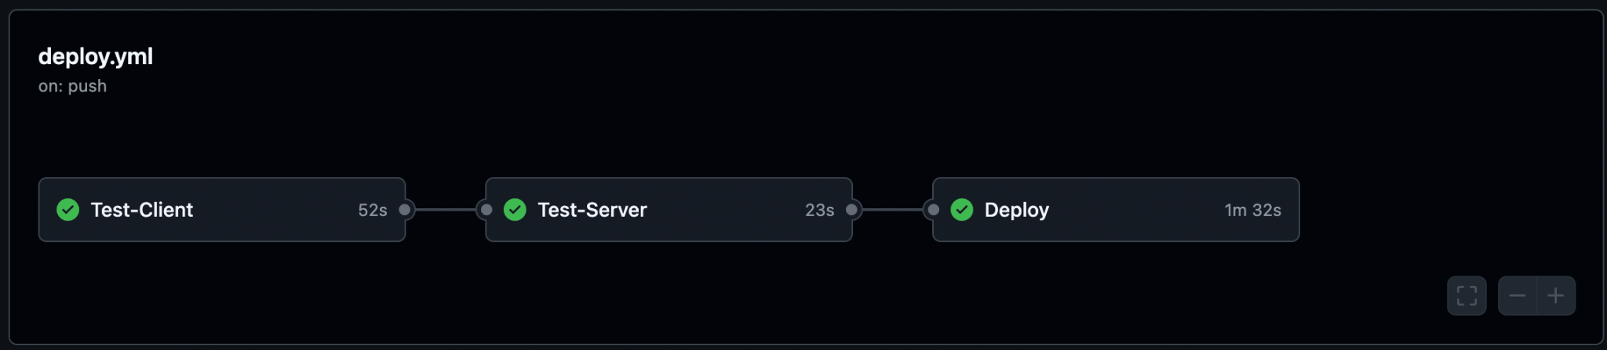
Unit Testing
Automated Testing
We have implemented automated unit testing via the Jest Testing Framework
Testing has been split into client side tests and server side tests
Team members can run the testing framework in the CLI via “npm run test”
We developed a total of 56 unit tests that are organized into 13 testing suites
The unit tests focus on:
Page rendering
Chart rendering
Server connection
User authentication
Form validation (User Registration, Manage Profile, Create Goal, and Enter Daily Data pages)
Endpoints (User, Goal, Daily Data Controllers)
We also integrated Heroku with Github, which automatically runs all of the unit tests before deploying the application's dev branch:

Slide 19
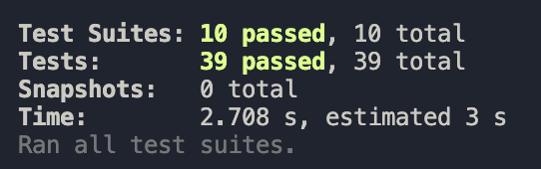
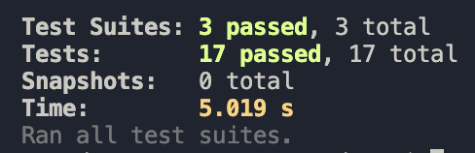
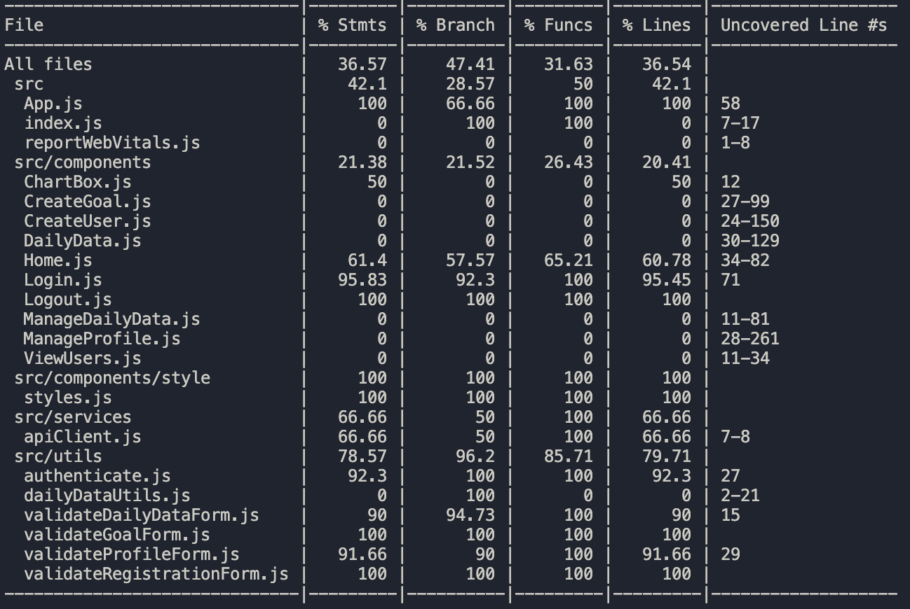
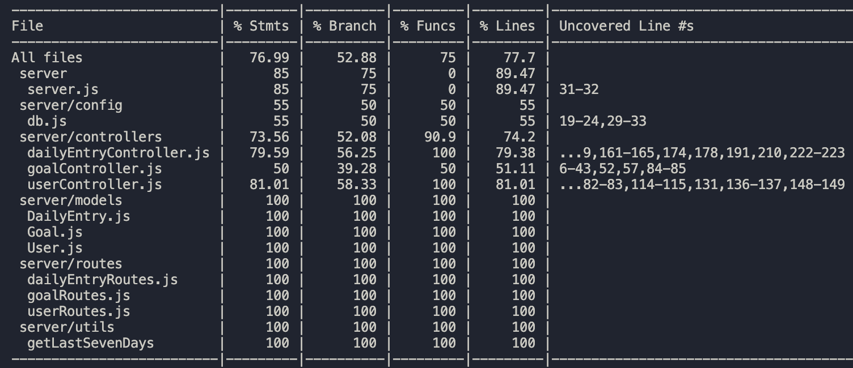
Unit Testing Metrics
Client Side
Server Side
Test Pass Rate: 100%
Test Pass Rate: 100%
Test Coverage (Statements): 36.6%
Test Coverage (Statements): 77.0%

Slide 20
Integration Testing
Manual Testing
As our team developed new features for our application, we also conducted manual integration testing to ensure that the front end and back end are communicating as expected. Some examples include:
Testing that all pages reroute to Login if user is not logged in
Testing that after user logs in the application will only display logged in user’s information
Testing that charts are responding to changing data inputs for daily data entries
Testing Manage Profile only updates the logged in user’s information in back end and displays the newly updated information in the front end
Testing that a Daily Data Entry is created or updated in back end, dependant on if the user has already logged an entry for the given date
We have also validated that our deployed Heroku application aligns to the locally developed version

Slide 21
Security

Slide 22
Security
Password Encryption
For the Node.js backend, Bcrypt is a common library for hashing and salting. It not only provides a secure hash algorithm, but also automatically handles the salting process.
Enforce strong password policies.
Feedback about password
Use zxcvbn to provide password strength feedback.
Use password-validator to define password rules and validate passwords against those rules.
Login password masking
When a user types their password in the login screen, it is displayed as dots or asterisks (● or *),which prevents anyone nearby from seeing the actual characters being typed.
Dotenv
To manage environment variables. Ensure the environment variable files (.env*) are not included in our version control.
HTTPS
Implement HTTPS for secure data transmission. Heroku provides this by default.

Slide 23
Security
After validating the user’s credentials, a JWT will be created containing the user’s user ID
The JWT is stored in a cookie, and will expire after one hour
Each view will validate if the user is logged in, redirecting to the login page if they are logged out or if their token has expired
Using the information encoded in the JWT, the application will be able to query for information specific to the user
Upon log out, the cookie containing the token will be destroyed

Slide 24
Deployment

Slide 25
CI/CD Overview
Continuous Integration: Automatically run tests on both client and server before any deployment.
Continuous Delivery: Docker images are built and tested with every code push to dev or release branches.
Continuous Deployment: Successful builds and tests automatically trigger deployment to Heroku.
Workflow Structure
GitHub Actions Workflow:
Triggers on code push to dev or release/* branches.
Steps:
Test-Client: Run tests for frontend using Jest.
Test-Server: Run backend tests using Jest after frontend tests pass.
Deploy: Build Docker images and deploy to Heroku if all tests pass.
Fail Fast Principle: Workflow stops if any tests fail, preventing broken code from being deployed.

Slide 26
(CI/CD cont.)
Key Workflow Steps
Key Benefits
Step 1: Jest Testing
Client Tests: Ensures React front-end code is stable.
Server Tests: Verifies Node.js back-end logic.
Step 2: Docker Build
Builds Docker images for both frontend and backend.
Step 3: Deployment
Images are pushed to Heroku Container Registry.
Releases for client and server are executed in Heroku.
Automated Testing: Reduces risk of bugs in production.
Quick Feedback: Fast identification of failing tests or builds.
Efficient Deployment: Continuous integration ensures only passing code is deployed.
Consistent Environment: Docker ensures the app behaves consistently from development to production.

Slide 27
Project Management

Slide 28
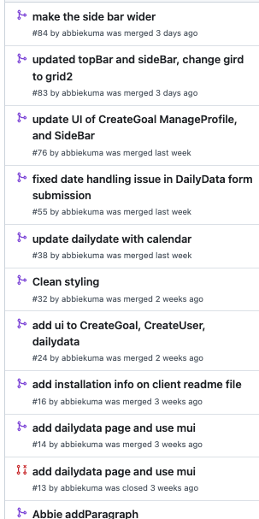
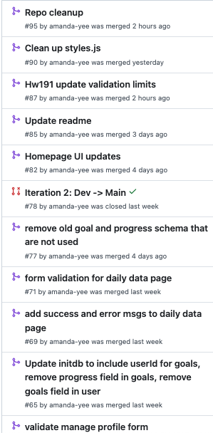
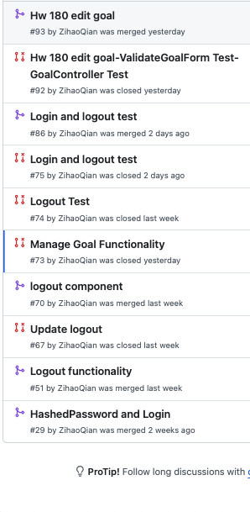
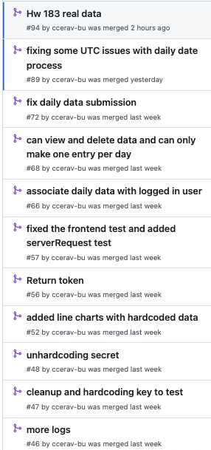
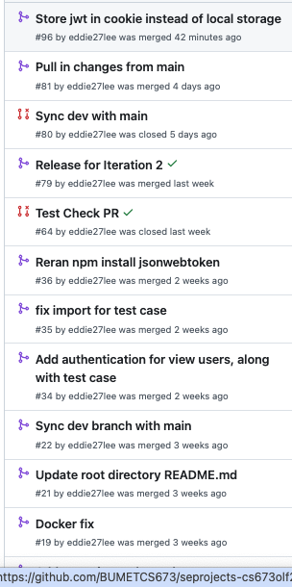
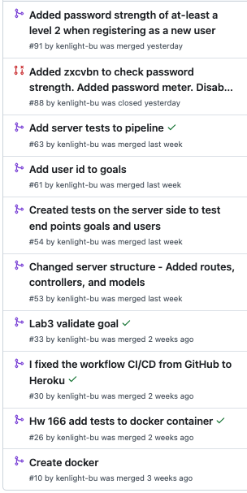
Roles & Contribution
Everybody made significant contributions to the repository. (Snapshot of PRs)
Abbie
Amanda
Alex
Chris
Eddie
Kenny

Slide 29
Roles & Contribution (cont.)
Responsibilities were shared.
Abbie
Amanda
Alex
Chris
Eddie
Kenny
D&I
QA
Sec.
PM
Config.
Req.
+
+
+
+
+
+
Req.
PM
QA
D&I
Sec.
Config.
+
+
+
+
+
+
…
…
…
…
...
…

Slide 30
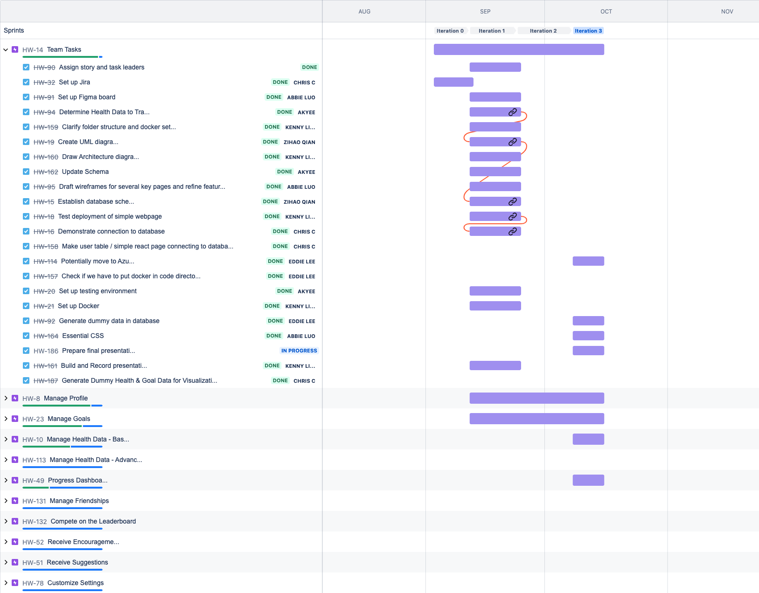
Tracking Key Tasks in Jira

Slide 31
Iterations
0: Planning
- Decided on our project idea
- Defined tech stack
- Started on requirements analysis and project plan via Jira board
- Created Figma wireframes
1: Architecture
- Created React application
- Set up MongoDB database with schemas
- Set up Docker, Heroku, Jest
- Pages for Add User, View Users, Add Goals, Login, and Record Daily Data
2: Core Features
- Automated deployment
- Connected all pages to user data in database
- Charts
- User validation
- Server-side tests
- MUI
3: Refinement
- Charts connect to data + chart tests
- Use cookie instead of local storage
- Edit goal functionality + test
271
200
140
132
111
104
113
84
47
66
1
14
commits
files
hours
commits
files
hours
commits
files
hours
commits
files
hours

Slide 32
Risk Management
Personnel Risks:
Chris went to LA for a week, Kenny got caught in multiple hurricanes. Our team was resilient.
Communication Risks:
Discord chat ongoing everyday, recurring scheduled meetings with clear decisions and actions
Planning Risks:
Simplified some requirements (reducing to 5 data points), we cut some requirements (“friendships” feature) and we were able to exceed in other areas (UI).
Technology Competence:
React tutorial through codewithmosh, lots of personal research (Heroku, Docker, Chart.JS, etc.)
Design & Implementation:
Careful review of PRs on an ongoing basis to ensure quality and consistency, passing tests
Integration & Deployment
We defined our automated CI/CD pipeline early, so we were able to focus on refining features, tests, and documentation for Iteration 3.

Slide 33
Challenges, Achievements, & Lessons
Challenge | Achievement | Lesson
Automating CI/CD pipeline | Fully automatic testing, containerization, and deployment to Heroku in GitHub Actions | Pipeline made development easier, allowed vision to the actual functionality of our app at every step
Production vs. development envs | Automatic switching, no changes needed in code | Teamwork makes the dream work (resolved together on call)
Getting acquainted with MUI | Beautiful UI | Leverage existing tools, would have been difficult to build styles entirely from scratch
User authentication | Implemented true login functionality | Cookie is better than local storage because it is a longer term option and prevents against CSRF attacks
Duplicate work | Everybody made distinct contributions | Timely communication is key

Slide 34
Live Demo

