Slide 1

Team 3
Team Lead: Chris
Design and Implementation Lead: Abbie
Configuration Lead: Eddie
QA Lead: Amanda
Security Lead: Alex
Requirements Lead: Kenny

Slide 2
Project: Health and Wellness Tracker
Problem: It can be easy to lose track of our own diet, exercise, and wellness routines when life gets busy.
Solution: This project seeks to provide a straightforward and user-friendly system that helps users stay accountable, motivated and on track.

Slide 3
Iteration 2: Project Progress
Data | Refined and simplified schema for the users and goals tables Created daily_entries table
Design | Implemented consistent styling via Material-UI across the application Reorganized and restructured codebase Reworked goals to serve as a daily goal Connect goals to user via user ID rather than a user owning several goals
Front end | Implemented Manage Profile page Added health metric charts to Home page
Back end | Implemented authentication for all pages using JWT Logged in users will only see their data Connected Daily Data page to back end
Testing | Implemented several automated test cases for frontend and backend - totaling 38 test cases (previously 2) Integration testing to confirm all aspects of application are behaving as expected
Deployment | Application deploys to Heroku each time dev is updated

Slide 4
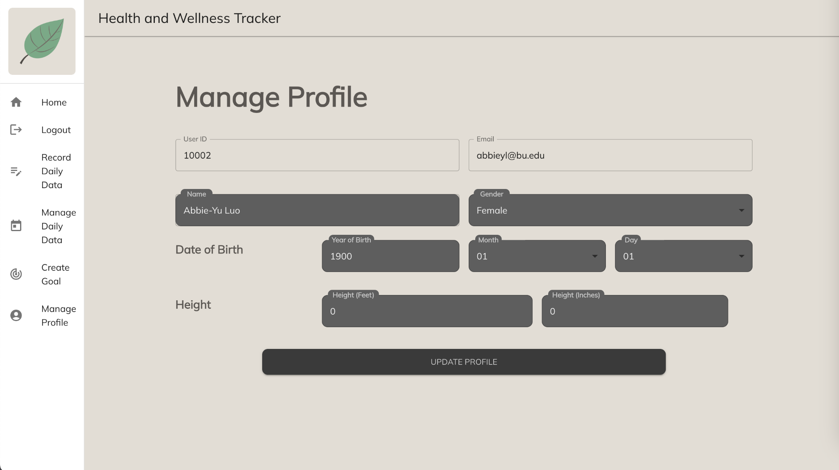
New Feature - Manage Profile
When a user is logged in, they have the ability to update their personal profile information via the “Manage Profile” tab

Slide 5
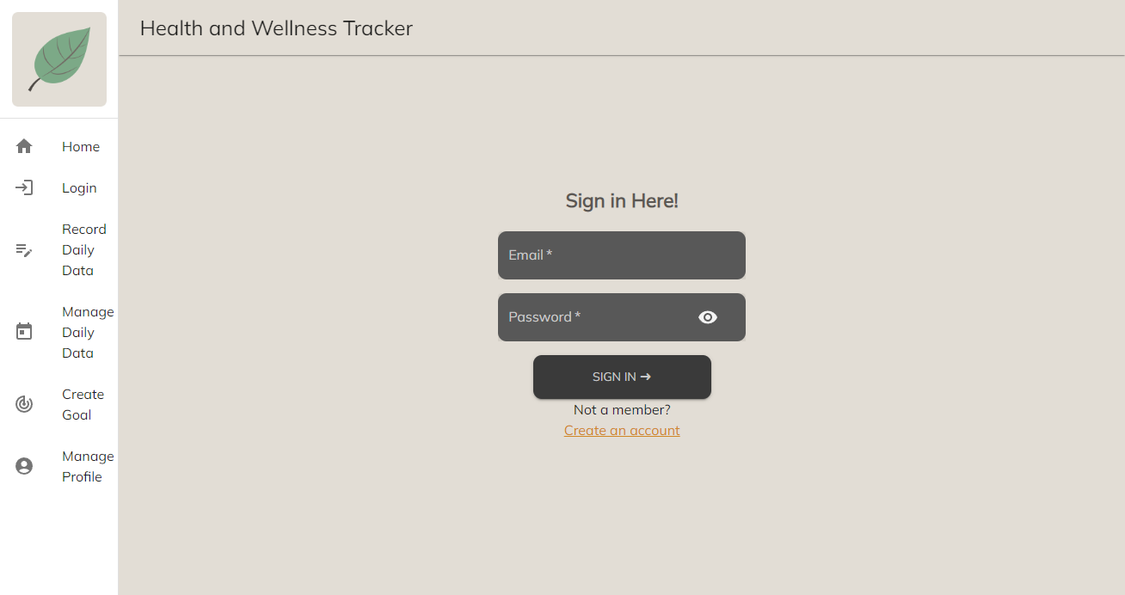
Security
For users data security, if users log out their accounts, all information will be invisible until they login again.
All side bars will redirect to the login page.

Slide 6
Security - JWT
After validating the user’s credentials, a JWT will be created containing the user’s user ID and email
The JWT is stored in the user’s local storage, and will expire after one hour
Each view will validate if the user is logged in, redirecting to the login page if they are logged out or if their token has expired
Using the information encoded in the JWT, the application will be able to query for information specific to the user
Upon log out, the token will be removed from the local storage

Slide 7
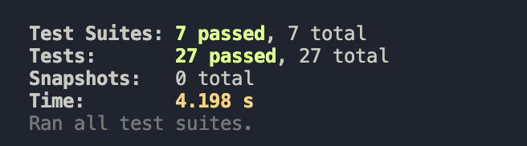
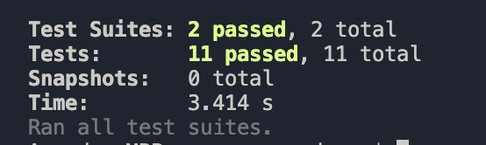
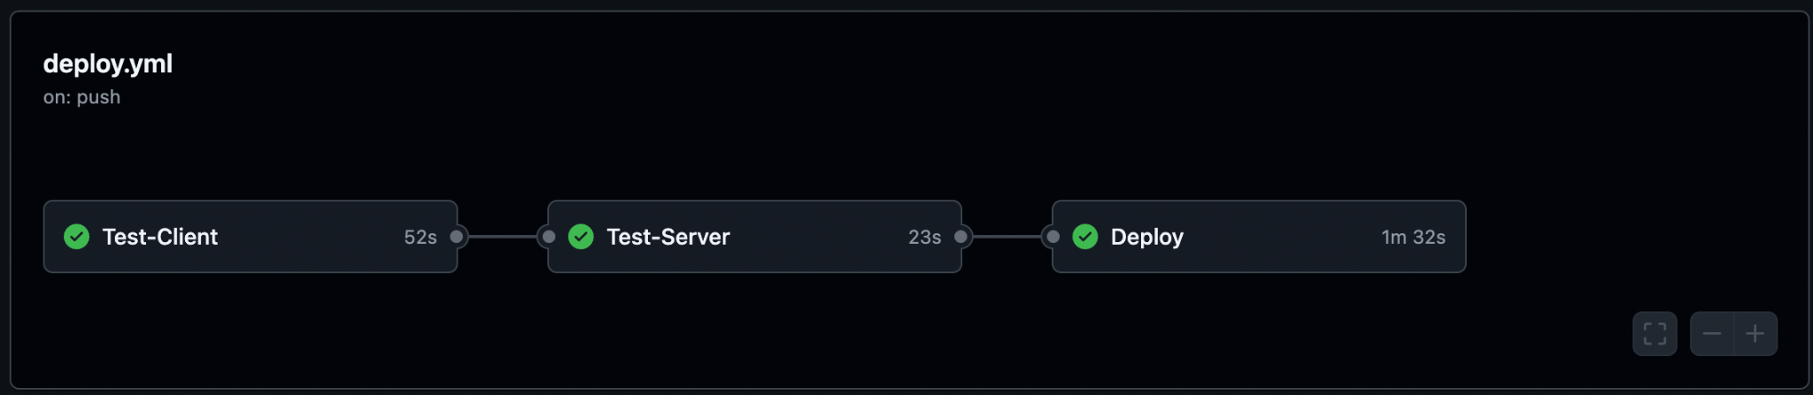
Testing
100% test pass rate
Automated Testing
We have continued to implement automated unit testing via the Jest Testing Framework
Testing has been split into client side tests and server side tests. Team members can easily run the testing framework in the CLI via “npm run test”
There are now 38 unit tests that test the front end page rendering, form validation, user authentication, and the endpoints
We have integrated Heroku with Github, which will automatically run all unit tests before deploying the application's dev branch:
client:
server:

Slide 8
Testing cont.
Manual Testing
As our team develops new features for our application, we also conduct manual integration testing to ensure that the front end and back end are communicating as expected, such as:
Testing that all pages reroute to Login if user is not logged in
Testing that after user logs in the application will only display logged in user’s information
Testing Manage Profile only updates the logged in user’s information in back end and displays the newly updated information in the front end
Testing Daily Data Entry is created or updated in back end, dependant on if the user has already logged an entry for the given date
We have also validated that our deployed Heroku application aligns to the locally developed version

Slide 9
Live Demo

