Slide 1

Team 3
Team Lead: Chris
Design and Implementation Lead: Abbie
Configuration Lead: Eddie
QA Lead: Amanda
Security Lead: Alex
Requirements Lead: Kenny

Slide 2
Project: Health and Wellness Manager
Problem: It can be easy to lose track of our own diet, exercise, and wellness routines when life gets busy.
Solution: This project seeks to provide a straightforward and user-friendly system that helps users stay accountable, motivated and on track.

Slide 3
Iteration 1: Project Progress
Data | Determine Health Data to Track Establish data schema Create initial basic UML diagram for User and Goal classes
Design | Set up Figma Board, design key pages, determine color scheme
Docker | Set up Docker Clarify folder structure and Docker setup
Front end | Login page Create User page Create Goal page View Users page Daily Health Tracking page
Back end | Demonstrate connection to external database (MongoDB)
Testing | Set up testing environment
Deployment | Test deployment of simple webpage (Heroku)

Slide 4
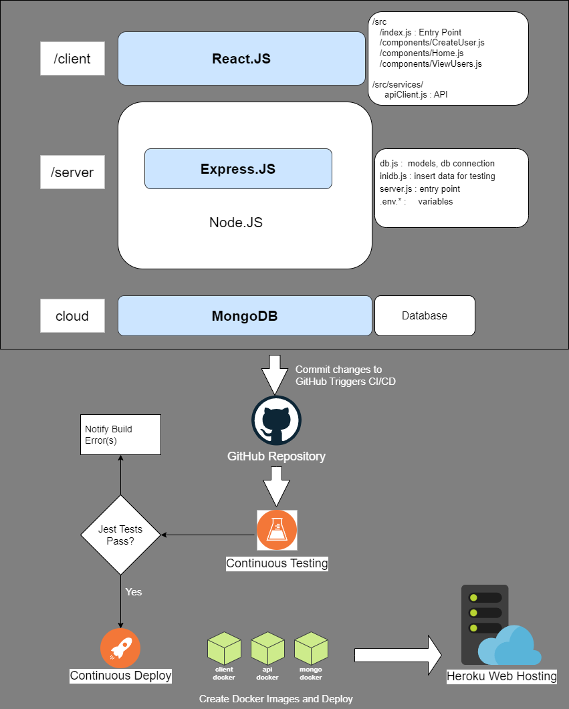
Architectural Diagram

Slide 5
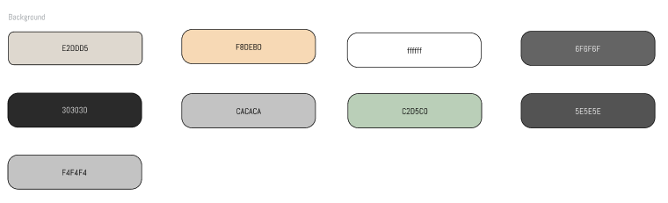
UI Design
Figma
https://www.figma.com/design/VcXGJmgO54kiw4UjBzcu3Z/Health-and-Wellness-Manager?node-id=0-1&t=WuZBwwm96zRx3BYt-1
Material-UI
Leveraging MUI components for custom theming, consistency and responsiveness across different screen sizes.
Layout
Left Column: Side panel for navigation and actions
Menu items include: Home, Health Data, Calendar, Settings, and Logout/Login
Right Column: Main content area for user interaction with different pages.
Color Scheme

Slide 6
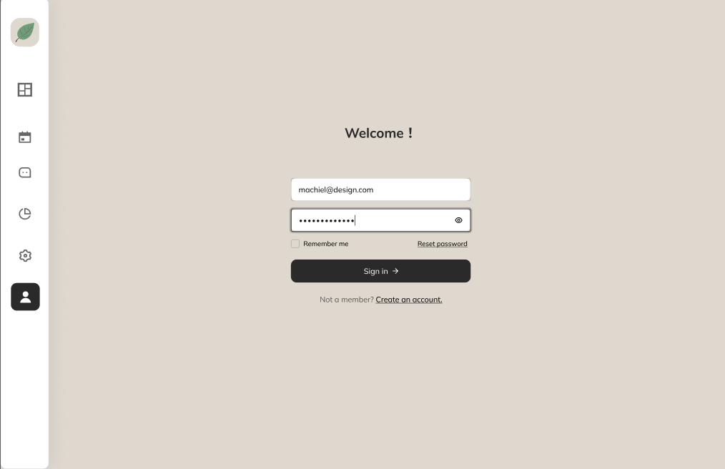
Login Page

Slide 7
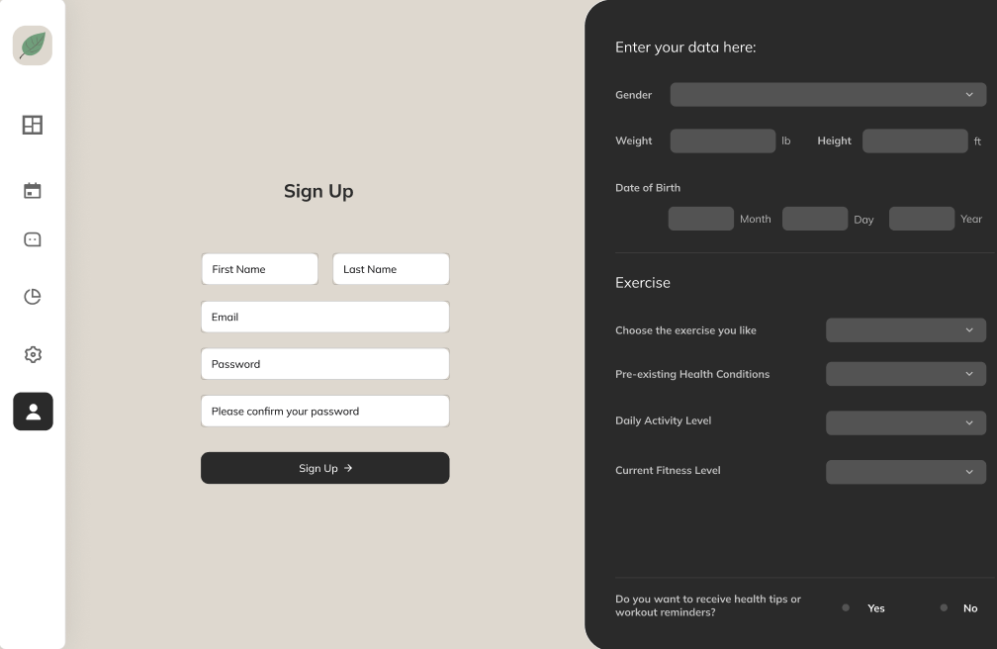
Figma Mockup - Register
Users can register the account and enter basic information

Slide 8
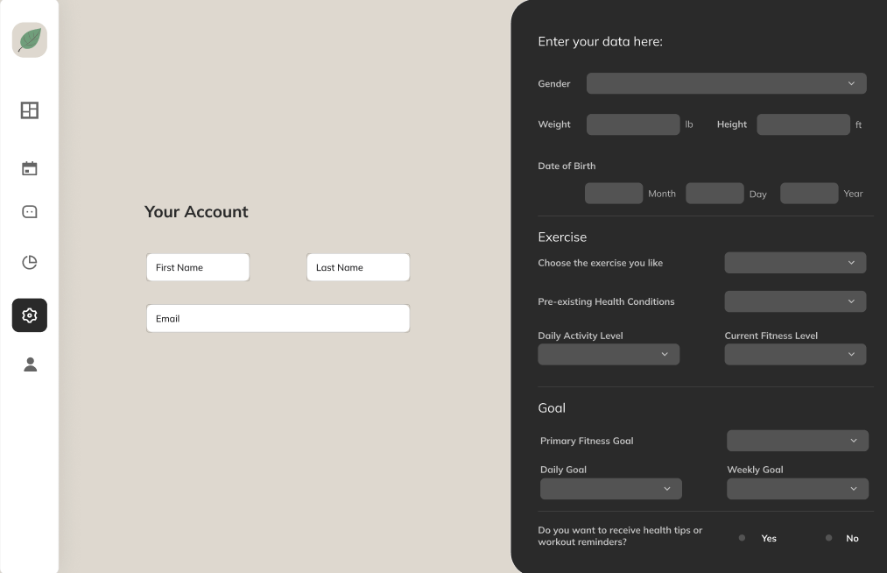
Figma Mockup - Settings
Users can view and manage their preferences, adjust account settings, and configure personalized options to enhance their experience.

Slide 9
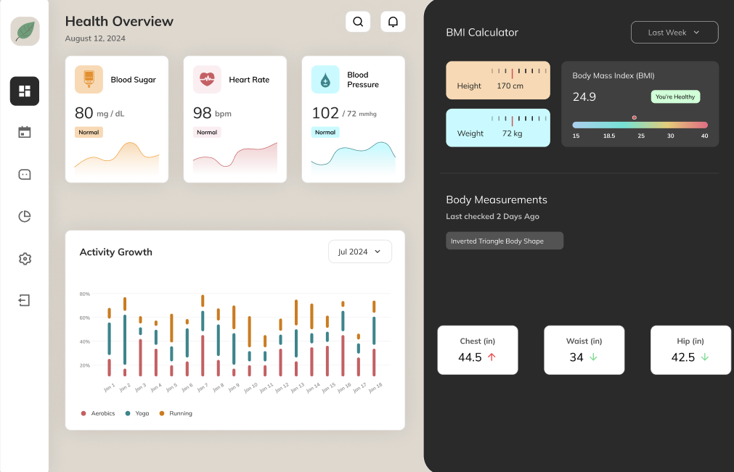
Figma Mockup - Main Page
Users can view an overview of their health data, including key metrics and insights into their daily habits and progress.

Slide 10
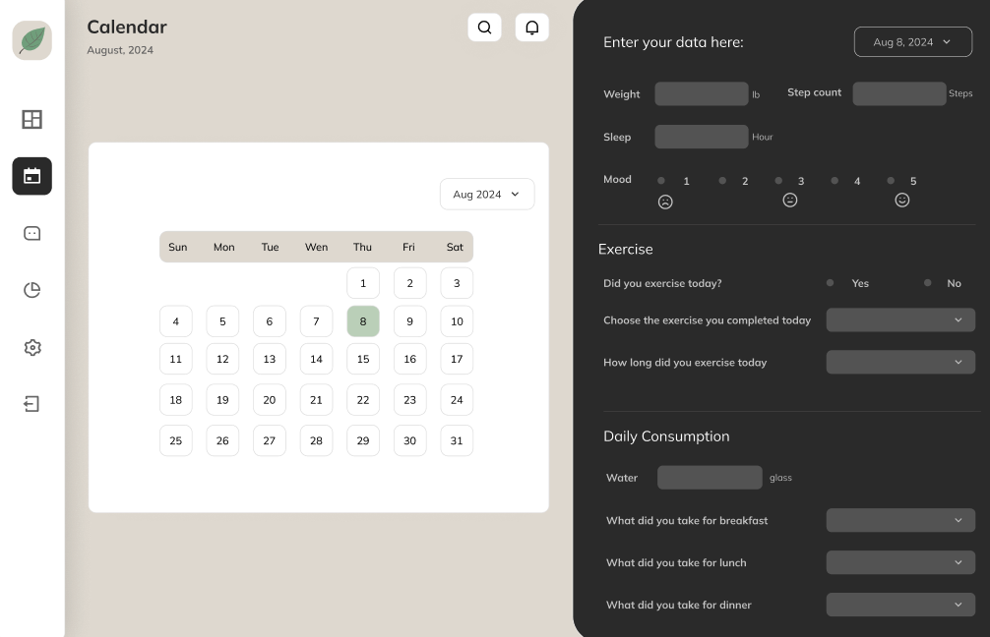
Figma Mockup - Daily Health Data Submission
Users can select a specific date and input their daily health data, tracking progress and maintaining a record of their wellness activities.

Slide 11
Docker Architecture Overview
Docker Compose Files
docker-compose-dev.yml:
Usage: Used to set up the development environment.
Instructions: Executes the docker.dev file, defining services (client and server) and their dependencies, and runs mongo.
docker-compose-production.yml:
Usage: Used to set up the production environment.
Instructions: Executes the docker.production file, configuring the services optimized for production.
Docker Files
Project Structure
/code/client/docker.dev.yml
/code/client/docker.production.yml
/code/server/docker.dev.yml
/code/server/docker.production.yml
docker.dev and docker.production:
Purpose: These files define the configuration for the Docker images for both development and production environments.

Slide 12
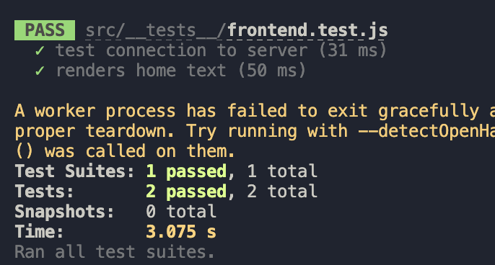
Testing
Automated Testing
We have set up the Jest Testing Framework and will be using it for JavaScript unit testing
Team members can easily run the testing framework in the CLI via “npm run test”. Test summary results will print out
Two unit tests have been implemented in this iteration
Further tests will be developed in the upcoming iterations
Manual Testing
As our team has been developing the health tracking application and building features, we have conducted various manual tests which include:
Ensuring form fields and pages are rendered as expected
Ensuring the front end and server communicate effectively, so that user input is saved to the external database and the correct information is retrieved and displayed
After testing the application by starting the client and server in separate terminals, the docker-compose-dev.yml would be run to confirm the application would run the same way
The server would be tested to be reachable with “curl http://localhost:5000” when validating the images

Slide 13
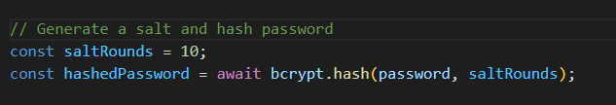
Security
Password Encryption
For the Node.js backend, Bcrypt is a common library for hashing and salting. It not only provides a secure hash algorithm, but also automatically handles the salting process.
Enforce strong password policies.
Use zxcvbn to provide password strength feedback.
Use password-validator to define password rules and validate passwords against those rules.
Login password masking
When a user types their password in the login screen, it is displayed as dots or asterisks (● or *), which prevents anyone nearby from seeing the actual characters being typed.
DOMPurify (sanitization library)
To cleanse form input data to mitigate the risk of cross-site scripting (XSS) attacks. Control user permissions when implementing multiple roles.
Dotenv
To manage environment variables. Ensure the environment variable files (.env*) are not included in our version control.
HTTPS
Implement HTTPS for secure data transmission. Heroku provides this by default.

Slide 14
express-validator
for validating and sanitizing input on the server side.
GitHub & Heroku store secrets
This can be used to store information like API keys, database credentials, and secrets tokens (authentication and authorization such as JWT or OAuth).
Security cont.

Slide 15
Live Demo

