Slide 1

TeamBuilder
CS673 Team 4
Notes:
Jake

Slide 2
Overview
TeamBuilder is a team assignment tool to help create teams based on a few simple, but important questions that users will answer. The motivation and purpose to create this tool is to make a team where collaboration, inclusivity, efficiency, and flexibility are emphasized to help users become more productive and engaging, improving overall team performance. The potential users are any group of people who want to form separate teams. The application will work as so: the user will get on the website, they will answer a few questions, and they will be placed into a team according to their answers and the answers of others.
Notes:
Jake

Slide 3
Team members
Team and Requirements Leader: Jake Kelly
Configuration Leader: Raymond Chen
QA Leader: Vishal Sundaram
Security Leader: Wenli Gai
Design and Implementation Leader: Max
Notes:
Jake

Slide 4
Project management
Meetings: Discord Thursday 7:30PM ET - meeting minutes if missed
Digital communication: Discord
Self progress reports updated weekly
Risk management updated weekly
Biggest achievement: working algorithm that works with questionnaire
Biggest challenge: getting email system set up
Lessons learned: get started early!
Notes:
Jake

Slide 5
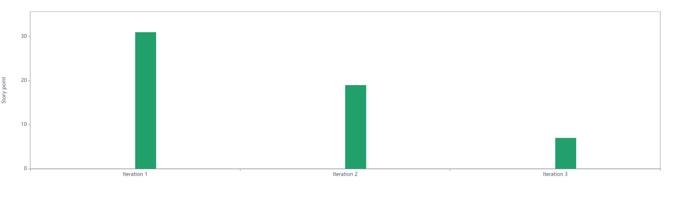
Requirements Analysis
Notes:
Jake

Slide 6
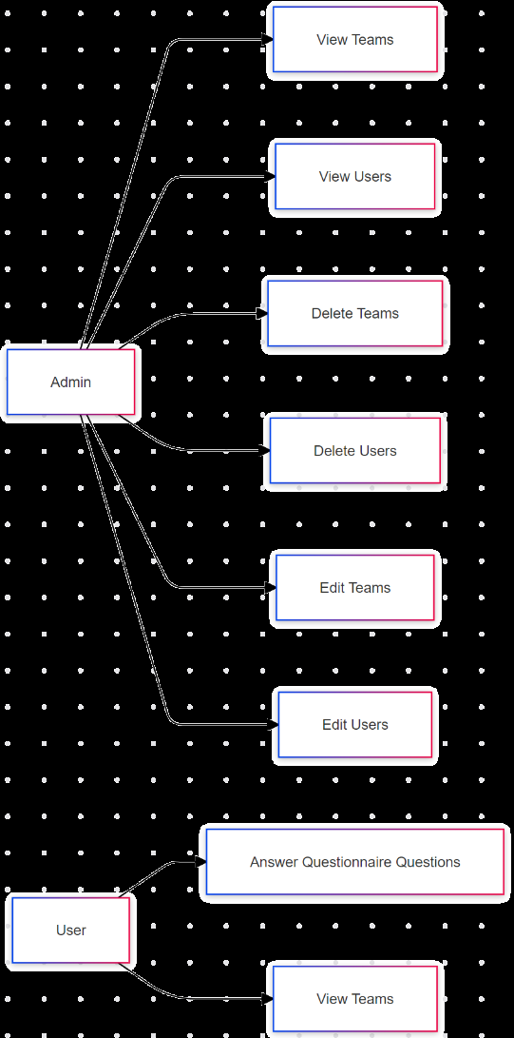
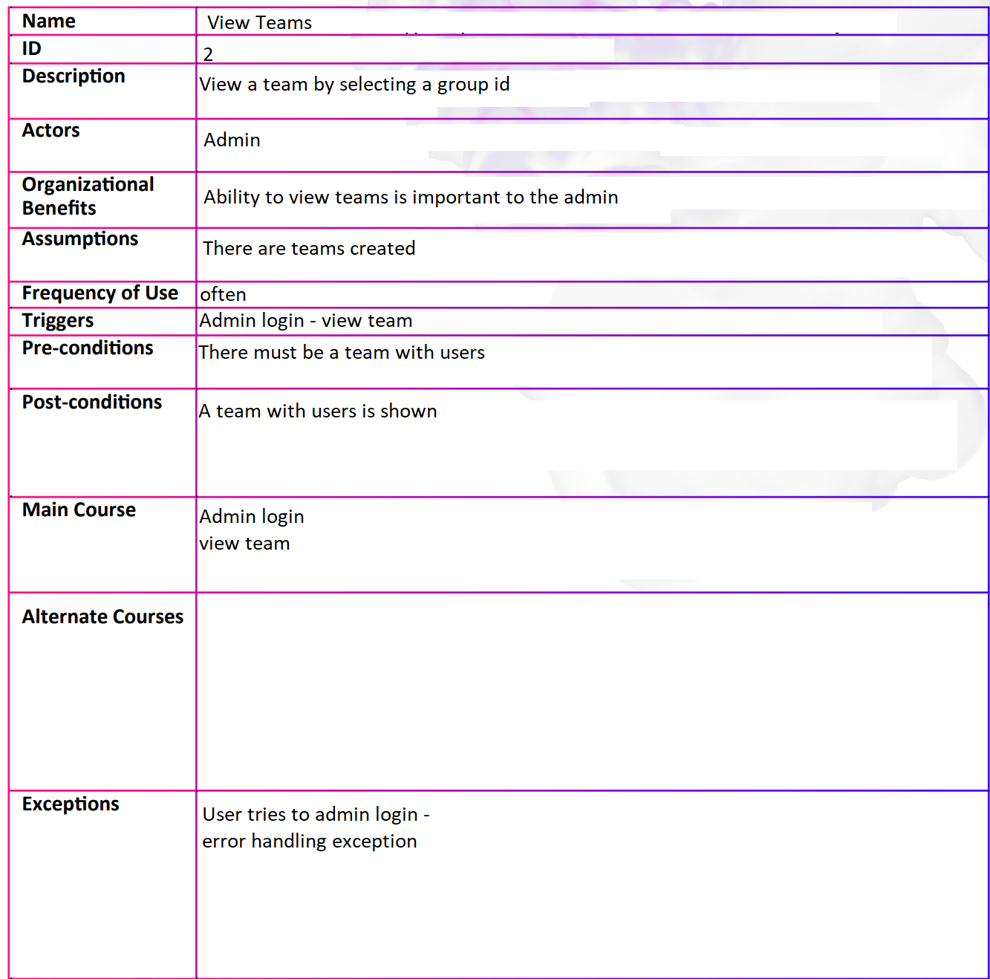
Use Cases
Notes:
Jake

Slide 7
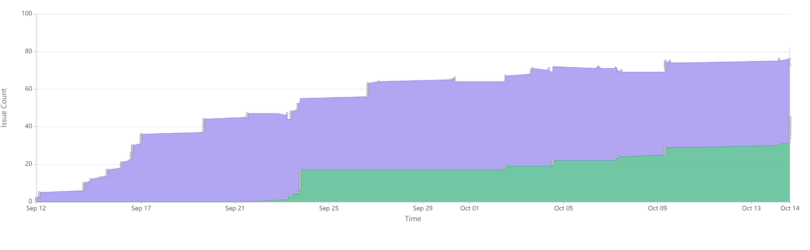
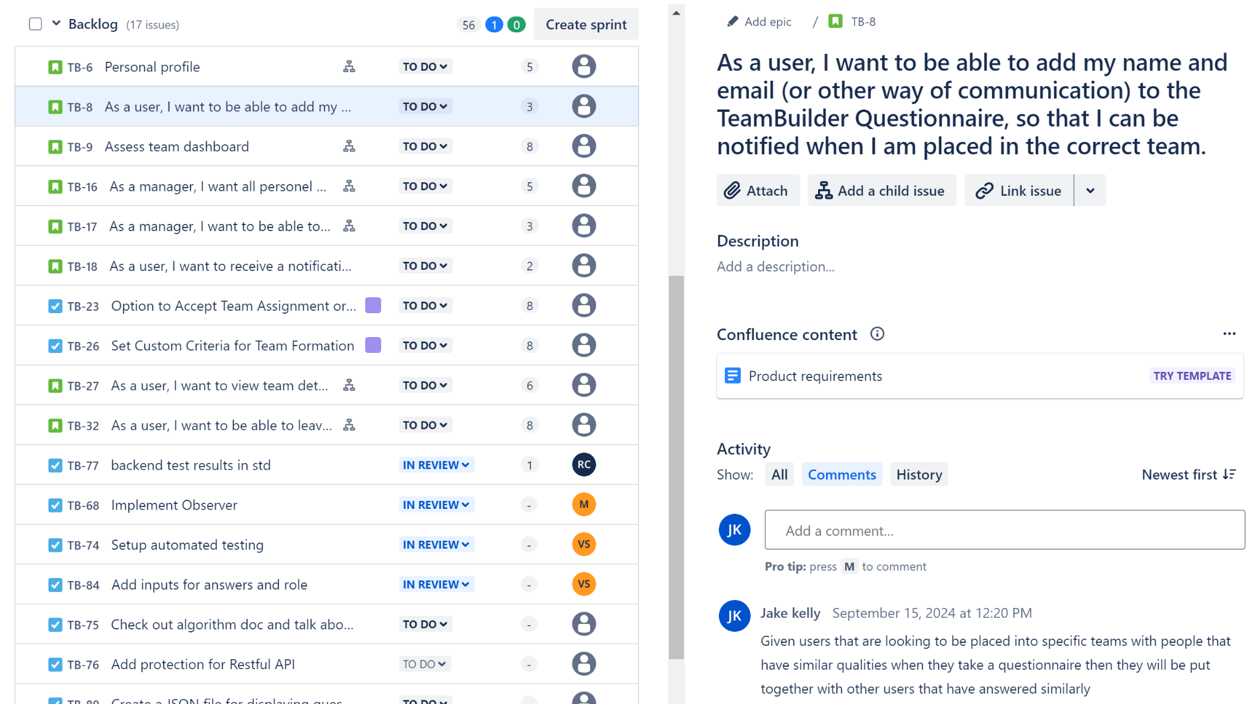
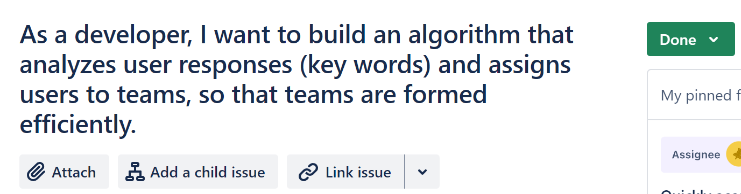
User Stories
To Do
Done
vs Desired
Required
Notes:
Jake

Slide 8
Design
e.g. the software architecture, database design, classes, design patterns, important algorithms used.

Slide 9
Database design
Users Table, Admin Table, Groups Table, Teams table
Relationships:
A User belongs to one Group (Many-to-One)
A Group can have many Users (One-to-Many)
A Team belongs to one Group (Many-to-One)

Slide 10
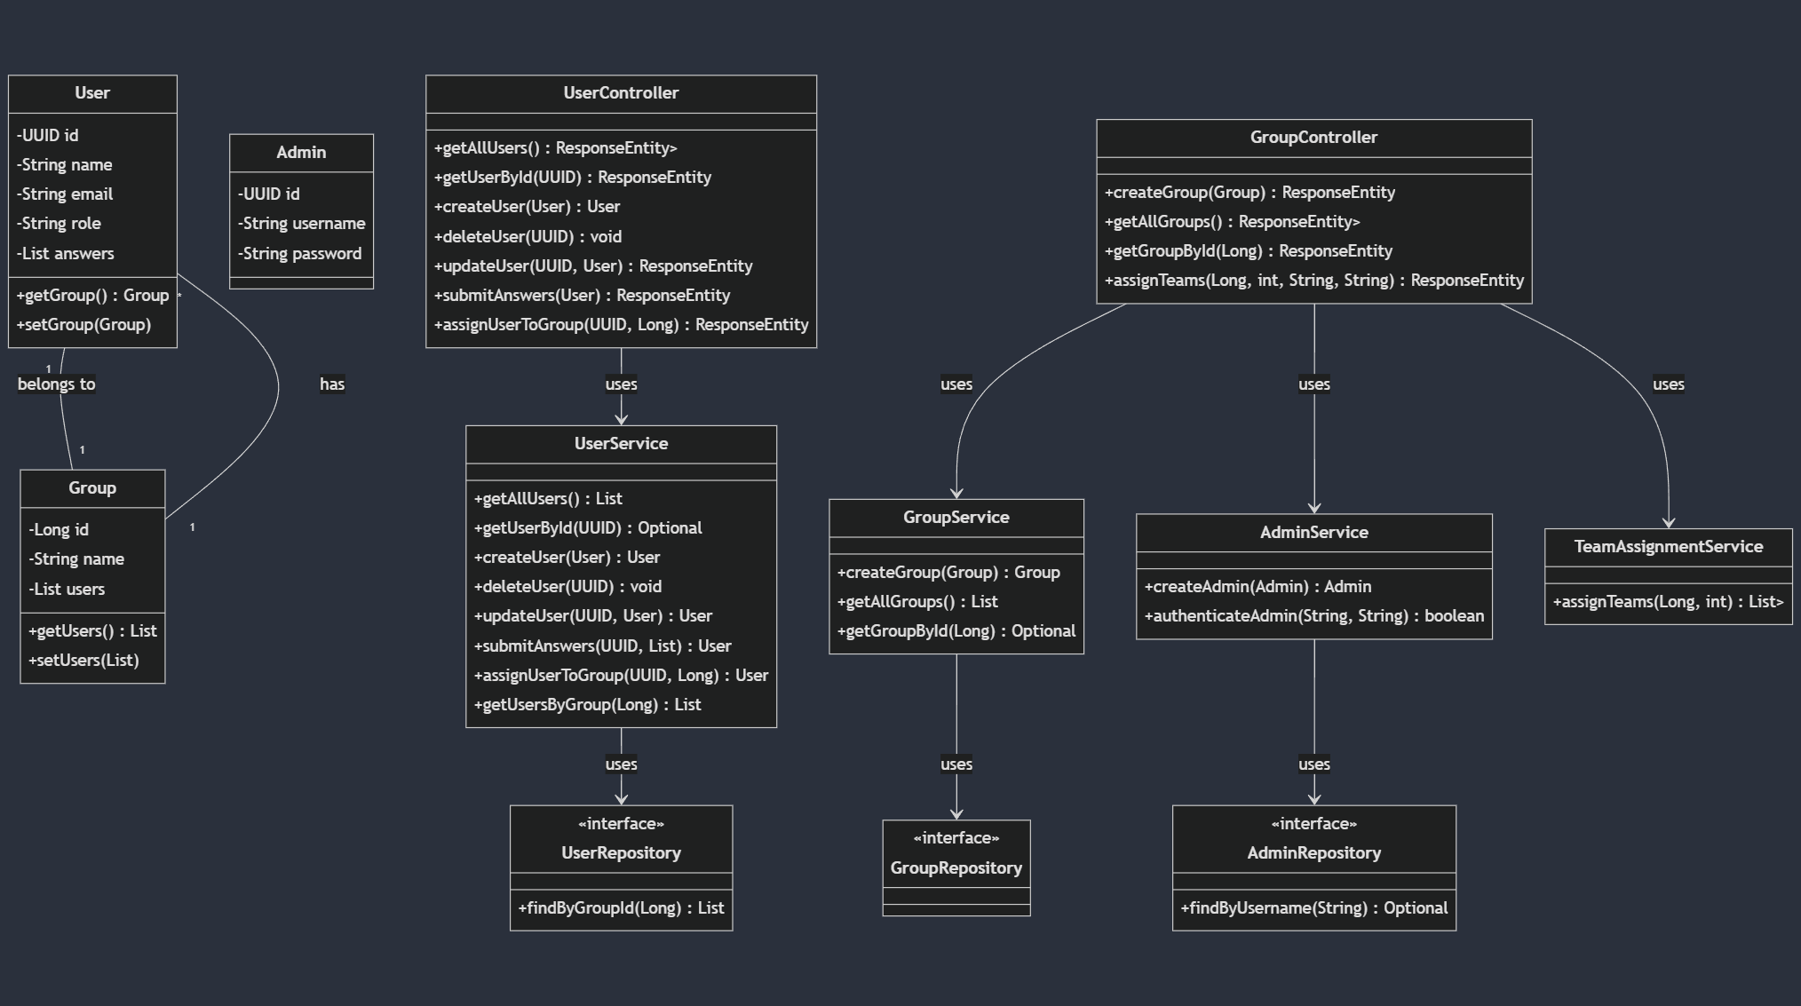
Class Diagram

Slide 11
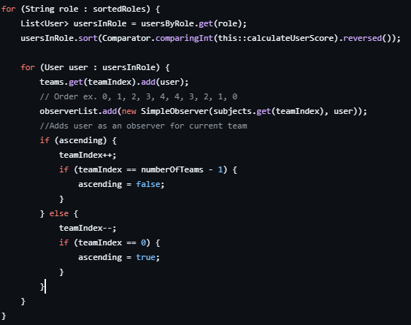
Team Assignment Algorithm
Objective: Distribute users into balanced teams based on roles and skills
Input: a list of Users each with a list of answers
Key Steps:
1. Group users by role
2. Calculate user scores
3. Sort users within roles
4. Assign users to teams

Slide 12
Design Pattern
Observer Pattern
Upon team assignment, a subject is created for each team
Subsequently, an observer is created containing each user effected. This observer is updated with the user’s team number and a the observer sends a notification
Would lead into the desired feature of email notifications. But would require recreation of observer classes in spring

Slide 13
Implementation

Slide 14
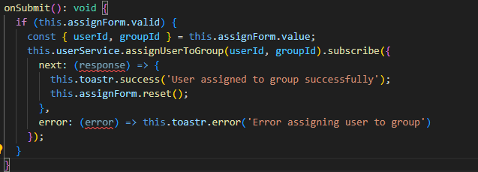
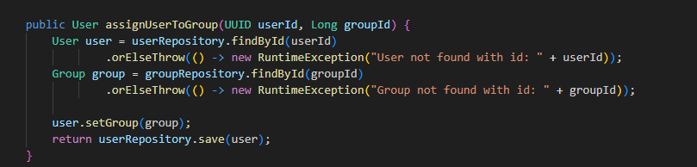
Project structure
Frontend: Angular
Manage the user interface, handling user inputs via forms, and sending requests to the backend through RESTful APIs.
Backend: Spring Boot - H2 database
Handle all business logic, including processing questionnaire data, team formation, and managing groups.

Slide 15
Deployment
Backend is deployed on Render via the dockerfile through Github Repository.

Slide 16
Testing

Slide 17
Testing Summary
What was tested:
UI unit tests - 19
Sidenav
Creation of sidenav component
should have two navigation items as a non Admin - Home, Add User
should call toggleAdminLogin when the slide toggle is changed
should display the admin login toggle with the correct default label
User details
Creation of user details component
Should disable save when form is invalid
Should enable save when form is valid
Authentication
should not allow activation if the user is not logged in
should allow activation if the user is logged in
should be created

Slide 18
Testing Summary
What was tested:
Server side logic - 14 unit tests
User service tests
Create user
Get all users
Group service tests
Create group
Assign teams
Controller tests
UserController
GroupController
End-to-end testing: 1 test
Manual tests

Slide 19
Testing Summary
Testing techniques used:
Manual
Automated
Unit tests
End-to-end tests

Slide 20
Testing Summary
Test results
UI Unit Test coverage summary:
Statements : 42.73% ( 103/241 )
Branches : 3.75% ( 11/80 )
Functions : 27.55% ( 27/98 )
Lines : 42.19% ( 100/237 )
Server side unit test coverage: 88%
End-to-end testing summary:
1 test to add a user
Coverage : 100%

Slide 21
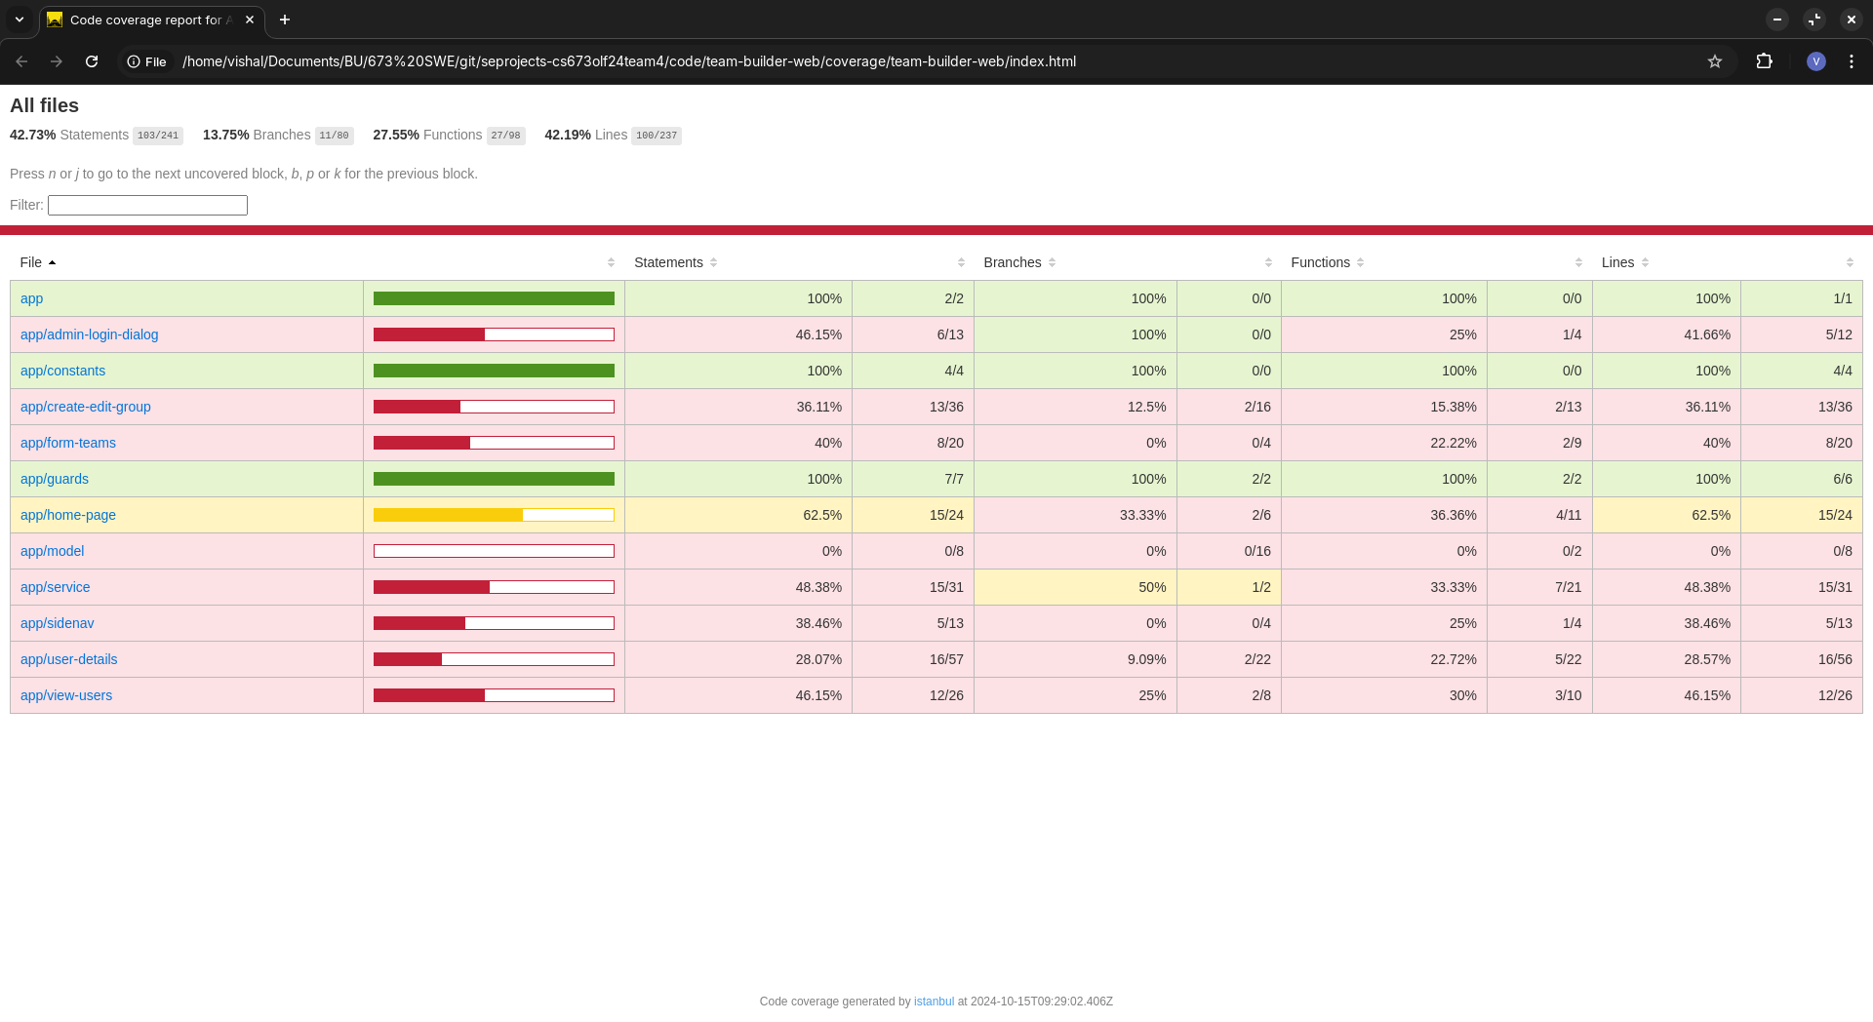
Automated Testing
UI Unit tests overall coverage report:

Slide 22
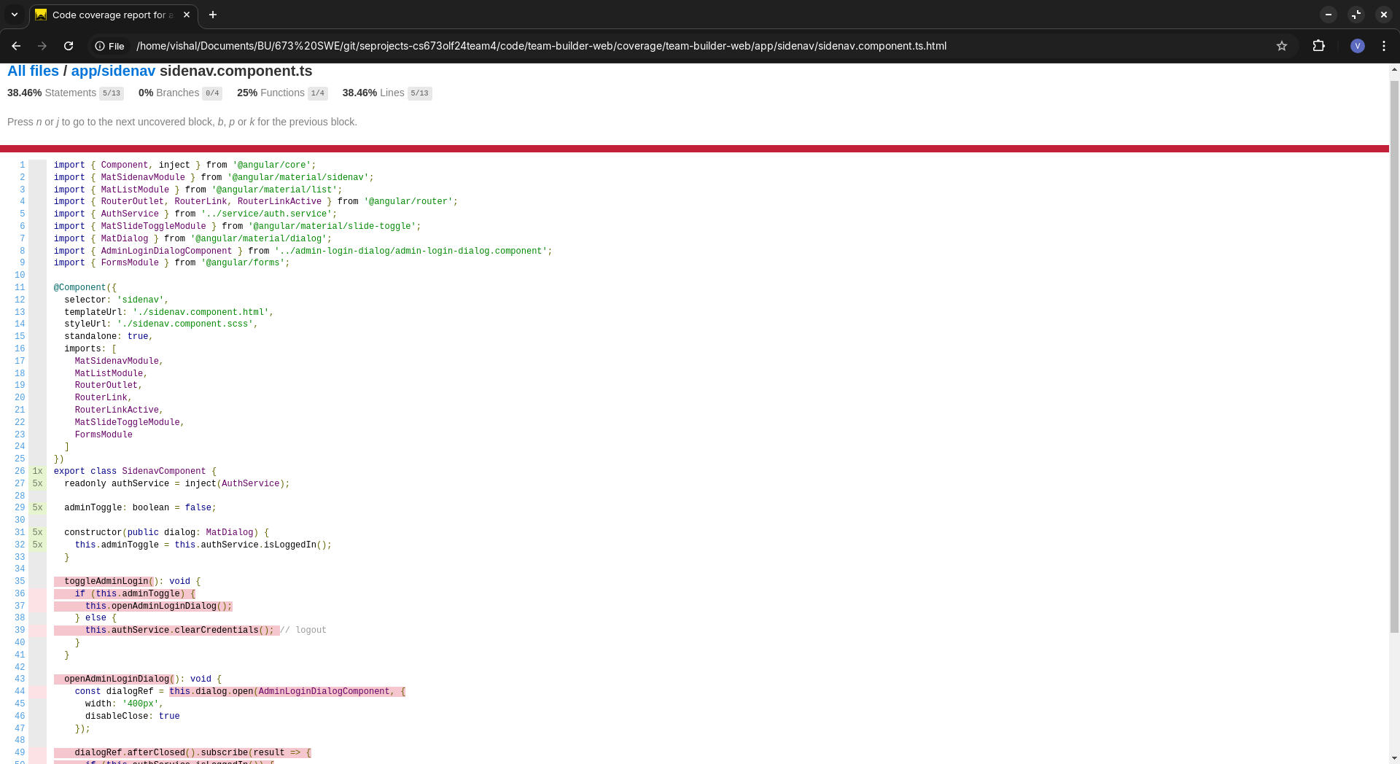
Automated Testing
Coverage report of Sidenav component:

Slide 23
Automated testing
End-to-end testing - add user test:
test('should fill user details and enable save button', async ({ page }) => {
const userDetailsPage = new UserDetailsPage(page);
await userDetailsPage.goto();
await userDetailsPage.navigateToAddUserPage();
await userDetailsPage.expectSaveButtonToBeDisabled();
await userDetailsPage.addUserDetails('Test User', 'test.user@tb.com', ['Python', 'Flask'], 'Team Leader');
await userDetailsPage.expectSaveButtonToBeEnabled();
await userDetailsPage.saveUser();
await userDetailsPage.expectSuccessNotification();
});

Slide 24
Testing metrics summary
UI unit tests:
Number of test cases: 19
Test coverage: 42.73%
End-to-end tests:
Number of tests: 1
Test coverage: 100%
Server tests:
Number of tests: 14
Test coverage: 88%
Defects: 0

Slide 25
Wenli Gai
Security

Slide 26
Admin-Only Access to User Data in Security Design
Wenli Gai
Purpose:
To enforce role-based access control (RBAC) ensuring that only administrators can access sensitive user data.
Key Security Design Principle:
Role-Based Access Control (RBAC): The system restricts user data access based on the role of the authenticated user. In this case, only users with admin credentials can view all users’ information.
Authentication and Authorization: Both the authentication (validating admin credentials) and authorization (granting access to user data) are strictly enforced.
Code Implementation:
The getAllUsers method ensures that only valid administrators can retrieve the list of users. The request parameters adminUsername and adminPassword are used to verify admin access.

Slide 27
Security. Cont
Wenli Gai
If the credentials match, the admin can retrieve the list of users.
If the credentials do not match, the system returns an Unauthorized (HTTP 401) status.
}
Authentication Check:
if (adminService.authenticateAdmin(adminUsername, adminPassword)) {
// Valid admin credentials
List<User> users = userService.getAllUsers();
return ResponseEntity.ok(users);
} else {
// Unauthorized access
return ResponseEntity.status(HttpStatus.UNAUTHORIZED).build();
}

Slide 28
Security Cont.
Wenli Gai
Security Considerations:
Minimization of Exposure: By restricting access to all user data, only authorized admins are allowed to perform sensitive actions.
Protection Against Unauthorized Access: Unauthorized users are prevented from accessing sensitive data by returning an HTTP status of 401 Unauthorized.
Scalable for Future Enhancements: This code can be expanded to include logging, monitoring for failed login attempts, and multi-factor authentication (MFA).
Implement HTTPS for secure data transmission.

Slide 29
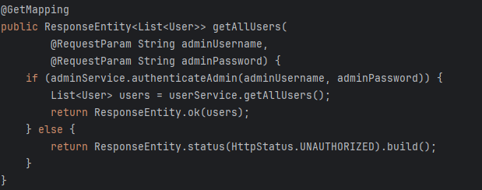
Security Cont.
Wenli Gai

Slide 30
Demo

