Slide 1
TeamBuilder
CS673 Team 4

Slide 2
Team Members
Team Leader: Jake Kelly - Has worked as a Microelectronics Security Analyst for about 10 years and is starting to switch towards the software side of things. Coding in Java for a little over a year, but have learned a lot from coworkers that are willing to help.
Design and Implementation Leader: Meng Zhou - Currently in the second semester of the METCS program. Completed undergraduate studies in China with no related work experience yet. Familiar with Java and other related technologies with a goal to focus on backend development, currently working hard to build skills in that area.
Configuration Leader: Raymond Chen - Currently full-time student in the software development program. Has a background in computer science bachelor's. Over the years, Raymond has developed some web application projects using Java, Go, Javascript and React.

Slide 3
Members Cont.
QA Leader: Vishal Sundaram - Currently working for Boeing as a programmer analyst and enrolled in the MSSD program. Has around three years of experience in software development, with a focus on Java and frontend technologies like Angular.
Security Leader: Wenli Gai - Currently a second-year student at Boston University, pursuing a Master's degree in Computer Science. Experience in programming with Java and Python. Skilled in using SQL for database queries and R for data analysis.
Requirements Leader: Max - (just joined)

Slide 4
Overview
TeamBuilder is a team assignment tool to help create teams based on a few simple, but important questions that users will answer. The motivation and purpose to create this tool is to make a team where collaboration, inclusivity, efficiency, and flexibility are emphasized to help users become more productive and engaging, improving overall team performance. The potential users are any group of people who want to form separate teams. The application will work as so: the user will get on the website, they will answer a few questions, and they will be placed into a team according to their answers and the answers of others.

Slide 5
Related Work
Tried searching for sites that would help build a team for a group of people, but not really finding anything closely related to what our website will be offering. Most searches come up with team building exercises or articles related on how one could successfully build a good team.

Slide 6
Requirements
Creating a good team for users. As a user, I want to get into the right team, so that we can have the best performance. Given users that answer questions when they use the TeamBuilder application then they will be placed into fitting teams accordingly.
Quick use of the application. As a user, I want to be able to go through the application quickly and with ease, so that I can be put into a team as soon as possible. Given a short questionnaire when users use the TeamBuilder application then they will be placed into teams quickly.
Creating code that helps. As a developer, I want to create a way to put people in teams, so that they can coordinate and perform better together. Given multiple people that have answered a few questions in different ways when they use the TeamBuilder application, then they are placed in the best teams possible.

Slide 7
Design Considerations
· Why Angular for frontend: component-based architecture, dynamic rendering
· Why Spring Boot for backend: scalability, integration with Java
· H2 Database: lightweight for prototyping and easy integration

Slide 8
Design Considerations
User Submits Information:
The user enters and submits personal information through the Angular frontend.
Frontend and Backend Interaction:
Angular sends the information to the Spring Boot backend via an HTTP POST request.
Backend Processing:
Spring Boot processes the data using business logic and the team assignment algorithm.
Data Storage:
The processed data is stored in the H2 Database and can be queried and updated.
Returning Results:
Spring Boot sends the processed results back to the frontend via a RESTful API.
User Views Results:
The frontend receives and displays the team assignment results to the user.

Slide 9
Management Plan
Objectives：
The primary objective of the TeamBuilder project is to develop a team assignment tool that improves collaboration, inclusivity, and team performance.
Priorities:
Completing all essential features as outlined in the functional requirements
Deploying the tool successfully with zero critical bugs
Providing flexibility for users to form teams with varying group sizes
Maintaining high-quality performance
Constantly refining the system for optimal team matching based on user inputs.

Slide 10
Risk Management Plan
Data Management Risk
System Overload
User Experience
Feature Creep
Risk Management: CS673_SPPP_RiskManagement_team4

Slide 11
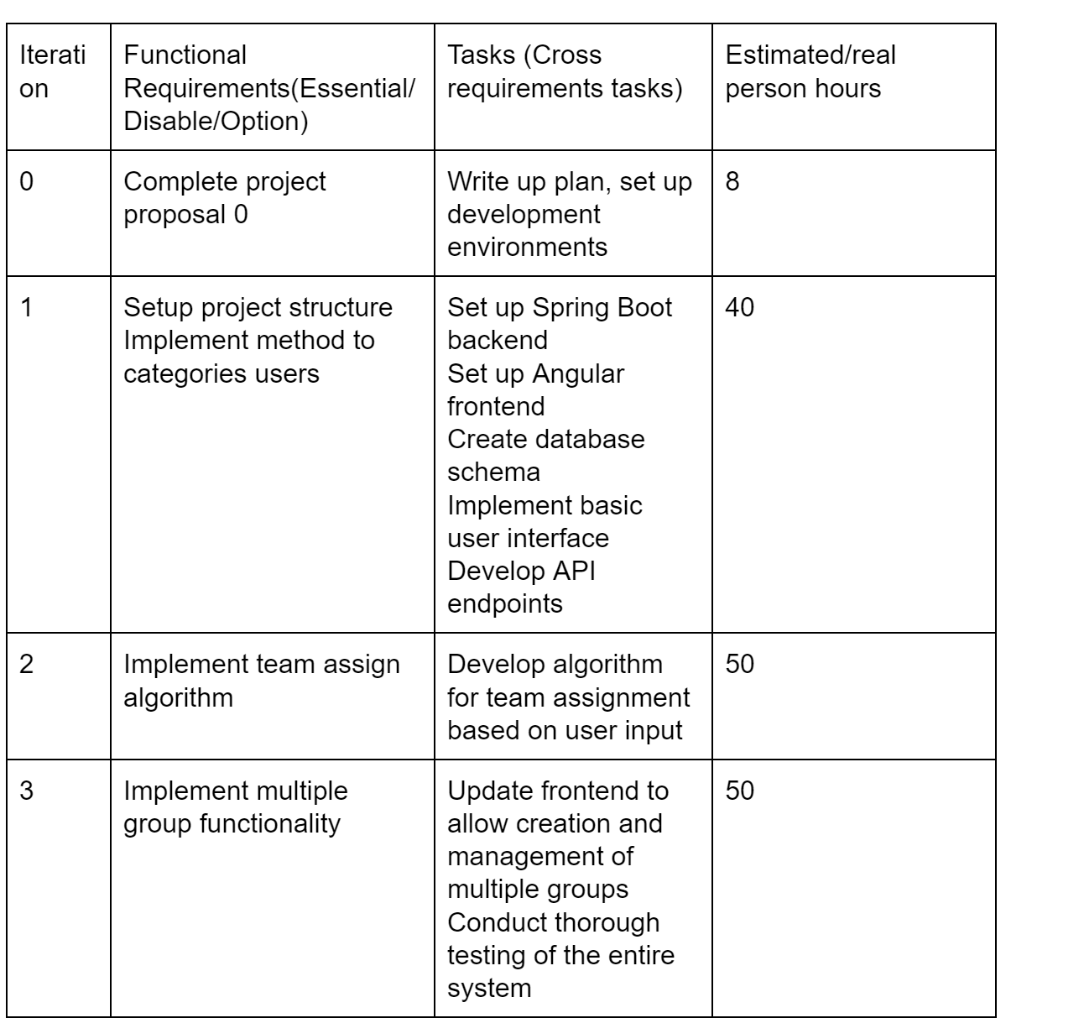
Management Plan Cont.
Timeline:

Slide 12
Configuration Management Plan
Tools used:
Version Control: Git/GitHub
Project Management: Jira
Integrated Development Environment (IDE): IntelliJ IDEA
Backend Development: Spring Boot
Database: H2 Database
Testing Frameworks: JUnit, Playwright
Frontend Development: Angular
CI/CD tools: GitHub Actions
Containerization: Docker
GitHub strategy:
Gitflow branching strategy
main: production-ready
Iteration branches
Feature branches
Task branches

Slide 13
Quality Assurance Plan - Metrics
Metric | Description | Measurement | Target
Lines of Code (LOC) | Measures the size of the codebase | Total number of lines of code | -
Cyclomatic complexity | Measures the complexity of the code logic | Count of independent paths through the code | ≤ 10 for methods
Test coverage | Measures the percentage of code exercised by tests | (Lines of code executed ÷ total LOC) × 100 | ≥ 80%
Number of defects | Measure of accuracy of code | Number of bugs reported | -
Sprint/iteration velocity | Tracks the number of user stories completed per sprint/iteration | Number of user stories completed per sprint | -
Customer Satisfaction | Measures how satisfied users are with the software | Surveys or feedback ratings (scale of 1-5) | ≥ 4

Slide 14
Quality Assurance Plan - Coding standard
Naming conventions
Use upper Camel case for Class names e.g. StudentProfile
Use lower Camel case for method and variable names e.g. myString
Use upper Snake case for constants e.g. MAX_RETRIES
Use lower case for package names e.g. edu.bu.csmet.teambuilder
Use Kebab case for Angular component/file names e.g. student-profile.component.ts
Typescript guidelines
Use strict types (string, number, boolean, etc.) and avoid using any
Null and Undefined: Handle null and undefined values explicitly to avoid runtime errors
Async/Await: Prefer async/await for handling asynchronous code instead of callbacks or promises

Slide 15
Quality Assurance Plan - Code Review Process
Author creates a Pull Request for the newly developed feature
Initial automated testing (unit, integration, E2E) and static code analysis to catch basic issues early on through CI/CD pipeline
Peer Review:
One or more reviewers are assigned based on expertise
Local testing and verify feature requirements
Code readability and maintainability
Should adhere coding standard
Reviewer gives feedback directly on the PR and author makes necessary changes
Once reviewer approves changes, code is merged to main branch

Slide 16
Quality Assurance Plan - Testing strategy
Testing framework
JUnit for unit tests on server side
Playwright for Acceptance/E2E tests
Jasmine/Karma for UI unit testing
Manual testing to test for usability, consistency of look & feel, performance
Developer will unit test their own code
QA Leader is responsible for integration and end-to-end testing

Slide 17
Quality Assurance Plan - Defect Management
Bugs are tracked through project management tool - JIRA
Treat bugs the same way as features
Bug classification based on priority:
Critical
High
Medium
Low

