Slide 1

TeamBuilder
CS673 Team 4

Slide 2

Team Members
Team and Requirements Leader: Jake Kelly -
Configuration Leader: Raymond Chen - Currently full-time student in the software development program. Has a background in computer science bachelor's. Over the years, Raymond has developed some web application projects using Java, Go, Javascript and React.

Slide 3

Members Cont.
QA Leader: Vishal Sundaram - Currently working for Boeing as a programmer analyst and enrolled in the MSSD program. Has around three years of experience in software development, with a focus on Java and frontend technologies like Angular.
Security Leader: Wenli Gai - Currently a second-year student at Boston University, pursuing a Master's degree in Computer Science. Experience in programming with Java and Python. Skilled in using SQL for database queries and R for data analysis.
Design and Implementation Leader: Max - Pursuing a Masters in Software Development with Boston University. Has experience with C++, C, Java and python. Previously worked on different projects including a .wav player and a C++ built compiler for assembly language into machine language.

Slide 4
Overview
TeamBuilder is a team assignment tool to help create teams based on a few simple, but important questions that users will answer. The motivation and purpose to create this tool is to make a team where collaboration, inclusivity, efficiency, and flexibility are emphasized to help users become more productive and engaging, improving overall team performance. The potential users are any group of people who want to form separate teams. The application will work as so: the user will get on the website, they will answer a few questions, and they will be placed into a team according to their answers and the answers of others.

Slide 5
Related Work
Tried searching for sites that would help build a team for a group of people, but not really finding anything closely related to what our website will be offering. Most searches come up with team building exercises or articles related on how one could successfully build a good team.

Slide 6


Requirements
Creating a good team for users - User Tracker:
As a user, I want to be able to add my name and email (or other way of communication) to the TeamBuilder Questionnaire, so that I can be notified when I am placed in the correct team (knowing TeamBuilder only builds teams up to 10 people). Given users that answer questions when they use the TeamBuilder application then they will be placed into fitting teams accordingly. Est. hours: 30
Quick use of the application. Notification System:
As a user, I want to receive a notification of my team assignment being completed, so that I can know who my teammates are as soon as possible. Given a questionnaire when users use the TeamBuilder application then they will be notified when the teams are created immediately. Est. hours: 5
Creating code that helps. Easy to navigate UI:
As a developer, I want to create a friendly UI for the questionnaire, so that users can easily complete it. Given multiple people that have answered a few questions in different ways when they use the TeamBuilder application, then they are placed in the best teams possible. Est. hours: 5

Slide 7
Design Considerations
· Why Angular for frontend: component-based architecture, dynamic rendering
· Why Spring Boot for backend: scalability, integration with Java
· H2 Database: lightweight for prototyping and easy integration

Slide 8
Design Considerations
User Submits Information:
The user enters and submits personal information through the Angular frontend.
Frontend and Backend Interaction:
Angular sends the information to the Spring Boot backend via an HTTP POST request.
Backend Processing:
Spring Boot processes the data using business logic and the team assignment algorithm.
Data Storage:
The processed data is stored in the H2 Database and can be queried and updated.
Returning Results:
Spring Boot sends the processed results back to the frontend via a RESTful API.
User Views Results:
The frontend receives and displays the team assignment results to the user.

Slide 9
Management Plan
Objectives：
The primary objective of the TeamBuilder project is to develop a team assignment tool that improves collaboration, inclusivity, and team performance.
Priorities:
Completing all essential features as outlined in the functional requirements
Deploying the tool successfully with zero critical bugs
Providing flexibility for users to form teams with varying group sizes
Maintaining high-quality performance
Constantly refining the system for optimal team matching based on user inputs.

Slide 10
Risk Management Plan
Data Management Risk
System Overload
User Experience
Feature Creep
Risk Management: CS673_SPPP_RiskManagement_team4

Slide 11
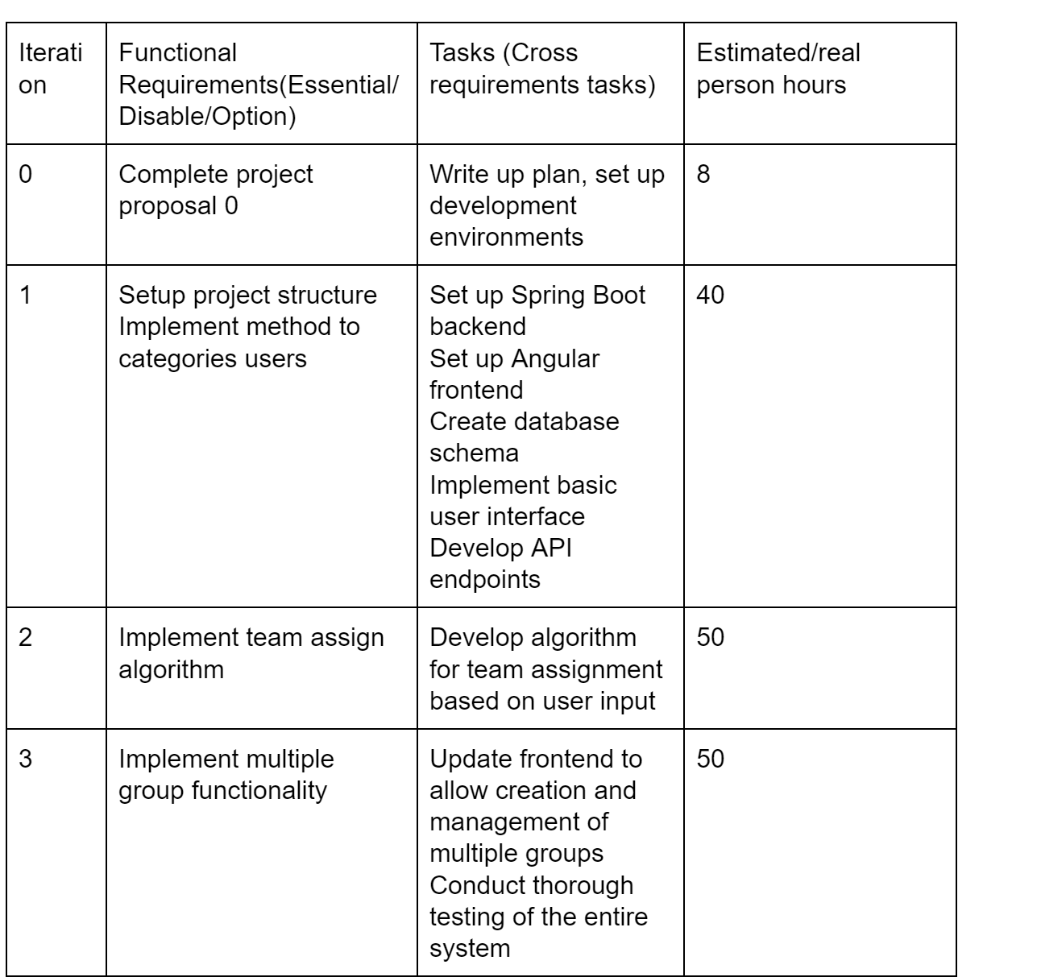
Management Plan Cont.
Timeline:

Slide 12
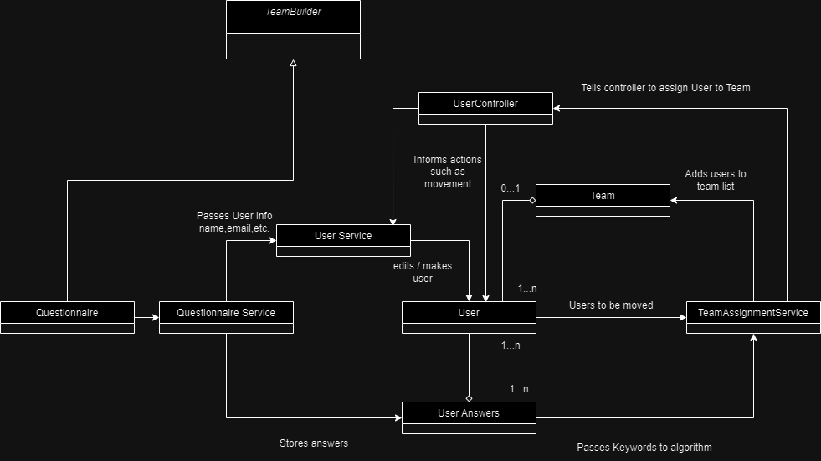
Software Design
Class Diagram:

Slide 13
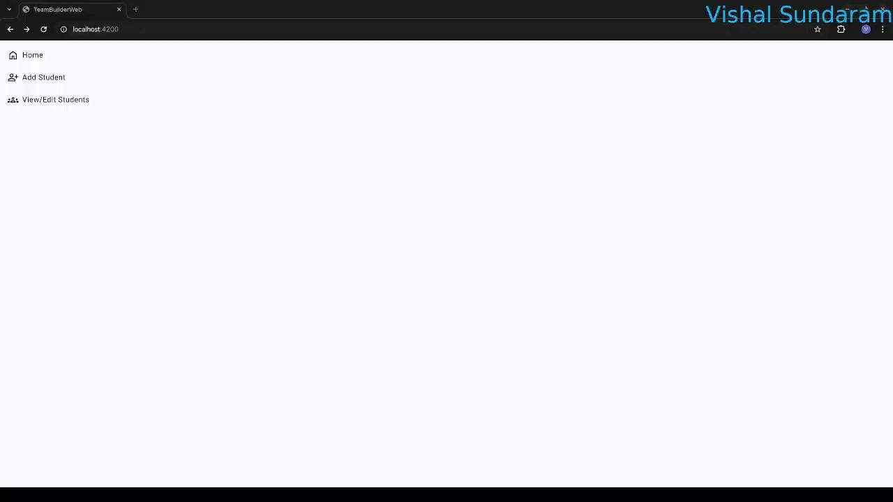
Software Design - UI Demo

Slide 14
Software Testing - Testing Summary
Tested the following:
UI components
Side navigation
Student details
Testing techniques used:
Manual
Automated
Unit tests
Test result:
UI Test coverage summary:
Statements : 70% ( 7/10 )
Branches : 0% ( 0/1 )
Functions : 66.66% ( 2/3 )
Lines : 62.5% ( 5/8 )

Slide 15
Software Testing - Manual Test 1
Test case ID: 1
Test case name: Side navigation
New test
Test items:
Side navigation bar
navigation items
Test priority: High
Test steps:
Navigate to website
See whether the side navigation bar is loaded to the left side of the app
Three navigation items should be displayed on the side navigation bar
Expected output: Side navigation bar shall be displayed on the left side of the application with three items:
Home
Add Student
View/Edit Student

Slide 16
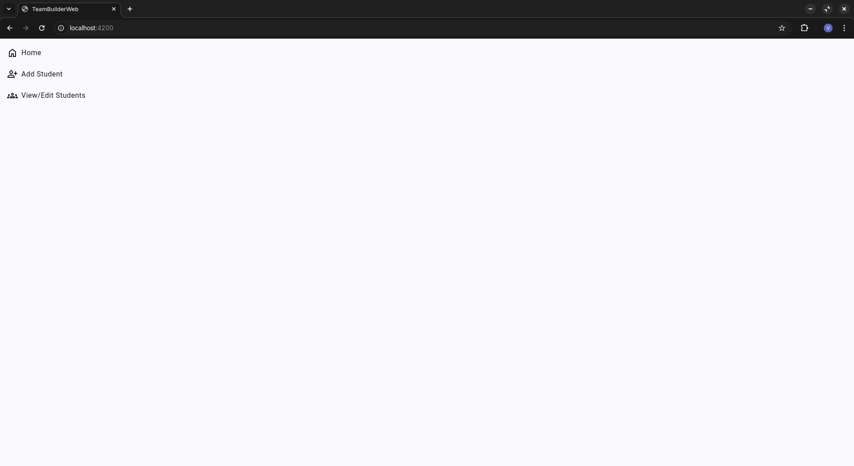
Software Testing - Manual Test 1
Actual output:
Test result: PASS

Slide 17
Software Testing - Manual Test 2
Test case ID: 2
Test case name: Add student details
New test
Test items:
Add student page
Form input
Save button
Test priority: high
Test steps:
Navigate to website
On the side navigation, click on ‘Add Student’
On the ‘Basic details’ section, give valid and invalid inputs
Expected output:
Three sections shall be displayed on ‘Add Student’ page
On ‘Basic details’, four input fields - Name, Email, Degree, Concentration shall be displayed
Given valid values, the save button shall be enabled

Slide 18
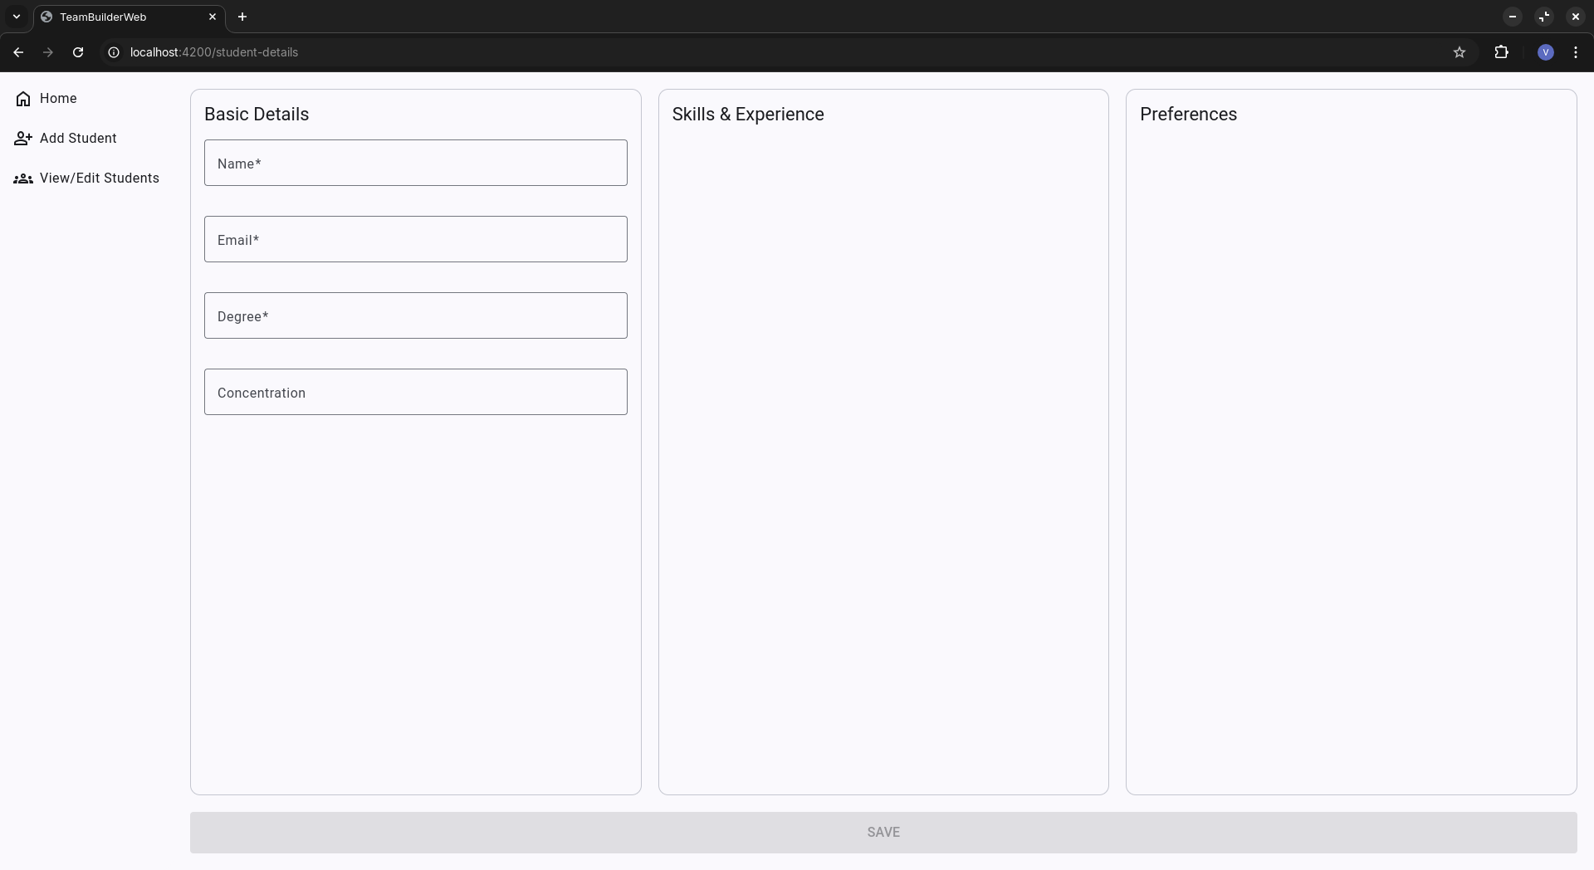
Software Testing - Manual Test 2
Actual output:

Slide 19
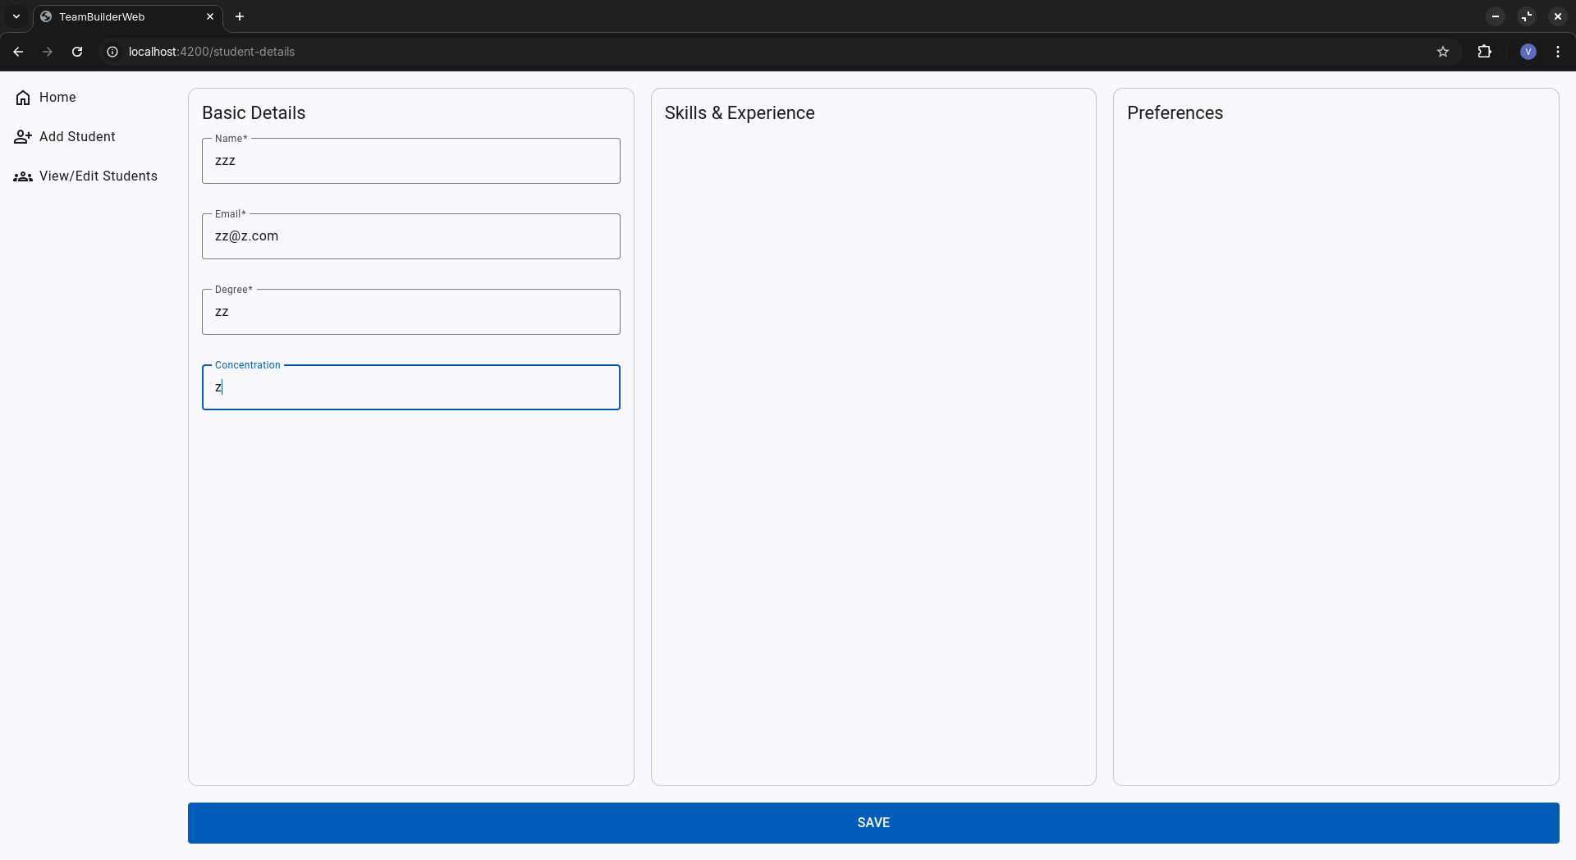
Software Testing - Manual Test 2
Actual output:

Slide 20
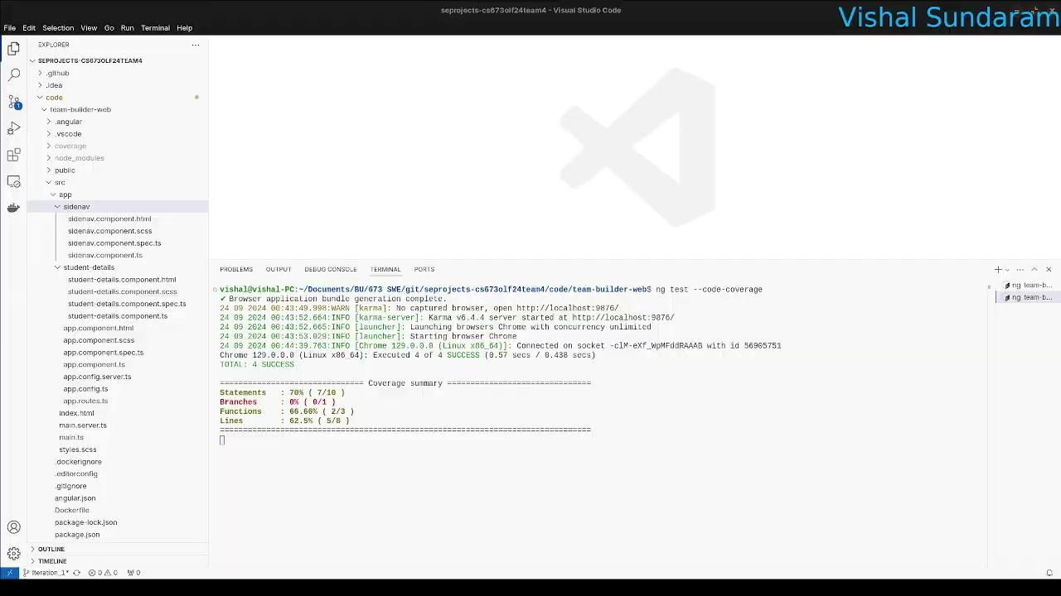
Software Testing - Automated testing - UI demo

Slide 21
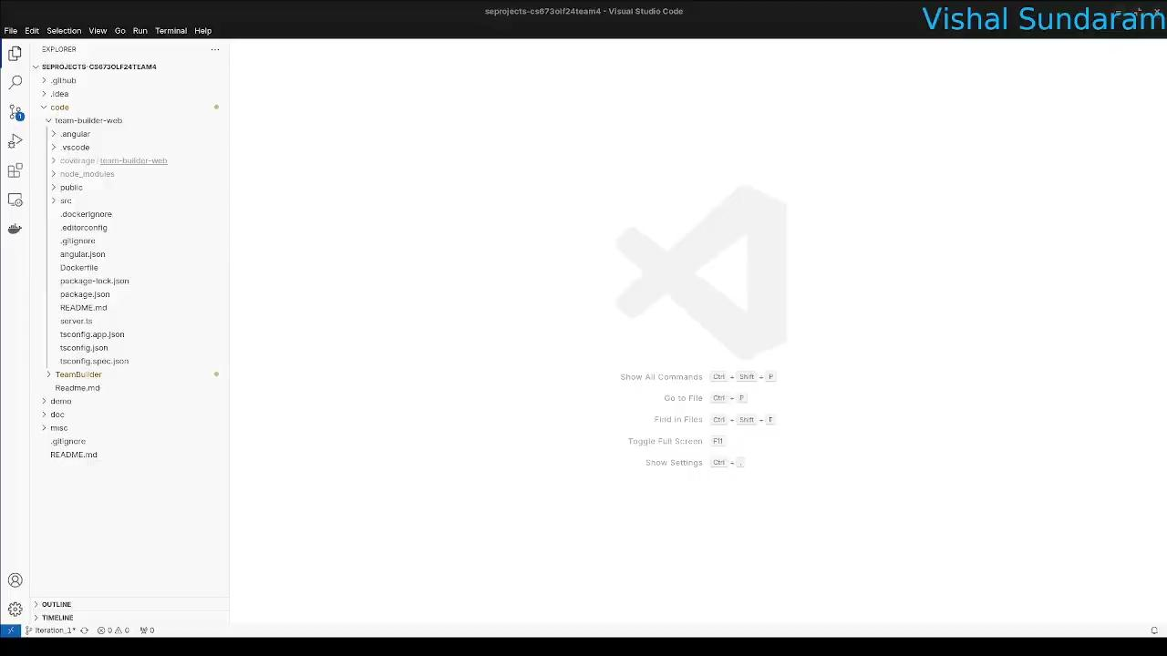
Software testing - Automated testing - Coverage report

Slide 22
Software Testing - Metrics
Number of test cases written so far: 4
Test coverage: 62.5%
Defects: 0

