Slide 1
Team (6) BlockBuster
Project Top Movie API
Project Team: Elizabeth Tyree, Josh Shilts, Ricky Zheng, Alex Flinchum, James Zheng, and Rekik Mengstu

Slide 2
Doc updates
Previous work (iteration 0):
Determined and configured framework and dependent tools
Created and documented high-level architecture design document
Create UI mockup document
Determined our datasource (Kaggle)
Created commit documentation
Set up branch protections
Compiled assignment documentation

Slide 3
Doc Updates (current work)
Changes (iteration 1):
Created UML database design diagram
Decision (the team will use pycharm)
Testing github actions, microservice flow
We started discussion on javascript IDE
TBD with respect to Security Requirements

Slide 4
Accomplishments
Database design diagram
Created the movies database based on the schema design
The code creates all tables
A test code was created to verify table creation
The code drops tables after test, in order to the test database again if needed
Decided on each name on the data table to have an unique key

Slide 5
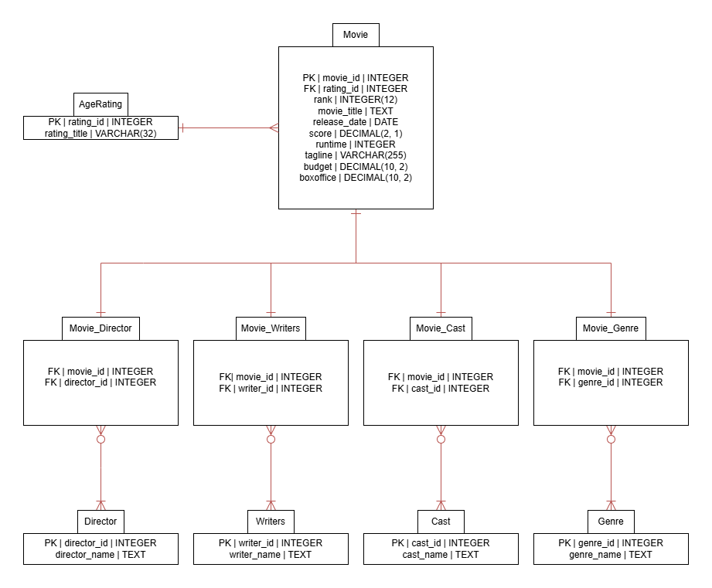
Accomplishments Database design diagram

Slide 6
Accomplishment(s)
Created and Dockerized Frontend and Backend MVP
Backend Story Frontend Story
Connected and tested two Microservices with Rest API
Backend Story Created github actions Pipeline with three jobs
-Docker-and-Python-Flask-Service (Build and Runs Python backend)
-Node-Service (Install)
-Docker-and-Node Service (Build and Runs Python backend)

Slide 7
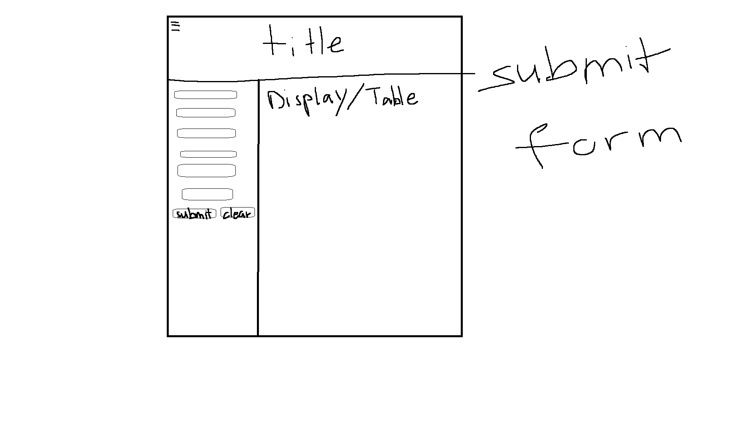
UI new functionality
A home page
The button on the home page links to the search page
Changed the format of the submit or search page
Adding a hamburger button to the top left

Slide 8
Project Tools
Tools used for this iteration 1 for this project are:
Docker
Python
SQLite
HTML
CSS
Pycharm
Git
Nodejs
Flask
Podman
VmWare Workstation 17

Slide 9
Work in Progress
Frontend UI layout
Github actions
Pipeline
Scaling-up Frontend with NodeJS
Loading data into database
Containerizing SQLite database as a microservice
Researching security tools

Slide 10
Next steps for iteration 2
Incorporate database microservice into pipeline
Create security process
Continue Github Actions progress
Finish UI layout and start incorporating CSS and Reactjs for organization

