Slide 1
Team 6: Blockbuster
Top Movie API
Team Members: Joshua Shilts, Elizabeth Tyree, Ricky Zheng, Alex Flinchum, and James Zheng

Slide 2
Team Members
Team Leader - Joshua Shilts
Requirements Leader - Elizabeth Tyree
Design and Implementation Leader - Elizabeth Tyree
Security Leader - James Zheng
Presenters:
Configuration Leader - Ricky Zheng
QA Leader - Alex Flinchum

Slide 3
Overview
Updates
Backend
Frontend
Database
Security
Pipeline
Accomplishments
Plan for Iteration 3

Slide 4
Backend Updates
Created new Flask route that responds to a new request with required data
Created new Unit test to test New route call
Refactored repo file structure to now contain a src and test dir
Started implementation on query calls to database
Updated Docker container with new dependencies
Notes:
Flask - creating a function that communicates with the frontend; responds to a new submission request
Submission request is unit tested add to pipeline
Dependencies - pyTest; flask course

Slide 5
Frontend Updates
Integrated unit tests
Jest
Implemented Submit Form Data Inputs
Created multiple sections of data input for search criteria.
Integrated style sheet into submit form, making all inputs into a uniform structure.
Implemented Clear Button for Data Inputs
Created an input tag with a reset type in order to clear out the data inputs when clicked
Added Style to whole webpage

Slide 6
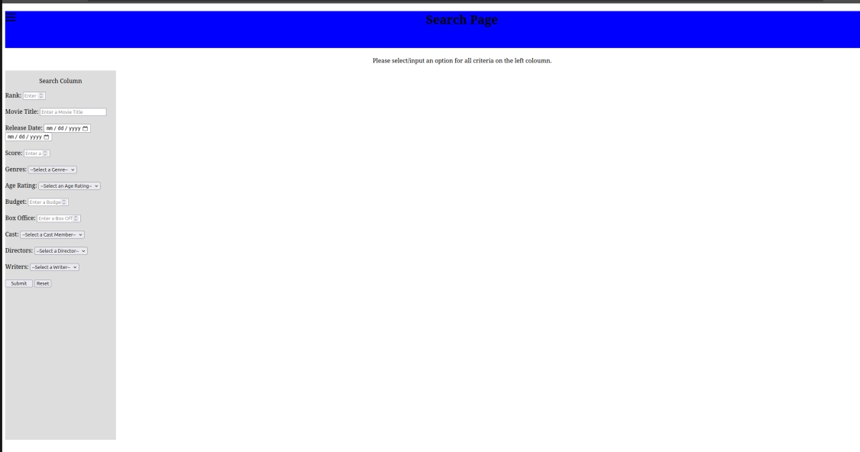
UI Submit Form

Slide 7
Database Updates
Database is implemented
Created a start_movies.py script that automatically creates the movies database and loads it with data
Created docker container for Movies database that automatically runs the start_movies.py script
Creates the Movies database automatically every time the container is spun up
Integrated PyTest
Database image and unit test integrated into pipeline

Slide 8
Security Updates
Ran Pylint against all python code
Database
Backend
At the moment, no security vulnerability just technical debt
Next couple of action items are to integrate and analyze reports from:
SonarQube SCA scan
Conan Scan (anchore-cli)

Slide 9
Pipeline Updates
Integrated unit tests
Frontend
Backend (PyLint)
Database
Integrated Docker container pushing to GitHub Package registry
Flask Backend
Node Frontend
SQLite Database
Implemented workflow job dependency
Multiple jobs in workflow will dependent on the success of previous jobs.

Slide 10
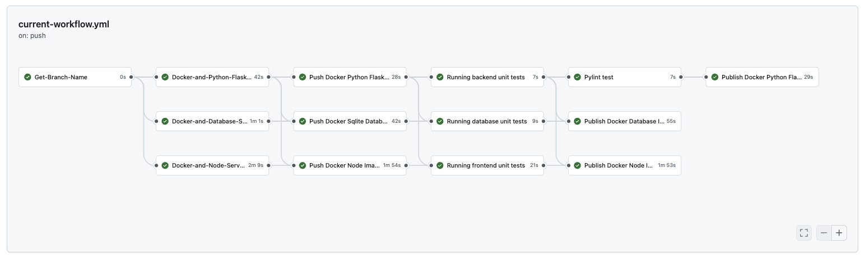
Pipeline Workflow

Slide 11
Accomplishments
Backend
New Flask route
Unit test
Query calls to database
UI
Submit Form inputs created
Style sheets implemented
Database
Database is implemented, containerized, and tested
Created unit tests for the frontend , backend, and the database
Database and backend code runned through PyLint
Pipeline
PyLint run against backend code
Integrated unit tests after build jobs
Docker containers now pushed to registry after every run
Jobs are dependent on previous job pass/fail status

Slide 12
Plan for Iteration 3
Create and integrate new unit tests
Frontend
Linking API calls to frontend
Docker Compose to test container communication
Pipeline
SonarQube
Conan
Deployment
AWS Elastic Beanstalk (Tentative)

