Slide 1
Team BlockBuster
Project Top Movies API

Slide 2
Meet the Team
Josh Shilts - Leader
Elizabeth Tyree - Design and Implementation Leader
Alex Flinchum - QA Leader
James Zheng - Security Leader
Ricky Zheng - Configuration Leader
Rekik Mengstu- Requirement Leader

Slide 3
Project Top Movies API
Data Science based application
Ability to query and display movie data
Based on a variety of data points.
Utilizing Kaggle data
Built using Python Flask and NodeJs and SQLite
Container based application

Slide 4
Accomplishments This Sprint
Determined and configured framework and dependent tools
Created and documented high-level architecture design document
Create UI mockup document
Determined our datasource (Kaggle)

Slide 5
Accomplishments This Sprint Cont..
Created commit documentation
Set up branch protections
Compiled assignment documentation Lab1

Slide 6
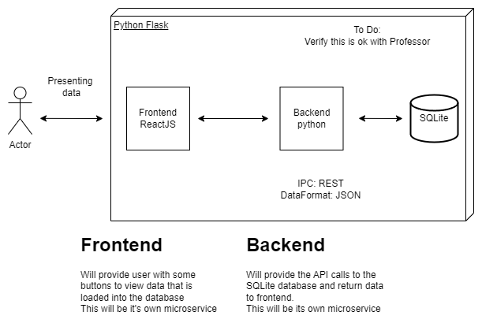
Accomplishments This Sprint Cont..

Slide 7
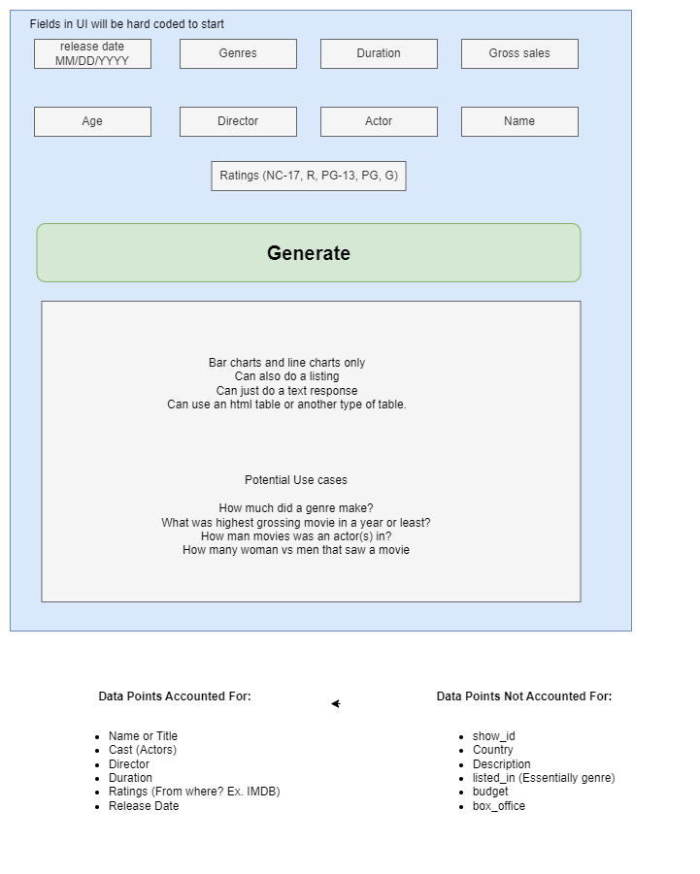
Accomplishments This Sprint Cont..

Slide 8
WIP (Work in Progress)
Draft requirements
Testing skeleton application
Creating more new epics and stories

Slide 9
Demo

Slide 10
Thank you

