Slide 1
Med Tracker
Iteration 3
Team 1:
Andrew Gieraltowski, Divya Thomas, Yuan Wang, Haiyang Lu

Slide 2
Our Product
Med Tracker:
Track and manage medications
Intuitive design for the elderly and disabled

Slide 3
Features
Add new medications
Delete old medications
Notifications
Easy to use UI

Slide 4
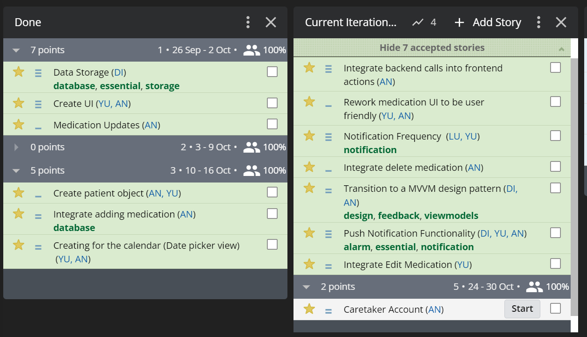
Iteration 3

Slide 5
Requirement Analysis
The system should be able to create, delete, and edit medications
The system should be able to notify users of the time which they need to take the medicine
The system should be able to record if the patient took the medication at the designated times

Slide 6
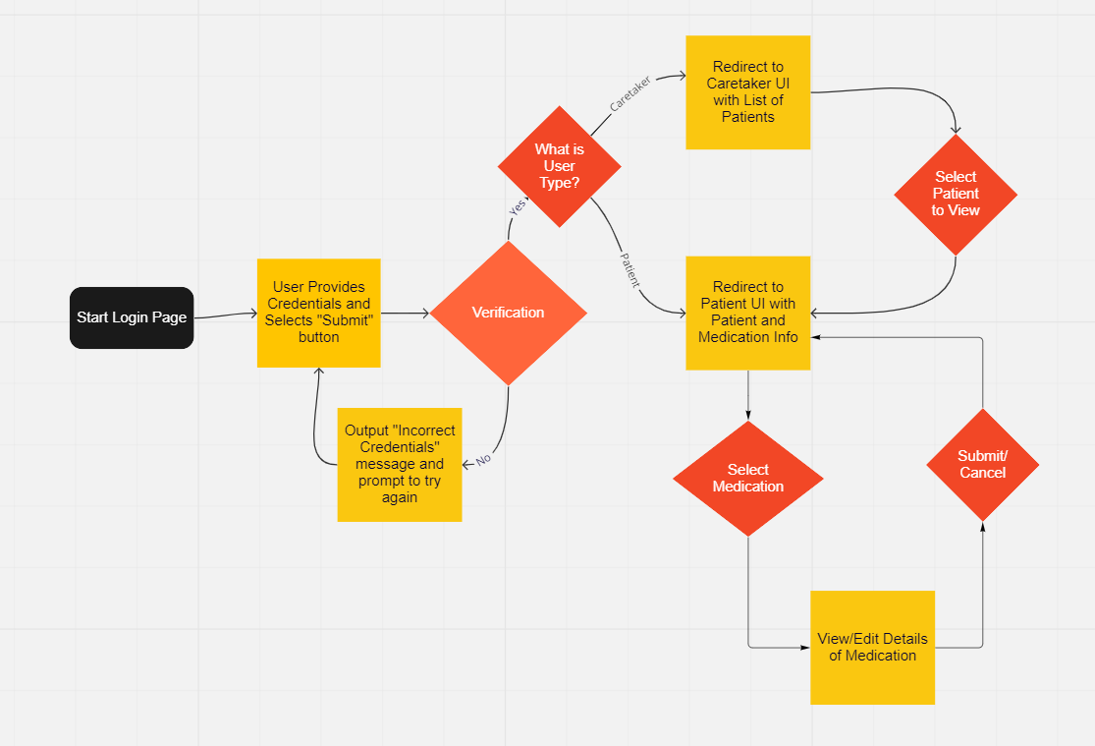
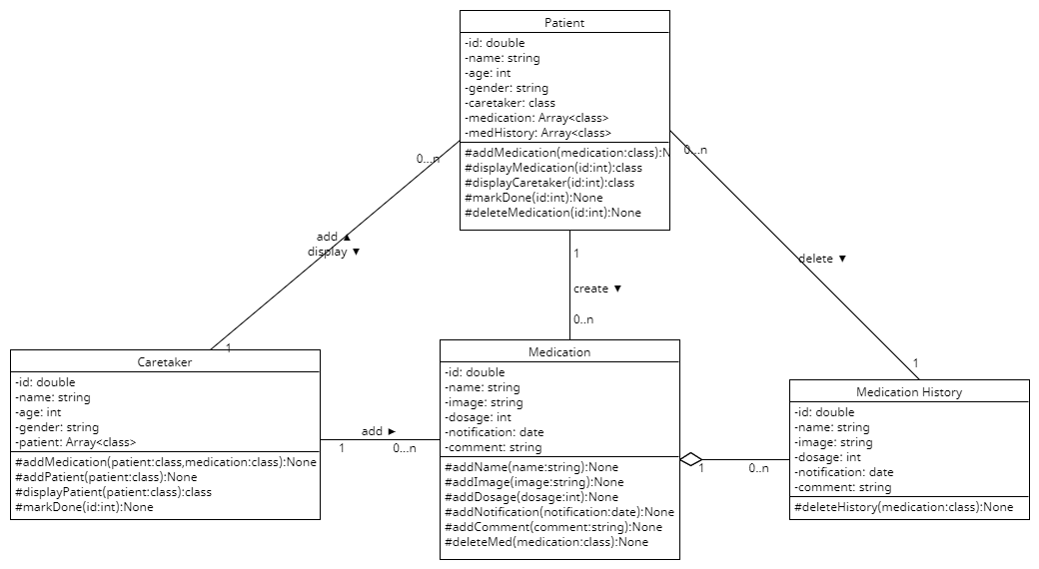
Design

Slide 7
Design Cont.
Database Design
Local Database
Singleton Database Object
Data Access Object
MVVM architecture
Security Design
Local Hosting within Device
Device security protects the user

Slide 8
Implementation
Written in java
Built with gradle
Developed in Android Studio
Hosted on Github

Slide 9
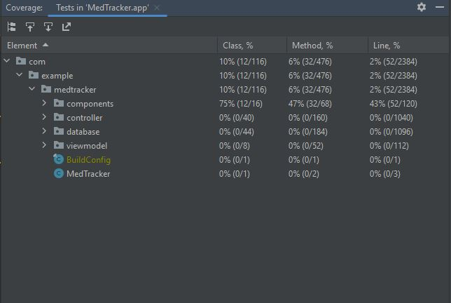
Testing
Unit Testing
Junit
Goal was 80 percent code coverage
Actual was 75 percent of components
Significantly less for functional code coverage

Slide 10
Testing Cont.
Manual Testing
Verifying features
User can add medication
User can edit/update medications
User can access settings
User can update settings
Notification plays at selected time
Verifying database components
Database data is persistent across restarts/activities
Database data is accurate to user input

Slide 11
Security
Keeping all databases local to the device running the application
Opted not to host data on servers
Delegating security to the operating system of the device
Users that can log into the phone can access the application
Minimize risk by keeping data local to the application

Slide 12
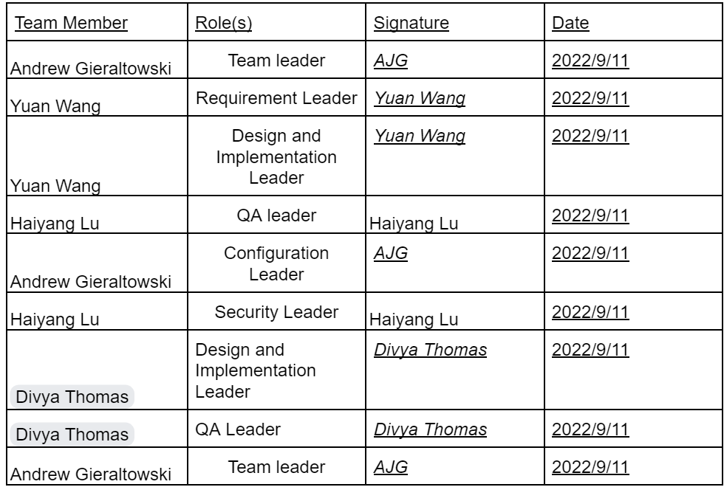
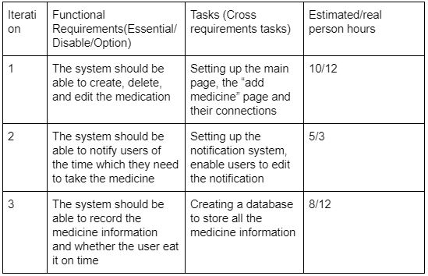
Project Management
Team roles: Management plan:

Slide 13

Demo

Slide 14
Future Plans
No plans to release the application

Slide 15
Thank you!

