Slide 1
1. Data Tree

Slide 2
Group Dataset (Type 1 BIDS Folder Structure)
Type 1 BIDS Folder Structure:
For all higher level processing group, subject, and session, the dataset folder structure has a corresponding folder.
Folder/File Tree
Gk -- group folder
Sj -- subject folder
Ei -- session folder
Rh -- run folder
D* -- derived / homer
Gk
Gk / Sj
Gk / Sj / Ei
Gk / Sj+1
Gk / Sj / Ei /
Rh.snirf
Gk / Sj / Ei+1
NOTE:
This group is shown with 3 subject folders but to save space only one file/folder branch Gk/Sj/Ei is fully shown down to its runs (3 in this case). The other branches are only partially shown but it is to be assumed that all branches have run files.
Gk / Sj / Ei /
Rh+1.snirf
Gk / Sj+2
Gk / Sj / Ei /
Rh+2.snirf
Gk / D* /
Gk.mat
+
groupResult.mat
Gk / D* / Sj /
Sj.mat
Gk / D* / Sj / Ei /
Ej.mat
Gk / D* / Sj / Ei /
Rh.mat
Gk / D* / Sj+1 /
Sj+1.mat
Gk / D* / Sj / Ei+1 /
Ej+1.mat
Gk / D* / Sj / Ei /
Rh+1.mat
Gk / D* / Sj+2 /
Sj+2.mat
Gk / D* / Sj / Ei /
Rh+2.mat

Slide 3
Gk - group folder
Group Dataset (Type 1 BIDS Folder Structure)
Folder/File Tree
Gk -- group folder
Sj -- subject folder
Ei -- session folder
Rh -- run folder
D* -- derived / homer
Gk
Gk / Sj
Gk / Sj / Ei
Gk / Sj+1
Gk / Sj / Ei /
Rh.snirf
Gk / Sj / Ei+1
Gk / Sj / Ei /
Rh+1.snirf
Gk / Sj+2
Gk / Sj / Ei /
Rh+2.snirf
Group Gk derived data
Gk / D* /
Gk.mat
+
groupResult.mat
Gk / D* -- Gk / derived / homer
Gk / D* / Sj /
Sj.mat
Gk / D* / Sj / Ei /
Ej.mat
Gk / D* / Sj / Ei /
Rh.mat
Gk / D* / Sj+1 /
Sj+1.mat
Gk / D* / Sj / Ei+1 /
Ej+1.mat
Gk / D* / Sj / Ei /
Rh+1.mat
Gk / D* / Sj+2 /
Sj+2.mat
Gk / D* / Sj / Ei /
Rh+2.mat

Slide 4
Corresponding Data Tree (Type 1 BIDS Folder Structure)
Data Tree
Gk
Gk.Sj
Gk.Sj+1
Gk.Sj+2
Gk.Sj.Ei
Gk.Sj.Ei+1
Gk.Sj.Ei.Rh
Gk.Sj.Ei.Rh+1
Gk.Sj.Ei.Rh+2
currElem
acquired
formatVersion data probe stim aux
procStream (derived data)
fcalls input output

Slide 5
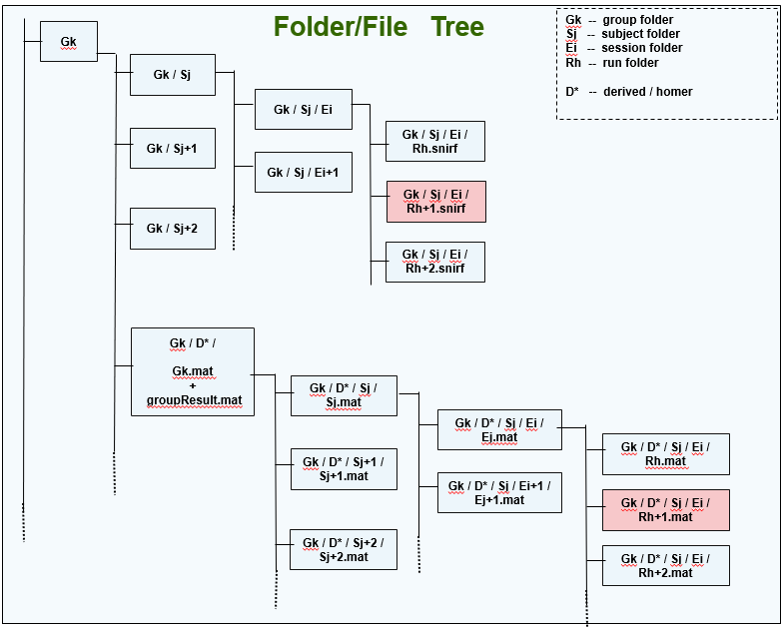
Loading/Saving Acquired and Derived Data (Type 1 BIDS Folder Structure) to Data Tree
(file distribution scheme)
Data Tree
Gk
load/save acquired data (snirf) from/to Rh+1.snirf
Gk.Sj
Gk.Sj+1
Gk.Sj+2
Gk.Sj.Ei
Gk.Sj.Ei+1
Gk.Sj.Ei.Rh
Gk.Sj.Ei.Rh+1
Gk.Sj.Ei.Rh+2
currElem
acquired
formatVersion data probe stim aux
procStream (derived data)
fcalls input output
load/save derived output data (output field) from/to Rh+1.mat
load/save derived input data (fcalls + input) from/to groupResults.mat

Slide 6
Group Dataset (Type 2 BIDS Folder Structure)
Type 2 BIDS Folder Structure:
Processing levels group and subject have corresponding folders but not session.
Folder/File Tree
Gk -- group folder
Sj -- subject folder
Rh -- run folder
D* -- derived / homer
Gk
Gk / Sj
Gk / Sj /
Rh.snirf
Gk / Sj+1
Gk / Sj /
Rh+1.snirf
Gk / Sj+2
Gk / Sj /
Rh+2.snirf
Gk / D* /
Gk.mat
+
groupResult.mat
Gk / D* / Sj /
Sj.mat
Gk / D* / Sj /
Rh.mat
Gk / D* / Sj+1 /
Sj+1.mat
Gk / D* / Sj /
Rh+1.mat
Gk / D* / Sj /
Rh+2.mat
Gk / D* / Sj+2 /
Sj+2.mat

Slide 7
Gk - group folder
Group Dataset (Type 2 BIDS Folder Structure)
Folder/File Tree
Gk -- group folder
Sj -- subject folder
Rh -- run folder
D* -- derived / homer
Gk
Gk / Sj
Gk / Sj /
Rh.snirf
Gk / Sj+1
Gk / Sj /
Rh+1.snirf
Gk / Sj+2
Gk / Sj /
Rh+2.snirf
Group Gk derived data
Gk / D* /
Gk.mat
+
groupResult.mat
Gk / D* -- Gk / derived / homer
Gk / D* / Sj /
Sj.mat
Gk / D* / Sj /
Rh.mat
Gk / D* / Sj+1 /
Sj+1.mat
Gk / D* / Sj /
Rh+1.mat
Gk / D* / Sj /
Rh+2.mat
Gk / D* / Sj+2 /
Sj+2.mat

Slide 8
Corresponding Data Tree (Type 2 BIDS Folder Structure)
NOTE:
In place of the missing session folders one session level is created in each subject of the data tree.
Data Tree
Gk
Gk.Sj
Gk.Sj+1
Gk.Sj+2
Gk.Sj.Ei
Gk.Sj.Ei.Rh
Gk.Sj.Ei.Rh+1
Gk.Sj.Ei.Rh+2
currElem
acquired
formatVersion data probe stim aux
procStream (derived data)
fcalls input output

Slide 9
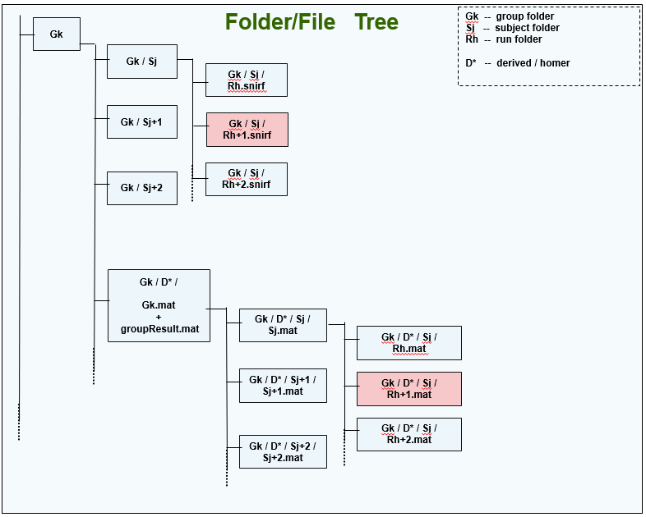
Loading/Saving Acquired and Derived Data (Type 2 BIDS Folder Structure) to Data Tree
(file distribution scheme)
Data Tree
Gk
load/save acquired data (snirf) from/to Rh+1.snirf
Gk.Sj
Gk.Sj+1
Gk.Sj+2
Gk.Sj.Ei
Gk.Sj.Ei.Rh
Gk.Sj.Ei.Rh+1
Gk.Sj.Ei.Rh+2
currElem
acquired
formatVersion data probe stim aux
procStream (derived data)
fcalls input output
load/save derived output data (output field) from/to Rh+1.mat
load/save derived input data (fcalls + input) from/to groupResults.mat

Slide 10
4. Stimulus

Slide 11
g1
Group Directory Structure
Data Tree stim and stim conditions example
s1
g1s1r1.snirf
g1s1r2.snirf
g1s1r3.snirf
Assume group data set with this directory/file structure
s2
g1s2r1.snirf
g1s2r2.snirf
g1s2r3.snirf
s3
g1s3r1.snirf
g1s3r2.snirf
g2

Slide 12
Data Tree stim and stim conditions example: Adding new stim to new condition
Data Tree
g1
1 | 2 | 4 | 5
g2
. . .
2. Regenerate conditions set in derived data of entire group
1. Add 3 stims to NEW condition “4” in derived data of run 1,2,1
s1
1 | 2 | 4 | 5
s2
1 | 2 | 4 | 5
s3
1 | 2 | 4 | 5
r1
1 | 2 | 4 | 5
3 | 0 | 0 | 0
r2
1 | 2 | 4 | 5
3 | 2 | 0 | 2
r3
1 | 2 | 4 | 5
0 | 4 | 0 | 4
r1
1 | 2 | 4 | 5
0 | 0 | 0 | 4
r2
1 | 2 | 4 | 5
0 | 4 | 3 | 0
r3
1 | 2 | 4 | 5
4 | 0 | 0 | 5
r1
1 | 2 | 4 | 5
0 | 4 | 0 | 4
r2
1 | 2 | 4 | 5
3 | 4 | 0 | 0
condition names
g1s1r1
1
3
g1s2r1
1 | 2 | 5
3 | 2 | 2
g1s1r3
2 | 5
4 | 4
g1s3r1
2 | 5
4 | 4
g1s3r2
1 | 2
3 | 4
number of trials
g1s2r1
5
4
g1s2r2
2 | 4
4 | 3
g1s2r3
1 | 5
4 | 5
3. Save changed run stim to acquisition file g1s2r2

Slide 13
Data Tree stim and stim conditions example
Data Tree
g1
1 | 2 | 5
g2
. . .
s1
1 | 2 | 5
s2
1 | 2 | 5
s3
1 | 2 | 5
r1
1 | 2 | 5
3 | 0 | 0
r2
1 | 2 | 5
3 | 2 | 2
r3
1 | 2 | 5
0 | 4 | 4
r1
1 | 2 | 5
0 | 0 | 4
r2
1 | 2 | 5
0 | 4 | 0
r3
1 | 2 | 5
4 | 0 | 5
r1
1 | 2 | 5
0 | 4 | 4
r2
1 | 2 | 5
3 | 4 | 0
condition names
g1s1r1
1
3
g1s3r1
2 | 5
4 | 4
g1s3r2
1 | 2
3 | 4
number of trials
g1s2r1
1 | 2 | 5
3 | 2 | 2
g1s1r3
2 | 5
4 | 4
g1s2r1
5
4
g1s2r3
1 | 5
4 | 5
g1s2r2
2
4

