Slide 1

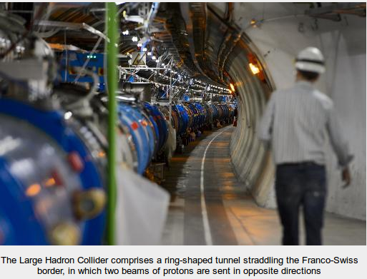
Boston University
Electronics Design Facility
LHC Upgrade Plans – Xilinx Products

Slide 2
ATCA Projects
Direct BU collaboration
  ATLAS MDT muon trigger
    Collaboration with U.Mass, U.C. Irvine and MPI (Germany)
    64 blades installed ~ 150 fibers each (10Gbps class)
    Substantial LUT / register use
  CMS outer tracker readout
    Collaboration with Imperial College London, Rutgers, Fermilab, Cornell, others
    256 blades installed ~ 200 fibers each (25 Gbps class)
Other groups
  1000+ blades developed by many groups worldwide
Essentially all use Zynq SoC on a commercial SoM
  For today’s discussion
Essentially all use one or more XCVU13P in A2577 package
(CERN negotiated common purchase agreement/price)

Slide 3
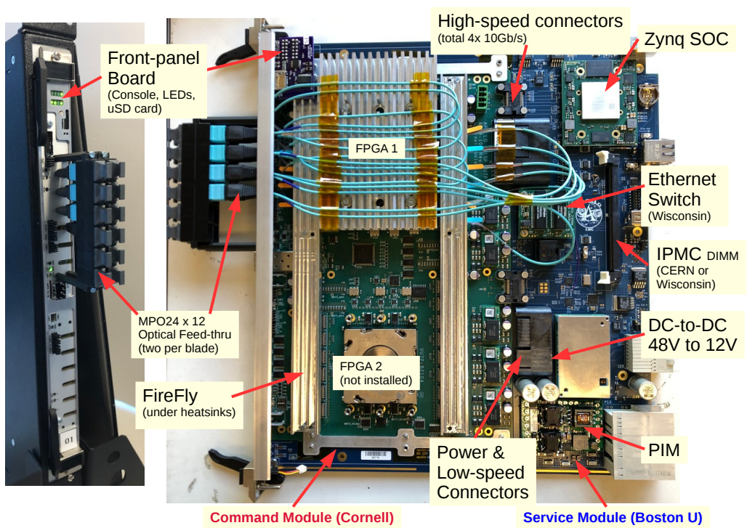
“APOLLO” Platform
Family of similar ATCA blades developed by BU, Cornell, Umass, MPI and others
(Example of the type of blade being developed)

Slide 4
Zynq SoM
SoM requirements
  64-bit ARM core (Zynq ultrascale+)
  Minimum (4) 10Gb/s capable MGTs
  Some FPGA fabric (modest requirements)
  4GB PS RAM, Ethernet
  ~100 GPIOs
Current status
  LHC blade designs currently using product from Enclustra, Trenz and others (~ $2k each!)
  Kria is a very attractive alternative at ~$300, but...

Slide 5
Zynq SoM
Concerns about Kria SoM
  Closed design (everything else is open…)
  Any chance to get schematics?
  Single source
  What do we do if SoM is discontinued?
  Other vendors have provided schematics and offered conditional licenses for us to manufacture if product is discontinued

