Slide 1

Internet structure: network of networks
local
ISP
Tier 3
ISP
local
ISP
local
ISP
local
ISP
Tier-2 ISP
Tier-2 ISP
Tier 1 ISP
NAP
Tier-1 ISP
Tier-1 ISP
Tier-2 ISP
Tier-2 ISP
Tier-2 ISP
local
ISP
local ISP
local
ISP
local
ISP
Extracted from slides of Computer Networking course of Prof. J. Kurose

Slide 2
TCP/IP Protocol Suite – Layering
application
application
application details
7
6
presentation
user process
5
session
Sockets
4
transport
TCP
UDP
XTI
3
network
IPv4, IPv6
kernel
2
datalink
device
driver
and
hardware
communications details
1
physical
OSI model
Internet protocol suite
Figure 1.14 Layers in OSI model and Internet protocol suite
Extracted from Unix Network Programming, Vol. 1, 3rd. Ed., W. Stevens,

Slide 3
TCP/IP Protocol Suite - Layering
User
process
User
process
User
process
User
process
application
TCP
UDP
transport
TCP：Transmission Control Protocol
ICMP
IP
IGMP
network
UDP：User Datagram Protocol
IP：Internet Protocol
ICMP：Internet Control Message Protocol
ARP
Hardware
Interface
RARP
IGMP：Internet GroupManagement Protocol
link
ARP：Address Resolution Protocol
RARP：Reverse Address Resolution Protocol
media
Figure 1.4 Various protocols at the different layers in the TCP/IP protocol suite
Notes:
TCP协议：支持可靠通讯，保证数据包不会丢失
UDP协议：不管接收方是否收到，数据包可能会丢失
上述两个协议通过IP协议来传：这两个协议会把数据准备好送给IP包，在包头上带上接收方和发送方的地址和protoco字段 网卡接收后 操作系统判断为IP包进而交给IP协议
IP协议如何判断数据包发给TCP协议还是UDP协议：
protoco字段取值为6则为TCP协议；17则为UDP协议
上层多个协议的数据可以通过下层一个协议发送出去，复用。
UDP TCP IP 为传输协议

Slide 4
IEEE 802.2/802.3 encapsulation(RFC 1042):
802.3 MAC
802.2 LLC
802.2 SNAP
destination
addr.
source
addr.
length
DSAP
AA
SSAP
AA
cntl
org code
00
type
data
CRC
6
6
2
1
1
1
3
2
38 - 1492
4
type
0800
IP datagram
2
38 - 1492
type
0806
ARP request/reply
PAD
2
28
10
type
8035
RARP request/reply
PAD
2
28
10
Ethernet encapsulation(RFC894) :
46 - 1500
destination
addr.
source
addr.
type
data
CRC
6
6
2
46 - 1500
4
type
0800
IP datagram
2
46 - 1500
type
0806
ARP request/reply
PAD
2
28
18
type
8035
RARP request/reply
PAD
2
28
18
Figure 2.1 IEEE 802.2/802.3 encapsulation(RFC 1042) and Ethernet encapsulation(RFC894)

Slide 5
ARP Cache
  maintains the recent mappings from Internet addresses to hardware addresses
  The normal expiration time of an entry in the cache is 20 minutes from the time the entry was created
hostname
hostname
FTP
resolver
(1)
IP addr.
(2)
establish connection with IP address
TCP
(3)
send IP datagram to IP address
IP
ARP
(4)
(5)
(6)
(8)
(9)
Ethernet
driver
ARP request (Ethernet broadcast)
Ethernet
driver
Ethernet
driver
ARP
(7)
ARP
IP
TCP
Figure 4.2 Operation of ARP when user types “ftp hostname”

Slide 6
=1: for Ethernet
= 0x0800: for IP address
hard size
prot size
= 0x0806
=1: ARP request; =2: ARP reply (2);
=3: RARP request; =4: RARP reply
Ethernet
destination
addr
Ethernet
source
addr
frame
type
hard
type
prot
type
op
Sender
Ethernet
addr
sender
IP addr
target
Ethernet
addr
target
IP addr
6
6
2
2
2
1
1
2
6
4
6
4
Ethernet header
28 bytes ARP request/reply
Figure 4.3 Format of ARP request or reply packet when used on an Ethernet
The special Ethernet destination address of all one bits means the broadcast address.

Slide 7
number of 32-bit words in the header
3-bit precedence field; 4 TOS bits, and an unused bit set to 0
total length of the IP datagram in bytes
calculated over IP header only
IP Header
uniquely identifies each datagram sent
4-bit
version
4-bit header
length
4-bit type of service
(TOS)
16-bit total length (in bytes)
16-bit identification
0
D
F
M
F
13-bit fragment offset
8-bit time to live
(TTL)
8-bit protocol
16-bit header checksum
20 bytes
32-bit source IP address
upper limit on the number of routers through which a datagram can pass
32-bit destination IP address
option (if any)
data
don’t fragmentation.
turned on for each fragment comprising a datagram except the final fragment.
contains the offset of this fragment from the beginning of the original datagram.
A variable-length list of optional information
Options defined: security and handling restrictions, record route, timestamp, loose source routing, strict source routing
These options are rarely used and not all hosts and routers support all the options

Slide 8
IP datagram
IP
header
UDP
header
UDP data (1473 bytes)
20 bytes
8 bytes
IP
header
UDP
header
IP
header
20 bytes
8 bytes
1472 bytes
20 bytes
1 byte
packet
packet
Figure 11.8 Example of UDP fragmentation

Slide 9
routing
daemon
route
command
netstat
command
routing table updates
from adjacent routers
UDP
TCP
ICMP
yes
ICMP
redirects
our packet(one of
our IP addresses or
broadcast address)?
no
forward datagram
(if forwarding enabled)
routing
table
IP output:
calculate next hop
router (if necessary)
source routing
process IP options
IP input queue
IP layer
Network interfaces
Figure 9.1 Processing done at the IP layer

Slide 10
Interconnected ASes
3c
3a
2c
3b
2a
AS3
2b
1c
AS2
1a
1b
1d
AS1
Forwarding table is configured by both intra- and inter-AS routing algorithm
  Intra-AS sets entries for internal dests
  Inter-AS & Intra-As sets entries for external dests
Intra-AS
Routing
algorithm
Inter-AS
Routing
algorithm
Forwarding
table
Extracted from slides of Computer Networking course of Prof. J. Kurose

Slide 11
BGP messages
BGP messages exchanged using TCP.
BGP messages:
  OPEN: opens TCP connection to peer and authenticates sender
  UPDATE: advertises new path (or withdraws old)
  KEEPALIVE keeps connection alive in absence of UPDATES; also ACKs OPEN request
  NOTIFICATION: reports errors in previous msg; also used to close connection
Extracted from slides of Computer Networking course of Prof. J. Kurose

Slide 12
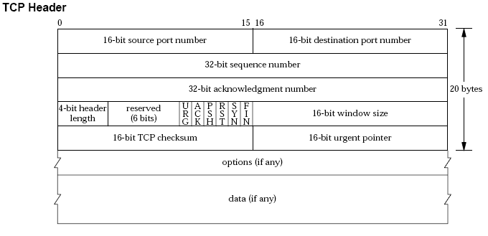
contains the next sequence number that the sender of the acknowledgment expects to receive
length of the header in 32-bit words
a positive offset that must be added to the sequence number field of the segment to yield the sequence number of the last byte of urgent data.
the number of bytes, starting with the one specified by the acknowledgment number field, that the receiver is willing to accept
It's a notification from the sender to the receiver for the receiver to pass all the data that it has to the receiving process.
a reset is sent by TCP whenever a segment arrives that doesn't appear correct for the referenced connection.

Slide 13
Indicate normal transition for client
Indicate normal transition for server
starting point
send: indicate what is sent for this transition
CLOSED
recv: indicate state transitions taken when segment received
appl: passive open
appl: indicate state transition s taken when application issues operation
send: <nothing>
appl: active open
send: SYN
LISTEN
recv:SYN; send: SYN, ACK
passive open
appl: send data
send: SYN
recv: RST
recv: SYN
appl: close
SYN_RCVD
send: SYN, ACK
SYN_SENT
or timeout
simultaneous open
active open
recv: ACK
recv: SYN, ACK
send: ACK
send: <nothing>
appl: close
recv: FIN
ESTABLISHED
send: ACK
CLOSE_WAIT
send: FIN
data transfer state
appl: close
send: FIN
appl: close
send: FIN
simultaneous close
recv: FIN
recv: ACK
FIN_WAIT_1
send: ACK
CLOSING
LAST_ACK
send: <nothing>
recv: ACK
recv: FIN, ACK
recv: ACK
send: <nothing>
send: ACK
send: <nothing>
passive close
recv: FIN
FIN_WAIT_2
send: ACK
TIME_WAIT
2MSL timeout
active close
Figure 18.12 TCP State transition diagram

Slide 14
Client
Server
(active open) SYN_SENT
SYN J
LISTEN (passive open)
SYN_RCVD
SYN k, ack J+1
ESTABLISHED
ack k+1
ESTABLISHED
(active close) FIN_WAIT_1
FIN M
CLOSE_WAIT (passive close)
ack M+1
FIN_WAIT_2
FIN N
LAST_ACK
TIME_WAIT
ack N+1
CLOSED
Figure 18.13 TCP states corresponding to normal connection establishment and termination

Slide 15
slip.1024
vangogh.discard
1
1:257(256) ack 1
RTT #1
2
（1.061ms）
ack 257, win 7936
3
257:513(256) ack 1
4
513:769(256) ack 1
RTT #2
（0.808ms）
5
ack 513
8
ack 749
6
7
769:1025(256) ack 1
RTT #3
1025:1281(256) ack 1
（1.015ms）
9
1281:1537(256) ack 1
10
ack 1025
12
ack 1281
11
15
1537:1793(256) ack 1
13
1793:2049(256) ack 1
Figure 21.2 Packet exchange and RTT measurement

Slide 16
sun.1181
bsdi.discard
Fast Sender
SYN 690560000:690560000(0)
Slow Receiver
win 4096, <mss 1460>
SYN 2566353409: 2566353409(0)
ack 690560001, win 4096, <mss 1024>
ack 1, win 4096
PSH 1:1025(1024) ack 1, win 4096
PSH 1025:2049(1024) ack 1, win 4096
PSH 2049:3073(1024) ack 1, win 4096
PSH 3073:4097(1024) ack 1, win 4096
ack 4097, win 0
ack 4097, win 4096
PSH 4097:5121(1024) ack 1, win 4096
PSH 5121:6145(1024) ack 1, win 4096
PSH 6145:7169(1024) ack 1, win 4096
FIN, PSH 7169:8193(1024) ack 1, win 4096
ack 8194, win 0
ack 48194, win 4096
FIN 1:1(0) ack 8194, win 4096
ack 2, win 4096
Figure 20.3 Sending 8192 bytes from a fast sender to a slow receiver

Slide 17
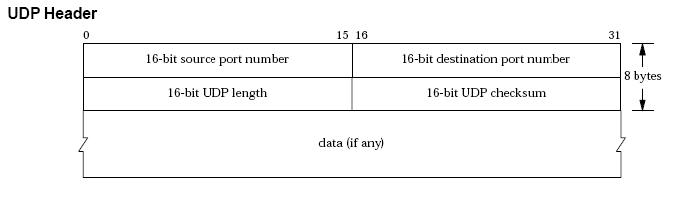
identify the sending process and the receiving process
the length of the UDP header and the UDP data in bytes
optioanl, UDP checksum covers the UDP header and the UDP data

Slide 18
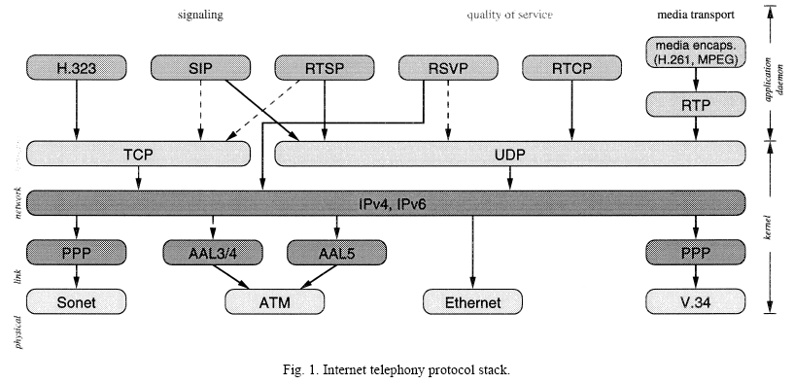
SIP: Session Initiation Protocol
RTSP: Real-Time Streaming Protocol
RSVP: Resource Reservation Protocol
RTP: Real-time Transport Protocol
RTCP: Real-Time Control Protocol
From “Internet Telephony : architecture and protocols - an IETF perspective”, H. Schulzrinne, et al., Computer Networks 31(1999)237–255

Slide 19
SNMP manager
SNMP Agent
get-request
UDP port 161
get-response
get-next-request
UDP port 161
get-response
set-request
UDP port 161
get-response
trap
UDP port 162
Figure 25.1 Summary of the five SNMP operators.
SNMPv1

Slide 20
Message ::= SEQUENCE {
version -- version-1 for this RFC
INTEGER {
version-1(0) },
community -- community name
OCTET STRING,
data -- e.g., PDUs if trivial
ANY -- authentication is being used
}
PDUs ::= CHOICE {
get-request
GetRequest-PDU,
get-next-request
GetNextRequest-PDU,
get-response
GetResponse-PDU,
set-request
SetRequest-PDU,
trap
Trap-PDU
}

Slide 21
GetRequest-PDU ::= [0] IMPLICIT SEQUENCE {
request-id
RequestID,
error-status -- always 0
ErrorStatus,
error-index -- always 0
ErrorIndex,
variable-bindings
VarBindList
}
VarBind ::= SEQUENCE {
name ObjectName,
value ObjectSyntax
}
VarBindList ::= SEQUENCE OF VarBind
RequestID ::= INTEGER
ErrorStatus ::= INTEGER {
noError(0),
tooBig(1),
noSuchName(2),
badValue(3),
readOnly(4),
genErr(5) }
ErrorIndex ::= INTEGER

Slide 22
GetNextRequest-PDU ::= [1] IMPLICIT SEQUENCE {
request-id
RequestID,
error-status -- always 0
ErrorStatus,
error-index -- always 0
ErrorIndex,
variable-bindings
VarBindList
}
GetResponse-PDU ::= [2] IMPLICIT SEQUENCE {
request-id
RequestID,
error-status
ErrorStatus,
error-index
ErrorIndex,
variable-bindings
VarBindList
}

