Slide 1

Introduction to NL2SQL
Zecheng Zhan
2019/09/08

Slide 2

What
Why
CONTENT
How
END

Slide 3
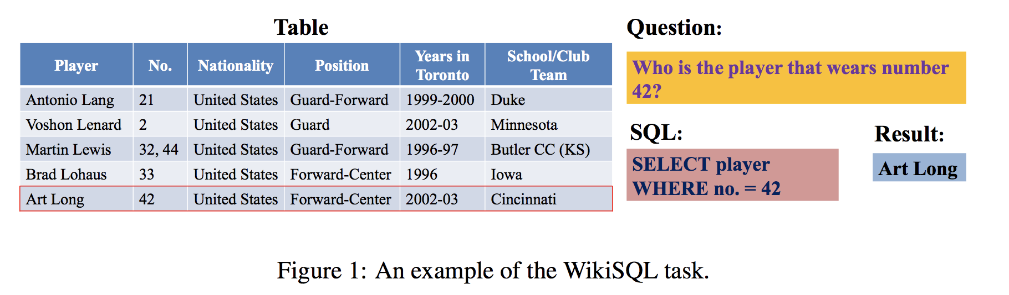
What is NL2SQL
Semantic Parsing : NL2SQL
输入：[自然语言, 要查询的schema]
输出：SQL语句
“SQLNet: GENERATING STRUCTURED QUERIES FROM NATURAL LANGUAGE WITHOUT REINFORCEMENT LEARNING” 2017

Slide 4
How to NL2SQL
Implication: NL2SQL
Sketch-Based
SQLNet
TypeSQL
IncSQL
SQLova
Generated-Based
Seq2SQL
SyntaxSQLNet
Coares2Fine
IRNet

Slide 5
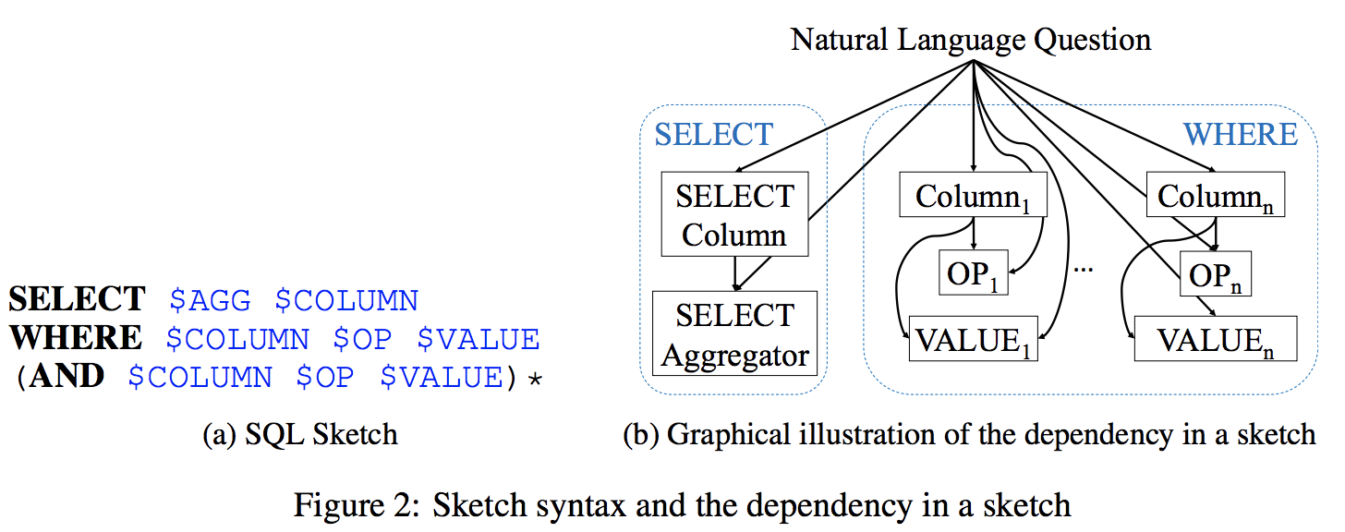
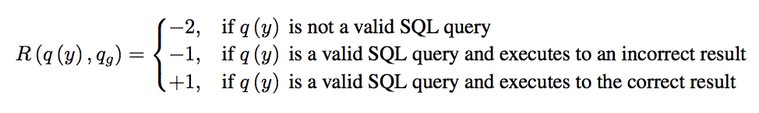
How to NL2SQL: Sketch-Based
Implication: NL2SQL:Sketch-Based
Sketch-Based
SQLNet
TypeSQL
IncSQL
SQLova
What about Complex SQL with Cross Domain ?

Slide 6
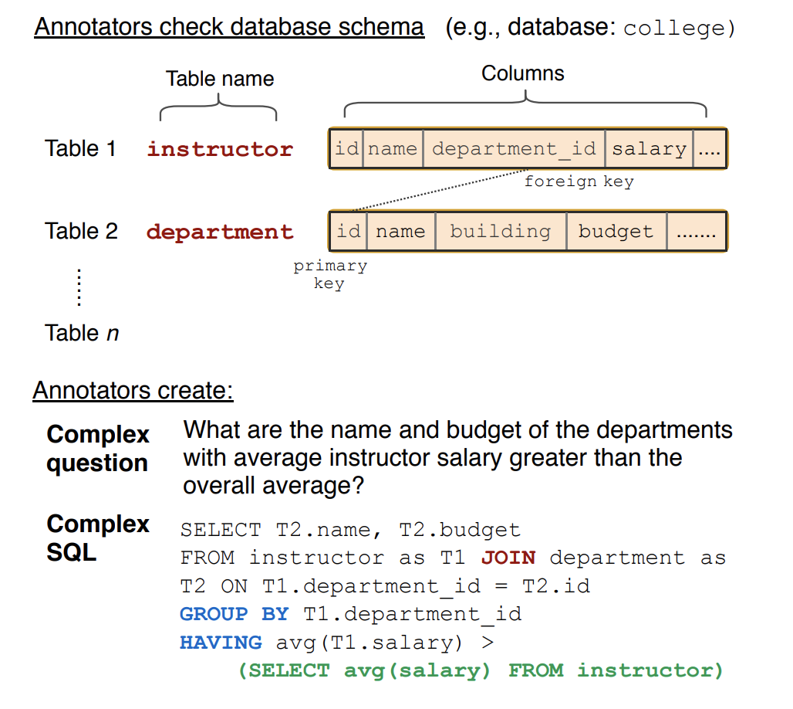
How to NL2SQL: Spider DateSet
Yale Semantic Parsing and Text-to-SQL Challenge
Complex SQL queries
Different SQL Components
GroupBy;OrderBy;Limit;Having
Nested Query(Sub-query)
Cross Domain Databases
Multi-Table
“Spider: A Large-Scale Human-Labeled Dataset for Complex and Cross-Domain Semantic Parsing and Text-to-SQL Task” EMNLP’18

Slide 7
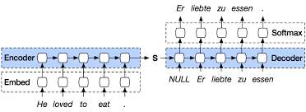
How to NL2SQL: Generated-Based
Implication: NL2SQL:Generated-Based
符合SQL语法规范
Vanilla Seq2Seq [X]
Seq2Tree (Search Constrained Seq2Seq)
如何处理 Cross-domain
Schema Linking

Slide 8
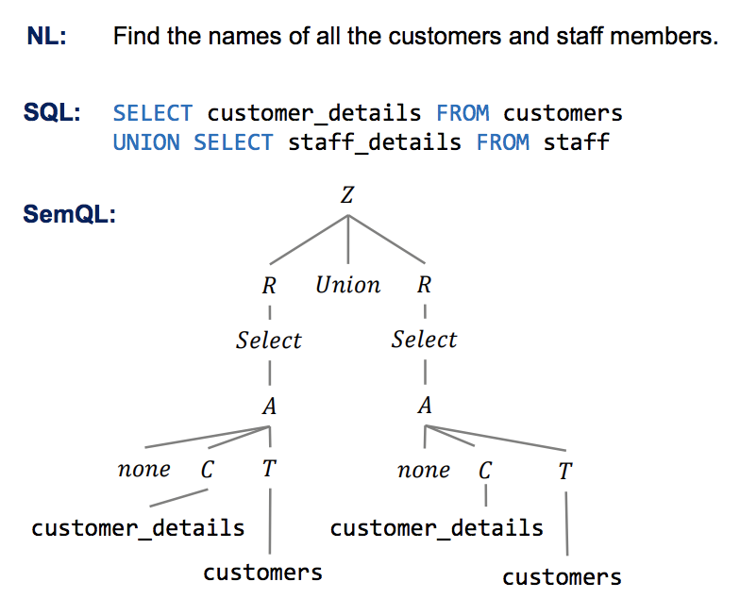
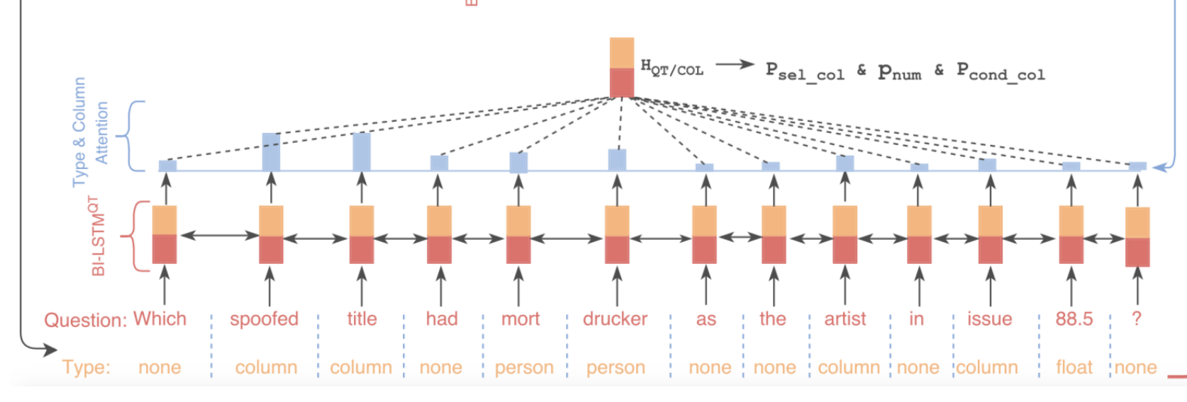
How to NL2SQL: Generated-Based
Implication: NL2SQL:Generated-Based
符合SQL语法规范
Vanilla Seq2Seq [X]
Seq2Tree (Search Constrained Seq2Seq)
如何处理 Cross-domain
Schema Linking

Slide 9
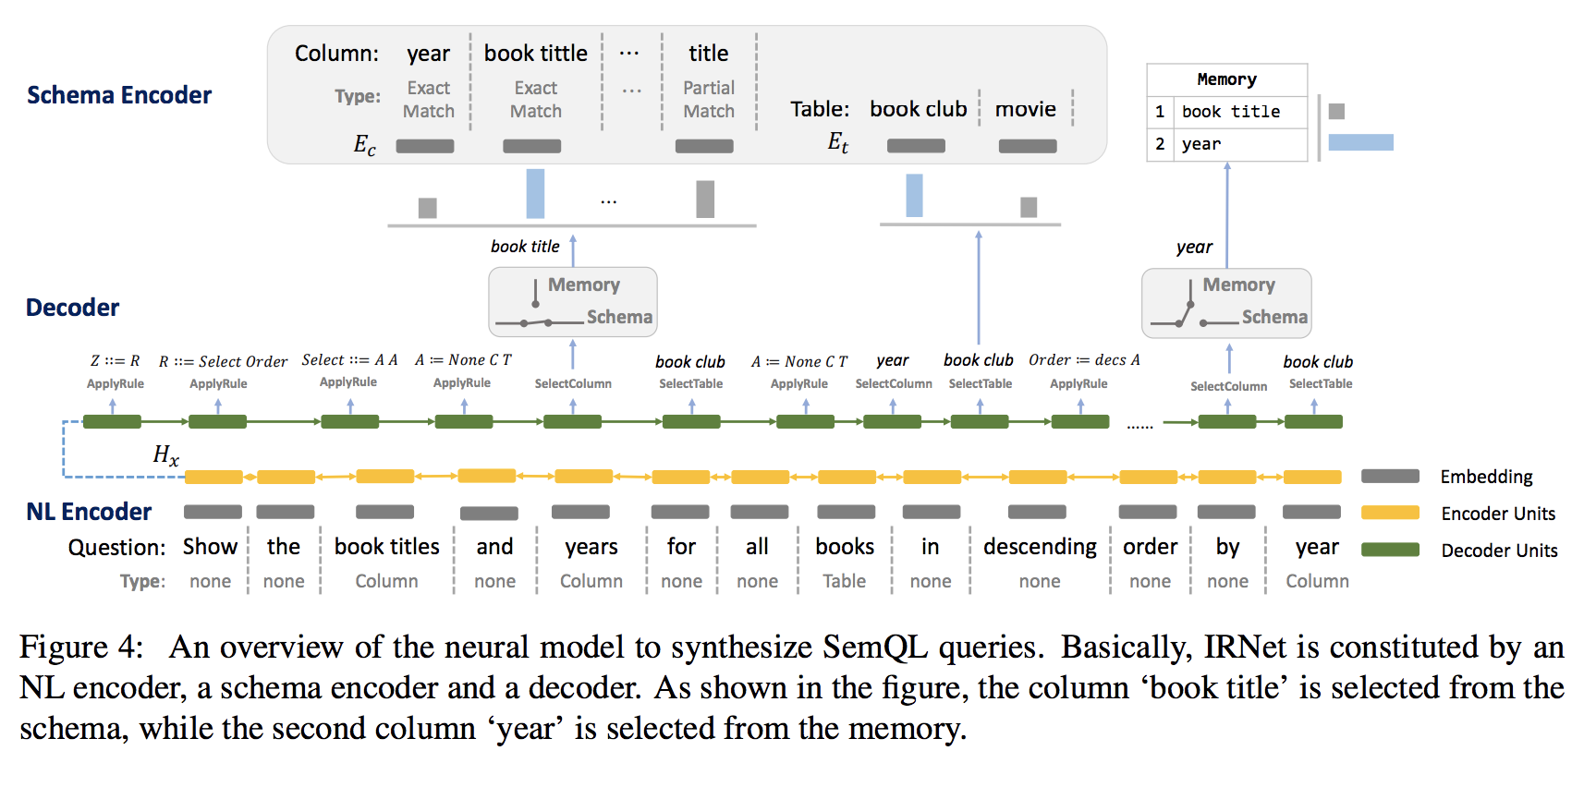
How to NL2SQL: Generated-Based
Implication: NL2SQL:Generated-Based

Slide 10
References
A Syntactic Neural Model for General-Purpose Code Generation
Towards Complex Text-to-SQL in Cross-Domain Database with Intermediate Representation
SEQ2SQL: GENERATING STRUCTURED QUERIES FROM NATURAL LANGUAGE USING REINFORCEMENT LEARNING
SQLNet: GENERATING STRUCTURED QUERIES FROM NATURAL LANGUAGE WITHOUT REINFORCEMENT LEARNING
TypeSQL: Knowledge-based Type-Aware Neural Text-to-SQL Generation
TRANX: A Transition-based Neural Abstract Syntax Parser for Semantic Parsing and Code Generation
Spider: A Large-Scale Human-Labeled Dataset for Complex and Cross-Domain Semantic Parsing and Text-to-SQL Task
Representing Schema Structure with Graph Neural Networks for Text-to-SQL Parsing
SyntaxSQLNet: Syntax Tree Networks for Complex and Cross-DomainText-to-SQL Task
Global Reasoning over Database Structures for Text-to-SQL Parsing

Slide 11
Thanks

