Slide 1
Path-Sensitive Sparse Analysis without Path Conditions
2021-05-14

Slide 2
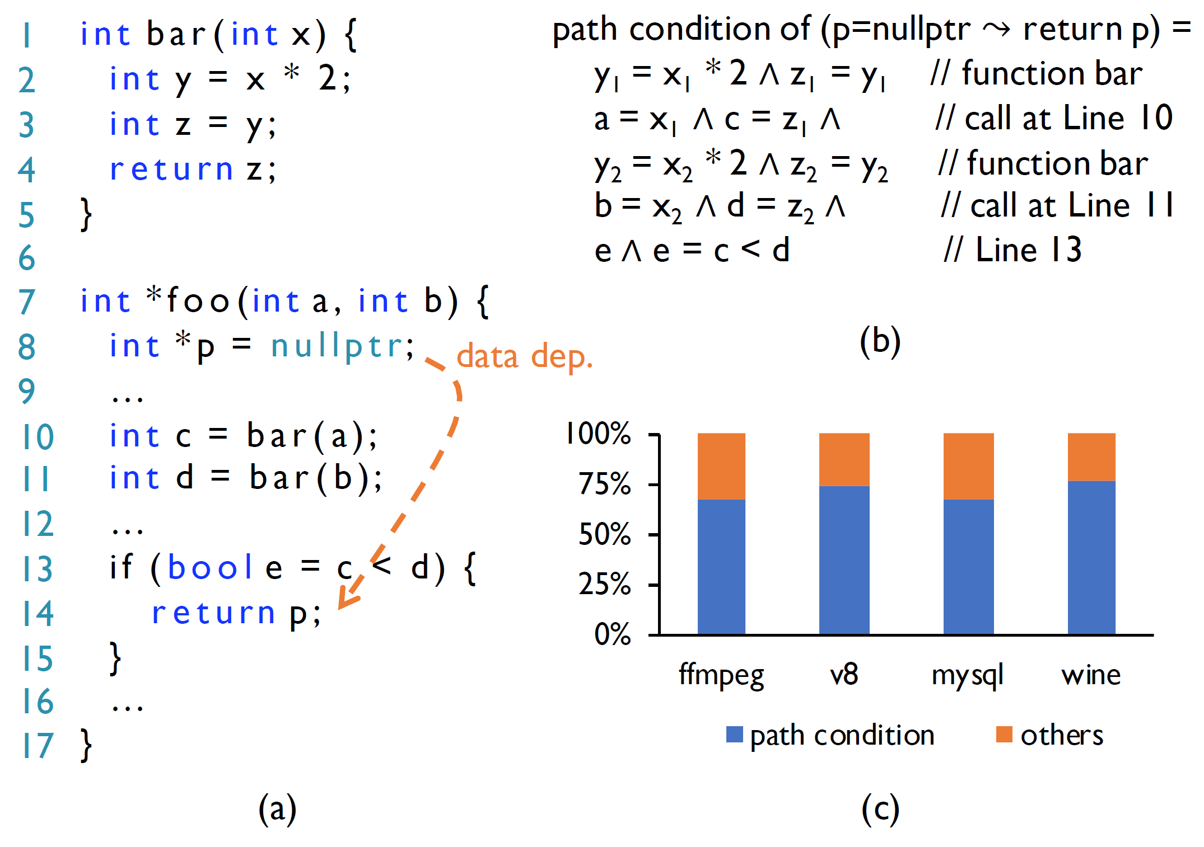
Motivation
The return-value condition, z = y ∧ y = 2x, of the function bar is repetitively instantiated at every call site.
Caching these path conditions as function summaries severely overload the memory and limit the analysis scalability.
Quantifier elimination (QE), Formula simplification (FS), or abstract refinement (AR) introduce extra computational overhead and extra SMT solving procedures.

Slide 3
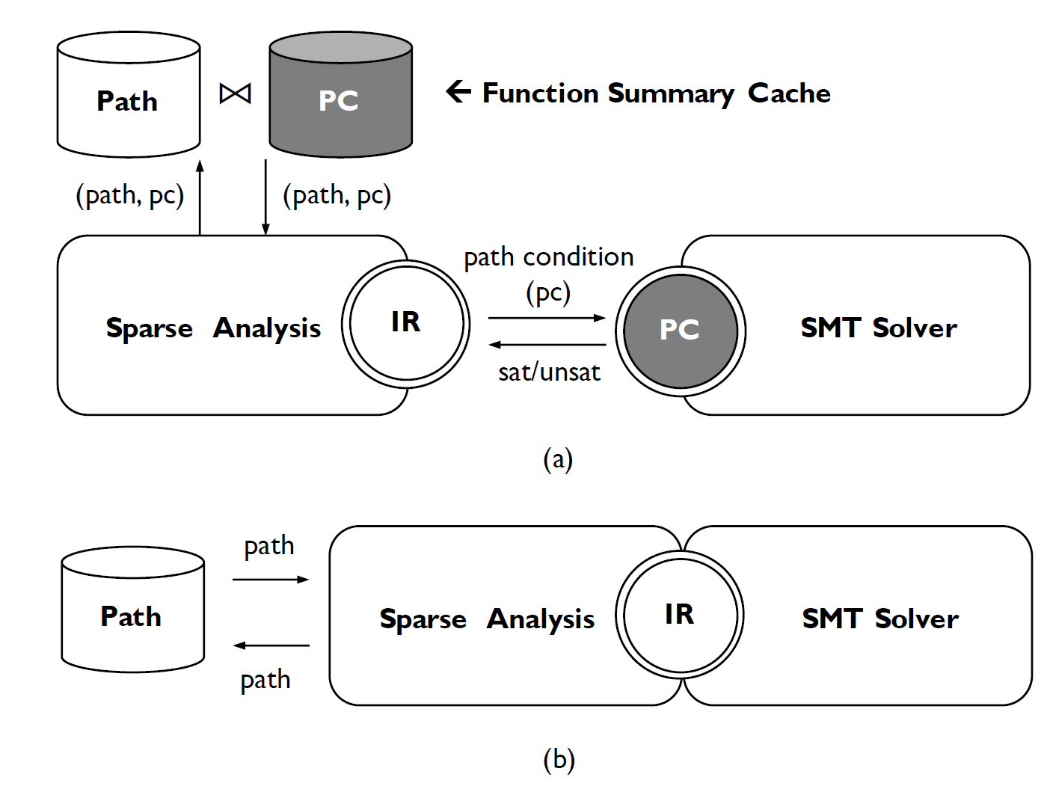
Insight and Solution
Program dependence graph and path condition are allotropes because they encode the same program information, i.e., the control dependence and the data dependence.
The SMT solver no longer works separately to check the satisfiability of path conditions, but works together with the sparse analysis on its linear-sized program intermediate representation (IR), which is known as the program dependence graph.

Slide 4
Contribution
A fused design that enables a scalable inter-procedurally path-sensitive sparse analysis.
An optimized SMT solving method that works directly on the program dependence graph.
An extensive experiment that evaluates the scalability and the precision of our approach.

Slide 5
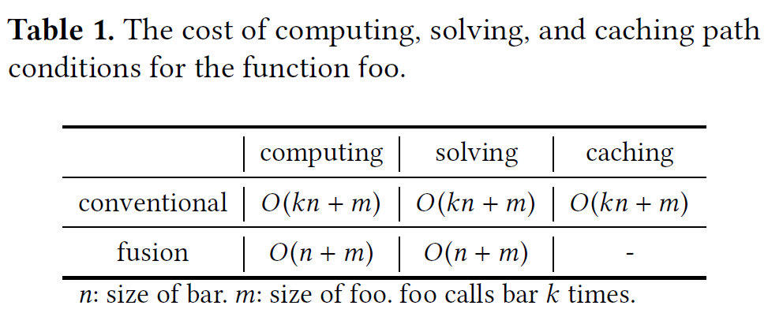
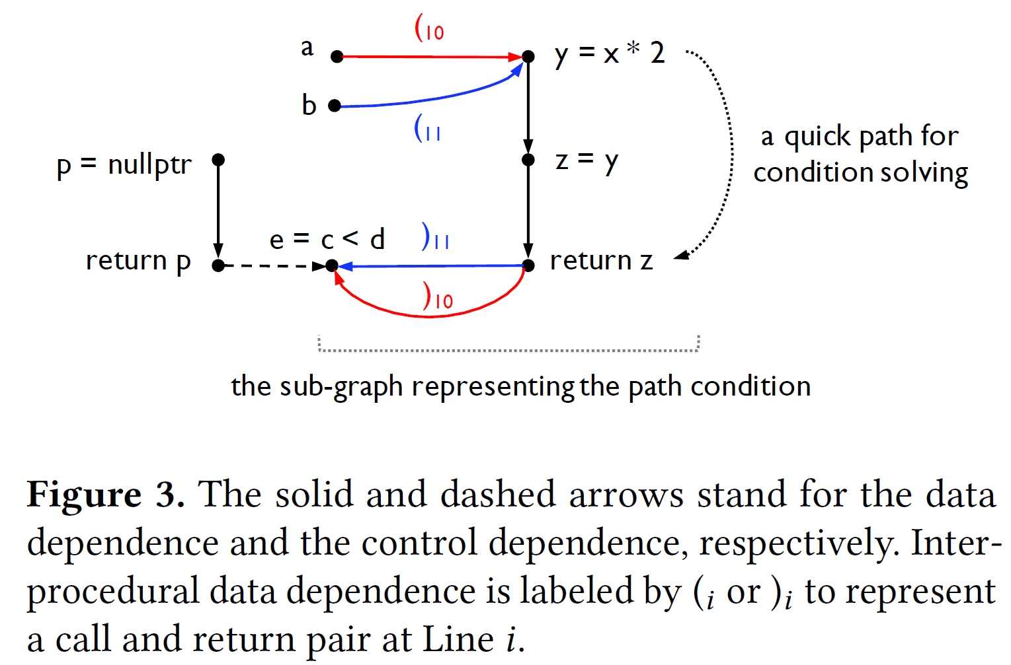
Fusion in a Nutshell
Size n
k times
Size m
Size n
Notes:
Computing | path condition via a linear scan | caching path

Slide 6
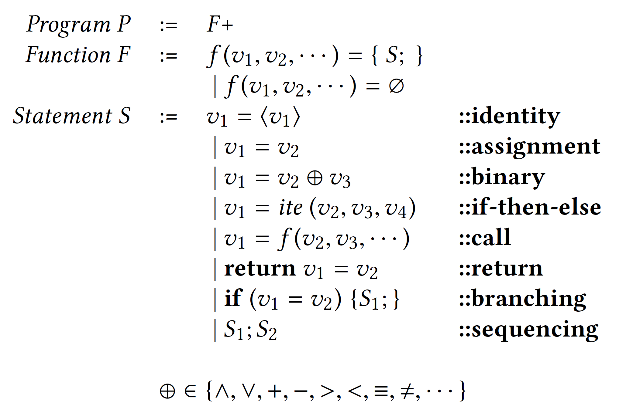
Background and Problem Statement
Call-by-value tiny language
Each function parameter must be initialized using the identity statement, e.g., f (v) = {v = ⟨v⟩; · · ·}.
if v2 is true, v3 is assigned to v1. Otherwise, v4 is assigned to v1
= and ≡ to distinguish the assignment operator and the equality operator
Because the pointer analysis is not our technical contribution and, in the implementation, we follow the existing work to resolve pointer relations (~\cite{pinpoint}).
We assume the code in the language is loop-free as we often unroll loops for a fixed number of times in practice.

Slide 7
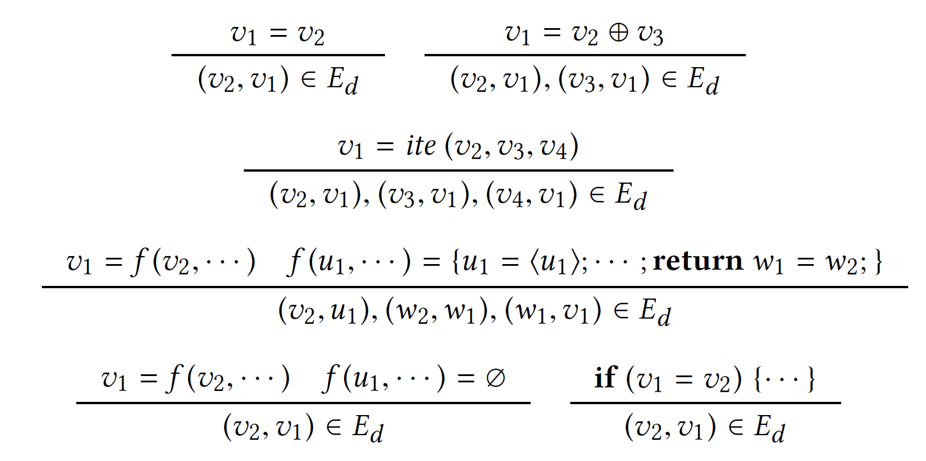
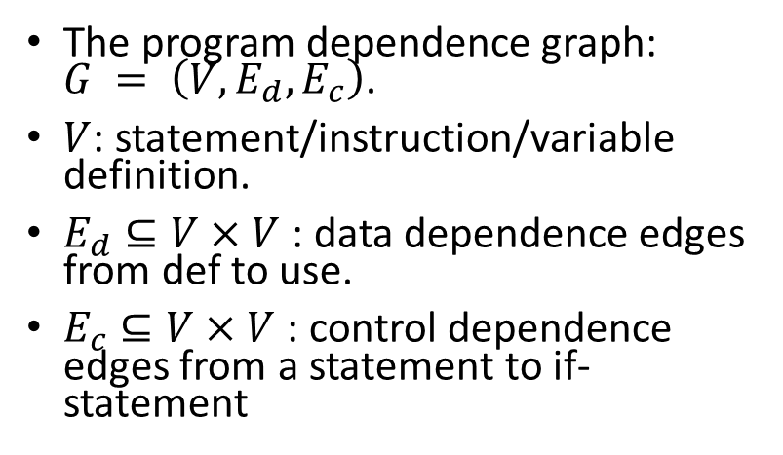
Background and Problem Statement
Program dependence graph
The program dependence graph: $G = \left(V, E_{d}, E_{c}\right)$.
$V$: statement/instruction/variable definition.
$E_{d}⊆V×V$: data dependence edges from def to use.
$E_{c}⊆V×V$: control dependence edges from a statement to if-statement
Each edge is from a statement to an if-statement — the source statement is reachable at runtime if and only if the if-statement is reachable and the branch condition defined in the if-statement is true.
Non-empty function: CFL-reachability method to label each pair of call and return edges with a unique pair of parentheses.

Slide 8
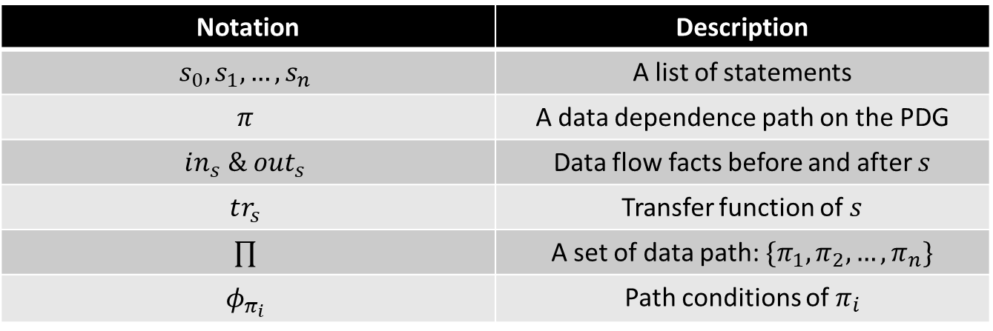
Background and Problem Statement
Path-Sensitive Sparse Analysis
Notation | Description
$$s_{0},s_{1},…, s_{n}$$ | A list of statements
$$π$$ | A data dependence path on the PDG
$$in_{s} \& out_{s}$$ | Data flow facts before and after $s$
$$tr_{s}$$ | Transfer function of $s$
$$∏$$ | A set of data path: $\{π_{1},π_{2},…, π_{n}\}$
$$φ_{π_{i}}$$ | Path conditions of $π_{i}$

Slide 9
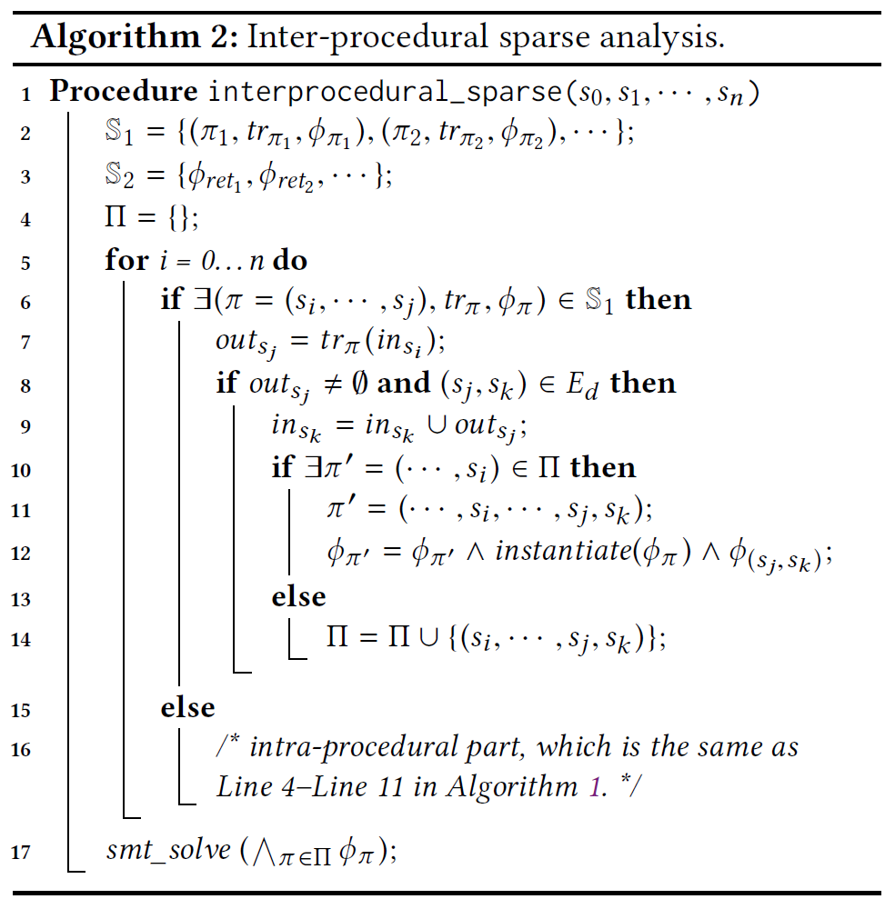
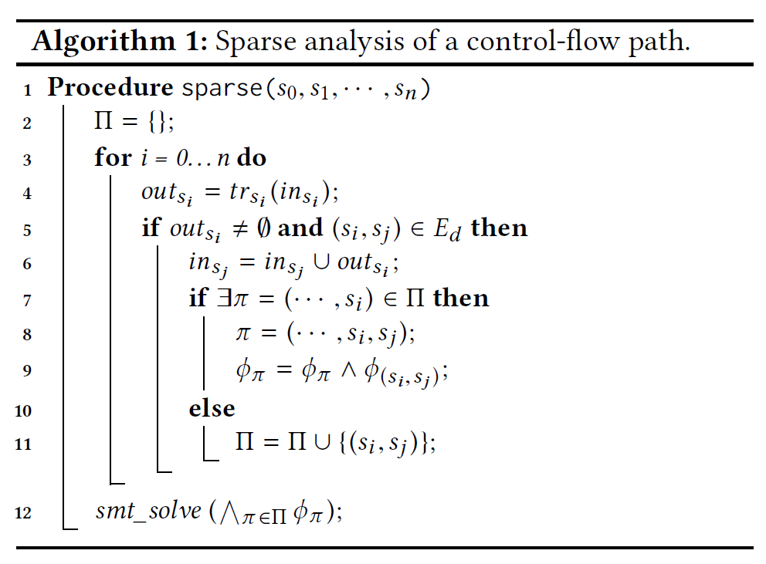
Background and Problem Statement
Path-Sensitive Sparse Analysis

Slide 10
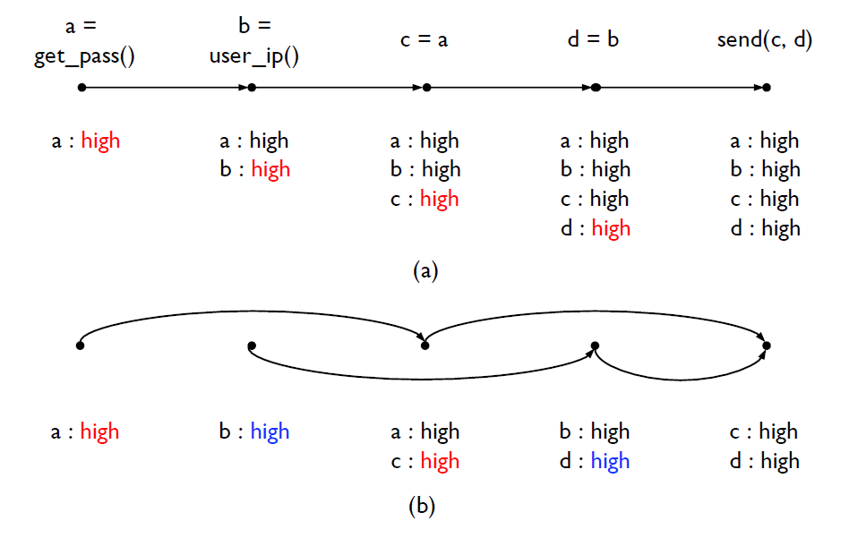
Background and Problem Statement
Path-Sensitive Sparse Analysis
Conventional analysis
Propagates all data flow facts along the control flows and find a taint issue at the final statement where a password may be sent to a sensitive site.
Sparse analysis
Spatial sparsity: Only stores the data flow facts used at each statement.
Temporal sparsity: propagates the data flow facts along the data dependence edges, thus skipping unnecessary control flows.
$π_{1}=\left(a,c,send\left(c,d\right)\right) π_{2}=\left(b,d,send\left(c,d\right)\right)$
$a, b→send\left(c,d\right)$: Check if the conjunction of their path conditions$φ_{π_{1}}∧φ_{π_{2}}$is satisfiable.

Slide 11


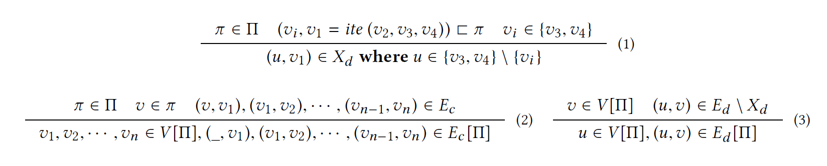
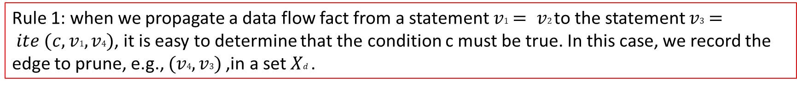
Fusing Sparse Analysis and SMT Solving
Linear Allotropic Transformation (slicing)
Goal: transform the program dependence graph to the path condition in linear time and space.
Slicing rule (3) to produce a slice :
Rule 1: when we propagate a data flow fact from a statement $v1 = v2$to the statement $v3 = ite (c,v1,v4)$, it is easy to determine that the condition c must be true. In this case, we record the edge to prune, e.g., $(v4,v3)$,in a set $Xd$ .

Slide 12
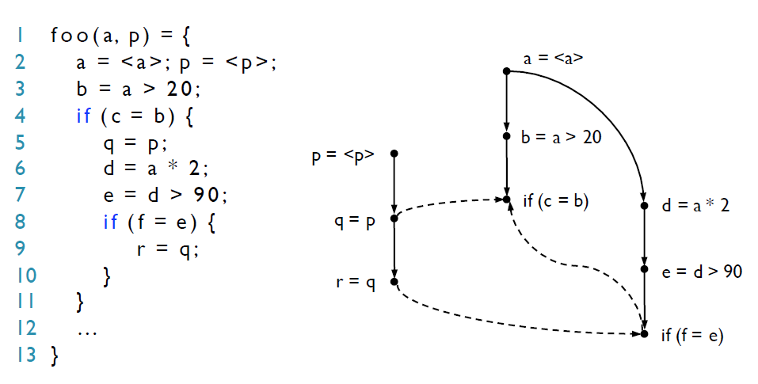

Fusing Sparse Analysis and SMT Solving
Linear Allotropic Transformation (slicing)
$$Π = \{(p=⟨p⟩, q=p, r=q)\}$$
Rule (2) adds $if (c=b)$ and $if (f=e)$ into $V [Π]$
Rule (3) adds all other $V$ data-depend on into $V [Π]$
Rule (2) and (3) work collectively
Next, we clone the callee function at each call site to achieve context-sensitivity. Such function cloning allows us to remove the parentheses on the call and return edges.

Slide 13
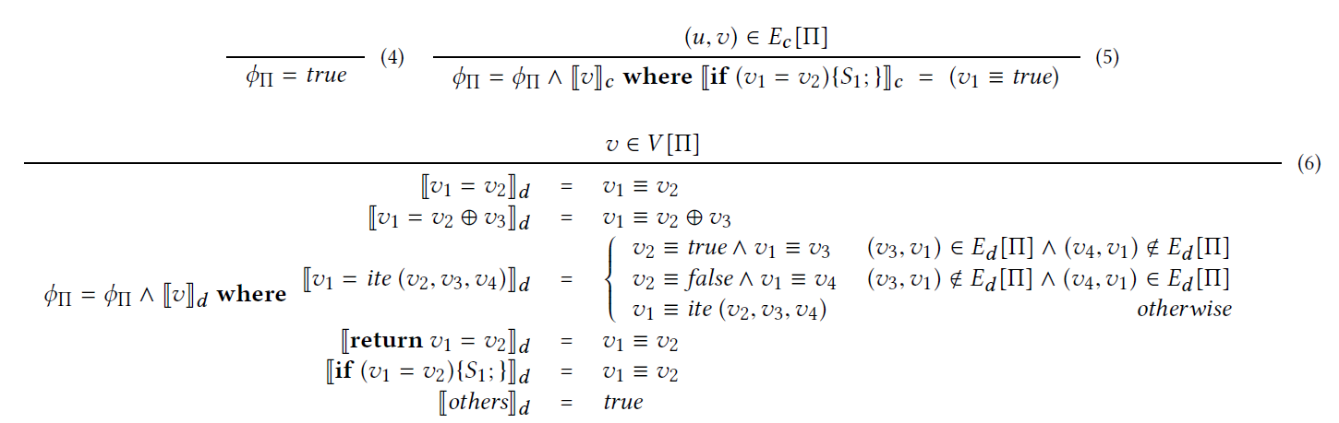
Fusing Sparse Analysis and SMT Solving
Linear Allotropic Transformation (Translation)

Slide 14
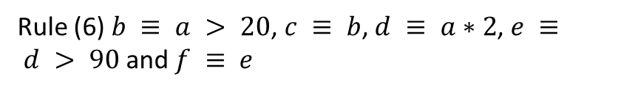
Fusing Sparse Analysis and SMT Solving
Linear Allotropic Transformation (Translation)
$$Π = \{(p=⟨p⟩, q=p, r=q)\}$$
Rule (5) $f ≡ true$and $c ≡ true$.
Rule (6) $b ≡ a > 20$, $c ≡ b$, $d ≡ a∗2$, $e ≡ d > 90$ and $f ≡ e$
$$f ≡ true ∧ c ≡ true ∧ b ≡ a > 20 ∧ c ≡ b ∧ d ≡ a ∗ 2 ∧ e ≡ d > 90 ∧ f ≡ e$$

Slide 15
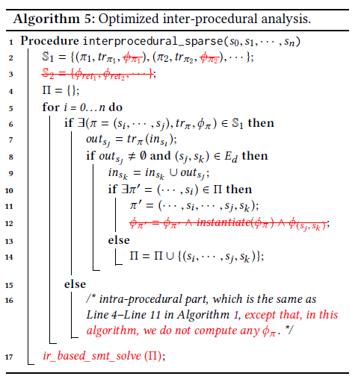
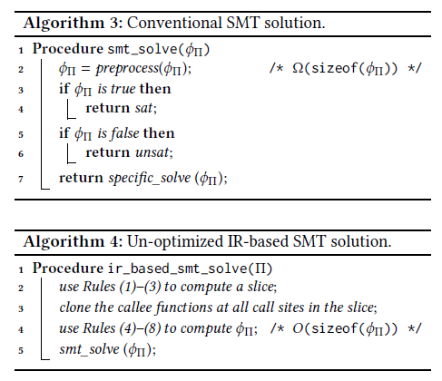
Fusing Sparse Analysis and SMT Solving
Unoptimized IR-Based SMT Solution

Slide 16
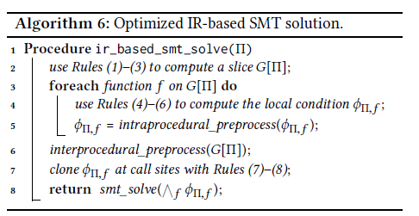
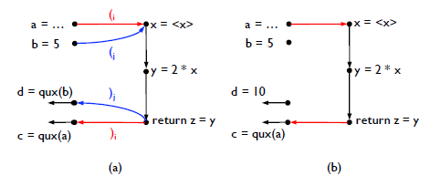
Fusing Sparse Analysis and SMT Solving
Optimized IR-Based SMT Solution
Intra-procedural dependence graph. Such local path conditions can be preprocessed by a series of standard methods like the Gaussian elimination to reduce the condition size. Thus, the size of the conditions to clone is reduced.
Eliminate the unnecessary function calls, thereby reducing the
function clones. (inter-procedural constant propagation)

Slide 17

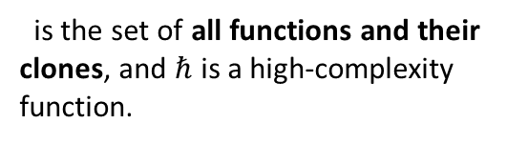
Fusing Sparse Analysis and SMT Solving
Optimized IR-Based SMT Solution
1. The inter-procedural propagation-style preprocessing can be made more efficient via the modular structure.
2. Expensive preprocessing methods, such as the Gaussian elimination, are decomposed into multiple functions.
Preprocessing Complexity
Intraprocedural condition
preprocess
Cloning
intra-preprocessed condition
Original solver
Optimized IR-Based solver
is the set of all functions and their clones, and $ℏ$ is a high-complexity function.
is the set of functions without clones.

Slide 18
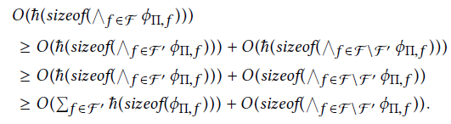
Fusing Sparse Analysis and SMT Solving
Optimized IR-Based SMT Solution

Slide 19
Benefits of This Approach (Fusion)
No caching: PDG (way smaller in size) is equivalent to path conditions.
Little cloning: The modularity of PDG allows further optimization (e.g., constant propagation), which not only reduces the function clones but also speeds up the preprocessing procedures in our SMT solver.
Analysis side: Focus on the design of the data flow analysis, i.e., the abstract domains and the transfer functions.
SMT solver side: easily implement many SMT optimizations (the data dependence, the control dependence, the modular program structure, and many others).

Slide 20
Implementation
Built on LLVM compiler infrastructure (Version 3.6) and the Z3 SMT solver (Version 4.5).
PDG is built offline using pinpoint.
Made a few reasonably unsound (a.k.a., soundy), e.g., Recursive calls are handled as loops by unrolling each cycle twice on the call graph.
Detect null dereference and taint analyses for checking relative path traversal (CWE-235) and transmission of private resources (CWE-4026).
Intra-procedural preprocessing: forward and backward constant propagation, equality propagation, unconstrained-variable elimination, Gaussian elimination, and strength reduction.
Inter-procedural preprocessing, e.g., constant propagation, equality propagation, and the “unconstrained” property propagation.
Notes:
The former allows attackers to access files outside of a restricted folder and is modeled as a data dependence path from an external input to file operations, e.g., from input=gets(...) to fopen(...). The latter may leak private data to attackers and is modeled as a data dependence path from sensitive data to I/O operations, e.g., from password=getpass(...) to sendmsg(...).

Slide 21
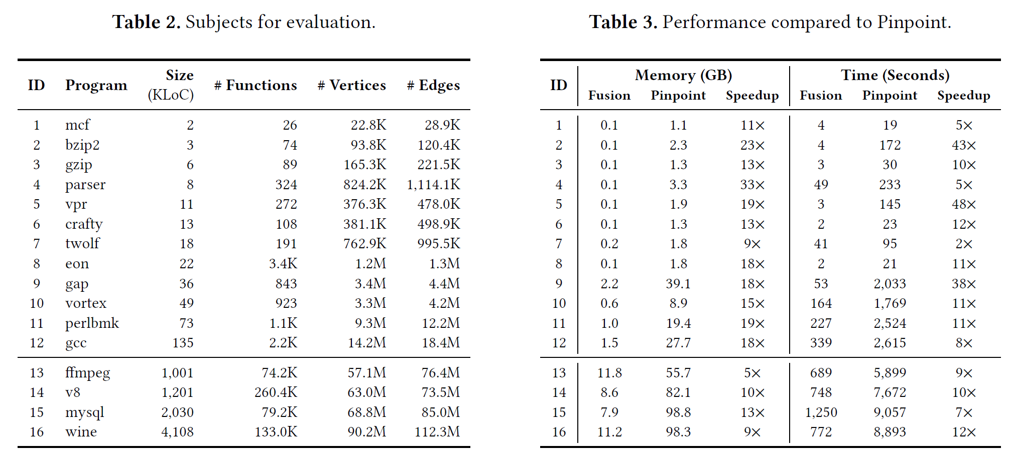
Evaluation

Slide 22
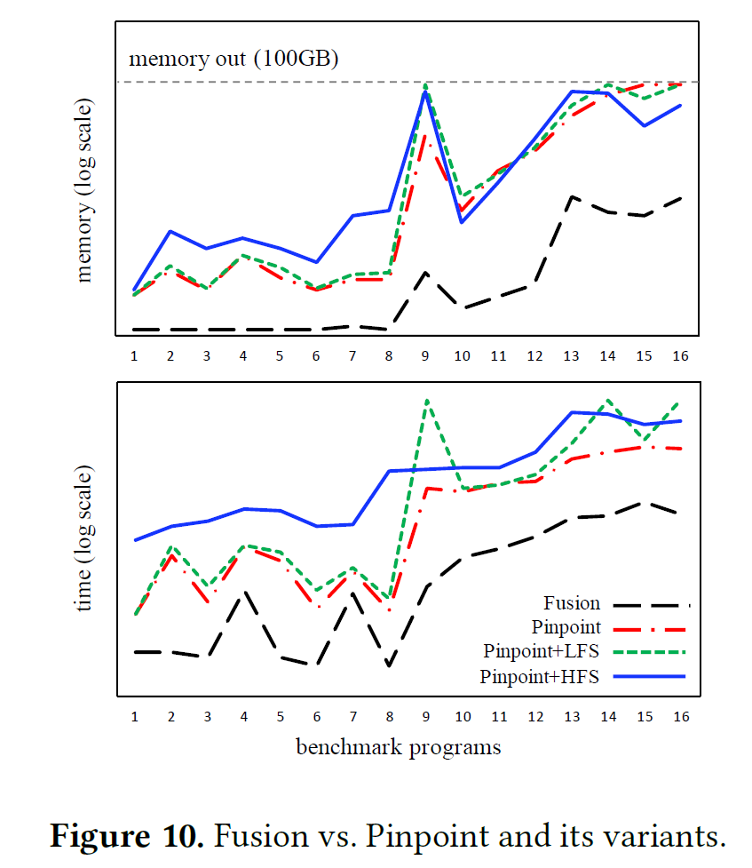
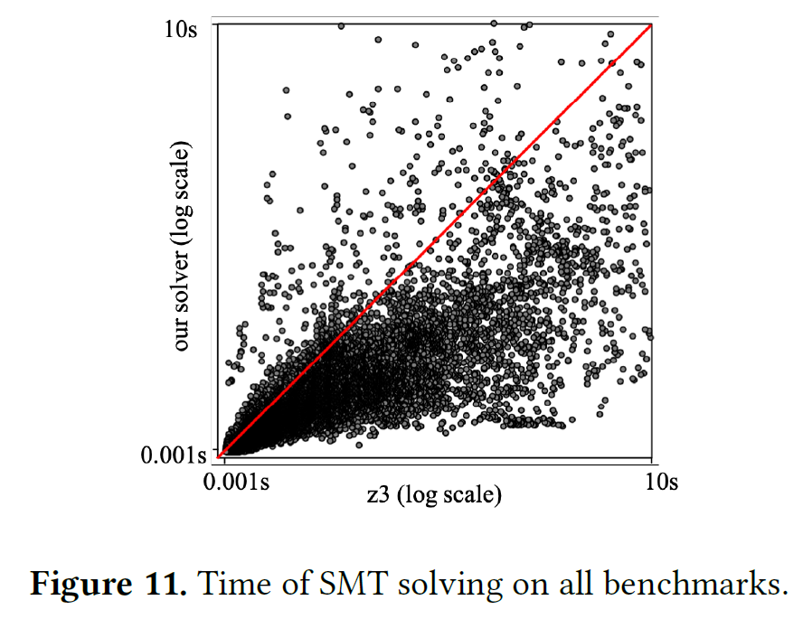
Evaluation

Slide 23
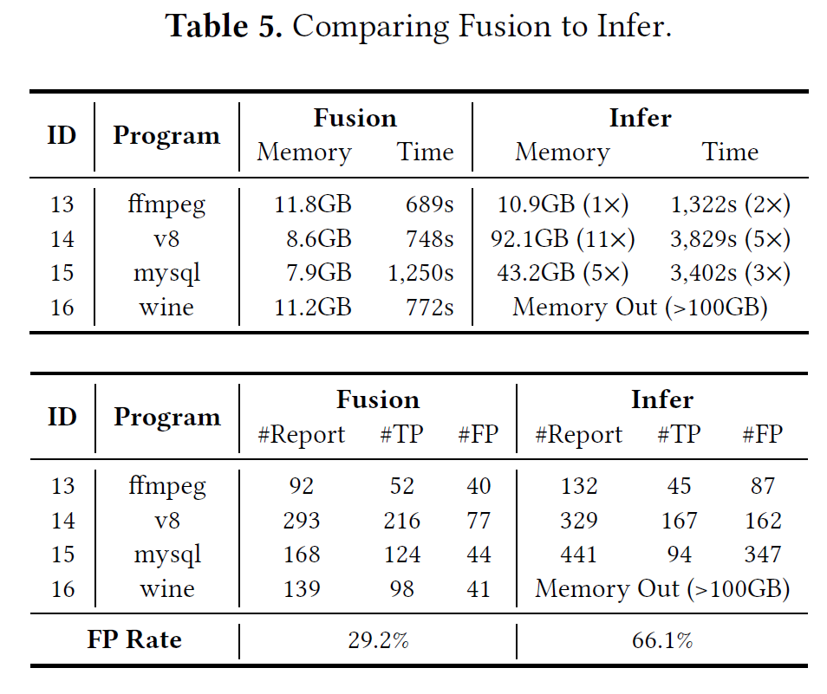
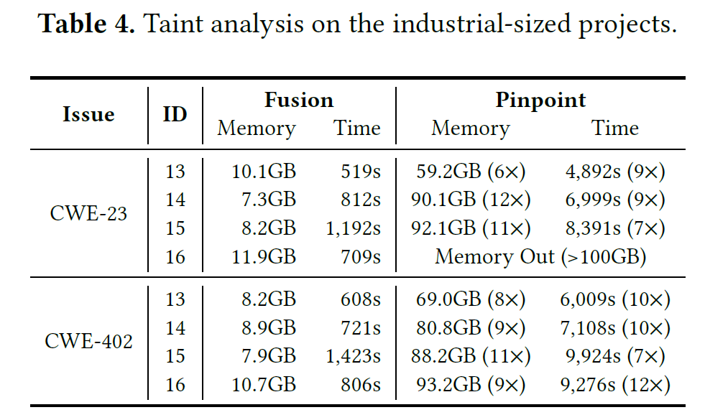
Evaluation

