Slide 1
Asymmetric Transitivity Preserving Graph Embedding
Mingshan
7 June
Notes:
yes the name sounds a little obscure if you are not familiar with the area.

Slide 2
OUTLINE
0. Graph Embedding
Asymmetric transitivity in Social Network
Intuition & Solution
(Linear Algebra Background)
High-Order Proximity Preserved Embedding
Experiment
Conclusion
Notes:
experiments which prove its superiority.

Slide 3
GRAPH EMBEDDING
Nodes
Vectors
Advantages:
Apply classic vector-based machine learning techniques to process graph data;
Facilitate parallelization of graph analysis;
Application:
Graph reconstruction
Link prediction
Classification …
Notes:
Many data are in the format of graph: social network, web link, and ofc in program analysis : call graph, CFG, VFG …
Project nodes of the graph into a vector space, while preserving the structure and inherent properties of the graph.
Simply put, Using vectors to represent nodes.
So, why should we do that?

Slide 4
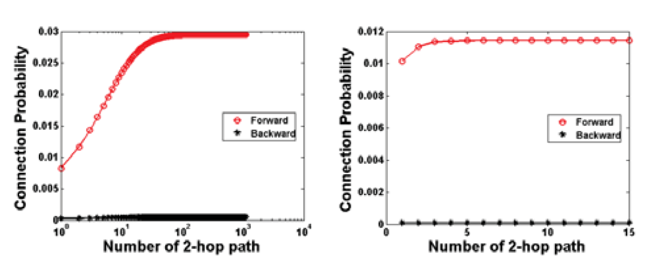
Asymmetric transitivity in Social Network
u5
u1
u3
u4
u2

Slide 5
INTUITION & SOLUTION
Source vector
Node
Target vector
The more and the shorter paths from vi to vj ,
the more similar should be vi’s source vector and vj ’s target vector.
Embedding Vectors
Approximate
High-Order Proximity
Matrix
High-Order Proximity
Notes:
these properties coincides with high-order proximities of nodes. i.e. Katz Index, Rooted PageRank
We can also view this HOP of nodes, as a matrix representation which preserves the AT property.

Slide 6
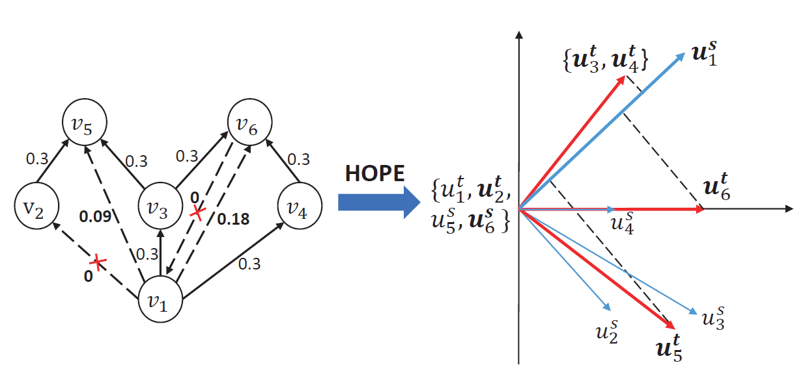
EXAMPLE
Notes:
1s is similar to 3t,4t because there is direct edge between 1->3 and 1->4
1->6 is closer to 1->5 (higher probability)

Slide 7

LINEAR ALGEBRA BASIS
Matrix Inverse: AA⁻¹ = A⁻¹A = I
Nonsingular matrix: one that has a matrix inverse.
Matrix transpose: (ABC)^{T} = C^{T}B^{T}A^{T}
Diagonal matrix: Any square diagonal matrix is a symmetric matrix: A^{T} = A
Orthogonal matrix: O^{T} = O⁻¹
Eigenvalues and eigenvectors: A$\vec{e}$_{λ} =λ$\vec{e}$_{λ}
Eigendecomposition: A = QΛQ⁻¹ , for normal matrices A = OΛO⁻¹
Singular Value Decomposition (SVD): A = UΣV^{T}
Notes:
The inverse matrix A-1 undoes whatever A did.
Not all matrices are invertible: A-1 exists if and only if det(A) != 0.
Diagonal matrices contain entries on the diagonal and zeros everywhere else.
‘eigen’ is German word self.
lambda is an eigenvalue and e is an eigenvector of the matrix A.
It shows that: Multiply A by one of its eigenvectors e, and the result is the same vector scaled by the constant.
Q is a matrix whose columns are eigenvectors of, and capital lamba is a diagonal matrix containing the eigenvalues of A.
SVD: generalization of the eigen-decomposition which can be used to analyze rectangular matrices

Slide 8
HIGH-ORDER PROXIMITY PRESERVED EMBEDDING
Notations:
G = {V, E}
V = {v₁, … v_{i}, … v_{N}} , N is the number of vertexes.
e_{ij} = (v_{i}, v_{j})∈E represents a directed edge form v_{i} to v_{j}
A: adjacency matrix (NxN)
S: high-order proximity matrix (NxN), S_{ij} is the proximity between v_{i} and v_{j}
U = [U^{s}, U^{t}] is the embedding matrix, u_{i} is the embedding vector for v_{i}.
U^{s}, U^{t} ∈R^{NxK} are the source embedding vectors and target embedding vectors, K is embedding dimensions.
Notes:
A: A_ij = 1 if edge (i, j) exists, otherwise A_ij = 0;
1s in Row_i denotes vertex i's outgoing edges; 1s in Col_i denotes vetex i's incoming edges;
A tells us information about the connectivity in G. power of A: A_2_ij: number of ways to go from vertex i to j in two steps.

Slide 9
HIGH-ORDER PROXIMITY PRESERVED EMBEDDING
Problem Definition:
Embedding to approximate high-order proximity
Notes:
transpose of Ut
Us and Ut are both N by k matrix
So, the question becomes finding an embedding matrix U, to approximate S,
or to put in another way, minimize the distance between U and S.
L2 norm: the square root of the sum of the squared vector values

Slide 10





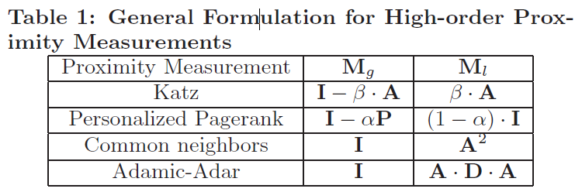
HIGH-ORDER PROXIMITY PRESERVED EMBEDDING
High-order proximity (S):
Katz Index
Rooted PageRank
Common Neighbours
Adamic-Adar
(2)
Global
Local
Notes:
All of them can be put in a general formulation, which will facilitate the following computation.

Slide 11


HIGH-ORDER PROXIMITY PRESERVED EMBEDDING
The objective is to find an optimal rank-K approximation of S
Solution: Performing SVD on S, and using the largest K singular value and corresponding singular vectors to construct the optimal embedding vectors.
Thus, the vectors we aim to find are:
Too expensive!

Slide 12
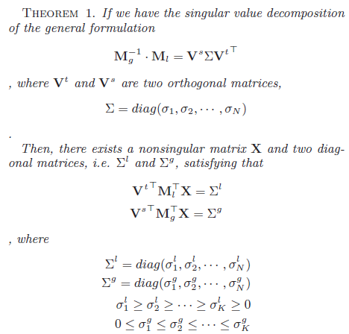

HIGH-ORDER PROXIMITY PRESERVED EMBEDDING
Notes:
I will give a quick proof of it, which is not shown on the paper.

Slide 13





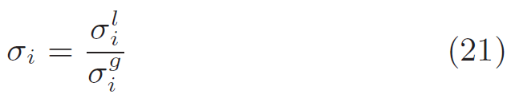
HIGH-ORDER PROXIMITY PRESERVED EMBEDDING
Instead of performing standard SVD on S, to get
Recall， and through performing JDGSVD on Mg and Ml,
we can get:
And calculating through

Slide 14
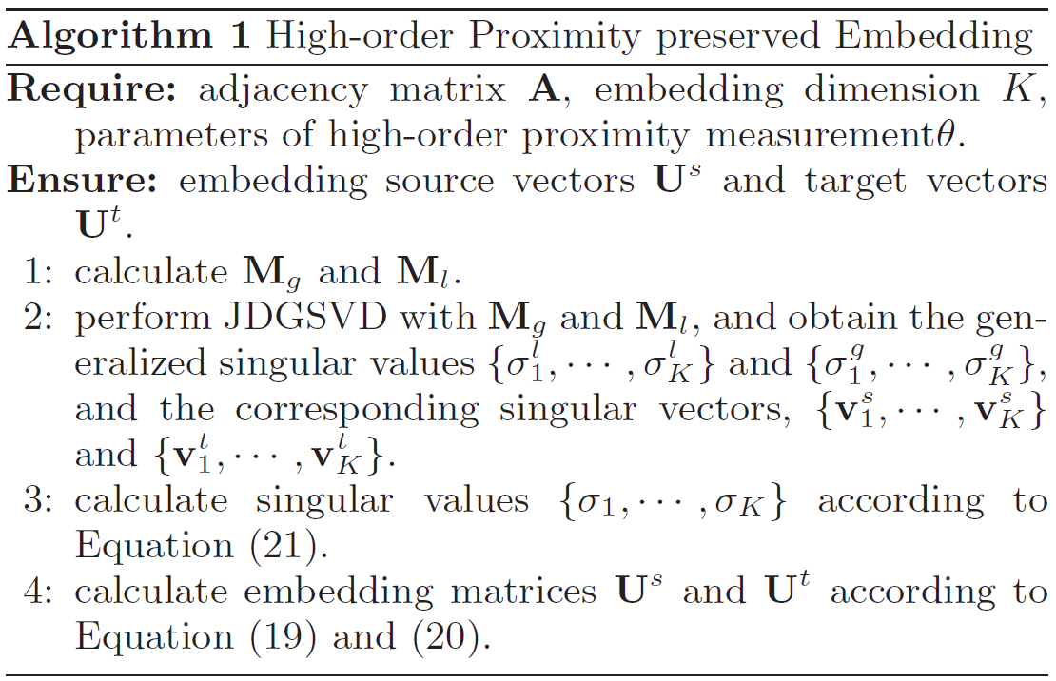
HIGH-ORDER PROXIMITY PRESERVED EMBEDDING

Slide 15
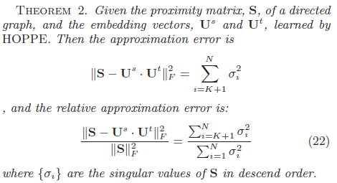
HIGH-ORDER PROXIMITY PRESERVED EMBEDDING
Approximation Error
Τ
Τ

Slide 16



EXPERIMENT
1. Dataset:
2. Baseline methods:
LINE, DeepWalk, PPE, Common Neighbors, Adamic-Adar
3. Applications:
Error of approximation
Graph reconstruction
Link prediction
Vertex recommendation
 | Syn | Cora | SN-Twitter | SN-TWeibo
|V| | 10,000 | 23166 | 465,017 | 1,944,589
|E| | 144,555 | 91500 | 834,797 | 50,655,143
Notes:
They are doing experiments on four dataset: synthetic data, Cora is a citation network of academic papers.
the evaluation is done on four applications:
On the right side, we can see the specific metrics for each application.

Slide 17
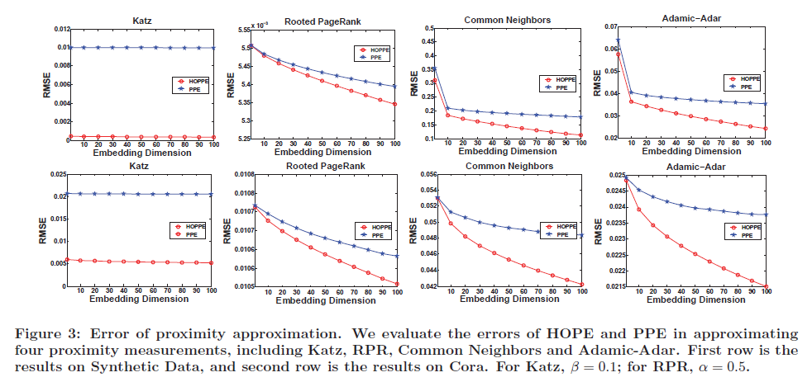
EXPERIMENT
Error of proximity approximation

Slide 18
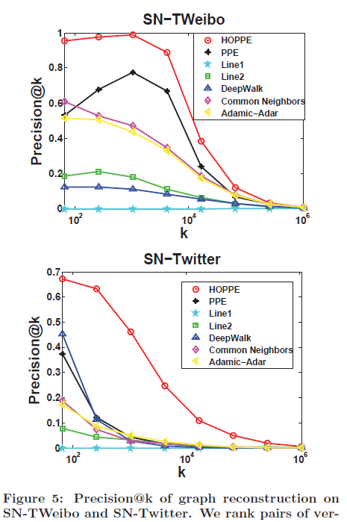
EXPERIMENT
Graph Reconstruction
Notes:
This is to reconstruct the graph edges based on the proximity between nodes. We will use the inner product between embedding vectors to reconstruct the proximity matrix.
Notice that this is done on training set.

Slide 19
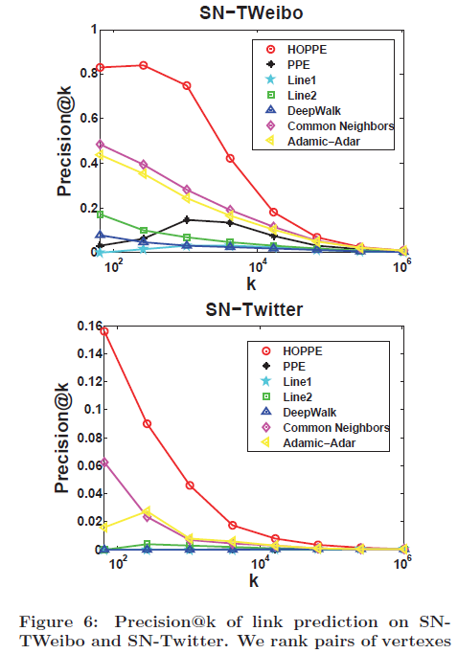
EXPERIMENT
Link Prediction
Notes:
this is done on testing set.

Slide 20
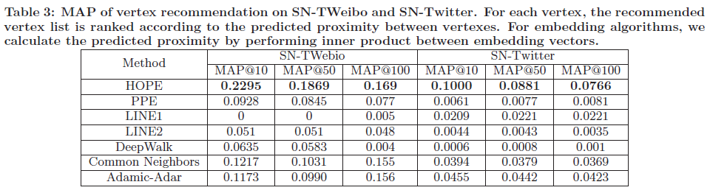
EXPERIMENT
Vertex Recommendation
Notes:
it is not essentially different from link prediction, but from vertex perspective.
for some sampled nodes, we hide 20% outgoing edges as ground. then derive the top100 vertexes with the highest proximity as recommendation candidates.

Slide 21
CONCLUSION
Contributions:
Approximate
High-Order Proximity Matrix
Embedding Vectors
HOPE Algorithm

