Slide 1
Type-Based Alias Analysis
(TBAA)

Slide 2
#include <stdio.h>
int foo(int *i, short *s) {
*i = 20;
*s = 10;
return *i;
}
int main(void) {
int i;
short s;
printf(“%d”, foo(i, (int *)s));
}

Slide 3
Alias Analysis
Can these two pointers (p and q) point to the same thing?
Must alias: always
No alias: never
May alias: sometimes, or maybe?
Partial alias: part of the pointees overlap
p
q
p
q
?
?
p
q
p
q

Slide 4
Compiler Optimisations
Must alias or no alias
=
more optimisations
May alias
=
fewer optimisations
Aggressive dead code elimination
Loop invariant code motion
Argument promotion
Global Value Numbering
Includes redundant load elimination
memcpy optimisations
Dead store elimination

Slide 5
Overview of TBAA
(Sort of) stateless alias analysis
Relies only on:
The C/C++ specifications
Assumes programmers conform to these specifications (!!!)
Type declarations in the program
Fast
Queries: two reachability tests on a small graph
Works for incomplete programs
Can not infer must-alias relations

Slide 6
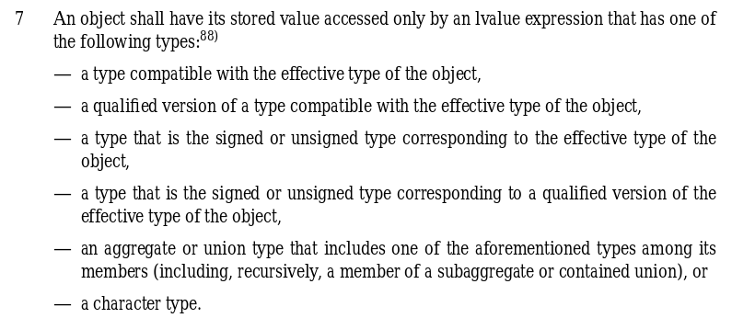
The rules

Slide 7
int x;
int *p = &x;
*p; // Legal.
const unsigned int *q = &x;
*q; // Legal.
float *r = &x;
*r; // Illegal!

Slide 8
struct s {
int x;
float y;
};
struct s s;
struct s *p = &s;
*p; // Legal, and can access
// the int/float field.
int *q = &s.x;
*q; // Legal, q may alias p.

Slide 9
int x;
char *p = &x;
*p; // Legal.

Slide 10
char
struct s {
int x;
float f;
};
struct t {
struct s s;
short z;
};
int
float
short
long
double
…
s
t

Slide 11
char *c; int *i;
// MAY ALIAS
long *l; struct t *t;
// NO ALIAS
struct s *s; struct t *t;
// MAY ALIAS
short *s; struct t *t;
// MAY ALIAS
char
int
float
short
long
double
s
t

Slide 12
#include <stdio.h>
int foo(int *i, short *s) {
// s and i DO NOT ALIAS
*i = 20;
*s = 10;
return *i;
}
int main(void) {
int i;
short s;
printf(“%d”, foo(i, (int *)s));
}
char
int
short

Slide 13
int foo(int *i, short *s) {
store 20 in i;
store 10 in s;
load i and return;
}
int foo(int *i, short *s) {
// s and i DO NOT ALIAS
*i = 20;
*s = 10;
return *i;
}
int foo(int *i, short *s) {
store 20 in i;
store 10 in s;
return 20;
}

Slide 14
Solution
An alias analysis that does not rely on the specification
Challenge: performance
Challenge: incomplete programs
Challenge: doing what the programmer expects
Build the type graph on the fly depending on casts

Slide 15
#include <stdio.h>
int foo(int *i, short *s) {
// s and i MAY ALIAS
*i = 20;
*s = 10;
return *i;
}
int main(void) {
int i;
short s;
printf(“%d”, foo(&i, (short *)&i));
}
char
int
short

Slide 16
No TBAA
No “miscompilations”
New TBAA
No “miscompilations”
Standard TBAA
Potential “miscompilations

Slide 17
