Slide 1
Introduction of Quantum computing
Jiawei Ren

Slide 2
Classical bit:
2 basic states: 0 and 1
Quantum bit(Qubit):
2 basic states: |0⟩and |1⟩
superposition: linear combination of 2 basic states
|φ⟩=a₀|0⟩+a₁|1⟩, where a₀²+a₁²= 1 and they are complex numbers
a qubit could be in state |0⟩, |1⟩or a linear combination of two basic states |φ⟩(SP).
A classical bit can only be in state 0 or state 1,
but a qubit can be in a superposition |φ⟩(represent |0⟩and |1⟩ simultaneously)

Slide 3
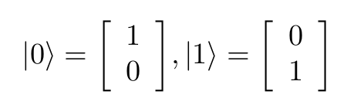
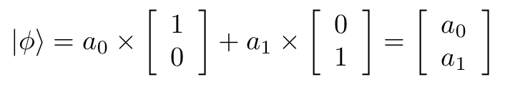
Matrix reperesentation of quantum computing:
Hilbert space H
1 qubit:

Slide 4
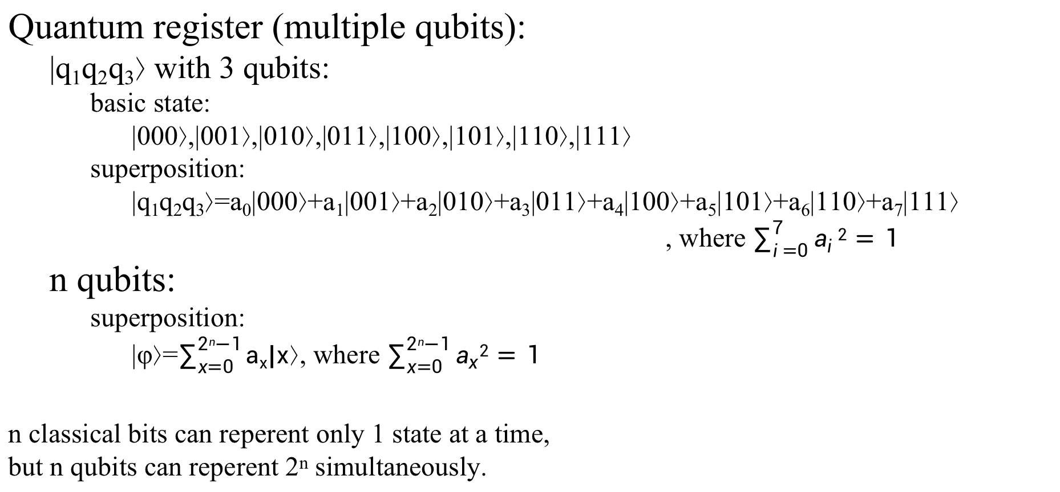
Quantum register (multiple qubits):
|q₁q₂q₃⟩ with 3 qubits:
basic state:
|000⟩,|001⟩,|010⟩,|011⟩,|100⟩,|101⟩,|110⟩,|111⟩
superposition:
|q₁q₂q₃⟩=a₀|000⟩+a₁|001⟩+a₂|010⟩+a₃|011⟩+a₄|100⟩+a₅|101⟩+a₆|110⟩+a₇|111⟩
, where $\sum_{i=0}^{7}{a_{i}2}=1$
n qubits:
superposition:
|φ⟩=$\sum_{x=0}^{2n−1}{ax|x⟩}$, where $\sum_{x=0}^{2n−1}{a_{x}2}=1$
n classical bits can reperent only 1 state at a time,
but n qubits can reperent 2^{n} simultaneously.

Slide 5
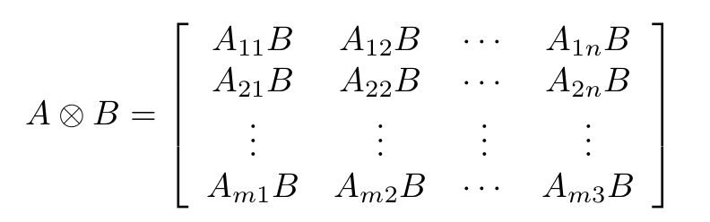
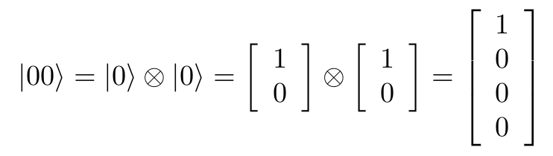
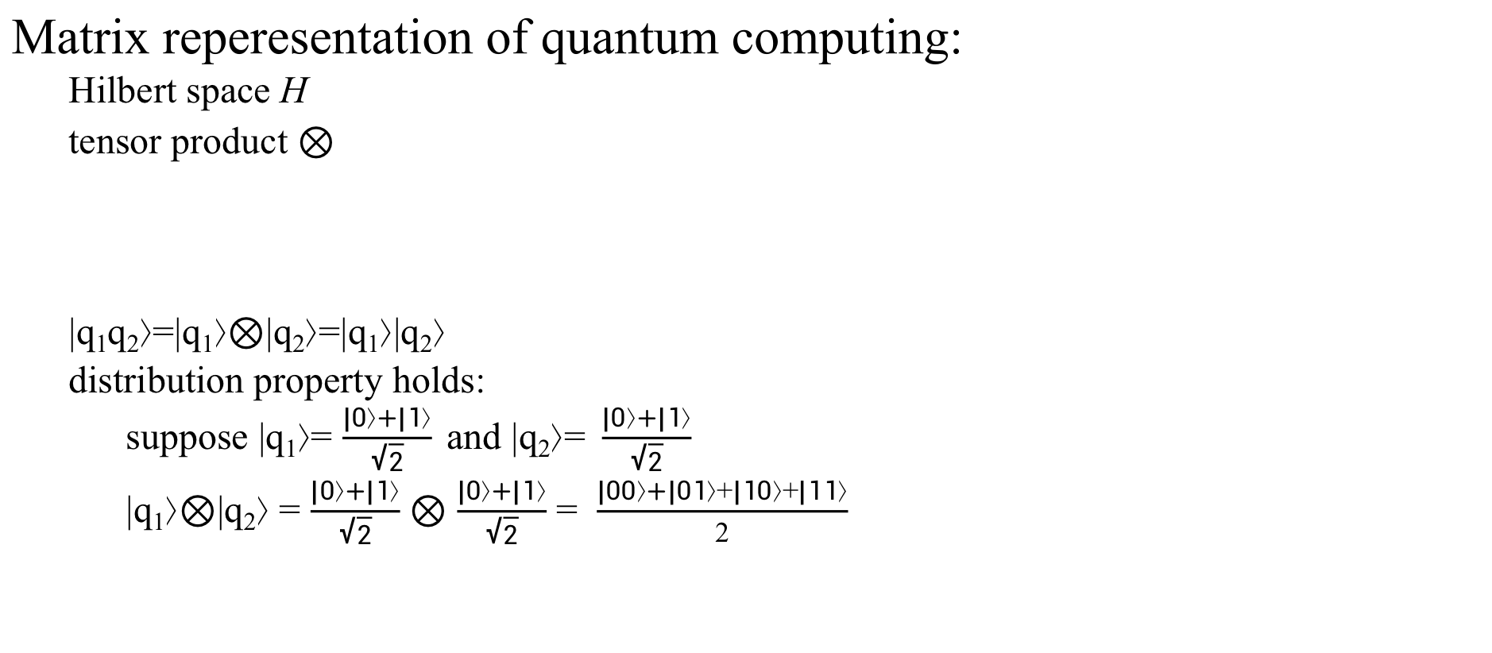
Matrix reperesentation of quantum computing:
Hilbert space H
tensor product $⊗$
|q₁q₂⟩=|q₁⟩$⊗$|q₂⟩=|q₁⟩|q₂⟩
distribution property holds:
suppose |q₁⟩= $\frac{|0⟩+|1⟩}{\sqrt{2}}$and |q₂⟩=$\frac{|0⟩+|1⟩}{\sqrt{2}}$
|q₁⟩$⊗$|q₂⟩ = $\frac{|0⟩+|1⟩}{\sqrt{2}}$ $⊗$ $\frac{|0⟩+|1⟩}{\sqrt{2}}$ = $\frac{|00⟩+|01⟩+|10⟩+|11⟩}{2}$

Slide 6
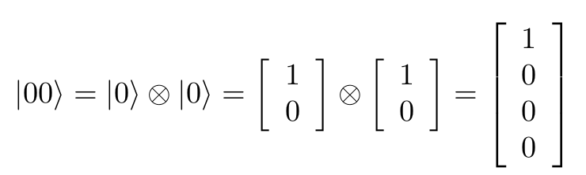
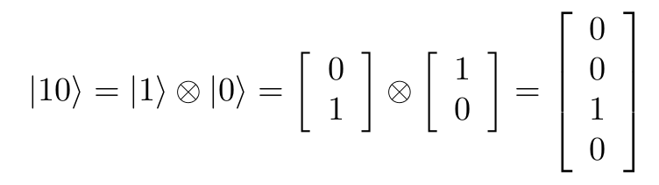
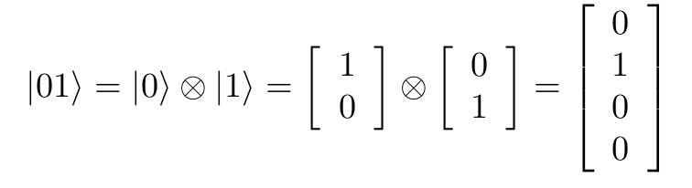
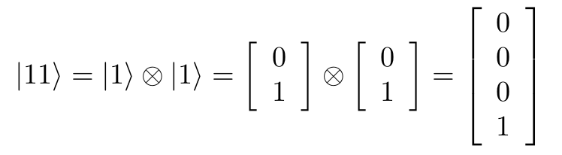
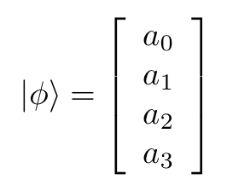
Matrix reperesentation of quantum computing(2):
multiple qubits:
For n-qubit register, basic state |x⟩ is a 2^{n} by 1 matrix with only position x is 1 and all other positions are 0.
superposition: |φ⟩=a₀|00⟩+a₁|01⟩+a₂|10⟩+a₁₁|11⟩

Slide 7
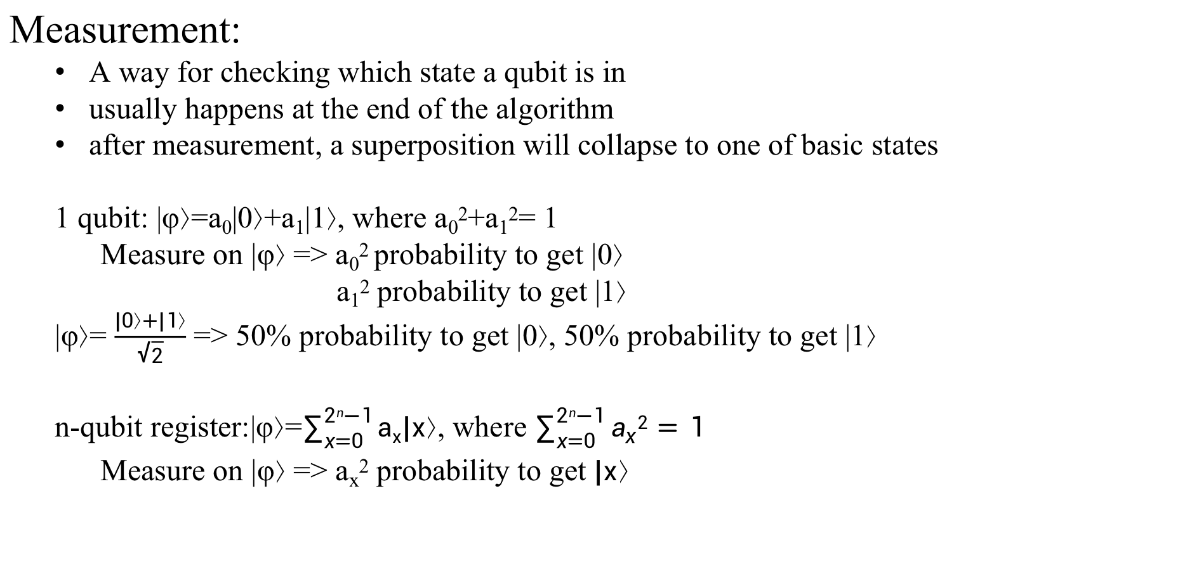
Measurement:
A way for checking which state a qubit is in
usually happens at the end of the algorithm
after measurement, a superposition will collapse to one of basic states
1 qubit: |φ⟩=a₀|0⟩+a₁|1⟩, where a₀²+a₁²= 1
Measure on |φ⟩ => a₀² probability to get |0⟩
a₁² probability to get |1⟩
|φ⟩= $\frac{|0⟩+|1⟩}{\sqrt{2}}$ => 50% probability to get |0⟩, 50% probability to get |1⟩
n-qubit register:|φ⟩=$\sum_{x=0}^{2n−1}{ax|x⟩}$, where $\sum_{x=0}^{2n−1}{a_{x}2}=1$
Measure on |φ⟩ => a_{x}² probability to get $|x⟩$

Slide 8
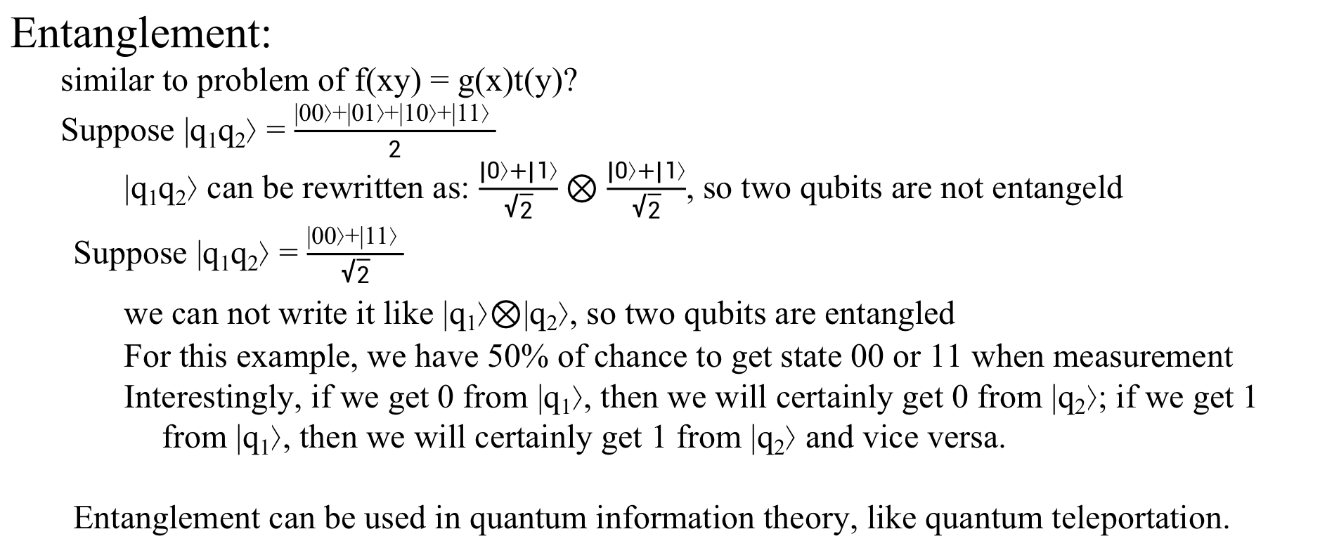
Entanglement:
similar to problem of f(xy) = g(x)t(y)?
Suppose |q₁q₂⟩ = $\frac{|00⟩+|01⟩+|10⟩+|11⟩ }{2}$
|q₁q₂⟩ can be rewritten as: $\frac{|0⟩+|1⟩}{\sqrt{2}}⊗\frac{|0⟩+|1⟩}{\sqrt{2}}$, so two qubits are not entangeld
Suppose |q₁q₂⟩ = $\frac{|00⟩+|11⟩ }{\sqrt{2}}$
we can not write it like |q₁⟩$⊗$|q₂⟩, so two qubits are entangled
For this example, we have 50% of chance to get state 00 or 11 when measurement
Interestingly, if we get 0 from |q₁⟩, then we will certainly get 0 from |q₂⟩; if we get 1 from |q₁⟩, then we will certainly get 1 from |q₂⟩ and vice versa.
Entanglement can be used in quantum information theory, like quantum teleportation.

Slide 9
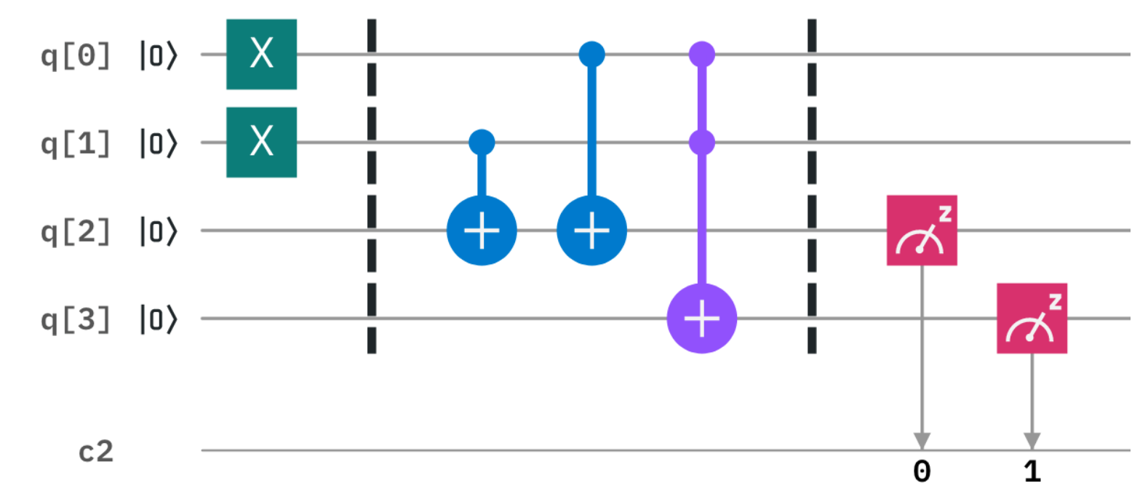
Quantum circuit:
apply several operations on qubits

Slide 10

Quantum gates:
operation on qubits
single qubit
mulple qubits
can be written as a unitary matrix, satisfying

Slide 11
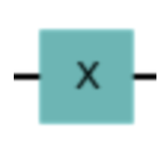
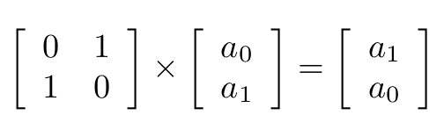
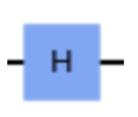
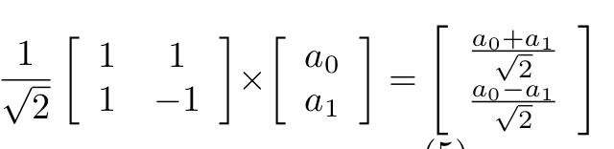
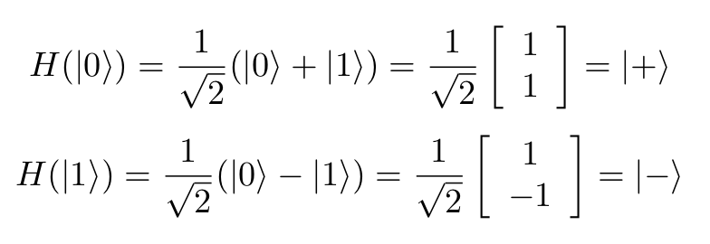

Single qubit gates:
X (Quantum not) gate:
X(a₀|0⟩+a₁|1⟩) =a₁|0⟩+a₀|1⟩
X(a₀|0⟩) =a₀|1⟩
X(a₁|1⟩) =a₁|0⟩
Hadamard gate:
H(a₀|0⟩+a₁|1⟩) =$\frac{a0+a1}{\sqrt{2}}$|0⟩+$\frac{a0−a1}{\sqrt{2}}$|1⟩
Generating superposition with equal probability:
...

Slide 12
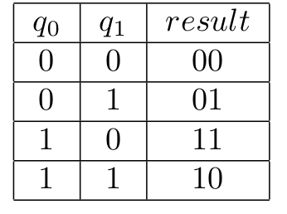
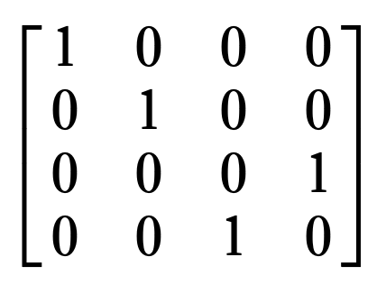
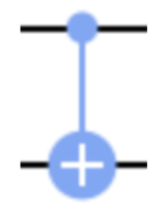
Multipule qubit gates:
CX/CNOT (control not) gate:
Apply X operation on target qubit when control qubit is |1⟩

Slide 13
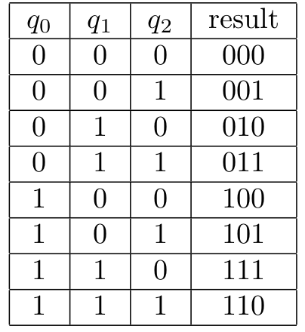
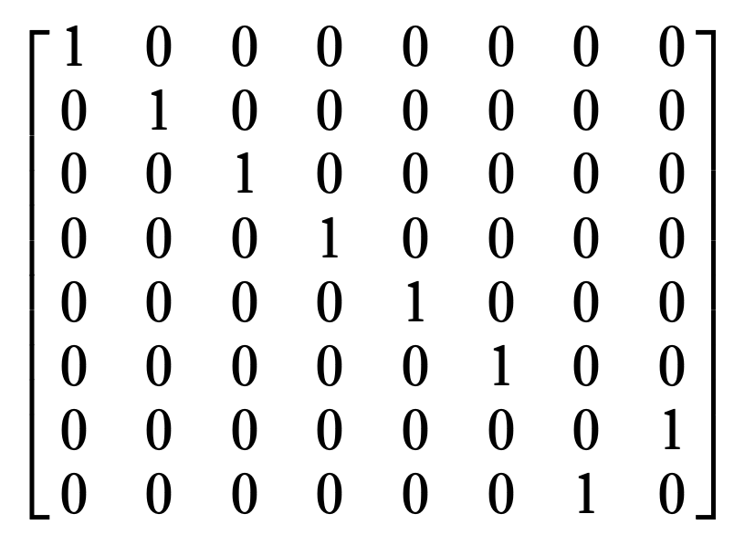
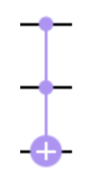
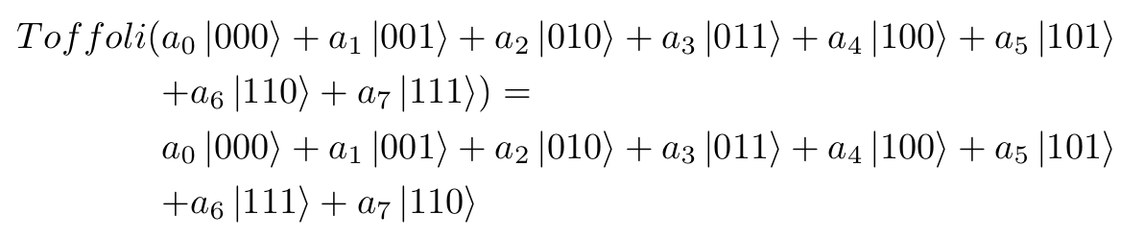
Multipule qubit gates:
Toffoli gate:
Apply X operation on target qubit when both control qubits are |1⟩

Slide 14
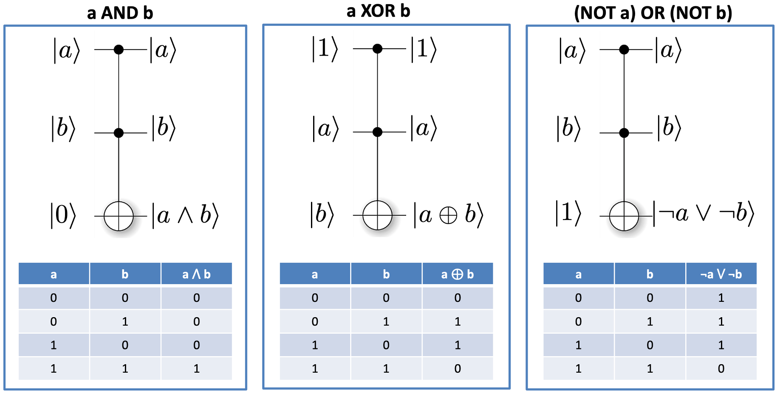
Quantum AND, XOR and OR

Slide 15
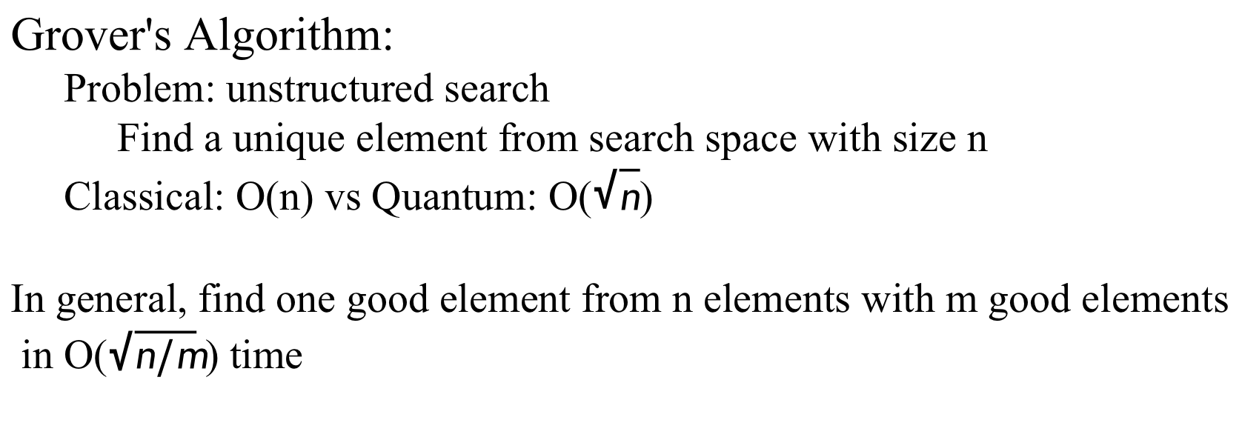
Grover's Algorithm:
Problem: unstructured search
Find a unique element from search space with size n
Classical: O(n) vs Quantum: O($\sqrt{n}$)
In general, find one good element from n elements with m good elements
in O($\sqrt{n/m}$) time

Slide 16
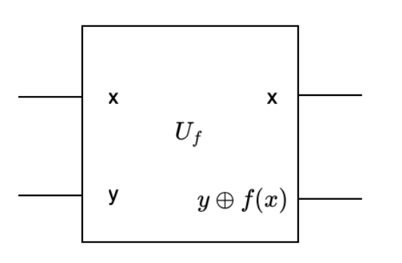
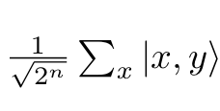

Quantum parallelism
key feature of many quantum algorithms
Advantage: evaluate f(x) of different input x simultaneously
Classically, call function n times to evaluate n outputs
Quantumly, call function 1 time to evaluate n outputs but with some restrictions
reversible computation: size of input = size of output
ancilla qubit y

Slide 17
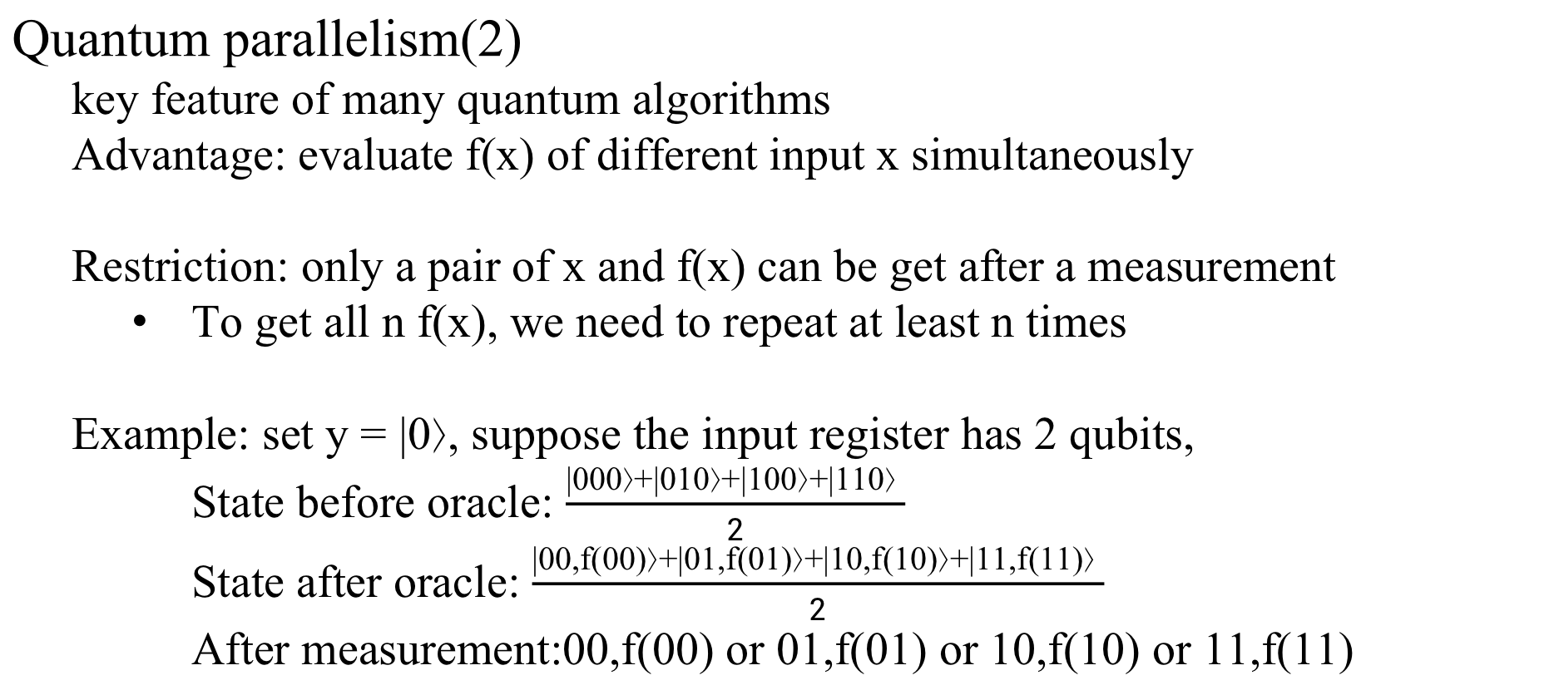
Quantum parallelism(2)
key feature of many quantum algorithms
Advantage: evaluate f(x) of different input x simultaneously
Restriction: only a pair of x and f(x) can be get after a measurement
To get all n f(x), we need to repeat at least n times
Example: set y = |0⟩, suppose the input register has 2 qubits,
State before oracle: $\frac{|000⟩+|010⟩+|100⟩+|110⟩ }{2}$
State after oracle: $\frac{|00,f(00)⟩+|01,f(01)⟩+|10,f(10)⟩+|11,f(11)⟩ }{2}$
After measurement:00,f(00) or 01,f(01) or 10,f(10) or 11,f(11)

Slide 18
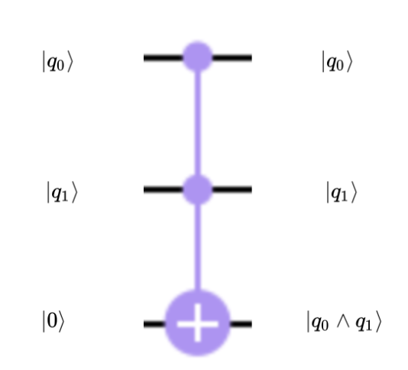
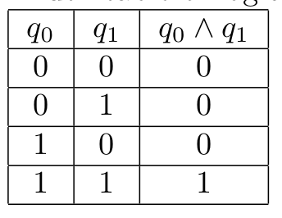
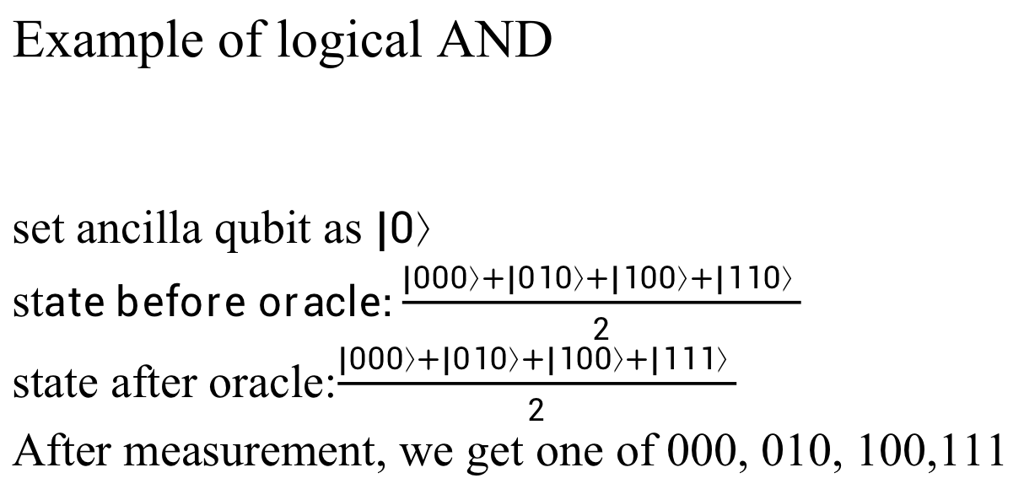
Example of logical AND
set ancilla qubit as $|0⟩$
st$ate before oracle:\frac{|000⟩+|010⟩+|100⟩+|110⟩ }{2}$
state after oracle:$\frac{|000⟩+|010⟩+|100⟩+|111⟩ }{2}$
After measurement, we get one of 000, 010, 100,111

Slide 19
Multipule qubit gates:
Toffoli gate:
Apply X operation on target qubit when both control qubits are |1⟩

Slide 20
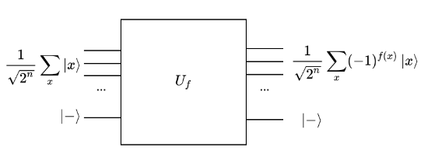
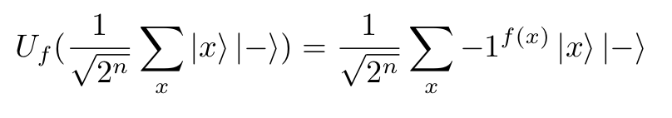
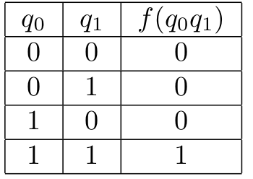
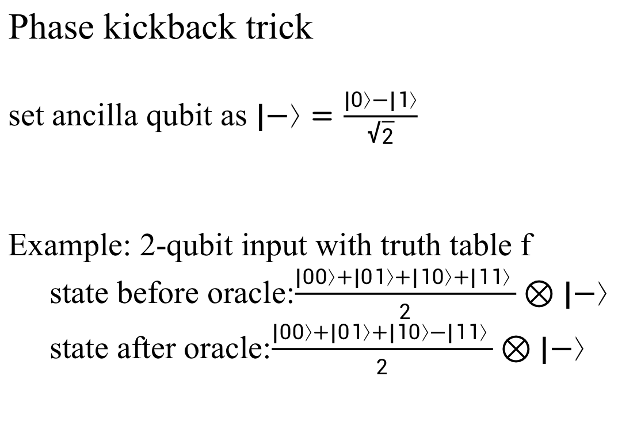
Phase kickback trick
set ancilla qubit as $|−⟩=\frac{|0⟩−|1⟩}{\sqrt{2}}$
Example: 2-qubit input with truth table f
state before oracle:$\frac{|00⟩+|01⟩+|10⟩+|11⟩ }{2}⊗|−⟩$
state after oracle:$\frac{|00⟩+|01⟩+|10⟩−|11⟩ }{2}⊗|−⟩$

Slide 21
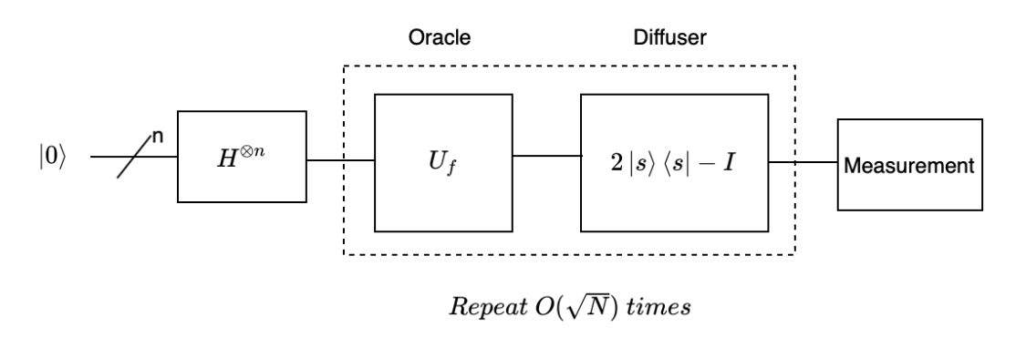
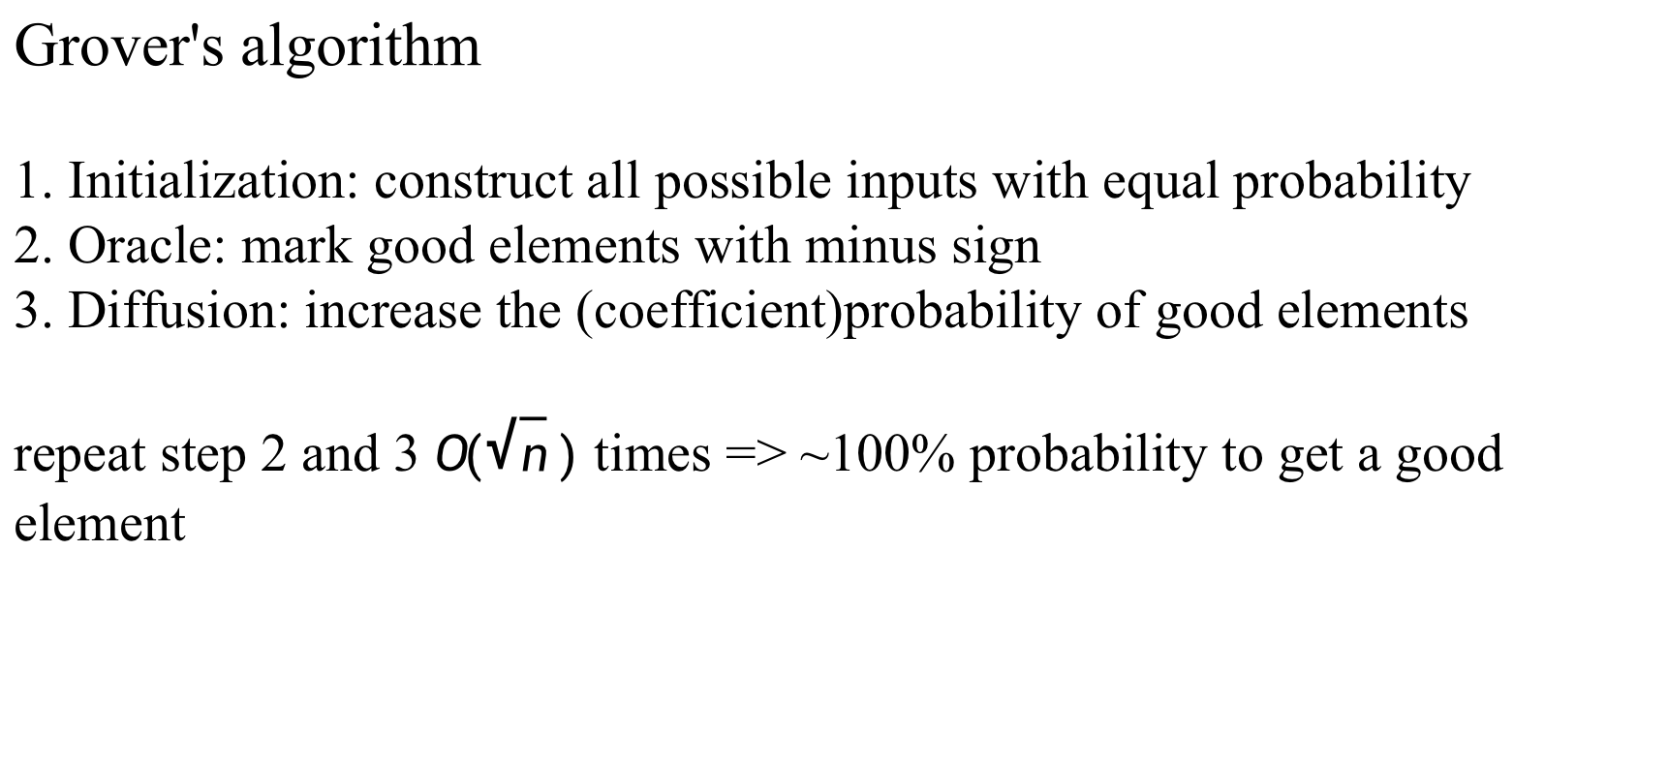
Grover's algorithm
1. Initialization: construct all possible inputs with equal probability
2. Oracle: mark good elements with minus sign
3. Diffusion: increase the (coefficient)probability of good elements
repeat step 2 and 3 $O(\sqrt{n} )$ times => ~100% probability to get a good element

Slide 22
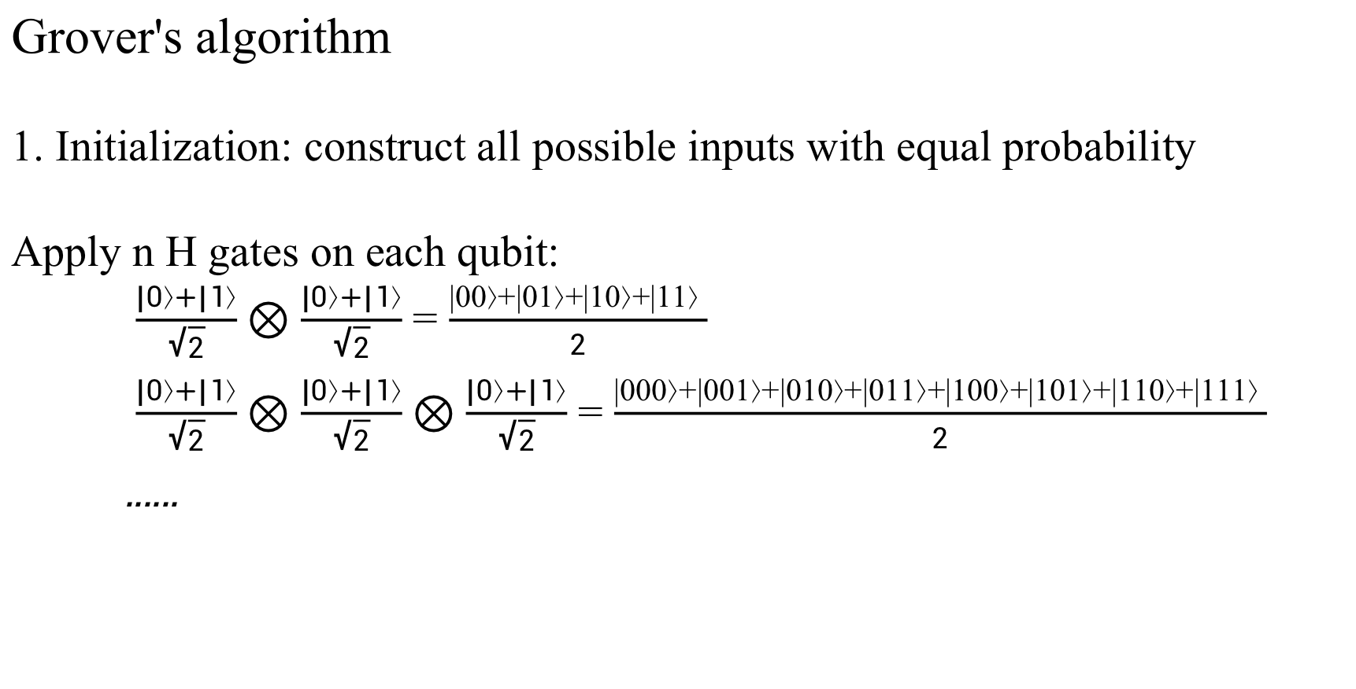
Grover's algorithm
1. Initialization: construct all possible inputs with equal probability
Apply n H gates on each qubit:
$\frac{|0⟩+|1⟩}{\sqrt{2}}⊗\frac{|0⟩+|1⟩}{\sqrt{2}}$ = $\frac{|00⟩+|01⟩+|10⟩+|11⟩ }{2}$
$\frac{|0⟩+|1⟩}{\sqrt{2}}⊗\frac{|0⟩+|1⟩}{\sqrt{2}}⊗\frac{|0⟩+|1⟩}{\sqrt{2}}$ = $\frac{|000⟩+|001⟩+|010⟩+|011⟩+|100⟩+|101⟩+|110⟩+|111⟩ }{2}$
......

Slide 23
Grover's algorithm
2. Oracle: mark good elements with minus sign
phase kickback trick can be used here to mark element with f(x)=1

Slide 24
Grover's algorithm
3. Diffusion: increase the (coefficient)probability of good elements
can be explained as inversion about mean:
update coefficient using:a_{new}=2∗mean−a_{old}.

Slide 25
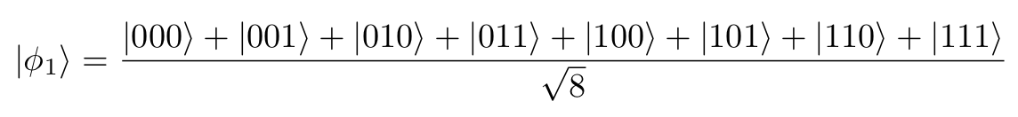
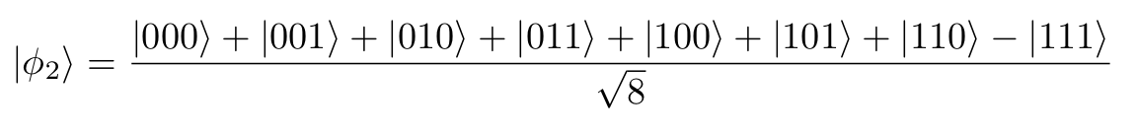

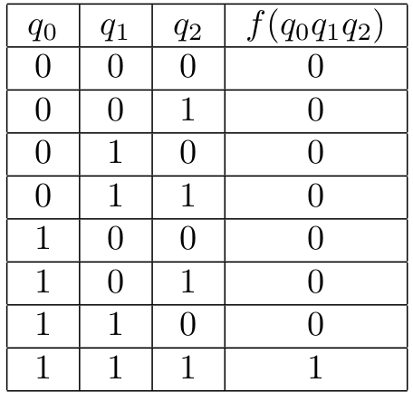


Example:
Initialization
Oracle
mean:
Diffusion
Oracle
mean:
Diffusion
stop, because O($\sqrt{8}$)$≈2$
Measurement: 0.97² $≈$ 94%probability to get 111

Slide 26
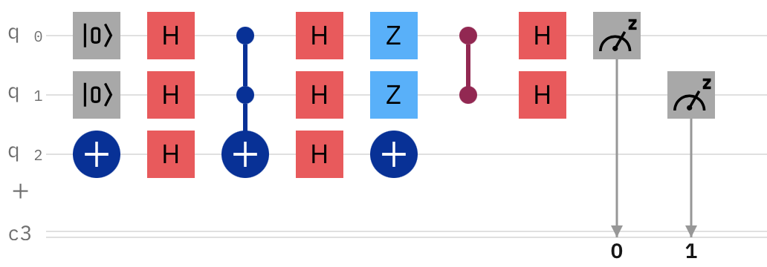
Logical AND example

Slide 27
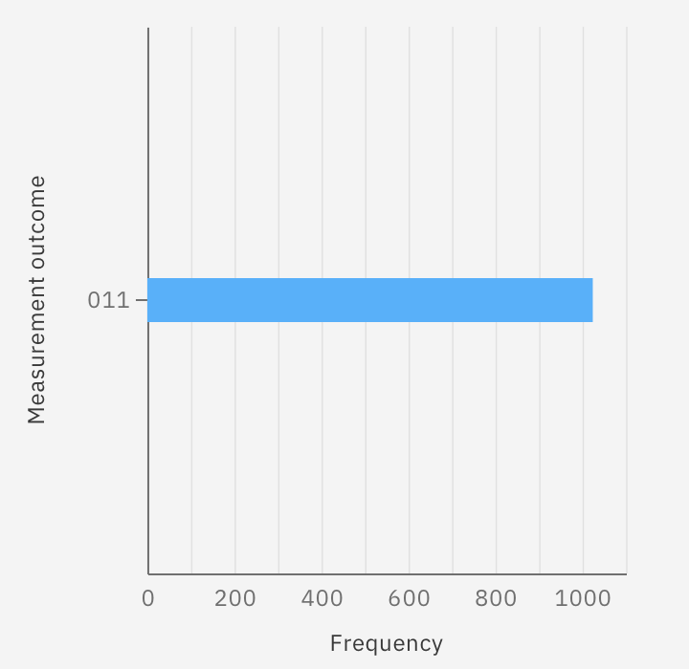
Logical AND example

Slide 28
Thanks

