Slide 1
Towards Automated Detection of Unethical Issues in Open-source Software (OSS) Projects
Hsu Myat Win

Slide 2
Content
Background
Existing work and limitations
Our proposed solution - Methodology
Experiment
Conclusion

Slide 3
Background – Ethic & Principles
Ethic - a set of moral principles , Unethical - not morally correct
Principles
Informed Consent.
An agreement between the individual and the institution
To protect the privacy and maintain other ethical values (autonomy, and transparency).
Accountability.
An individual is accountable for his/her action
In OSS projects, the participants contribute the artifact (i.e., the source code or software design, etc.) that affect the stakeholders, and each person bears responsibility.
Attribution.
Acknowledging as a credit to the author of a work. (copyright, IP)
Regulating the flow of information : presenting details about how entities can copy or use certain information).
Welfare.
Human welfare (physical, material, and psychological wellbeing).
In OSS projects, incentive compensation for participants’ benefits.
Notes:
Incentive compensation is a form of variable compensation/income in which a contributor (or other participant's) earnings are directly tied to the amount of product/project they sell, the success of their team, or the organization's success.

Slide 4
Background – GitHub
A code hosting platform for version control and collaboration
A large number of OSS projects exist
Eg; GitHub lists over 190 million repositories
Problem
With the massive growth in open-source software development, ethics is a concern for all stakeholders.
Cause: The lack of awareness from proper ethical-related scenarios and stories. [3][4]
Effect: Unethical approaches by contributors towards the projects might lead to the loss of their trust, and unethical development might result in loss of funding, reputation, or other resources.
Notes:
As of January 2021, GitHub reports having over 73 million users and at least 28 million public repositories.

Slide 5
Existing works
[5] addressed the ethics issues when mining open-source software repositories by highlighting human subjects because personal information or identifiers can be mapped to individuals.
[6] investigated license inconsistencies between cloned files in OSS projects
[7] conducted an empirical study of Java applications and observed that changing licenses is a common event and a lack of traceability between why and when the license of a system changes.
[8] proposed to open a discussion about the implications of the interest, whether the free and open source communities acknowledge being under “surveillance” and how to deal with the ethical obstacles related to the human subject research.
However,
no taxonomy of the different unethical practice/ scenarios in OSS projects.
no automated detection tool for unethical issues.

Slide 6
Our proposed solution
Empirical study on Unethical issues in GitHub OSS projects
To provide a taxonomy of different unethical issues with scenarios/stories
An automated tool - Ethic detector (Etor)
To detect the unethical issues

Slide 7
Methodology
Exploratory mixed − methods research design [1]
Qualitative
Quantitative
Linking and Integration
Data collection
Data Analysis
Data collection
Data Analysis
We often interleave quantitative and qualitative methods to explore phenomena and pursue explanations.
Ethical considerations. We analyzes only public artifacts, including source code, pull request, discussions on GitHub repositories, and product descriptions and comments on the Google Play store.
Scope. We adopt innovation-friendly [9] - allows us to focus explorations first on a smaller set to be familiar, then expand our search to refocusing and re-working on specific findings and facts.
Study Sample Set (SSS) : "ethic" keyword - 1642 issues(as of 31st December 2021)
Evaluation Sample Set (ESS) : 2021 top fork/stars - 2000 repo , 205,180 issues/pull requests*~
*some are duplicated - needed to count again
~some detectable issues
Notes:
Qualitative: Understanding behaviors of values, beliefs and assumptions [8]
Quantative: Facilitated numerical data for groups and extents of agree or disagree from respondents [8]
[8] Looi Theam Choy. 2014. The strengths and weaknesses of research methodology: Comparison and complimentary between qualitative and quantitative approaches. IOSR Journal ofHumanities and Social Science 19, 4 (2014), 99–104.
Incrementally study publicly available resources on OSS projects . We explore iteratively, with results from prior phases informing subsequent phases of research (e.g., motivating additional research questions to examine unexpected outcomes). We often interleave quantitative and qualitative methods to explore
phenomena and pursue explanations.

Slide 8
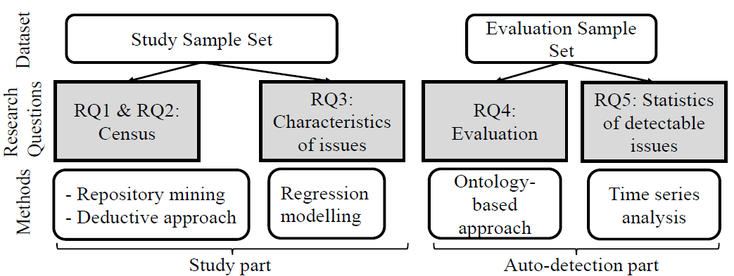
Overview of our Research (Research steps)
RQ1: What are the types of unethical issues in open source software projects?
RQ2: Among these unethical issues, what types of software artifacts (repository, source code, etc) are affected?
RQ3: What are the characteristics of issues?
RQ4: Can unethical issues be automatically detected and does our tool detect the issues successfully?
RQ5: Does the number of issues decrease over the years?
Notes:
We used a deductive approach, meaning we deduce our theory based on the existing taxonomy of ethical considerations in Crowdsourcing [20] [14] because GitHub is a crowdsourcing-based OSS development platform [22]. Our deductive approach began by deriving candidate ethical principles values, identifying keywords, distinguishing common artifacts used by the participants. For each issue, we first located the messages about ethic concern by searching the bug reports with secondary terms (concepts related to ethics) such as privacy, copyright, etc. Then, we manually inspected all the related report messages around the keyword, understood the context, filtered out the false positives, located the actual issue that led to occur the unethical practice, and categorized it. We took the relevant code of ethics based on the root causes and decision-making discussed in the report for the issue.

Slide 9
OSS Project structure
Study Part
Repository
is stored in
Source Code
License
includes
declares
OSS Project
can have
allows
depends on
Other libraries
Issues
Pull Request

Slide 10
Possible unethical is(RQ1 : Types of unethical issues)
Study Part
✓
✓
✓
✓
✓
✓
✓

Slide 11
(RQ2: Affected software artifacts)
Study Part
License inconsistency
Soft forking
Unmaintained Android project with Paid service
Repository
No opt-in/option allowed
No attribution to the author in cod
Hacking
No license provided for public repository
is stored in
Source Code
License
Naming confusion
includes
Uninformed License change
declares
OSS Project
Privacy violation
Offensive
Language
can have
allows
depends on
Other libraries
Issues
Licenses incompatibility
Pull Request
Self-promoting
Unfairness

Slide 12
Characteristics of issues (RQ3)
Study Part
Popularity/ Ranking (fork count, star count)
Usage of third parties
Active (commit history)
Project age (project created date)
Contributions (# of contributors)

Slide 13
Auto-detection tool - based on ontological engineering and Semantic Web Rule Language (SWRL) rules.
Auto-detection Part
1) No License Provided For Public Repository
2) License Inconsistency
3) Uninformed License Change
4) Unmaintained Project With Paid Service
5) No Attribution To The Author In Code
6) Soft Forking
7) Self Promotion

Slide 14
Web Ontology Language (OWL) , Reasoners and Semantic Web Rule Language (SWRL) rules
Auto-detection Part
To learn the conditions (a set of rules) that distinguish an unethical issue from a ethical one
OWL
a Semantic Web language
knowledge representation languages for authoring ontologies (eg; class hierarchy)
an ontology
a set of concepts and categories that represent the subject. (eg; class)
Reasoner
to check whether all the definitions in the ontology are mutually consistent and can also recognize which concepts fit under which definitions.
SWRL
allows users to write rules that can be expressed in terms of OWL concepts (eg; conditions)

Slide 15
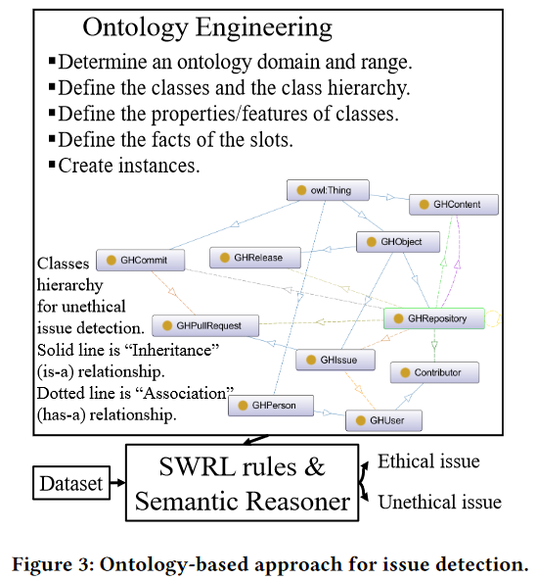
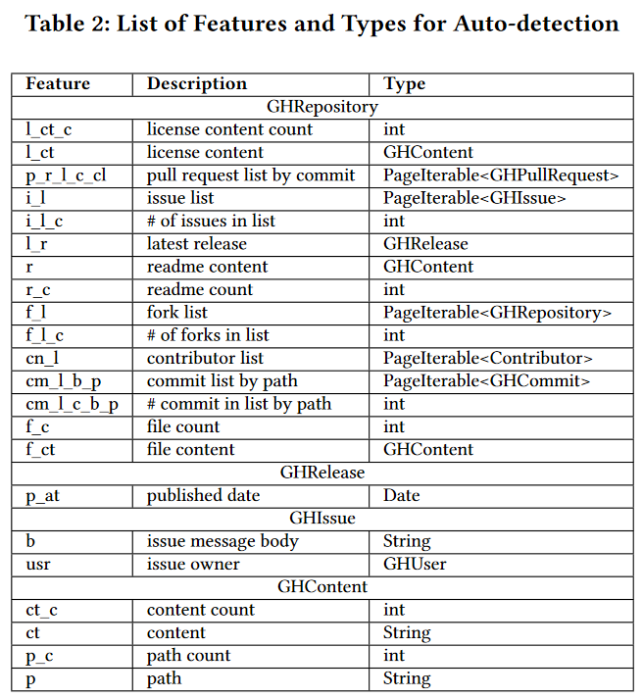
We used GitHub API for features extraction and WebVOWL ontology visualization tool (Protégé 5.5.0 [10] [11]) to define the knowledge model.
Notes:
A set of rules (conditions) are used to check whether the instance is fit to these conditions. The rules are determined by some specific thresholds which are capable of predicting the probability of issues.
For example, SWRL rules for inferring that a particular repository belongs to “No license provided for public repository” can be built as: if a repository’s license content count (i.e., hasL_ct_c) is less than 1, and no license is mentioned in README.md, as shown in Fig 2(2).
We also formed predefined constraints based on the characteristics of each issue (e.g., for “Unmaintained Android project with paid service”, the project must be an Android app with paid service and provide Google Play store
link). We demonstrates our auto-detection approach in SWRL rules in Figure 2.

Slide 16
SWRL - Example
Auto-detection Part
Person
Parent
Brother
Uncle
Features
Person:X1
Person:X2
Person:X3
A simple use of SWRL rules would be to assert that the combination of the hasParent and hasBrother properties implies the hasUncle property. Informally, this rule could be written as:
hasParent(?x1,?x2) & hasBrother(?x2,?x3) ⇒ hasUncle(?x1,?x3)

Slide 17
1. No license provided for the public repository
GitHub encourages having a license for an open-source software project.
Licensing proposal is motivated by issues: wanting to know who is using the artifacts, any results obtained from its use, and the possibility of some stakeholders misinterpreting or misusing the artifacts without support from the repository owner.
If no license is provided in an open-source project, it is a possible unethical issue (i.e., No license provided for the public repository).
Motivating Example
Principles | Guidelines | Type | Examples
Informed consent | To support transparency | No license provided for public repository | https://github.com/pkalogiros/AudioMass/issues/1 https://github.com/pinellolab/AmpUMI/issues/3

Slide 18
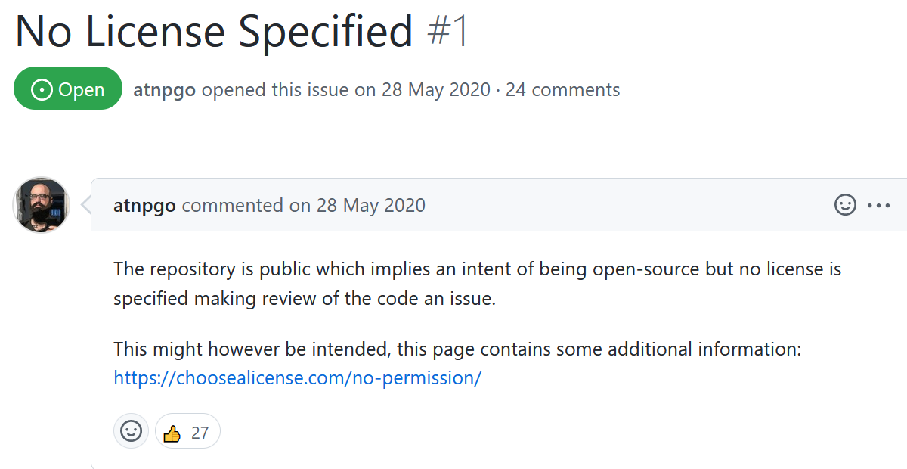
1. No license provided for the public repository - Example

Slide 19
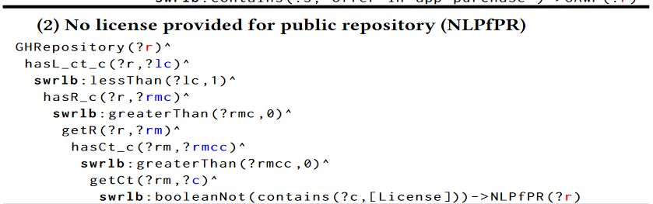
1. No license provided for the public repository – SWRL
Auto-detection Part

Slide 20
2. License inconsistency
The project owner/contributors should have a consistent license in open-source projects.
If a different license is found in repository, it is a possible unethical issue (i.e., License inconsistency).
Motivating Example
Principles | Guidelines | Type | Examples
Informed consent | To support transparency | License inconsistency | https://github.com/platzhersh/pacman-canvas/issues/42

Slide 21
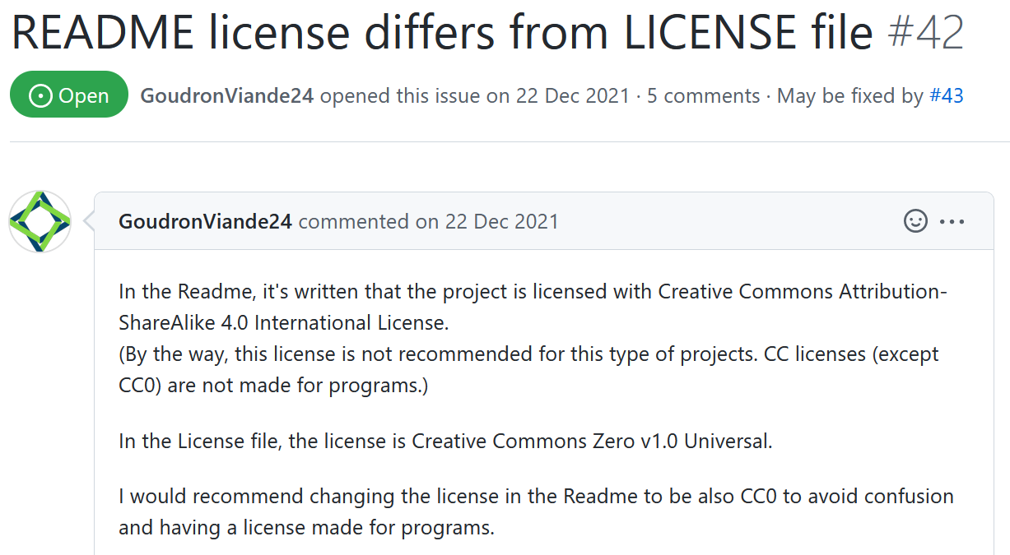
2. License inconsistency- Example

Slide 22
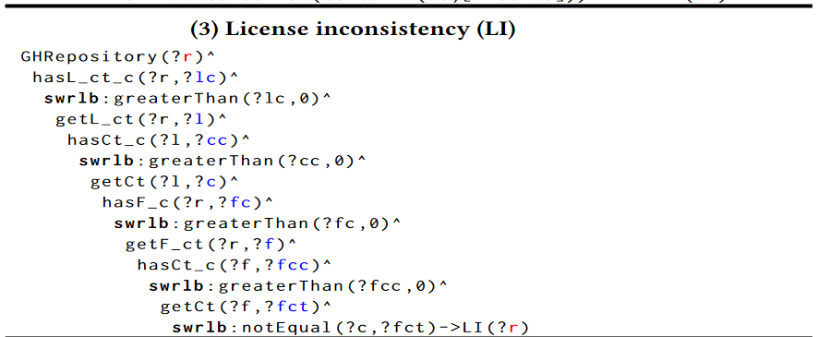
2. License inconsistency - SWRL
Auto-detection Part

Slide 23
3. Uninformed license change
While the project's license is changed, it should be an announcement or pull request to inform the stakeholders for awareness.
If the project owner changes the license without telling the stakeholders, it fails transparency, and it is a possible unethical issue (i.e., Uninformed license change).
Motivating Example
Principles | Guidelines | Type | Examples
Informed consent | To support transparency | Uninformed License change | https://github.com/mattandahalfew/Levenshtein_search/issues/23 https://github.com/minio/minio/issues/12143

Slide 24
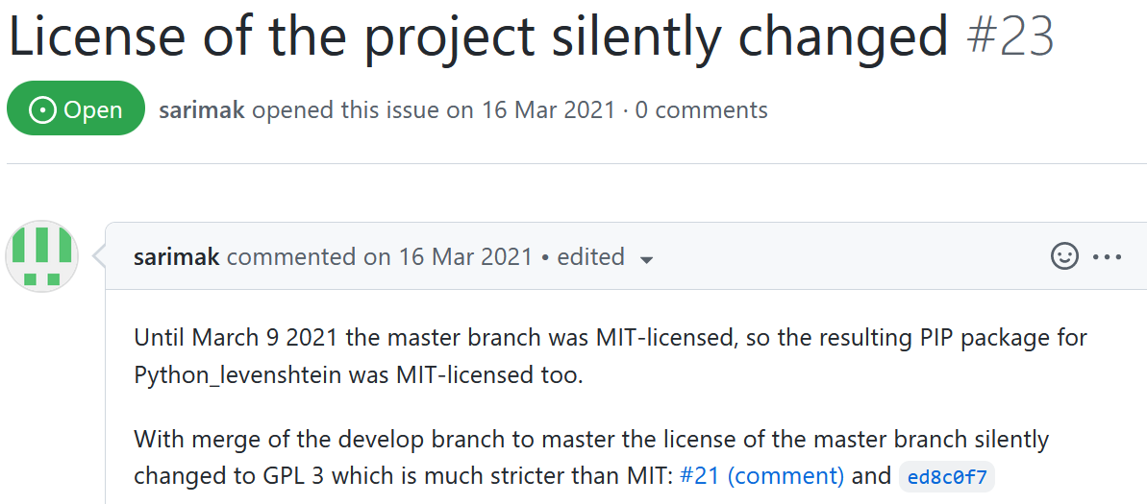
3. Uninformed License Change - Example

Slide 25
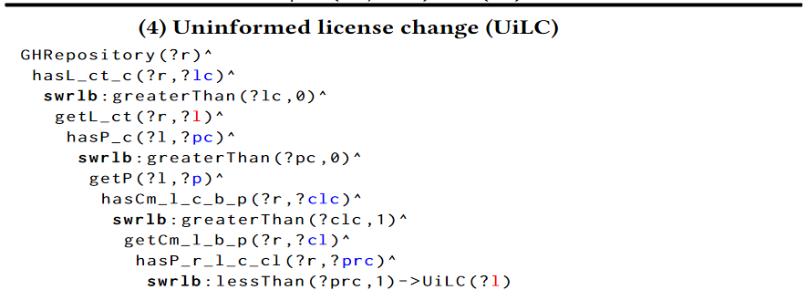
3. Uninformed license change – SWRL
Auto-detection Part

Slide 26
4. Unmaintained Android project with paid service
Accepting bugs in software is irresponsible, and maintaining (fixing) the bugs is the responsibility of the project owner and contributors, especially if the project has a paid service.
Therefore, in GitHub, if the Android app has paid service and no maintenance for more than 5 months, it is a possible unethical issue.
In our approach, we check the latest release date of the project and check the Android app at Google Play.
If we find ''Paid'' service and the latest release date is more than 5 months, it is a possible unethical issue (i.e., an Unmaintained Android project with paid service).
Motivating Example
Principles | Guidelines | Type | Examples
Accountability | To be responsible for the project maintenance | Unmaintained project with paid service | https://github.com/tranleduy2000/javaide/issues/236

Slide 27
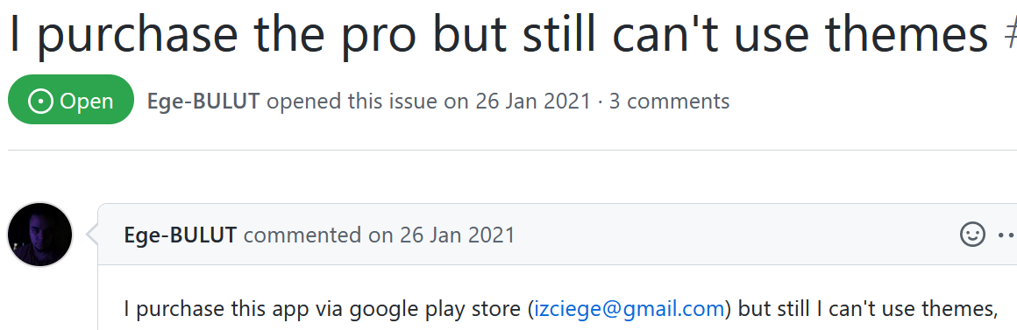
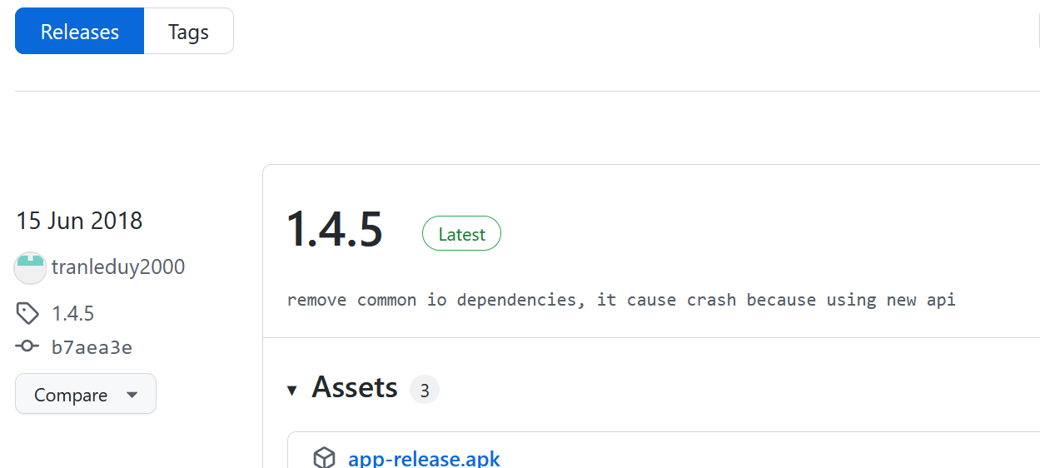
4. Unmaintained Android project with Paid Service - Example

Slide 28
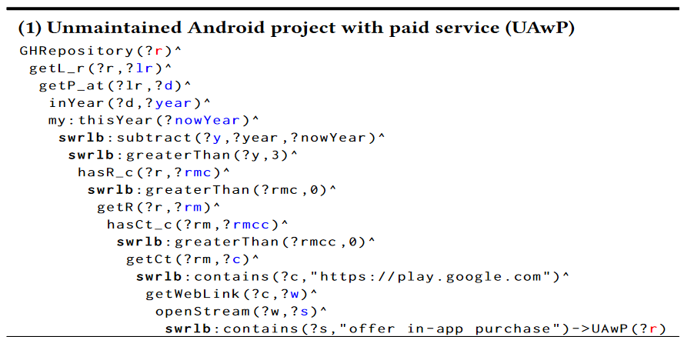
4. Unmaintained Android project with paid service - SWRL

Slide 29
5. No attribution to the author in code
When using the code or fragment of code, we should give the credit or acknowledge the author in the source code, especially when we use the code from the source under a different license.
In our approach, we check whether contributors copied/used code fragments from stackoverflow.com.
If there is no credit to the author in the code, it is a possible unethical issue (i.e., No attribution to the author in the code).
Motivating Example
Principles | Guidelines | Type | Examples
Attribution | To respect copyright | No attribution to the author in code | https://github.com/gxgl/videojs-vjsdownload/pull/1

Slide 30
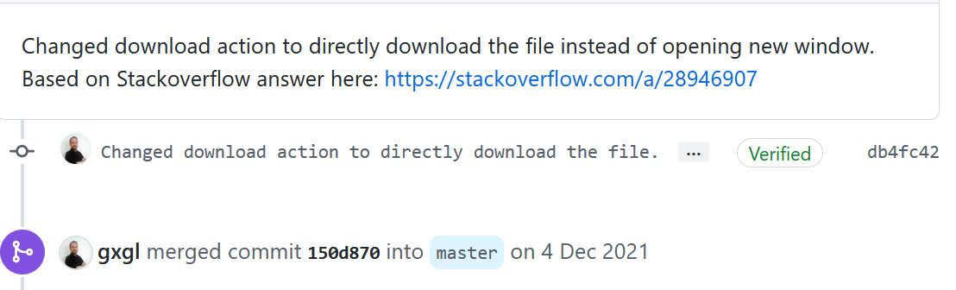
5. No attribution to the author code - Example

Slide 31
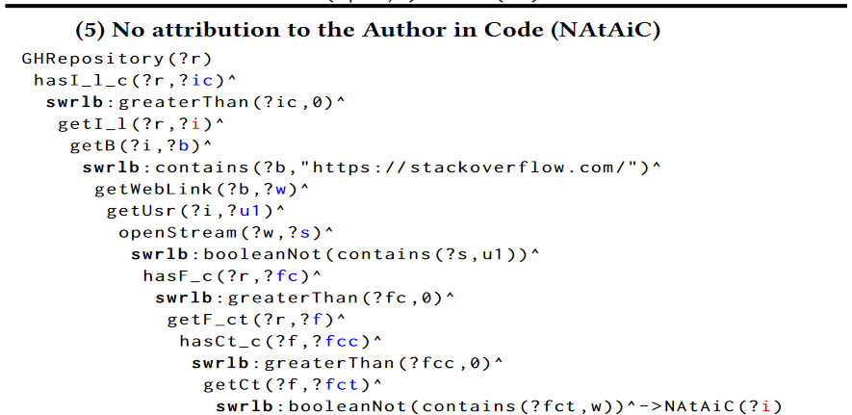
5. No attribution to the author in code – SWRL
Auto-detection Part

Slide 32
6. Soft-forking
In GitHub, we should fork the project instead of copying and creating a new project.
Without forking, copying projects directly becomes a possible unethical issue (i.e., Soft-forking).
Motivating Example
Principles | Guidelines | Type | Examples
Attribution | To respect copyright | Soft-forking | https://github.com/biddyweb/yes-cart/issues/33

Slide 33
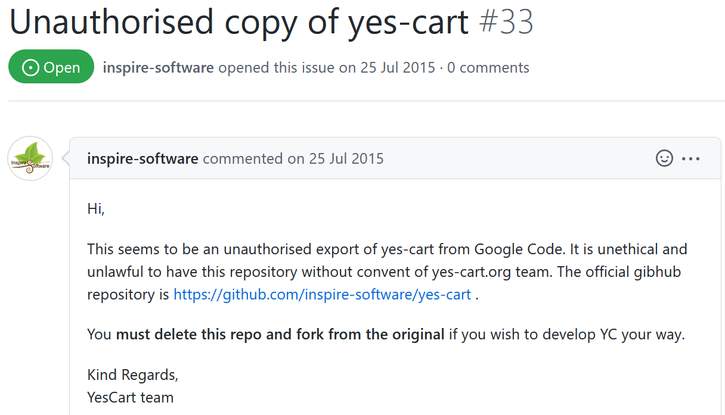
6. Soft-forking - Example

Slide 34
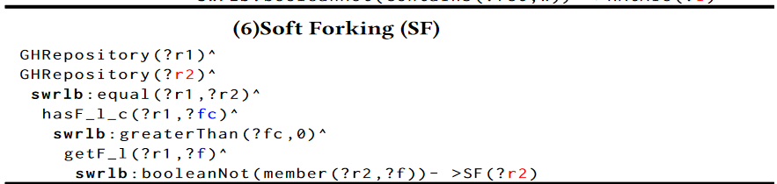
Auto-detection Part
6. Soft-forking - SWRL

Slide 35
7. Self-promoting
Active attempts to gain additional visibility for work were recognized as a somewhat distasteful activity and something the developers said they wouldn't do.
Instead, we should discuss the current issue in an ongoing conversation in GitHub pull request or issues.
It is a possible unethical issue (i.e., Self-promotion) if the stakeholders promote his/her GitHub repository without mentioning he/she is a contributor to that repository.
Motivating Example
Principles | Guidelines | Type | Examples
Welfare | To respect incentive compensation | Self-promotion | https://github.com/babel/babel/pull/13783

Slide 36
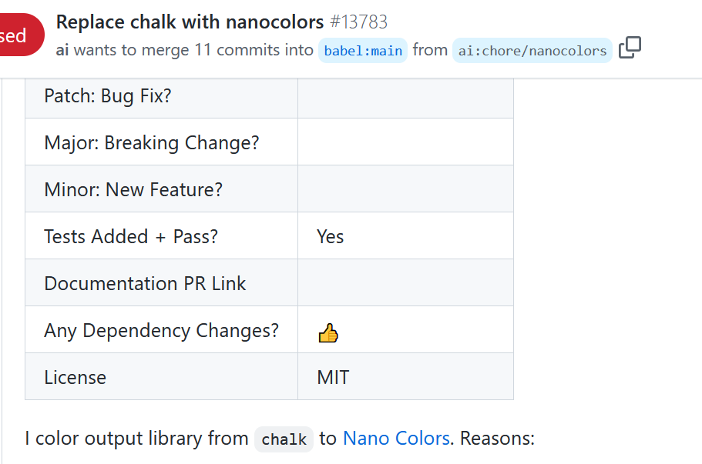
7. Self-Promotion - Example

Slide 37
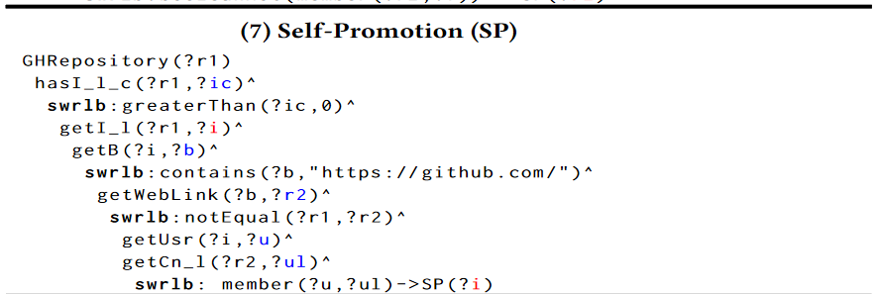
7. Self-promoting - SWRL
Auto-detection Part

Slide 38
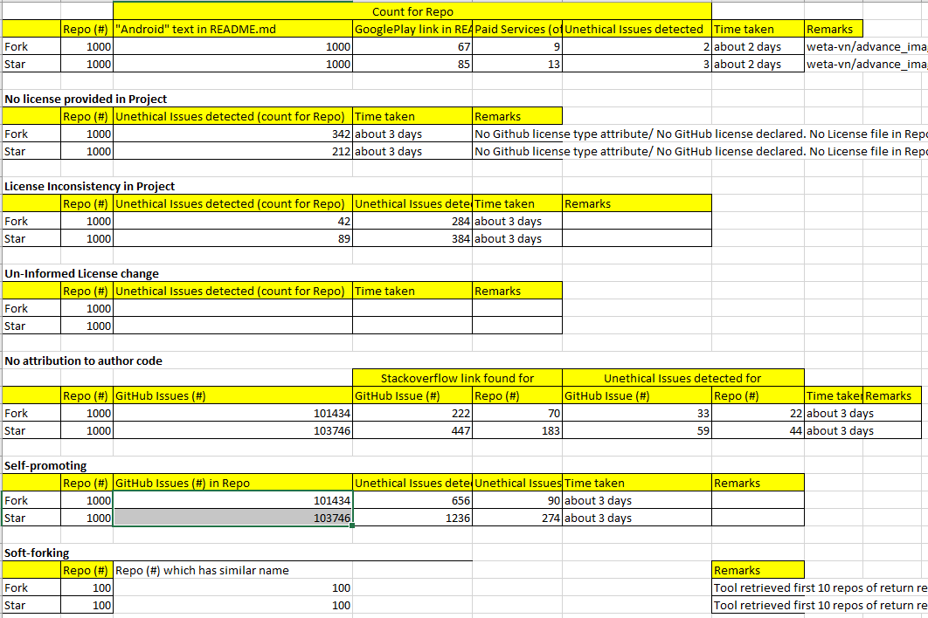
Evaluation (RQ4 : Does our tool detect the issues successfully?)
We will get help from student for counter-check.
We will get the feedback from stakeholders by commenting at GitHub issues.

Slide 39
RQ5 : Does the number of issues decrease over the years?
– still working

Slide 40
Conclusion
First auto-detection approach for unethical issues in OSS projects
A taxonomy
Evaluation : ?

Slide 41
Reference
[1] Looi Theam Choy. 2014. The strengths and weaknesses of research methodology: Comparison and complimentary between qualitative and quantitative approaches. IOSR Journal ofHumanities and Social Science 19, 4 (2014), 99–104.
[2] David Kocsis and Gert-Jan de Vreede. 2016. Towards a taxonomy of ethical considerations in crowdsourcing. (2016).
[3] Andrew McNamara, Justin Smith, and Emerson Murphy-Hill. [n.d.]. Does ACM’s code of ethics change ethical decision making in software development?. In Proceedings of the 2018 26th ACM joint meeting on european software engineering conference and symposium on the foundations of software engineering. 729–733
[4] 2012. , The Menlo Report: Ethical Principles Guiding Information and Communication Technology Research pages. https://www.dhs.gov/sites/default/files/
publications/CSDMenloPrinciplesCORE-20120803_1.pdf
[5]Nicolas E Gold and Jens Krinke. [n.d.]. Ethical Mining: A Case Study on MSR Mining Challenges. In Proceedings of the 17th International Conference on Mining Software Repositories. 265–276.
[6] Yuhao Wu, Yuki Manabe, Tetsuya Kanda, Daniel M German, and Katsuro Inoue. [n.d.]. A method to detect license inconsistencies in large-scale open sourcprojects. In 2015 IEEE/ACM 12th Working Conference on Mining Software Repositories. IEEE, 324–333
[7]Christopher Vendome, Mario Linares-Vásquez, Gabriele Bavota, Massimiliano Di Penta, Daniel German, and Denys Poshyvanyk. [n.d.]. License usage and changes: a large-scale study of java projects on github. In 2015 IEEE 23rd International Conference on Program Comprehension. IEEE, 218–228.
[8] Christopher %J 4th Research Room FOSDEM: Libre software communities meet research community Oezbek. 2008. Research ethics for studying Open Source projects. (2008).
[9]Christopher Bogart, Christian Kästner, James Herbsleb, and Ferdian Thung. 2016. How to break an API: cost negotiation and community values in three software ecosystems. In Proceedings of the 2016 24th ACM SIGSOFT International Symposium on Foundations of Software Engineering. 109–120.
[10] Mark A Musen. 2015. The protégé project: a look back and a look forward. AI matters 1, 4 (2015), 4–12.
[11] Natalya F Noy, Deborah L McGuinness, et al. 2001. Ontology development 101: A guide to creating your first ontology.

