Slide 1
Fast and Precise Handling of Positive Weight Cycles for Field-sensitive Pointer Analysis
Yuxiang Lei and Yulei Sui
University of Technology Sydney, Australia

Slide 2
Pointer Analysis
Pointer analysis is to statically determine the run time value of a pointer.
Usages:
compiler optimizations, bug detection, program understanding, etc..
Scope of our work:
field-sensitivity: distinguish the fields of an aggregated object
flow-insensitivity: ignore the order of instructions
Notes:
Pointer analysis is to statically determine the run time value of a pointer and is now widely used in compiler optimizations, bug detection, program understanding, etc..
In this paper, the scope of our work is field-sensitive, which distinguishes the field of aggregated object
and flow-insensitive, which ignores the order of instructions.

Slide 3
Our Contributions
DEA, a fast and precision-preserving handling of positive weight cycles by capturing its derivation equivalence.
A new stride-based field abstraction to identify and collapse a sequence of derivation equivalent fields.
Experimental results show an average 7.1X speed up over the state-of-the-art field-sensitive pointer analysis (PKH).
Implemented in LLVM and merged it to the open-source tool SVF (https://github.com/SVF-tools/SVF).
Notes:
Our contribution includes ….

Slide 4
Overview
Background
Motivation
Our Approach
Result
Notes:
This talk includes 4 parts:
… instruction-based field-sensitive pointer analysis for C/C++;
… positive weight cycle and its derivation equivalence;
…
…

Slide 5

Inclusion-based Pointer Analysis for C/C++
Inclusion-based pointer analysis resolves pointer analysis as a set constraint problem.
Point-to set
1 int x;
2 void* p;
3 p = &x;
points-to relationship
Notes:
Inclusion-based pointer analysis was first proposed by Andersen, which resolves the pointer analysis as a set constraint problem. It maps program instructions into set inclusion relationship where variables pointed by a pointer are collected in a set called point-to set.
For example, given this C code fragment, according to line 3, pointer p points to variable x. Then it can be denoted by the point to set of p, namely pts(p) = {x}.

Slide 6
Inclusion-based Pointer Analysis for C/C++
Four basic instructions involved in pointer analysis
Instructions
Rules:
AddrOf
Copy
Load
Store
p = &o;
p = q;
p = *q;
*p = q;
o ∈ pts(p);
pts(p) ∪= pts(q);
∀a∈pts(q), pts(p) ∪= pts(a);
∀a∈pts(p), pts(a) ∪= pts(q);
Notes:
The instructions of C/C++ involve in pointer analysis are simplified to four basic types, with corresponding rule to solve the points-to relationship.
They are addrOf, put an object into a point-to set;
copy, copy a point-to set to another one;
load, for each element in a point-to set, copy the point-to set of the element to another one;
store, for each element in a point-to set, copy another one’s point-to set to the element.

Slide 7
Inclusion-based Pointer Analysis for C/C++
Pointer analysis is transformed into graph-solving problem.
Rules
C Code
Constraint Graph
AddrOf
Copy
Load
Store
p1 = &o1;
p2 = &o2;
*p1 = p2;
p3 = *p1;
o₂
o₁
p₁
p₂
p₃
Notes:
with such rules, pointer analysis is further transformed into a graph-solving problem.
The graph is called constraint graph, with the edges on the graph called constraints.
Take this C code fragment as an example, the 2 addrOf instructions are transformed into 2 addrOf edges highlighted in green.
And the store instruction and load instruction are transformed into a store edge highlighted in blue and a load edge highlighted in red.

Slide 8
Inclusion-based Pointer Analysis for C/C++
Pointer analysis are transformed into graph-solving problem.
Rules
C Code
Constraint Graph
Result
pts(p₁) = {o₁};
pts(p₂) = {o₂};
pts(o₁) = {o₂};
pts(p₃) = {o₂};
AddrOf
Copy
Load
Store
{o₂}
p1 = &o1;
p2 = &o2;
*p1 = p2;
p3 = *q1;
o₁
o₂
{o₁}
{o₂}
p₁
p₂
{o₂}
p₃
Notes:
Then solving this constraint graph can produce the result of pointer analysis.

Slide 9
Field Sensitivity in C/C++
However, C/C++ has its address-of-field instruction: p = &q→f_{i}.
Rule
field-insensitive field-sensitive
Field pts(p) ∪= pts(q) ; ∀o∈pts(q), o.f_{i} ∈ pts(p) ;
Constraint Graph
positive weight
{o}
{o.f_{i}}
q
+i
p
Notes:
However, different from Java, which does not permit taking the address of a field, C/C++ has its addOf field instruction p = &q→f_{i.}
Previous field-insensitive analysis treats such instruction as copy constraint, but in field-sensitive modelling, the access of field needs to be specified. The rule of the field instruction is defined as: given the field index I, the i-th field of each elements is put into pts of p.
In constraint graph we use an edge with a label on top of it to denote field edge, and the label i is usually called positive weight.
since solving such constraint will derive a new field in constraint graph, field sensitive pointer analysis will face a problem named positive weight cycle.

Slide 10
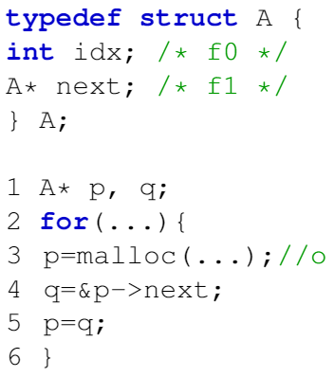
Field Sensitivity in C/C++
Positive weight cycle (PWC).
pts(q) ⊆ pts(p)
pts(p) ⊆ pts(q)
∀o∈pts(q), o.f_{i} ∈ pts(p)
pts(p) ⊆ pts(q)
{o, o.f₁}
{o, o.f₁, o.f₂}
{o}
{o}
{o, o.f₁, o.f₂, …}
{o.f₁, o.f₂, …}
{o.f₁, o.f₂}
{o.f₁}
{o}
{}
normal cycle
field-insensitive
positive weight cycle
field-sensitive
Notes:
this example manipulate a struct of type A with 2 fields. line3 to line 5 is translated into such constraints and forms a normal cycle based on field-insensitive pointer analysis. And forms a pwc which comprises of 1 field edge and 1 copy edge.
lets see the C code fragment. The instruction from line 3 to line 5 forms a cycle like this.
While solving the cycle, a new field edge is derived and propagated along the cycle. And in the next iteration, another new field is derived from the field derived in the last iteration.
Such iterations will never terminate unless a particular limitation is set to restrict the infinite derivation.
Different from normal cycle, namely non pwc, which comprises of only copy edges, a Positive weight cycle is a cycle that comprise of copy edges and at least one field edge.
………….

Slide 11
Field Sensitivity in C/C++
Positive weight cycle (PWC).
∀o∈pts(q), o.f_{i} ∈ pts(p)
pts(p) ⊆ pts(q)
PKH
{o, o.f₁, o.f₂, …, o.f_{max}}
{o.f₁, o.f₂, …, o.f_{max}}
positive weight cycle
field-sensitive
Notes:
The classic method that proposed by Pearce and Kelly, usually called PKH, is to set a max field number of each object, when the max field number is reached, the derivation terminates.

Slide 12
Field Sensitivity in C/C++
NodesInPWC: the node number that the largest PWC contains;
NodesInCycles: the number of node in cycles (= PWC + non-PWC).
Significance of PWC
Notes:
Let see the significance of pwc in modern C/C++ programs.
In this table, the green column shows the num of PWCs in each program. We can see the num is not large, usually tens or around 100.
But when we look at the red column showing the number of nodes in PWC in each program. The number is quite large, varied from thousands to more than ten thousands.

Slide 13
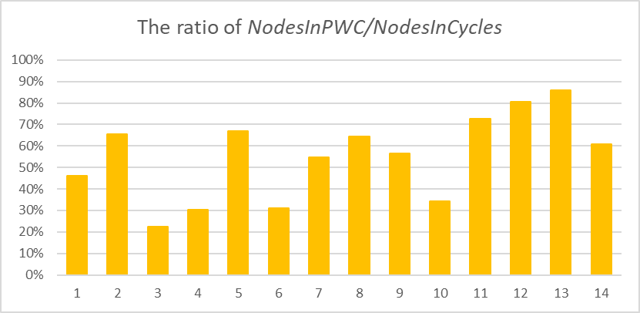
Field Sensitivity in C/C++
NodesInPWC: the node number that the largest PWC contains;
NodesInCycles: the number of node in cycles (= PWC + non-PWC).
Significance of PWC
Notes:
this graph shows the ratio of the num of nodes in pwc out of that in all cycles.
We can find nodes in positive weight cycles takes a large proportion, varied from 20% to 80%.

Slide 14
Motivating Example
How PWCs cause computational redundancy
Observation 1
Notes:
Here we use 2 examples to demonstrate how pwcs bring redundant computation.
This example shows how extra point to set propagations are brought by pwc via the field and copy constraints.
This pwc comprises of 1000 nodes, with only one field edge. Initially, there is an object o in the pts of the source node of the field edge.

Slide 15
Motivating Example
How PWCs cause computational redundancy
Observation 1
Notes:
And in every loop, point-to set propagation needs to be done 1000 times.

Slide 16
Motivating Example
How PWCs cause computational redundancy
Observation 1
Notes:
Given the max field number of the object o is also 100,

Slide 17
Motivating Example
How PWCs cause computational redundancy
Observation 1
Notes:
then point-to set propagation needs to done 100,000 times to completely solve the PWC.

Slide 18
Motivating Example
How PWCs cause computational redundancy
Observation 2
Notes:
This example shows how pwc brings redundant computation via store and load constraints.
There is a pwc comprised of 2 nodes p1 and p2, and connected by one store edge and one load edge.
Initially, p2 points to o.f1.

Slide 19
Motivating Example
How PWCs cause computational redundancy
Observation 2
Notes:
During solving the pwc, once a new field is derived and added into pts of p1, there should always have new edges created to connect from the source of the store edge to the new field, and from the new field to the tgt of the load edge.

Slide 20
Motivating Example
How PWCs cause computational redundancy
Observation 2
Notes:
Accordingly, the pts have to be repeatedly propagated via the new copy edges.

Slide 21
Motivating Example
How PWCs cause computational redundancy
Observation 2

Slide 22
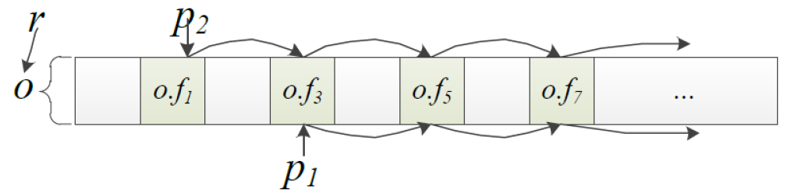
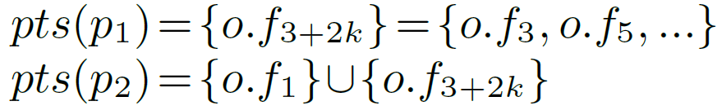
Motivating Example
Derivation Equivalence of PWCs
Notes:
Based on these observations, we found our motivation.
That is, the fields derived by a pwc follows an equivalent stride and such fields also equivalently involve in the store and load constraints connected with the cycle.
In this example, the field derived from the pwc o.f3, o.f5, o.f7, etc. follows an equivalent stride 2, and their pts are equivalently propagated from q1 and to q2.
So represented by a sequence o.f3+2k.
based on this equivalency, the motivation of our approach is to merge such equivalent fields to one node, in order to reduce the computational redundancy.
Lets still use this constraint graph to …

Slide 23

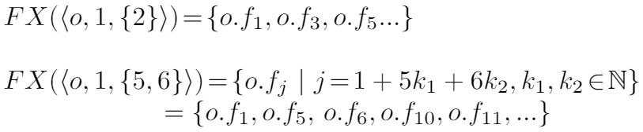
Our Approach
Stride-based Field Representation
(Definition 1)
o – the base object of the sequence of fields;
i – the initial index of the sequence of fields;
S – a set holding strides of the sequence of fields.
Examples
Notes:
Data structure…
, we defined a notation named stride based field representative sfr and denoted by sigma. Sigma is a 3 tuple, where o is …
For example, an sfr … denotes a sequence of field with their initial index 1 and a stride 2;
an sfr … denotes a sequence of field with their initial index 1 and with 2 strides 5 and 6.

Slide 24
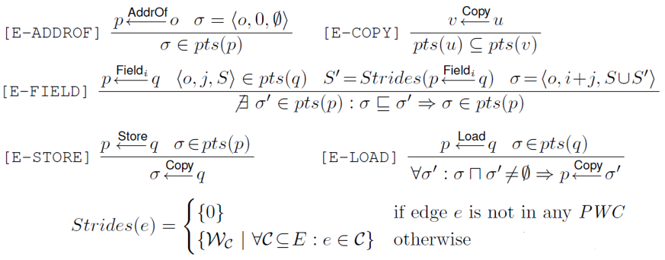
Our Approach
Stride-based Field Representation
Rules
Notes:
Based on sfr, we proposed the following rules.

Slide 25
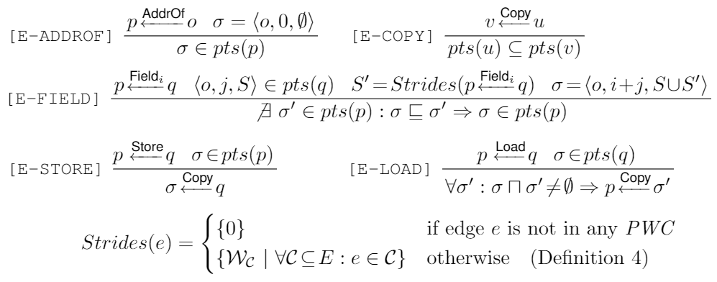
Our Approach
Stride-based Field Representation
Rules
Previous Rules
o ∈ pts(p);
pts(p) ∪= pts(q) ;
∀a∈pts(p), pts(a) ∪= pts(q) ;
Notes:
Among which the addrOf, copy and store works the same principle as the previous 3 rules.

Slide 26

Our Approach
Stride-based Field Representation
Rules
i – the weight of the field edge;
j – the index of SFR in the point-to set of source node;
S – the strides of SFR in the point-to set of source node;
S’ = Strides(e) – the strides of cycles containing the field edge.
Notes:
While solving the field constraint, the aim is to calculate a new sfr sigma and put it into the point-to set of the tgt node of the field edge.

Slide 27
Our Approach
Stride-based Field Representation
Rules
Notably, if σ is a subset of any element of pts of the target node, then propagation of σ is stopped.
Notes:
Notably, if the expansion of sigma is a subset of any element of pts of the target node, then propagation of sigma is stopped.

Slide 28
Our Approach
Stride-based Field Representation
Rules
Notes:
While solving load constraints, all the sfrs that intersects with the element in the point-to set of the source node should propagate their pts to the tgt node.
This is because in this field representation, a field may belong to one or multiple sfrs, any addition to point-to set of one of the sfr is equivalent to addition to the point-to set of the field. So to exactly propagate the point-to set of any fields in an sfr, all other sfrs that intersect with the sfr should propagate their point-to sets to the point-to set of the load edge.
Let’s use an example to demonstrate this rule. Here sigma 1 comprises of … sigma 2 comprises of … and the intersect of sigma1 and sigma2 is not empty.
So once either sigma 1 or sigma 2 is in the point-to set of the source node of a load edge, they should both propagate their pts to the tgt node.
Generally

Slide 29



Our Approach
Stride-based Field Representation
Example 1
{}
Notes:
Let’s use 3 examples to explain how such 5 rules work.
The first one is a simple pwc, with initially sigma 1 in the point-to set of node p.
According to the field rule, sigma 2 is created and put into the pointer-to set of q.

Slide 30




Our Approach
Stride-based Field Representation
Example 1
Derivation stops here because
Stop at the 2nd iteration
Notes:
It is then propagated back to node p via the copy edge.
At the beginning of the next loop, sigma 3 is derived. But since sigma 3 is a subsect of sigma 2, it will not be put into q’s point-to set, and the propagation is terminated here.
In this example, our method solves this pwc within only 2 iterations, instead of hundreds of iterations via previous method.

Slide 31


Our Approach
Stride-based Field Representation
Example 2
Notes:
This is an example about nodes and edges involved in multiple cycles.
Initially, sigma 1 p1 points to sigma 1.
The solving begins with the field edge from p1 to p2, sigma 2 is calculated and put into p2’s point-to set.

Slide 32
Our Approach
Stride-based Field Representation
Example 2
Notes:
Then sigma 2 is propagated to q2’s point-to set.

Slide 33

Our Approach
Stride-based Field Representation
Example 2
Notes:
While solving this field edge, sigma 3 is derived and added into q1’s point-to set.

Slide 34


Approach
Stride-based Field Representation
Example 2
Derivation stops here
because
Stop at 2nd iteration
Notes:
Then p1 receives sigma 2 and sigma 3 into its point-to set via the 2 copy edges.
In the next iteration, sigma 4 and sigma 5 are derived respectively from sigma 2 and sigma 3 via solving the field edge...
But since sigma 4 and sigma 5 are respectively subset of sigma 3 and sigma 3, derivation and propagation terminates here.
In this example, propagation terminates within only 1 iterations by our approach.

Slide 35
Our Approach
Stride-based Field Representation
Example 3
q
p
σ₁
r
σ₂
Notes:
This is an example demonstrating the store and load rules our approach.
Initially, p points to sigma 1, q points to sigma 3 and sigma 2 points to sigma 4. Sigma 1 and sigma 2 intersect with each other.
While solving the store edge, the point-to set of q is propagated to sigma 1.

Slide 36
Our Approach
Stride-based Field Representation
Example 3
q
p
σ₁
r
σ₂
Notes:
When solving the load edge, sigma 1 propagates its pts to r.
Since the intersect of sigma 1 and sigma 2 is not empty and sigma 1 is in pts of p,
sigma 2 should also propagate its point-to sets to r.
More straightforward, o.f2 is included in sigma 1, so its pts contains sigma 3. o.f2 is also included in sigma 2, so its pts also contains sigma 4. So in order to fully propagate its pts, both sigma 3 and sigma 4 should be put into r’s pts. to maintain the correctness

Slide 37
Implementation
Our Method: DEA
Source code
Clang
Bitcode files
WLLVM
Whole-program bc file
SVF
DEA
Result
Constraint Graph
Notes:
We implement our method as an open source tool named DEA.
In our implementation, The source code of each program is compiled into bit code files by Clang-7.0.0 and then linked together using WLLVM to produce whole program bitcode files.
After using Clang to retrieve LLVM IR from whole program bitcode files, a constraint graph is build via SVF.
Then the result of pointer analysis is retrieved from the constraint graph via our DEA tool.

Slide 38
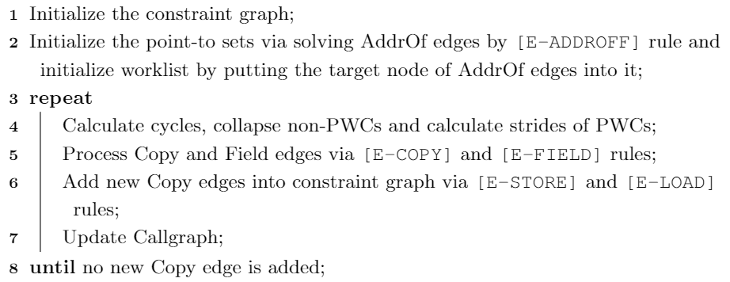
Implementation
Worklist solver (Algorithm )
Notes:
Our worklist solver can be abstracted as follows:
based on e-addrof…
update callgraph

Slide 39
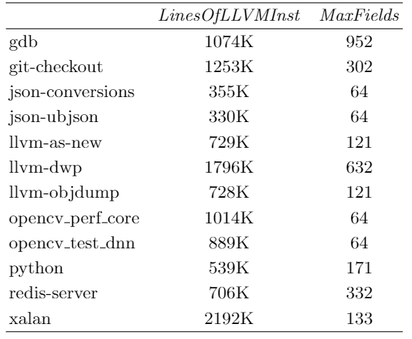
Implementation
The lines of LLVM instructions and max field numbers of each program.
Notes:
We chose 11 open source programs as our benchmarks. The lines of llvm instructions, showed in column LOC, varied from 330 thousands to 2.2 million.

Slide 40
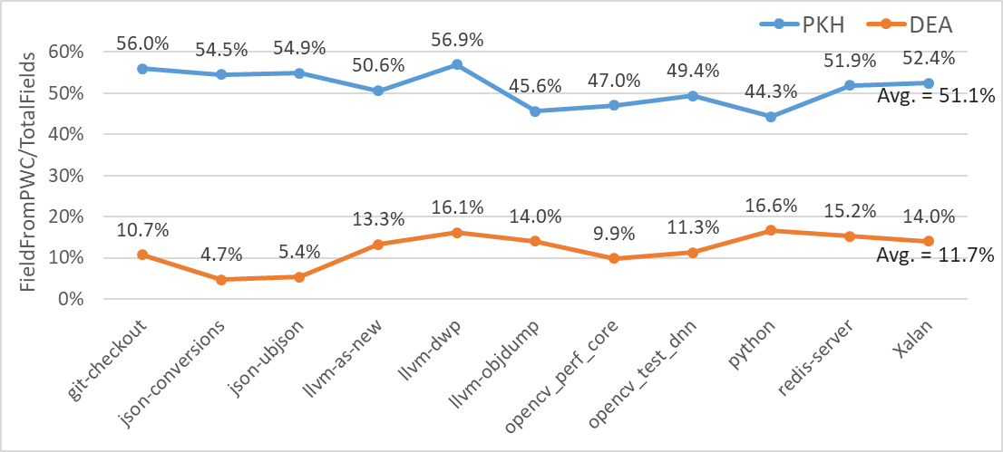
Evaluation Results
The percentages of fields derived from solving PWCs out of the total number of fields
Notes:
This graph shows the percentages of fields derived from solving PWCs out of the total number of fields.
We can see that the percentage is largely reduced by DEA, which means the stride based field representation effectively reduced the redundantly derived fields
Comparing to previous PKH, DEA has a largest reduction from 54.5% to 4.7% and a smallest reduction from 44.3% to 16.6%. And on average, the ratio obtained by DEA is 11.7%, reduced from 51.1% that obtained by PKH.

Slide 41
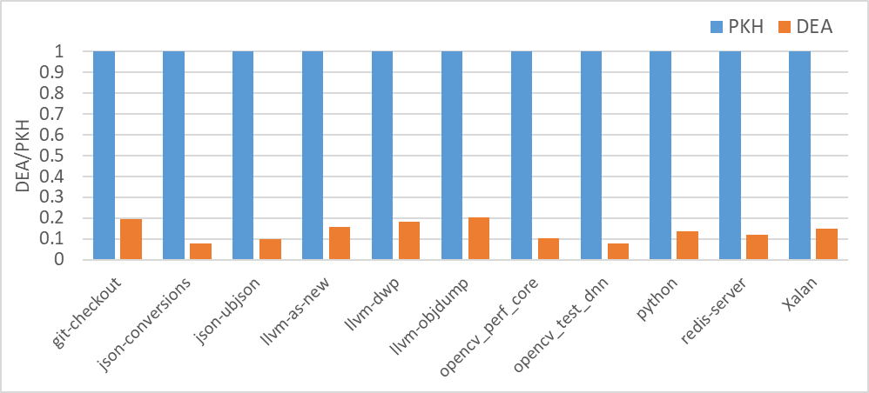
Evaluation Results
Speed up
Max: 13x
Min: 4.9x
Avg: 8.2x
13.0x
4.9x
Comparing pts propagation time between PKH and DEA (normalized with PKH as base).
Notes:
This chart compares time costed by point-to set propagation between PKH and DEA, the values are normalized with PKH as base. In the chart the largest reduction is …, the smallest reduction is and the average reduction is …
This means that the largely reduced field number via sfr. can effectively reduce the time costed by point-to set propagation.

Slide 42
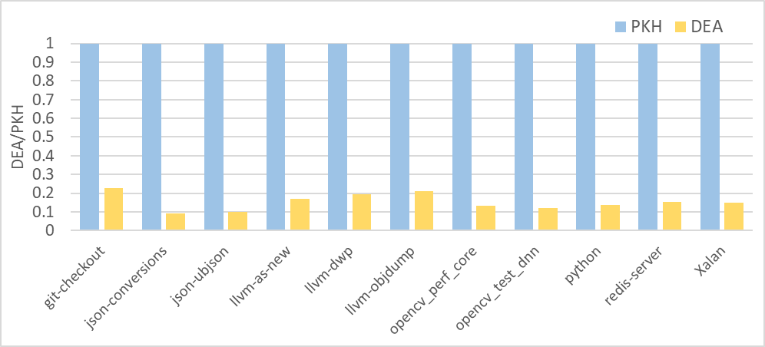
Evaluation Results
Speed up
Max: 11x
Min: 4.4x
Avg: 7.1x
4.4x
11.0x
Comparing total analysis time between PKH and DEA (normalized with PKH as base).
Notes:
This graph compares the total analysis time between PKH and DEA, with the left of each column is PKH and the right of each column is DEA.
We can see that DEA significantly accelerated analysis with the max speed up of 11.0 times and minimum speed up of 4.4 times and the average speedup of 7.1 times. Our method is effective to improve the efficiency of field-sensitive pointer analysis for C/C++, while producing the same result as state-of-the-art PKH method.

Slide 43
Summary
This paper:
Introduces a new stride-based field representation to identify and collapse the sequences of equivalently derived fields.
Implements the method as an open-source tool DEA, and achieves a 7.1x speed up over state-of-the art method PKH.
Code available at:
https://github.com/SVF-tools/SVF
Command line:
wpa –sfrander example.bc
Notes:
To summarize, this paper …
This is the link of our open-source tool, after complied by cmake and llvm-7, just type the following instruction to retrieve your result of a bitcode’s analysis.

Slide 44
Thank you!
Our open-source tool: https://github.com/SVF-tools/SVF

