Slide 1
Fault Localization in Android using Top-Down approach
Hsu Myat Win

Slide 2
Content
AndroidSlicer - A paper I read
Title : Dynamic slicing for Android , 2019 ICSE
Fault Localization in Android using Top-Down approach – Hsu
What is Top-Down? Why?
Overall Architecture
Example

Slide 3
Dynamic slicing for Android(Problem Address/Novelty)
AndroidSlicer, the first slicing approach for Android(Novelty)
Slicing mobile, event-based systems is challenging due to their asynchronous callback construction and the IPC (inter process communication)-heavy, sensor-driven, timing-sensitive nature of the platform although slicing is useful for a variety of tasks, from testing to debugging to security(Problem)
AndroidSlicer serves as a building block for constructing three applications (Novelty):
(1) finding and tracking input parts responsible for an error/crash,
(2) fault localization, i.e., finding the instructions responsible for an error/crash, and
(3) reducing the regression test suite

Slide 4
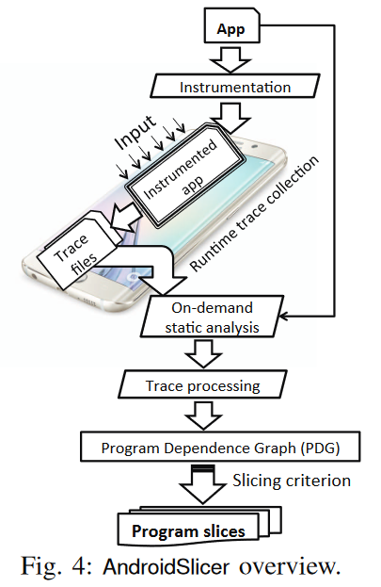
Dynamic slicing for Android(Architecture)
Instrumentation: identify app entry points; construct method summaries; and add instruction/meta-data tracing capabilities to the app
On-demand Static Analysis: a post-run on-demand static analysis that uses the collected runtime information to narrow down the scope of the static analysis to only those app parts that have been exercised during the run
Trace Processing and PDG Construction: The PDG is built gradually via backward exploration of dependences, adding nodes and edges
Generating Program Slices from the PDG:
Notes:
-Source & Sink
-Our prior static analysis produces two sets: (1)StaticDatasi– the set of static data dependence nodes for an instruction si,and (2)StaticControlsi– the set of static control dependencenodes for an instruction si
Sequential data dependence edges.For every occurrenceof an instructionsi, add a data dependence edge to the lastexecuted occurrence of every instruction in itsStaticDatasi.Sequential control dependence edges.For every occur-rence of an instructionsi, add a control dependence edgeto the last executed occurrence of every instruction in itsStaticControlsi.Asynchronous data dependence superedges
Asynchronous control dependence superedges
slicing criterion〈t, st,vs〉 : represents the register (vs) in instruction (s) at a particular time stamp (t).
The output OUTs t is the set of distinct nodes in the PDG we encounter while backward traversing from st to any of the app entry points affecting the value held in register vs
*************************
Step 1: Run instrument.sh to instrumented with Keyword "SLICING" > this stage generate insturmented apk
Step 2: Run logcat to get for those SLICING trace log by monkey triggering to apk at emulator > this stage generate log
Step 3: Run preslicer.sh (like on-demand static analysis) with the help of log file getting from step 2 and source sink text file >>> at this stage , they differantiate supernode and normal node with keyword "on" (eg; onCreate()) and generate callbacks.txt file as well as create a <apk_file>.logcat.processed.txt file. Each line starts with a number. You need to pick a number (your interesting point as the slicing criteria) to add to the next command.
Step 4: Run slicer.sh by using step 2 log & sourcesink txt file and then enter the number that you picked from previous step:
Finally, you will have the slices files wrt your slicing criteria

Slide 5
Dynamic slicing for Android(Gap/Weakness/Future work)
Paper
forward slicing and language-agnostic slicing that would permit slicing apps containing code written in different programming languages
Hsu:
Slice block will be returned only if line number is given based on pre-run data for fault localization.
Notes:
Fault localization: we compute the execution slice for (verr) by back propagating through the execution slice. While we traverse the PDG backwards, we consider asynchronous callbacks and their input parameters if they have a direct data or control dependence to the final value of (verr). This way, we can both handle the non-determinism of the events and also support the random inputs from internal and external sources.
Eg; null pointer exception for file not exist when file exploer - fault localization

Slide 6
Top-Down approach - Hsu
What is Top-Down approach?
the breaking down of a system to gain insight into its compositional sub-systems in a reverse engineering fashion.
What is problem to address?
Instrumentation to find precise fault localization in order to generate repair patch
What is contribution?
It can give developer/program to find out accurate fault localization by providing clear picture of system architecture
Why Top-Down approach?
So far, most CFG are mainly focus on UI and not logical System Architecture to address (like Service, Provider and Receiver)
Notes:
Fault localization: we compute the execution slice for (verr) by back propagating through the execution slice. While we traverse the PDG backwards, we consider asynchronous callbacks and their input parameters if they have a direct data or control dependence to the final value of (verr). This way, we can both handle the non-determinism of the events and also support the random inputs from internal and external sources.
Eg; null pointer exception for file not exist when file exploer - fault localization

Slide 7
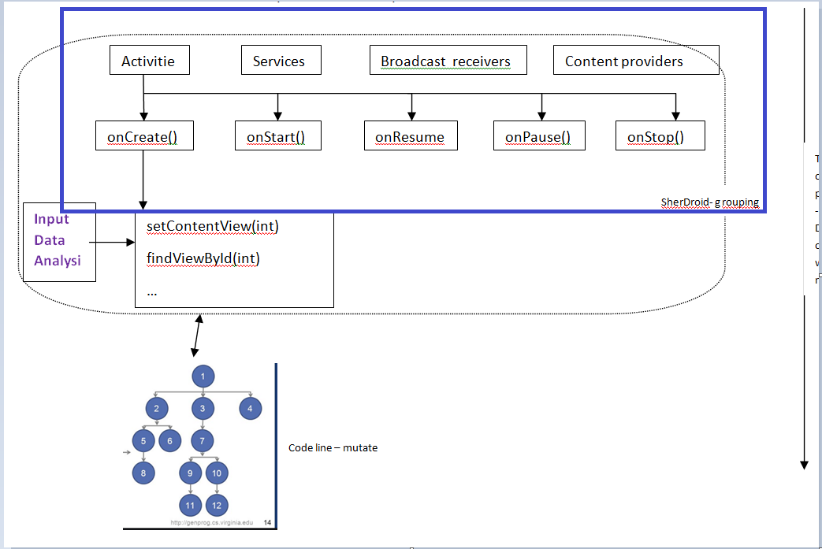
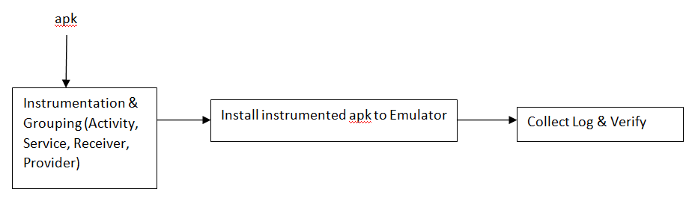
Architecture - Hsu
Notes:
Fault localization: we compute the execution slice for (verr) by back propagating through the execution slice. While we traverse the PDG backwards, we consider asynchronous callbacks and their input parameters if they have a direct data or control dependence to the final value of (verr). This way, we can both handle the non-determinism of the events and also support the random inputs from internal and external sources.
Eg; null pointer exception for file not exist when file exploer - fault localization

Slide 8
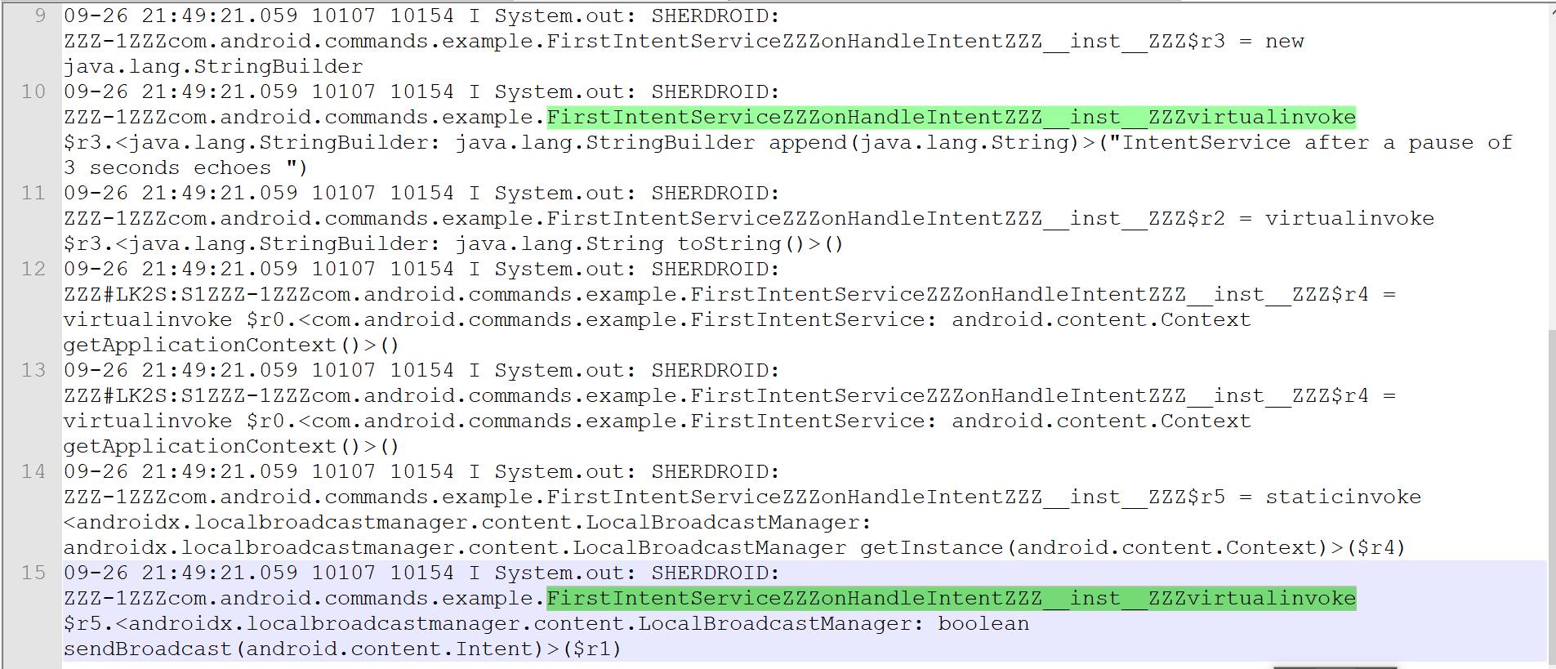
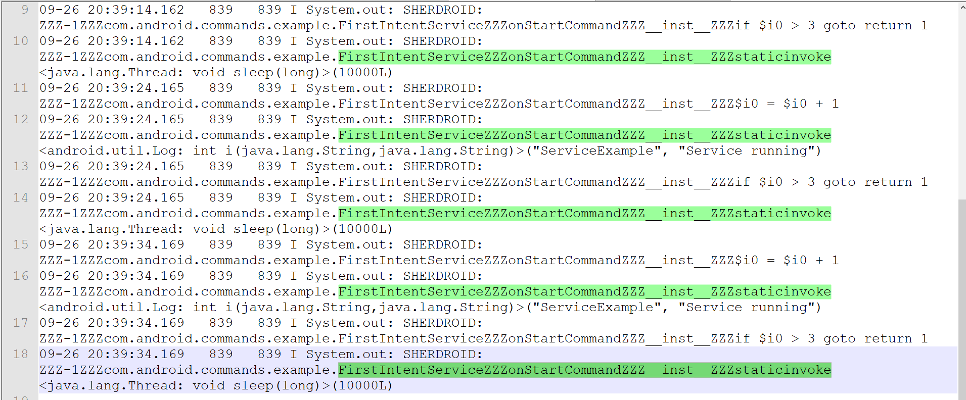
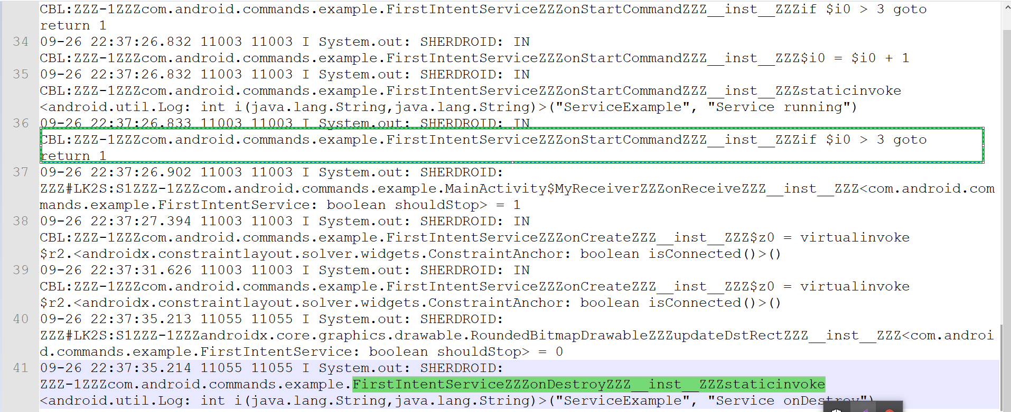
Example - Hsu
IntentService without implementing onStartCommand() and working fine | IntentService with implementing onStartCommand without calling stopSelf() & app crash | IntentService with implenting onStartCommand as well as call stopSelf() & working fine
IntentService implementation : onCreate > onHandleIntent
IntentService implementation : onCreate > onStartCommand> onDestroy
IntentService implementation : onCreate > onStartCommand > onDestroy
Notes:
Fault localization: we compute the execution slice for (verr) by back propagating through the execution slice. While we traverse the PDG backwards, we consider asynchronous callbacks and their input parameters if they have a direct data or control dependence to the final value of (verr). This way, we can both handle the non-determinism of the events and also support the random inputs from internal and external sources.
Eg; null pointer exception for file not exist when file exploer - fault localization

Slide 9
Q & A
Notes:
Fault localization: we compute the execution slice for (verr) by back propagating through the execution slice. While we traverse the PDG backwards, we consider asynchronous callbacks and their input parameters if they have a direct data or control dependence to the final value of (verr). This way, we can both handle the non-determinism of the events and also support the random inputs from internal and external sources.
Eg; null pointer exception for file not exist when file exploer - fault localization

