Slide 1
Software Fairness - How to find discrimination in Machine Learning to improve software fairness?
Hsu Myat Win

Slide 2
Content
Introduction
Background
Existing Efforts and Limitations
Motivating Example (TBC)
My Solution (TBC)
Challenge (TBC)
Design and Implementation (TBC)
Evaluation (TBC)
Summary (TBC)
References

Slide 3
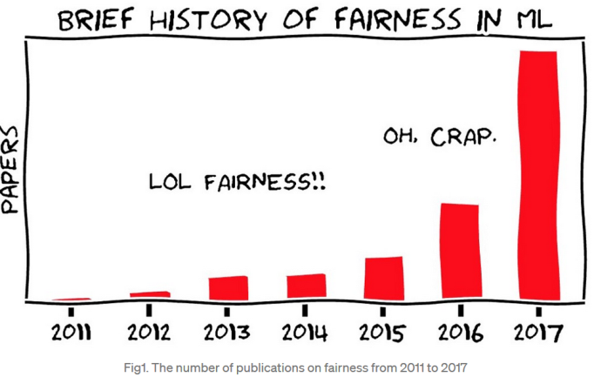
Introduction: Fairness
What?
Treatment or behaviour without favouritism or discrimination
Why needed in Software Engineering (SE)?
Fairness is one important non-functional testing property that deserves more efforts from Software researchers[1]
What happen in Machine Learning (ML)? [3]
To be fairness, numerous software engineering challenges
(requirements, specification, testing and so on)
https://towardsdatascience.com/a-tutorial-on-fairness-in-machine-learning-3ff8ba1040cb

Slide 4
Background: Fairness in ML
ML is to aid decision making, such as income prediction.
Feature/Attributes is input
Label is output
Protected attributes – protected characteristics or sensitive attributes
Race, Gender, Age, etc.
Unprotected attributes

Slide 5
Background: Discrimination in ML
Discrimination is often defined over a set of protected attributes/features.
Form of discrimination in ML
Group
Individual
Intuitively, discrimination happens when a machine learning model tends to make different decisions for different individuals (individual discrimination) or subgroups (group discrimination) differentiated only by one/multiple protected attributes.
Protected attributes - Gender (1 = male, 0 = female)
x1 : [4, 0, 6, 6, 0, 1, 2, 1, 1, 0, 0, 40, 100]
decision: D1 ≠ D2
x2 : [4, 0, 6, 6, 0, 1, 2, 0, 1, 0, 0, 40, 100]

Slide 6
Existing works
test generation for detecting fairness violations [4][8]
training data mutation for locating the unfairness [5]
empirical studies to understand the effectiveness and efficiency of existing fairness improvement methods [6] [7]

Slide 7
White-box Fairness Testing through Adversarial Sampling (ICSE 2020)[8]
A scalable approach for searching individual discriminatory instances of deep neural networks (DNN)
Individual Discrimination
Gradient-based adversarial attack

Slide 8
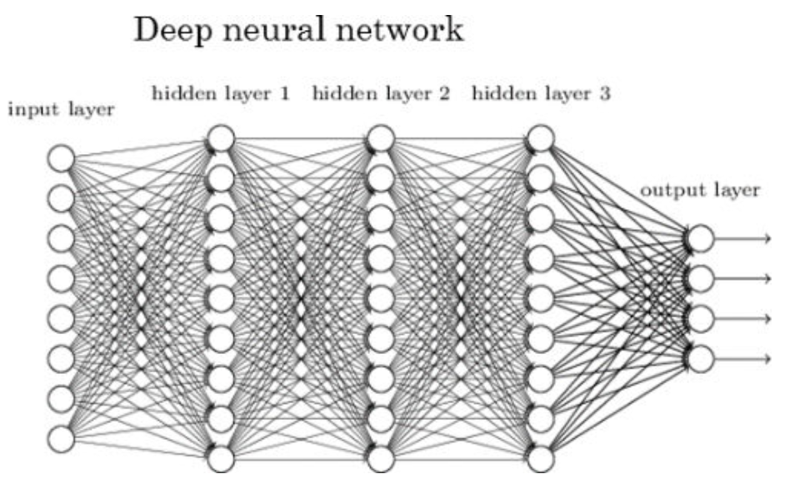
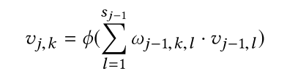

Deep neural networks (DNN)
DNN contains an input layer, multiple hidden layers and an output layer
- denote these layers as NL = {${NL}_{j}$ |j ∈ {0, . . . , J}}
- assume the j-th layer has $s_{j}$ neurons. 0 ≤ k ≤ sj
the weighted sum of the outputs of all the neurons in its previous layer and then applies an activation function (e.g., sigmoid or rectified linear unit )
Notes:
For each neuron, it first calculates the weighted sum of the outputs of all the neurons in its previous layer to get the output vj,k (as shown in Equation 1) and then applies an activation function (e.g., Sigmoid, hyperbolic tangent (tanh), or rectified linear unit (relu) [17]) ϕ.
In the following, we use θ = {ωj,k |1 ≤ j ≤ J, 0 ≤ k ≤ sj } to denote the set of parameters of D. In this work, we focus on DNN classifiers D : X → Y, i.e., for a given instance x ∈ X, a DNN outputs a predicted label y ∈ Y which has the highest probability.

Slide 9
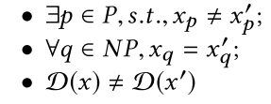
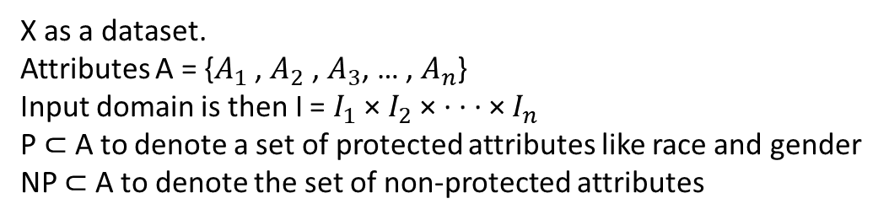
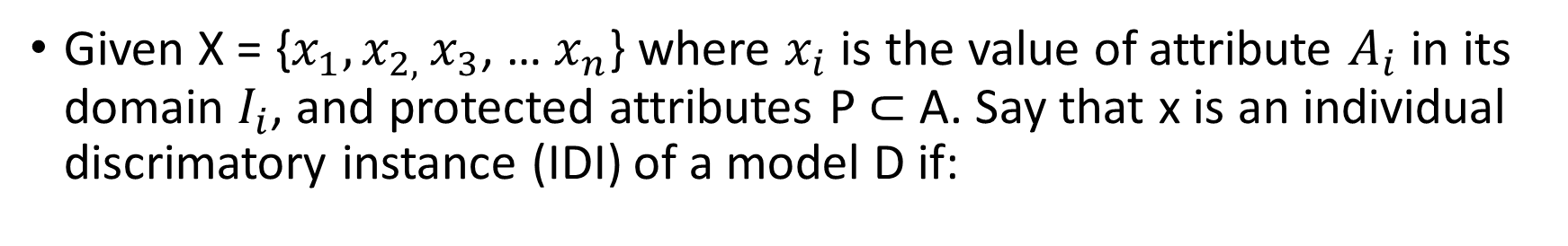
Individual Discrimination
Given X = {$x_{1},x_{2, }x_{3}$, … $x_{n}$} where $x_{i}$ is the value of attribute $A_{i}$ in its domain $I_{i}$, and protected attributes P ⊂ A. Say that x is an individual discrimatory instance (IDI) of a model D if:
X as a dataset.
Attributes A = {$A_{1}$ , $A_{2}$ , $A_{3}$, … , $A_{n}$}
Input domain is then I = $I_{1}$ × $I_{2}$ × · · · × $I_{n}$
P ⊂ A to denote a set of protected attributes like race and gender
NP ⊂ A to denote the set of non-protected attributes

Slide 10
Gradient-based adversarial attack
perturb the original normal input subtly and yet able to fool the DNN model
perturb the original input in the gradient direction so that the DNN will change its output to the largest extent

Slide 11
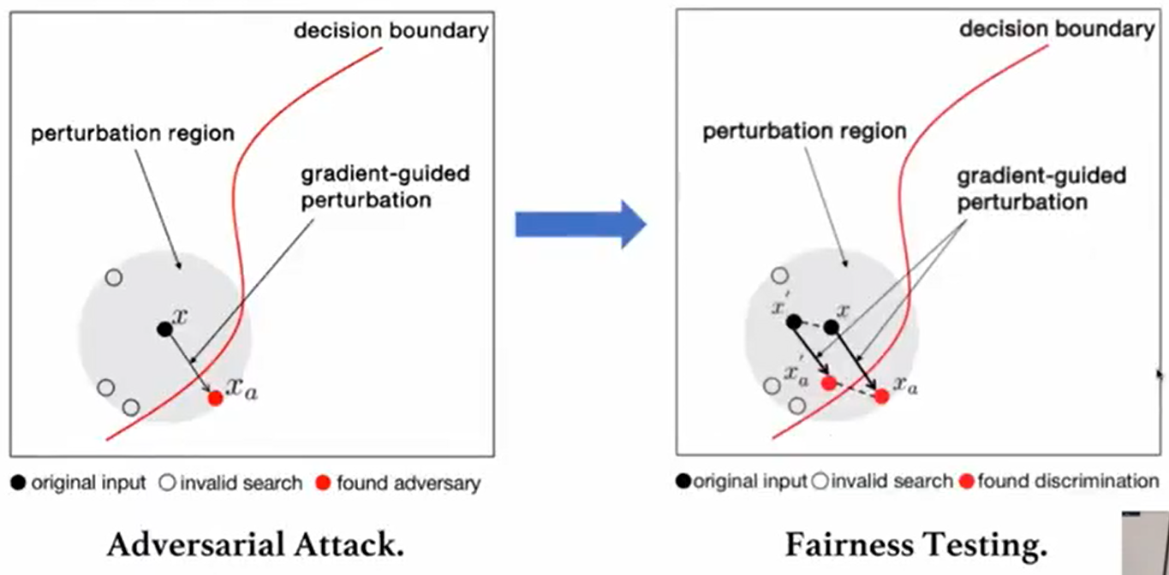

Slide 12
Reference
[1] Jie M.Zhang, Mark Harman, Lei Ma and Yang Liu, Machine learning testing survey, landscapes and horizons. IEEE TSE 2020
[2] Yuriy Brun and Alexandra Melou, Software fairness, FSE 2018
[3] https://towardsdatascience.com/a-tutorial-on-fairness-in-machine-learning-3ff8ba1040cb
[4] Sainyam Galhotra, Yuriy Bran, and Alexandra Meliou. Fairness testing: testing software for discrimination. In Proceedings of the 2017 11th Joint Meeting on Foundations of Software Engineering, pages 498-510, 2017.
[5] Arnab Sharma and Heike Wehrheim. Testing machine learning algorithms for balanced data usage. In Proc. ICST, pages 125-135, 2019.
[6] Joymallya Chakraborty, Tianpei Xia, Fahmid M Fahid, and Tim Menzies. Software engineering for fairness: A case study with hyperparameter optimization. arXiv preprint arXiv:1905.05786, 2019.
[7] Sumon Biswas and Hridesh Rajan. Do the machine learning models on a crowd sourced platform exhibit bias? an empirical study on model fairness. FSE 2020 (to appear), 2020.
[8] Peixin ZHANG, Jingyi WANG, Jun SUN, Guoliang DONG, XinyuWANG, Xingen WANG, Jin Song DONG, and Dai TING. White-boxfairness testing through adversarial sampling. In42nd InternationalConference on Software Engineering, 2020

