Slide 1
Introduction to Natural Language Processing
Group Presentation: Program Analysis Group
Gurparteek Singh | 12027013 | 07/05/2021

Slide 2
Background

Slide 3
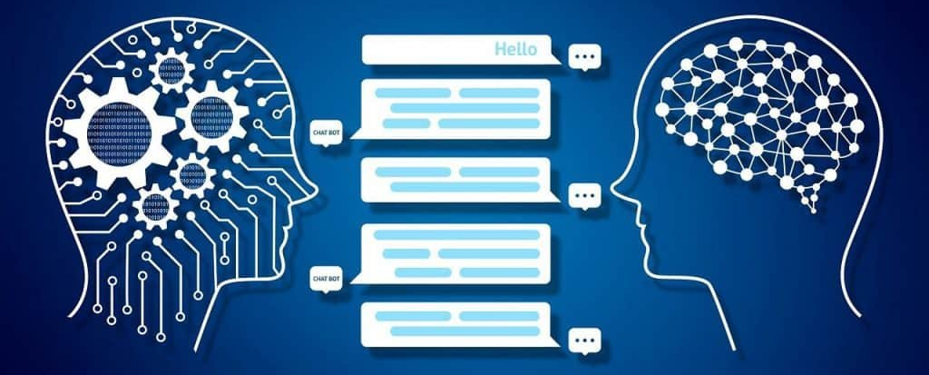
Overview
Subfield of Artificial Intelligence. Idea of “Machine Translation”.
Based on Deep Learning which enables machines to analyse and interpret human language.
Research on NLP first published in the 1950’s. Detailed timeline available at: https://en.wikipedia.org/wiki/History_of_natural_language_processing
Image Source: https://www.analyticsinsight.net/comprehensive-guide-natural-language-processing/
Notes:
Converting Russian sentences into English.

Slide 4





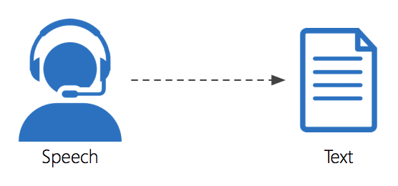
Applications
Sentimental Analysis
Machine Translation
Spellcheck
Spam Detection
Speech Recognition
Information Extraction

Slide 5
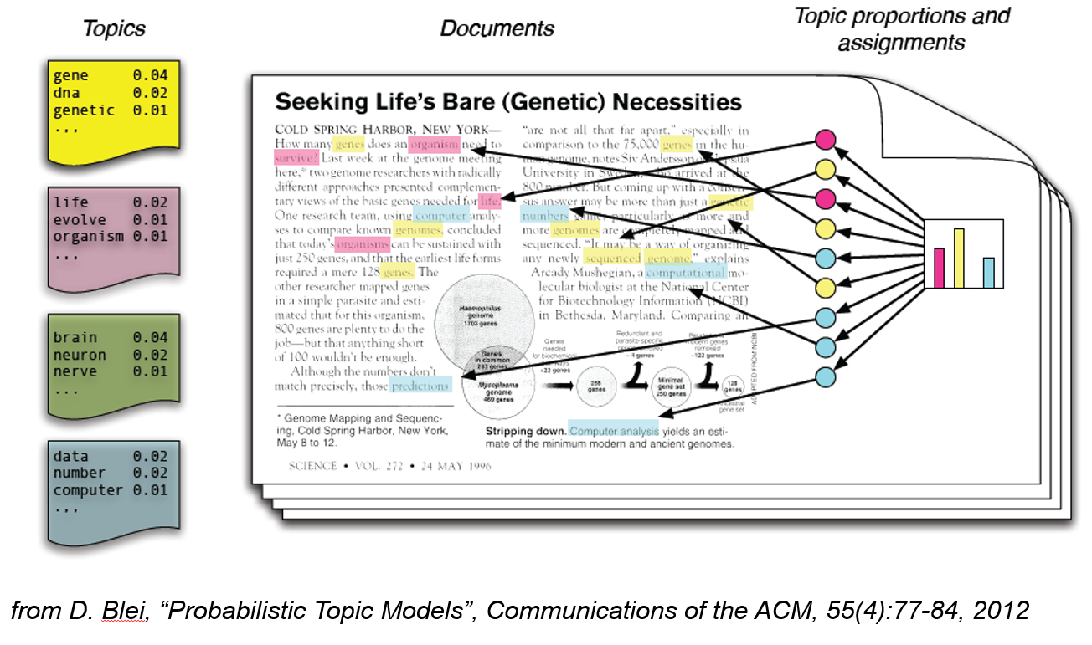
Topic Modelling

Slide 6
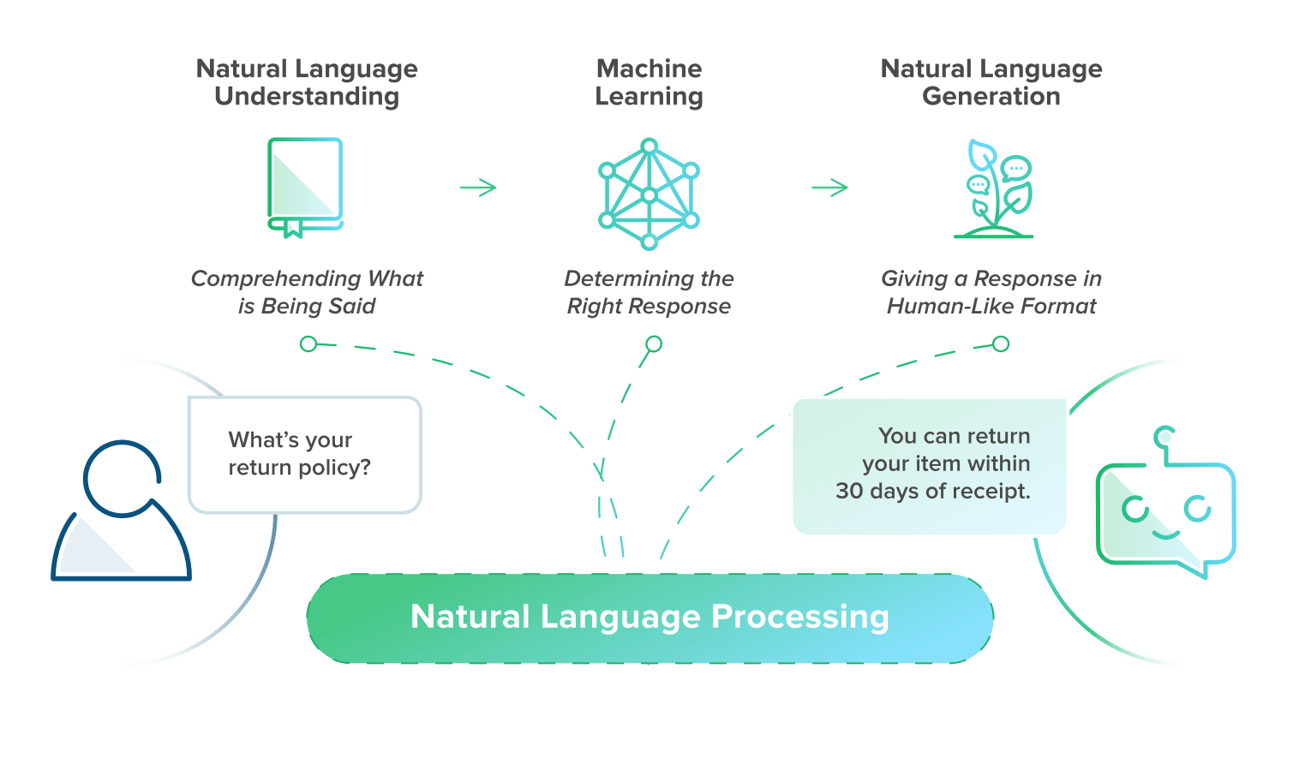
Chatbot
1
2
3
Source: https://www.bold360.com/learn/what-is-natural-language-processing
Notes:
NLP is not a Search engine
Don’t have to reply on specific key words
Designed for many things but not everything i.e

Slide 7
1. Natural Language Understanding
Topic analysis: Discovering the meaning or "intent" of what the user has said.
Contextual extraction: Understanding the current context.
Syntactic analysis: Analyzing the syntax, or structure of the sentence, and the roles of the words used.
Entity extraction: Finding entities like a person, place, organization, or event, and determining how important those entities are.
Semantic analysis: Concluding the meaning of words based on context, which is especially important when one word has multiple meanings.
Sentiment analysis: Identifying how the user feels (mood, emotion, opinions).
Source: https://www.bold360.com/learn/what-is-natural-language-processing
Notes:
Understanding what the customer is trying to
requires breaking down sentences into their component parts
identifying parts of speech, otherwise known as part-of-speech tagging

Slide 8
2. Machine Learning
Content categorization: Grouping intents into categories to be used by the machine.
Machine translation: Converting human text or speech into machine language.
Machine language: Binary code that the machine can act on.
Source: https://www.bold360.com/learn/what-is-natural-language-processing
Notes:
Now that the machine knows the intent,
how does it categorize that intent in order to create an appropriate response?
The machine turns the human language into binary machine code so it can find the answer using its algorithms,
such as neural networks that recognize and classify patterns, similar to how the human brain works.
In other words, this is how AI converts text into structured data that the machine understands.

Slide 9
3. Natural Language Generation (NLG)
Sentence generation: Creating sentences from machine code.
Document creation: Structuring sentences into a compelling narrative.
Document summarization: Generating synopses of large bodies of text.
Source: https://www.bold360.com/learn/what-is-natural-language-processing
Notes:
translate the answer from machine code back into human language
using meaningful words, phrases, and sentences the user will understand.
When NLG is dialed all the way up, this is where chatbots are able to not just offer a response in a human-like way, but write their own answers based on its own autonomous deep learning.
This can be a little scary for brands (just ask Microsoft who deployed and killed its Twitter chatbot, Tay, within 24 hours after it started spitting out offensive content).

Slide 10
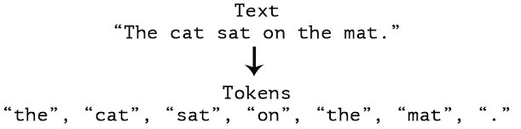
Tokenization
Breaks down the sentence into words as “Tokens”
Notes:
Convert words into vectors
Libraries include soaCy, NLTK

Slide 11
Schematic Analysis: Bag of Words
# | Sentence Text
1 | He is a good boy
2 | She is a good girl
3 | Boy and girl are good
# | Sentence Text
1 | good boy
2 | good girl
3 | boy girl good
Stop Keywords
Word | Frequency
good | 3
boy | 2
girl | 2
# | Feature 1: good | Feature 2: boy | Feature 3: girl
1 | 1 | 1 | 0
2 | 1 | 0 | 1
3 | 1 | 1 | 1
Vectors: Bag of Words
Notes:
Convert bag of words into vectors.
Numeric vector that represents a whole document
F1, f2, f3 are independent features and output feature will be dependent.
Converted into numerical repartition
Disadvantage of BoW:
- not able to derive which word is more important

Slide 12
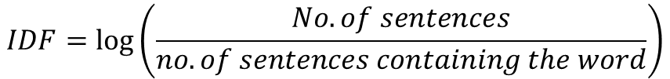



Schematic Analysis: TF-IDF (Term Frequency – Inverse Document Frequency)
# | Sentence Text
1 | good boy
2 | good girl
3 | boy girl good
$$TF= \frac{No. of Rep. of words in sentence}{No. of words in sentence }$$
$$−→TF ∗IDF$$
$$IDF=log⁡\left(\frac{No. of sentences}{no. of sentences containing the word}\right)$$
TF
 | S1 | S2 | S3
Good | ½ | ½ | 1/3
Boy | ½ | 0 | 1/3
Girl | 0 | ½ | 1/3
IDF
Word | IDF
Good | log(3/3) = 0
Boy | log(3/2)
Girl | log(3/2)
# | Feature 1: good | Feature 2: boy | Feature 3: girl
1 | 0 | ½ * log(3/2) | 0
2 | 0 | 0 | ½ * log(3/2)
3 | 0 | 1/3 * log(3/2) | 1/3 * log(3/2)
$$∗$$
=

Slide 13
Stemming and Lemmatization
Stemming |  | Lemmatization
Finally | Fina | Finally | Final
Final |  | Final
Finalised |  | Finalised
Notes:
Why stemming? Use cases such as restraint reviews. To pick up the most common stem words
Lemmatization gets converted into a meaningful word
Lemmatization is slower but more meaningful

Slide 14
Topic Modelling Examples
Example from dataset 20 Newsgoups which contains 11,314 documents:
['rec.autos' 'comp.sys.mac.hardware' 'rec.motorcycles' 'misc.forsale'
'comp.os.ms-windows.misc' 'alt.atheism' 'comp.graphics'
'rec.sport.baseball' 'rec.sport.hockey' 'sci.electronics' 'sci.space'
'talk.politics.misc' 'sci.med' 'talk.politics.mideast'
'soc.religion.christian' 'comp.windows.x' 'comp.sys.ibm.pc.hardware'
'talk.politics.guns' 'talk.religion.misc' 'sci.crypt']
We need to first pre-process all the documents
Source: NPL Workshop by Massimo Piccardi at UTS

Slide 15
Pre-processing
removing some characters and strings with regular expressions
tokenization (split document into words)
stopword elimination (“a”, “and”…)
minimum length enforcement (set it to 3)
lemmatization
stemming (“sensational” -> “sensat”)
Collect the vocabulary from all documents
59,575 unique tokens; we keep only the 10,000 most frequent
Source: NPL Workshop by Massimo Piccardi at UTS

Slide 16
Example of a document
From: lerxst@wam.umd.edu (where's my thing)
Subject: WHAT car is this!?
Nntp-Posting-Host: rac3.wam.umd.edu
Organization: University of Maryland, College Park
Lines: 15
I was wondering if anyone out there could enlighten me on this car I saw
the other day. It was a 2-door sports car, looked to be from the late 60s/
early 70s. It was called a Bricklin. The doors were really small. In addition,
the front bumper was separate from the rest of the body. This is
all I know. If anyone can tellme a model name, engine specs, years
of production, where this car is made, history, or whatever info you
have on this funky looking car, please e-mail.
Thanks,
- IL
---- brought to you by your neighborhood Lerxst ----

Slide 17
Example of a document
After removing some characters (e.g., newlines) and strings with regular expressions:
From: (wheres my thing) Subject: WHAT car is this!? Nntp-Posting-Host: rac3.wam.umd.edu Organization: University of Maryland, College Park Lines: 15 I was wondering if anyone out there could enlighten me on this car I saw the other day. It was a 2-door sports car, looked to be from the late 60s/ early 70s. It was called a Bricklin. The doors were really small. In addition, the front bumper was separate from the rest of the body. This is all I know. If anyone can tellme a model name, engine specs, years of production, where this car is made, history, or whatever info you have on this funky looking car, please e-mail. Thanks, - IL ---- brought to you by your neighborhood Lerxst ----

Slide 18
Example of a document
After the full preprocessing (listed before):
55 words left, 49 unique (word “car” occurs 5 times, word “door”, 2, and word "look", 2)
['where', 'thing', 'subject', 'car', 'nntp', 'post', 'host', 'rac', 'wam', 'umd', 'edu', 'organ', 'univers', 'maryland', 'colleg', 'park', 'line', 'wonder', 'enlighten', 'car', 'saw', 'day', 'door', 'sport', 'car', 'look', 'late', 'earli', 'call', 'bricklin', 'door', 'small', 'addit', 'bumper', 'separ', 'rest', 'bodi', 'know', 'tellm', 'model', 'engin', 'spec', 'year', 'product', 'car', 'histori', 'info', 'funki', 'look', 'car', 'mail', 'thank', 'bring', 'neighborhood', 'lerxst']

Slide 19
Vocabulary
The vocabulary contains the 10,000 most frequent words in the preprocessed documents
First few entries:
0 'addit'
'bodi'
'bring'
'bumper'
'call'
'car'
'college‘
'day',
'door'

Slide 20
Bag of Word Representation
unique words are represented as indexes in the vocabulary
42 of the 49 unique words of this document are present in the vocabulary
[(0, 1), (1, 1), (2, 1), (3, 1), (4, 1), (5, 5), (6, 1), (7, 1), (8, 2), (9, 1), (10, 1), (11, 1), (12, 1), (13, 1), (14, 1), (15, 1), (16, 1), (17, 1), (18, 1), (19, 2), (20, 1), (21, 1), (22, 1), (23, 1), (24, 1), (25, 1), (26, 1), (27, 1), (28, 1), (29, 1), (30, 1), (31, 1), (32, 1), (33, 1), (34, 1), (35, 1), (36, 1), (37, 1), (38, 1), (39, 1), (40, 1), (41, 1)]

Slide 21
TF-IDF representation
[(0, 0.11508442817773791), (1, 0.11685057831170038), (2, 0.10456035163095019), (3, 0.19896571341777863), (4, 0.07963218255191856), (5, 0.48155481965801966), (6, 0.1055901817721483), (7, 0.07269467616139666), (8, 0.2710264439439116), (9, 0.1179554553082054), (10, 0.04863998565248088), (11, 0.0862932890573073), (12, 0.18340279049813846), (13, 0.2497846855427294), (14, 0.11457177783495281), (15, 0.02917346631574589), (16, 0.09768538767174806), (17, 0.03711699368049964), (18, 0.12419581401291628), (19, 0.11245948040574812), (20, 0.07165494230955832), (21, 0.1624752269645684), (22, 0.11291605604833643), (23, 0.19523966229762876), (24, 0.02969577526919512), (25, 0.1291317450322251), (26, 0.10349888872509058), (27, 0.2457291354618299), (28, 0.1111822519746563), (29, 0.11685057831170038), (30, 0.12651536951197986), (31, 0.10078068649118861), (32, 0.14750624995128475), (33, 0.13428883062011865), (34, 0.058700053499970276), (35, 0.05831719013606671), (36, 0.19268794854030857), (37, 0.030928779903281762), (38, 0.23306749659783652), (39, 0.21655465471348062), (40, 0.09552164848273034), (41, 0.0586164594345401)]

Slide 22
Topics
Topics for this document (LDA BoW):
[(10, 0.35617992), (13, 0.6254527)]
Score: 0.6255542039871216 Topic: 0.014*"car" + 0.008*"articl" + 0.007*"like" + 0.006*"work" + 0.006*"space"
Score: 0.3560783863067627 Topic: 0.011*"space" + 0.010*"wire" + 0.005*"nasa" + 0.005*"center" + 0.005*"research"
Topics for this document (LDA tf-idf):
[(1, 0.03618599), (3, 0.48642957), (15, 0.33754307), (18, 0.123514846)]
Score: 0.48652100563049316 Topic: 0.005*"bike" + 0.003*"car" + 0.003*"orbit" + 0.002*"ride" + 0.002*"engin"
Score: 0.3374459445476532 Topic: 0.003*"key" + 0.003*"chip" + 0.003*"encrypt" + 0.002*"think" + 0.002*"clipper"
Score: 0.12352421134710312 Topic: 0.005*"atari" + 0.004*"triniti" + 0.004*"nintendo" + 0.004*"roth" + 0.004*"nsa"
Score: 0.03618228808045387 Topic: 0.010*"printer" + 0.006*"postscript" + 0.005*"european" + 0.005*"print" + 0.004*"winbench"
Notes:
Latent Dirichlet Allocation (LDA) is a generative statistical model that allows sets of observations to be explained by unobserved groups that explain why some parts of the data are similar.

Slide 23
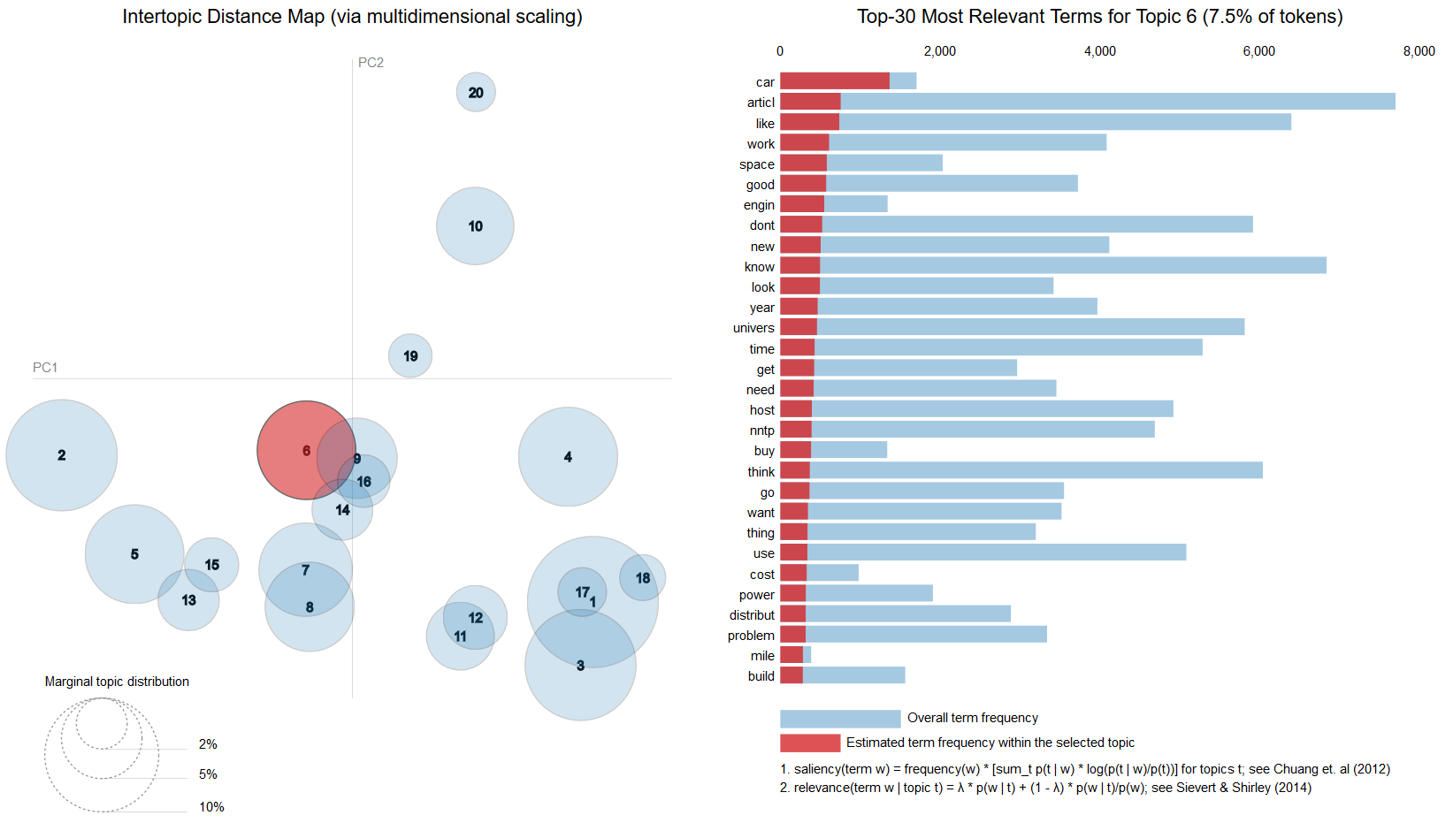
View of Topics
Notes:
here the topics are numbered in decreasing size order. The topic of index 13 in LDA BoW is number 6

Slide 24
Machine Learning
Data can be categorised into:
1. Numerical i.e. age, income, speed, etc.
2. Categorical i.e. car model, words, profession, etc.
Machine Learning: Way to predict the numerical or categorical value
Classification: Predict categorical value
Regression: Predict numerical value
Clustering: group numerical data “homogenously”

Slide 25
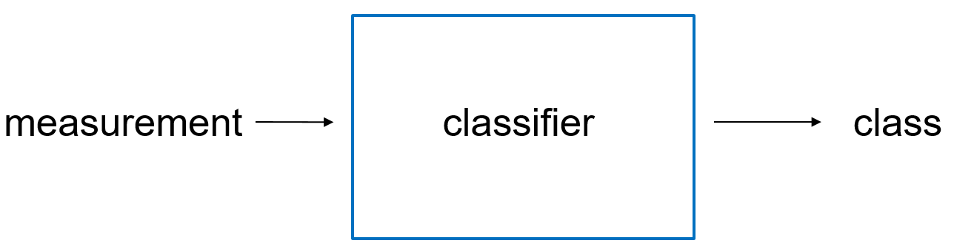
Classification
The class takes categorical values; e.g., “Netflix subscriber”
The measurement can be multiple (e.g., age, income, occupation), and both numerical and categorical

Slide 26
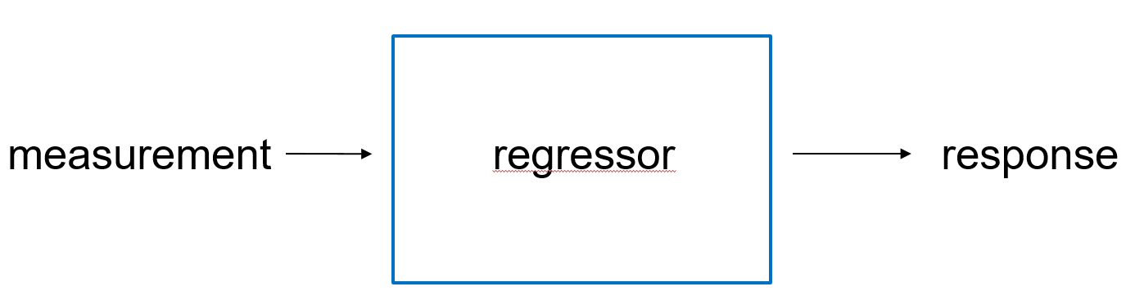
Regression
The response takes numerical values; e.g., “holiday expenses”
The measurement can, again, be multiple (e.g., age, income, occupation), and both numerical and categorical

Slide 27
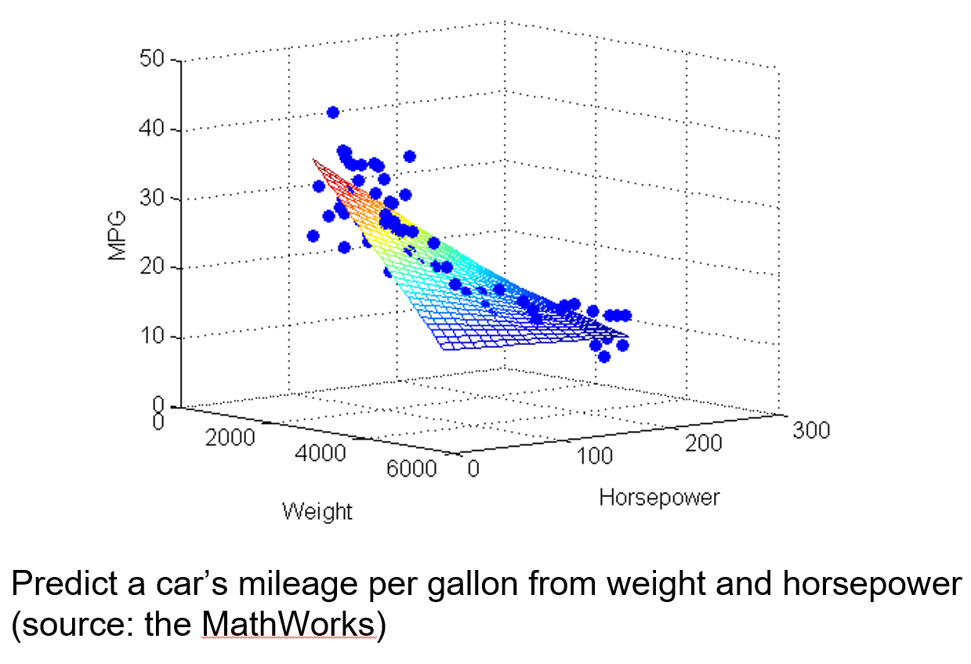
Notes:
For classification and regression, you will need a supervised aka annotated dataset of pairs:

Slide 28
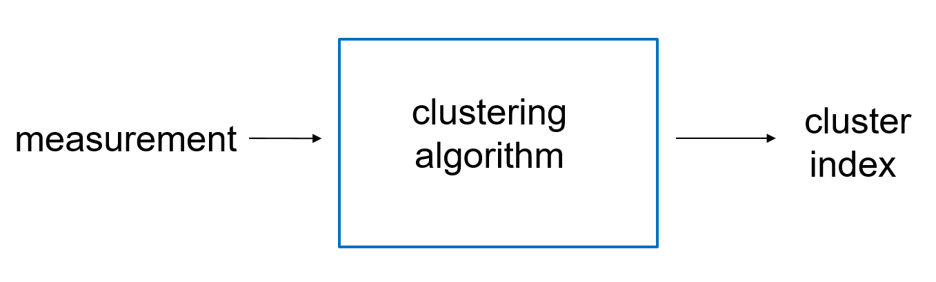
Clustering
The cluster index is akin to a categorical value; e.g., “cluster 3”, “cluster B”.
The measurement is typically multiple and numerical
Notes:
For clustering, you typically need only an unsupervised/unannotated dataset of measurements

Slide 29
Adversarial

Slide 30
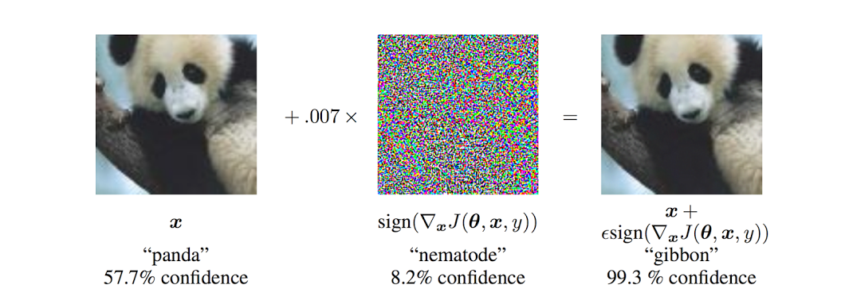
Adversarial Attacks: Images

Slide 31
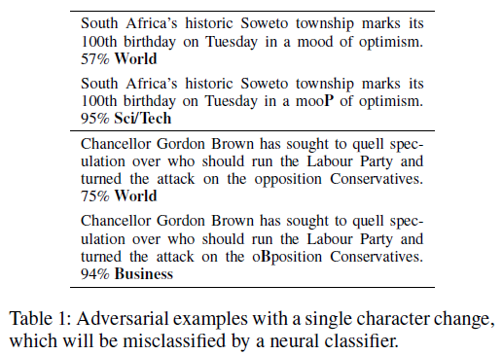
HotFlip
White box attack
Trick a neural text classifier at character-level
Generate adversarial examples with character substitutions aka flips
Also supports insertion and deletion operations
Method relies on atomic flip operation:
Swaps one token/character for another, based on the gradients of the one-hot input vector
Ebrahimi, J., Rao, A., Lowd, D. and Dou, D., 2017. Hotflip: White-box adversarial examples for text classification. arXiv preprint arXiv:1712.06751.
Notes:
Black box = unknown internal architecture
White box = known internal architecture, worst case attacks so able to find more vulnerabilities

Slide 32
HotFlip: How does it work
It uses the gradient with respect to a one-hot input representation
to efficiently estimate which individual change has the highest estimated loss,
and it uses a beam search to find a set of manipulations that work well together
to confuse a classifier.

Slide 33

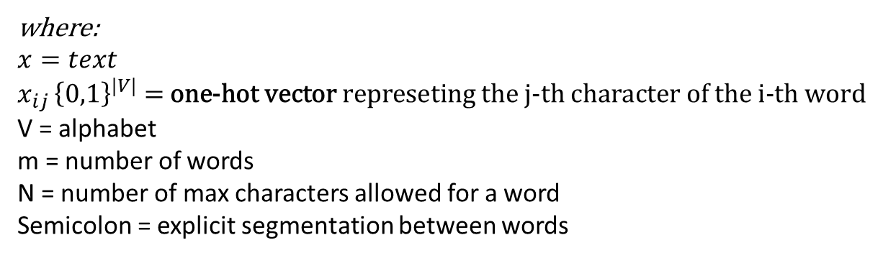
HotFlip
We can represent character sequence by:
where:
$$x=text$$
$$x_{ij }{\left\{0,1\right\}}^{|V|}\text{ = }\text{one}\text{-}\text{hot} \text{vector} \text{represeting} \text{the} \text{j}\text{-}\text{th} \text{character} \text{of} \text{the} \text{i}\text{-}\text{th} \text{word}$$
V = alphabet
m = number of words
N = number of max characters allowed for a word
Semicolon = explicit segmentation between words

Slide 34

Derivative Operations
Text operations can be represented as vectors in the input space
Estimate the change in loss by directional derivatives with respect to these operations.
Based on these derivatives, the adversary can choose the best loss-increasing direction.
HotFlip requires just one function evaluation (forward pass) and one gradient computation (backward pass) to estimate the best possible flip.
Example: flipping j-th chatacter of the i-th word (a → b) can be represented as this vector:
$$\text{where}\text{ -1 }\text{and}\text{ 1 }\text{are} \text{in} \text{the} \text{corresponding} \text{positions} \text{for} \text{the} \text{a}\text{-}\text{th} \text{and} \text{b}\text{-}\text{th} \text{characters}$$
Loss function: used to determine the error or loss between the output of an algorithm and the target value.

Slide 35

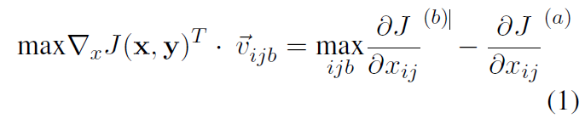
Approximating Change in Loss
A first-order approximation of change in loss can be obtained from a directional derivative along this vector:
The vector with the biggest increase in Loss in chosen:
Notes:
MAYBE
Using the derivatives as a surrogate loss, we simply need to find the best change by calling the function mentioned in eq. 1,
to estimate the best character change (a → b).
This is in contrast to a naive loss-based approach, which has to query
the classifier for every possible change to compute
the exact loss induced by those changes. In other
words, apart from the overhead of calling the func
tion in eq. 1, one backward pass saves the adversary
a large number of forward passes.

Slide 36
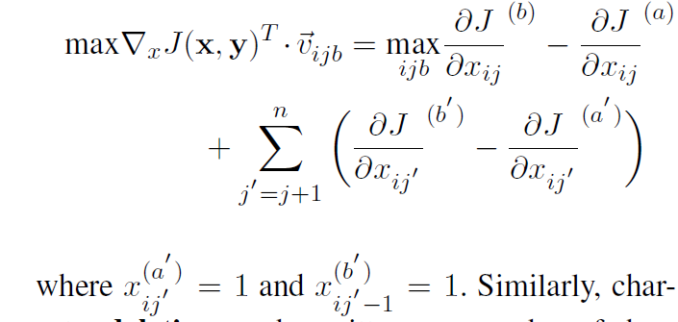
Character Insertion and Deletion
Insertion at the j-th positon of the i-th word can also be treated as a character flip,
which is followed by more flips as characters are shifted to the right until the end of the word.
Deletion can be written as number of character flips as characters are shifted to the left.
Notes:
We explained how to estimate the best single
change in text to get the maximum increase in loss.
Next is how to do multiple changes.

Slide 37
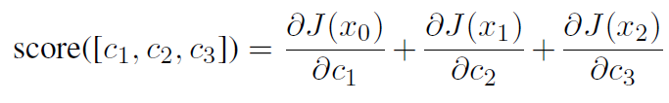
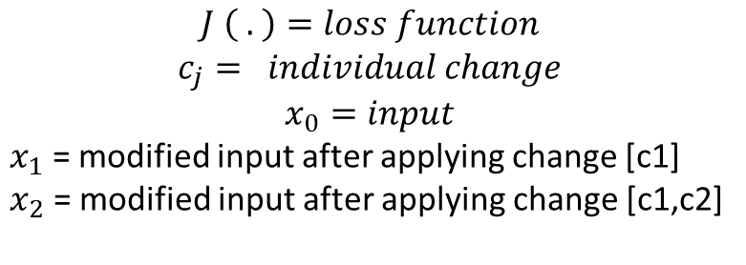
Multiple Changes: Greedy or beam search
$$J \left( . \right)=loss function$$
$$c_{j}= individual change$$
$$x_{0}=input$$
$x_{1}$ = modified input after applying change [c1]
$x_{2}$ = modified input after applying change [c1,c2]
Notes:
Score the changes

Slide 38
Training
CharCNN-LSTM architecture [1]
AG’s news dataset [2]
Consists of 120,000 training and 7,600 test instances
Four equal sized classes: World, Sports, Business and Science/Technology
Only allow character changes if the new word does not exist in the vocabulary to avoid changes which may change the meaning of the text
Only 10% of the training set and test set were used
Compared with two other black box attacks
[1] Yoon Kim, Yacine Jernite, David Sontag, and AlexanderMRush. 2016. Character-aware neural language models. Proceedings of AAAI.
[2] https://www.di.unipi.it/˜gulli/

Slide 39
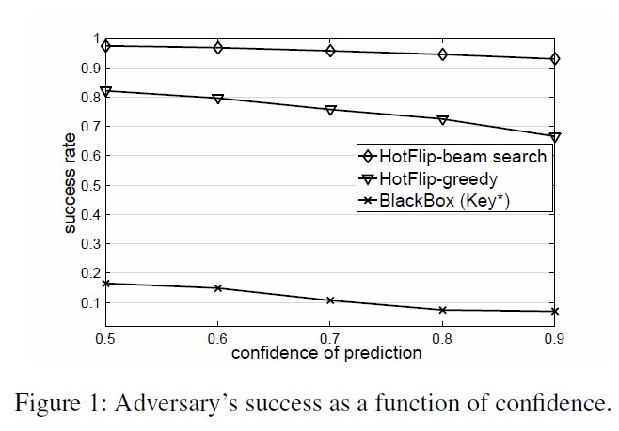
Black-box vs White-box Attacks
Explained before
Simple query with random changes
Character is replaced with any character in the alphabet.
Notes:
- plot the success rate of the adversary against an acceptable confidence score for the misclassification.
the beam-search strategy is very effective in fooling the classifier even with an 0.9 confidence constraint, tricking the classifier for more than 90% of the instances.
A greedy search is less effective especially in producing high-confidence scores.
White box attacks are more damaging and has higher success rate.

Slide 40
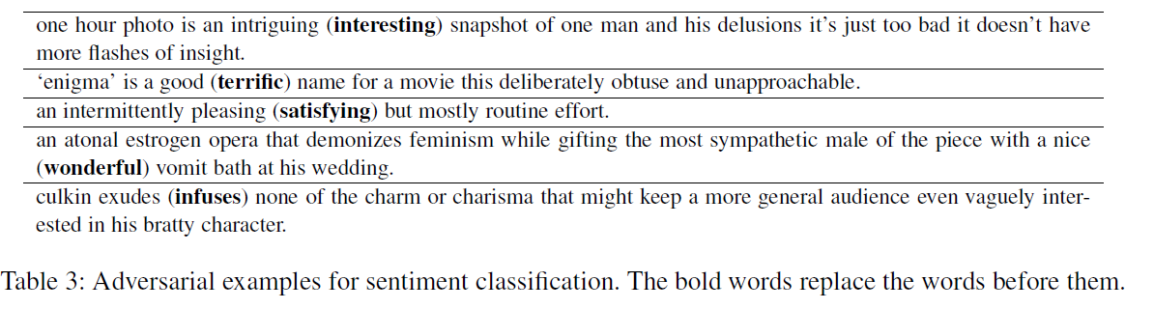
HotFlip at Word-Level
can be adapted to generate adversarial examples for word-level models, by computing
derivatives with respect to one-hot word vectors.
Notes:
- After a few character changes, the meaning of the text is very likely to be preserved by the reader
- word-level adversarial manipulations are much more likely to change the meaning of text, which makes the use of semantics-preserving constraints necessary.
- For example, changing the word good to bad changes the sentiment of the sentence “this was a good movie”.
In fact, we expect the model to predict a different label after such a change.

Slide 41
Thanks for listening!

