Slide 1
Event-Aware Precise Dynamic Slicing for Android (ESDroid)
Hsu Myat Win,
Program Analysis Group
University of Technology Sydney (UTS)
10 July 2020

Slide 2
Content
Introduction (problem – high level)
Introduction (problem – specific)
Background including Existing Works and Limitations
Delta Debugging
Dynamic Slicing
Motivation
Our solution
Design
Motivating Example
Implementation
Experiment Setup and Methodology
Evaluation
Summary

Slide 3
Introduction (Problem – High Level)
Manual debugging and fault localization : Time-consuming
The larger search space, the longer time to debug
Program debugging and fault localization : the process of identifying program statements which cause misbehaviour.

Slide 4
Introduction (Problem – Specific)
For Android, debugging and fault localization is more difficult than traditional Java
Cause | Effect
Non-deterministic asynchronous event-nature | Larger search space
ICC | Standard stack trace can miss the buggy statement
Events are a common way to collect and process data regarding user events/inputs
Inter-component communication (ICC) allows App communication among different components such as Activity, Content Provider.

Slide 5
Background – Delta Debugging
To simplify a test input
systematically breaks down the original input(for eg; test case) into smaller sets until a minimal failure-inducing set is found

Slide 6
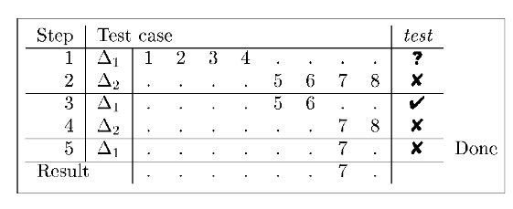
Delta Debugging
Minimizing of test case

Slide 7
Delta Debugging
Existing works | Limitation
A. Zeller and R. Hildebrandt, “Simplifying and isolating failure-inducing input,” IEEE Transactions on Software Engineering, vol. 28, no. 2, pp. 183–200, 2002. | non-event-based programs
K. Yu, M. Lin, J. Chen, and X. Zhang, “Practical isolation of failure-inducing changes for debugging regression faults,” in Proceedings of the 27th IEEE/ACM International Conference on Automated Software Engineering, 2012, pp. 20–29.
L. Clapp, O. Bastani, S. Anand, and A. Aiken, “Minimizing gui event traces,” in Proceedings of the 2016 24th ACM SIGSOFT International Symposium on Foundations of Software Engineering, 2016, Conference Proceedings, pp. 422–434. | work on inputs but not Android’s source code or bytecode
B. Jiang, Y. Wu, T. Li, and W. K. Chan, “Simplydroid: Efficient event sequence simplification for android application,” in 2017 32nd IEEE/ACM International Conference on Automated Software Engineering (ASE). IEEE, 2017, Conference Proceedings, pp. 297–307.

Slide 8
Background - Dynamic Slicing
An technique to find all program statements that directly or indirectly affect the value of a variable occurrence under a given program input.
An enabling technique for many other software engineering tasks, such as debugging, fault localization and dynamic taint tracking.

Slide 9
Dynamic Slicing – Backward Approach
1:
2:
3:
4:
5:
6:
int n = Integer.parseInt(System.console().readLine());
int x = 0;
if(n>0)
{x = n - 1 ; }
else if(n<0)
{x = n + 1; }
Blue – data dependence (define and used)
Pink – control dependence (initiator and follower)
Figure 1: A program fragment to be sliced
If input value “-5”
Criteria : variable x at “Line 6”
1
5
6
Figure 2: Dynamic Slicing

Slide 10
Dynamic Slicing
Existing works | Limitations
H. Agrawal and J. R. Horgan, “Dynamic program slicing,” ACM SIGPlan Notices, vol. 25, no. 6, pp. 246–256, 1990. | Inadequate results for Android apps, yielding unsound (due to unaware of Android’s ICCs) yielding imprecise (due to a large number of redundant Android events as inputs)
N. Gupta, H. He, X. Zhang, and R. Gupta, “Locating faulty code using failure-inducing chops,” in Proceedings of the 20th IEEE/ACM international Conference on Automated software engineering, 2005, Conference Proceedings, pp. 263–272.
J. Maras, J. Carlson, and I. Crnkovi´c, “Client-side web application slicing,” in 2011 26th IEEE/ACM International Conference on Automated Software Engineering (ASE 2011). IEEE, Conference Proceedings, pp. 504–507. | The event’s nature in the Web application and Android apps are different. Android has an unique challenges to slicing with lifecycle managements rules among components (for example, Fragment and Activity) ICC - not only in the same application but also across the different applications.
P. Tonella and F. Ricca, “Web application slicing in presence of dynamic code generation,” Automated Software Engineering, vol. 12, no. 2, pp. 259–288, 2005.

Slide 11
Dynamic Slicing for Android - AndroidSlicer
AndroidSlicer introduces the traditional slicing algorithm to adapt to Android’s event-based model by capturing control and data-dependence in the presence of Android’s lifecycle callbacks and ICC
Limitation
Cause | Effect
Does not consider the inputs (i.e., a sequence of user events) | A large amount of spurious nodes on its slice when analyzing real-world apps.

Slide 12
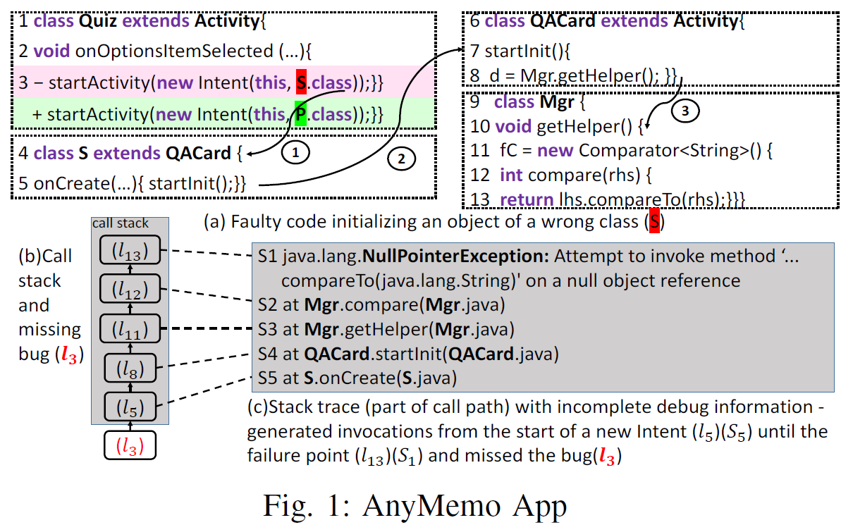
Motivation
A real-world app (AnyMemo) to demonstrate the importance of tracking the dependence between two events (Quiz and QACard) when conducting dynamic slicing for a NullPointerException (triggered at Line 13).
Each activity maintains its own call stack, Figure 1(c) reports the call stack (a coarse-grained execution trace) when the crash happened consisting only the call stack in QACard with an important buggy statement at Line 3 missed.

Slide 13
Our solution : Event-Aware Precise Dynamic Slicing for Android (ESDroid)
The combination of segment-based delta debugging and dynamic backward slicing
Why? - to narrow the search space to produce precise slices for Android
How? - by introducing segment-based delta debugging into dynamic backward slicing after simplifying the inputs (sequence of events) / isolating the bug-introducing events
Segment - subsequence of event (occurrence of event)

Slide 14
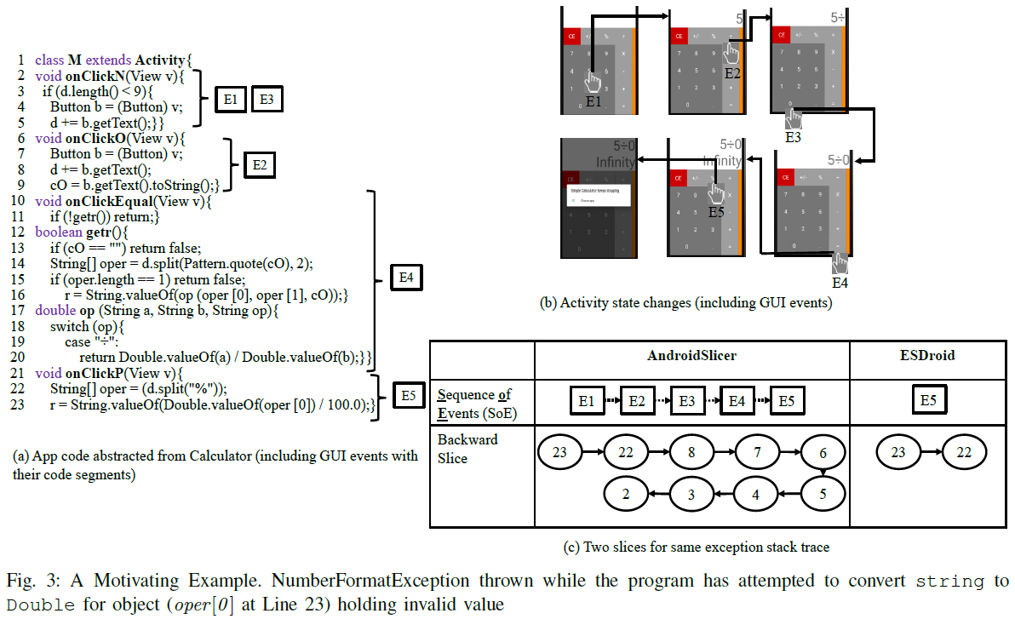
Motivating Example

Slide 15
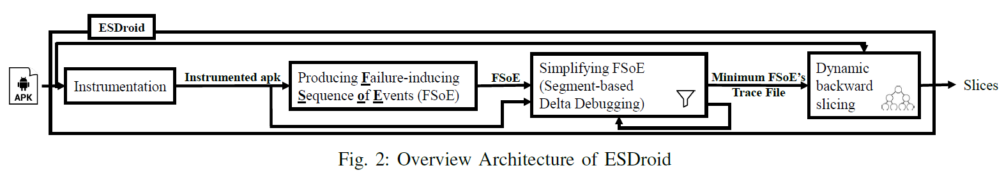
Design
1)Instrumentation – To log the executed statements
2)Producing FSoE - To produce the event sequence which makes program failed
3) Segment-based Delta Debugging – To simplify the event sequence which makes program failed
4) Dynamic backward slicing – To extract the statements affecting on failure point

Slide 16
1) Instrumentation
Timestamp - time when the particular instruction runs.
Data - event ID, program line number, class name, event name and instruction including the objects if available.
Eg;
05-19 00:23:51.027 System.out:ESDroid_ID4_23_com.muledog.calculator.M_onClicP_$r2 = $r3[0]

Slide 17
2) Producing FSoE
To generate the random events to exercise instrumented apps until the program failed.
For example, the event sequence
E1 -> E2 -> E3 -> E4 -> E5

Slide 18
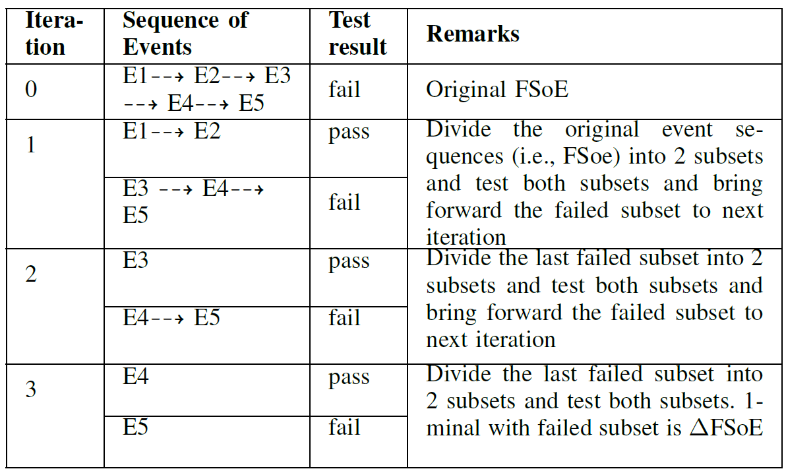
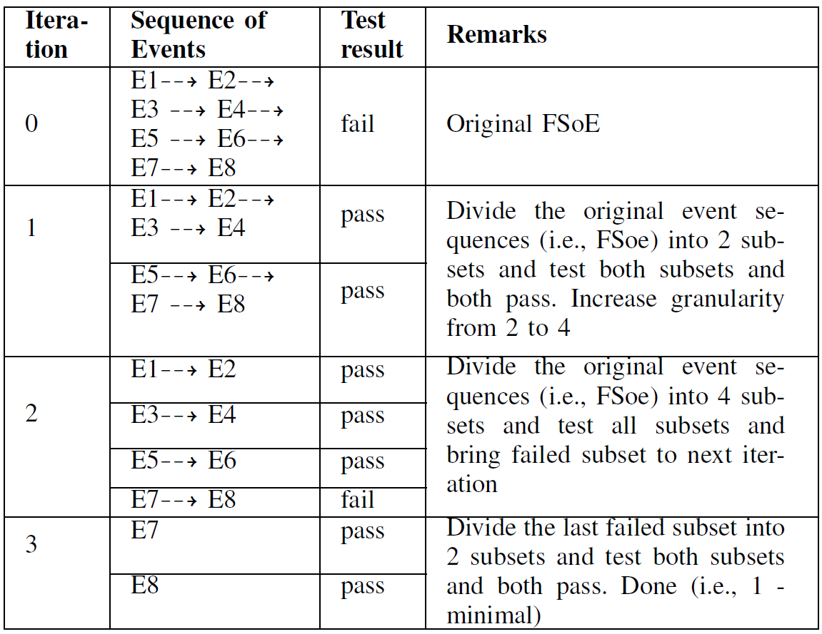
3) Simplifying FSoE
To eliminate the redundant events which are irrelevant to a program failure
(1) Divide and Conquer
FSoE = failure-inducing event sequence
ΔFSoE = minimum failure-inducing event
(2) Increase granularity
18

Slide 19
3) Simplifying FSoE
Four possible outcomes of each iteration
the app exited normally without any crash.
the app crashed with the different error or exception type
the app crashed with the same error but the different stack trace
the app crashed with the same error and the same stack trace

Slide 20
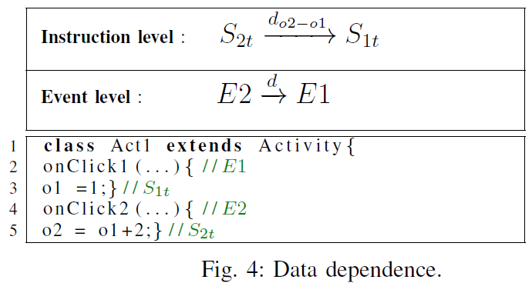
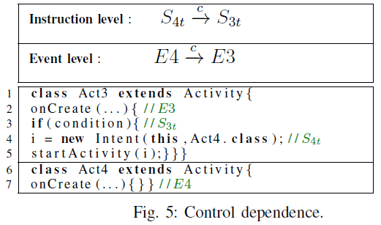
4) Dynamic Backward Slicing
To extract the statements effecting on the failure point
Program Dependence Graph (PDG)
Data dependence (defined and used)
– two levels (Instruction level and Event level)
Control dependence (initiator and follower)
– two levels (Instruction level and Event level)
There are three possible initiators:
Direct initiator. For example, startActivity because startActivitydirect initiates the called Activity
Indirect initiator. For example, startActivityForResult because startActivityForResult of an Activity indirectly initiates onActivityResult of the same Activity.
Control initiator. For example, onPause callback because onCreate of initiated Activity will not be invoked until onPause of the initiator Activity returns.

Slide 21
Implementation
Instrumentation
Soot to conduct instrumentation to produce customized logging information
Producing Failure-Inducing Sequence of Event
A simple python program that generates random events using MonkeyRunner
Simplifying Failure-Inducing Sequence of Event
A standalone Java program
to execute python script with MonkeyRunner to conduct the testing on Android’s emulator (Runtime.exec(String command) method)
to compare the test outcome of current FSoE with the outcome of the original FSoE, we passed the exception information (the exception type, the line number, the method name, and class name produced by adb Logcat)
Dynamic Backward Slicing
A standalone Java program
Static Program Dependence Graph (Event level , Instruction level)
Event level : keyword (eg; startActivity)
Instruction level : Flowdroid

Slide 22
Experiment Setup and Methodology
Eight real defects from seven open-source Android apps
Data collection Criteria
C1: Apps from different categories (Droixbench, SimplyDroid, AndroidSlicer)
C2: Crashes with the different types of exceptions
C3: Crashes that can be reproduced by our random event sequence generation (5k events per run , maximum 5 runs)
Excludes 36 defects
Mutant bugs
The dataset was not publicly available and we failed to find the corresponding apps in GitHub
Crashes require complex inputs and specific sequences of events that could not be generated automatically by our event sequence generation

Slide 23
Evaluation
RQ1: What is the effectiveness of ESDroid in reducing the size of the input event sequence?
RQ2: What is the effectiveness of ESDroid in reducing the size of the dynamic slices produced by the state-of-the-art tool, AndroidSlicer?
RQ3: How is the quality of the slices generated by ESDroid compared with the slices generated by AndroidSlicer?

Slide 24
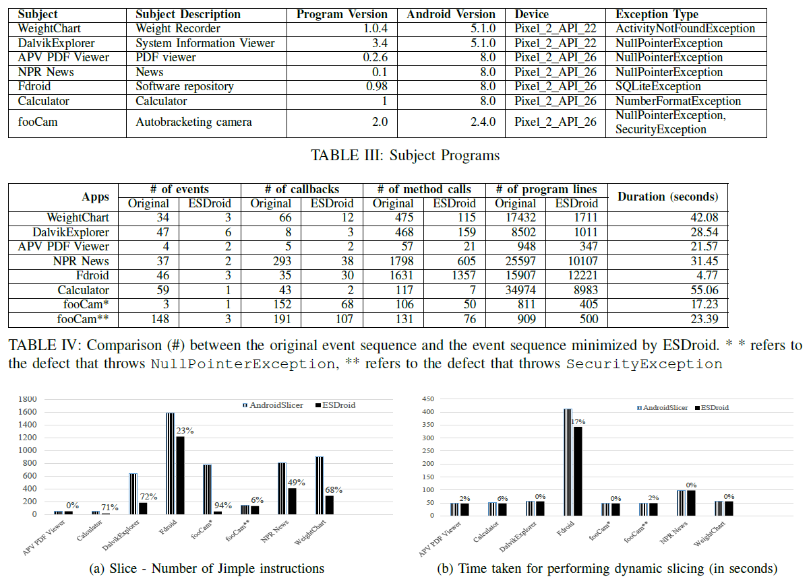
Experiment Data , Evaluation (RQ1, RQ2)
RQ1: What is the effectiveness of ESDroid in reducing the size of the input event sequence?
RQ2: What is the effectiveness of ESDroid in reducing the size of the dynamic slices produced by the state-of-the-art tool, AndroidSlicer?

Slide 25
Evaluation – RQ3 (How is the quality of the slices generated by ESDroid compared with the slices generated by AndroidSlicer?)
Manually examination - We decompiled each app to get the Java bytecode and manually checked the slices with respect to the slicing criterion with the three steps:
Instruction - We checked which instructions were related to the failure point.
Method - We investigated which particular call paths qualified for the above instructions. (In other words, we examined what corresponding methods were required to invoke.)
Segment - As we recorded the execution history using the segment, we also analyzed the program by checking which segments enabled the methods mentioned above to make sure that each segment reflecting the required state and events for the app crash.
*all generated slices include buggy statements and our slice computation is correct

Slide 26
Summary (Our contributions and Future)
Our contributions
We present ESDroid, a new event-aware dynamic slicing technique by simplifying inputs for Android apps.
We present how to apply delta debugging in dynamic slicing to yield a more precise PDG while capturing the same bug as the state-of-the-art tool AndroidSlicer.
We have implemented ESDroid and evaluate it using seven real-world apps. The results show that ESDroid outperforms AndroidSlicer by successfully reducing 94% the redundant and spurious nodes on the dynamic PDG, while maintaining all the true nodes on the PDG.
Future
Automated program repair for Android Apps

Slide 27
Thank you
Q & A

