Slide 1
CFL Reachability in Demand-Driven Alias Analysis for C
Yuxiang Lei
21/06/2019

Slide 2
Alias Analysis
Alias analysis is a technique in compiler theory, used to determine if a storage location may be accessed in more than one way.
Whether two pointers may point to the same location(s).

Slide 3
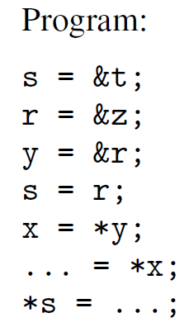
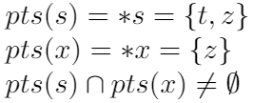
Pointer Analysis vs. Alias Analysis?
Pointer Analysis
Alias Analysis
Pointer s and pointer x are aliases

Slide 4
Demand-Driven Alias Analysis
Different from exhaustive analysis, demand-driven alias analysis only calculate the point-to information relevant to the queried variables (pointers), which can avoid redundant computations for irrelevant instructions and variables.

Slide 5
Context Free Language (CFL)
CFL + Demand-Driven Alias Analysis

Slide 6
Context-Free Language
A context-free language (CFL) is a language generated by a context-free grammar (CFG).
A context-free grammar (CFG) is a set of recursive rewriting rules (or productions) used to generate patterns of strings.
Example: S → aS | ε denotes a^{n}
S → aS → aaS → aaaS → … → a^{n}

Slide 7
Context-Free Language
Example: S → aS | ε denotes a^{n}
Four components:
Terminal T
Nonterminal N
Productions
Start symbol – nonterminal
a
S
S → aS | ε or S := aS | ε
S

Slide 8
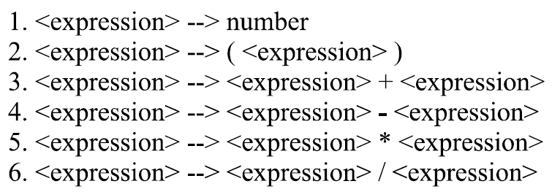
Context-Free Language
Another example grammar that generates strings representing arithmetic expressions with the four operators “+, -, *, /” and numbers as operands is:

Slide 9
Context-Free Language
To generate expression (1+2)*3:
Start symbol <expression>
<expression> * <expression>
(<expression>) * <expression>
(<expression> + <expression>) * <expression>
(1+2)*3

Slide 10
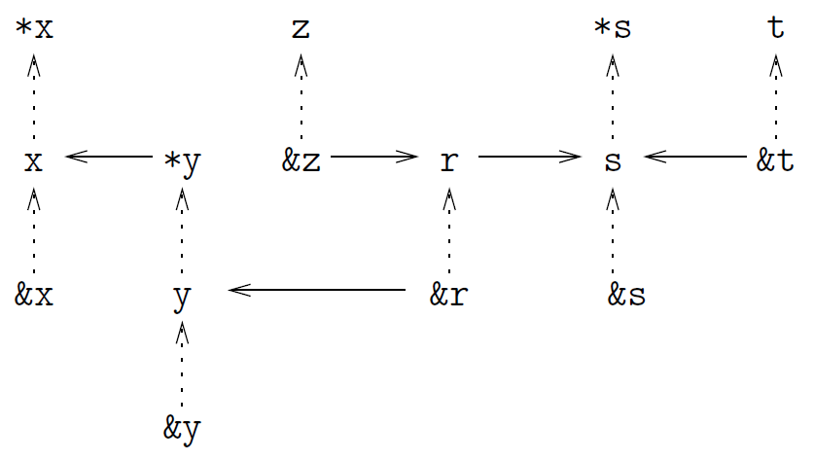
CFL + Demand-Driven Alias analysis
Program Expression Graph

Slide 11
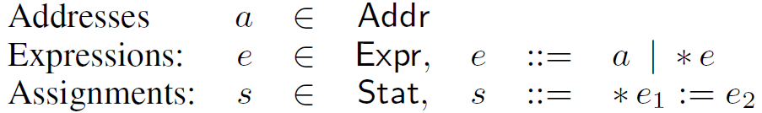
CFL + Demand-Driven Alias analysis
This method is for flow- and field-insensitive alias analysis for C
Program expressions and assignments are represented in a canonical form
Memory aliases: two lvalue expressions are memory aliases if they might denote the same memory location;
Value aliases: two expressions are value aliases if they might evaluate to the same pointer value.

Slide 12
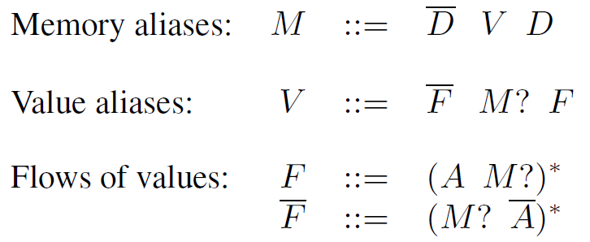
CFL + Demand-Driven Alias analysis
Two kinds of edges in Program Expression Graph (PEG)
Pointer dereference edges (D): for each dereference *e, there is a D-edge from e to *e.
Assignment edges (A): for each assignment *e₁ := e₂ , there is an A-edge from e₂ to *e₁.
?: optional term;
*: Kleene star operator.

Slide 13

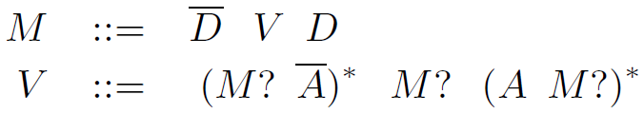
CFL + Demand-Driven Alias analysis
V can be an empty string.
Relations V and M are symmetric.

Slide 14
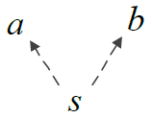
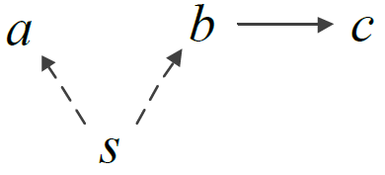
CFL + Demand-Driven Alias analysis
a := *s
b := *s
a := *s
b := *s
c := b
Productions:
Terminals: D, A
Nonterminals: M, V

Slide 15
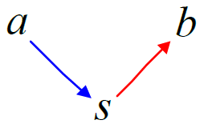
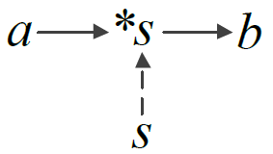
CFL + Demand-Driven Alias analysis
Constraint graph
Program Expression Graph
*s = a
b = *s

Slide 16
CFL + Demand-Driven Alias analysis
Program Expression Graph

Slide 17

CFL + Demand-Driven Alias analysis
Are *x and *s memory aliases?
Path: [*x, x, *y, y, &r, r, s, *s]
CFL string:

