Slide 1
Flow-insensitive Field-sensitive Pointer Analysis
Yuxiang Lei
9 May 2019

Slide 2
Andersen’s Pointer Analysis
Field-sensitive Pointer Analysis
Precision-preserving Stride-based Field Representation

Slide 3
Pointer Analysis
Pointer analysis or points-to analysis is a static program analysis that determines information on the values of pointer variables or expressions (Yannis Smaragdakis, 2015).
Pointer analysis is to establish which pointers, or heap references, can point to which variables, or storage locations.

Slide 4
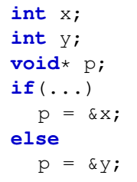

Pointer Analysis
Example
Which objects may pointer p point to?
Flow-insensitively:
Notes:
If certain condition is satisfied
If we omit the order and condition of statements.

Slide 5

Andersen’s Pointer Analysis
Inclusion-based pointer analysis was first proposed by Andersen in 1994, which converts point-to information into the relationship of set inclusion.
Notes:
The approach commonly used for resolve pointer analysis is Andersen’s pointer analysis

Slide 6
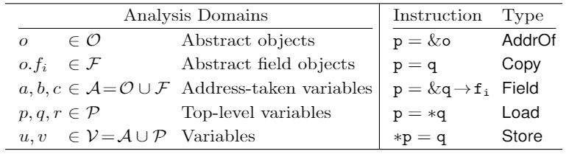
Andersen’s Pointer Analysis
Analysis domains and basic instructions for pointer analysis
Notes:
Inclusion-based pointer analysis was first proposed by Andersen in 1994, which converts point-to information into the relationship of set inclusion.

Slide 7
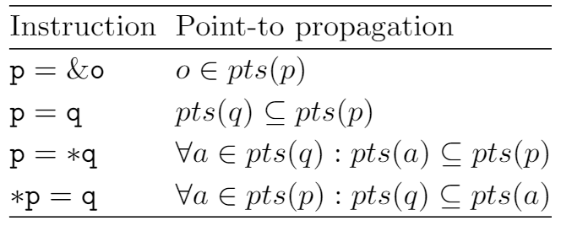


Andersen’s Pointer Analysis
Rules for point-to set propagation (field-insensitive)
Notes:
Here field-insensitive means not to specify any field access of a program and replace the fields as their base objects in point-to sets.
Pts q is propagated to pts p, which means all elements in pts q are put into pts p.

Slide 8
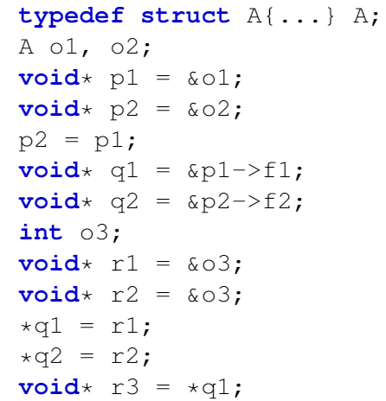
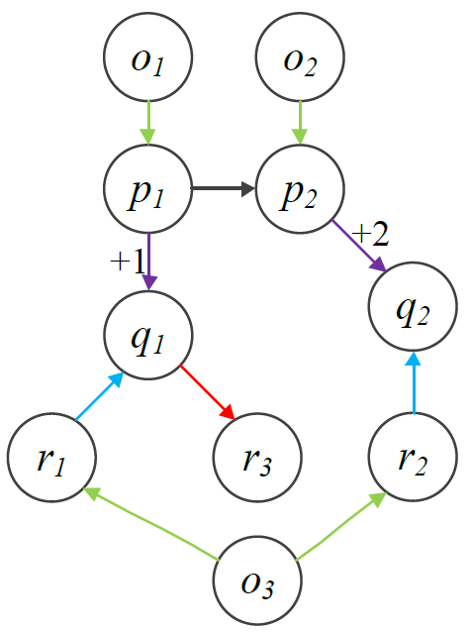
Andersen’s Pointer Analysis
Constraint graph
Notes:
First, we should introduce constraint graph.
Once code is convert to constraint graph, pointer analysis is transformed into graph solving problem.

Slide 9

Andersen’s Pointer Analysis
Constraint
Point-to set
Notes:
So this field-insensitive pointer analysis. It is very fast and very easy to implement.

Slide 10

Andersen’s Pointer Analysis
Problem:
Notes:
But there is a problem.
Since it does not specify any field access of a program and replace the fields as their base objects

Slide 11
Field-sensitive Pointer Analysis
Notes:
Field-sensitive pointer analysis aims to accurately determine any field accessed by certain instructions of a program.

Slide 12
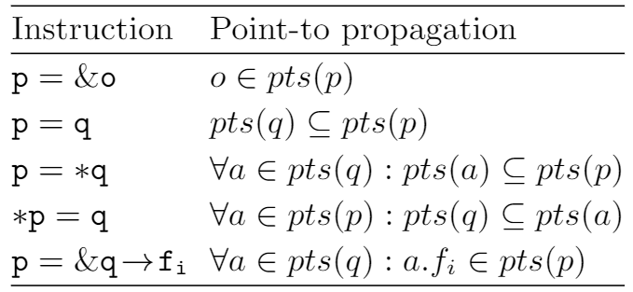
Field-sensitive Pointer Analysis
Rules for field-sensitive pointer analysis
Notes:
Field-sensitive pointer analysis is to specify any field access of objects via constraint resolution.

Slide 13


Field-sensitive Pointer Analysis
How to denote field of field?
Field flattening
Notes:
The field of field is flattened to field of object.
The indice of the flattened field is the sum of the indices such fields at the left side.

Slide 14
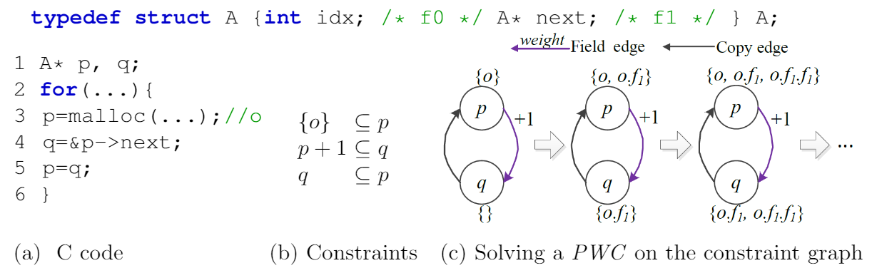
Field-sensitive Pointer Analysis
Positive weight cycle

Slide 15
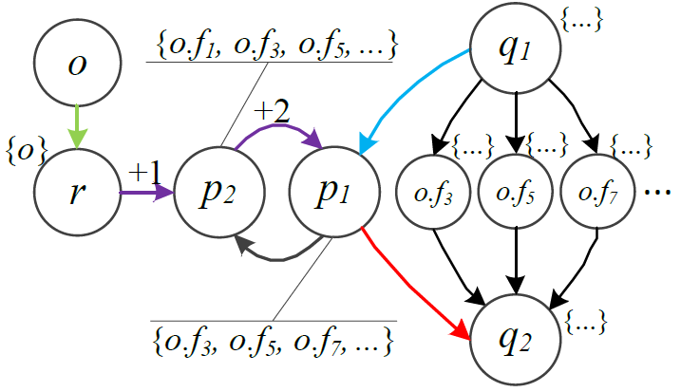
Field-sensitive Pointer Analysis
Extra computational burden
PKH
Notes:
According to the rules, incoming store edges / outgoing load edges will create copy edges linked to/from the elements of point-to set of p1

Slide 16

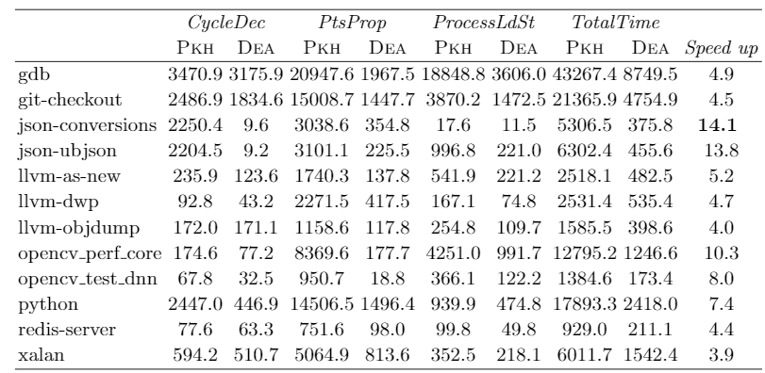
Field-sensitive Pointer Analysis
One solution
Drawback

Slide 17
Field-sensitive Pointer Analysis
Extra computational burden
Notes:
The indices of the field are regular, following a style of progression.

Slide 18
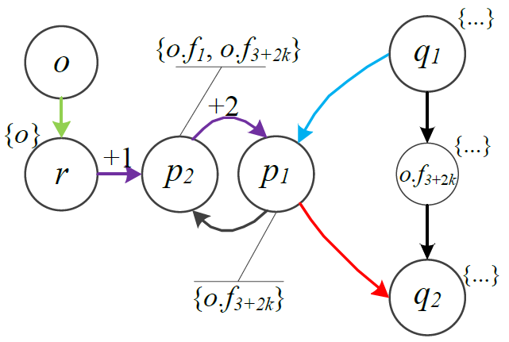
Field-sensitive Pointer Analysis
Motivation
DEA

Slide 19

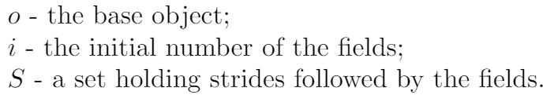
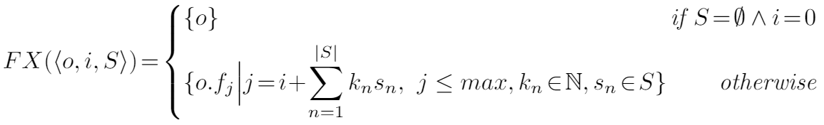
Stride-based Field Representation
Notes:
K is a natural number

Slide 20
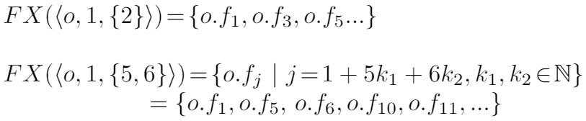
Stride-based Field Representation
Example:

Slide 21

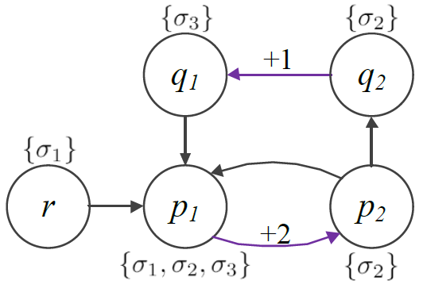
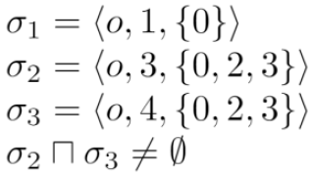
Stride-based Field Representation
Why we use this
Notes:
One node can exist in one or multiple PWCs. If it exists in multiple PWCs, the fields can be derived from any of such cycles. Since different cycles may have different weights, there are multiple strides that indices of fields can follow.

Slide 22
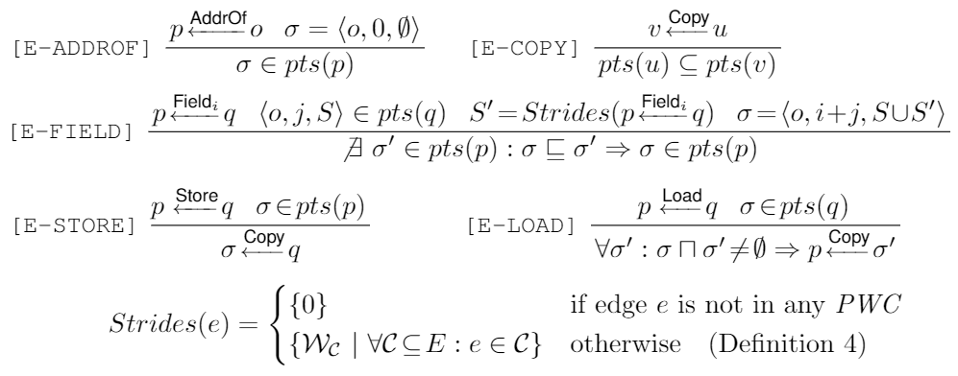
Stride-based Field Representation
Rules

Slide 23
Future work
Two approaches for resolving pointer analysis:
Via resolving constraint graph;
Via resolving context-free language reachability problem.

