Slide 1

Taming Transitive Redundancy For Context-Free Language Reachability
OOPSLA 2022
Yuxiang Lei, University of Technology Sydney
Yulei Sui, University of Technology Sydney
Shuo Ding, Georgia Institute of Technology
Qirun Zhang, Georgia Institute of Technology
Reported by Yuxiang Lei
Yuxiang.Lei@student.uts.edu.au

Slide 2
Overview
This paper improves the efficiency of context-free language reachability by reducing the computational redundancy caused by transitive relations, using a partially ordered algorithm running on a hybrid data structure.

Slide 3
Background
What is CFL-reachability?
Context-free language reachability (i.e., CFL-reachability) is a fundamental framework for program analysis:
shape analysis
data flow analysis
typestate analysis
pointer analysis

Slide 4
Background
What is CFL-reachability?
A CFL-reachability problem is to determine whether specific source-sink pairs in a given edge-labeled directed graph are connected by a reachable path.
Reachable path: a path whose edge labels form a string accepted by the given CFL.

Slide 5
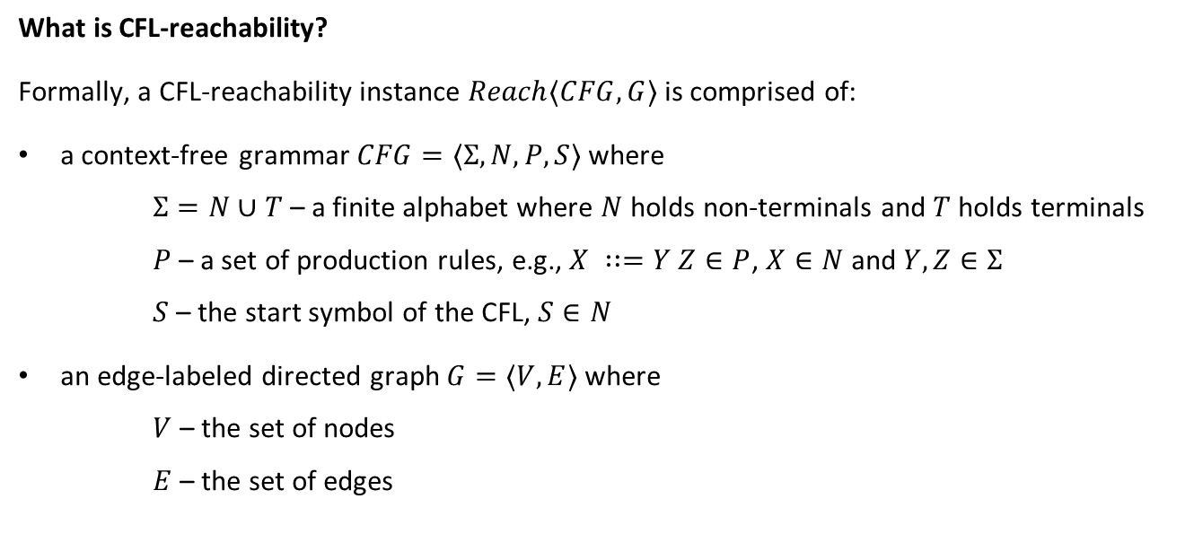
Background
What is CFL-reachability?
Formally, a CFL-reachability instance $Reach⟨CFG, G⟩$ is comprised of:
a context-free grammar $CFG=⟨Σ, N,P,S⟩$ where
$Σ=N∪T$ – a finite alphabet where $N$ holds non-terminals and $T$ holds terminals
$P$ – a set of production rules, e.g., $X ∷=Y Z∈P$, $X∈N$ and $Y,Z∈Σ$
$S$ – the start symbol of the CFL, $S∈N$
an edge-labeled directed graph $G=⟨V,E⟩$ where
$V$ – the set of nodes
$E$ – the set of edges

Slide 6
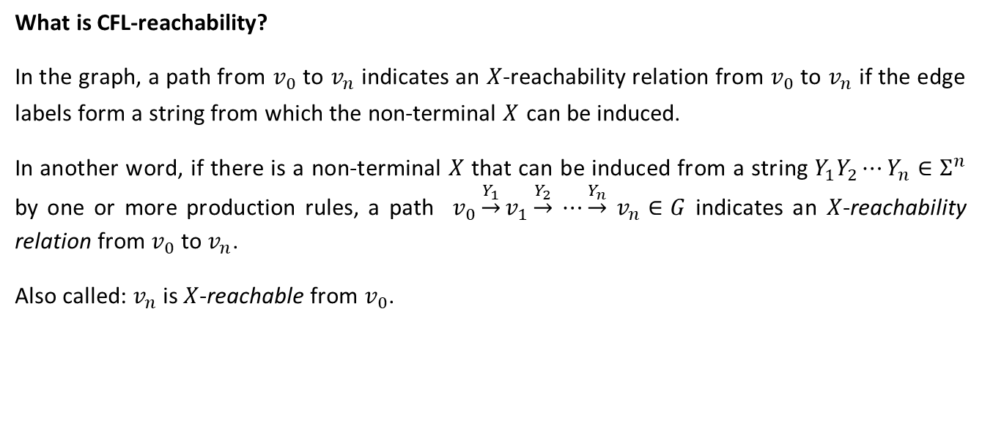
Background
What is CFL-reachability?
In the graph, a path from $v_{0}$ to $v_{n}$ indicates an $X$-reachability relation from $v_{0}$ to $v_{n}$ if the edge labels form a string from which the non-terminal $X$ can be induced.
In another word, if there is a non-terminal $X$ that can be induced from a string $Y_{1}Y_{2}⋯Y_{n}∈Σ^{n}$ by one or more production rules, a path $v_{0}\underset{→}{Y_{1}}v_{1}\underset{→}{Y_{2}}$ $⋯\underset{→}{Y_{n}}$ $v_{n}∈G$ indicates an $X$-reachability relation from $v_{0}$ to $v_{n}$.
Also called: $v_{n}$ is $X$-reachable from $v_{0}$.

Slide 7
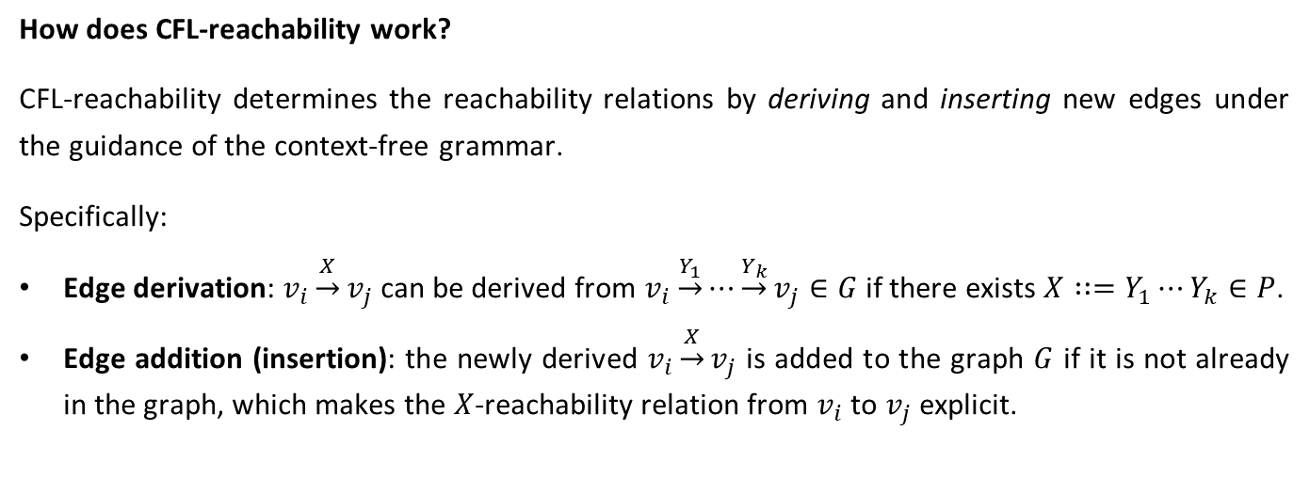
Background
How does CFL-reachability work?
CFL-reachability determines the reachability relations by deriving and inserting new edges under the guidance of the context-free grammar.
Specifically:
Edge derivation: $v_{i}\underset{→}{X}v_{j}$ can be derived from $v_{i}\underset{→}{Y_{1}}⋯\underset{→}{Y_{k}}v_{j}∈G$ if there exists $X∷=Y_{1}⋯Y_{k}∈P$.
Edge addition (insertion): the newly derived $v_{i}\underset{→}{X}v_{j}$ is added to the graph $G$ if it is not already in the graph, which makes the $X$-reachability relation from $v_{i}$ to $v_{j}$ explicit.

Slide 8
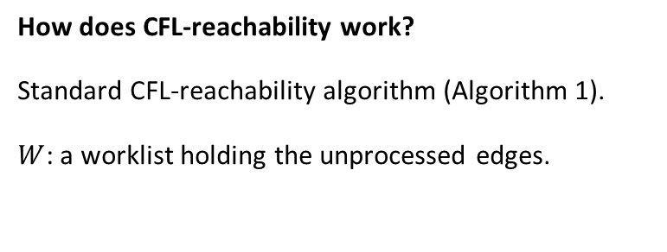


Background
How does CFL-reachability work?
Standard CFL-reachability algorithm (Algorithm 1).
$W$: a worklist holding the unprocessed edges.
Initialization
$$E$$
$$W$$
worklist

Slide 9



Background
Initialization
How does CFL-reachability work?
Standard CFL-reachability algorithm (Algorithm 1).
$$E$$
$$∀e∈E$$
$$∀v_{i}∈V$$
$$∀X∷=ε∈P$$
$$\underset{⇒}{derive} v_{i}\underset{→}{X}v_{i}$$
$$W$$

Slide 10
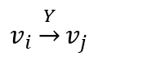
Background
Solving
How does CFL-reachability work?
Standard CFL-reachability algorithm (Algorithm 1).
$$E$$
$$W$$
$$v_{i}\underset{→}{Y}v_{j}$$

Slide 11
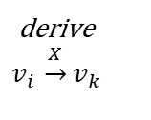
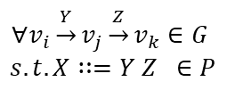

Background
Solving
How does CFL-reachability work?
Standard CFL-reachability algorithm (Algorithm 1).
$$E$$
$$∀v_{i}\underset{→}{Y}v_{j}\underset{→}{Z}v_{k}∈G$$
$$s.t. X∷=Y Z ∈P$$
Check successors:
derive
$$v_{i }\underset{→}{X}v_{k}$$
$$W$$
$$v_{i}\underset{→}{Y}v_{j}$$

Slide 12

Background
Solving
How does CFL-reachability work?
Standard CFL-reachability algorithm (Algorithm 1).
$$E$$
$$v_{i }\underset{→}{X}v_{k}∉E$$
Check successors:
$$W$$

Slide 13
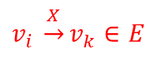
Background
Solving
How does CFL-reachability work?
Standard CFL-reachability algorithm (Algorithm 1).
$$E$$
$$v_{i }\underset{→}{X}v_{k}∈E$$
Check successors:
Discard
$$W$$

Slide 14
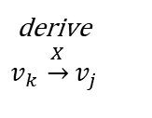
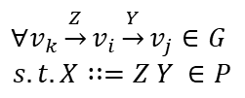

Background
Solving
How does CFL-reachability work?
Standard CFL-reachability algorithm (Algorithm 1).
$$E$$
$$v_{i}\underset{→}{Y}v_{j}$$
$$∀v_{k}\underset{→}{Z}v_{i}\underset{→}{Y}v_{j}∈G$$
$$s.t. X∷=Z Y ∈P$$
Check predecessors:
derive
$$v_{k }\underset{→}{X}v_{j}$$
$$W$$

Slide 15

Background
Solving
How does CFL-reachability work?
Standard CFL-reachability algorithm (Algorithm 1).
$$E$$
$$v_{k }\underset{→}{X}v_{j}∉E$$
Check predecessors:
$$W$$

Slide 16

Background
Solving
How does CFL-reachability work?
Standard CFL-reachability algorithm (Algorithm 1).
$$E$$
$$v_{k }\underset{→}{X}v_{j}∈E$$
Check predecessors:
Discard
$$W$$

Slide 17
Background
Limitation
The order of CFL-reachability solving, i.e., edge processing, depends only on the order of the elements in the worklist, rather than the features of the graph.
This causes inefficiency, which is mainly brought by transitive redundancy.
$$E$$
$$W$$
Notes:
The limitation is that …

Slide 18
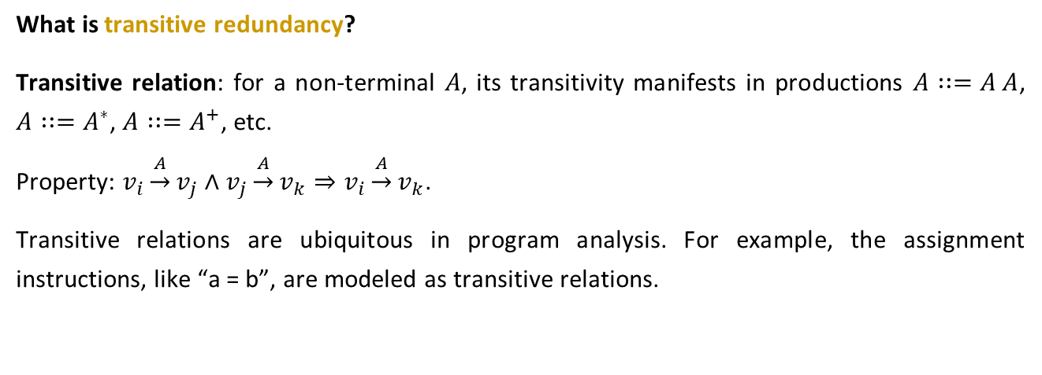
Background
What is transitive redundancy?
Transitive relation: for a non-terminal $A$, its transitivity manifests in productions $A∷=A A$, $A∷=A^{∗}$, $A∷=A^{+}$, etc.
Property: $v_{i}\underset{→}{A}v_{j}∧v_{j}\underset{→}{A}v_{k}⇒v_{i}\underset{→}{A}v_{k}$.
Transitive relations are ubiquitous in program analysis. For example, the assignment instructions, like “a = b”, are modeled as transitive relations.

Slide 19
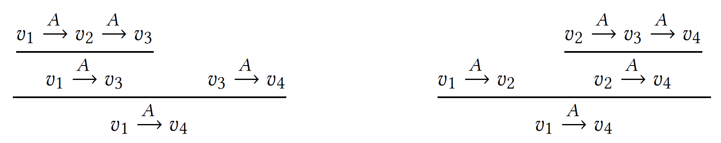
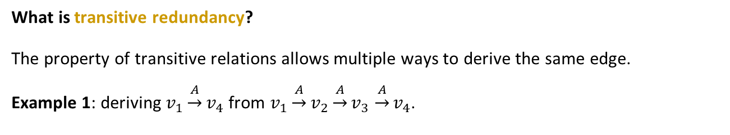
Background
What is transitive redundancy?
The property of transitive relations allows multiple ways to derive the same edge.
Example 1: deriving $v_{1}\underset{→}{A}v_{4}$ from $v_{1}\underset{→}{A}v_{2}\underset{→}{A}v_{3}$ $\underset{→}{A}v_{4}$.
From the head to the tail.
From the tail to the head.
Notes:
The property of transitive relations allows multiple ways to derive the same edge.
In this example, we have two ways to derive the edge v1 a v4 from the path v1 a v2 a v3 a v4.
We can either derive the edge from the head to the tail, where the edge v1 a v3 is derived first,
Or from the tail to the head, where the edge v2 a v4 is derived first.

Slide 20
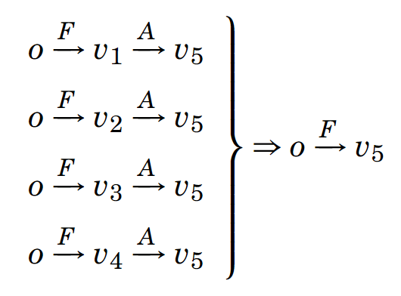
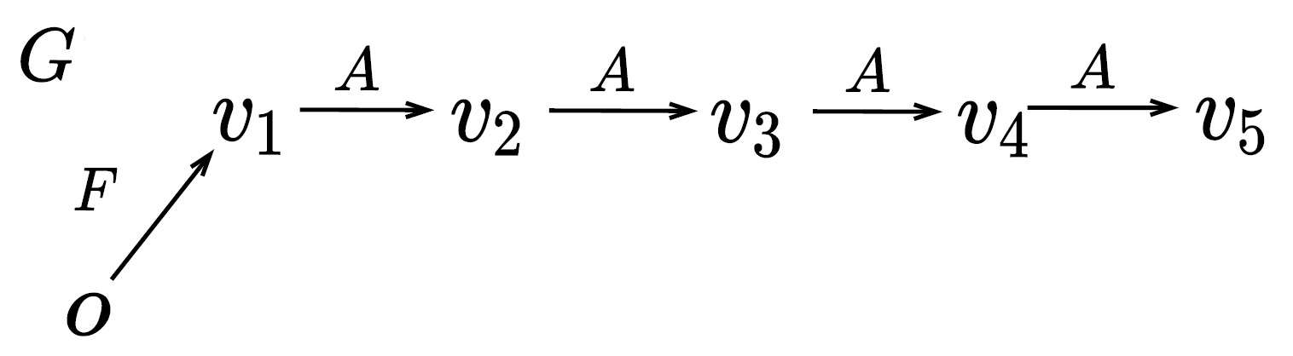
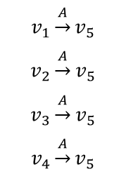
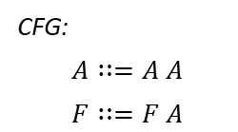



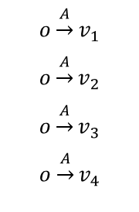

Background
What is transitive redundancy?
Example 2: There are four ways to derive $o\underset{→}{F}v_{5}$.
CFG:
$$A∷=A A$$
$$F∷=F A$$
$A∷=A A$
$$F∷=F A$$
$$v_{1}\underset{→}{A}v_{5}$$
$$v_{2}\underset{→}{A}v_{5}$$
$$v_{3}\underset{→}{A}v_{5}$$
$$v_{4}\underset{→}{A}v_{5}$$
$$o\underset{→}{A}v_{1}$$
$$o\underset{→}{A}v_{2}$$
$$o\underset{→}{A}v_{3}$$
$$o\underset{→}{A}v_{4}$$
However, $o\underset{→}{F}v_{5}$ needs to be added to the graph only once!
Notes:
Here is another example.
According to the context-free grammar, there are 4 ways to derive o f v5.
However, $o\underset{→}{F}v_{5}$ only needs to be added to the graph once to make the reachability relation explicit.
In most cases, the standard algorithm will trigger all the 4 ways, which means that there are at least 3 redundant derivations.

Slide 21
Background
What is transitive redundancy?
According to our empirical results from two popular clients, i.e., value-flow analysis and alias analysis, redundant derivations occupy over 95% of all derivations.

Slide 22
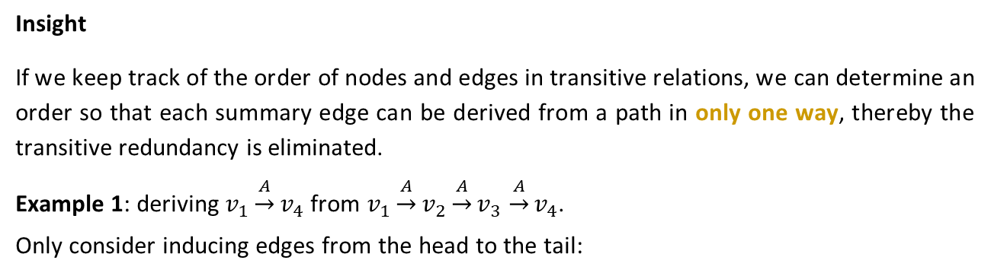
Our Solution
Insight
If we keep track of the order of nodes and edges in transitive relations, we can determine an order so that each summary edge can be derived from a path in only one way, thereby the transitive redundancy is eliminated.
Example 1: deriving $v_{1}\underset{→}{A}v_{4}$ from $v_{1}\underset{→}{A}v_{2}\underset{→}{A}v_{3}$ $\underset{→}{A}v_{4}$.
Only consider inducing edges from the head to the tail:
Preserved
Discarded
Notes:
Our insight is that, if we keep track of the order of nodes and edges in transitive relations, we can determine an order so that each summary edge can be derived from a path in only one way, thereby the transitive redundancy is eliminated.
For the first example, if we only consider inducing edges from the head to the tail, the second way for deriving v1 a v4 can be discarded.

Slide 23
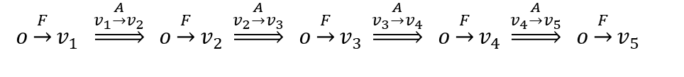
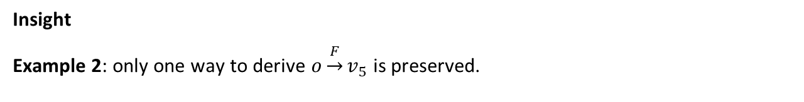
Our Solution
Insight
Example 2: only one way to derive $o\underset{→}{F}v_{5}$ is preserved.
CFG:
$$A∷=A A$$
$$F∷=F A$$
Discarded
Preserved
Notes:
Similarly, in the second example, by only inducing edges from the head to the tail, only the last way to derive the edge o f v5 is preserved.

Slide 24
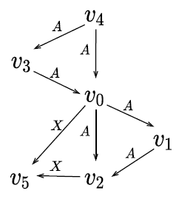
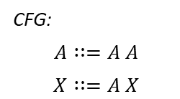
Our Solution
Insight
Challenge: as in the graphs of real problems, a node/edge can reside in multiple paths, there is not a universal order that can cover all edge derivations in a graph while excluding all the redundant ones.
E.g.,
CFG:
$$A∷=A A$$
$$X∷=A X$$
G:

Slide 25
Our Solution
Insight
Challenge: as in the graphs of real problems, a node/edge can reside in multiple paths, there is not a universal order that can cover all derivations in a graph as well as excluding all the redundant ones.
Our solution is to let the derivations of different paths follow different orders, including a hybrid data structure and a partially ordered CFL-reachability algorithm.

Slide 26
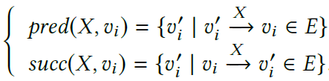
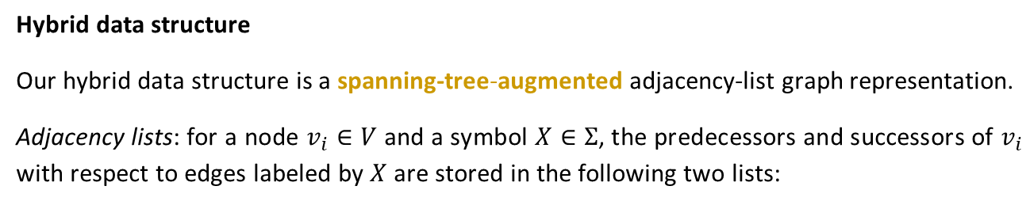
Our Solution
Hybrid data structure
Our hybrid data structure is a spanning-tree-augmented adjacency-list graph representation.
Adjacency lists: for a node $v_{i}∈V$ and a symbol $X∈Σ$, the predecessors and successors of $v_{i}$ with respect to edges labeled by $X$ are stored in the following two lists:

Slide 27
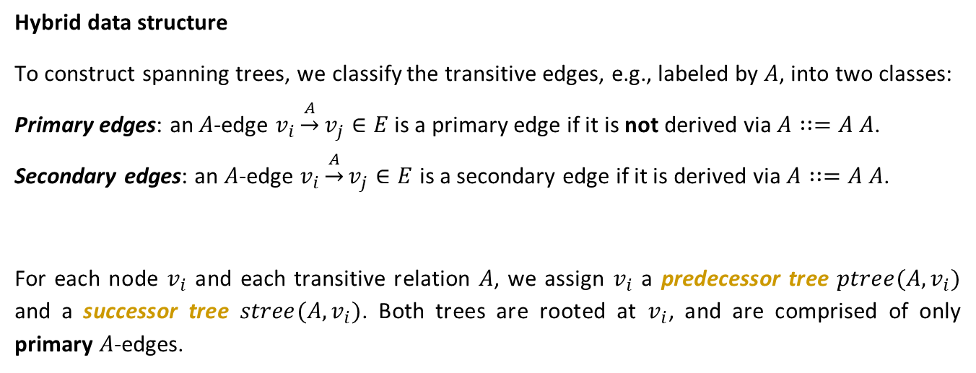
Our Solution
Hybrid data structure
To construct spanning trees, we classify the transitive edges, e.g., labeled by $A$, into two classes:
Primary edges: an $A$-edge $v_{i}\underset{→}{A}v_{j}∈E$ is a primary edge if it is not derived via $A∷=A A$.
Secondary edges: an $A$-edge $v_{i}\underset{→}{A}v_{j}∈E$ is a secondary edge if it is derived via $A∷=A A$.
For each node $v_{i}$ and each transitive relation $A$, we assign $v_{i}$ a predecessor tree $ptree(A,v_{i})$ and a successor tree $stree(A,v_{i})$. Both trees are rooted at $v_{i}$, and are comprised of only primary $A$-edges.

Slide 28
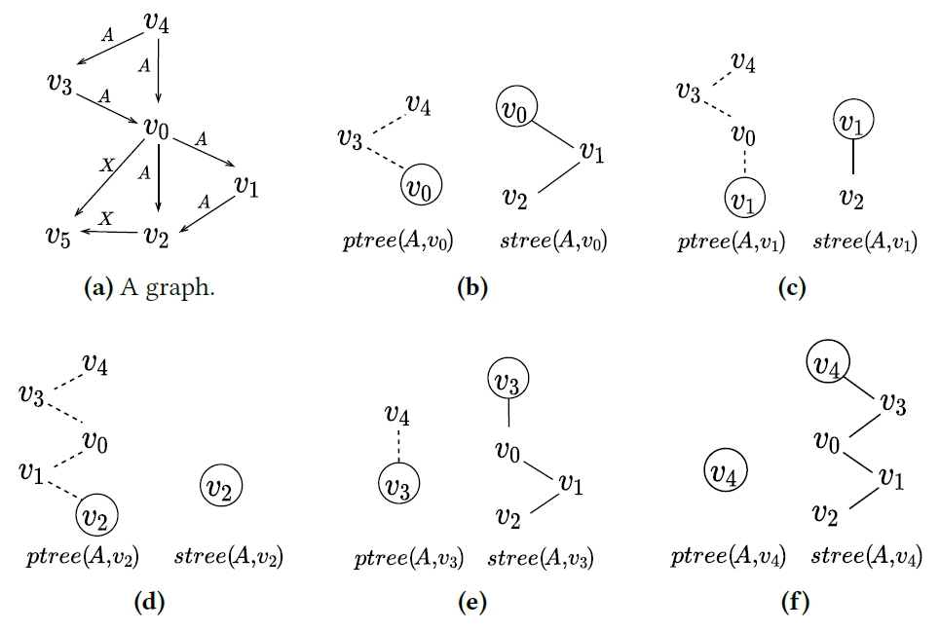
Our Solution
Hybrid data structure
Example of predecessor trees and successor trees.
No secondary edge is included in the spanning trees.

Slide 29


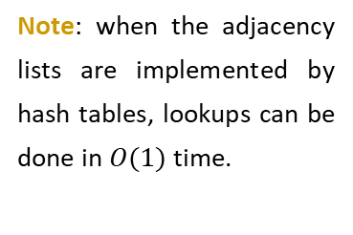
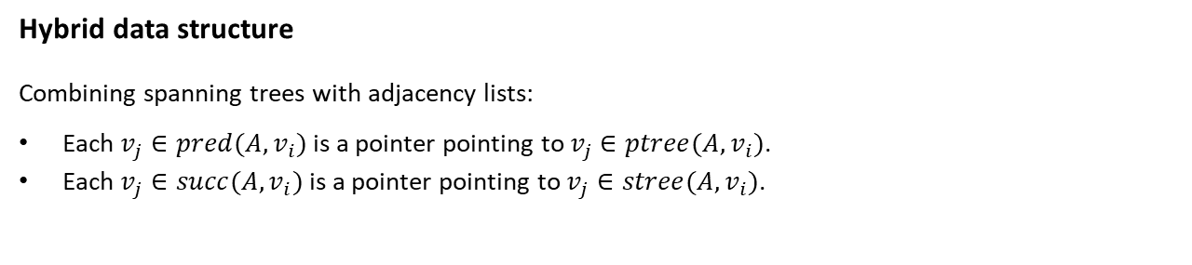












Our Solution
Hybrid data structure
Combining spanning trees with adjacency lists:
Each $v_{j}∈pred(A,v_{i})$ is a pointer pointing to $v_{j}∈ptree(A,v_{i})$.
Each $v_{j}∈succ(A,v_{i})$ is a pointer pointing to $v_{j}∈stree(A,v_{i})$.
$pred(A,v_{i})$
$ptree(A,v_{i})$
$succ(A,v_{i})$
$stree(A,v_{i})$
Note: when the adjacency lists are implemented by hash tables, lookups can be done in $O(1)$ time.
$$v_{3}$$
$$v_{4}$$
$$v_{0}$$
$$v_{1}$$
$$v_{2}$$
$$v_{0}$$
$$v_{3}$$
$$v_{1}$$
$$v_{4}$$
$$v_{2}$$

Slide 30
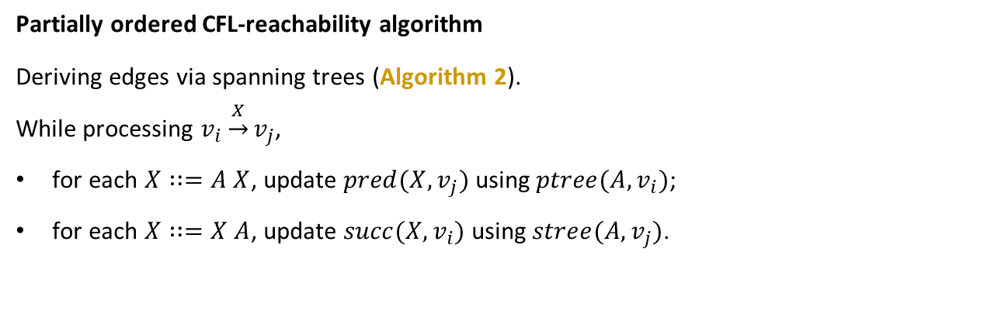
Our Solution
Partially ordered CFL-reachability algorithm
Deriving edges via spanning trees (Algorithm 2).
While processing $v_{i}\underset{→}{X}v_{j}$,
for each $X∷=A X$, update $pred(X,v_{j})$ using $ptree(A,v_{i})$;
for each $X∷=X A$, update $succ(X,v_{i})$ using $stree(A,v_{j})$.

Slide 31
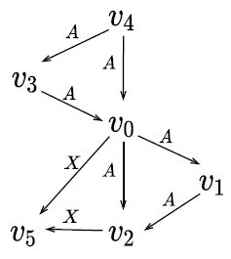
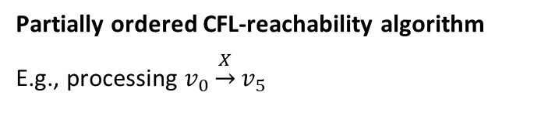






Our Solution
Partially ordered CFL-reachability algorithm
E.g., processing $v_{0}\underset{→}{X}v_{5}$
$$X∷=A X$$
$pred(X,v_{5})$
$ptree(A,v_{0})$
$$v_{0}$$
$$v_{0}$$
$$v_{3}$$
$$v_{4}$$
Notes:
Here is an example, while processing the edge $v_{0}\underset{→}{X}v_{5}$ based on the production rule x = a x, we traverse the predecessor tree ptree a v0 from the root to the leaf, and update adjacency list pred x v5

Slide 32

Our Solution
Partially ordered CFL-reachability algorithm
E.g., processing $v_{0}\underset{→}{X}v_{5}$
$$X∷=A X$$
$pred(X,v_{5})$
$ptree(A,v_{0})$
$$v_{0}$$
$$v_{3}$$
$$v_{0}$$
$$v_{3}$$
$$v_{4}$$
Notes:
Here is an example, while processing the edge $v_{0}\underset{→}{X}v_{5}$ based on the production rule x = a x, we traverse the predecessor tree ptree a v0 from the root to the leaf, and update adjacency list pred x v5

Slide 33




Our Solution
Partially ordered CFL-reachability algorithm
E.g., processing $v_{0}\underset{→}{X}v_{5}$
$$X∷=A X$$
$pred(X,v_{5})$
$ptree(A,v_{0})$
$$v_{0}$$
$$v_{3}$$
$$v_{0}$$
$$v_{3}$$
$$v_{4}$$
Notes:
Here is an example, while processing the edge $v_{0}\underset{→}{X}v_{5}$ based on the production rule x = a x, we traverse the predecessor tree ptree a v0 from the root to the leaf, and update adjacency list pred x v5

Slide 34

Our Solution
Partially ordered CFL-reachability algorithm
E.g., processing $v_{0}\underset{→}{X}v_{5}$
$$X∷=A X$$
$pred(X,v_{5})$
$ptree(A,v_{0})$
$$v_{0}$$
$$v_{3}$$
$$v_{4}$$
$$v_{0}$$
$$v_{3}$$
$$v_{4}$$
Notes:
Here is an example, while processing the edge $v_{0}\underset{→}{X}v_{5}$ based on the production rule x = a x, we traverse the predecessor tree ptree a v0 from the root to the leaf, and update adjacency list pred x v5

Slide 35

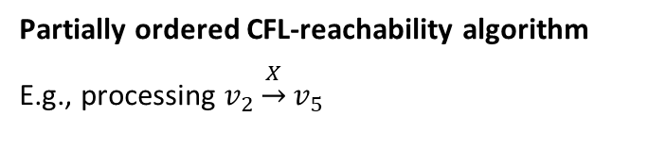






Our Solution
Partially ordered CFL-reachability algorithm
E.g., processing $v_{2}\underset{→}{X}v_{5}$
$$X∷=A X$$
$pred(X,v_{5})$
$ptree(A,v_{2})$
$$v_{0}$$
$$v_{3}$$
$$v_{4}$$
$$v_{2}$$
$$v_{2}$$
$$v_{1}$$
$$v_{0}$$
$$v_{3}$$
$$v_{4}$$
Notes:
Similarly, while processing the edge $v_{2}\underset{→}{X}v_{5}$, we traverse the predecessor tree ptree a v2, and update the adjacency list pred x v5

Slide 36

Our Solution
Partially ordered CFL-reachability algorithm
E.g., processing $v_{2}\underset{→}{X}v_{5}$
$$X∷=A X$$
$pred(X,v_{5})$
$ptree(A,v_{2})$
$$v_{0}$$
$$v_{3}$$
$$v_{4}$$
$$v_{2}$$
$$v_{1}$$
$$v_{2}$$
$$v_{1}$$
$$v_{0}$$
$$v_{3}$$
$$v_{4}$$
Notes:
Similarly, while processing the edge $v_{2}\underset{→}{X}v_{5}$, we traverse the predecessor tree ptree a v2, and update the adjacency list pred x v5

Slide 37




Our Solution
Partially ordered CFL-reachability algorithm
E.g., processing $v_{2}\underset{→}{X}v_{5}$
$$X∷=A X$$
$pred(X,v_{5})$
$ptree(A,v_{2})$
$$v_{0}$$
$$v_{3}$$
$$v_{4}$$
$$v_{2}$$
$$v_{1}$$
$$v_{2}$$
$$v_{1}$$
$$v_{0}$$
$v_{0}$ already exists in $pred\left(X,v_{5}\right)$, stop.
$$v_{3}$$
$$v_{4}$$
$v_{3}$ and $v_{4}$ must be added to $pred(X,v_{5})$ by another traversal which does not stop at $v_{0}$.
Notes:
Notably, while the traversal of ptree a v2 goes to v0, as v0 is already in the adjacency list pred x v5, the traversal stops. In this way, two redundant derivations caused by v3 and v4 are avoided.
Here, stopping the traversal at v0 is safe because $v_{3}$ and $v_{4}$ must be added to $pred(X,v_{5})$ by another traversal which does not stop at $v_{0}$.

Slide 38
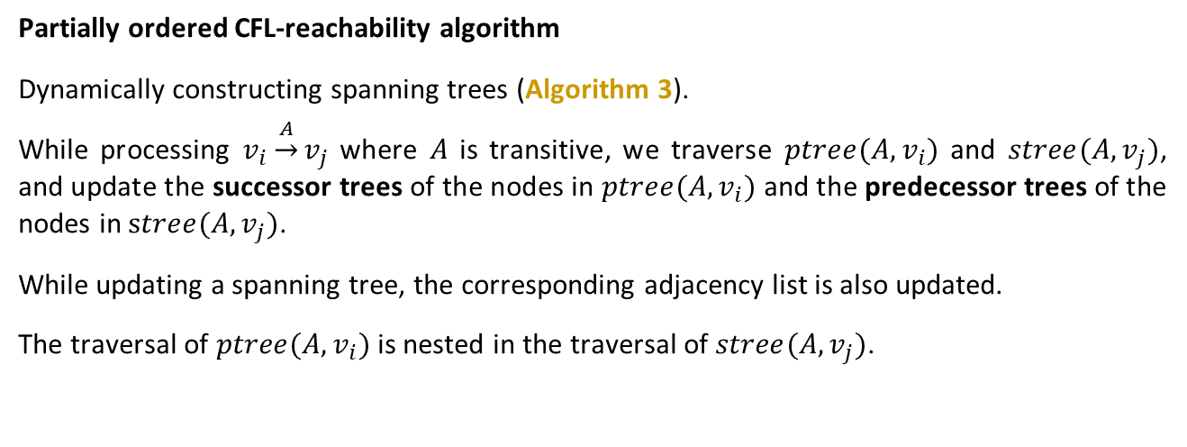
Our Solution
Partially ordered CFL-reachability algorithm
Dynamically constructing spanning trees (Algorithm 3).
While processing $v_{i}\underset{→}{A}v_{j}$ where $A$ is transitive, we traverse $ptree(A,v_{i})$ and $stree(A,v_{j})$, and update the successor trees of the nodes in $ptree(A,v_{i})$ and the predecessor trees of the nodes in $stree(A,v_{j})$.
While updating a spanning tree, the corresponding adjacency list is also updated.
The traversal of $ptree(A,v_{i})$ is nested in the traversal of $stree(A,v_{j})$.

Slide 39
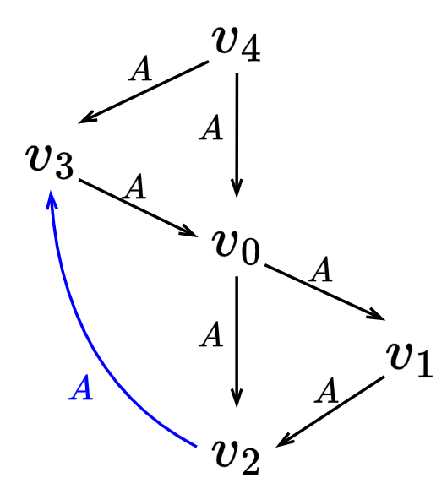


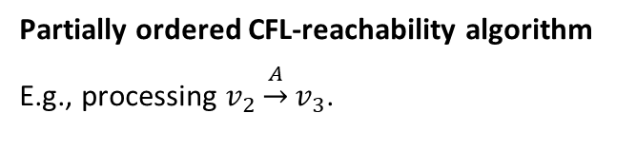













Our Solution
Partially ordered CFL-reachability algorithm
E.g., processing $v_{2}\underset{→}{A}v_{3}$.
Traverse:
Update:
$ptree(A,v_{2})$
$stree(A,v_{3})$
$stree(A,v_{2})$
$ptree(A,v_{3})$
$$v_{2}$$
$$v_{3}$$
$$v_{2}$$
$$v_{3}$$
$$v_{1}$$
$$v_{0}$$
$$v_{3}$$
$$v_{2}$$
$$v_{4}$$
$$v_{0}$$
$$v_{1}$$
$$v_{3}$$
$$v_{2}$$
$$v_{4}$$
Notes:
Here is an example, while processing the edges $v_{2}\underset{→}{A}v_{3}$, we traverse ptree a v2 and stree a v3, where the traversal of $ptree(A,v_{2})$ is nested in the traversal of $stree(A,v_{3})$.
During the traversal, we update the successors trees of v2, v1, v0, and the predecessor tree of v3.

Slide 40







Our Solution
Partially ordered CFL-reachability algorithm
E.g., processing $v_{2}\underset{→}{A}v_{3}$.
Traverse:
Update:
$ptree(A,v_{2})$
$stree(A,v_{3})$
$stree(A,v_{1})$
$ptree(A,v_{3})$
$$v_{2}$$
$$v_{3}$$
$$v_{1}$$
$$v_{3}$$
$$v_{1}$$
$$v_{0}$$
$$v_{2}$$
$$v_{2}$$
$$v_{4}$$
$$v_{0}$$
$$v_{1}$$
$$v_{3}$$
$$v_{1}$$
$$v_{3}$$
$$v_{2}$$
$$v_{4}$$
Notes:
Here is an example, while processing the edges $v_{2}\underset{→}{A}v_{3}$, we traverse ptree a v2 and stree a v3, where the traversal of $ptree(A,v_{2})$ is nested in the traversal of $stree(A,v_{3})$.
During the traversal, we update the successors trees of v2, v1, v0, and the predecessor tree of v3.

Slide 41








Our Solution
Partially ordered CFL-reachability algorithm
E.g., processing $v_{2}\underset{→}{A}v_{3}$.
Traverse:
Update:
$ptree(A,v_{2})$
$stree(A,v_{3})$
$stree(A,v_{0})$
$ptree(A,v_{3})$
$$v_{2}$$
$$v_{3}$$
$$v_{0}$$
$$v_{3}$$
$$v_{1}$$
$$v_{0}$$
$$v_{1}$$
$$v_{2}$$
$$v_{4}$$
$$v_{0}$$
$$v_{1}$$
$$v_{2}$$
$$v_{1}$$
$$v_{3}$$
$$v_{2}$$
$$v_{3}$$
$$v_{0}$$
$$v_{4}$$
Notes:
Here is an example, while processing the edges $v_{2}\underset{→}{A}v_{3}$, we traverse ptree a v2 and stree a v3 from the roots to the leaves, where the traversal of $ptree(A,v_{2})$ is nested in the traversal of $stree(A,v_{3})$.
During the traversal, we update the successors trees of v2, v1, v0, and the predecessor tree of v3.

Slide 42

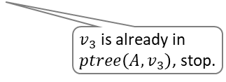


Our Solution
Partially ordered CFL-reachability algorithm
E.g., processing $v_{2}\underset{→}{A}v_{3}$.
Traverse:
Update:
$ptree(A,v_{2})$
$stree(A,v_{3})$
$stree(A,v_{0})$
$ptree(A,v_{3})$
$$v_{2}$$
$$v_{3}$$
$$v_{0}$$
$$v_{3}$$
$$v_{1}$$
$$v_{0}$$
$$v_{1}$$
$$v_{2}$$
$$v_{4}$$
$$v_{0}$$
$$v_{1}$$
$$v_{2}$$
$$v_{1}$$
$$v_{3}$$
$$v_{2}$$
$$v_{3}$$
$$v_{0}$$
$$v_{4}$$
$v_{3}$ is already in $ptree\left(A,v_{3}\right)$, stop.
Notes:
In this case, the traversal of ptree a v2 stops at v3, because v3 is already in ptree a v3. In this way, we avoid the redundant derivation caused by v4.
Similar to the first method, stopping the traversal at v3 is safe because v4 must be added to ptree a v3 by another traversal.

Slide 43






Our Solution
Partially ordered CFL-reachability algorithm
E.g., processing $v_{2}\underset{→}{A}v_{3}$.
Traverse:
Update:
$ptree(A,v_{2})$
$stree(A,v_{3})$
$stree(A,v_{2})$
$ptree(A,v_{0})$
$$v_{2}$$
$$v_{3}$$
$$v_{2}$$
$$v_{0}$$
$$v_{1}$$
$$v_{0}$$
$$v_{3}$$
$$v_{3}$$
$$v_{0}$$
$$v_{1}$$
$$v_{0}$$
$$v_{2}$$
$$v_{4}$$
$$v_{3}$$
$$v_{2}$$
$$v_{4}$$
Notes:
After finishing an iteration of traversal of ptree a v2, the outer traversal of stree a v3 moves from v3 to v0, starting another inner traversal of ptree a v2.
This dynamic construction method stops when all the inner traversals of ptree a v2 an all the outer traversals of stree a v3 are finished.

Slide 44
Our Solution
Partially ordered CFL-reachability algorithm (POCR)
Overall CFL-reachability solver (Algorithm 4).
The only difference of POCR from the standard algorithm is the scheme for processing an edge.
$$E$$
$$W$$
$$v_{i}\underset{→}{Y}v_{j}$$
Notes:
We integrate the forementioned two methods into an overall cfl-reachability solver, as algorithm 4 in the paper.
The only difference of our algorithm from the standard one is the scheme for processing an edge.

Slide 45
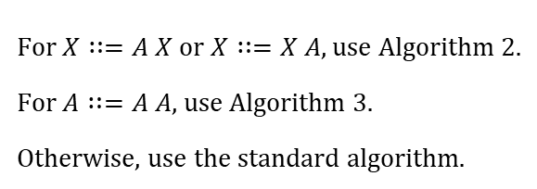
Our Solution
Partially ordered CFL-reachability algorithm (POCR)
Overall CFL-reachability solver (Algorithm 4).
$$E$$
For $X∷=A X$ or $X∷=X A$, use Algorithm 2.
For $A∷=A A$, use Algorithm 3.
Otherwise, use the standard algorithm.
$$W$$
$$v_{i}\underset{→}{Y}v_{j}$$
Notes:
Specifically, while processing an edge, we use the two spanning-tree-based methods to handle the production rules
rules such as x = a x, x = x a and a = a a,
And handle the other productions in the same way of the standard algorithm.

Slide 46
Our Solution
Grammar-based optimization
Key idea: use spanning trees to reduce redundant derivations to the largest extent.

Slide 47
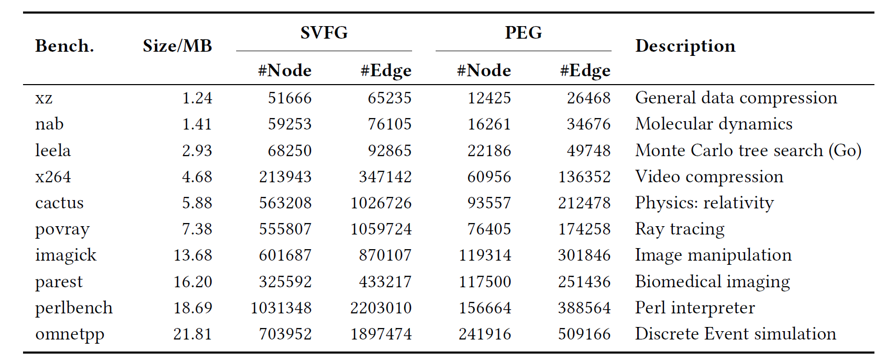
Evaluation
Clients
Context-sensitive value-flow analysis and field-sensitive alias analysis.
Benchmarks

Slide 48
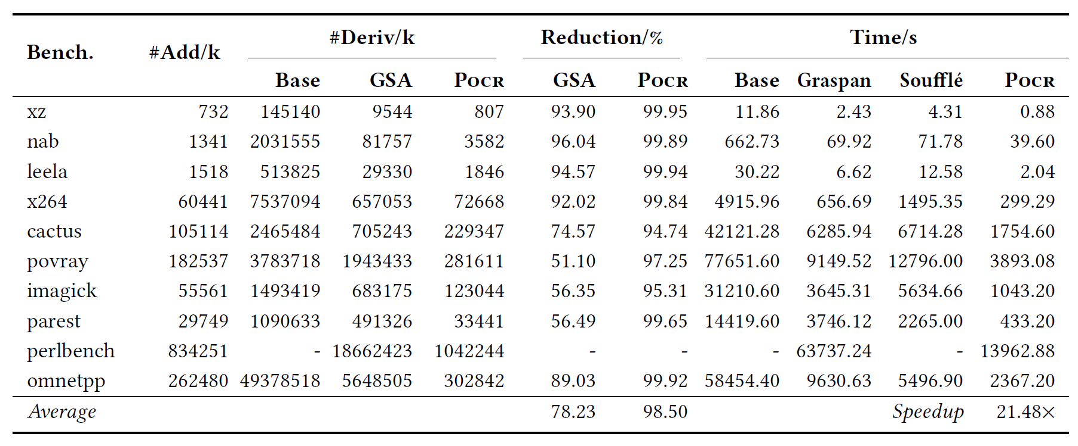
Evaluation
Reduction of redundancy and speedup
Context-sensitive value-flow analysis.
3.67×
4.10×

Slide 49
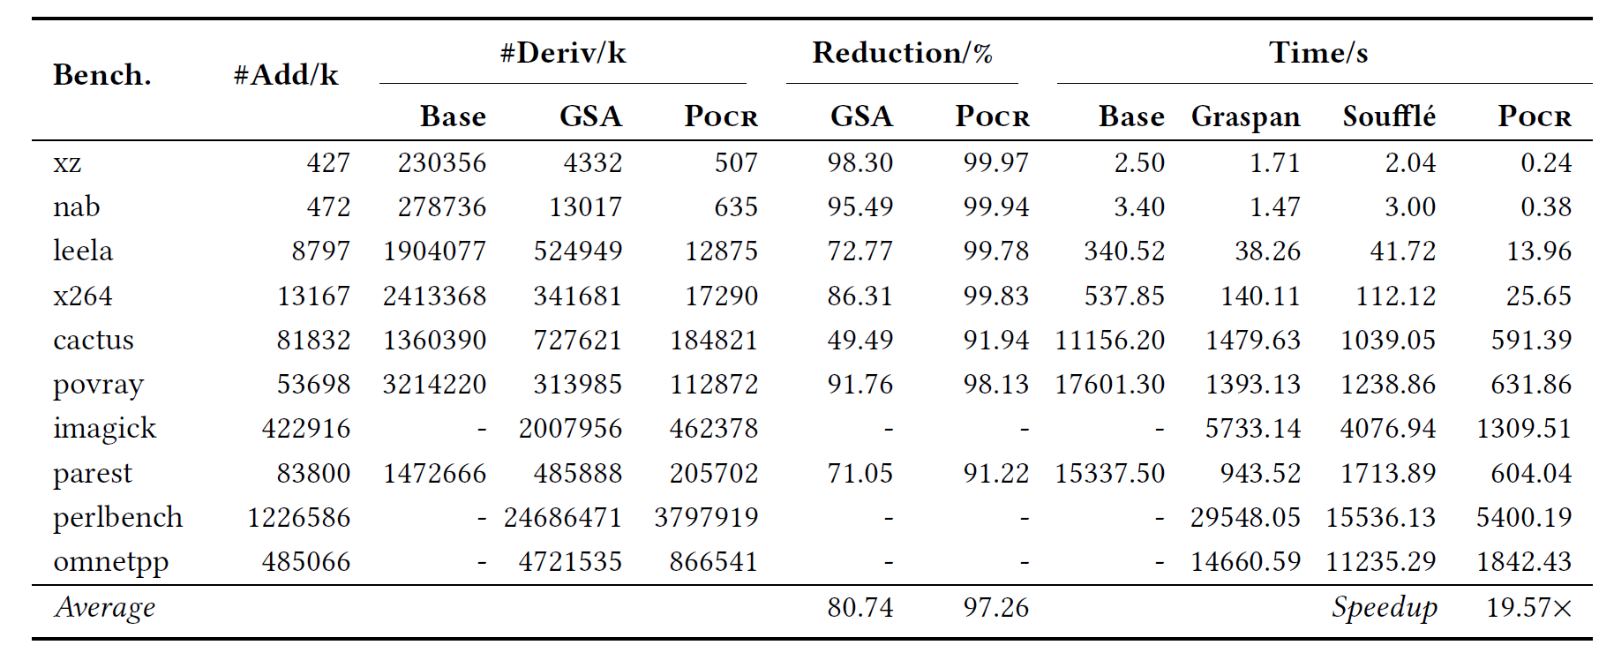
Evaluation
Reduction of redundancy and speedup
Field-sensitive alias analysis.
3.73×
4.19×

Slide 50
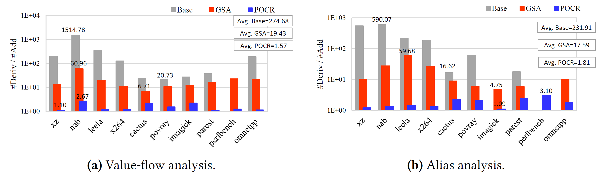
Evaluation
Reduction of redundancy and speedup
Statistics of computational redundancy.

Slide 51
Availability
The paper contains the details of our partially ordered CFL-reachability solver (i.e., POCR), including the design of data structure and pseudo-codes of the algorithm. You can implement your version according to the paper.
Our implementation is released on GitHub (https://github.com/kisslune/POCR). Further updates will also be released in the same repository.

Slide 52
Thank you!
Yuxiang Lei
Yuxiang.Lei@student.uts.edu.au

