Slide 1

Android Cross-language Analysis Based on Caller-Sensitive Specification
Yuhao
04/Nov/2022

Slide 2
Contents
Background
Motivation
Aims
Methods
Evaluation

Slide 3
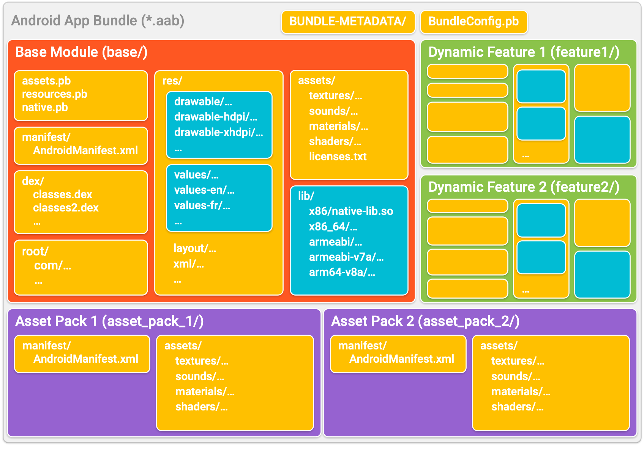
Background: A cross-language app in Android Ecosystem
Function Call
Dex files
(smali bytecode)
Binary files
(binary code)
Android App （APK）
Java – Bytecode
Java – Bytecode / Source code
Java Bytecode
(dex)
Java Libs
(jar/dex)
Native code
(so)
Native Libs
(so)
C/C++ - Binary code
C/C++ – Binary / Source code

Slide 4
Background: A cross-language app in Android Ecosystem
Function Call
Android System （AOSP）
Android App （APK）
Java – Bytecode
Java – Source code
Framework
Java Bytecode
(dex)
Java Libs
(jar/dex)
Activities
1. External call
Services
2. Native user code
3. Native system call
Broadcast receivers
Native code
(so)
Native Libs
(so)
Content providers
C/C++ - Binary code
C/C++ – Source code

Slide 5
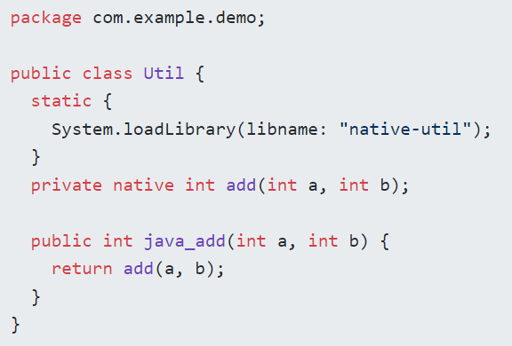

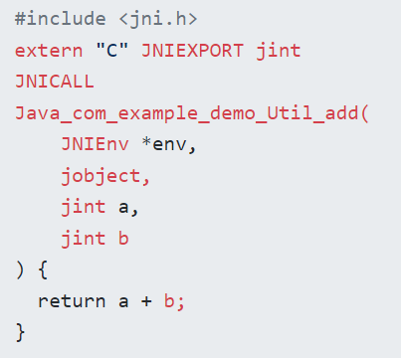

Background: JNI in Android
Util.java
compile
pack
Demo.apk
JNI function name rule:
Java_<namespace>_<class>_<method>
Java_com_example_demo_Util_add
add.cpp
native-util.so
compile

Slide 6
Motivation
How does an existing static analysis tool deal with external calls?
Without automatic specification generation:
Ignore external functions
Analyses with the bytecode (Only Java external functions)
Uses simple rules of thumb (such as “taint return value of call if one or more arguments are tainted”)
Hand-written specifications
Unsound
Time-consuming / No native code
Imprecise
Time-consuming / hard to maintain

Slide 7
Motivation
How does an existing static analysis tool deal with external calls?
Automatic specification generation:
Single language analysis
Cannot cover all the frequently-used external functions in Android apps
Without cross-language calls (such as JNI)
Haven’t analysed enough Android apps in the real world

Slide 8
Aims
Analyse the frequently-used external functions in Android apps and discover their patterns
Propose a novel method to generate specifications in cross-language apps used for taint analysis
Build a specification library for frequently-used Android external functions

Slide 9
Methods: Preliminary study
RQs:
How many frequently-used external functions are in apps? (Both binary and Java functions) Are there some patterns?
Do the existing specification generation methods can be used for cross-language function calls and are they effective?
Do the current specifications used in static analysis tools can cover the frequently-used external functions used by apps?

Slide 10






Methods: Preliminary study
Frequently-used external functions and their patterns
Collect 100k apps
Unpack apps
Dex files (Java bytecode)
Scan the external calls
SO files (binary code)
Effective?
Coverage?
FlowDroid
AmanDroid
……
Collect tools
Survey the methods
they used
Survey the external functions/libs
they can analyse
Compare and evaluate

Slide 11
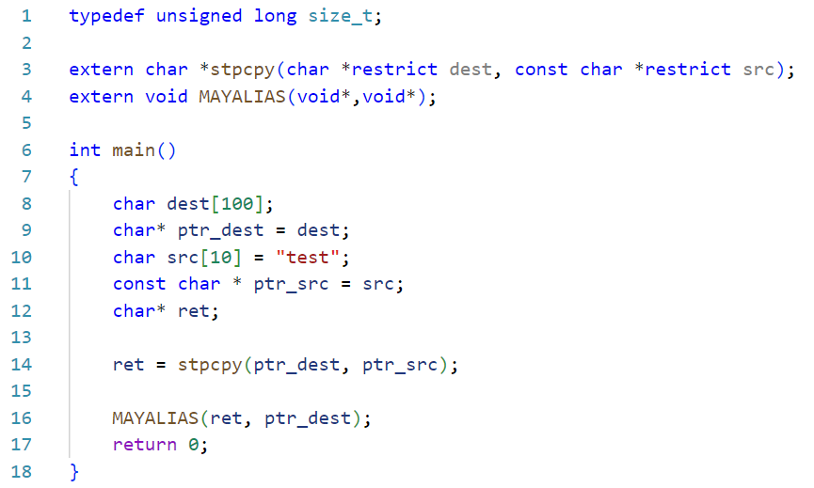
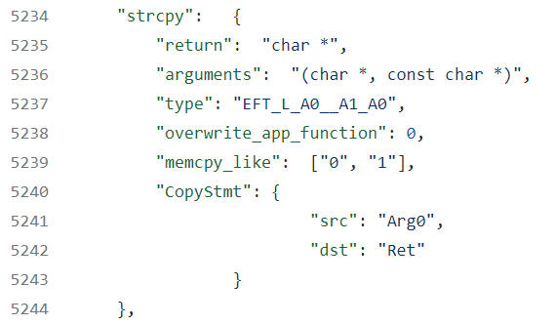
Methods: Generate specifications
Review: External calls in SVF
main.c
External call!
SVF/include/Util/ExtAPI.json
（Built-in specifications）

Slide 12
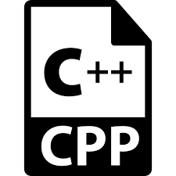



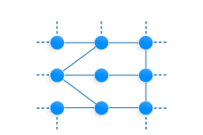

Methods: Generate specifications
Review: External calls in SVF
SVF IR
(without external functions)
main.c
LLVM IR
SVF IR
(with external functions)
SVF Analysis result
Hand-written!
Specification file
Specification of external functions

Slide 13


Methods: Generate specifications
Extend SVF to generate specifications from C/C++ source code for calls from Java code
Caller
(Java)
Caller specification
APK
Generate
SVF IR
(with caller information)
Unpack
Scan the external calls
Callee
(C/C++)
SVF Analysis result
(Callee)
Callee specification
Find
External function
(Source code)
LLVM IR
SVF IR
(without caller information)

Slide 14
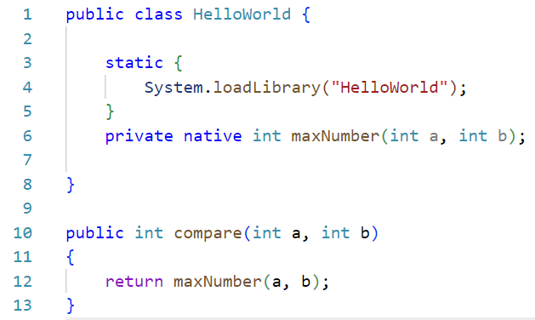
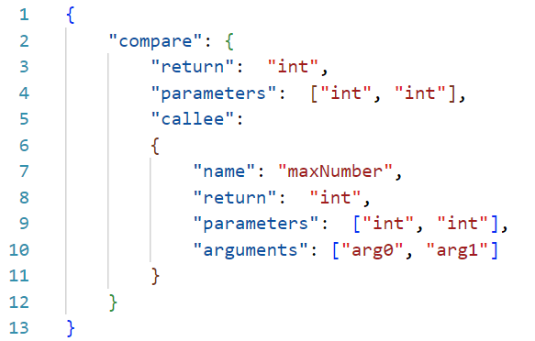
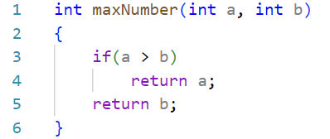
Methods: Generate specifications
Extend: Generate caller specification
HelloWorld.java
CallerSpecification.json
callee
Generate
caller
NativeCode.c
callee

Slide 15
Methods: Generate specifications
Extend: Caller-sensitive specification generation (in SVF)
CallerSpecification.json
SVF IR
(caller information)
SVF Analysis result
Callee specification
NativeCode.c
LLVM IR
SVF IR
(callee information)

Slide 16
Methods: Build a specification library
Collect apps
Caller-sensitive specification
Specification library

Slide 17
Evaluation
Coverage: based on the apps we collected
Accuracy: manually check
Compare with the existing tools

Slide 18
Thanks

