Slide 1
Fault Localization in Android
Hsu Myat Win

Slide 2
Contents
AndroidSlicer - Recap
What is AndroidSlicer?
Sample
Issues related to Intercomponent communication (ICC)
Example of ICC issue
How ICC issues might be missed by exisiting AndroidSlicer and adb log?
How can we enhance AndroidSlicer?

Slide 3
What is AndroidSlicer?
Backward dynamic slicing
Input : slicing criterion (t, s, value)
T = time stamp
S = instruction instance (Program line)
V = value in specific program line
Process : Slicing based on above input and generate the related block
Output : the related block (logging) contains executed program lines that have a direct or indirect effect on value

Slide 4
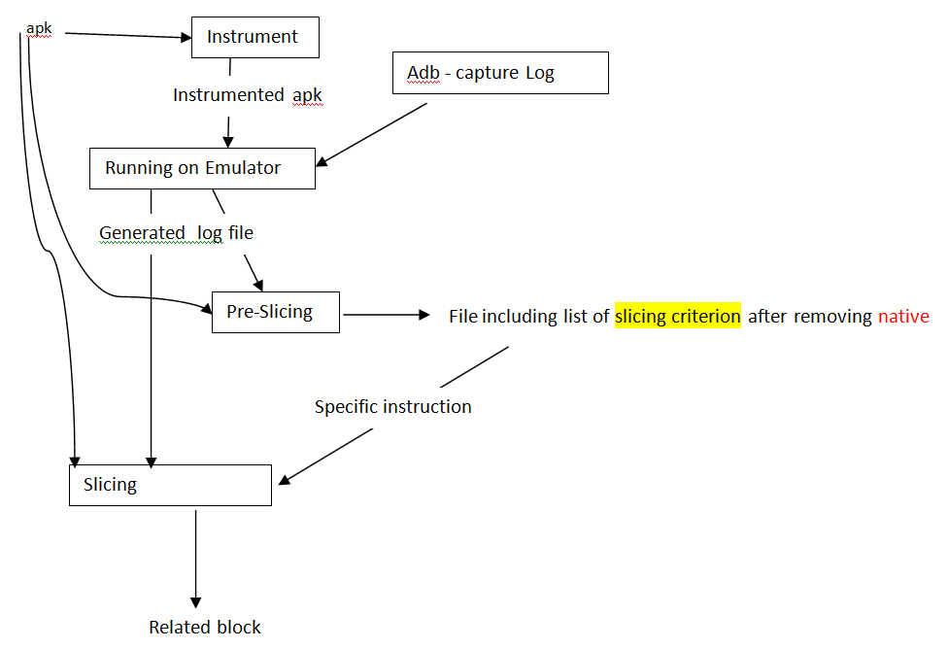
AndroidSlicer - Architecture

Slide 5
AndroidSlicer – Sample
Input :
T : logging time
S : "Likelihood l = new Likelihood(a, ld);"
Value : Likelihood l
Output :
public class DayTimeCondition
{
protected void doEvaluation() {
....
for (DiaryActivity a:list) {
float mean = DAY / 2.0f;
float var = 30*60*30*60;
...
double ld = DAY / 180 / Math.sqrt(2 * Math.PI * var); // Math.sqrt(2 * Math.PI);
ld = ld * Math.exp(-((now - mean) * (now - mean) / (2 * var)));
ld = ld * weight;
Likelihood l = new Likelihood(a, ld);
...
}
}
...
}

Slide 6
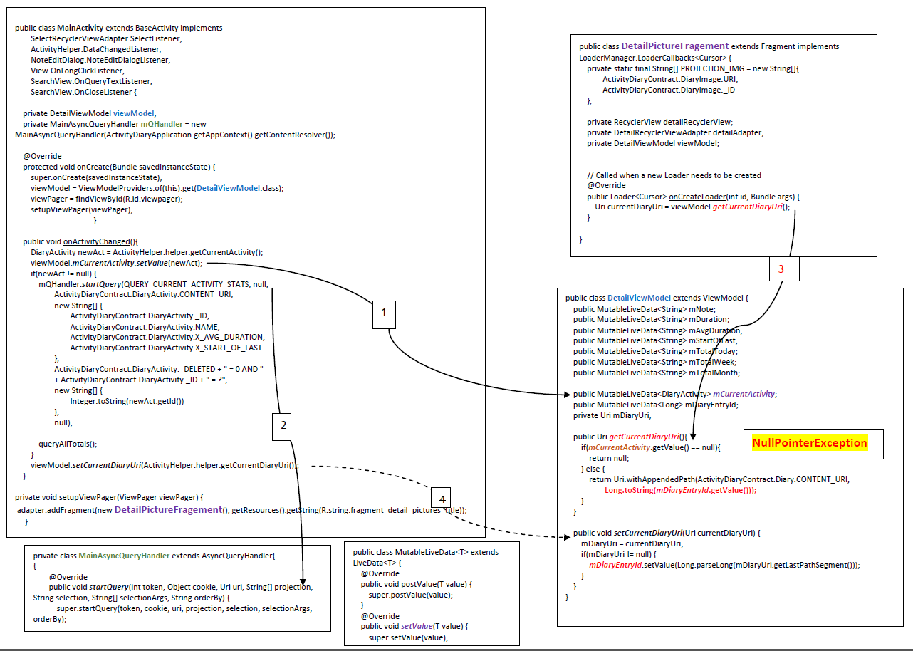
ICC issues : Example found in ActivityDiary Apps
Notes:
LiveData is an observable data holder class. Unlike a regular observable, LiveData is lifecycle-aware, meaning it respects the lifecycle of other app components, such as activities, fragments, or services.

Slide 7
How ICC issues might be missed by AndroidSlicer?
public class DetailViewModel extends ViewModel {
public MutableLiveData<Long> mDiaryEntryId;
public Uri getCurrentDiaryUri(){
if(mCurrentActivity.getValue() == null){
return null;
} else {
return Uri.withAppendedPath(ActivityDiaryContract.Diary.CONTENT_URI,
Long.toString(mDiaryEntryId.getValue()));
}
}
public void setCurrentDiaryUri(Uri currentDiaryUri) {
mDiaryUri = currentDiaryUri;
if(mDiaryUri != null) {
mDiaryEntryId.setValue(Long.parseLong(mDiaryUri.getLastPathSegment()));
}
}
AndroidSlicer can capture value within method (@local variables). But, if assign to global variable in method, it is able to trace.
In ICC, we need to check not only local variable but also global variable so that we can capture the whole data flow among components
Notes:
AndroidSlicer might show above two methods. But, might not extract mCurrentActivity related dependencies
253233ZZZgetCurrentDiaryUri:de.rampro.activitydiary.model.DetailViewModel:$r1 = $r0.<de.rampro.activitydiary.model.DetailViewModel: android.arch.lifecycle.MutableLiveData mDiaryEntryId>
-1ZZZgetCurrentDiaryUri:de.rampro.activitydiary.model.DetailViewModel:$r0 := @this: de.rampro.activitydiary.model.DetailViewModel
*****
A unit that assigns to a variable from one of {@parameter, @this, caughtexception}.
*****
747314ZZZ createRowEquals:android.support.constraint.solver.ArrayRow:virtualinvoke $r3.<android.support.constraint.solver.ArrayLinkedVariables: void put(android.support.constraint.solver.SolverVariable,float)>($r1, 1.0F)
-1ZZZ createRowEquals:android.support.constraint.solver.ArrayRow:$r1 := @parameter1: android.support.constraint.solver.SolverVariable
-1ZZZ createRowEquals:android.support.constraint.solver.ArrayRow:$r3 = $r0.<android.support.constraint.solver.ArrayRow: android.support.constraint.solver.ArrayLinkedVariables variables>
-1ZZZ createRowEquals:android.support.constraint.solver.ArrayRow:$r0 := @this: android.support.constraint.solver.ArrayRow
****

Slide 8
What adb log shows?
java.lang.NullPointerException: Attempt to invoke virtual method 'long java.lang.Long.longValue()' on a null object reference
at de.rampro.activitydiary.model.DetailViewModel.getCurrentDiaryUri(DetailViewModel.java:78)
at de.rampro.activitydiary.ui.main.DetailPictureFragement.onCreateLoader(DetailPictureFragement.java:84)
at android.support.v4.app.LoaderManagerImpl.createAndInstallLoader(LoaderManagerImpl.java:383)
at android.support.v4.app.LoaderManagerImpl.restartLoader(LoaderManagerImpl.java:447)
at de.rampro.activitydiary.ui.main.DetailPictureFragement.reload(DetailPictureFragement.java:77)
at de.rampro.activitydiary.ui.main.DetailPictureFragement.onCreateView(DetailPictureFragement.java:72)

Slide 9
How can we enhance?
If we can add in global variables data flow ?
If we can add functional flow?

