Slide 1
Demystifying the Underground Ecosystem of Account Registration Bots
Yuhao Gao
University of Technology Sydney
Sydney, Australia Beijing University of Posts and Telecommunications Beijing, China
Guoai Xu
Harbin Institute of Technology
Shenzhen, China
Beijing University of Posts and Telecommunications
Beijing, China
Li Li
Monash University
Melbourne, Australia
Xiapu Luo
The Hong Kong Polytechnic
University
Hong Kong, China
Chenyu Wang
Beijing University of Posts and Telecommunications
Beijing, China
Yulei Sui
University of Technology Sydney
Sydney, Australia
Notes:
Hello, everyone,
I’m Yuhao. Welcome to my presentation.
Today, I’m going to introduce our work which tried to Demystifying the Underground Ecosystem of Account Registration Bots.

Slide 2
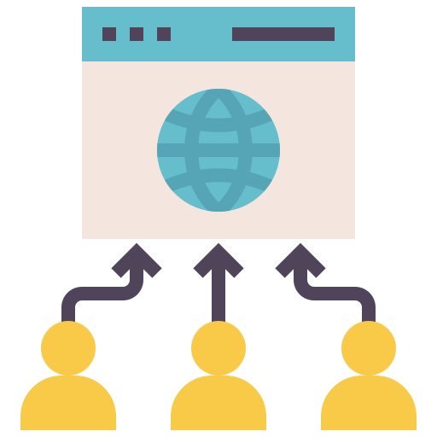

1 Membership systems
94% of the top websites listed on Alexa have such membership systems.
94%
Membership systems
Notes:
I believe every one of you has used the membership systems provided by different websites.
In our research, We found that ninety-four percent of top websites have such membership systems.

Slide 3
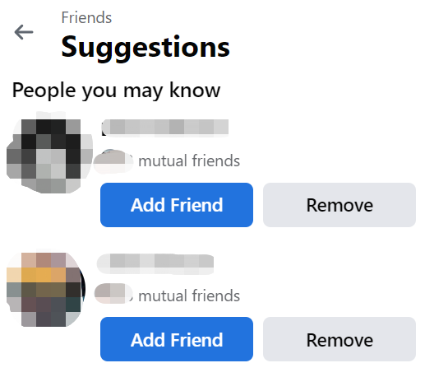
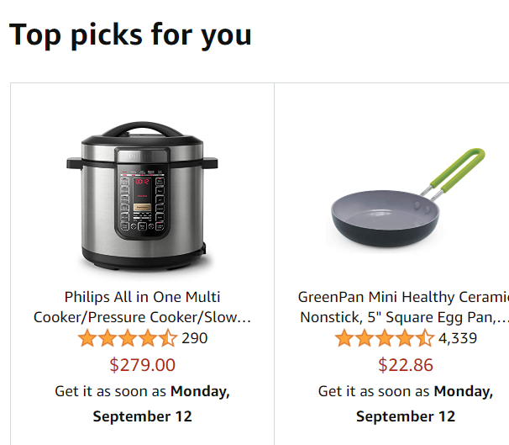
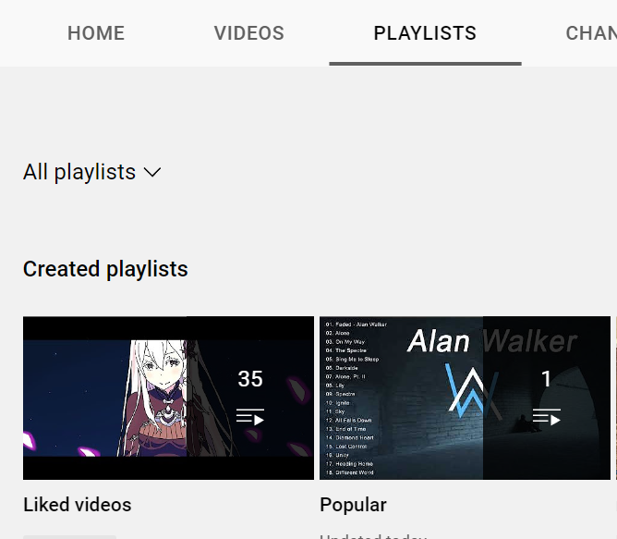
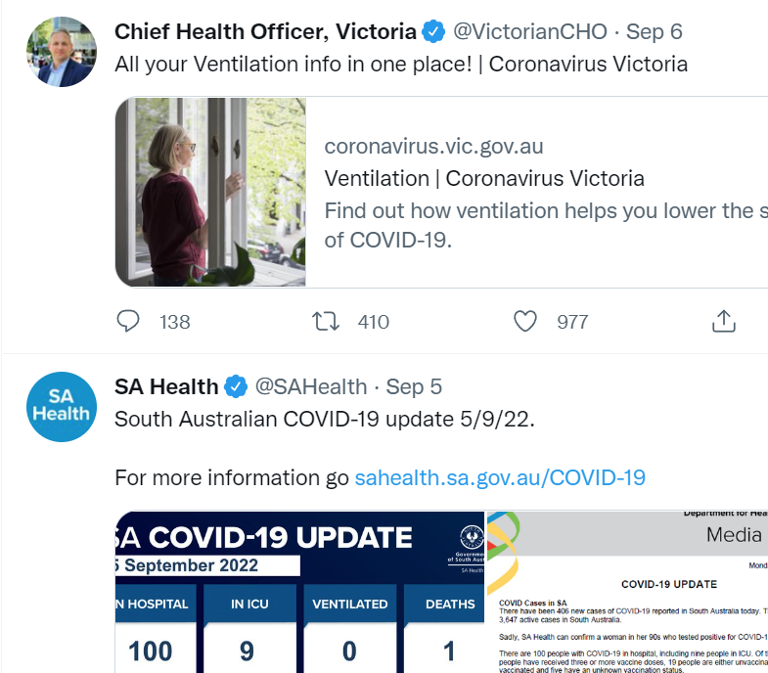


1 Membership systems
94% of the top websites listed on Alexa have such membership systems.
Friend suggestions
Shopping recommendations
Saving videos
Posting opinions
Notes:
With these membership systems, websites provide customised experiences, such as friend suggestions, shopping recommendations, saving videos, and posting your opinions.

Slide 4








1 Membership systems
There is also network crime using membership systems.
Collecting welcome coupons
Fabricating false ranking
How can an attacker get so many accounts for his attacks?
Account registration bots
Fake followers
Fake comments
Attackers
Notes:
However, there is also network crime using the membership system,
such as collecting welcome coupons, fabricating false rankings, and creating fake followers and comments.
OK. Here comes the question: How can an attacker get so many accounts?
Yes, the answer is Account registration bots. But how can these bots automatically create accounts?

Slide 5
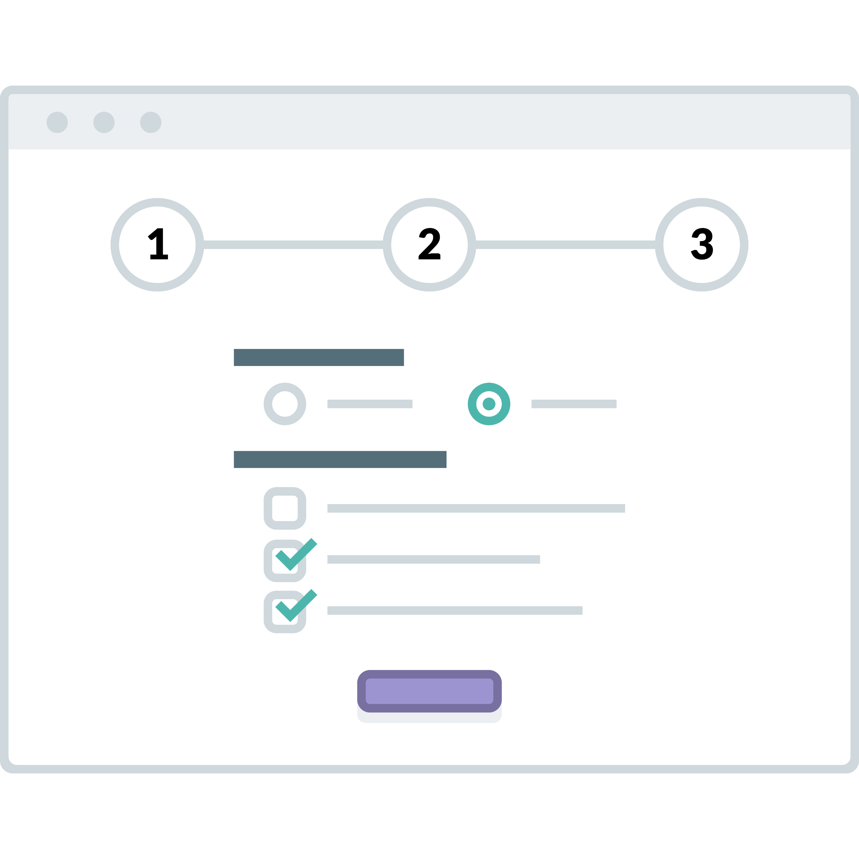

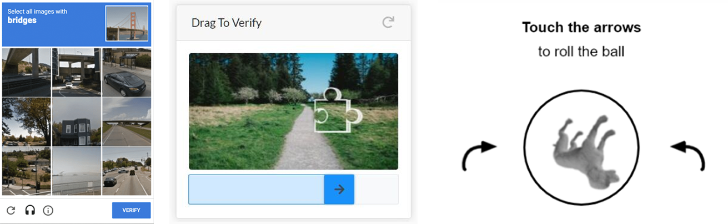
2.1 CAPTCHA
CAPTCHA
Completely Automated Public Turing test to tell Computers and Humans Apart
Text CAPTCHA
Create an account
Interactive CAPTCHA
Notes:
Of course, website owners use many different methods to prevent bots.
The most popular one is CAPTCHA.
Every time we create a new account, we see many kinds of CAPTCHA, such as the text CAPTCHA and interactive CAPTCHA, which include some click puzzles or sliding puzzles.

Slide 6

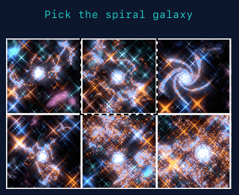



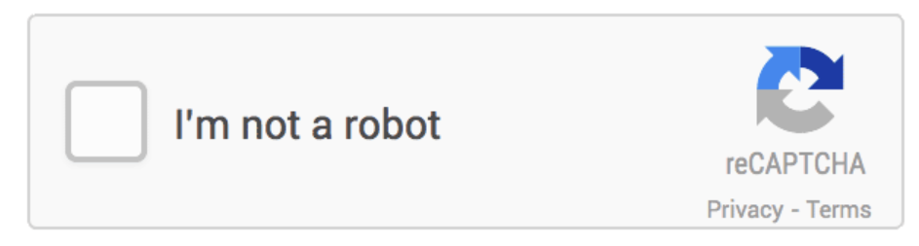

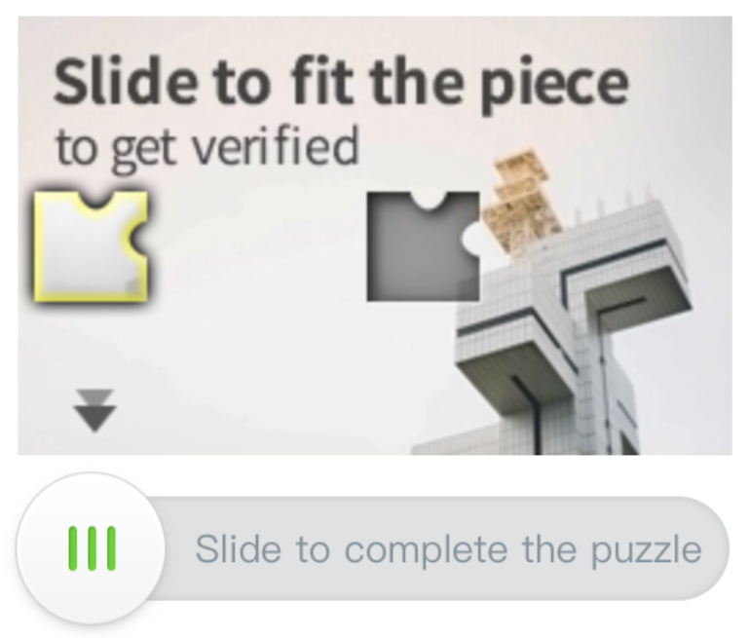

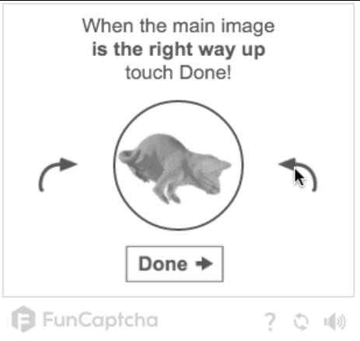

2.2 Human Verification in Registration
SMS verification and various forms of CAPTCHA are the most widely used human verification methods.
Restriction methods (Number of websites)
SMS (84)
Click puzzle (9)
Text CAPTCHA (46)
Third party account (8)
Top 200 websites
Google reCAPTCHA (22)
Smart click (4)
Sliding puzzle (15)
Phone voice (3)
Slider (12)
Funcaptcha (2)
Notes:
To understand the ecosystem of registration bots, we conduct a preliminary study to understand the human verification used by websites.
We manually analysed the top 200 popular websites and identified the verification methods they used.
SMS verification and CAPTCHA are the most widely used.

Slide 7
2.3 The Ecosystem of Registration Bots
Anti-human verification services
Notes:
Now, it’s time to have a look at the ecosystem of registration bots.
For normal users, when they want to create a new account, they have to finish the verifications by themselves.
However, malicious registrants can use their automatic tools, the registration bots, to create accounts automatically.
These tools may be developed by tools developers.
With the help of anti-human verification services, these tools can bypass the verification and create accounts.
In the end, the account sellers will sell these accounts in underground markets.
There is no doubt that anti-human verification services are the most important.

Slide 8
3 Anti-human verification services
Notes:
Based on our research of registration tools, we found the most critical three anti-human verification services.
The first one is the SMS receiving services, which can bypass SMS verification.
The second one is the CAPTCHA recognition services, which can bypass the various CAPTCHA.
And the third one is the Proxy services, which can bypass IP restrictions.
Now, let’s dive into these three services and learn more about them.

Slide 9
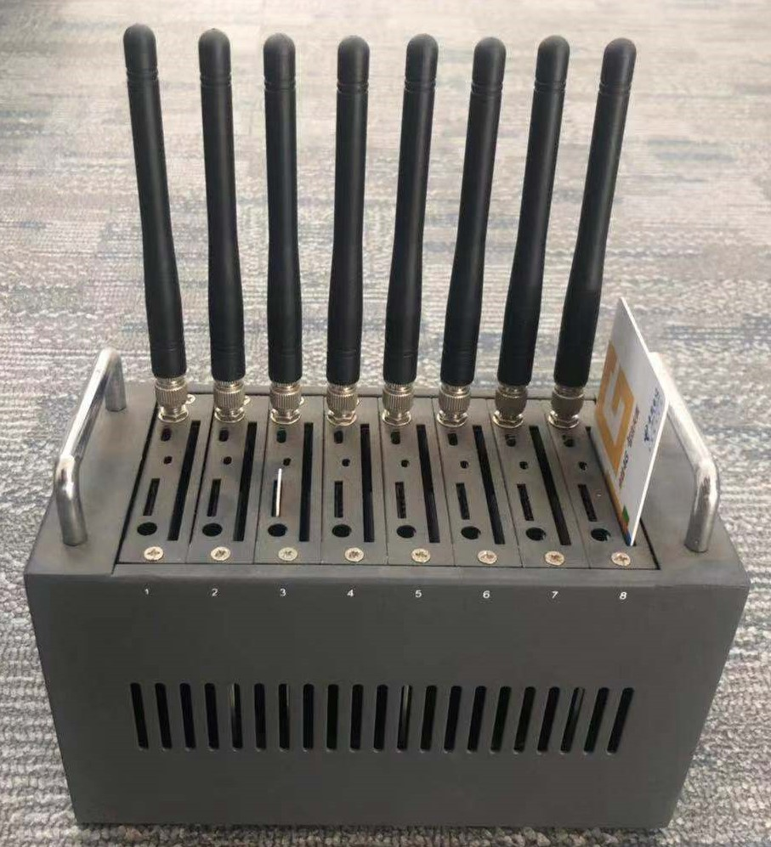
3.1 SMS Receiving Services
How can the SMS receiving services collect so many mobile numbers?
SIM cards
Device
SIM Card Supplier
SIM Card Supplier
SIM Card Supplier
SMS Receiving Service Platform
Notes:
TODO: find some icons for the platform and supplier.
How can the SMS receiving services collect so many mobile numbers?
Generally, SMS receiving services do not own any SIM cards.
Instead, the SIM card supplier is the actual owner of the phone numbers.
They use a special device like that, which has dozens of slots for SIM cards, to operate all the SIM cards at the same time.
And there are many card suppliers for one receiving service so that they can provide a lot of mobile numbers.

Slide 10




3.1 SMS Receiving Services
The reuse of mobile numbers
Website A
Malicious registrant A
1234-5678
1234-5678
1234-5678
Website B
Malicious registrant B
Website C
Malicious registrant C
Notes:
The receiving service will reuse their phone numbers on different websites.
For this reason, before receiving the SMS code, the user must choose the target websites first. If their targets are different, the services can provide them with the same phone number.
Then this phone number can be used to receive SMS codes on different websites.
The formats of messages are different.
So the SMS receiving services can send these verification codes to the correct receivers.

Slide 11
3.1 SMS Receiving Services
The workflow of an SMS receiving service
Notes:
Now, let’s look at the workflow of an SMS receiving services.
First, the user needs to choose their target website, also called the project.
Second, the service allocates a phone number,
Then the user submits the phone number to the website.
The website will send a code to this number.
And the service transfers it to the user.
In the end, the user gets the code and submits it.

Slide 12
3.2 CAPTCHA recognition Service
How can a CAPTCHA be bypassed?
Text CAPTCHA
Machine learning model
Interactive CAPTCHA
Labourers
Notes:
The next is the CAPTCHA recognition service.
How can a CAPTCHA be bypassed?
It depends on the types of CAPTCHA.
The easy types, such as text CAPTCHA, can be solved by a machine learning model.
But for the interactive CAPTCHA, most of them need to be solved manually by the labourers.

Slide 13
3.2 CAPTCHA recognition Service
The workflow of CAPTCHA recognition services
Notes:
TODO: add the details about choosing the CAPTCHA type.
The workflow of CAPTCHA recognition services is simple.
First, the user observes the puzzle from the website
and then transfers it to the CAPTCHA recognition service.
The service will solve it and send back the answer.
In the end, the user gets the result and submits the answer.

Slide 14
3.3 Proxy Service
How can they get a mass of IP addresses?
ADSL
VPS
Proxy services
Notes:
The last one is the proxy service. They can provide many different IP addresses for the bots to bypass the IP restrictions.
But how can they get a mass of IP addresses?
There are two major sources of their IP addresses.
The first one is the ADSL network service, which provides a different IP address for every dial.
The other one is the cheap VPS, which can provide static IP addresses.

Slide 15
3.3 Proxy Service
The workflow of proxy services
Notes:
Now let’s look at the workflow of proxy services.
When the user applies for an available IP, the proxy service allocates an IP proxy server to the user.
And the user can access the target website through the given proxy server.

Slide 16
4 Measurement of Anti-human Verification Services
RQ1: How many SMS receiving services are there in the wild and how many mobile phone numbers can be abused?
RQ2: Can existing CAPTCHA recognition services successfully bypass the diverse verification mechanisms?
RQ3: Can an IP proxy service provide enough services to efficiently fulfill the needs of large-scale account registrations?
RQ4: Can these anti-human verification services be used together for automatic account registration?
Notes:
After that, we tried to measure these three anti-human verification services.
Our research was driven by the following research questions.

Slide 17

4.1 SMS Receiving Services
Collection Script
Day 1
Day 31
Lifetime
1111-1111
1111-1111
1111-1111
1111-1111
2222-2222
2222-2222
2222-2222
2222-2222
Daily active phone numbers
3333-3333
5555-5555
5555-5555
3333-3333
4444-4444
3333-3333
3333-3333
4444-4444
4444-4444
4444-4444
6666-6666
6666-6666
6666-6666
Daily new phone numbers
Notes:
To collate as many phone numbers as possible, we developed a script to collect phone numbers from SMS receiving services we found for 31 days.
Based on the phone numbers we collected for each day, there are three important features.
The first one is the daily active phone numbers, which means how many different phone numbers are provided by the services.
The second one is the daily new phone numbers, which means how many new phone number appears in one day.
The third one is the lifetime of phone numbers, which means how many days we can see a phone number in our records.

Slide 18
4.1 SMS Receiving Services
ID | Domain | AVG. Daily active phone numbers | AVG. Daily new phone numbers | AVG. Lifetime (days)
1 | www.51ym.me | 1,451,529 | 61,540 | 15.93
2 | www.mangopt.com | 951,641 | 11,271 | 16.01
3 | www.cherryun.com | 220,676 | 9,557 | 15.54
4 | www.haima668.com | 28,208 | 2,487 | 13.9
5 | www.baiwanma.com | 77,838 | 2,918 | 13.73
6 | w6888.cn | 25,746 | 3,890 | 15.57
7 | www.yika66.com | 77,864 | 2,003 | 24.42
8 | www.yzm7.com | 27,010 | 907 | 13.58
9 | fxhyd.cn | 1,451,601 | 61,931 | 16.26
10 | js-yzm.com | 24,704 | 6,799 | 7.36
11 | www.shou-ma.com | 77,844 | 3,175 | 13.57
12 | www.51zggj.com | 223,934 | 19,579 | 11.06
13 | www.fxyzm.cn | 18,507 | 3,497 | 7.3
14 | www.yiyun66.com | 15,247 | 3,424 | 7.82
15 | www.517orange.com | 139,917 | 7,067 | 16.38
16 | www.ximahuang.com | 244,441 | 21,400 | 12.8
17 | api.ctep.cn | 283,102 | 26,598 | 8.28
18 | www.zxjmpt.com | 12,408 | 2,794 | 13.46
19 | www.66yzm.com | 629,141 | 21,404 | 14.82
20 | www.xinheyz.com | 1,453,282 | 20,352 | 16.96
21 | 47.244.115.89 | 6,351 | 101 | 4.71
22 | 120.78.91.0 | 3,476 | 1,144 | 10.89
23 | www.kmiyz.com | 12,760 | 5,452 | 10.79
24 | www.mili18.com | 28,384 | 7,925 | 12.11
25 | www.20982098.com | 51,554 | 1,340 | 10.36
26 | web.166idc.com | 47,278 | 1,281 | 12.61
Answer to RQ1
There are many SMS receiving services in the wild.
These SMS receiving services hold a mass of active phone numbers.
These services add tens of thousands of new phone numbers daily.
These phone numbers have a lifetime of about 10-15 days to allow for multiple uses.
Notes:
At last, we identified over 8 million different phone numbers from 26 SMS receiving services over 31 days.
And our experimental results can answer our first research question:

Slide 19











4.2 CAPTCHA Recognition Services
96688
32434
94853
2646
X:114
x=61,y=149
Notes:
For the CAPTCHA recognition services, we collect CAPTCHA images from different websites and use the CAPTCHA recognition services to solve them.
Then we manually check the result.
In addition, for the interactive CAPTCHA, we first mark the result on the pictures and then check them.
For the google reCAPTCHA, we analysed the website's response data to check the result.

Slide 20
4.2 CAPTCHA Recognition Services
Websites | chaojiying.com | yundama.com | chaorendama.com | fateadm.com | jsdati.com
www.360.cn | 94% | 94% | 91% | 94% | 78%
www.sina.com.cn | 85% | 91% | 84% | 88% | 92%
www.alipay.com | 89% | 88% | 86% | 91% | 85%
www.tianya.cn | 84% | 89% | 86% | 85% | 95%
www.huanqiu.com | 91% | 94% | 97% | 98% | 95%
www.caijing.com.cn | 95% | 92% | 100% | 93% | 100%
www.jrj.com.cn | 73% | 91% | 27% | 86% | 99%
www.baike.com | 67% | 80% | 77% | 85% | 78%
www.cdstm.cn | 100% | 100% | 98% | 99% | 98%
www.163.com | 82% | 90% | 85% | 94% | 40%
www.jiameng.com | 36% | 70% | 72% | 81% | 0%
www.scol.com.cn | 75% | 64% | 55% | 69% | 79%
www.chinadaily.com.cn | 96% | 89% | 87% | 92% | 90%
www.sonhoo.com | 51% | 55% | 46% | 37% | 48%
www.zol.com.cn | 78% | 83% | 78% | 86% | 74%
www.bzw315.com | 94% | 91% | 94% | 96% | 95%
www.91jm.com | 99% | 91% | 99% | 99% | 100%
www.efu.com.cn | 83% | 85% | 79% | 85% | 72%
www.zhiding.cn | 89% | 94% | 86% | 94% | 92%
www.focus.cn | 71% | 63% | 66% | 67% | 43%
www.gusuwang.com | 84% | 63% | 75% | 89% | 78%
www.haofang.net | 93% | 88% | 92% | 99% | 94%
www.photofans.cn | 93% | 95% | 95% | 99% | 96%
www.ceconline.com | 100% | 99% | 98% | 96% | 96%
www.gamersky.com | 75% | 87% | 93% | 85% | 50%
www.ibicn.com | 65% | 86% | 86% | 92% | 87%
www.cpic.com.cn | 98% | 97% | 97% | 96% | 98%
www.cnki.net | 90% | 83% | 89% | 90% | 83%
weibo.com | 91% | 95% | 99% | 94% | 96%
Apple.com | 94% | 96% | 93% | 87% | 77%
Tribunnews.com | 93% | 94% | 98% | 94% | 98%
Wikipedia.org | 64% | 59% | 10% | 38% | 67%
Answer to RQ2
In most popular websites, the CAPTCHA recognition service can bypass the diverse CAPTCHA verifications.
For text CAPTCHAs, in more than 93% of cases, the accuracy rate was higher than 50%.
The interactive and non-sense CAPTCHA also can be bypassed.
Notes:
With such a method, we test 32 websites.
And with our result, we can answer the research question 2:

Slide 21


4.3 Proxy Service
Real IP: 6.6.6.6
HTTP request
Script
Analysis Server
HTTP request
Proxy IP
Available
Anonymous
GET / HTTP/1.1
Host: analysis-server.com
…
HTTP_X_FORWARDED_FOR: [EMPTY]
…
1.1.1.1
2.2.2.2
3.3.3.3
GET / HTTP/1.1
Host: analysis-server.com
…
HTTP_X_FORWARDED_FOR: 6.6.6.6
…
4.4.4.4
Notes:
The next is Proxy services.
We developed a script to collect IP addresses from the proxy services.
Then we used these IPs to visit our analysis server to check whether they were available or anonymous, which means we could not get the real IP from an HTTP request.

Slide 22
4.3 Proxy Service
Platform | IP Count | IP repetition rate | IP availability rate | Anonymity
www.xdaili.cn | 1600 | 15% | 98% | Y
www.moguproxy.com | 36000 | 10% | 98% | Y
www.kuaidaili.com | 2370 | 0 | 98% | Y
h.zhimaruanjian.com | 1075 | 0 | 97% | Y
www.daxiangdaili.com | 34000 | 32% | 92% | Y
Answer to RQ3
The proxy services can provide many available IP addresses, from thousands to tens of thousands per day.
Most of these IP addresses have high availability and low repetition.
With their anonymity, these IP addresses can be used efficiently for registration bots to bypass IP restrictions.
Notes:
With such a method, we test 5 proxy services, and now we can answer the research question 3:

Slide 23
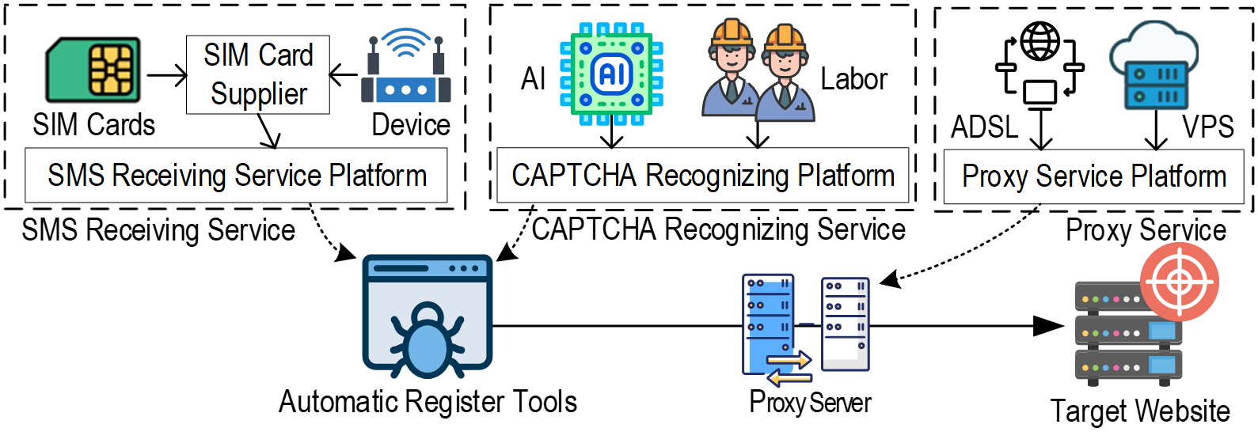
4.4 Registration test in real world websites
taobao.com
bilibili.com
zhihu.com
weibo.com
github.com
Answer to RQ4
Our experiments show that creating new accounts on websites can be automated simply by combining these anti-human verification services.
Although sometimes more than one attempt was needed to recognize a CAPTCHA or receive an SMS, the anti-human verification tools we assembled worked well on all the websites we tested.
Notes:
In the end, we combined all these three services and tried to create accounts on five real-world websites. Of course, we did it.
Now, we can answer the research question 4:

Slide 24
5 Characterizing the Impact
RQ5: Which websites are their targets and how many bot accounts are created?
RQ6: Can we estimate the market size of this underground ecosystem?
Notes:
With the data collected from the anti-human verification services, we further attempted to characterize the impact of these registration bots by answering the following research questions:

Slide 25
5.1 Estimating the number of registered accounts
Forgot password / Available check
Script
10,000 mobile phone numbers
Registered?
Websites | Type | Number of registered accounts | Percentage
baidu.com | Search engine and SNS | 2012 | 20.12%
sina.cn | News and SNS | 1804 | 18.04%
yylive.cn | Live online | 3778 | 37.78%
zhihu.com | Q&A website | 2725 | 27.25%
Answer to RQ5
Our result reveals that all types of websites are the targets of registration bots.
Moreover, about 20%-40% of mobile phone numbers we collected from SMS receiving services have been used to create new accounts.
Notes:
We selected 10,000 phone numbers to check whether they had been used to create accounts. We used the forgot password services or available check services provided by websites.
With the results on four different kinds of websites, we can answer the research question 5:

Slide 26

5.2 Market size estimation
×
Daily new
phone numbers
Number of registered accounts per mobile number
Cost per registration
×
=
Daily market size
$0.01724 - $0.45296
310,000
2.5
$13,361.00 - $351,044.00
Yearly market size
 | price
SMS Receiving Service | $0.015 - $0.15
CAPTCHA recognition Service | $0.0015 - $0.30
IP Proxy Service | $0.00074 - $0.00296
Tencent Mobile Manager
$13,361.00 - $351,044.00
100 mobile phone numbers
from SMS receiving services
Answer to RQ6
The market size of the malicious registration ecosystem sits at between US$4.8-128.1 million per year. However, because we cannot cover all the data of these services, the actual market size is bound to be much larger.
Notes:
Next, we try to calculate the market size.
First, we collect the price for each service and add them together as the cost per registration.
Then we multiply by the average daily new phone numbers.
The last one is the number of accounts created by each phone number. We manually check 100 mobile numbers with the Tencent Mobile Manager, which can tell you how many accounts have been created by one phone number. The result is 2.5.
OK, now we can get the daily market size and answer the research question 6.

Slide 27
6 Discussion
Bypass types
SMS receiving services and IP proxy services
CAPTCHA recognition services
We believe tracing phone number reuse and disrupting the bypassing workflows could throttle these two bypass types.
Notes:
In the end, we want to discuss the results of our research.
According to the differences in workflows, there are two major types of bypass services:
The first type includes the receiving services and IP proxy. They collect a lot of phone numbers and IPs to bypass verifications.
The second type is the CAPTCHA recognition services. They solve the CAPTCHA by machine learning or labour.
We believe tracing phone number reuse and disrupting bypassing workflows could throttle these two bypass types.

Slide 28
6 Discussion
Efforts and developments based on our findings
Adopt random SMS templates, deploy diverse CAPTCHA or even display them randomly
Track malicious registrations with the same phone numbers across websites in a short period
Uncover some malicious phone numbers with our data collection method
Notes:
According to our findings, we can defend against the registration bots using some methods, such as:
Adopt random SMS templates, deploy diverse CAPTCHA or even display them randomly to can disrupt the workflows.
Track malicious registrations with the same phone numbers across websites in a short period.
And uncover malicious phone numbers our data collection method.

Slide 29
Thanks!
We have released our dataset at:
https://mobile-app-research.tech/
Notes:
Thanks for your listening.
And we have released our dataset on our website.
Thanks.

