Slide 1
Confirmation Review:
DNN Verification with Symbolic Abstraction
-- Improving Software Analysis
Candidate: Jiawei Ren
Supervisor: Yulei Sui

Slide 2
Summary
Completion of GSOE9400 and required modules
Literature review
Research proposal
Paper accepted
Jiawei Ren, Yulei Sui, Xiao Cheng, Yuan Feng, and Jianjun Zhao. 2024. Dynamic Transitive Closure-Based Static Analysis through the Lens of Quantum Search. TOSEM (CORE A* journal)
Xiao Cheng, Jiawei Ren, and Yulei Sui. 2024. Fast Graph Simplification for Path-Sensitive Typestate Analysis through Tempo-Spatial Multi-Point Slicing. FSE (CORE A* conference)
1

Slide 3
Outline
Background
Literature Review
Research Gap
My Approach
Future Plan
Checklist
2

Slide 4
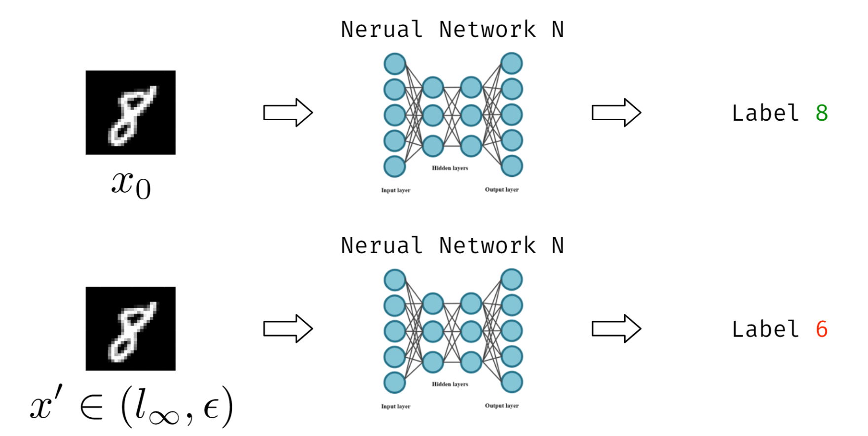
Adversarial Attack
Input image
Prediction
Background: DNN Verification
3

Slide 5


Neural Network Robustness Certification
Perturbed Input image
Prediction
Certification
The robust DNN satisfies:
Background: DNN Verification
4

Slide 6
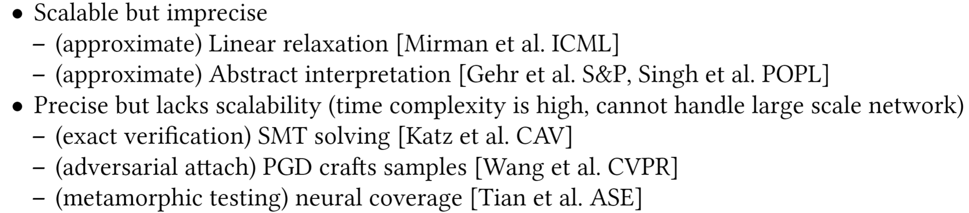
Existing Works
Literature Review: DNN Verification
5

Slide 7

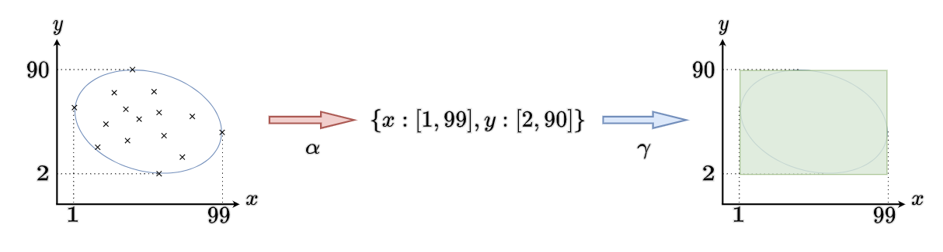
Abstract Interpretation
Sound approximation of the semantics of computer programs
Infer program variable information without running the program
Example.
concrete value
abstract value
abstraction
concretization
precision loss
Background: Abstract Interpretation
6

Slide 8
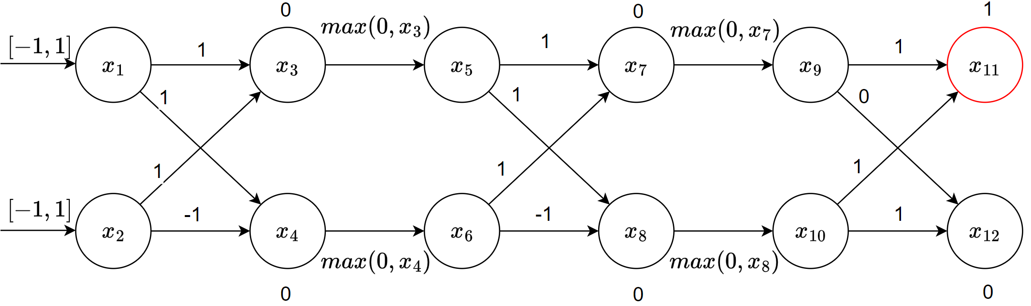
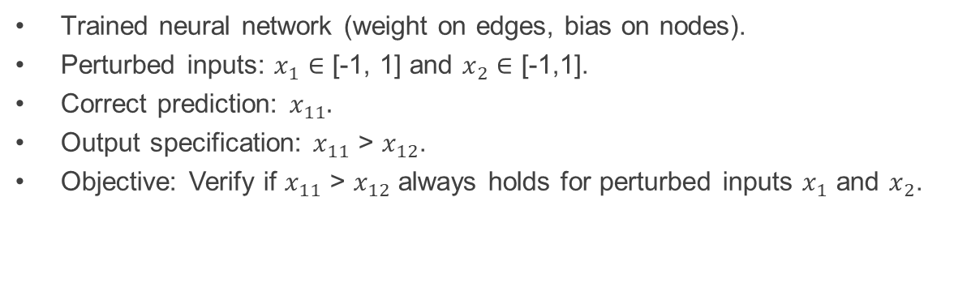
Example Neural Network
Trained neural network (weight on edges, bias on nodes).
Perturbed inputs: $x_{1}$ $∈$ [-1, 1] and $x_{2}$ $∈$ [-1,1].
Correct prediction: $x_{11}.$
Output specification: $x_{11}$ > $x_{12}$.
Objective: Verify if $x_{11}$ > $x_{12}$ always holds for perturbed inputs $x_{1}$ and $x_{2}$.
7

Slide 9
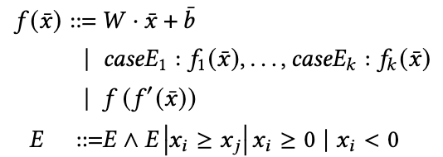
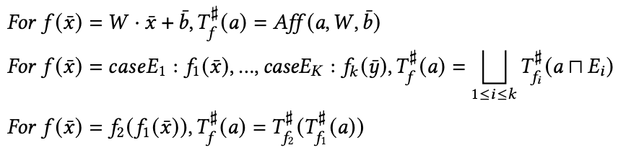
Rules For Abstract Interpretation-Based DNN Verification [Gehr et al. S&P]
Symbolic relations
Basic affine transformation (e.g., FCN)
Conditional cases (e.g., ReLU)
Recursive application (e.g., Layer)
Abstract transformer
Basic abstract transformer
Conditional cases
Recursive application
join and meet of the abstract domain
8

Slide 10
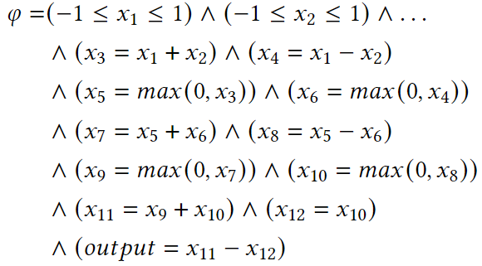
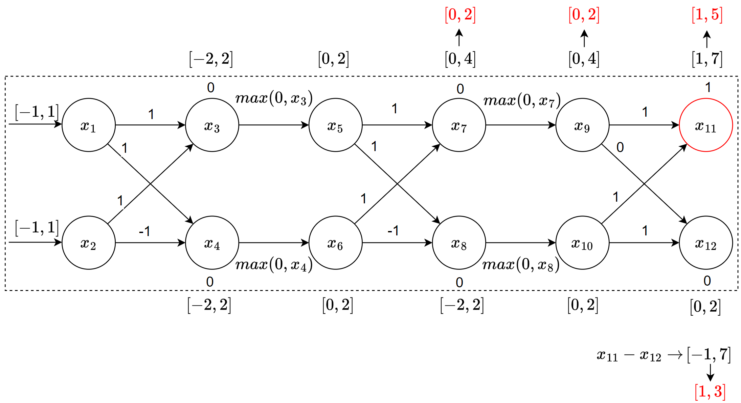

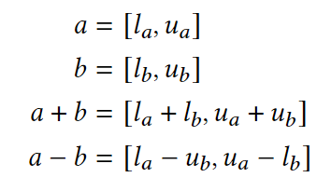

Analysis Result by Interval Domain
Fail to certify
Cannot prove $x_{11}>x_{12}$ always holds
Example
9

Slide 11
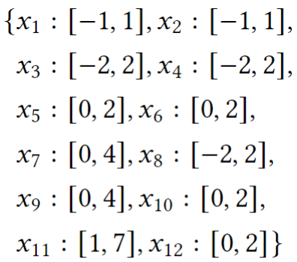
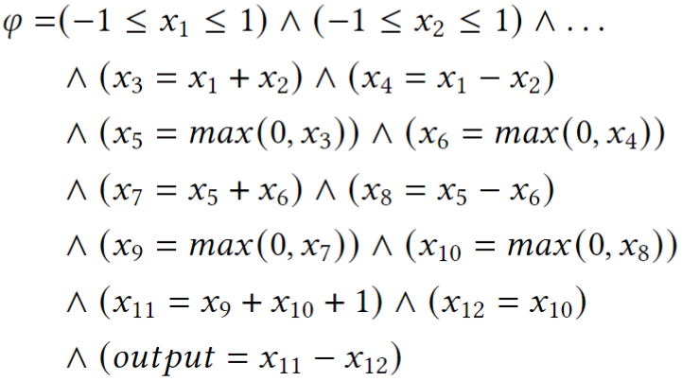
Between Abstraction and Logic
We can get abstract value and symbolic relation from DNN.
Can we improve analysis results?
Abstract value logical formula (symbolic relation)
?
Background: Symbolic Abstraction
10

Slide 12
Motivation
Most of existing works improve DNN verification by applying code verification techniques.
Investigate more advanced verification techniques from code verification.
Code Verification DNN Verification
Background: Symbolic Abstraction
11

Slide 13

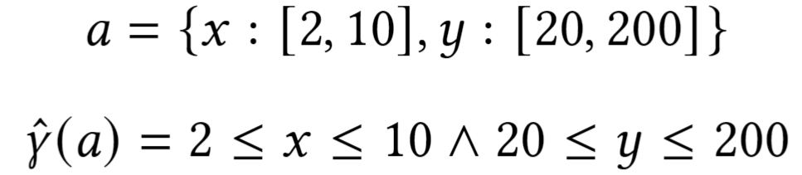
From Abstraction to Logic
Easy to translate from abstraction to logical formulas.
Symbolic concretization
How about moving from logic to abstraction?
Background: Symbolic Abstraction
12

Slide 14

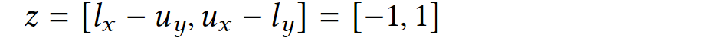
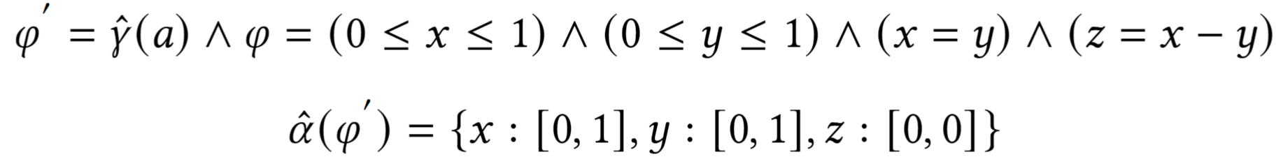
From Logic to Abstraction
We can apply symbolic abstraction to improve precision
Use logical formula to refine abstract value.
Symbolic abstraction
Improve abstract value to the best value.
Example in interval domain
Interval subtraction:
Symbolic abstraction:
Background: Symbolic Abstraction
13

Slide 15
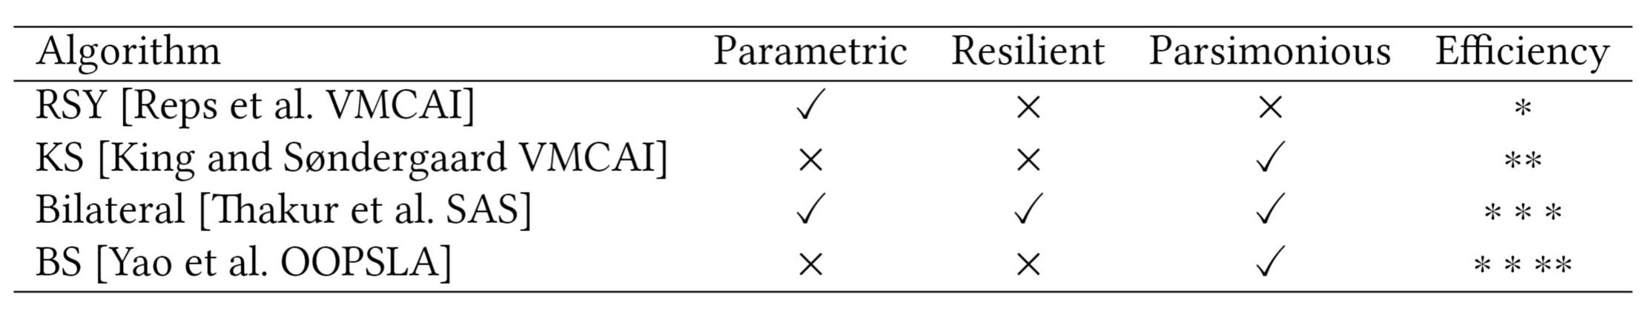
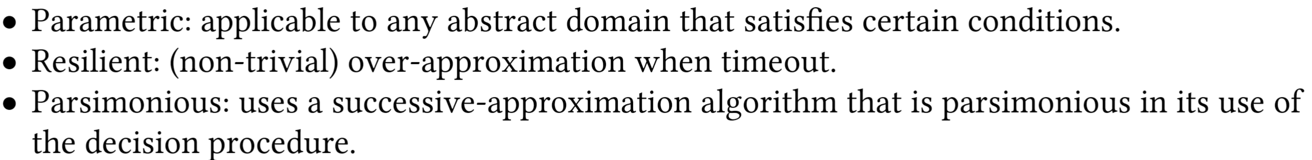
Existing Symbolic Abstraction Algorithms
binary search
interval domain and polyhedral domain
Literature Review: Symbolic Abstraction
14

Slide 16
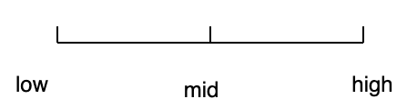
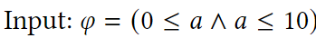
BS-Based Symbolic Abstraction [Yao et al. OOPSLA]
Reduce to Boxed OMT (Optimization Modulo Theories) problem.
Maximize the value of a variable x satisfying the given constraint using binary search strategy.
Reverse the sign and maximize -x to get the minimized value.
Example:
In the worst case, we get 0,1,2…10, which calls SMT solver 11 times. (O(N))
BS reduces the number of calls to 3 times. (O(log N))
C1: search from [5,10] and get a=5,
C2: search from [8,10] and get a=8,
C3: search from [10,10] and get a=10.
Maximizing multiple variables: reduce the total number of calls to SMT solver using conjunctive predicate abstraction.
Literature Review: Symbolic Abstraction
15

Slide 17
Research Gap
Precision : DNN verification + symbolic abstraction.
Efficiency: Improve the efficiency of symbolic abstraction.
16

Slide 18
Objectives
Github repo of our research group
Develop C++ DNN verification framework on SVF with another PhD student.
Support interval domain analysis according to AI2 [Gehr et al. S&P].
Plan to extend the support for symbolic abstraction.
My Approach
17

Slide 19
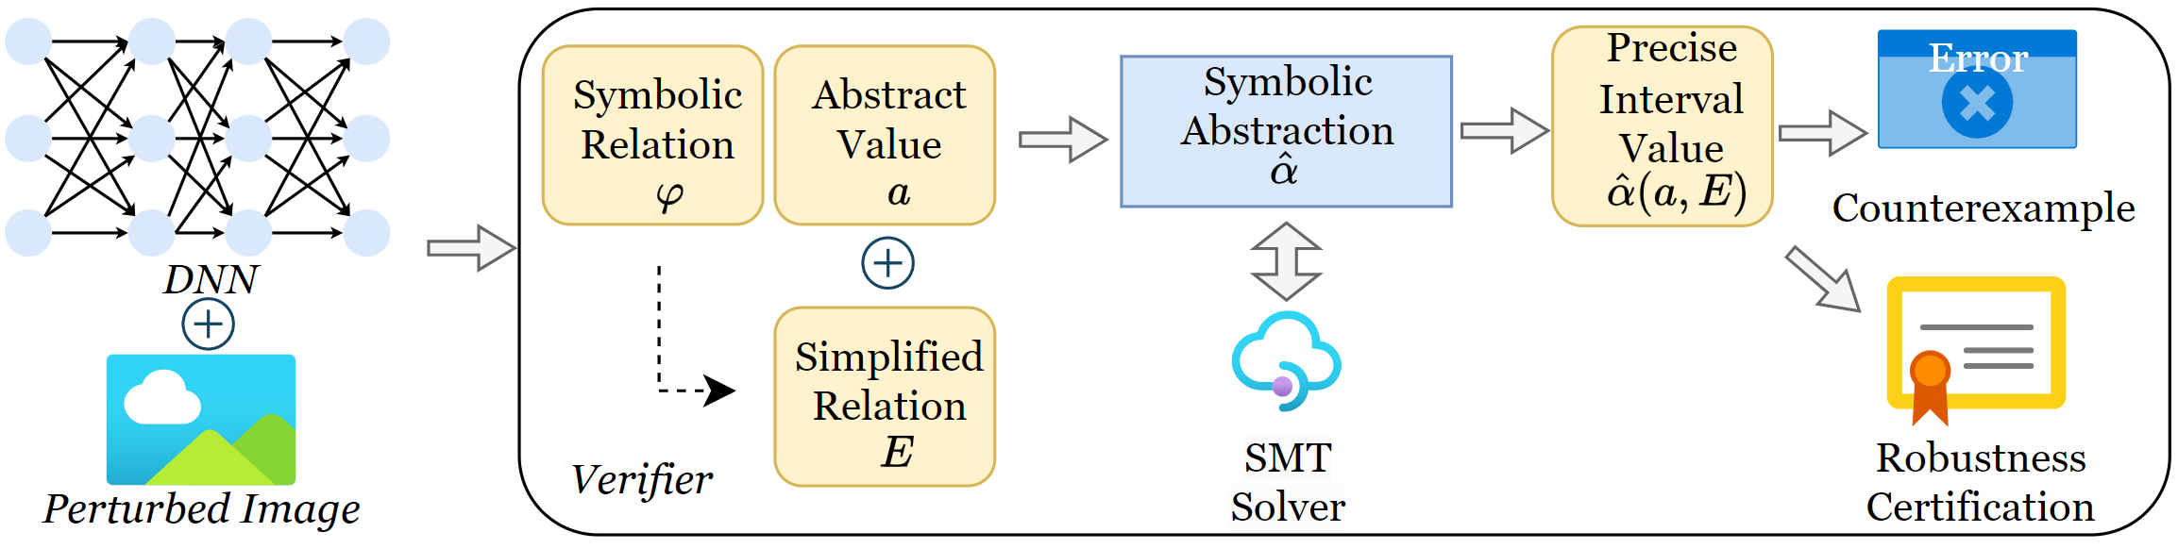
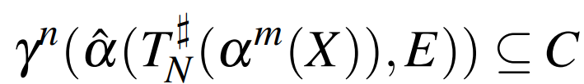
Proposed Method
The final goal is to prove:
Concretization function
Robustness property
Symbolic abstraction
Symbolic relation
Abstraction function
Abstract transformer
Input
My Approach
18

Slide 20
My Approach
Advantages:
Symbolic abstraction builds connections between interval and logic.
Symbolic abstraction can improve the precision of DNN verification.
Symbolic abstraction on interval domain can provide exact DNN verification.
Symbolic propagation can reduce the constraint complexity.
My Approach
19

Slide 21
Problems
Precision: Interval domain does not store relationships between variables.
Efficiency: Too many nodes in DNN lead to too many variables in constraint.
My Approach
20

Slide 22
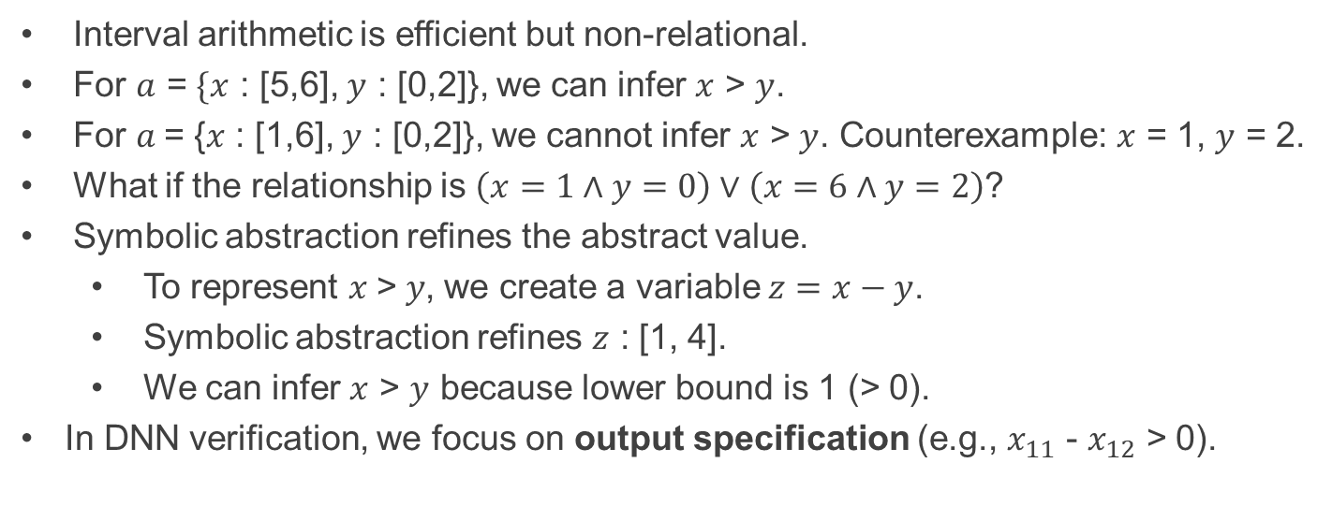
Variable Relationships on Interval Domain
Interval arithmetic is efficient but non-relational.
For $a$ = $\{x$ : [5,6], $y$ : [0,2]}, we can infer $x$ > $y$.
For $a$= {$x$ : [1,6], $y$ : [0,2]}, we cannot infer $x$ > $y$. Counterexample: $x$ = 1, $y$ = 2.
What if the relationship is $\left(x=1∧y=0\right)∨\left(x=6∧y=2\right)$?
Symbolic abstraction refines the abstract value.
To represent $x$>$y$, we create a variable $z=x−y$.
Symbolic abstraction refines $z$ : [1, 4].
We can infer $x$ > $y$ because lower bound is 1 (> 0).
In DNN verification, we focus on output specification (e.g., $x_{11}$ - $x_{12}$ > 0).
My Approach
21

Slide 23

Motivating Example: Exact Robustness Certification
1. Translate entire NN
2. Add output specification to constraint
Success to certify
Precise interval value of output specification
$x_{11}>x_{12}$ always holds because lower bound is 1
My Approach
22

Slide 24
Problems
Precision: Interval domain does not store relationships between variables.
Efficiency: Too many nodes in DNN lead to too many variables in constraint.
My Approach
23

Slide 25
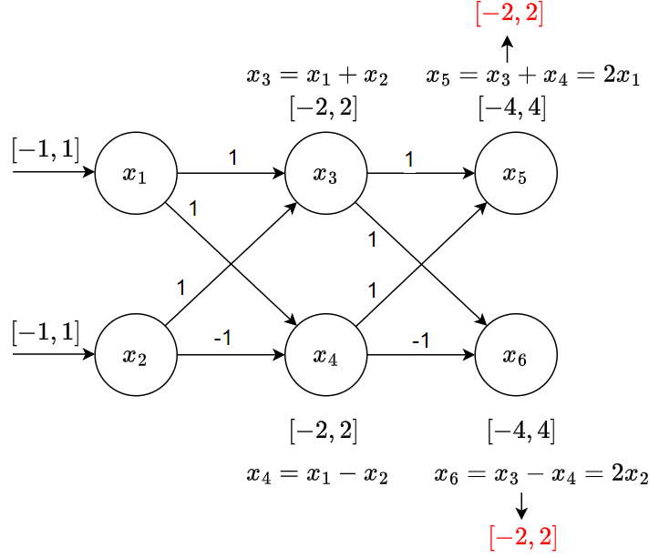
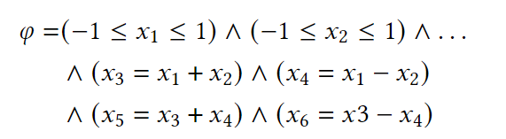
Reduce the Complexity of the Constraint
Symbolic abstraction
Refine
Translate
Snippet from DNN
Relationships are extracted from two linked layers.
My Approach
24

Slide 26
Reduce the Complexity of the Constraint
Symbolic propagation
Symbolic abstraction
same result
Build the relationships between the first layer and the last layer.
Snippet from DNN
My Approach
25

Slide 27

Reduce the Complexity of the Constraint
Symbolic abstraction
+symbolic propagation
Symbolic propagation reduces the constraint complexity for more efficient symbolic abstraction
Snippet from DNN
My Approach
26

Slide 28
Experiment Setting
Micro-benchmark (artificial NN).
Small scale (~ 30 - 500 neurons) including FC, CNN and ReLU.
Real-word benchmark.
Dataset: ACAS-Xu, MNIST, CIFAR-10.
Platform setting:
Symbolic abstraction and interval domain are implemented on SVF.
BS is more than 50 times faster than RSY and Bilateral algorithms when the search space of the logical formula is large.
Abstract interpretation is being implemented on SVF.
Read ONNX DNN file to SVF and analyze the neural network in C++.
27

Slide 29
Experiment Setting
Research questions:
Correctness of the framework.
Correctness testing. (Assertion-based post checking on microbenchmark)
Use SMT solver to get a group of feasible values of neurons in NN.
Check the transformer produces the same results using assertion.
Ablation analysis.
How tight are interval values after symbolic abstraction?
How many variables in the logical formula are reduced by symbolic propagation?
Precision analysis.
Compare analysis result with baselines using real-world benchmark.
28

Slide 30
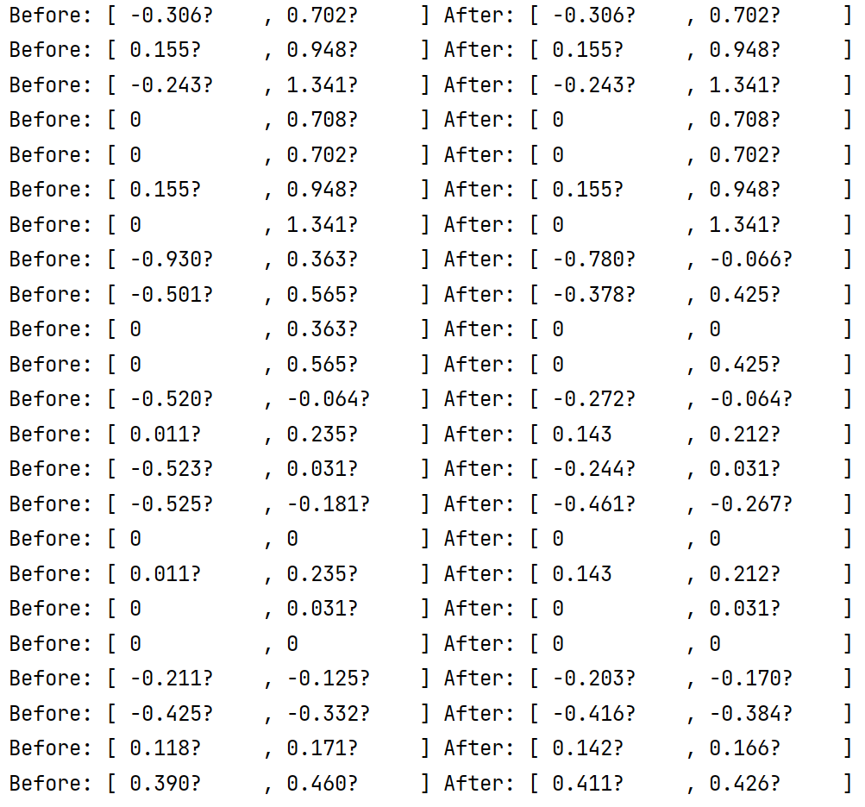
Preliminary Result
Before : Interval value of Interval arithmetic.
After : Interval value after symbolic abstraction
First several lines does not change because they are at the first two layers.
On average, 46% tighter interval range.
44%
25%
100%
25%
54%
69%
50%
43%
0%
69%
0%
0%
61%
65%
54%
78%
29

Slide 31
Experiment Setting
Real-word benchmark.
Baseline choice:
Exact: Reluplex [Katz CAV].
Abstract interpretation: AI2 [Gehr et al. S&P], DeepPoly [Singh et al. POPL].
Dataset: ACAS-Xu, MNIST, CIFAR-10.
Ablation analysis.
How tight are interval values after symbolic abstraction?
How many variables in the logical formula are reduced by symbolic propagation?
Precision analysis.
Can this tool produce more precise result compared to baselines?
To be continued…
30

Slide 32
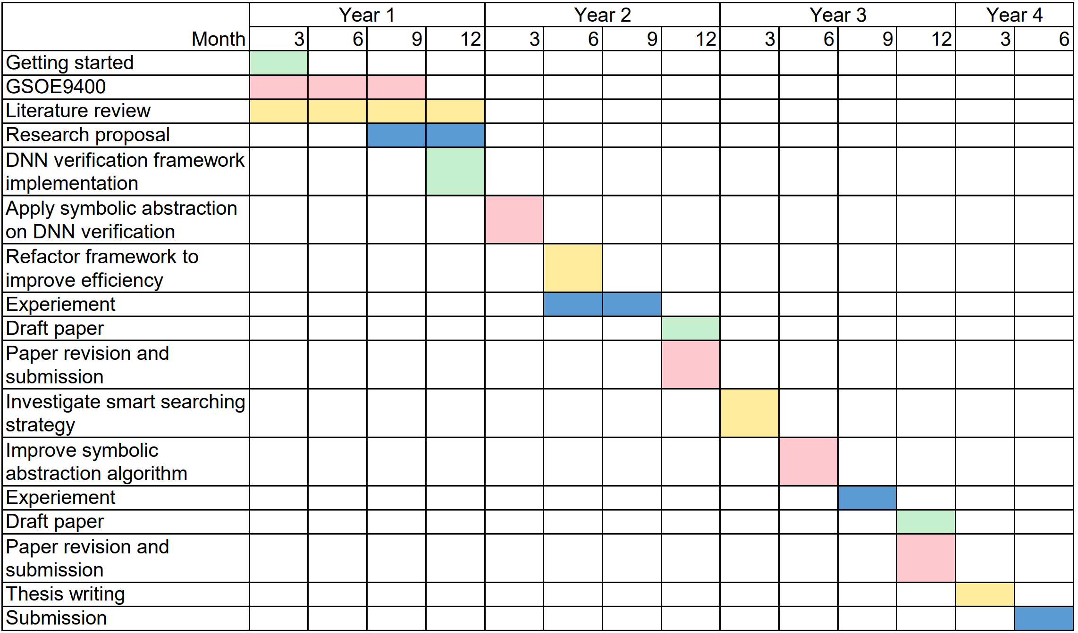
Plan for PhD
1st year: Proposal and literature review.
2nd year: Project 1.
3rd year: Project 2.
4th year: Writing Thesis.
31

Slide 33
Milestones of the Next Year
Apply proposed idea on DNN verification. (6/8/2024)
Improve the framework and complete experiments. (31/12/2024)
Draft paper. (1/4/2025)
Revision and submission. (6/5/2025)
32

Slide 34

First Year Checklist
Literature review
Research proposal
Completion of GSOE9400
Attendance at UNSW Induction for new HDR candidates
Completion of Research Integrity Module
Scheduled regular meetings with supervisory panel
Proof of Research Data management Plan (RDMP)
Proof of Data Archive
Oral Presentation
Milestones
33

Slide 35
Thanks

