Slide 1
Path-Sensitive Typestate Analysis through Tempo-Spatial Multi-Point Slicing
2023-08-18

Slide 2
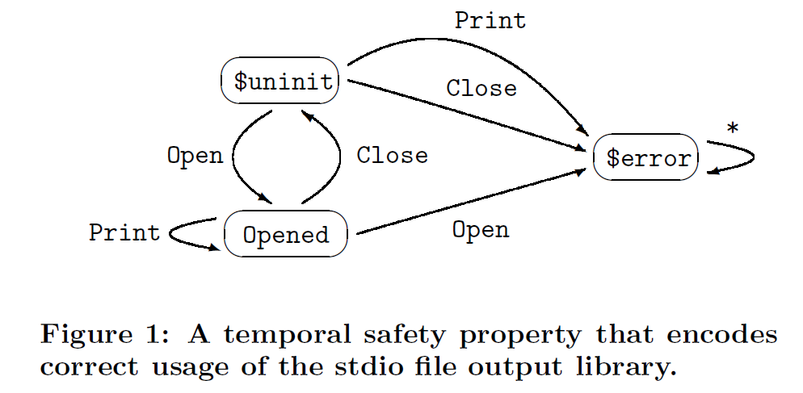
Typestate Analysis
Typestate analysis aims to determine whether a sequence of program operations violates safety specifications established by a finite state automaton (FSA).
This analytical method is highly valuable for detecting a range of vulnerabilities, including incorrect file library usage, use-after-frees/double frees, memory/resource leakages, access controls, and concurrency bugs.

Slide 3
Path-Sensitive Typestate Analysis (PSTA)
Path-sensitive typestate analysis (PSTA) enhances the precision of its path-insensitive counterpart by capturing correlations between different branches and eliminating false alerts stemming from infeasible paths.
In PSTA, the maintenance of an execution state that captures program variable values and path constraints is crucial, and it evaluates the feasibility of paths when encountering branching points.
if(Var0 < Var1) {
…
} else {
…
}
Variable | Value
Var0 | 5
Var1 | 10
… | …
execution state

Slide 4
Path-Sensitive Typestate Analysis (PSTA)
ESP: Path-Sensitive Program Verification in Polynomial Time
Full path-sensitive analysis: meet-over-path (MOP) solution.
Analyzing each path individually and merge the analysis results at the validation point.
Unbounded number of paths -> too much computational overhead
Unlike full path-sensitive analyses that compute a solution through a meet-over-all-path (MOP) approach, ESP takes a partially path-sensitive approach to avoid examining a potentially unbounded number of program paths.
At a control-flow joint point, ESP merges execution states with identical typestates, yielding a single symbolic state and thus achieving a maximal-fixed-point (MFP) solution with program paths sensitive to typestate preserved.

Slide 5
Path-Sensitive Typestate Analysis (PSTA)
ESP: Path-Sensitive Program Verification in Polynomial Time
Subsequently, several approaches [1-4] propose more effective analysis based on optimizing and speeding up the typestate transitions.
Their main focus is improving the precision of alias analysis, eliminating spurious and duplicated typestate transitions on non-aliased objects.
There are hybrid typestate analysis approaches attempting to combine static typestate analysis with the dynamic residual runtime monitor [5-7] or fuzzing [8].
[1] Stephen J. Fink, Eran Yahav, Nurit Dor, G. Ramalingam, and Emmanuel Geay. 2006. Effective typestate verification in the presence of aliasing. ISSTA 2006.
[2] Mathias Jakobsen, Alice Ravier, and Ornela Dardha. 2021. Papaya: Global Typestate Analysis of Aliased Objects. PPDP 2021.
[3] Tuo Li, Jia-Ju Bai, Yulei Sui, and Shi-Min Hu. 2022. Path-Sensitive and Alias-Aware Typestate Analysis for Detecting OS Bugs. ASPLOS 2022.
[4] Zhiqiang Zuo, John Thorpe, Yifei Wang, Qiuhong Pan, Shenming Lu, Kai Wang, Guoqing Harry Xu, Linzhang Wang, and Xuandong Li. 2019.
Grapple: A Graph System for Static Finite-State Property Checking of Large-Scale Systems Code. Eurosys 2019.
[5] Eric Bodden. 2010. Efficient hybrid typestate analysis by determining continuation-equivalent states. ICSE 2010.
[6] Eric Bodden, Patrick Lam, and Laurie Hendren. 2012. Partially Evaluating Finite-State Runtime Monitors Ahead of Time. TOPLAS.
[7] Matthew B. Dwyer and Rahul Purandare. 2007. Residual Dynamic Typestate Analysis Exploiting Static Analysis: Results to Reformulate and Reduce the Cost of Dynamic Analysis. ASE 2007.
[8] Haijun Wang, Xiaofei Xie, Yi Li, Cheng Wen, Yuekang Li, Yang Liu, Shengchao Qin, Hongxu Chen, and Yulei Sui.2020. Typestate-Guided Fuzzer for Discovering Use-after-Free Vulnerabilities. ICSE2020.

Slide 6
Path-Sensitive Typestate Analysis (PSTA)
ESP: Path-Sensitive Program Verification in Polynomial Time
To the best of our knowledge, all previous endeavors in PSTA primarily focused on enhancing the precision of typestate transitions through alias analysis or exploring new opportunities for integrating dynamic analysis techniques.
We focus on a new and orthogonal perspective, improving the efficiency of the path-sensitive algorithm.

Slide 7
Path-Sensitive Typestate Analysis (PSTA)
Improving the efficiency of the path-sensitive algorithm
Recently, several approaches propose sparse path-sensitive analyses [1-3] to scale path-sensitive analysis to large programs.
The key idea is to propagate data flow facts along def-use chains and skip unnecessary control flows.
[1] Yulei Sui, Ding Ye, and Jingling Xue. 2012. Static memory leak detection using full-sparse value-flow analysis. ISSTA 2012.
[2] Qingkai Shi, Xiao Xiao, Rongxin Wu, Jinguo Zhou, Gang Fan, and Charles Zhang. 2018. Pinpoint: Fast and Precise Sparse Value Flow Analysis for Million Lines of Code. PLDI 2018.
[3] Qingkai Shi, Peisen Yao, Rongxin Wu, and Charles Zhang. 2021. Path-Sensitive Sparse Analysis without Path Conditions. PLDI 2021.

Slide 8
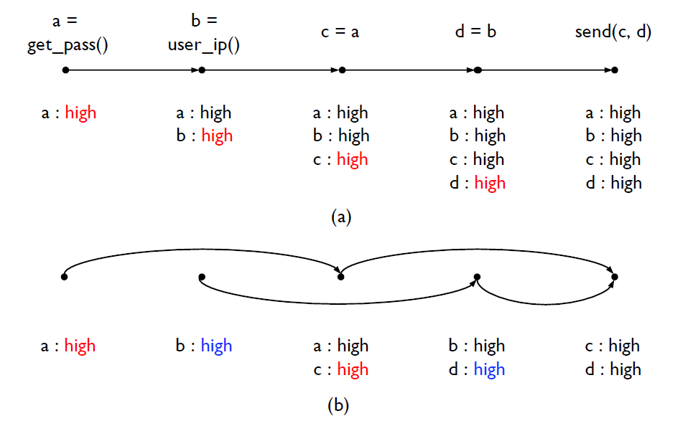
Path-Sensitive Typestate Analysis (PSTA)
Path-Sensitive Sparse Analysis
Conventional analysis
Propagates all data flow facts along the control flows and find a taint issue at the final statement where a password may be sent to a sensitive site.
Sparse analysis
Spatial sparsity: Only stores the data flow facts used at each statement.
Temporal sparsity: propagates the data flow facts along the data dependence edges, thus skipping unnecessary control flows.
- Qingkai Shi, Peisen Yao, Rongxin Wu, and Charles Zhang. 2021. Path-Sensitive Sparse Analysis without Path Conditions. PLDI 2021.

Slide 9
Path-Sensitive Typestate Analysis (PSTA)
Path-Sensitive Sparse Analysis
However, the def-use chains lack information on the temporal execution order on the control flow graph, e.g., use-to-use information.
The sparse analysis is primarily designed to solve source-sink problems such as taint issues.
While the sparse approach does offer the advantage of mitigating the computational burden associated with path-sensitive analysis, it falls short in detecting vulnerabilities associated with typestate concerns, which require a chronological progression of objects within the control flows.
Moreover, in contrast to the focus of the sparse analysis on solving a reachability problem from sources to sinks, PSTA may necessitate tracking multiple sequential program points to identify potential error states, e.g., detecting use-after-frees.

Slide 10
Path-Sensitive Typestate Analysis (PSTA)
Graph Simplification
To preserve the multi-point temporal information while harnessing the benefits of sparse analysis,
we focus on a more practical perspective--reducing the size of the control flow graph (graph simplification), rendering it a sparser structure with unnecessary control flows eliminated.
Our insight comes from slicing techniques, which can narrow the analysis by selectively considering the code fragment related to specific program points of interest.
These techniques are all path-insensitive and are mainly designed for different purposes, e.g., program debugging and comprehension. No prior works have explored multi-point slicing to improve the scalability of the PSTA problem.

Slide 11
Path-Sensitive Typestate Analysis (PSTA)
Graph Simplification
The primary technical challenge lies in devising an effective and efficient multi-point slicing algorithm.
Effectiveness refers to the ability of the algorithm to eliminate as many irrelevant nodes as possible, maximizing the extraction of pertinent information.
Simultaneously, the algorithm should operate efficiently, serving as a pre-processing step that executes significantly faster than the PSTA algorithm itself.
It is also crucial to ensure that the precision of PSTA is not compromised after applying the slicing technique.

Slide 12
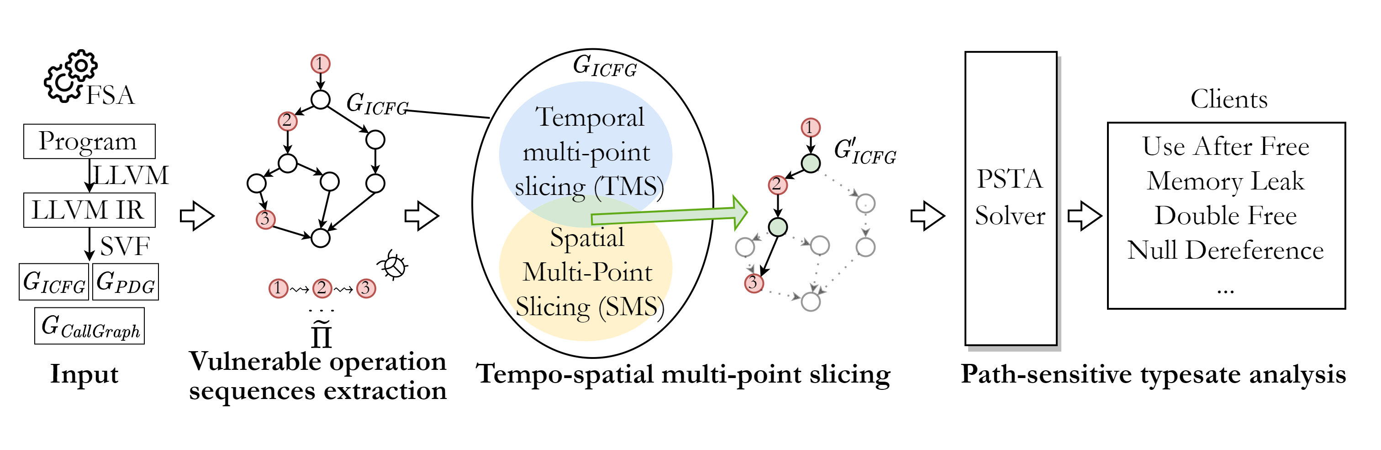
Framework Overview
Graph Simplification

Slide 13
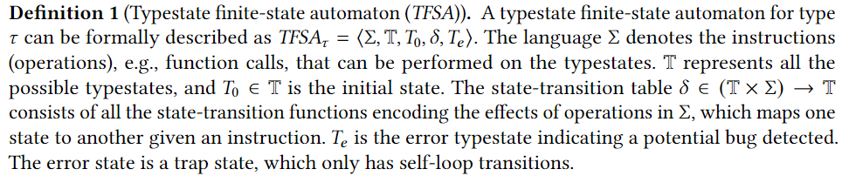
Preliminaries and Problem Formulation
Typestate finite-state automaton (TFSA)

Slide 14
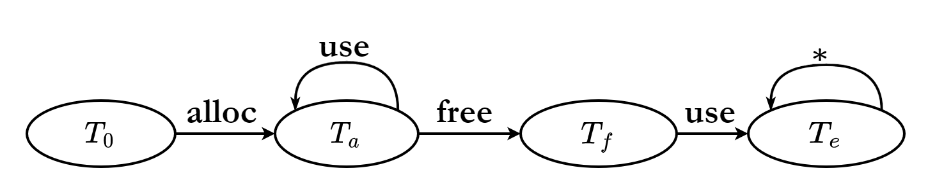

Preliminaries and Problem Formulation
TFSA for detecting use-after-frees

Slide 15
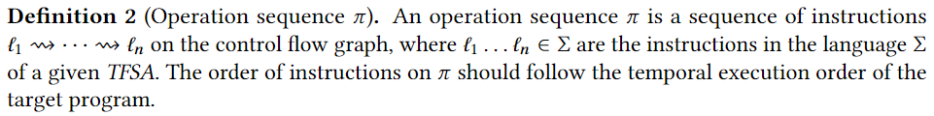
Preliminaries and Problem Formulation
Vulnerable Operation Sequence

Slide 16

Preliminaries and Problem Formulation
Vulnerable operation sequence for UAF

Slide 17
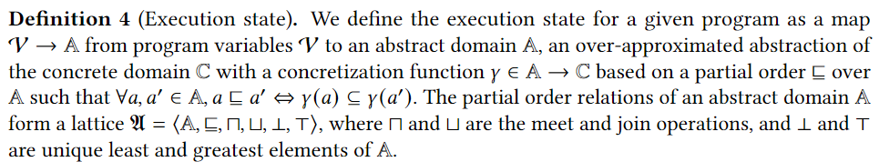
Preliminaries and Problem Formulation
Execution States and Symbolic States

Slide 18
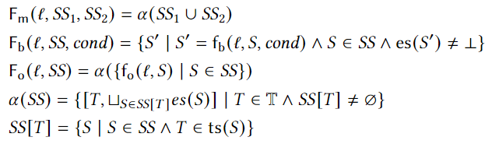
Preliminaries and Problem Formulation
Flow functions

Slide 19
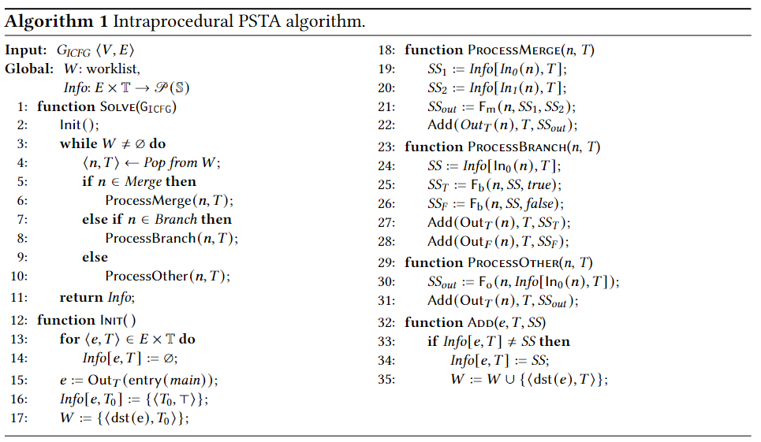
Preliminaries and Problem Formulation
Intraprocedural PSTA

Slide 20
Preliminaries and Problem Formulation
Intraprocedural PSTA

Slide 21
Preliminaries and Problem Formulation
Intraprocedural PSTA

Slide 22
Preliminaries and Problem Formulation
Intraprocedural PSTA

Slide 23
Preliminaries and Problem Formulation
Intraprocedural PSTA

Slide 24
Preliminaries and Problem Formulation
Intraprocedural PSTA

Slide 25
Preliminaries and Problem Formulation
Intraprocedural PSTA

Slide 26
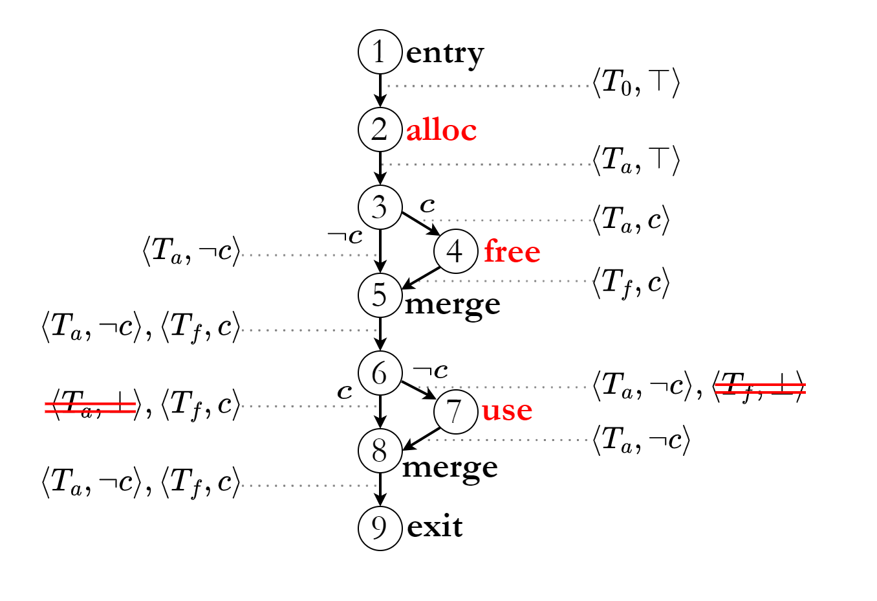
Preliminaries and Problem Formulation
Intraprocedural PSTA - example

Slide 27

Preliminaries and Problem Formulation
Intraprocedural PSTA - example

Slide 28

Preliminaries and Problem Formulation
Intraprocedural PSTA - example

Slide 29


Preliminaries and Problem Formulation
Intraprocedural PSTA - example

Slide 30


Preliminaries and Problem Formulation
Intraprocedural PSTA - example

Slide 31
Preliminaries and Problem Formulation
Interprocedural PSTA

Slide 32
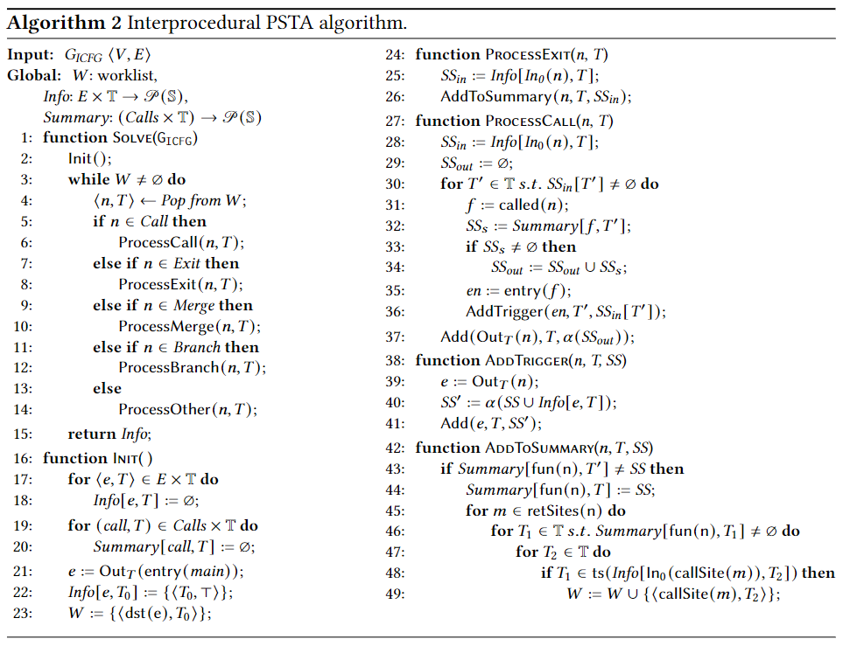


Preliminaries and Problem Formulation
Interprocedural PSTA

Slide 33
Preliminaries and Problem Formulation
ESP: Path-Sensitive Program Verification in Polynomial Time
ESP time complexity.
$$O(H(T+J+Q)|D|(|E||D| + Calls{\left|D\right|}^{2}))$$
Here, each element can become less precise at most H times,
T corresponds to a highly complex function for SMT solving
J and Q are the cost of the join operation and the equality operation on execution states, respectively.
D signifies the domain of typestate
E stands for ICFG edges,
Calls indicates the number of call sites in the program.

Slide 34
Preliminaries and Problem Formulation
Problem Formulation
ESP time complexity.
$$O(H(T+J+Q)|D|(|E||D| + Calls{\left|D\right|}^{2}))$$

Slide 35
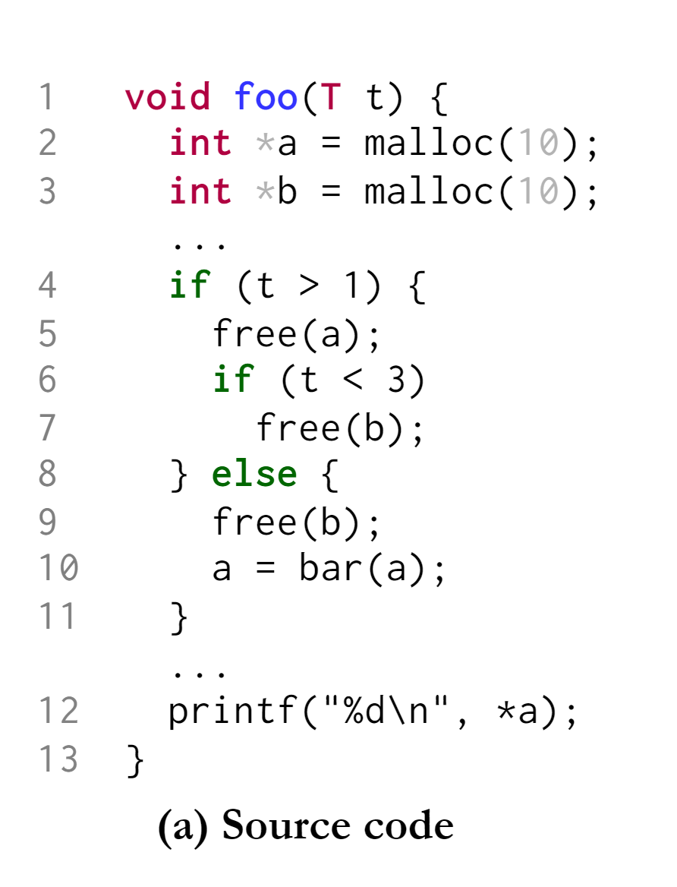
Motivating Example

Slide 36
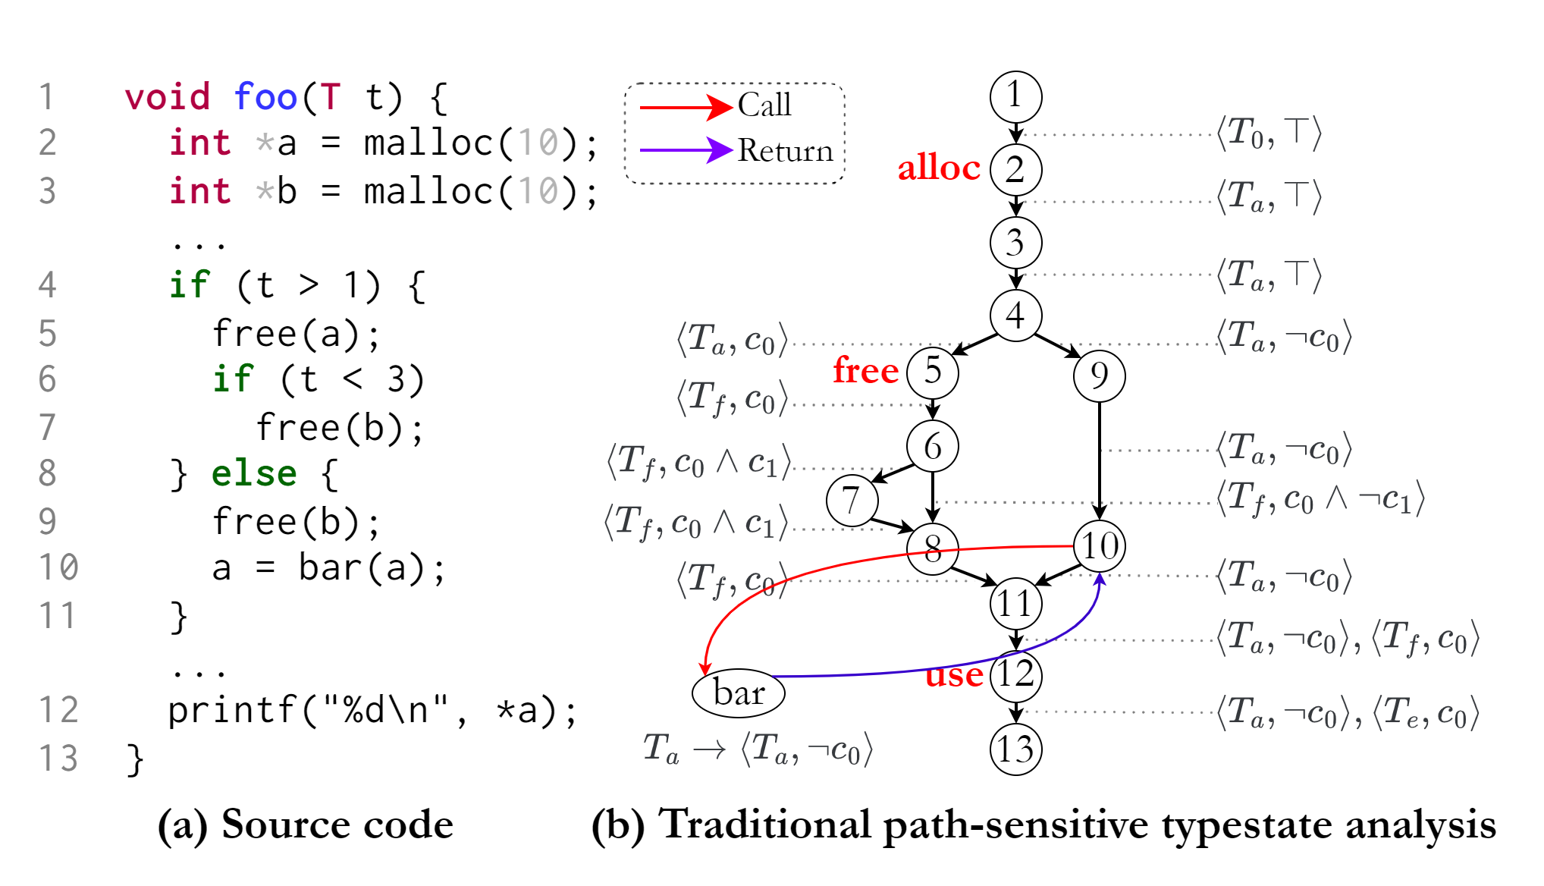
Motivating Example

Slide 37
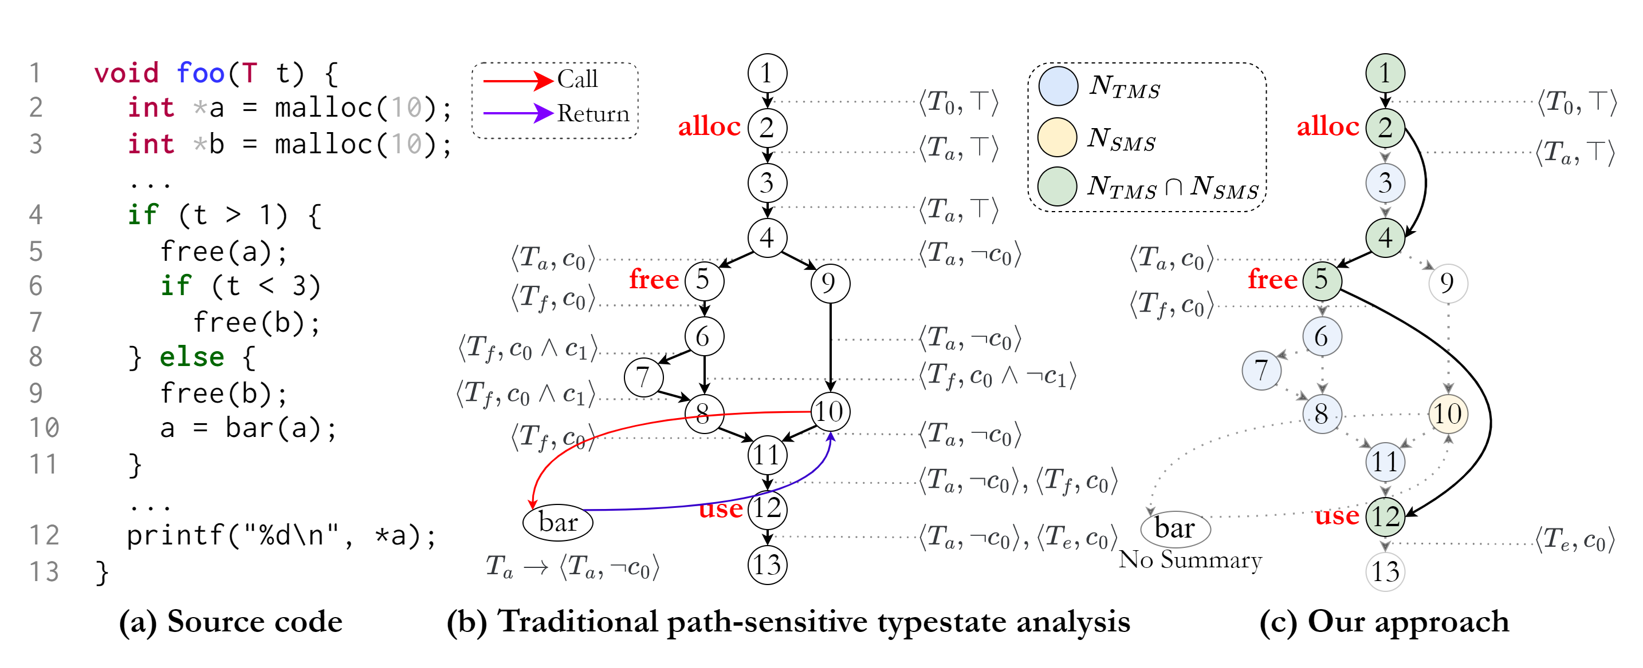
Motivating Example

Slide 38

Vulnerable Operation Sequences Extraction
Intuitively, we can employ either a Cartesian product of the instructions from the typestate language or utilize depth/bread-first search on ICFG to extract $\tilde{Π}$.
The Cartesian product may yield unrealizable sequences that do not exist on ICFG, while depth/bread-first search may result in an exponential blowup of program paths.
We propose to extract $\tilde{Π}$in a context-sensitive but path-insensitive manner based on the ESP framework.

Slide 39
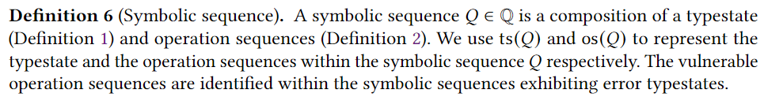


Vulnerable Operation Sequences Extraction
Symbolic Sequence and Flow Functions

Slide 40
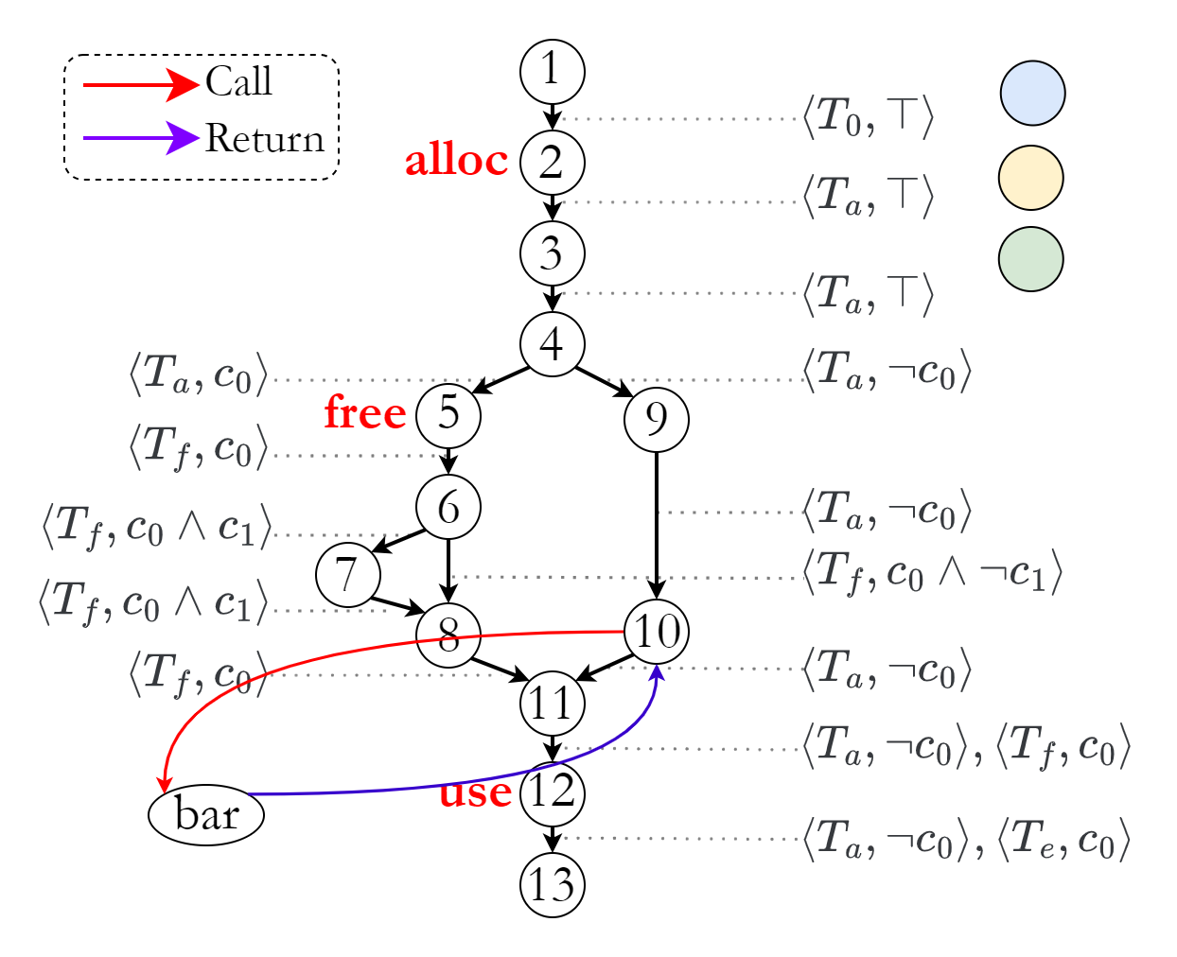
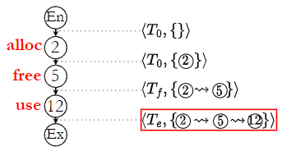
Vulnerable Operation Sequences Extraction
An Example

Slide 41
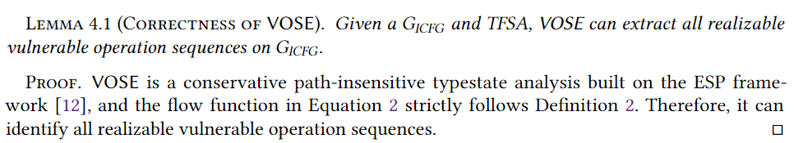
Vulnerable Operation Sequences Extraction
Correctness

Slide 42
Vulnerable Operation Sequences Extraction
Complexity
The computational complexity scales linearly with the quantity of the ICFG nodes and edges because it avoids expensive constraint solving and refrains from storing variable values throughout ICFG.

Slide 43
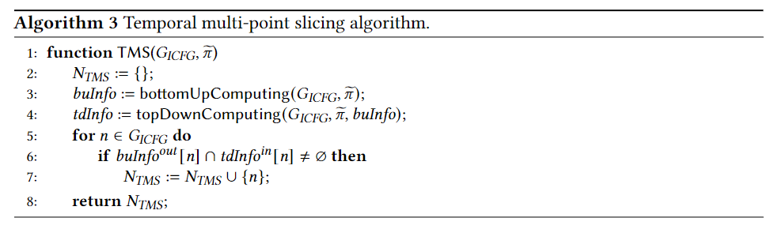
Temporal Multi-Point Slicing

Slide 44
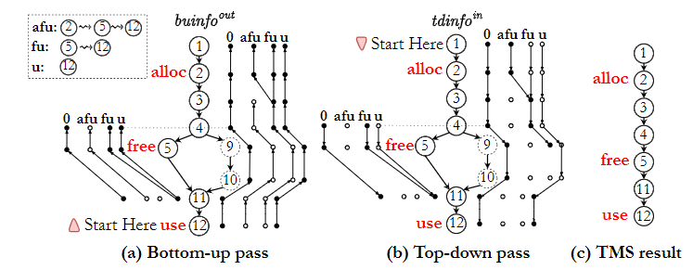
Temporal Multi-Point Slicing
An Example

Slide 45
Temporal Multi-Point Slicing
An Example

Slide 46
Temporal Multi-Point Slicing
An Example

Slide 47
Temporal Multi-Point Slicing
Correctness
[34] Yue Li, Tian Tan, Yifei Zhang, and Jingling Xue. 2016. Program Tailoring: Slicing by Se-quential Criteria. ECOOP2016.

Slide 48
Temporal Multi-Point Slicing
Complexity
The complexity of TMS can be indicated by the complexity of the IFDS framework, which is linear to the number of ICFG edges.

Slide 49
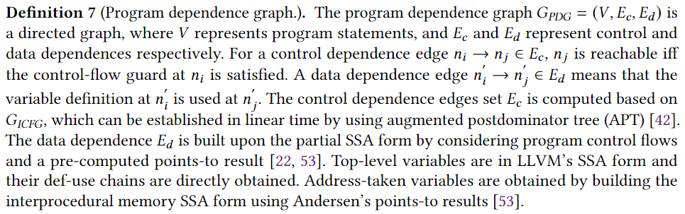
Spatial Multi-Point Slicing
Program Dependence Graph (PDG)

Slide 50
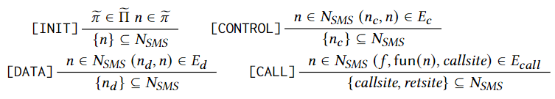
Spatial Multi-Point Slicing
Inference Rules

Slide 51
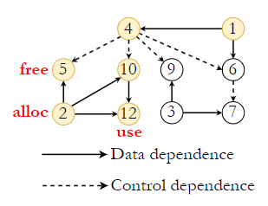
Spatial Multi-Point Slicing
An Example

Slide 52
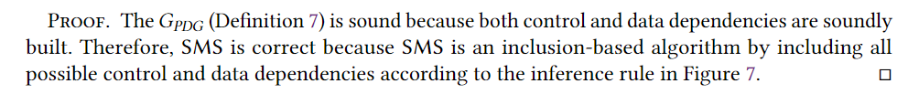
Spatial Multi-Point Slicing
Correctness

Slide 53
Spatial Multi-Point Slicing
Complexity
The complexity of SMS is linear to the number of ICFG nodes and edges because it is a depth-first search algorithm.

Slide 54
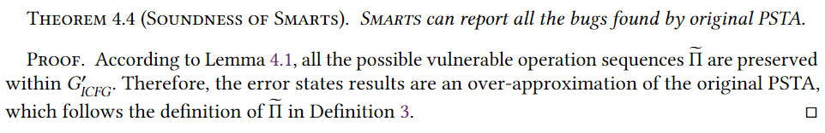
Putting It All Together
Soundness

Slide 55
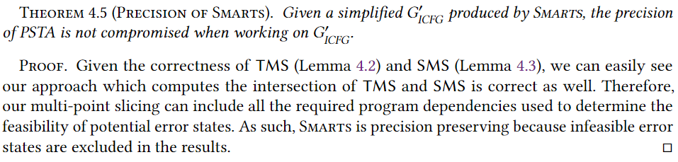
Putting It All Together
Precision

Slide 56
Thanks!

